Slide 1
F1.3-05 IL Road Test – Cav 1 Laser Displacement Data
J. Holzbauer on behalf of the Transportation Working Group
Investigation Meeting
Tuesday, July 31, 2018

Slide 2
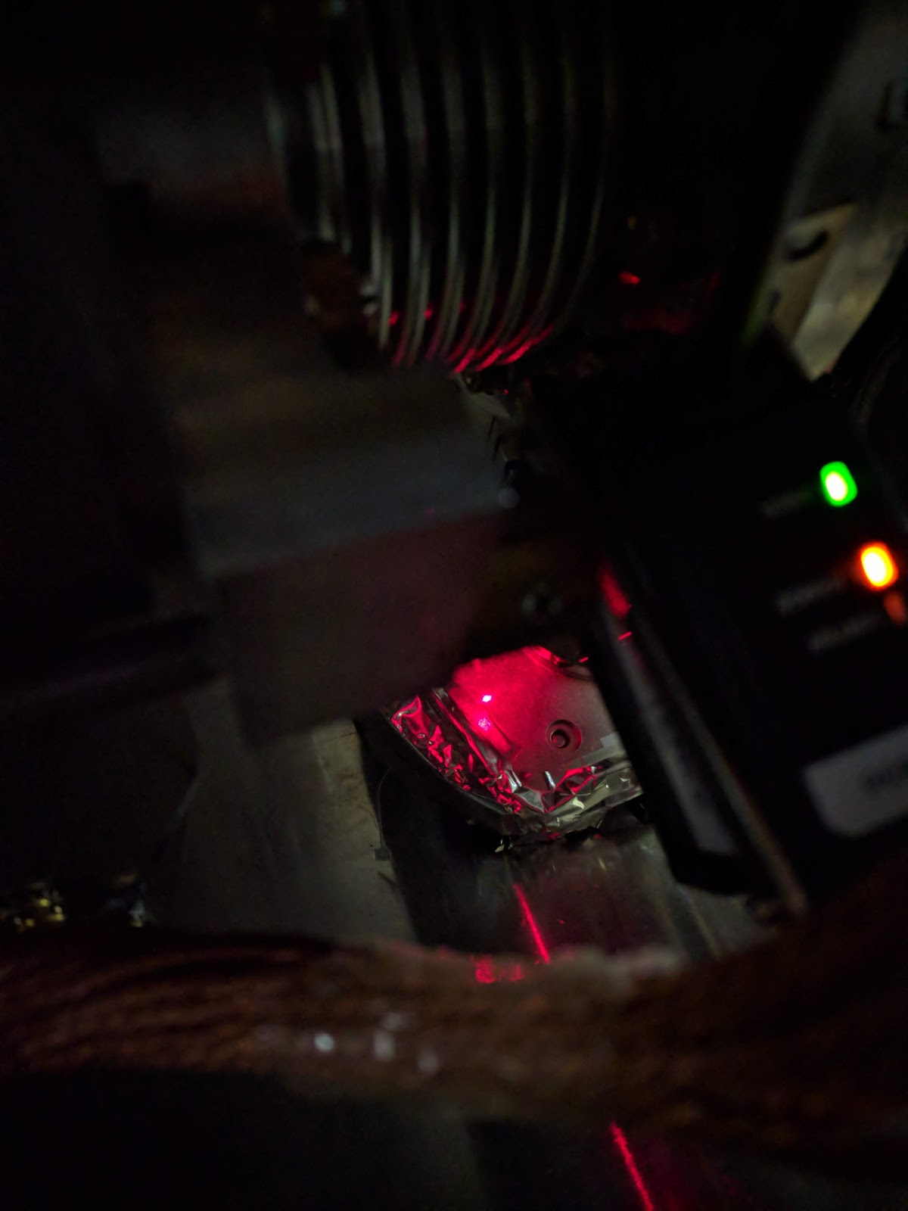
Displacement Sensor Overview
Keyence laser displacement sensors were purchased to directly measure differential measurement of the 50K coupler shroud
Mounting was designed on cavity 1 and cavity 4
Cavity 1 was mounted on:
  X-Axis from cavity beamline flange to coupler shroud (shown on the right)
  Y-Axis from K-Flange frame down onto top of the shroud thermal mounting bar (vacuum vessel to 50K shroud)
  Z-Axis from upstream cavity 1 vacuum vessel onto the side of the thermal shroud
Cavity 4 was mounted similarly to Cavity 1 in the X-Axis
  This laser was aimed at reflective tape and produced unreliable data
Intercavity Bellows
Laser Spot on 50K Shroud
Sensor

Slide 3
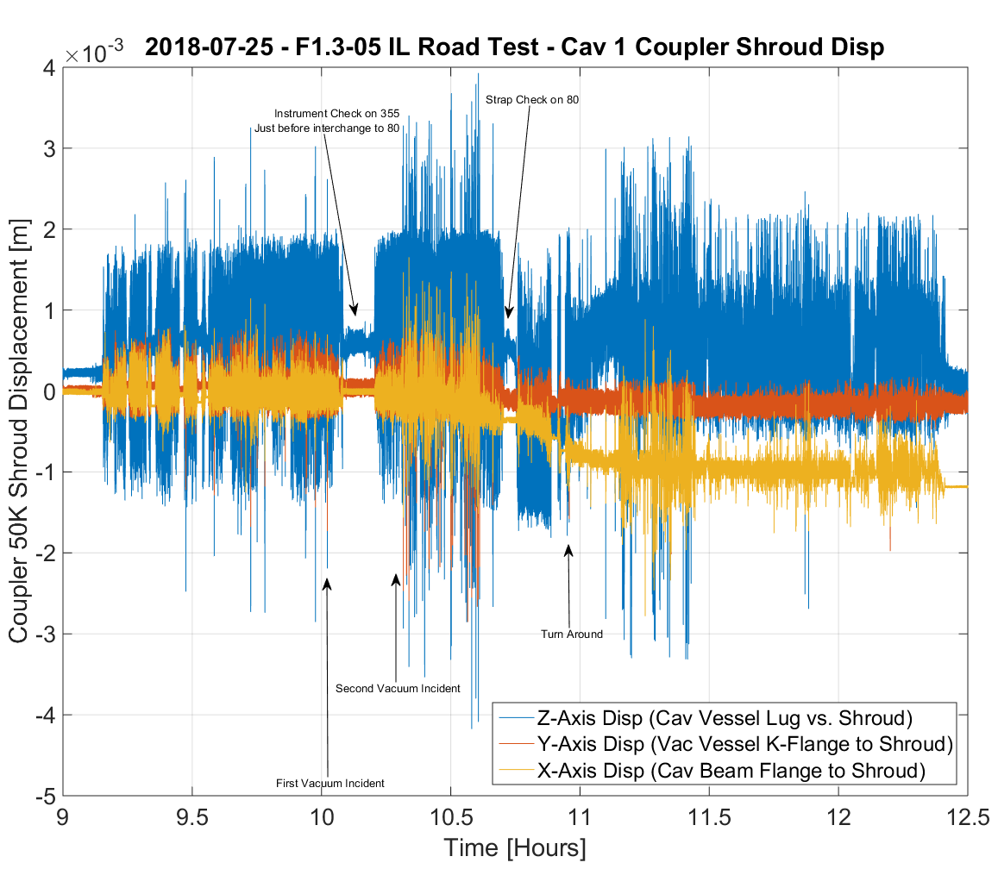
Trip Displacement Data – Cavity 1
X and Y displacement are significantly smaller than Z motion
Overall capture process and data quality is high, and the mounting was solid with no internal resonances below 100 Hz (and only in Z)
X-Axis shows clear evidence of shift from loss of beamline vacuum
Peak displacements on US-80, as expected

Slide 4
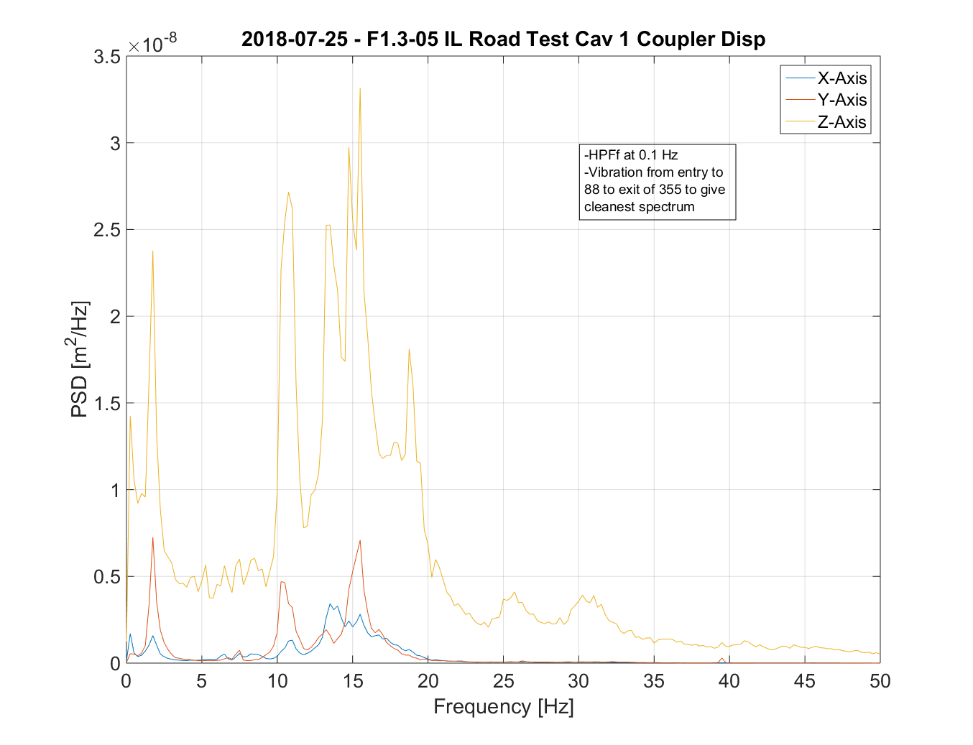
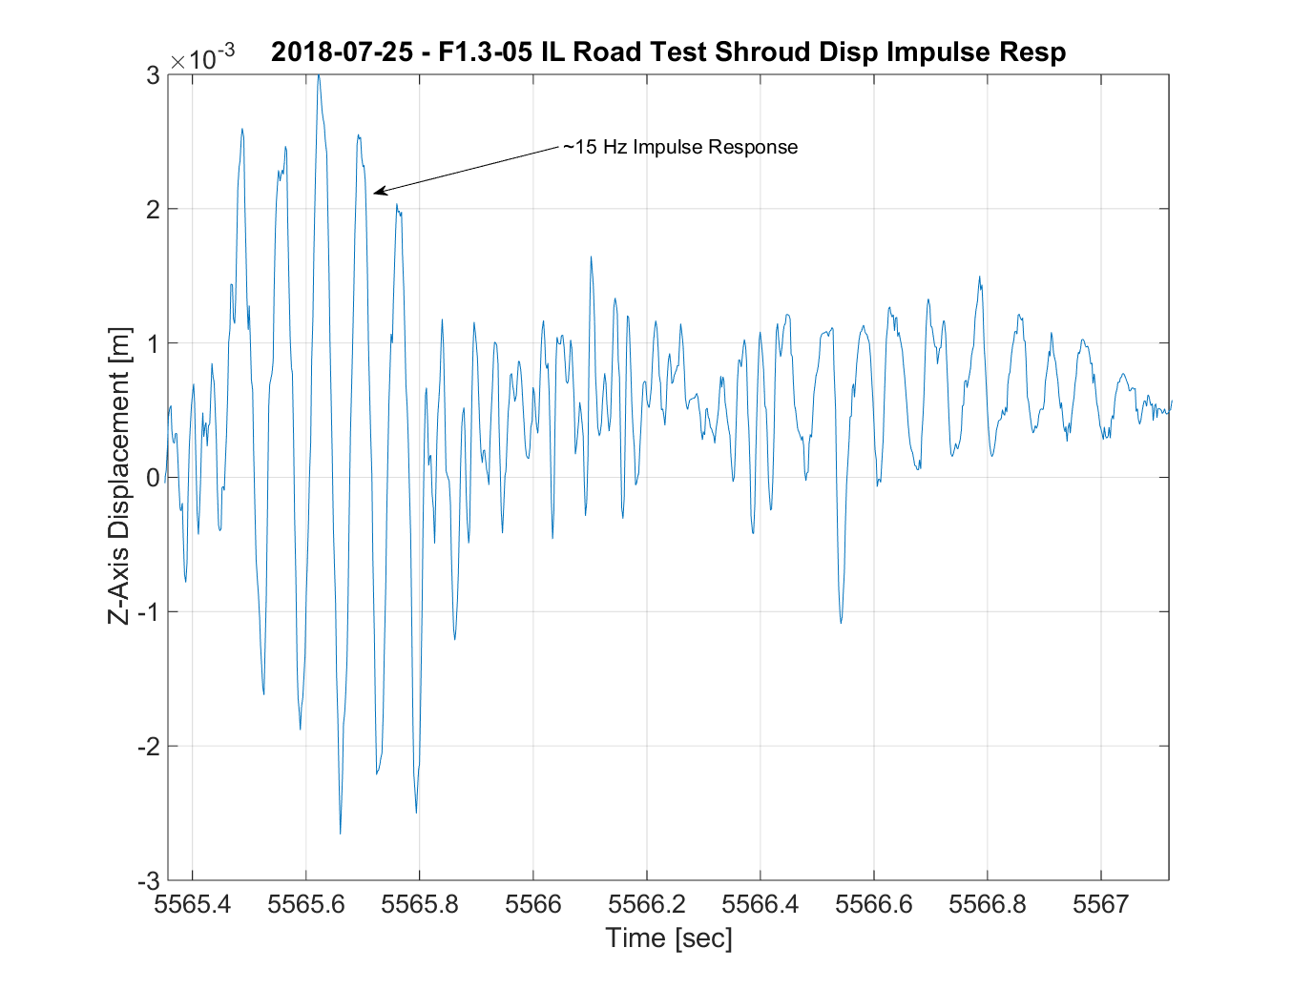
Displacement Spectrum
Significant energy in Y and Z at 2 Hz (air ride), 10/12 Hz (frame resonance?), and 15 Hz (coupler resonance)
Typical example of large impulse with 15 Hz response in Z-Axis with typical ring down.

Slide 5
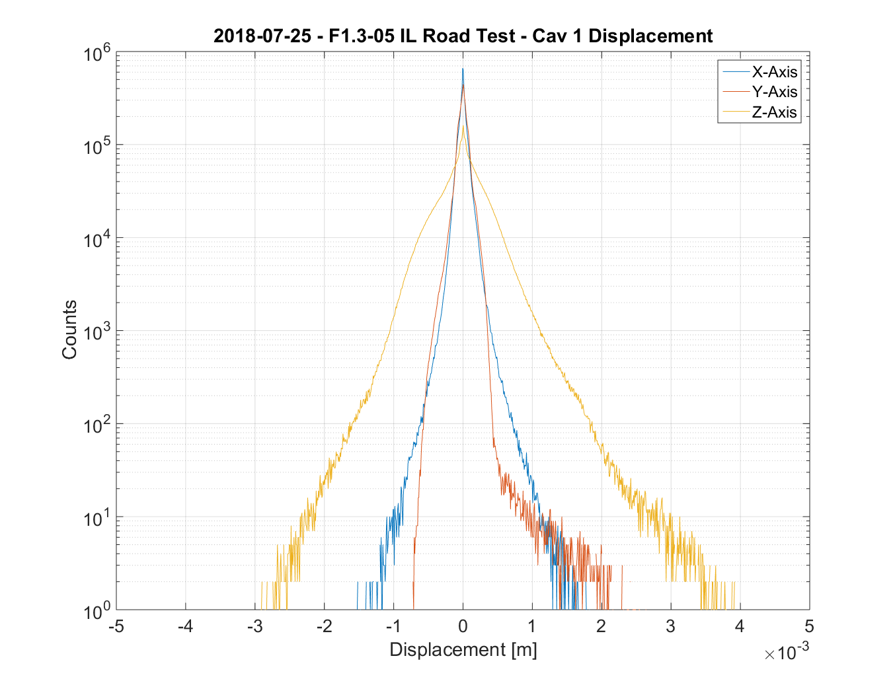
Displacement Distribution
Again, Z-Axis has clearly larger displacement
Notable asymmetry in Y-Axis motion presumed to be from G-10 block preventing large downward movement
Again, remember Y-Axis measurement is from vacuum vessel to shroud, not cavity to shroud
HPF at 0.1 Hz

