Slide 1
LCLS-II Cryomodule Shipping Frame Shock Attenuation
Naeem Huque

Slide 2
Road Trip Instrumentation
The following shock readings are taken from the SAVER9X and its satellite PCB Piezotronics accelerometers
GP1 units were used as back-ups to verify information; results were different but comparable
Graphs show peak shock readings for each event, comparing Outer Frame to Inner Frame
PCB Accelerometer
(On Cavity 1 WG)
PCB Accelerometer
(On Inner Frame)
SAVER 9XGPS
(On Outer Frame)

Slide 3
JLab pCM: Road Test To Bristol
Distance: ~800 miles
Shock Attenuation: 60%
First iteration of shimming, clamps and straps
Minimum shimming was used
Large shocks are an indication of shipping frame and cryomodule movement in relation to the trailer
Outer frame unit installed high on the frame, which may exaggerate shocks
Spec = 1.5g

Slide 4
JLab pCM: JLab to FNAL
Distance: ~900 miles
Instances of no attenuation
There were a total of 39 events where the shock on the Inner Frame was higher than 1.5g
The largest Inner Frame shock was 2.85g
These were all in the vertical (Y) axis
The five largest shock shown
Cryomodule clamps where found to have come loose. Large shocks likely due to excessive movement of the cryomodule
Results are similar to XFEL’s XM-2 shipment
Spec = 1.5g

Slide 5
JLab pCM: FNAL to JLab
Distance: ~900 miles
Attenuation: 45%
Route is same as JLab - FNAL
Data was only available from PCB on coupler
All shocks on the coupler were below 1.5g
Cryomodule clamps were torqued to a higher value and Loctite was added
Less relative cryomodule motion reduced shock values
Spec = 1.5g

Slide 6
J1.3-07: Road Test to Bristol
Distance: ~800 miles
Attenuation: 45%
Route is same as JLab pCM Road Test
Shocks on Inner Frame all below 1.5g
New clamps to fix CM to shipping frame were used
Extra shimming was used
Straps used chains instead of webbing to carry load
Lower shocks attributed to better cryomodule/frame/trailer bed stability
Spec = 1.5g

Slide 7
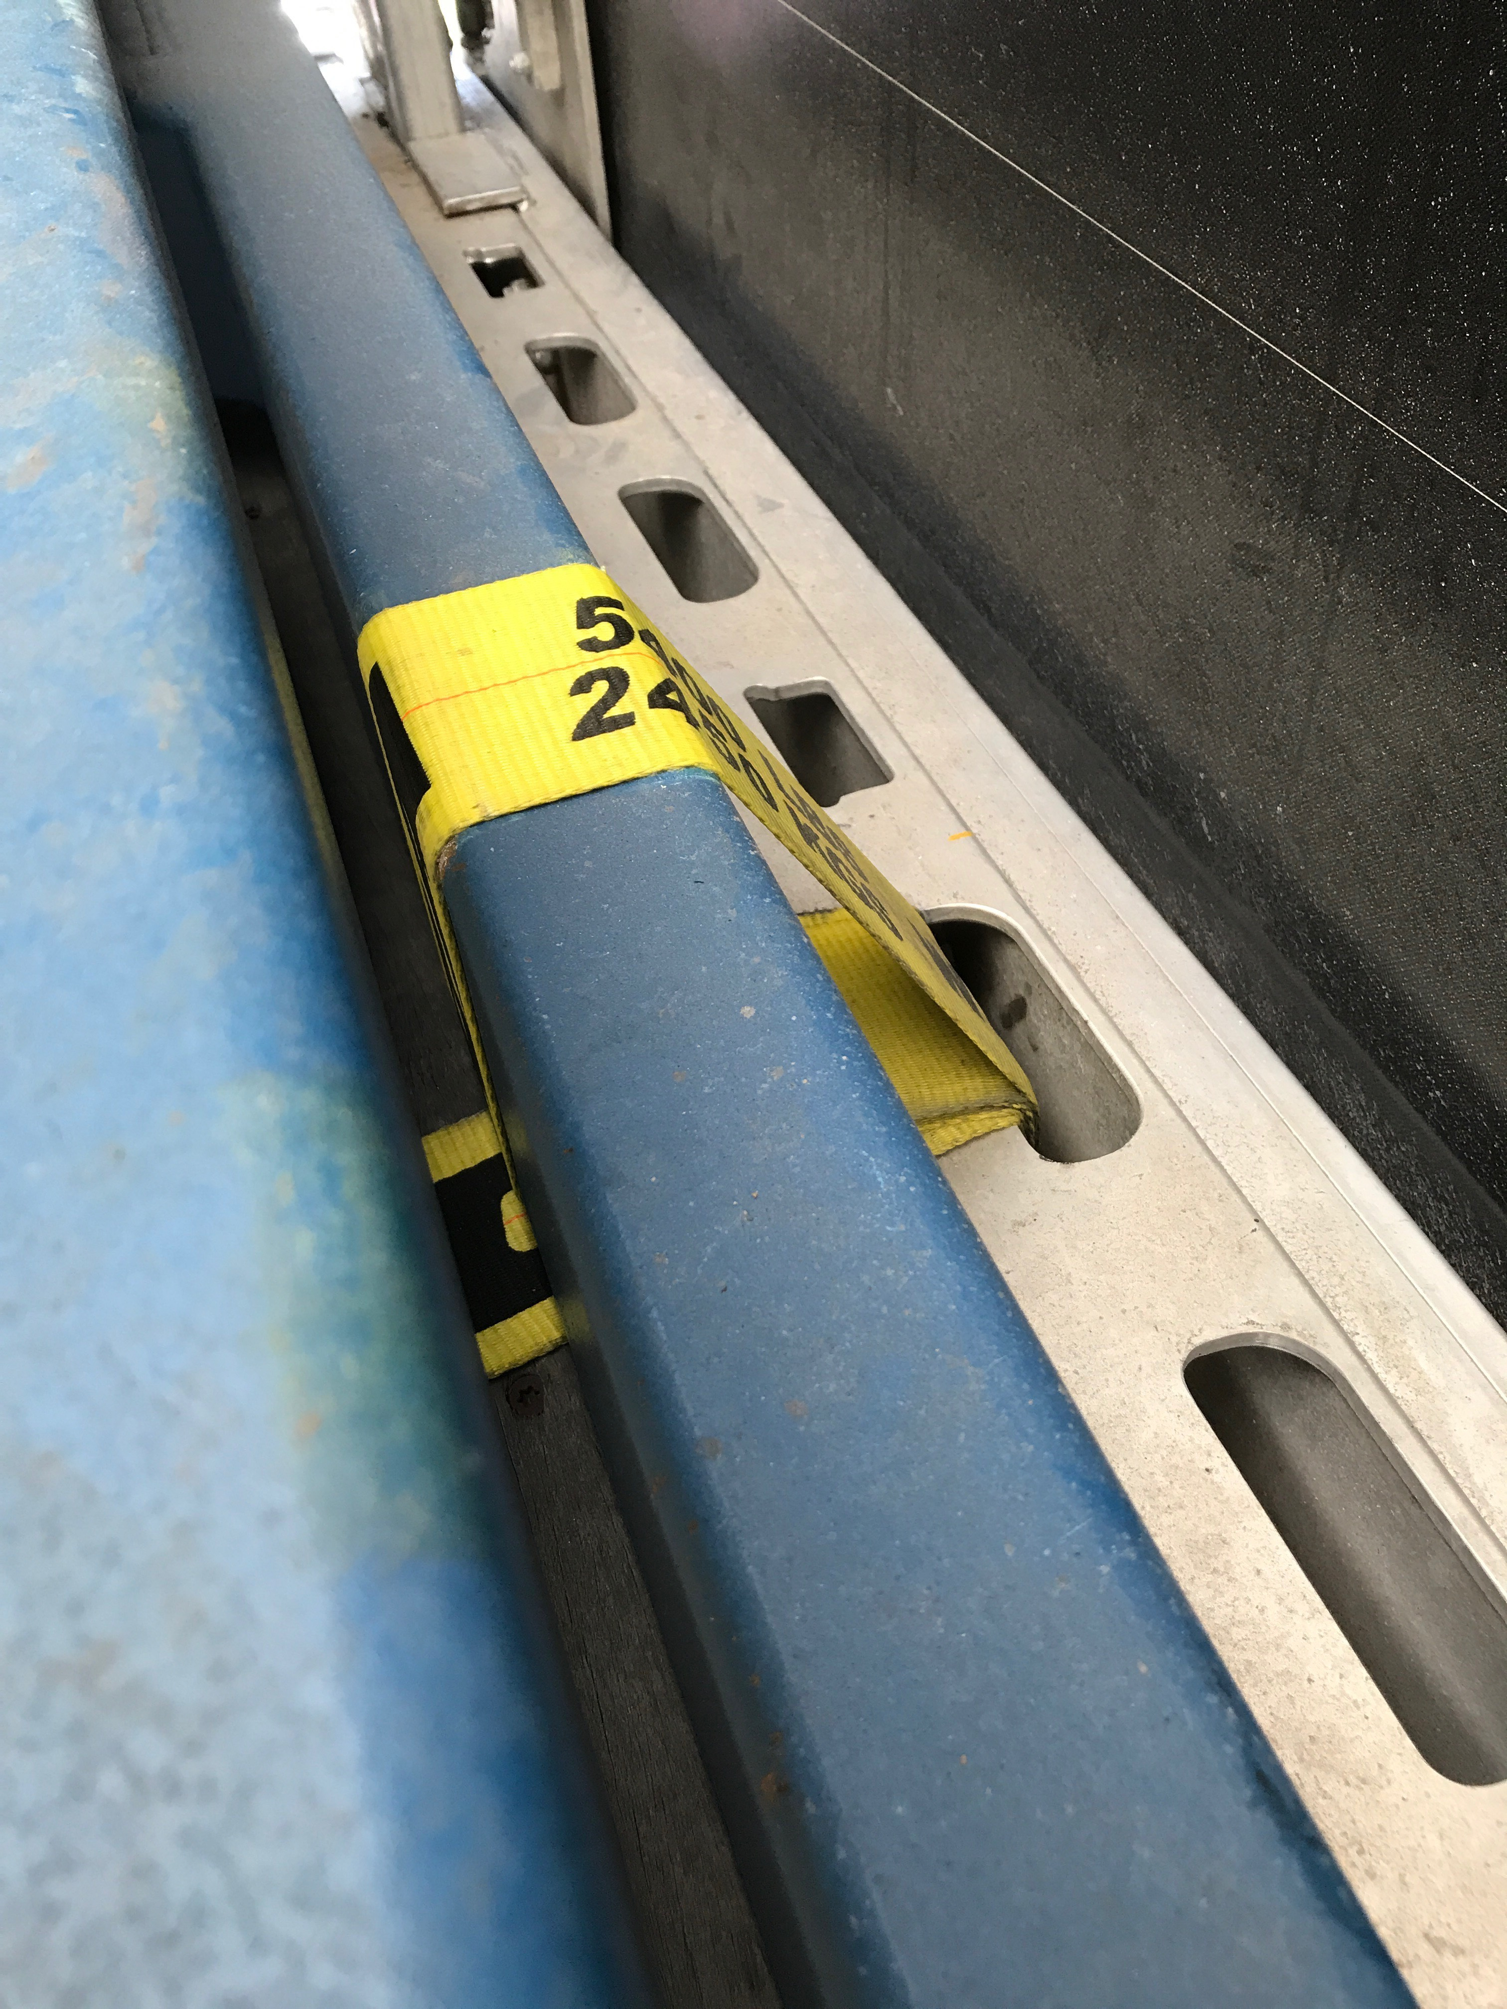
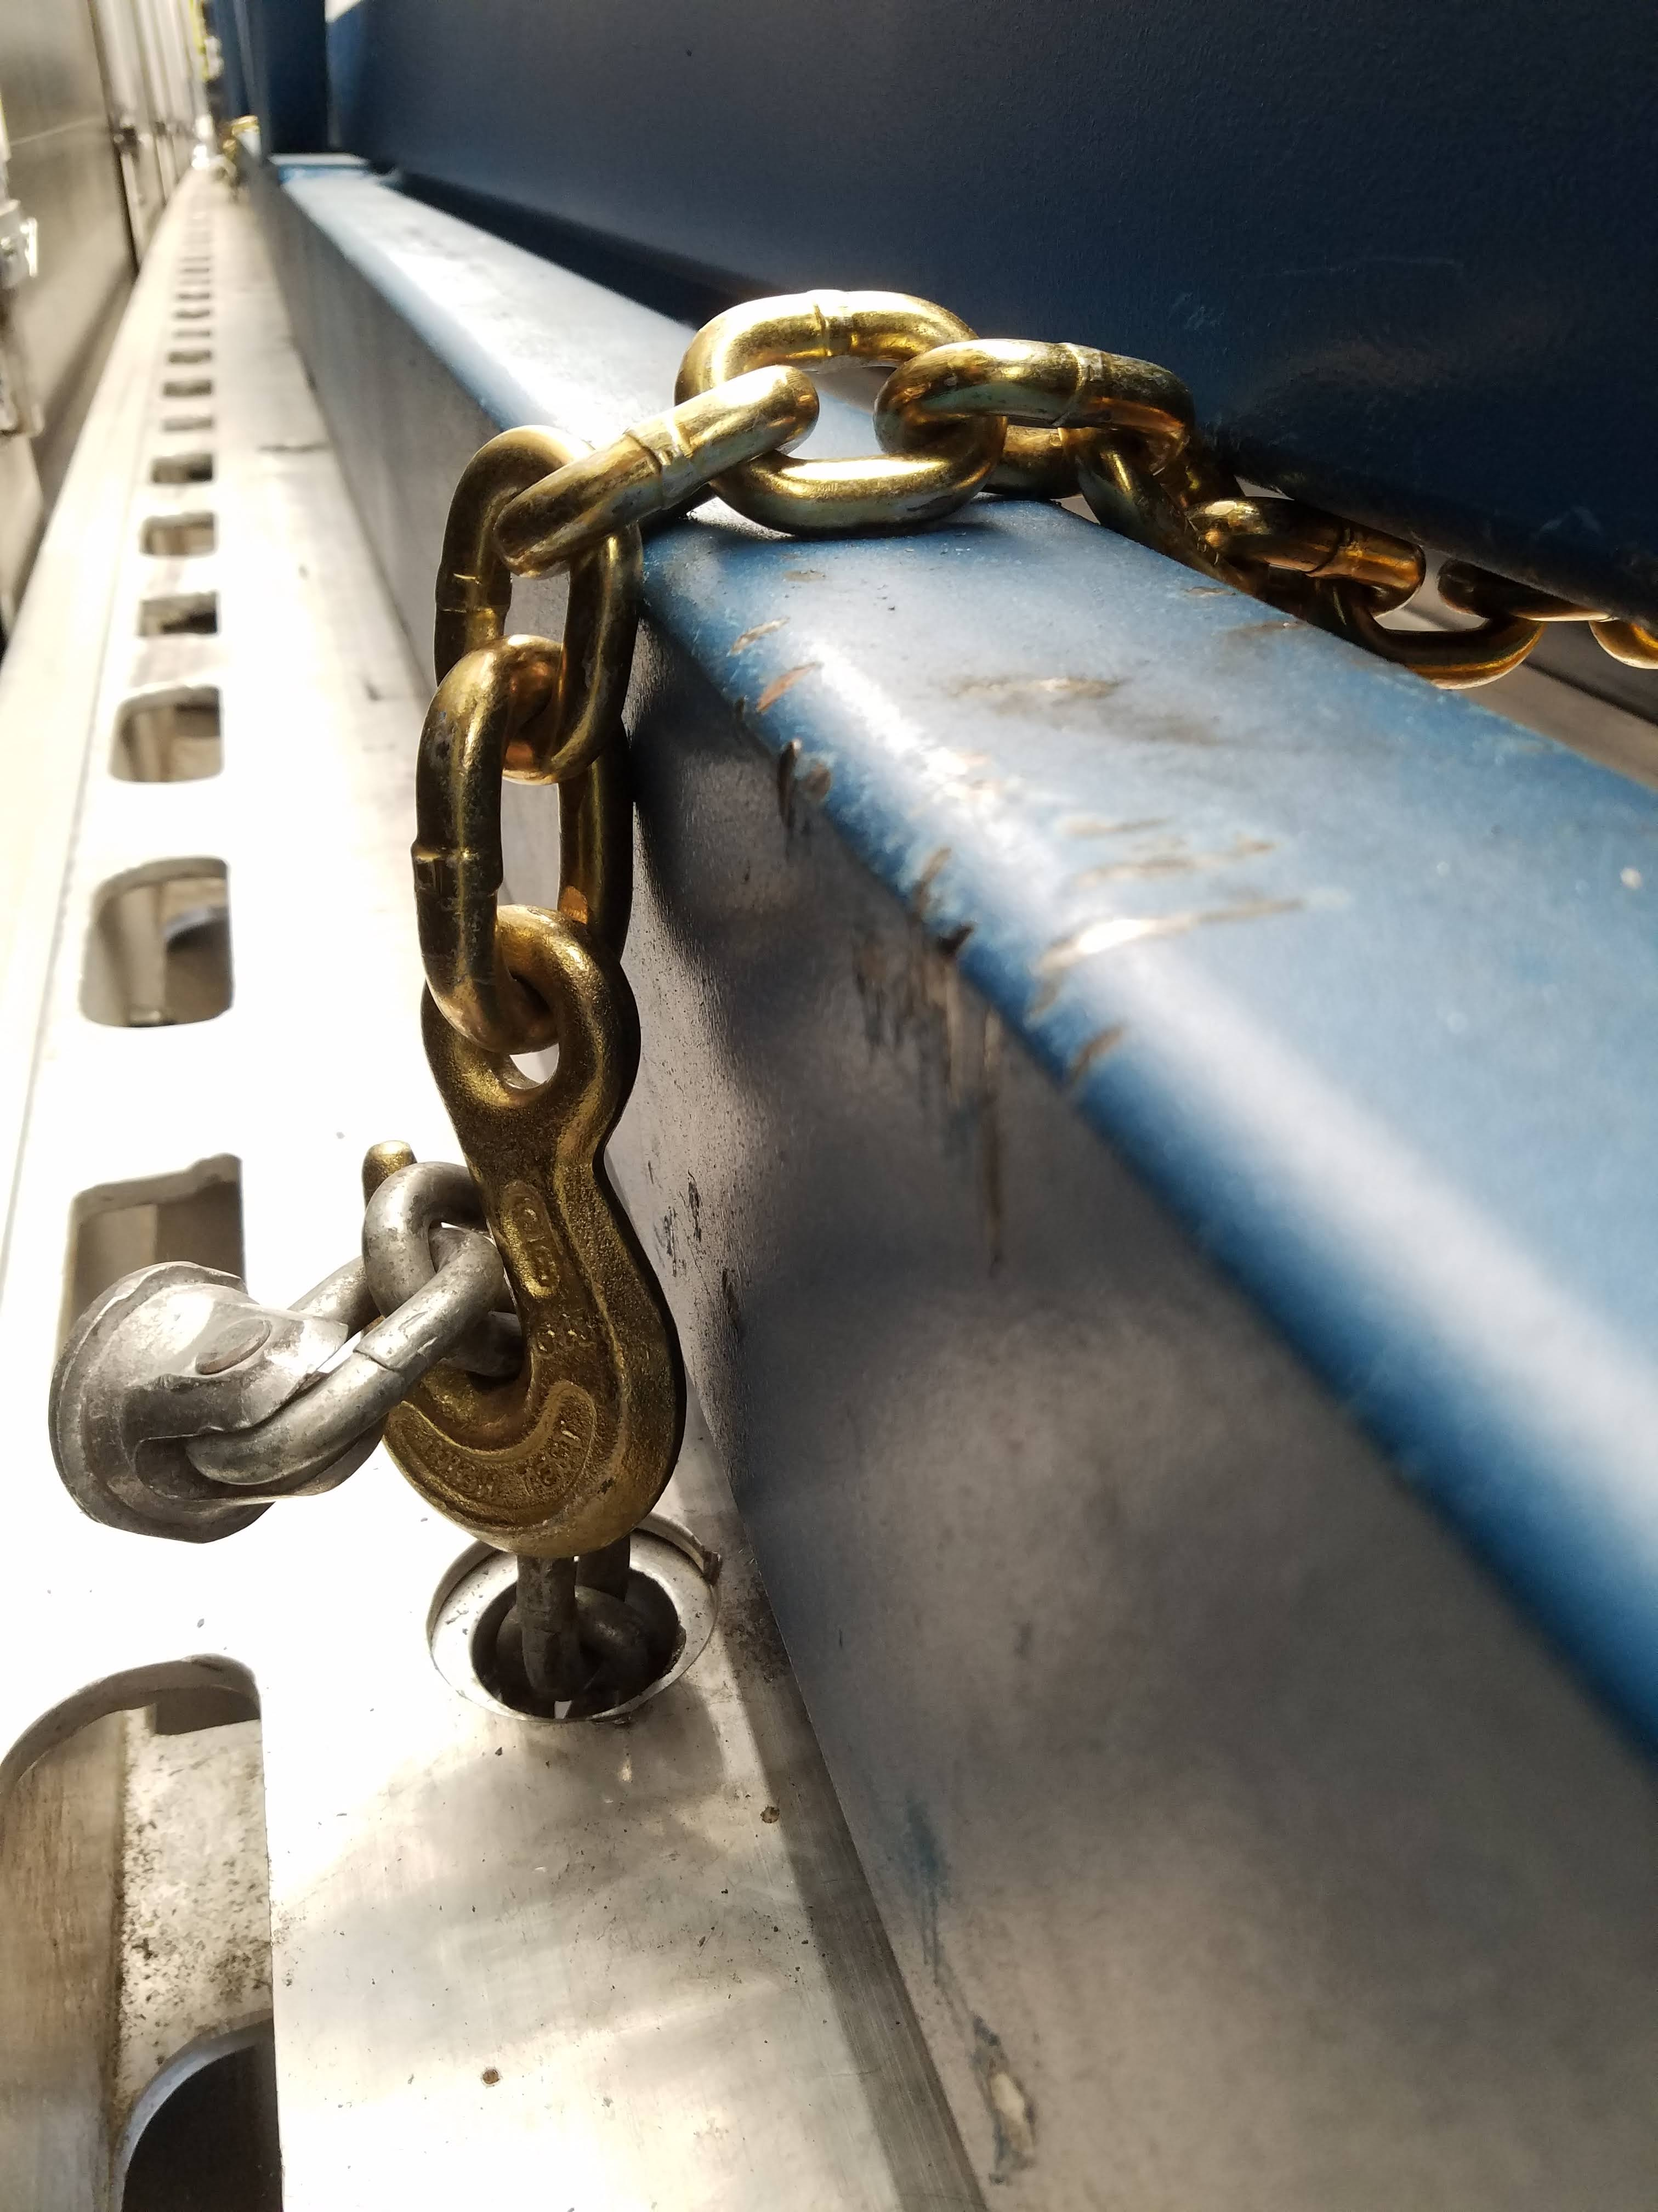
Differences Between J1.3-07 and F1.3-05: Straps
JLab
Vertical motion is restrained by metal chain links
Eyelets in trailer are used (12 in total
6 straps are used
FNAL
Vertical motion is restrained by strap webbing
Tie-down winches on trailer are used
12 straps are used

Slide 8
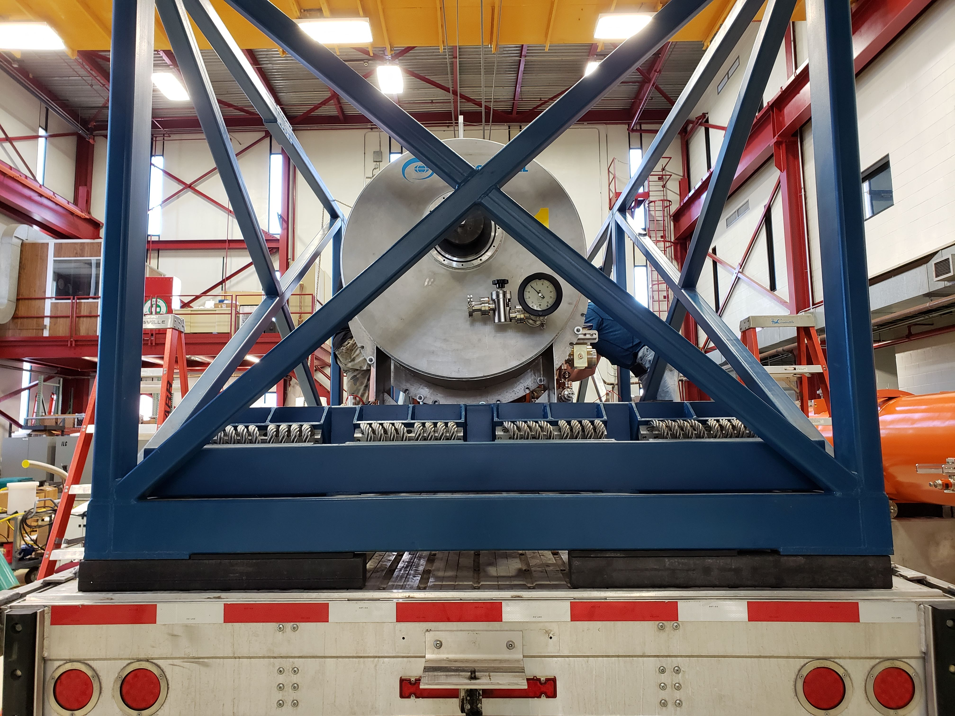
Differences Between J1.3-07 and F1.3-05: Shimming
JLab
Shipping frame loaded on trailer
Gaps between trailer bed and frame filled with wooden shims
About 1.5” - 2” of shimming required on each end
Large amount of contact between frame and trailer in center section
FNAL
HDPE shims (3.5”) are positioned on trailer
Frame (and then CM) are loaded on top of shims
Frame sits higher on the trailer
Contact between frame and trailer bed is minimal (also lined with rubber)

Slide 9
Shock Attenuation Differences
Differences in Shock Attenuation could be for several reasons:
Different sensors used: SAVER9X (JLab) vs Slam Stick X (FNAL)
Only peak shocks are used for JLab analysis (similar to XFEL)
Only largest shocks (> 1.5g) are considered for when calculating JLab percentage, while all shocks are used in FNAL calculations

