Slide 1
F05 Illinois Road Trip 7/24/18
Compared Files SSX8_002.mat (Axle side base frame) and SSX9_002.mat (Axle side isolation frame) which includes interval when the beamline vacuum pressure began to rise (see next slide)
  Swap X and Z data
  Next three slides show largest shock (slice 238.2) near start of pressure rise – this slice has only a 1 g peak shock but about 70 mm peak to peak vertical motion
Compared Files SSX8_003.mat (Axle side base frame) and SSX9_003.mat (Axle side isolation frame) which is the start of the rough road region
  Swap X and Z data
  Remaining slides show statistics on 10 sec slice data during this one hour period
  Do not see the large Y differences as occurred with the X2 sensors in the first IL Road Trip in this region on 7/3/18 – i.e., the base and isolation frame motion track very well
  Still see 12 Hz Z resonance, but as usual, no resonance in X or Y – do not see low frequency rise in Y transfer function as did with the X2 sensors.

Slide 2
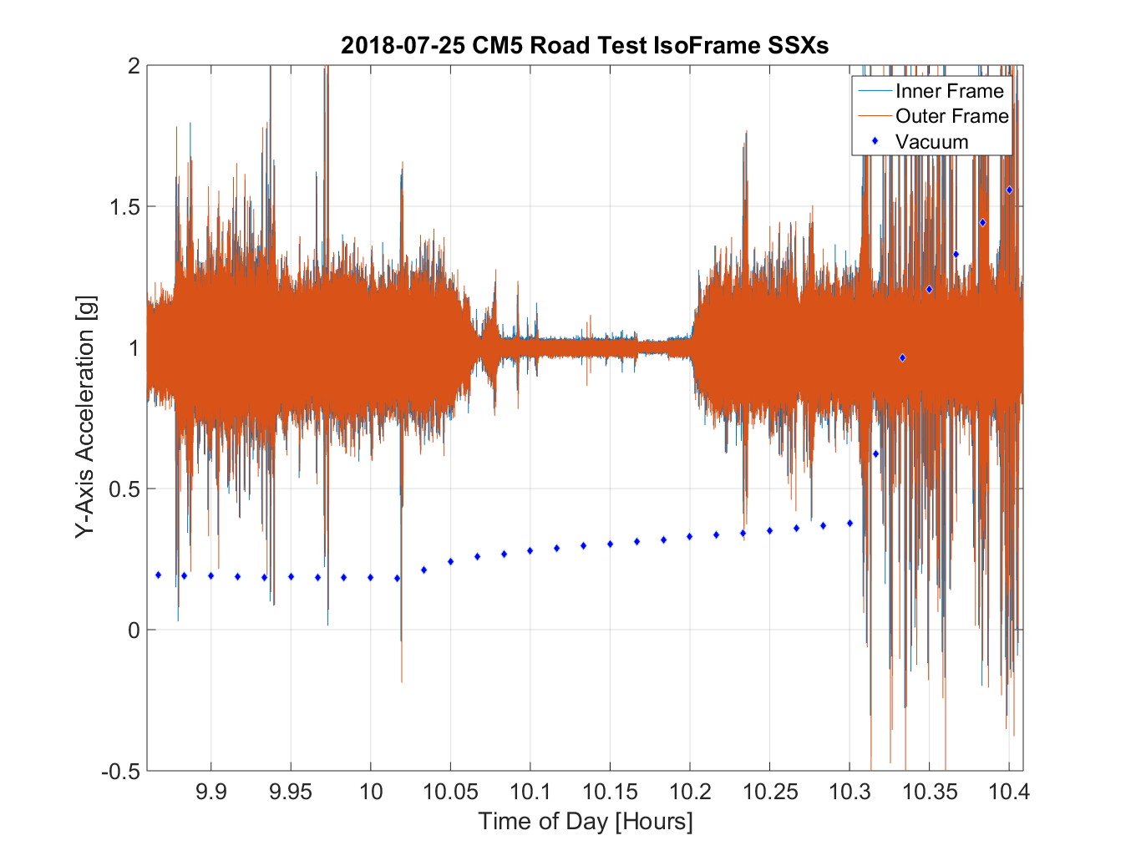
SSX-002
SSX-003
Slice 238.2
Slide Courtesy J Holzbauer

Slide 3
Slice 238.2

Slide 4
Slice 238.2

Slide 5
Slice 238.2

Slide 8
Do not see large Y differences as with the X2 sensors in the first IL Road Test

Slide 9
Ratio remains flat at low freq
Red = 12 Hz,
Q = 3.3 Resonance
Response

