Slide 1
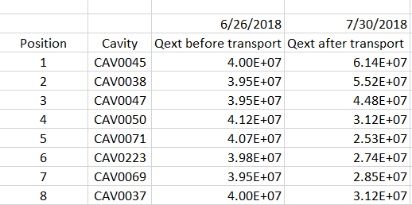
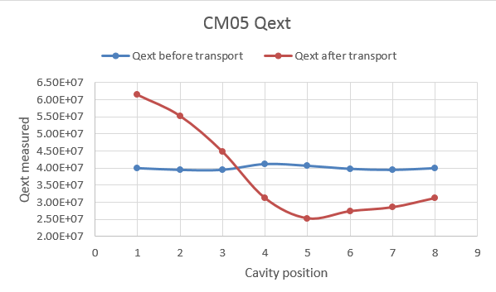
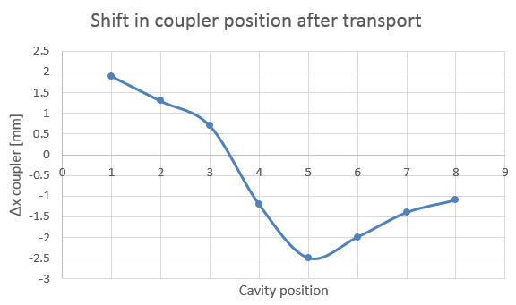
- Nominal value of Qext is 4E7.
Before shipping all couplers were within specs (see blue curve).
After transport all couplers seem to be at a different position with respect to the cavity.
Consistently lower for cavities 4 to 8 (IN), higher for cavities 1-3 (OUT).
No obvious responsible for leak has been identified.
Cavity #5 has the coupler with lowest Qext.

