Slide 1
F1.3-05 Beam Line Leak

Slide 2
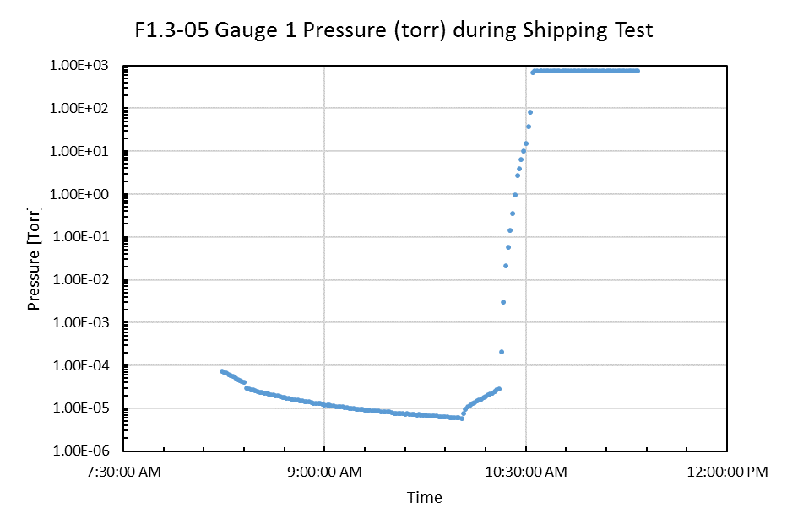
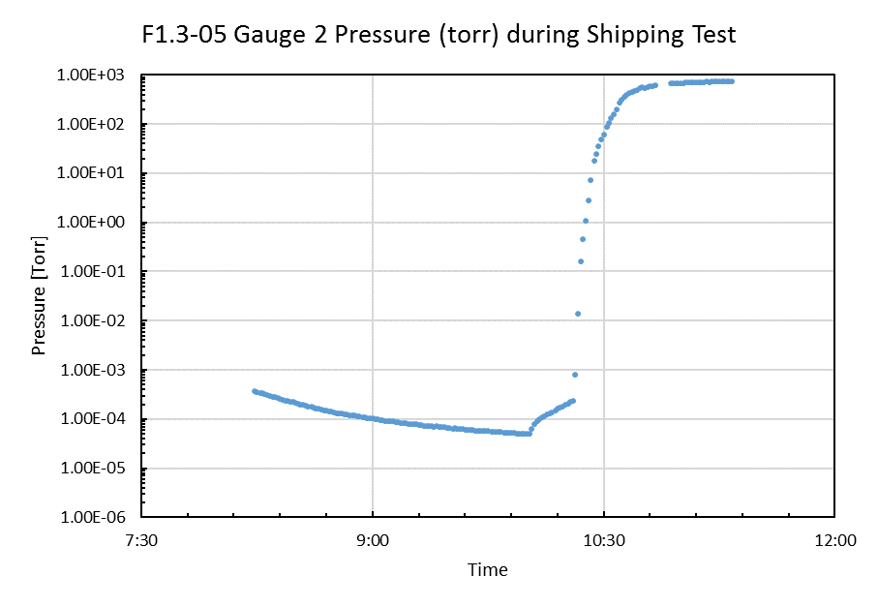
Beam Line Vacuum During Shipping
Actual
Scaled

Slide 3
Beam Line Vacuum Leak
Cavity | Sound Detection | Note
CAV1 | Apparent leaking sound | Coupler Bellows area sounded louder than cavity bellows
CAV2 | Background
CAV3 | Background
CAV4 | Background
CAV5 | Background
CAV6 | Background
CAV7 | Background
CAV8 | Background
Down stream manifold has background sound level
Vacuum pressure was ~86 torr when sound detection was conducted.
Pumping was through downstream shipping manifold
Vacuum pressure was stalled at 86 torr.

Slide 4
Beam Line Vacuum Leak
CAV1
When coupler antenna was pulled out ~2.5 mm (2 full turns), pressure started to increase. Sound level increased also.
When coupler antenna was restored to original position, pressure resumed normal decreasing at a slow rate.
CAV5
When coupler antenna was moved out and back in three full turns, pressure did not register any change as in CAV1.

Slide 5
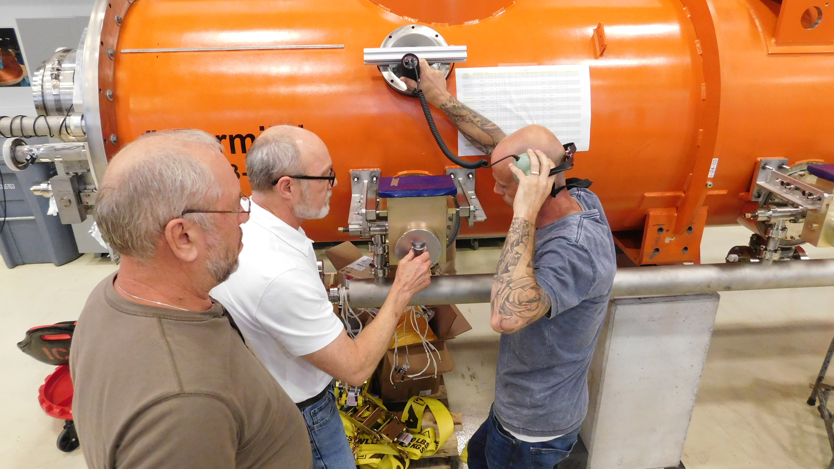
Picture from Rich Motill

