Slide 1
Project Monitor and Control: Estimate at Completion
Presenter’s Name: Mohammed Elrafih, Project Controls Specialist
Meeting Title : EVMS Training – Monitor & Control: Estimate at Completion and Change Control
1 March 2019

Slide 2
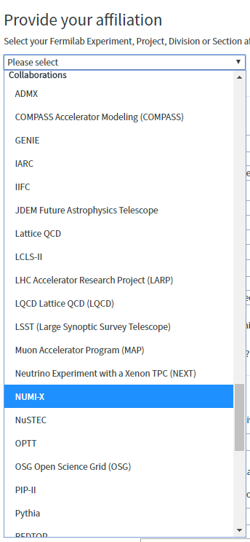
Obtain a Fermi Services Account
To request a Fermi account:
Go to - https://fermi.service-now.com/new_acct_request.do
Select your affiliation under “Collaborations” using the Pull-down menu
Fill out the rest of the information.
After submitting the form, it should come to the Project PM/Director for approval
Once approved it should be easy to get the Fermi account.
The training courses and the Fermi Workday system set up take a little time

Slide 3
Fermi Systems Access
Once you obtain your Fermi Services account PM/Director can (as appropriate):
Inform Risk Manager to authorize you to access the Fermilab web-based risk register.
Authorize access to DocDB or FermiPoint where all Project documents reside including
  P6 PDFs
  Status reports
  Other CAM reports
Inform OPSS for Access to:
  P6 can be granted if desired.
    Cost to Project ~$400 per year
    Read only for project files
    Read/Write for “Sandbox”
  Baseline Change Request (BCR) Tool – Needed for next week
  CAM eToolbox – Needed for next week

Slide 4

CAMs Address Deviations from Plan
“How do you let your PM know there will be an increase (or decrease) in cost or schedule?”
“When do you let your PM know there will be an increase (or decrease) in cost or schedule?”
Why do you notify PM?
How Would You Answer?

Slide 5
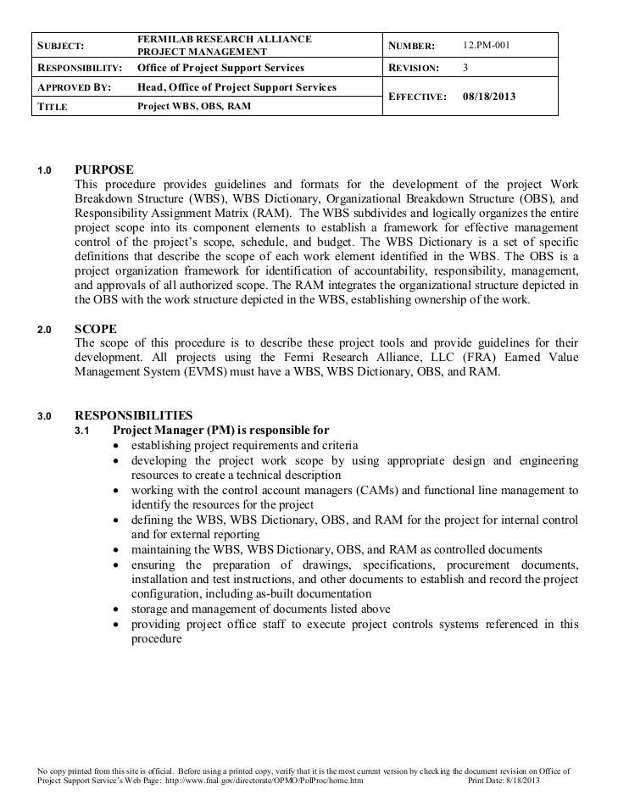
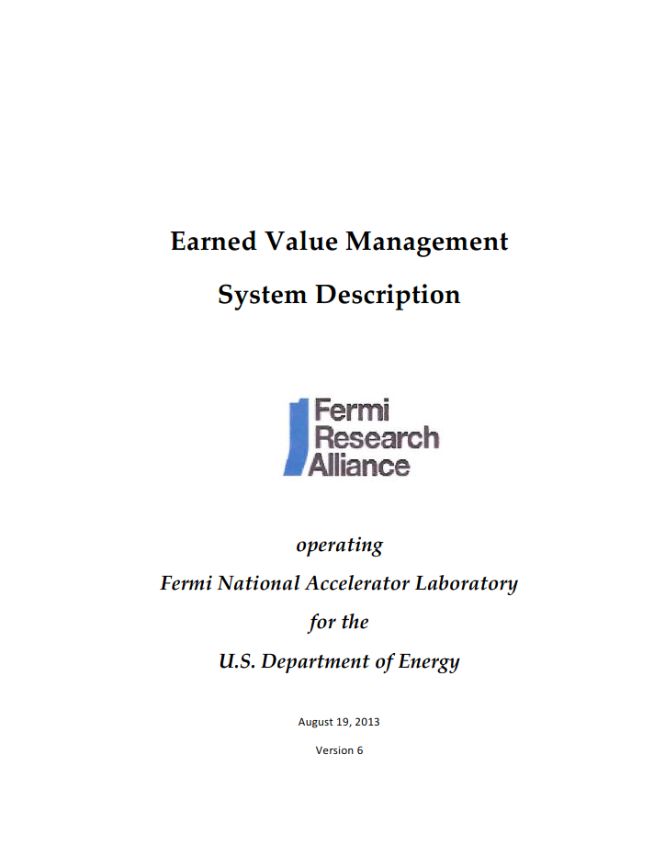
FNAL EVMS process is found in procedures
EVMS Procedures Answer:
  Who
  Why
  When
  How
  CAMs need to:
  Know
  Use
  Reference

Slide 6
FNAL EVMS Procedures (4/9)
Project WBS, OBS, RAM
Control Accounts, Work Packages, Planning Packages
Work Authorization
Project Scheduling
Cost Estimating
Monthly Status Reporting
Change Control
EVMS Surveillance & Maintenance
EVMS Description

Slide 7
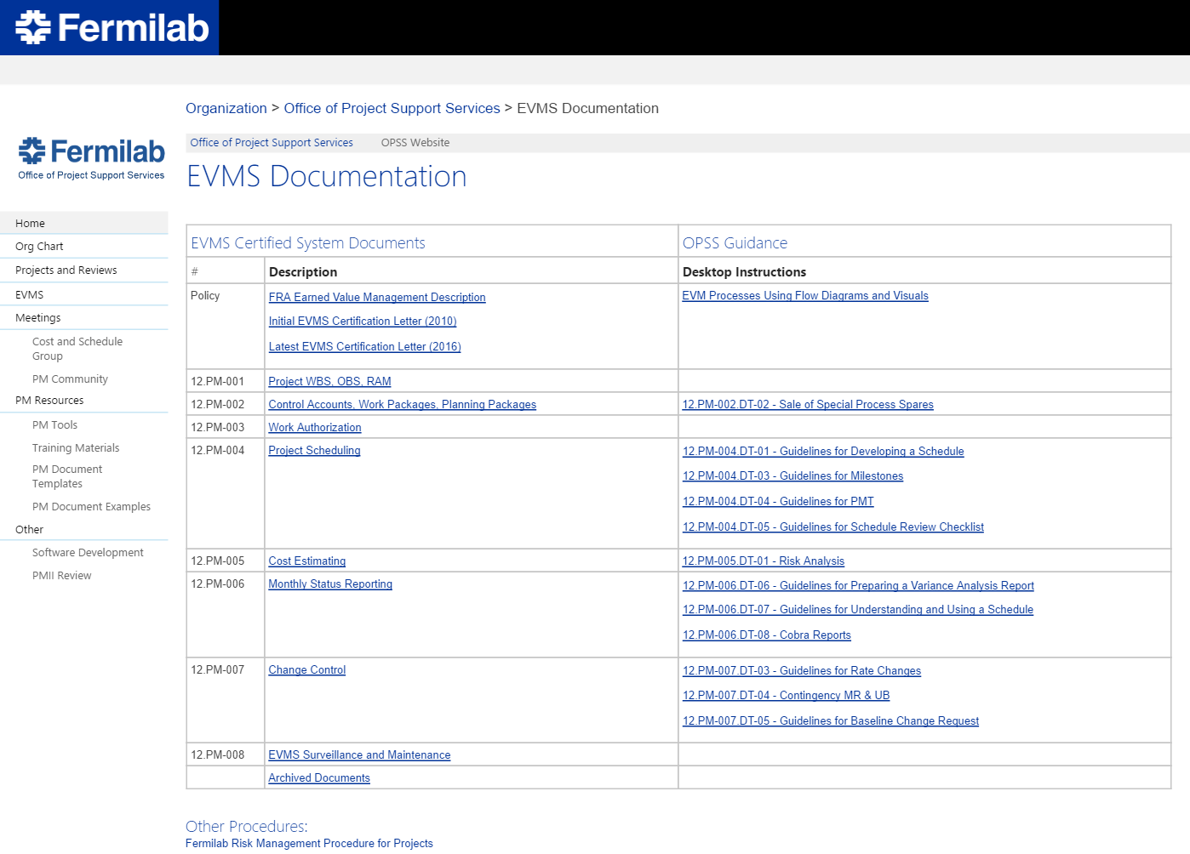
Getting to Procedures & Guidelines – Policies & Procedures
https://web.fnal.gov/organization/OPSS/Pages/EVMS-Documentation.aspx

Slide 8
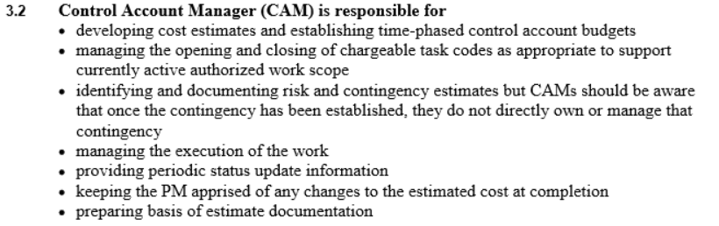
FNAL Procedure 12.PM-005 Cost Estimating

Slide 9
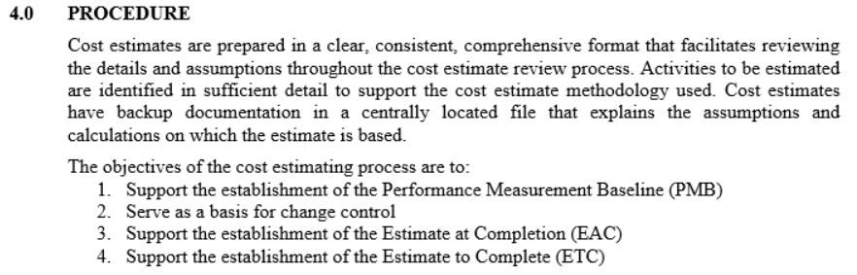
FNAL Procedure 12.PM-005 Cost Estimating
  EAC = Estimate At Completion
  ETC = Estimate To Completion

Slide 10

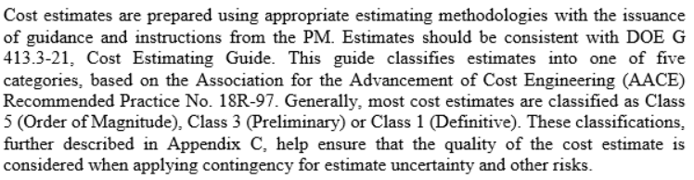

FNAL Procedure 12.PM-005 Cost Estimating

Slide 11
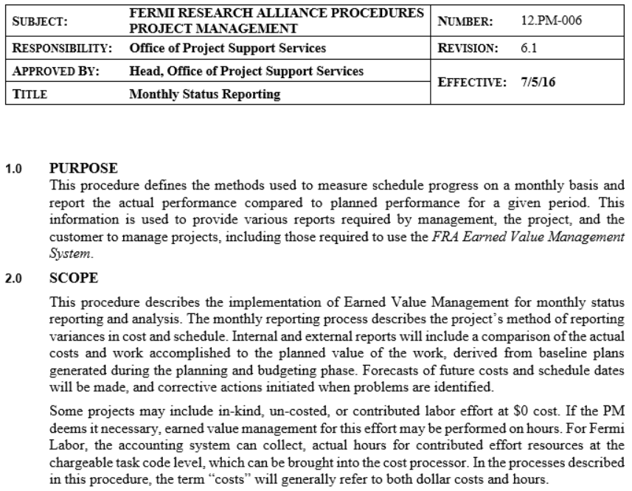
FNAL Procedure 12.PM-006 Monthly Status Reporting

Slide 12
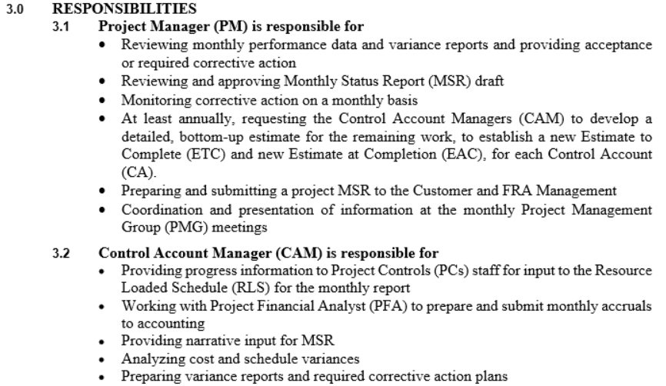

FNAL Procedure 12.PM-006 Monthly Status Reporting

Slide 13
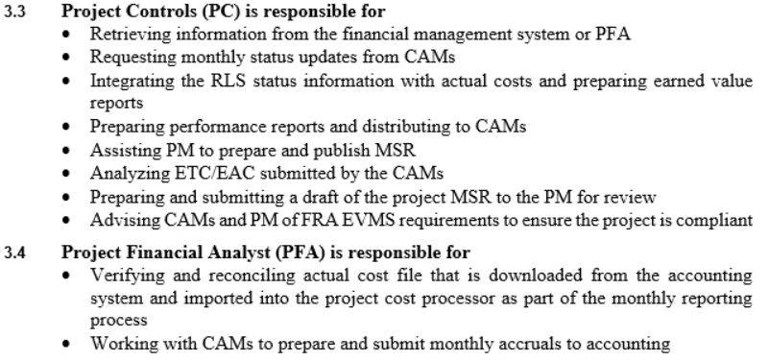
FNAL Procedure 12.PM-006 Monthly Status Reporting

Slide 14
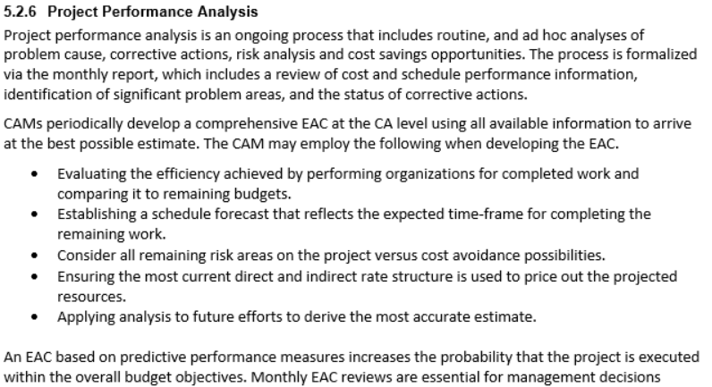
Fermilab Earned Value Management System Description

Slide 15
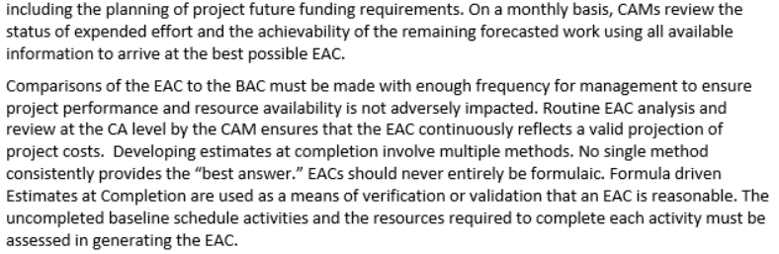
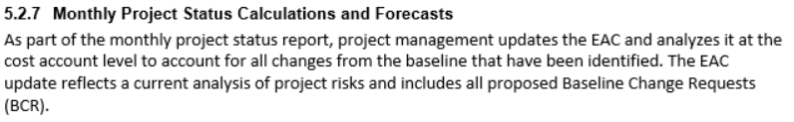
Fermilab EVMS Description – Continued 5.2.6

Slide 16


Deviations from Plan are Answered by EVMS Procedures
Who
  CAM
  PM
Why
  Required – OK but
  Manage
  Inform
When
  Annually
  When Requested
  Monthly Process
  When Known

Slide 17
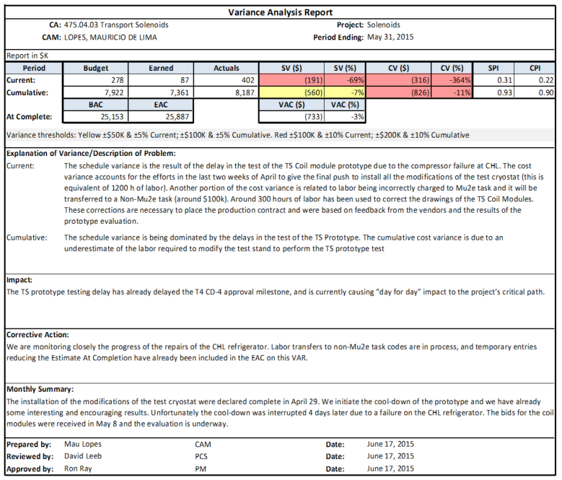
FNAL Deviation Communication Tool
What Formal Tool(s) does FNAL use to Communicate Cost and Schedule Deviations?

Slide 18
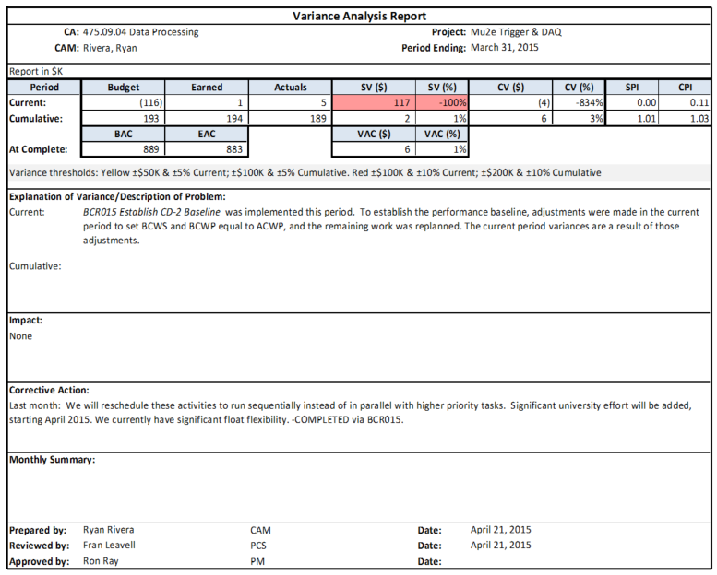
FNAL Deviation Communication Tool (Cont.)
What Formal Tool(s) does FNAL use to Communicate Forecast Cost Deviations (under/over)?

Slide 19
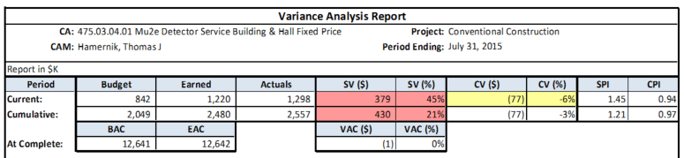


Cobra Reports – VAR: Forecast Communication Tool
1
2
3
At Complete
  BAC (Budget At Completion)
  EAC (Estimate At Completion)
  VAC (Variance At Completion)

Slide 20
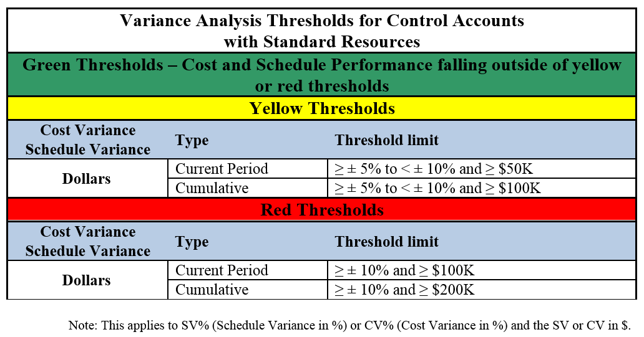
Variance Analysis Thresholds (Default)
Changed by Exception
FRA Management
Project Requirements
FRA Management
Project Requirements
  Risk
  Budget
  Reflected in PMP

Slide 21
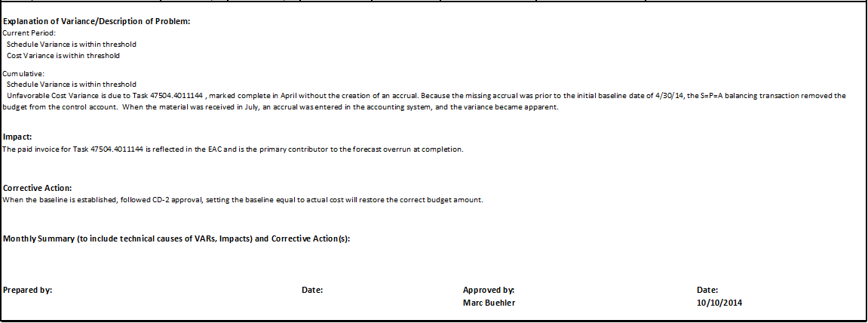
VAR – Narration (Four Key Elements)
Explanation of Variance
Impact
Corrective Action
Summary

Slide 22
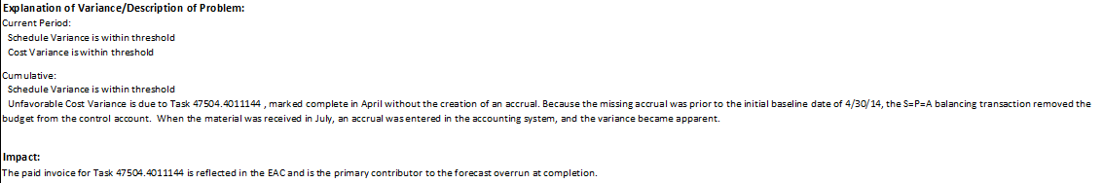
VAR – Narration (First Two Elements)
Explanation of Variance
Current
Cumulative
  Cost
  Schedule
    What
    Why
  At Completion
Impact
Schedule
Cost
CA
Think Successors
Project

Slide 23
VAR – Narration (Last Elements)
Corrective Action
Plan to Return to PMB
Time-frame to Correction
Track Actions to Completion
VAC – Usually None
Summary
Accomplishments
Technical Challenges
Look Ahead
  Over and Under Runs
Ensure your VAR is Approved (Project Manager)

Slide 24
Scenario #1
What if you know a Contract/M&S has cost more (or less) than Planned?
Actions
Communicate via VAR
  Explanation of Variance (VAC)
  Impact: CA increase EAC
  No Corrective Action (Unless warrants BCP on Future work)
Project Change in ETC if Appropriate

Slide 25
Scenario #2
What if you know a Future Contract/M&S will cost more (or less) than Planned?
Actions
Attempt to Mitigate
Project change in ETC
Communicate via VAR
  Cost Variance Explanation (VAC)
  Impact: CA increase EAC
  Corrective Action: Attempt Mitigation or BCR

Slide 26
Scenario #3
What if you know Rates (Labor/M&S) have Changed from Planned?
Actions: ETC
Project change in ETC
Communicate via VAR
  Cost Variance Explanation (VAC)
  No Corrective Action
Actions: BCP
Communicate via Change Control
VAR with new BAC
Decision of ETC vs BCP is PM’s

Slide 27
Scenario #4
What if you know a Field Change has been Initiated (Added Scope) or BCR will be implemented, but has not been yet?
Actions: ETC
Project change in ETC
Communicate via VAR
  Cost Variance Explanation (VAC)
  Corrective Action – Future BCR
Prepare Change Control Documentation
Identify in Summary (Look ahead)
Decision BCP approval is PM’s - Communicate

Slide 28
Scenario #4 (Cont.)
What if you know a Field Change has been Initiated (Added Scope) or BCR will be implemented, but has not been yet? Communicated to PM but PM will not allow BCR
Actions: ETC
Project change in ETC
Communicate via VAR
Identify in Summary (Look ahead)
Decision BCP approval is PM’s - Communicate

Slide 29
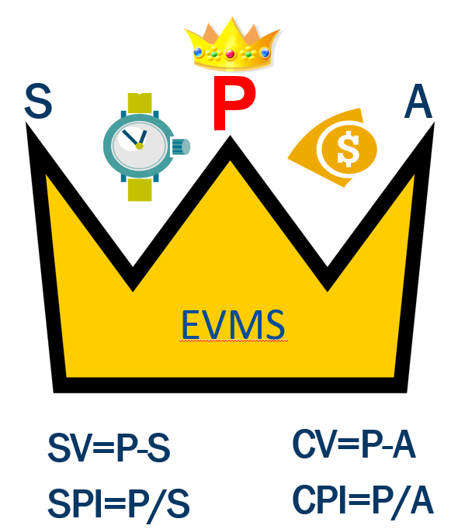
How to Calculate ETC
Information Needed to Start
BAC = Budget at Completion
BCWS_{CTD} = Cumulative BCWS
BCWP_{CTD} = Cumulative BCWP
ACWP_{CTD} = Cumulative ACWP
Calculations
EAC = ACWP_{CTD} + ETC
ETC = EAC - ACWP_{CTD}
ETC = BAC – BCWP_{CTD}
VAC = BAC - EAC

Slide 30
How to Calculate ETC
Information Needed to Start
BAC = Budget at Completion
BCWS_{CTD} = Cumulative BCWS
BCWP_{CTD} = Cumulative BCWP
ACWP_{CTD} = Cumulative ACWP
Calculations
EAC = ACWP_{CTD} + ETC
ETC = EAC - ACWP_{CTD}
ETC = BAC – BCWP_{CTD}
VAC = BAC – EAC
SPI, CPI & CV

Slide 31
How to Calculate ETC (Cont.)
What is Missing?
EAC = ACWP_{CTD} + ETC
ETC = EAC - ACWP_{CTD}
ETC = BAC – BCWP_{CTD}
VAC = BAC - EAC

Slide 32
How to Calculate ETC (Cont.)
Understand:
Assumes Plan is Perfect
  Does not Account for Good/Bad Performance
No Future Adjustments
No Cost of Schedule Slip
EAC = ACWP_{CTD} + ETC
ETC = EAC - ACWP_{CTD}
ETC = BAC – BCWP_{CTD}
VAC = BAC - EAC

Slide 33
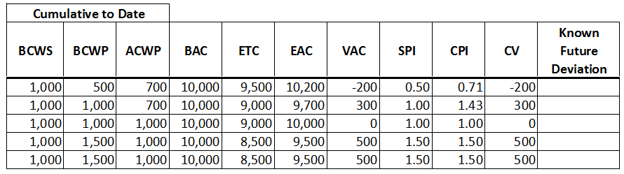
How to Calculate ETC (Cont.)
EAC = ACWP_{CTD} + ETC
ETC = EAC - ACWP_{CTD}
ETC = BAC – BCWP_{CTD}
VAC = BAC - EAC
+ Known Future Deviations
EVMS is:
Management Tool
Communication Tool
EVMS is:
Management Tool
Communication Tool

Slide 34
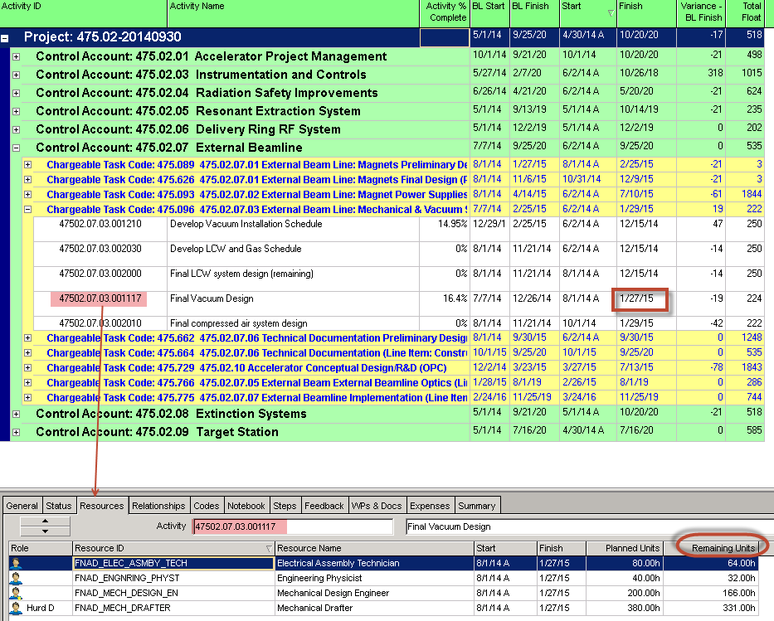
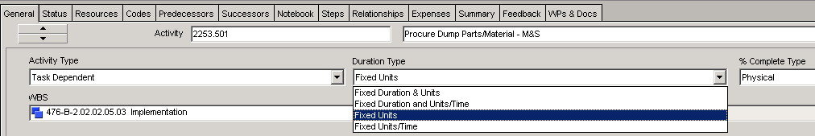
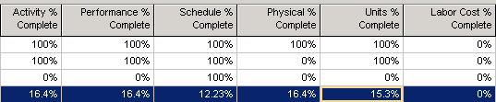
How to Calculate ETC using P6
P6 update included forecast dates and resource remaining units

Slide 35
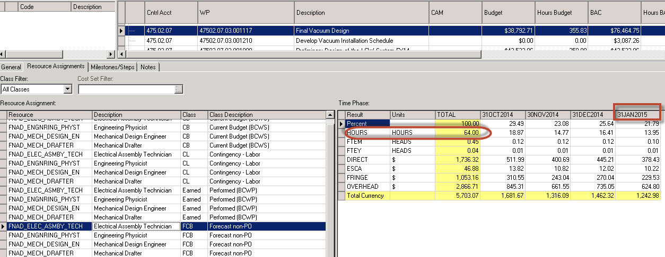
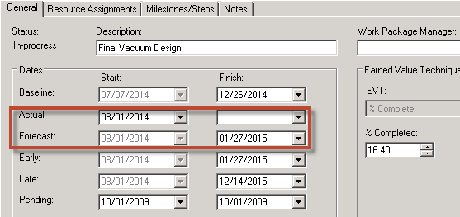
How to Calculate ETC using P6 (cont.)
P6 Forecast dates and remaining units integrated into Cobra

Slide 36
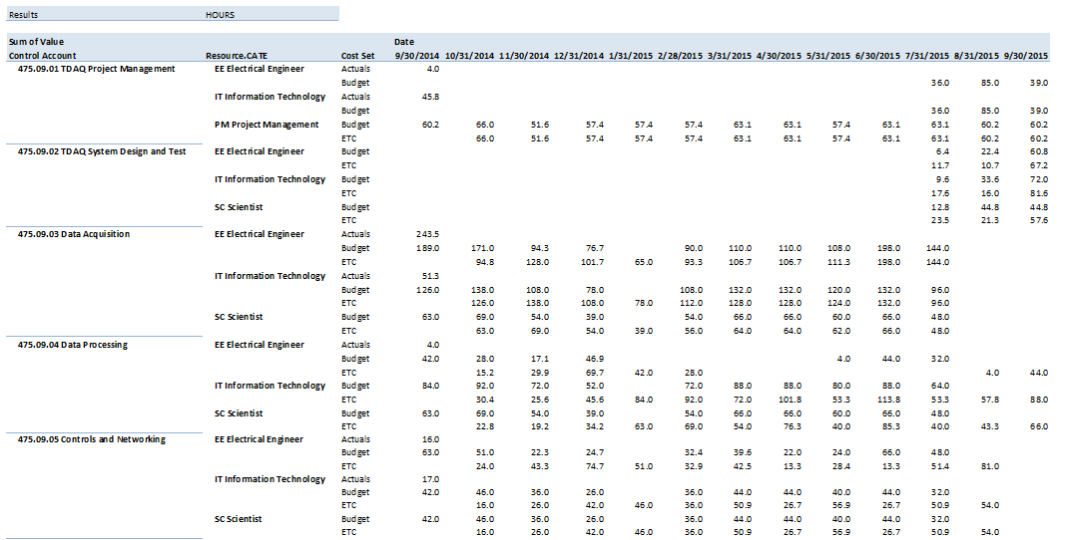
Reporting Tools – Understand ETC
Estimate To Completion i.e. cost of future work
Time-Phased ACWP (Actuals), BCWS (Budget) & ETC in Hours

Slide 37
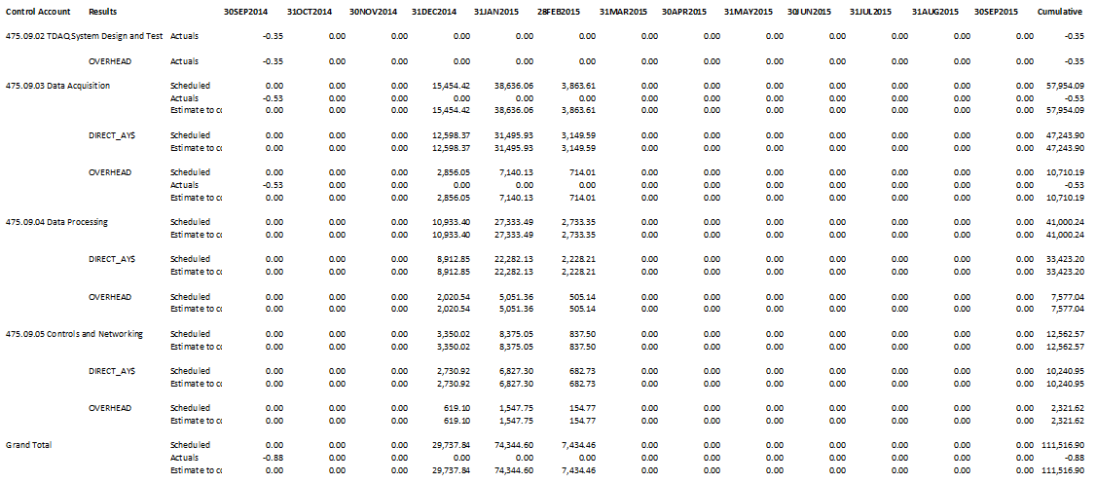
Reporting Tools – Understand ETC
Time-Phased ACWP, BCWS & ETC in Dollars

Slide 38
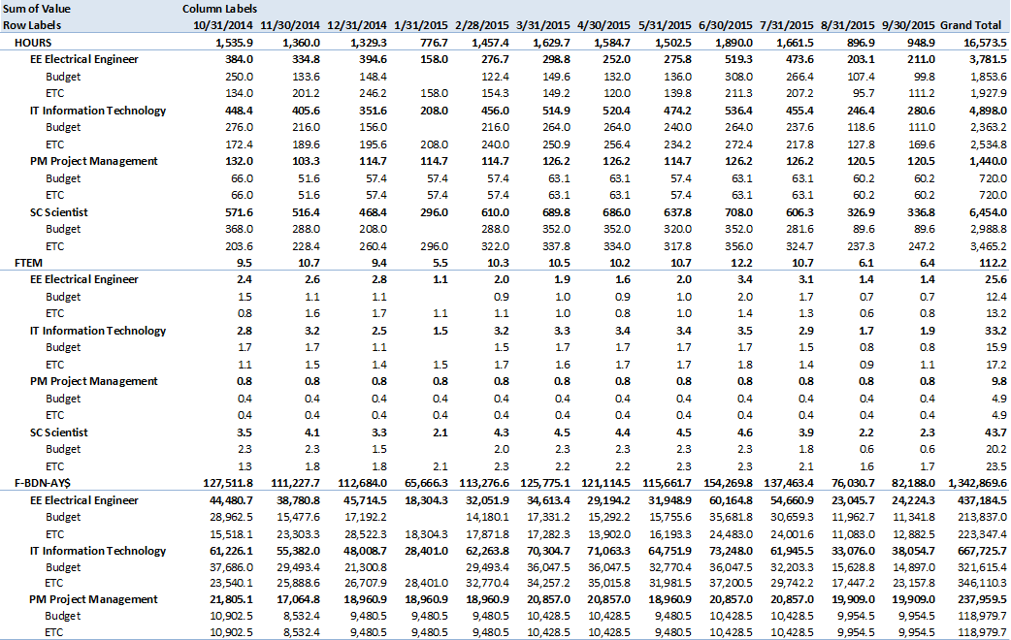
Reporting Tools – Understand ETC
Time-Phased BCWS (Budget) & ETC

Slide 39
CAMs Address Deviations from Plan
Now How Would You Answer?
“How do you let your PM know there will be an increase (or decrease) in cost or schedule?”
“When do you let your PM know there will be an increase (or decrease) in cost or schedule?”
Why do you notify PM?

Slide 40
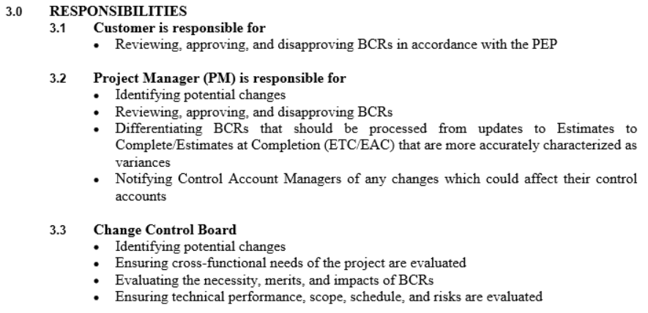
FNAL Procedure 12.PM-007 Change Control
Baseline Change Request

Slide 41
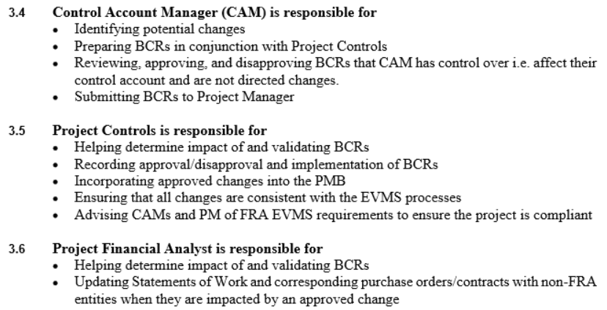
FNAL Procedure 12.PM-007 Change Control

Slide 42
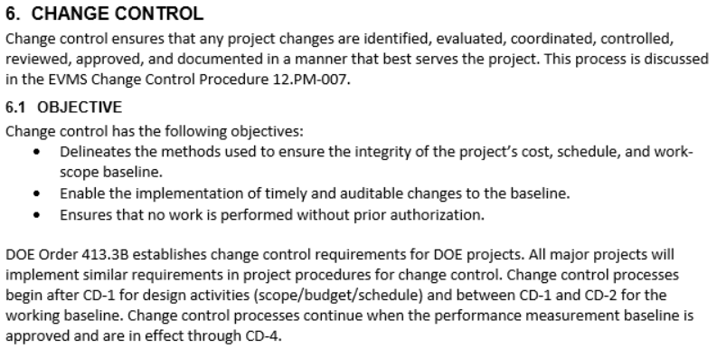
Fermilab Earned Value Management System Description

Slide 43
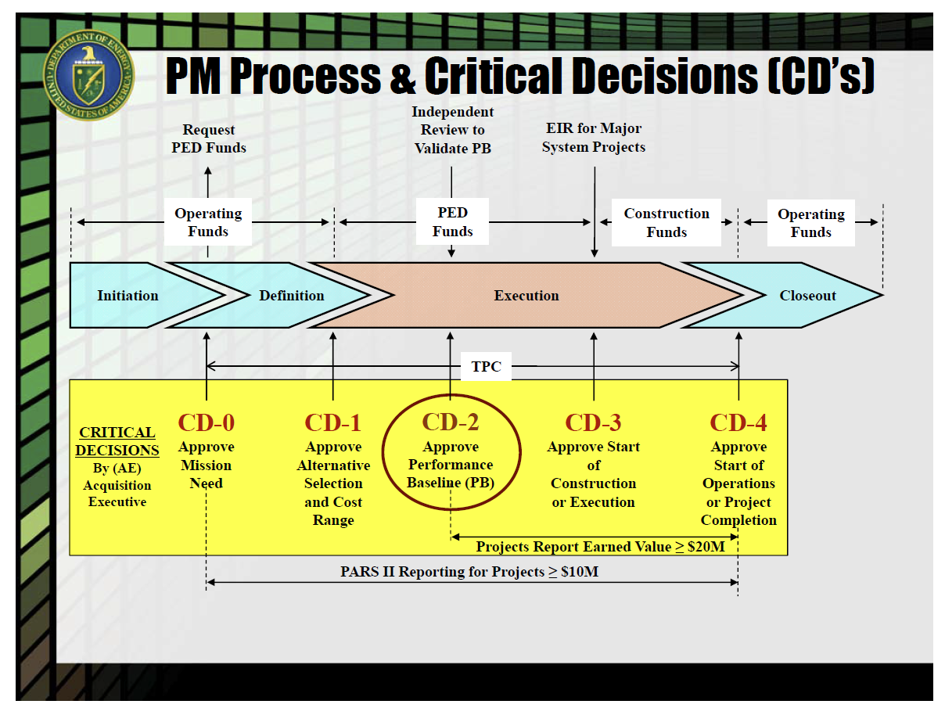
Project Life Cycle – Models Review
Initiation
Planning
Execution
Close-out
Begin then Implement Change Control

Slide 44
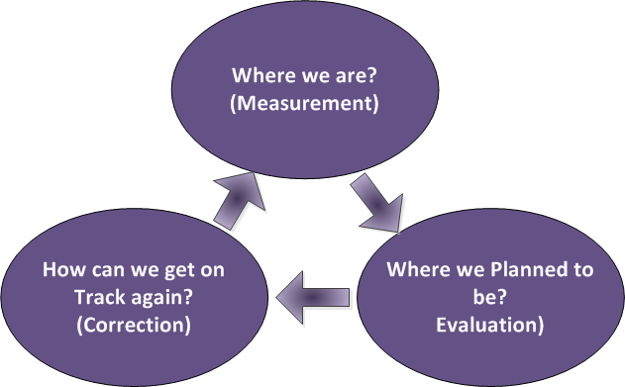
Project Life Cycle – Monitor & Control Review
Initia…
Monitor/Control
…tion
Plan…
Monitor/Control
…ning
Exacu…
Monitor/Control
…tion
Close…
Monitor/Control
…Out
Monitor & Control Cycle
Measure
Evaluate
Correct

Slide 45
Why We Monitor/Control and Initiate Change Control
During Baseline All agreed, Scope, Schedule, and Cost are reasonable
Deviations need to be Agreed to
Demonstrate We Manage not being Managed

Slide 46

Change Management – Primary Goal is Manage/Control
  Control Deviations from Original Plan
  Work
    Defined Scope
    Performed Scope
  Cost
    Budget
    Actual
  Schedule
    Baseline
    Actual
Work
Schedule
Cost

Slide 47

Types of Change
Scope/Schedule/Cost
  Internal Re-planning & Changes
    Changed Conditions
    Better Mouse Trap
    Missed Scope (requires FPD Approval)
    Realized Risks
  External/Directed (Added Scope)
  Authorized Unpriced Work (Field Changes)
Administrative
  Coding
  Typographical
  Description Clarification

Slide 48
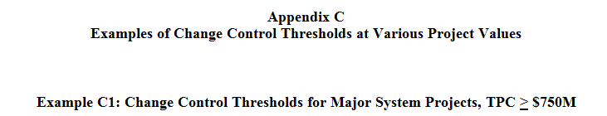
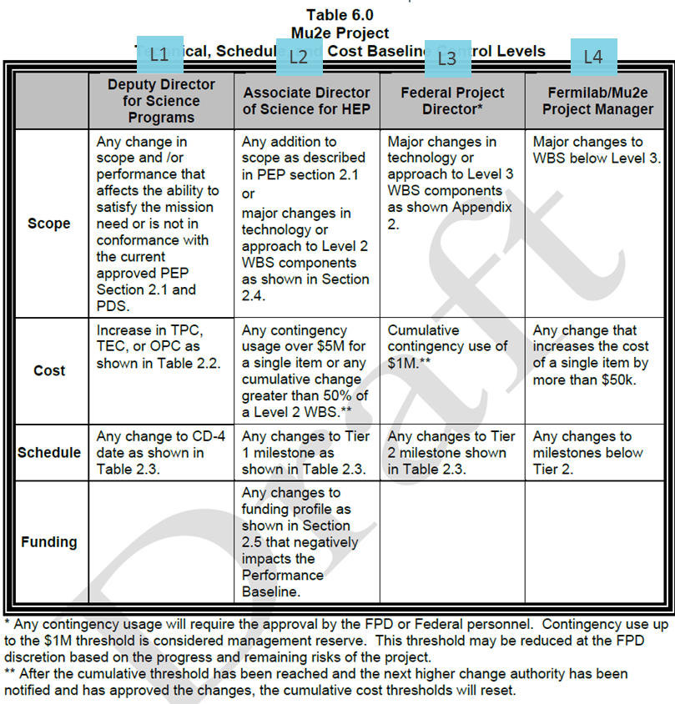
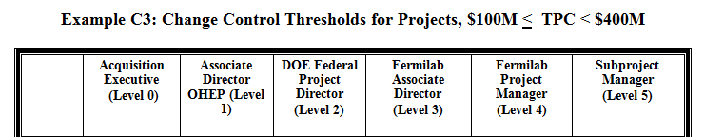
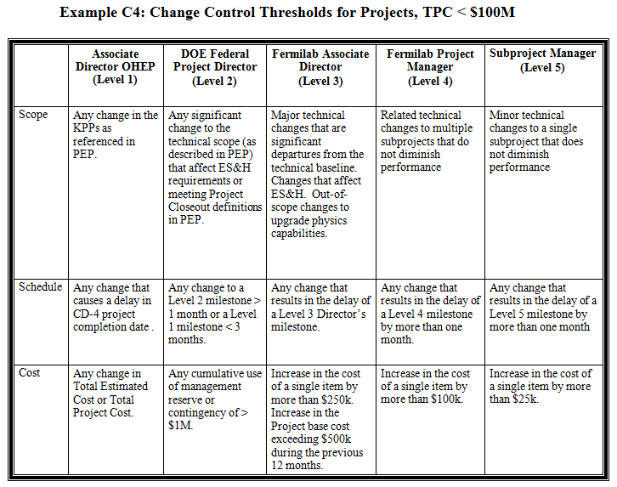
Where to Find Change Thresholds
Appendix C of Change Control Procedure (Guidance)
PEP –
Project Specific

Slide 49
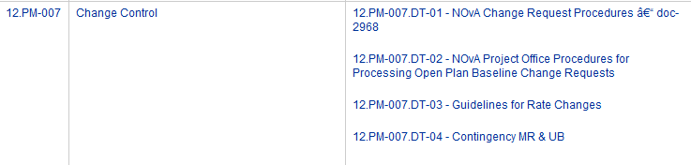
Questions about Change - CCB
What is a Change Control Board (CCB)?
“The CCB ensures technical performance, scope, cost, schedule, and associated risk impacts are understood and documented. CCB membership typically consists of key members of the project management team, including level 2 managers, the ES&H officer, the QA manager, the Project Controls Manager/Lead, and others as appropriate. The Project Controls Manager/Lead will ensure that all changes are consistent with the EVMS processes. The Project Technical Board or the Project Management Group may also serve as the Change Control Board provided that these groups include the necessary membership. The composition, duties, and responsibilities of the CCB will be included in the Project Management Plan template.”

Slide 50
Questions about Change – Contingency, UB, MR
I hear about Contingency, Undistributed Budget, and Management Reserve.
What are they?
Why should I Care?
Contingency = Created by a Combination of Estimate Uncertainty (Bottom-up) & Risk Mitigation (Top-Down) allowances.
Undistributed Budget (UB) = Money Approved but Temporarily not Allocated to Discrete WBS/Activities. Addressed in CA’s EAC.
Management Reserve (MR) = Tool for tracking Cumulative total of Contingency transferred to active budget via Change Control. Note: The portion of contingency retained by PM and is equal to PM’s approval threshold

Slide 51


More Questions about Change
Who Owns Contingency?
  CAM
  PM
  Funding Agency
Why Do I need to Think About Change Control?
  Responsibility
  Manage
  Inform
How Long Does it Take to Process a Change?

Slide 52
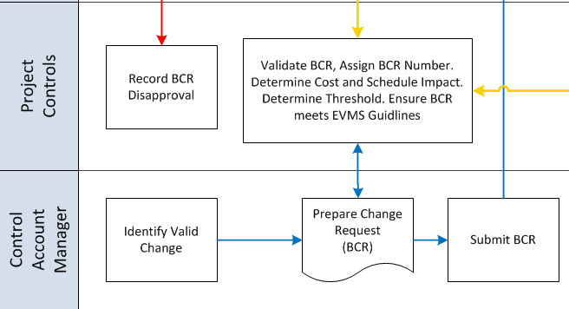
Change Flowchart

Slide 53


Questions regarding Change – Initiating BCR
Who Can Initiate A BCR?
  Anyone on Project
  Client
When Can I Initiate BCR?
  Approved Prior to Work Start
    Future = Managing Scope
    Past = Reaction Managed
  Field Changes (Construction Only)

Slide 54
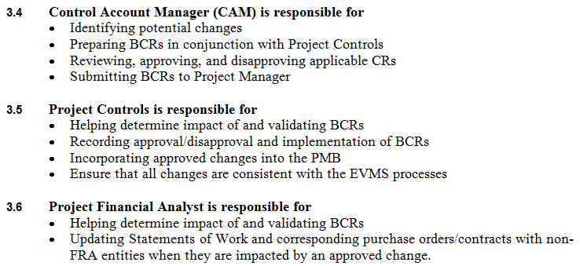
FNAL Procedure 12.PM-007 Change Control - Clarification
What does this mean?
Change Request
Response to Who can Initiate
Addresses CAM’s
  Ability to Manage
  Approve Means
    Preliminary
    Continues through Process
    PM/CCB ultimate approval/disapproval

Slide 55
Questions regarding Change – Action Steps
What Actions Do I take when Change is Identified?
  Start Documentation Process
  Iterative Process With PCS
  Communicate
    Alternatives
    Impacts
    Urgency
    Consequence of Not Approving
  Submit BCR
  Wait for Approval

Slide 56
Change Control Process
Steps to Change Control:
  1. Prepare supporting documentation [CAM]
  2. Fill out and submit Baseline Change Request (BCR) Form in BCR Tool [CAM]
  3. Enter routing data into BCR database [Config Mgr]
  4. Obtain approvals – depends on BCR Level [Config Mgr]
  5. Update cost & schedule information in P6 & Cobra, and finalize BCR database entries [PCS] → details Beyond Scope of this Training
  6. Then actually process
    the changes…

Slide 57
Questions regarding Change – Gate Keeper
I have Some Changes to Make, but my PCS won’t Process them Now - Why?

Slide 58

Change Control – PCS Limitations
Can Take Days or Weeks to Process
PM – Prioritizes / Approves
EVMS Guidelines
  Can NOT Change History
  Future ONLY with Four Exceptions
Rate Changes
Obvious Errors
Establishing PMB
Contract Changes

Slide 59

Change Control System – Formal Documented Process
Identified Change
  How
  When
  Type
When Work can Start
  Work Authorization & BCR Approval
  Demonstrate Management
  Demonstrates Control
Impacts of Change
  Cost
  Schedule
  Scope
  Risks
    Quality
    Safety
Authority / Responsibility for Approvals
Baseline Change Request

Slide 60
Baseline Change Request Tool
BCR Tool database is used to Manage Changes.
Data Input source is BCR form
Approval Workflow and Routing controlled by Change Manager in Tool
Tracks approval status
Records cost impact (both Preliminary and Final amounts) by type (M&S or Labor) and by Labor resource
Also records schedule impacts (Reflected in P6 Schedule)
Prints detailed report for each BCR
Database maintained by OPSS

Slide 61
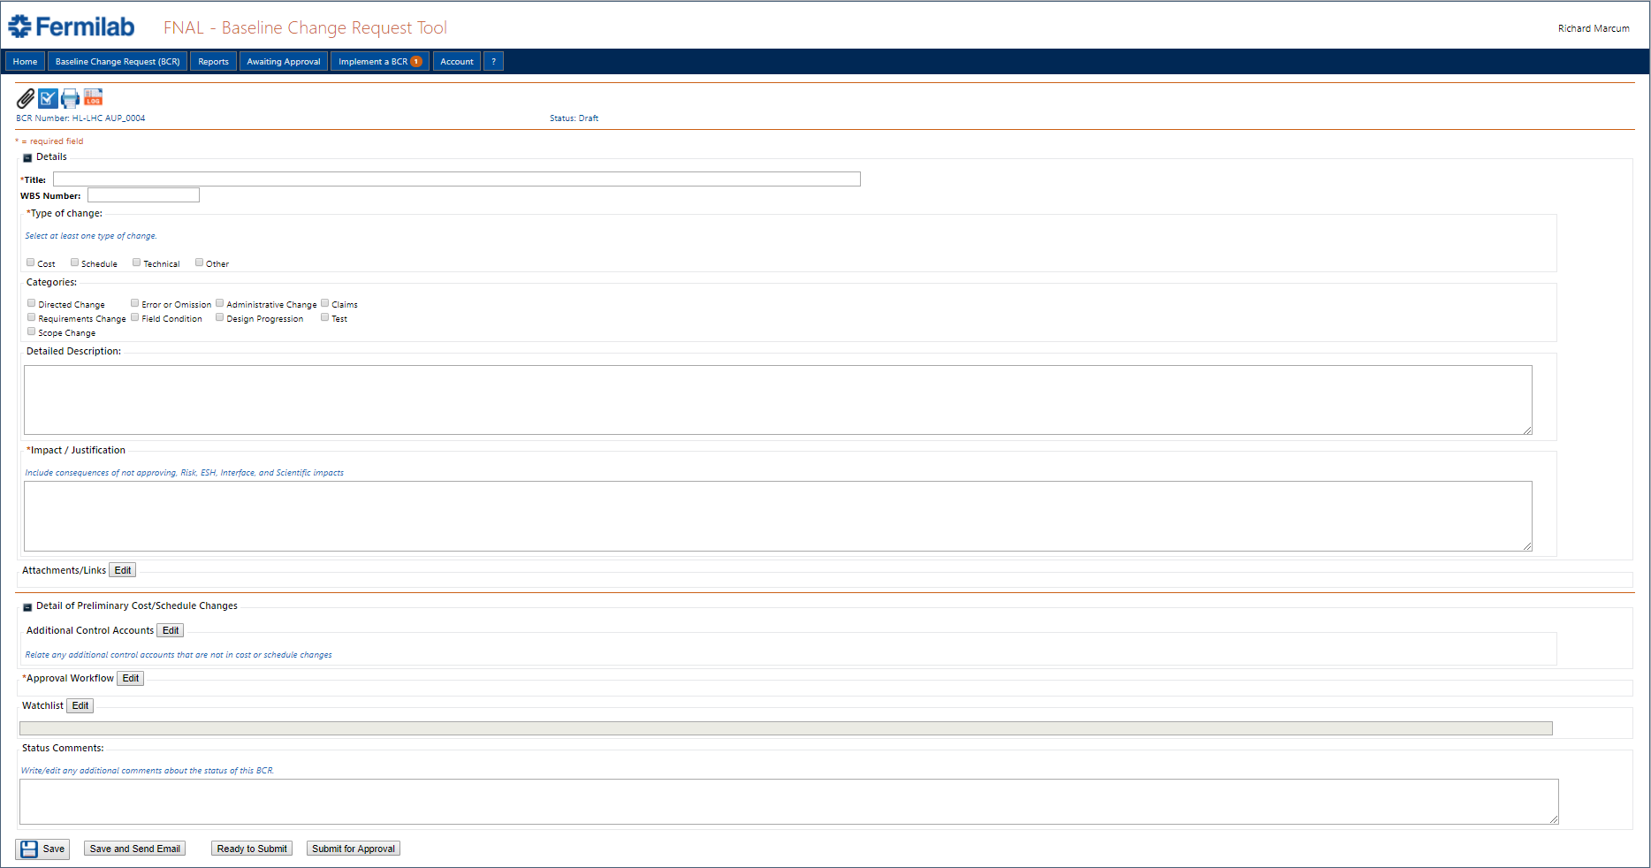
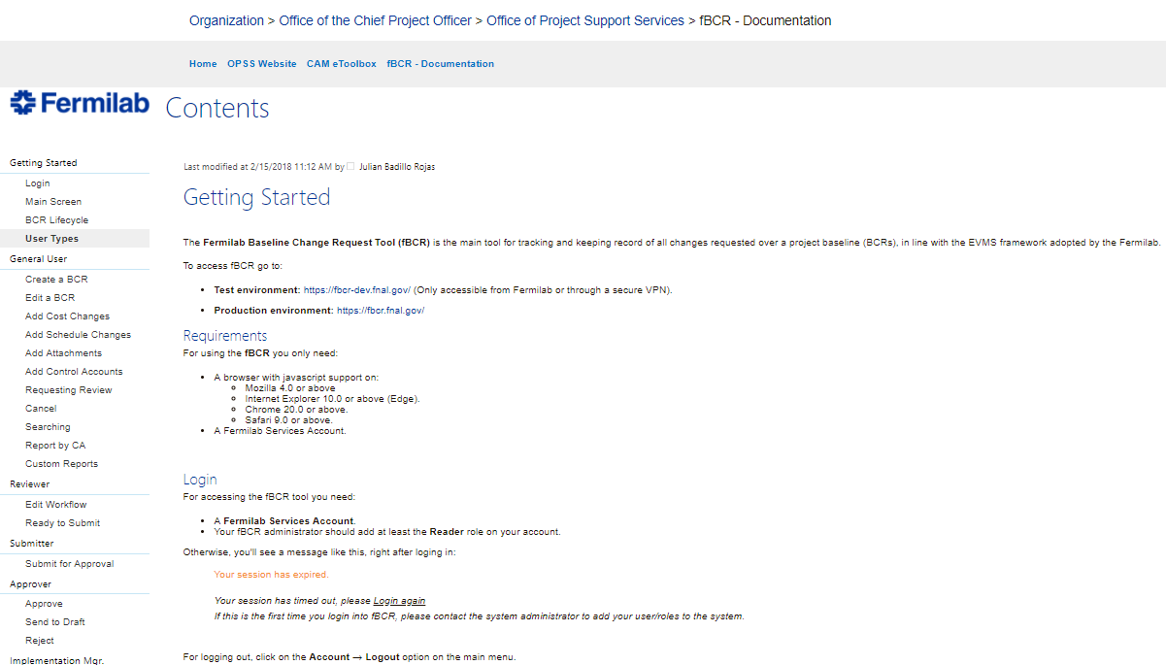
Change Request Form – Generated by BCR Tool

Slide 62
Change Request Form – Generated by BCR Tool (Cont.)
Title: Very Brief Summary
WBS Number: Single Lowest common WBS Element that encompasses all work.
Example 1: Work affects the following WBS elements 123.01.02, 123.01.04, 123.01.06 then Lowest common WBS Element would be 123.01
Example 2: Work affects the following WBS elements 1234.01.02, 123.01.04, 123.02.01 then Lowest common WBS Element would be 123

Slide 63
Change Request Form – Generated by BCR Tool (Cont.)
Describe all details of the change such as why it is needed, How need was discovered, Basic BOE information – what is the Basis for the Change (remember the BCR is used instead of BOE and should contain equivalent back-up. Can use Attachments later but at least brief description and note that will bring reviewers to attachment)
Include Consequences of NOT approving this Change. Also, specify and Risk, ESH, Interface, and Scientific impacts.

Slide 64
Change Request Form – Generated by BCR Tool (Cont.)
Filled out by Change Manager and Read Only for CAM after Request is Submitted.
Who will be Notified. Edited out by Change Manager and Read Only for CAM after Request is Submitted.

Slide 65
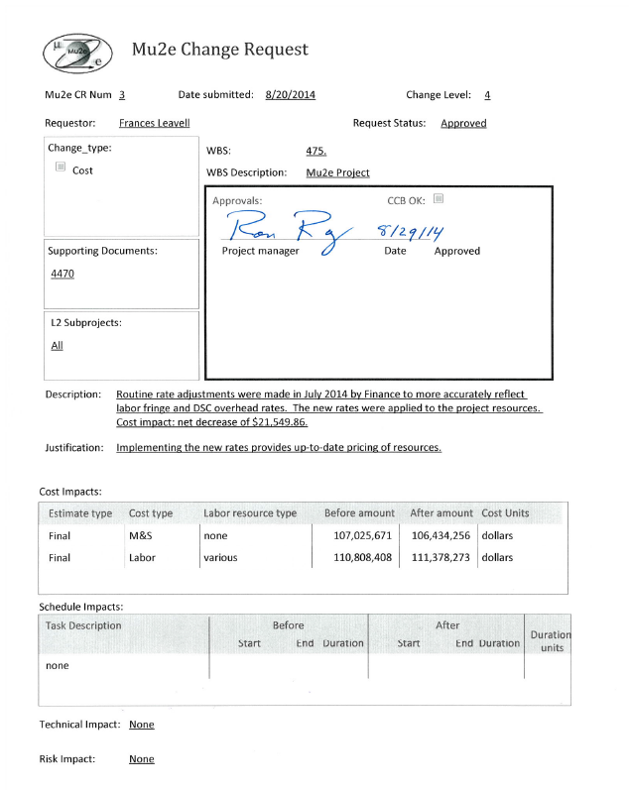
Example: Change Request Detail Report
This printable form is produced by Access for each BCR.
Stored as PDF in DocDB
Contains signature box for approvals
Lists cost, schedule impacts, supporting documents, change type and level, affected L2 subprojects, WBS, justification, technical & risk impacts…

Slide 66
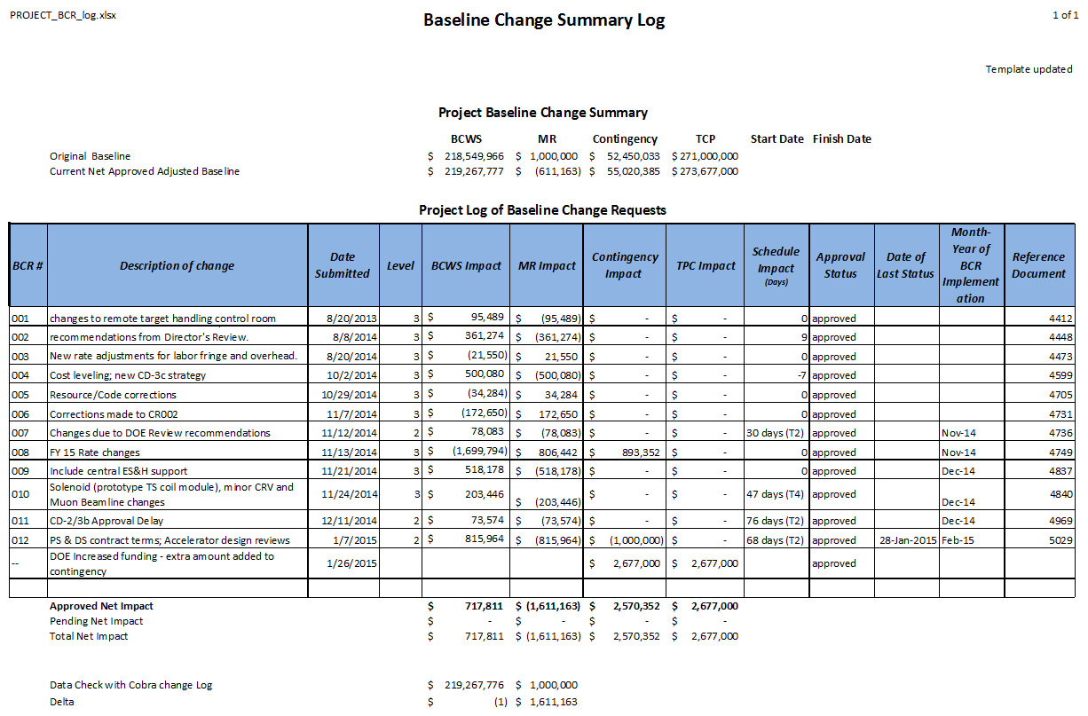
Example: Change Request Log (Summary)
Summary record of all changes
Tracks contingency and mgmt reserve used

Slide 67
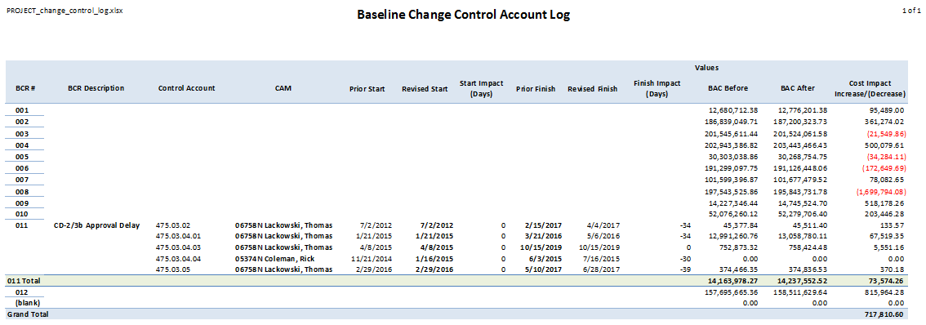
BCR Control Account Log (Control Account)

Slide 68
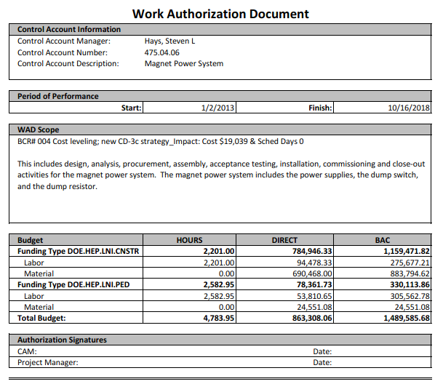
Work Authorization Document (WAD)

Slide 69
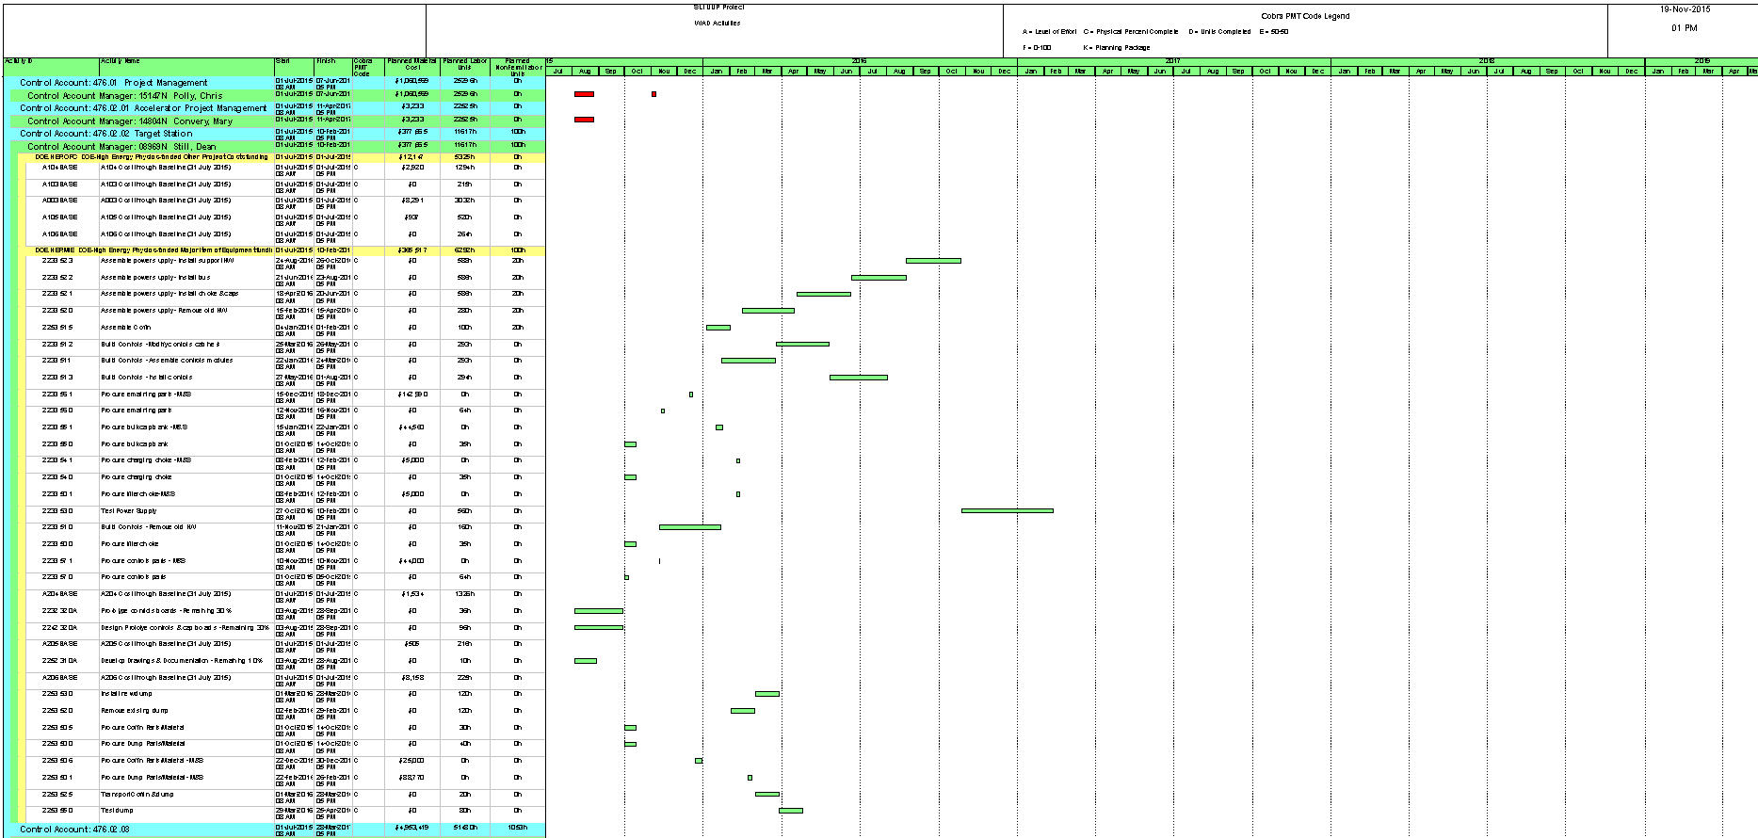
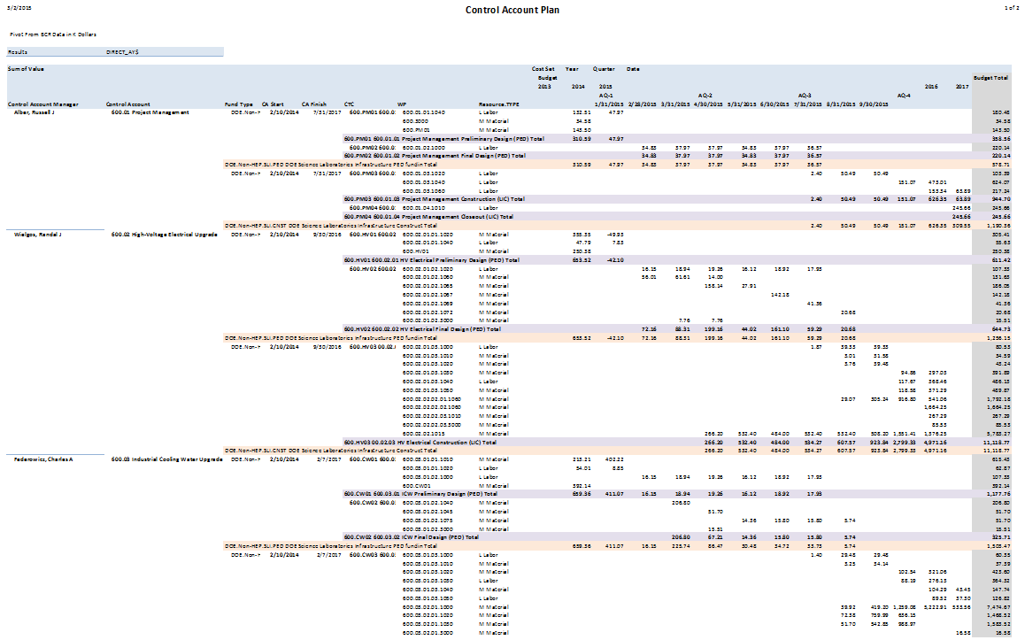
WAD Attachments Examples: Schedule & CAP
Procedure outlines required fields for these reports
WAD information is incomplete without these attachments

Slide 70
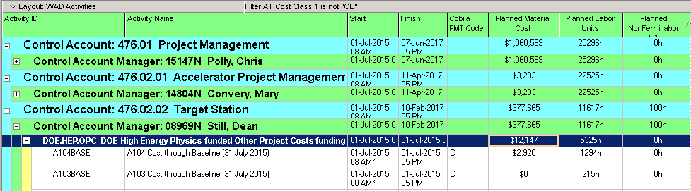
WAD Attachments: Schedule Reports (By CA)

Slide 71
WAD Attachments: Control Account Plan

Slide 72



BCR Documentation: Schedule Reports – Three Required
Milestone
Schedule Impacts Critical Path

Slide 73

BCR Documentation: Validation Reports (CA Impact i.e. Before & After)
Data Subtotaled

Slide 74


BCR Documentation: Validation Reports (History Unchanged)

Slide 75
Other Documents Possibly needing Update with BCR
Manage the documents is detailed in the project’s Configuration Management Plan
WBS
WBS Dictionary
Milestone Dict.
PEP
PMP

Slide 76


