Slide 1
Muon Department meeting
August 9, 2018

Slide 2
Department Business
Safety
  Work stoppage – details of the triggering incident
  Rethink activities that seem commonplace
    Pay attention to all signs and postings
    Follow two man rule in the tunnels
    Be careful about handling items from the tunnel
    Remember to frisk
  There was another Safety violation this week
  Everbridge drill today
Performance appraisal process
  All self evaluations are in
  Discussion with supervisor should be in September
  Start looking at goals for next year
“Friends of Fermilab for Science Education” tour on Sep 8
Power Outage schedule
  Aug 17 – BWT (all day)
  Aug 27 and Sep 10 – Site (15 minutes)

Slide 3
Shutdown Update
Electrician work
  M4 line vacuum cables – done
  US M4 instrumentation cables – done
  M5 line capacity increase for Q12,13 – done
  TLMs – done
  Collimators and Cooling Wedge – done
  Heliax pulls from AP-50 to MC-1 (3 out of 5 cables done)
  LOTO disconnect switch conversion to Kirk key (60% complete)
Miscellaneous work
  AP-0 interlock upgrade ()
  Target rotation repair (In progress)
  PWC investigation (in progress)
  Prototype g-2 target (materials to construct target have been ordered)

Slide 4
Shutdown Update
Vacuum work
  Delivery Ring Maintenance and leak check complete
  M2/M3 line collimators installed
    Only motion controls and readback connections remain
  RGA scan of 30 straight (data collected but no report yet)
  M4 line construction (up to temporary shield wall)
    Beam pipes are in the magnets
    Instrumentation stands in place
    Welder needed to interface beam pipes that are in place
    Vacuum tees and pumps and instruments need to be placed
  M4/M5 shared maintenance not started
  Cooling wedge installation not started
  Vacuum window replacement at end of M5 line not started.

Slide 5
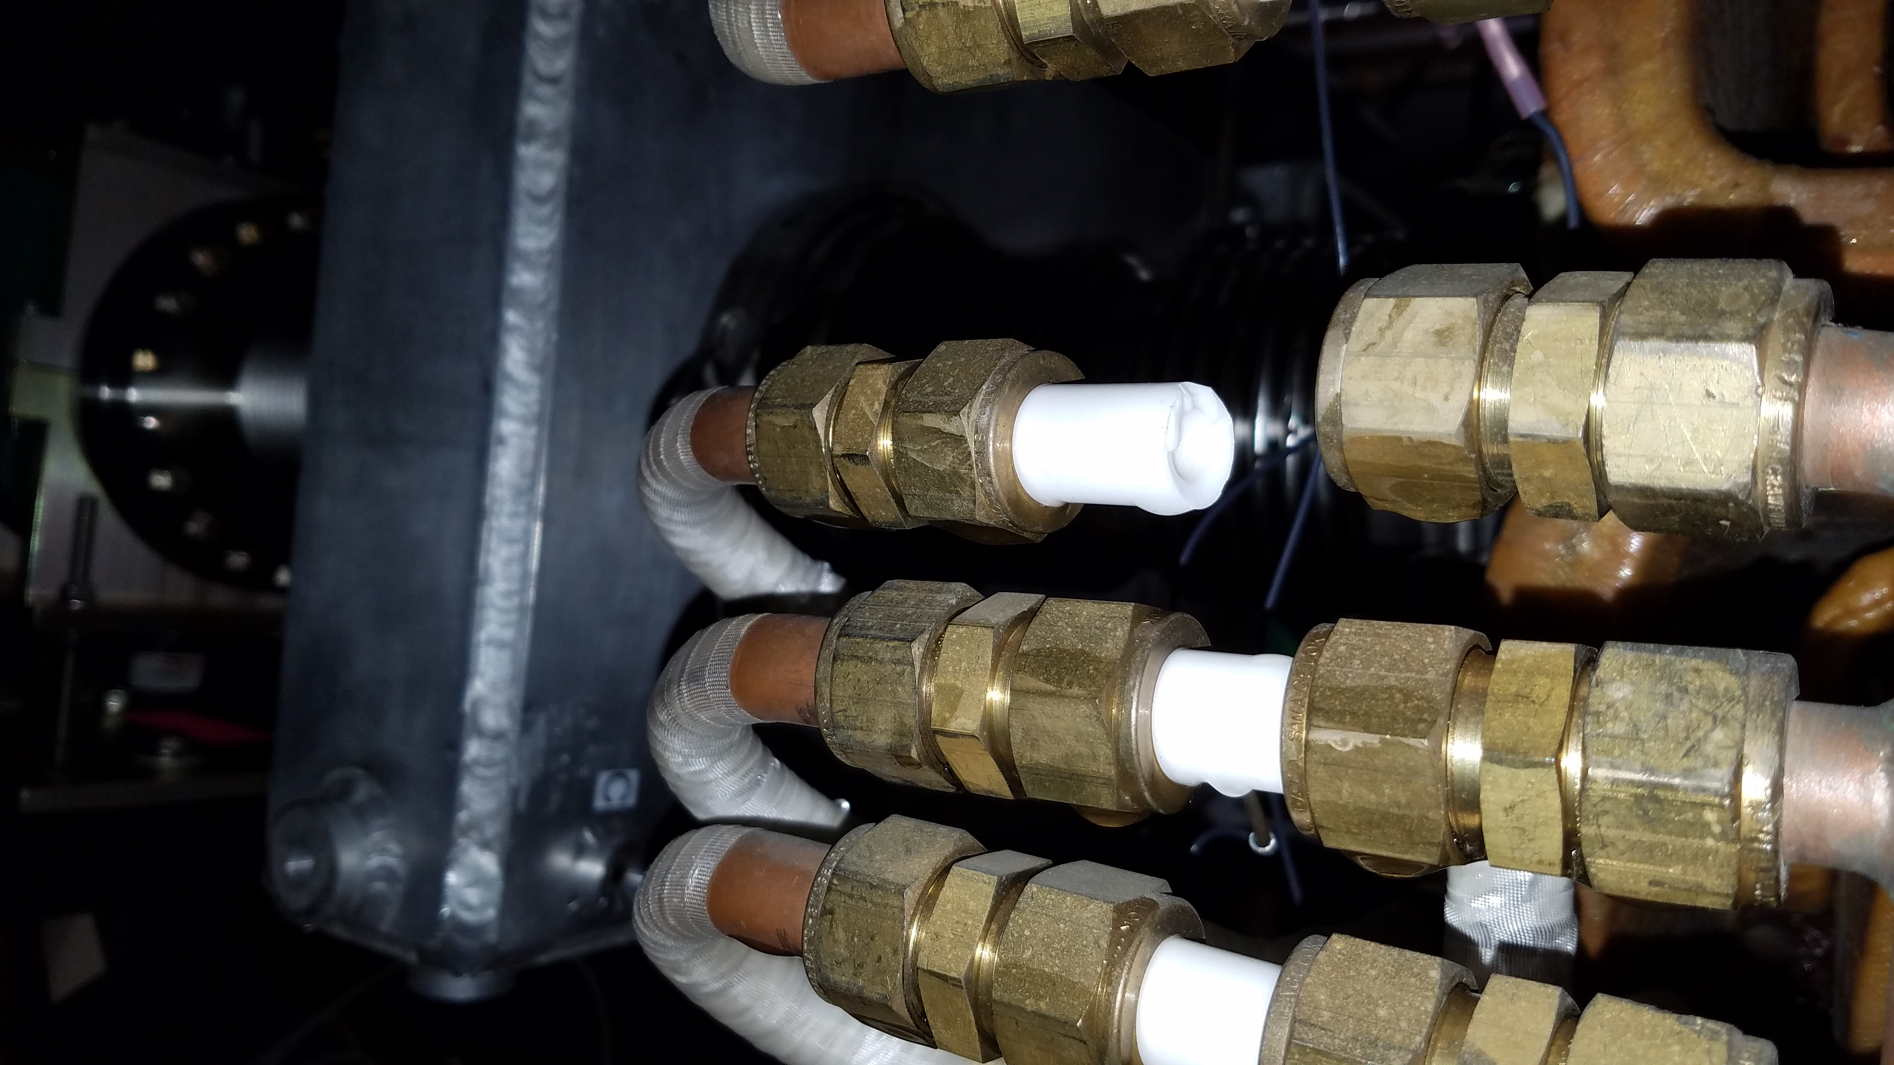
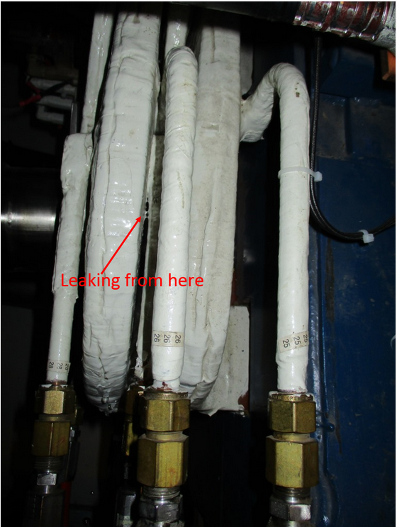
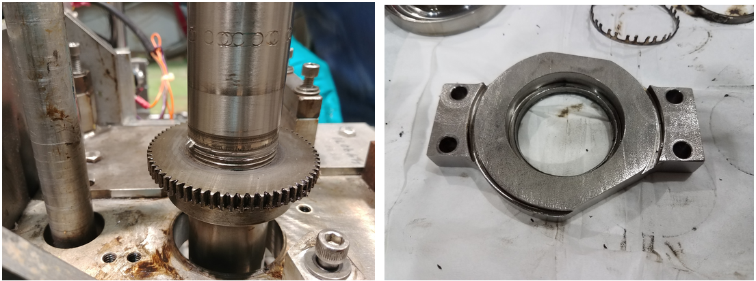
Shutdown Update
New (Unplanned) Jobs
  Target rotation bearing replacement
  Broke ceramic on D:H748
  Water leak on D:V003

Slide 6
Shutdown Activities (g-2 experiment)
Magnet was warmed up to purify helium and cooled down
Compressors in A0 have been refurbished
Work on Compressor Trip Cryo Response is continuing and behind schedule due to manpower
Ongoing work for overall reliability improvements to cryo system and controls
Electrostatic quadrupoles tested an additional so-called batman insulators. After successful testing, we are proceeding to produce and install the remaining 7 batman.
Quad testing at better vacuum allows us to raise the voltage to 29kV which is above operating voltages
Kicker - quadrupole interference was tested with better vacuum and we saw a significant improvement
Kicker bazooka upgrades is the main schedule driver at the moment. Currently we are working on the drawings to send them out for bidding.
Inflector passed final cold test, preparing final steps to ship to MC1. Inflector mini-review last week left us with homework which we are addressing to get approval for the installation of new inflector
Preparing to proceed with the magnet insulation

Slide 7
Path to higher flux
Improvements to flux this summer
  (5% gain) Replace F17B3 and V907 Beamline PS to allow faster switching between SY(FTBF) spills (really 7% convolve with more SY120 time)
  (20% gain) Add wedges for momentum compaction of beam…funded through LDRD and aiming to install this summer
  (10% gain) Reliable quad operation, possibly at higher n-value
  (10% gain) Kicker amplitude
  (40% gain) New inflector
  (10-20% gain) Broader beam in M2/M3, optics need to be understood
  (10% gain) New target – but target group stretched thin with LBNF work
Completing list in green improves flux by 213%

