Slide 1
Conversion of PIP2IT to a CM Test Stand
Jerry Leibfritz
PIP-II PMG Meeting
15 August 2018

Slide 2
Overview
CD-1 Plan
  Test HWR and SSR1-1 in PIP2IT with beam
  Convert SSR-1 slot in PIP2IT to test remaining SSR CM’s (without beam)
  Convert CMTS1 test stand to test 650MHz CM’s (without beam) after LCLS-II testing is complete
LCLS-II and LCLS-II-HE schedules are uncertain and create risk to PIP-II schedule, so revised plan
CD-2 Plan
  Test HWR and SSR1-1 in PIP2IT with beam
  Convert SSR-1 slot in PIP2IT to test remaining SSR CM’s (without beam)
  Convert HWR slot (and portion of MEBT) in PIP2IT to test 650 MHz CM’s (without beam)

Slide 3
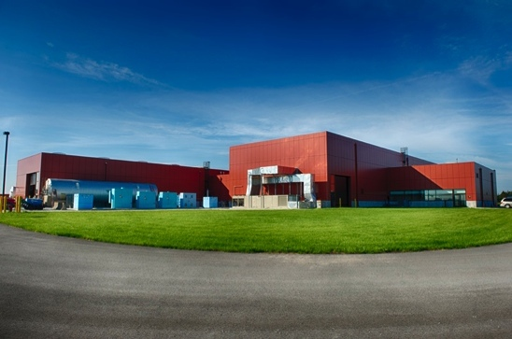
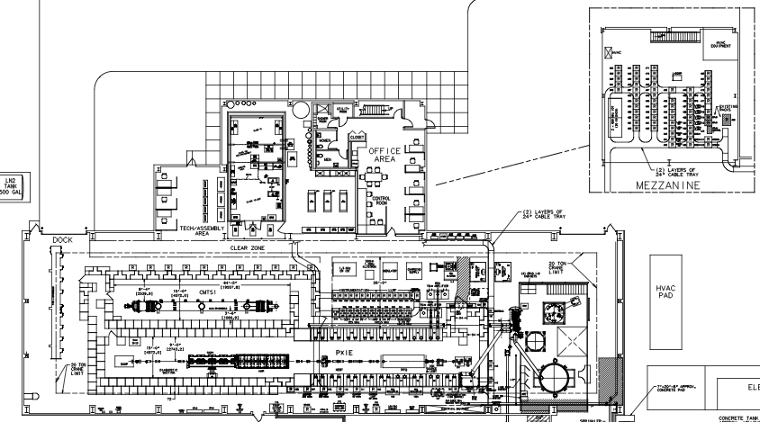
CMTF – Cryomodule Test Facility
The CMTF Building contains two test stands (CMTS1 and PIP2IT)
CMTF Building
CMTS1 Test Cave
PIP2IT Test Cave
Cryogenic Plant

Slide 4
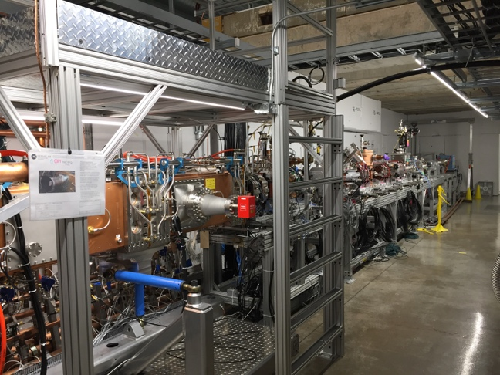
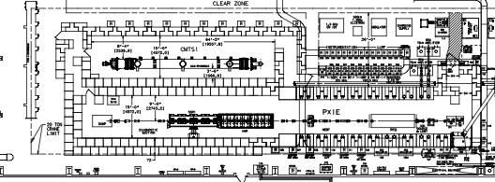
PIP2IT
PIP2IT (PIP-II Injector Test)
  Half Wave Resonator (HWR) and 1st 325 MHz cryomodule (SSR1-1) will be tested in PIP2IT as part of front-end test
  PIP2IT will be converted to a cryomodule test stand to cold RF test the remaining PIP-II cryomodules (no beam)
    SSR1-1 test stand will require minimal modifications to accommodate remaining SSR cryomodule testing
    HWR test stand will be converted to RF test 650 MHz cryomodules (no beam)
PIP2IT Test Cave
SSR 325MHz Test Stand
HWR/650 MHz Test Stand
PIP-II Injector Test (PIP2IT)

Slide 5
Feasibility layout of HB650 in PIP2IT
Goal is to see if it is possible (mechanical and cryo)
Used HB650 since it is longer than LB650
1.5m gap between CM’s to allow for vacuum stations
Avoid trapped roof blocks (cable tray)
Mechanically – Looks OK!
HWR

Slide 6
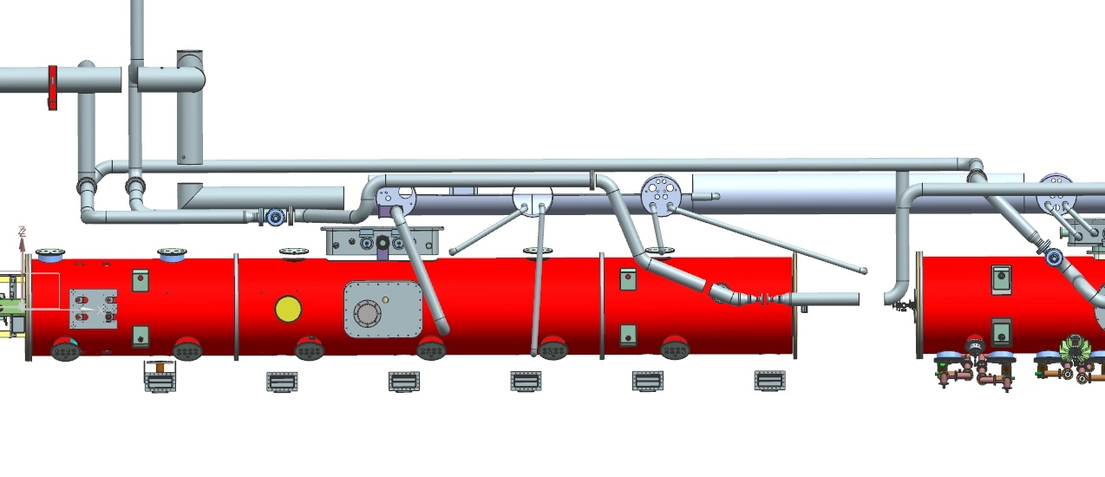
Feasibility - Cryogenic Transferline (CTL)
HB650 shown with existing CTL
Cryo engineers confirmed it is doable!
Current configuration is messy, bayonets would be long and overlapping
CTL bayonet boxes
CM Valve Box

Slide 7
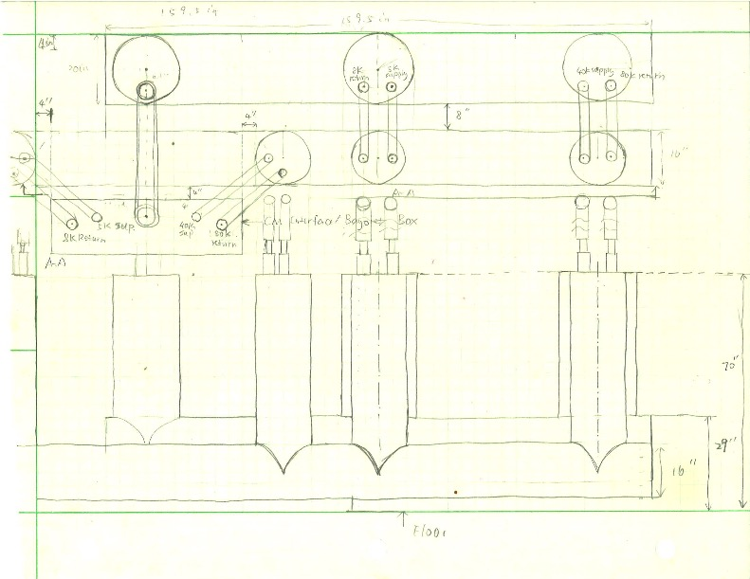
Cryo proposal to modify CTL for 650 MHz CM’s
Add secondary CTL
Move CM 28” towards aisle
Install new 16” transferline
Maintains a 44” aisle in PIP2IT
Sketch of new CTL
(Renzhuo Wang)

Slide 8
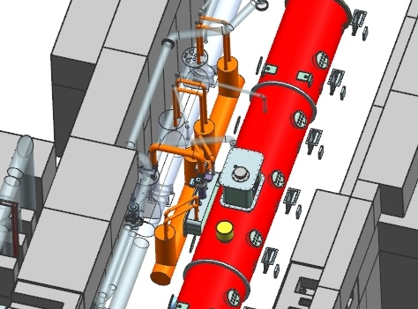
New CTL proposal (orange)

Slide 9
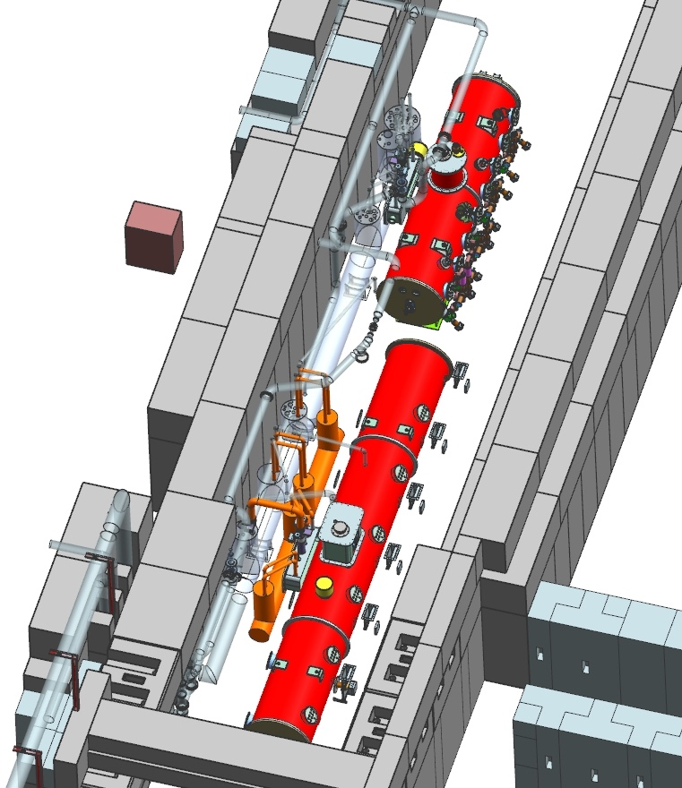
Full view – new CTL
New CTL in orange
HB 650 CM moved towards aisle 28”
Cost to modify CTL should be equal to (or less than) CD-1 cost to modify CMTS1 Cryo distribution

Slide 10
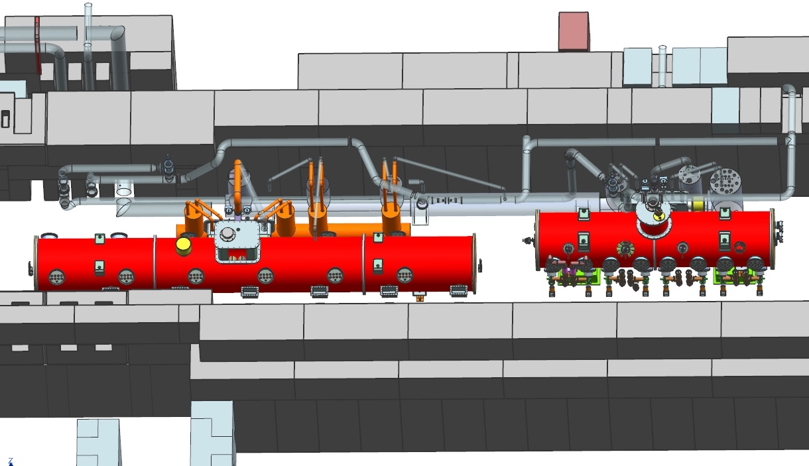
Additional view (2)

Slide 11
Next challenge - RF SSA layout & RF routing
Need space for SSA’s for:
  HWR (already have rack space assigned)
  SSR1 (8 SSA’s)
  SSR2 (5 SSA’s)
    Could SSR2 SSA’s replace SSR1 SSA’s, or do all have to be in place at same time?
  LB650 (8 SSA’s)
    Very large
    Will also be used for HB650

Slide 12
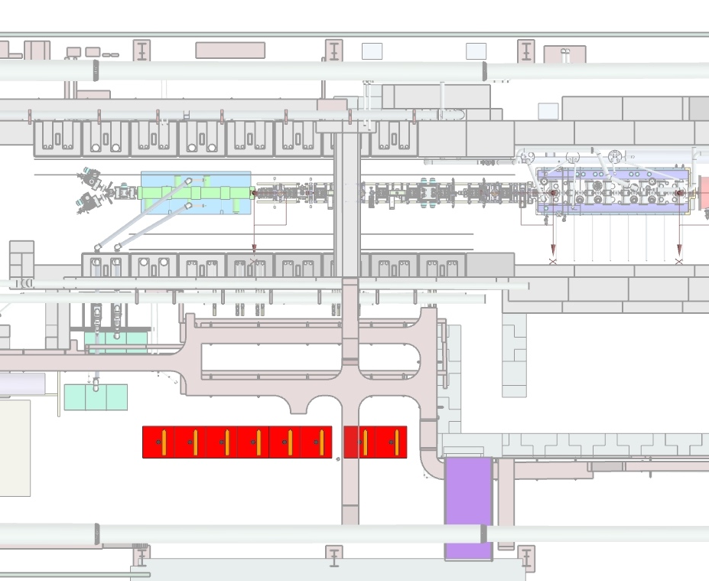
HWR and SSR1 SSA’s – conceptual plan
To be installed in FY19
HWR SSA’s
SSR1 SSA’s

Slide 13
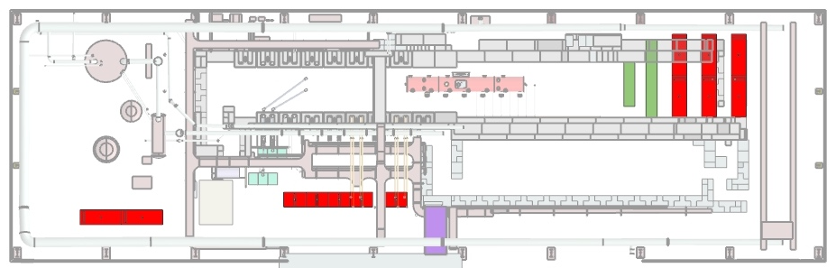
Preliminary concept - 1
Assuming SSR1 SSA’s can be removed prior to SSR2 testing
Used maximum SSA size envelope
Move cave wall
SSR2 SSA’s (5)
(Alternate SSR2 SSA’s (5))
LB650 SSA’s (8)

Slide 14
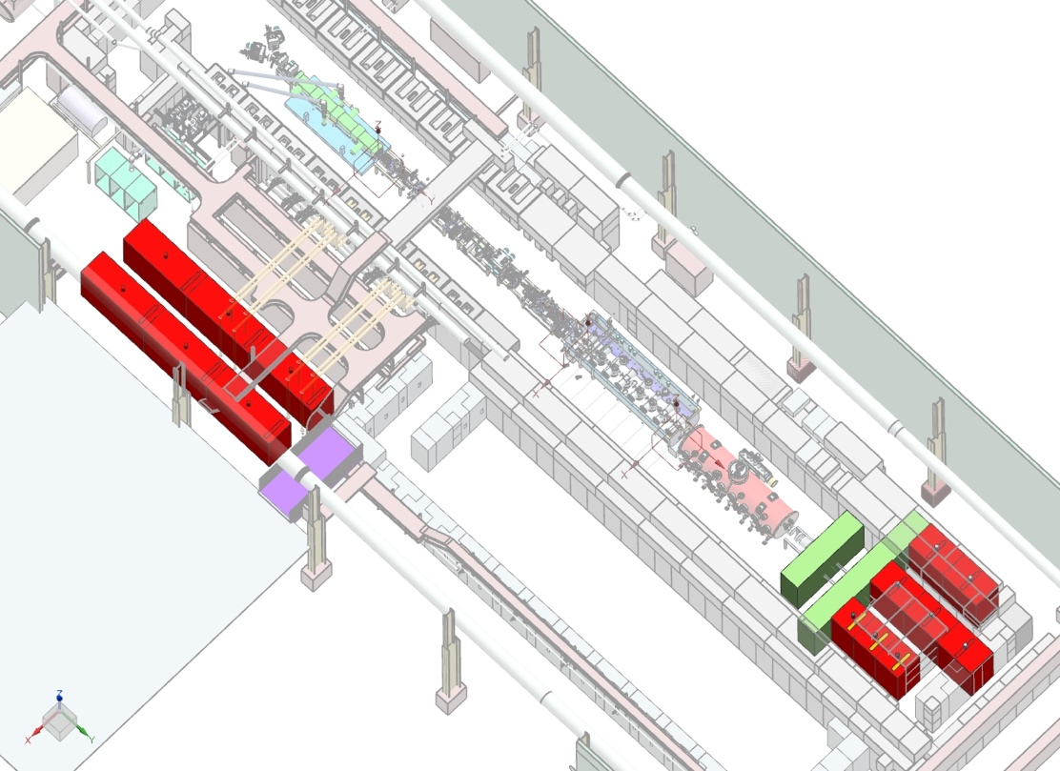
Preliminary concept - 2
Not ideal from RF distribution point of view
Layouts need further study and refinement of SSA schedule timing and actual size

Slide 15
Schedule – P6
10/19 – 4/21: Install and test HWR & SSR1-1
4/21 – 10/21: Install 650 Test Stand
  10/19 – 4/21: Design and fabricate 650 Test Stand
  (Have ~ 1 year to work on conceptual design/plan)
10/23-12/23: Install SSR1-2 Test Stand
  10/21 – 10/23 – Design and fabricate SSR1-2 Test Stand
  Modifications should be minimal

Slide 16
Backup Slides

Slide 17
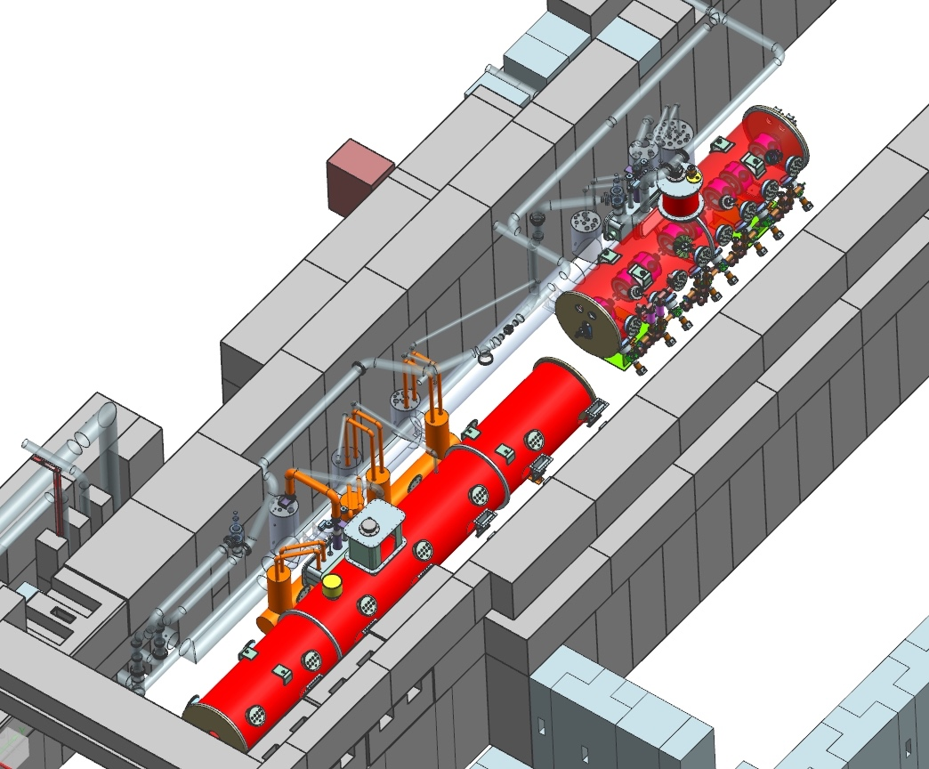
Additional view (3)

Slide 18
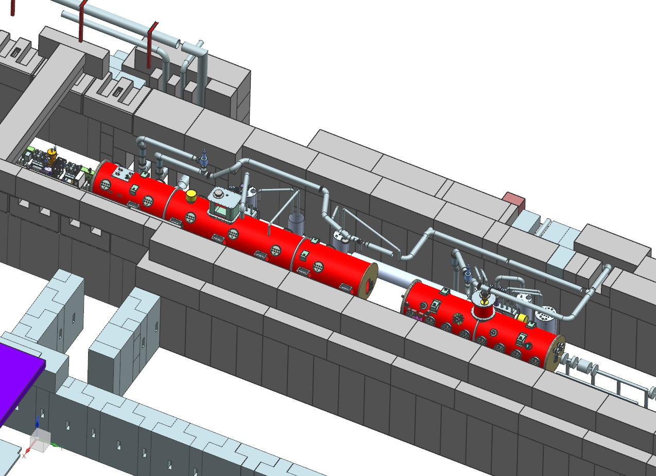
Additional view (4)

Slide 19
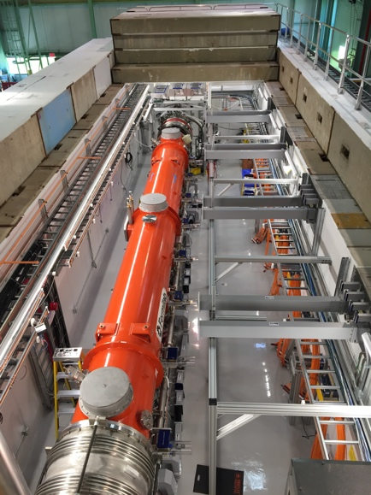
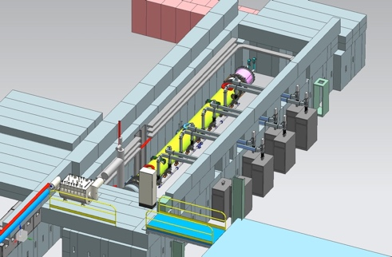
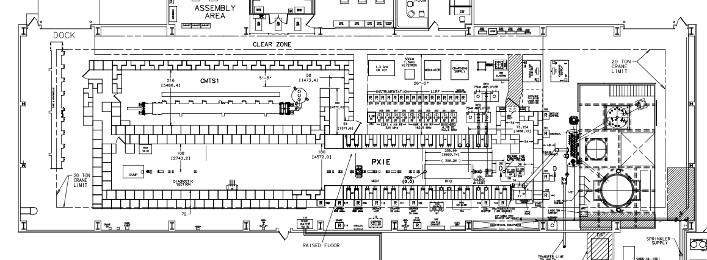
CMTS1
CMTS1 (Cryomodule Test Stand #1)
  Fully operational test stand for cold RF testing of cryomodules (no beam)
  Currently testing LCLS-II cryomodules (1.3 & 3.9 GHz, CW)
  After LCLS-II testing is complete, infrastructure will be reconfigured to test PIP-II 650 MHz cryomodules
CMTS1 650 Test Cave
CMTS1 Test Stand
3-D model of current CMTS1

Slide 20
CMTS1 – 121.3.21.2
Charge #2
Scope
  After LCLS-II cryomodule testing is complete, infrastructure will be reconfigured/modified to test PIP-II 650 MHz cryomodules
    Cryogenic distribution, RF power, mechanical & electrical infrastructure, controls, safety, etc.
Schedule
  The duration is estimated to be 6 months to install the new systems, followed by 2 months of commissioning. This is based on experience from configuring the CMTS1 test cave for the LCLS-II project
Design Maturity
  The plan is at a preliminary stage and the details are under development. Scope of work is similar to, and all estimates are based on, previous experience/costs from constructing and commissioning CMTS1 for LCLS-II
There is an experienced team already in place that developed, operates and maintains all systems associated with CMTS1and this same team of experts will be involved in the modification of CMTS1 for PIP-II

