Slide 1
PIP-II Project Manager’s Report
Marc Kaducak
Project Management Group
15 Aug 2018

Slide 2
Outline
Staffing/Organization
Funding, financials
International Updates
Technical Updates
CD-2/3a Preparations

Slide 3
Staffing
Hiring/Appointments:
  Project Controls Manager position still open.
    First interviews conducted week of 06-Aug-2018
  Procurement Administrator – scheduling interviews
  QA Manager
    Jemila Adetunji is leading the development of QA plans as well as the search for a permanent PIP-II QA manager.
Vacancies:
  Risk Manager
    Jim Morgan began helping this month
    Still need permanent risk manager

Slide 4
Funding Profile and Milestones
Corresponds to FY19 PBR. We are planning to $35M = $15M OPC + $20M TEC.
Milestone | Planned | Actual or Forecast
CD-0 | Q1 FY2016 | November 12, 2015 (A)
CD-1 | FY2017 | July 23, 2018 (A)
CD-2/3a | FY2019 | Q3FY2019
CD-3 | FY2020 | Q4FY2020
CD-4 | FY2026 | Q3FY2027

Slide 5
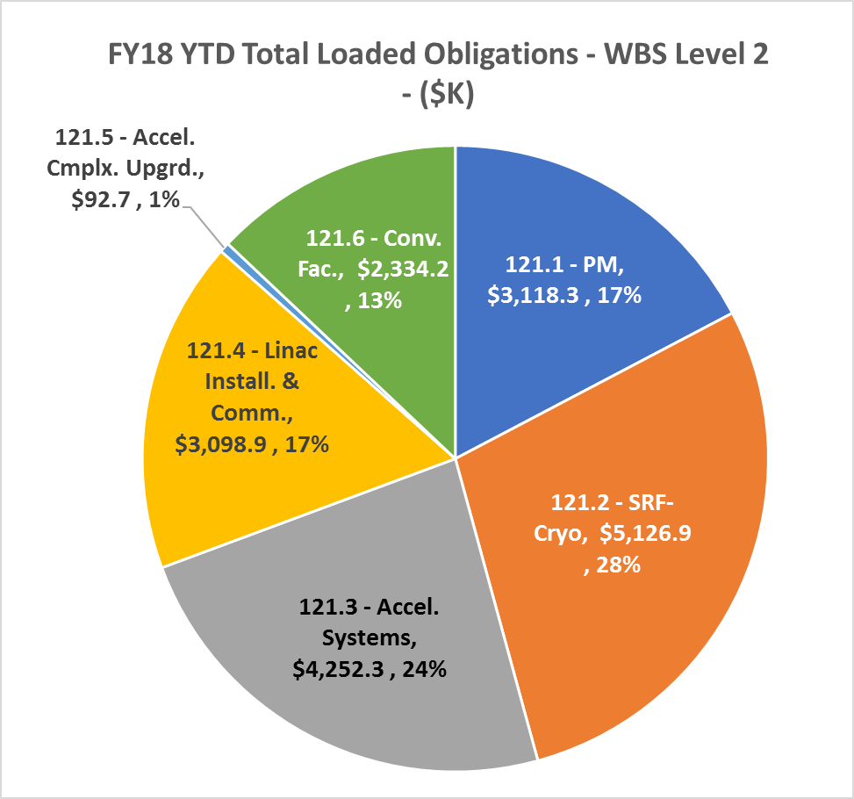
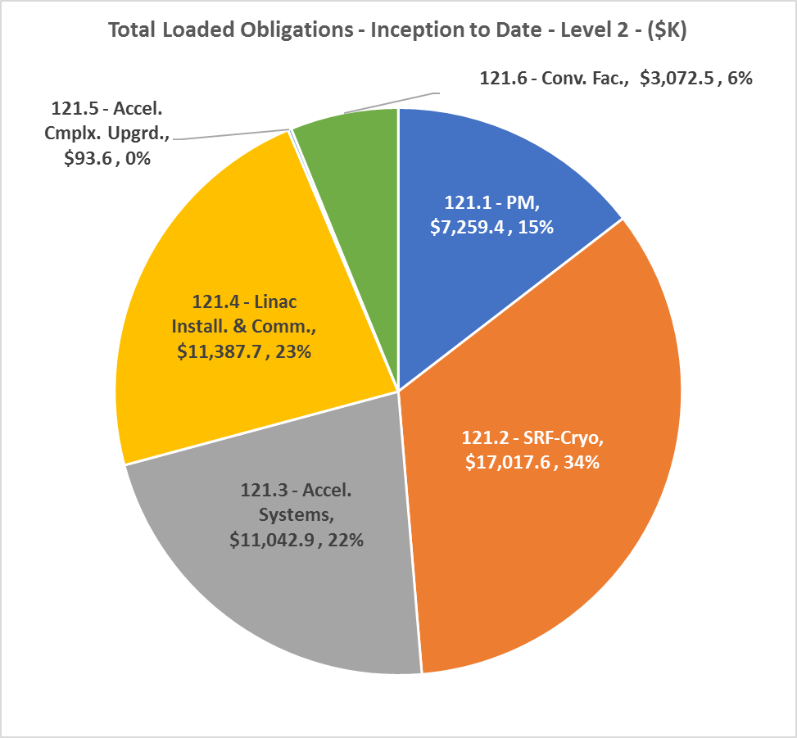
FY18 Financials thru July 2018
Year to Date | Inception to Date

Slide 6
Updates - International Partnerships, In-kind Contributions
Documents
  Project Planning Document (PPD) template for partner IKC sent to DOE-OHEP. To be reviewed by General Counsel.
  First version of International Agreement Plan in draft
  Draft of Project Annex has been sent from DOE to INFN, signaling start of official negotiations.
  Presented first draft of table of proposed India construction deliverables to IIFC Technical Coordinators - Working on estimating corresponding values in “DOE” accounting.
  CEA and INFN working with L. Lari on cost estimates for potential IKCs.
Visits
  David Longuevergne visited last week to refine IN2P3 IKCs
  Preparing for CM workshop & PC/TC meeting at BARC, Sept 3-8.
  Contingents from Wroclaw University visiting week of Sept 17, IFJ-PAN in November
  UK visitors Sept 27-28

Slide 7
ESH&Q Update
Wetlands Jurisdictional Determination received from USACOE
  Wetlands inside PIP-II project boundary have been declared non-jurisdictional
  Will not need to create compensatory wetlands or purchase credits (potentially several $M, can retire this risk now)
The USFWS and IDNR has concurred with our request for a “No Effect Determination” for the following endangered species that have the potential to occur within the PIP-II Project Area:
  Eastern prairie fringed orchid
  Leafy prairie-clover
  Mead’s milkweed
  Prairie bush clover
  Eastern massasauga rattlesnake
  Hine’s emerald dragonfly
For the newly listed Rusty-patched bumble bee that has been observed on the Fermilab site, USFWS concluded that the PIP-II Project may affect, but is not likely to adversely affect, the Rusty-patched bumble bee. The project will take necessary steps not to impact suitable bee habitat. This is great news as it precludes what could have been a lengthy and costly consultation.
All comments and subsequent follow up for the Preliminary DRAFT EA were gathered and provided to the subcontractor. Meeting with Arcadis today.
Presentation by J. Anderson on “Safety by Design” at next PIP-II All Hands (Aug.22, 9am, Curia-II)
J. Adetunji is providing input to the PDR, assessing the design review process and TRA methodology, and will be meeting with system managers to discuss specific QA issues.

Slide 8
WBS 121.2 SRF Updates - SSR1
SSR1 Cavities (Specification 10 MV/m, Q0 = 6e9)
Will re-HPR and test again

Slide 9
WBS 121.2 SRF Updates - HB650
HB650 5-cell Cavities (Specification 19 MV/m, 3.0e10)
Update: furnace now repaired

Slide 10
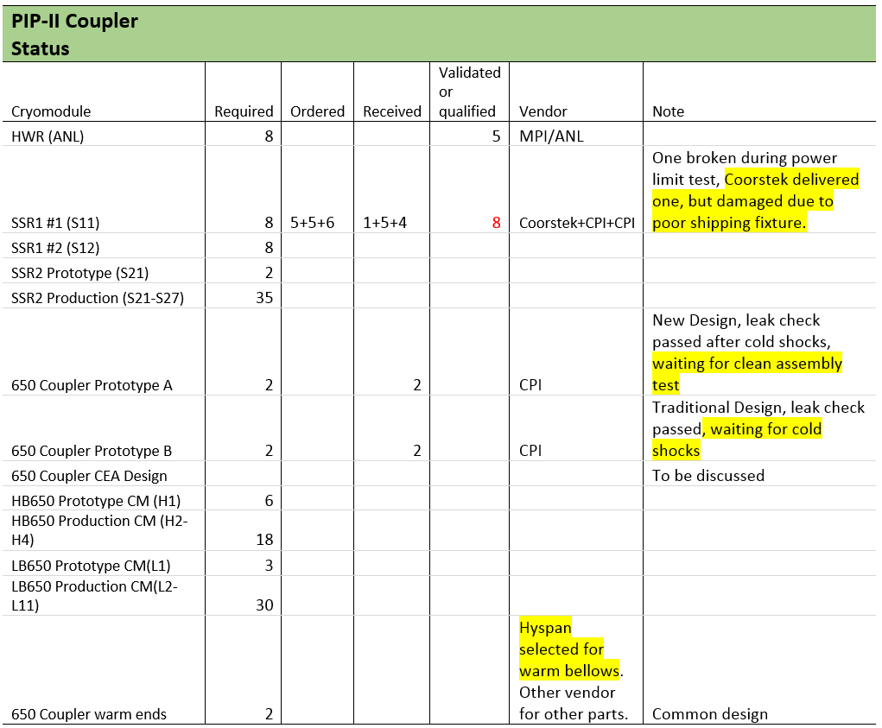
WBS 121.2 SRF Updates - Couplers

Slide 11
WBS 121.3 – Accelerator Systems Update
Work progresses towards 650 MHz coupler test stand at Meson Detector Building. The 650 MHz IOT amplifier was successfully powered to 16 kW, RF distribution network is being assembled, the Low Level RF hardware is proceeding apace.
Working with AD Radiation Safety on a preliminary shielding assessment document for the Cryo Plant Building. Approval of this document is necessary before we can go out for construction bids. We have agreed on an approach to produce the document.
L4’s for beam instrumentation have been appointed:
    BPM System – Nathan Eddy
    Beam Current System – Aisha Ibrahim
    BLM System – Randy Thurman-Keup
    Beam Profile System and Emittance – Vic Scarpine

Slide 12
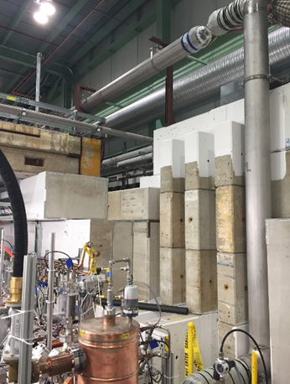
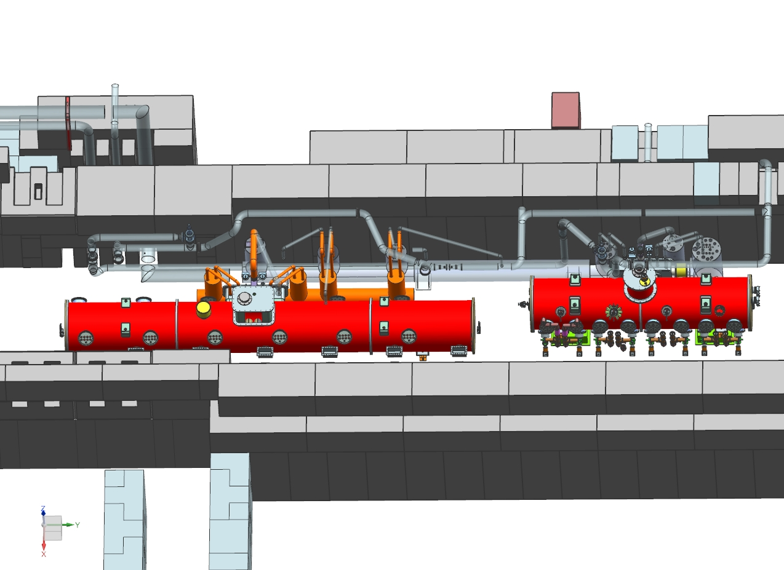
Updates - WBS 121.4 Linac Installation and Commissioning (1 of 3)
Test Infrastructure
Progress continues with the PIP2IT cave expansion.
  This month the vertical cryo transfer line for PIP2IT was installed
  Continued working on the high-level layout of using PIP2IT test stand for both 650 and SSR testing.
    Cryogenics experts confirmed that this is feasible.
Building Infrastructure
  AD/EE support assigned an interim electrical engineer to work on AC power distribution
    see J. Leibfritz presentation this PMG
    It is crucial to find a long-term solution for this position,
        Great opportunity to work side-by-side with the Senior Eng. to learn the job

Slide 13
Updates - WBS 121.4 Linac Installation and Commissioning (2 of 3)
Installation
  Team continues to evaluate lattice-to-CAD import
  Good progress on the cryomodules stands
    Primary requirements/goals
      Design shall be compatible with SSR1, SSR2, LB650 and HB650 cryomodules, with minimal modification between cryomodule types, (including HWR)
      Positively restrain the cryomodule in all degrees of freedom
    Plan is to build two CM stands for HWR/SSR1 at PIP2IT
    Current status:
      The conceptual design of the CM stands is done
      Drawings under review
Commissioning
  Start structuring the preliminary Commissioning Plan
    Reaching out to other labs (i.e. SNS) to seek for actual cost information, labor and M&S, during the commissioning efforts
    Start work on Transition to Operations Plan

Slide 14
Updates - WBS 121.4 Linac Installation and Commissioning (3 of 3)
Warm-Front End
  The MEBT kicker FDR/PRR review was conducted in August 2nd
    Agenda/presentations: https://indico.fnal.gov/event/17313/
    First review to go under the new direction developed by the Technical Integration Team
    Final close-out report has not yet been released by the committee.
      Unofficial recommendations - proceed with the procurement and fabrication of the mechanical assembly; but not the kicker driver system
        The recommendation is that one should proceed with the changes foreseen for the electrical system and have a new suite of measurements to verify that meets specifications prior declaring production run.
    Team agrees with this recommendation and is currently adjusting the schedule to reflect this change.

Slide 15
Conventional Facilities
Site Prep Design
  Design work continues;
  Preliminary Design Review (~60% complete) scheduled for August 20, 2018;
  Cost/Schedule Update in August 2018;
  Four construction packages:
    Site Clearing: Erosion Control, Topsoil Stockpile, Tree Removal, Temporary Road
    Utilities Package: Electrical Feeder, Utility Corridor
    Site Work: Final Grading, Roadwork, Pond Rework
    Site Restoration: Final Paving, Landscaping, Roadway Lighting
  Design Completion scheduled for December 2018.
Cryo Plant Building Technical Requirements
  Design work continues;
  Completion in October 2018.
A/E Re-compete
  Acquisition Plan approved;
  Request for Proposal and Source Evaluation Plan FSO review underway;
  A/E Selection likely delayed impacting completion of Cryo Plant Building.
Would like to start site clearing before March 2019

Slide 16
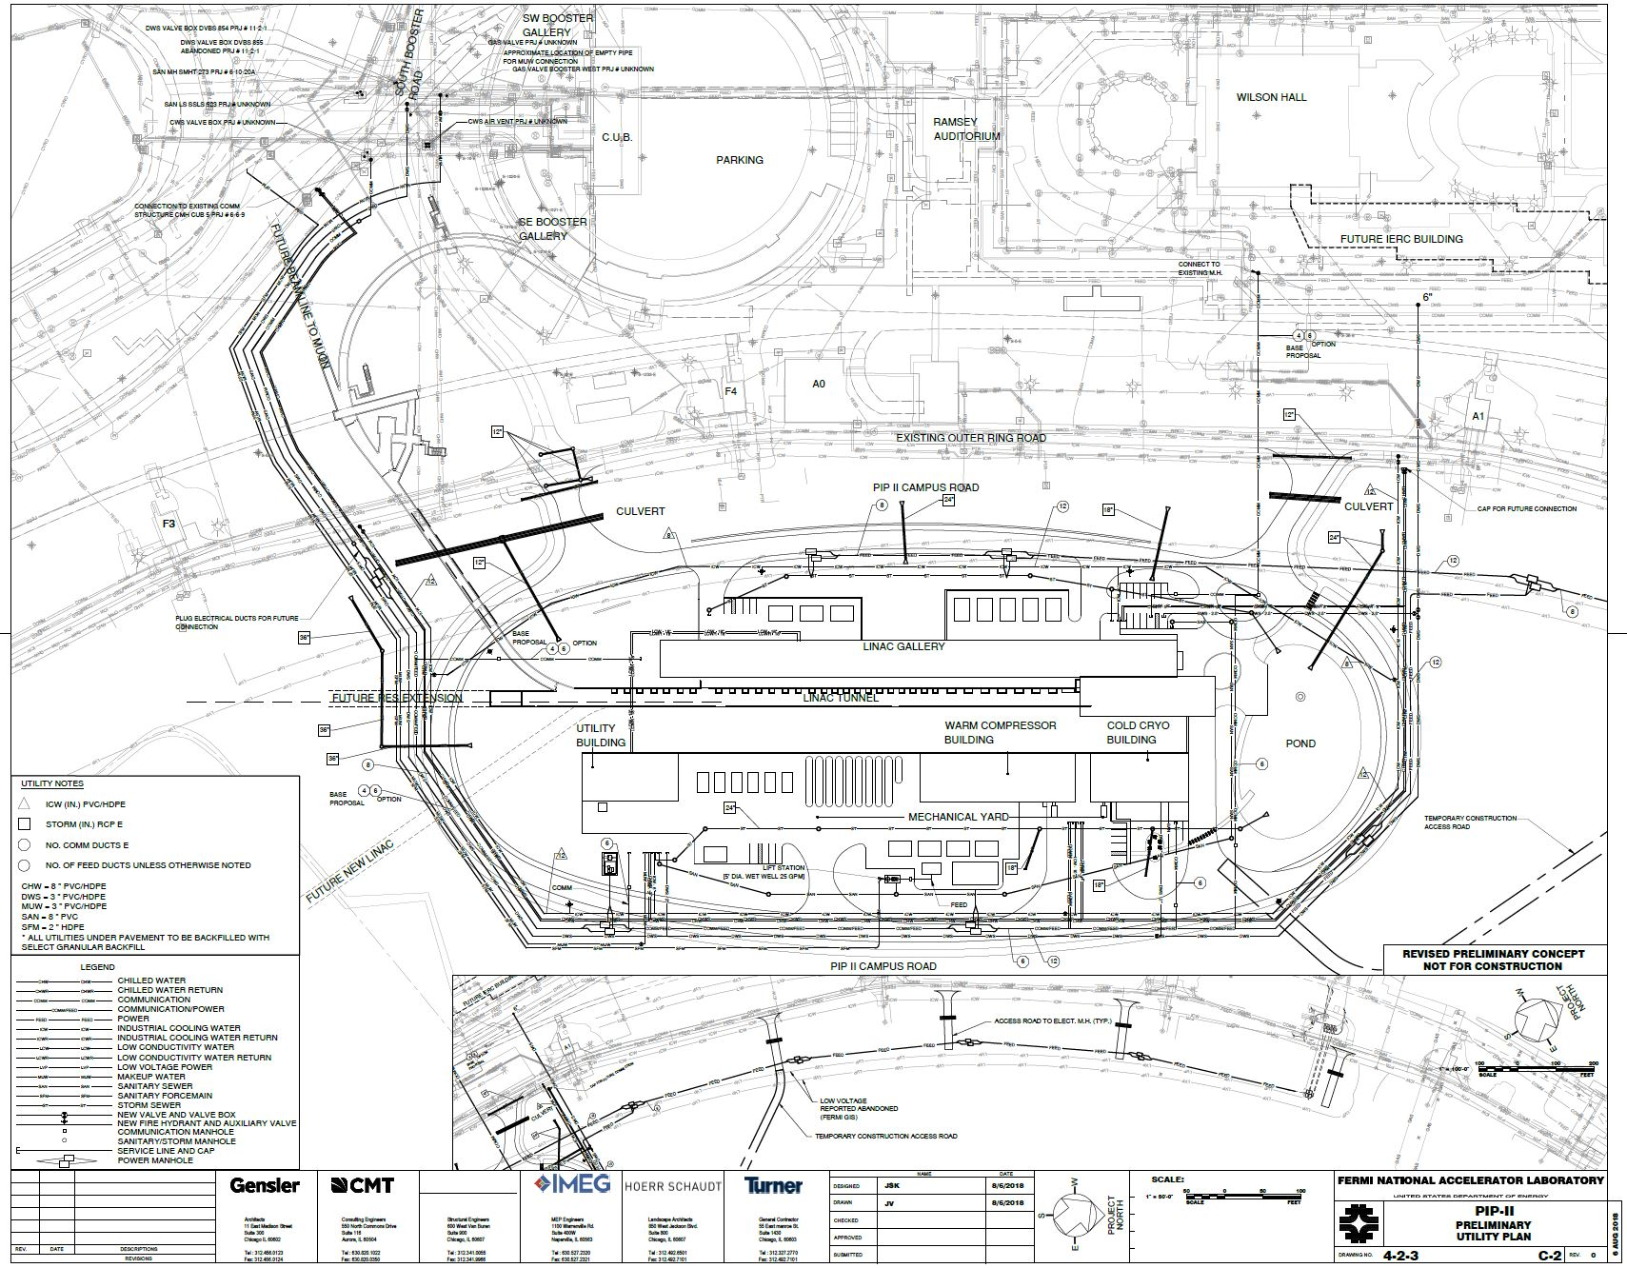
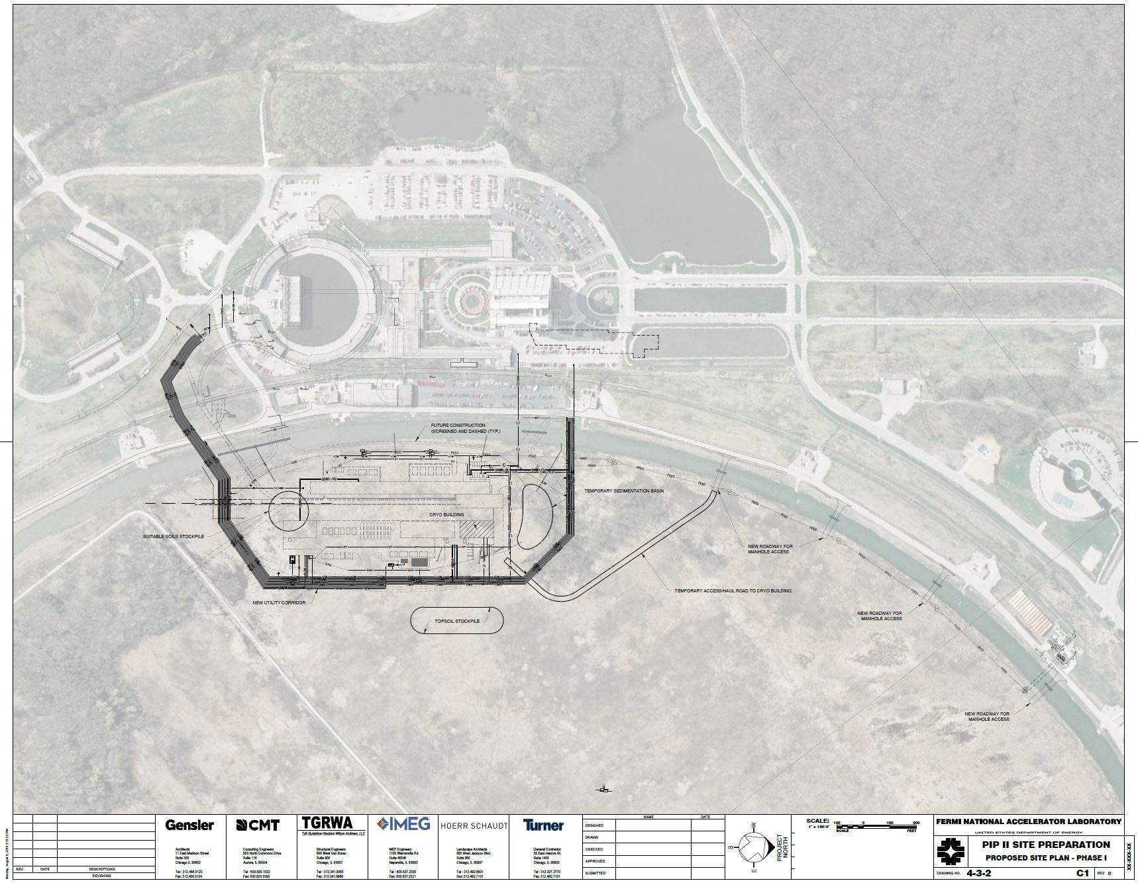
Site Preparation
06AUG18 Status Review Set

Slide 17
Cryo Plant Building
Thanks to B. Hansen (Cryoplant L3M)

Slide 18
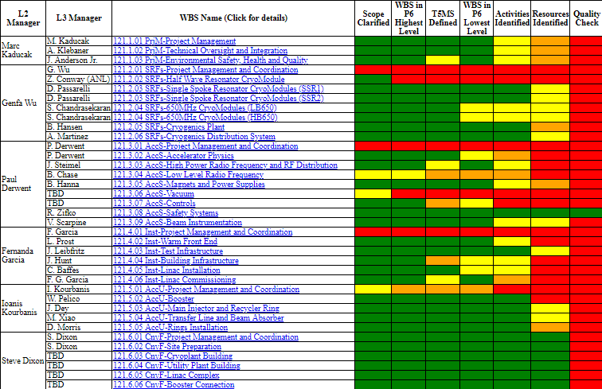
RLS Development Status as of 15-Aug-2018
Work in progress in all the technical areas and documented in RLS website
https://pip-ii-evms-tracking.fnal.gov/

Slide 19
CD-2 Preparation Scheduled (Revised 15-Aug-2018)

Slide 20
Summary
Need to reassess procurement cycle times, especially for near term CF procurements
Substantial progress on IKC documentation framework
CD-2/3a preparations continue to be the highest priority:
  RLS efforts moving toward EVMS. Still much left to do.
  Systems engineering team making steady progress, first review under new design plan guidelines conducted.
Planning for site preparation to commence early CY19.
PIP-II All Hands - August 22 at 9:00 in Curia II

