Slide 1
Preliminary Design Review
WBS 121.06.02 – Site Preparation
S. Dixon\R. Wielgos
Conventional Facilities
29-August-2018

Slide 2
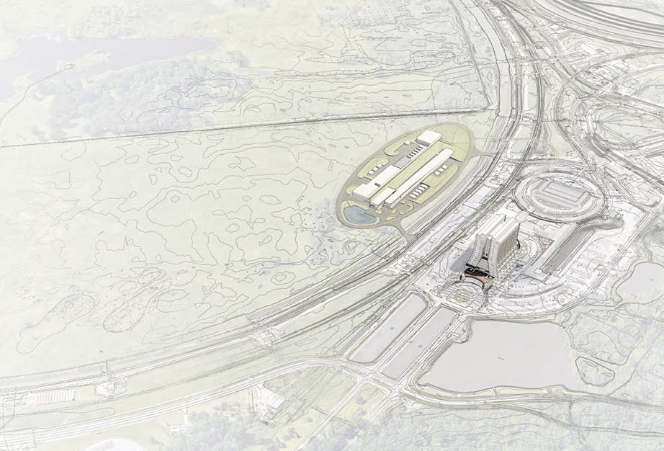
Agenda
Charge
Review Requirements
Overview (by Gensler Team)
Summary
Next Steps

Slide 3
Charge
Please review the information for appropriateness of the proposed systems, impacts on existing systems and operations, specific technical requirements to be incorporated into the design and compliance with best and required practices of authority having jurisdiction.

Slide 4
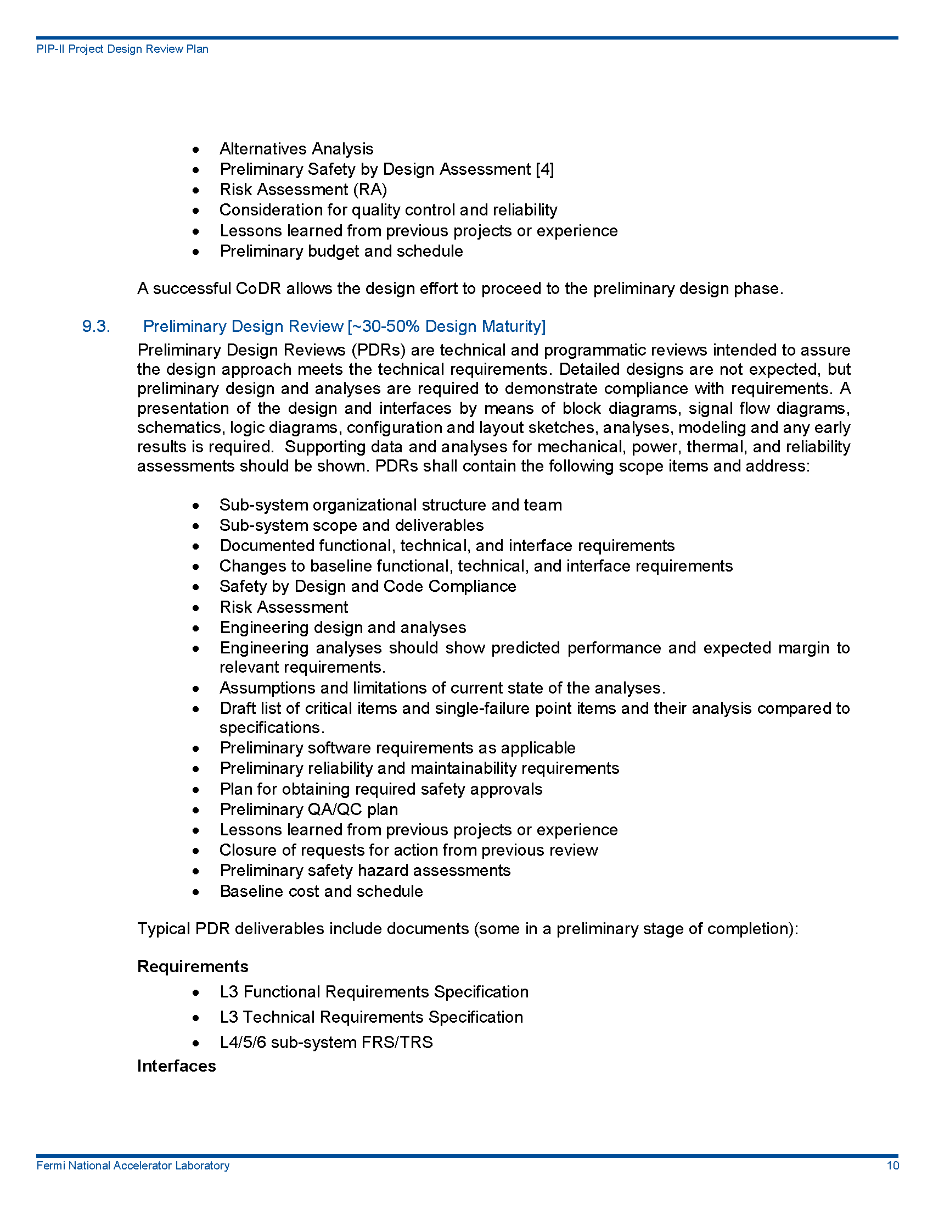
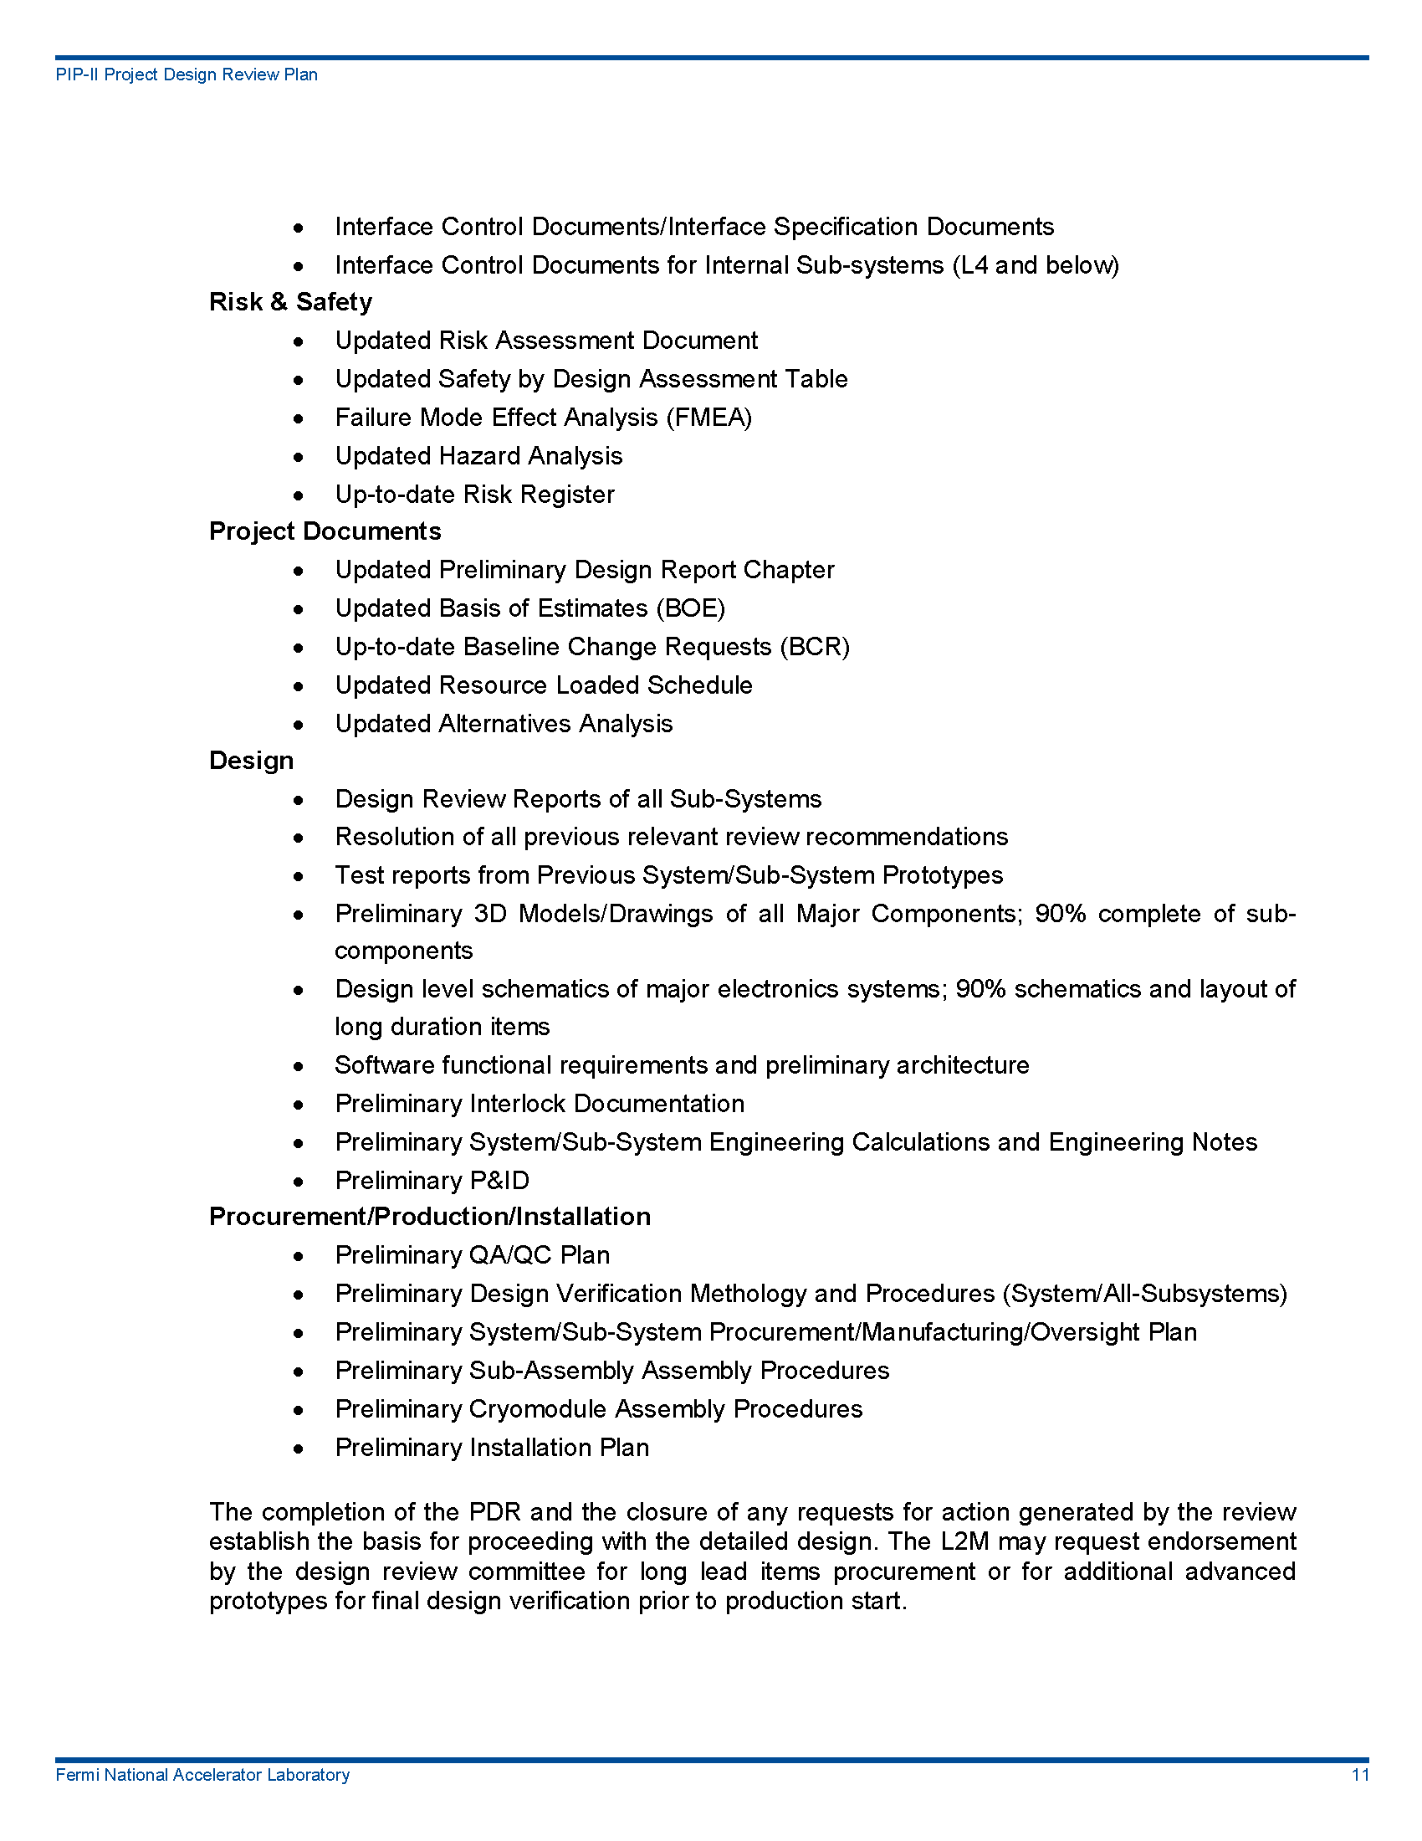
Review Requirements
From PIP-II Project Design Review Plan

Slide 5
Organizational Structure

Slide 6
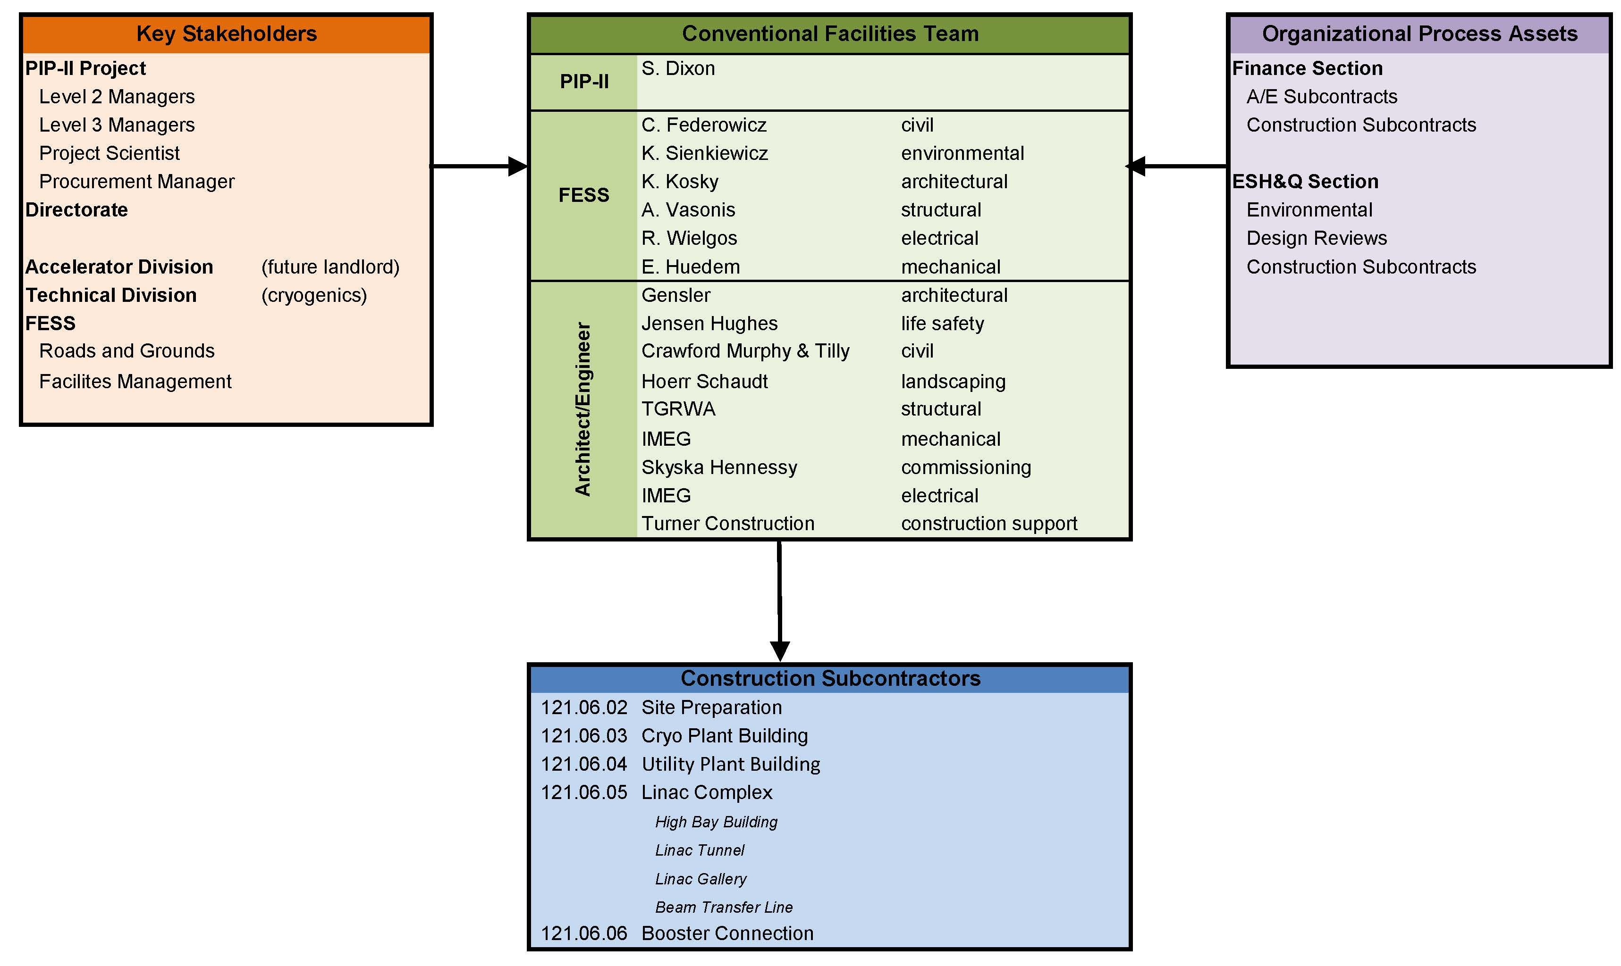
Design Team

Slide 7
Scope
The Site Preparation scope includes the following phases:
Phase 1 – Site Clearing
This is the work that is required to generally prepare the site for future work packages
Installation of erosion controls (silt fence);
Tree removal;
Installation of temporary road;
Topsoil striping and stockpile;
Sedimentation pond;
Pond crossing;
Phase 2 – Utility Corridor (completed prior to Cryo Plant Building completion)
This extends the existing utilities to the project site including:
Electrical ductbanks, manholes, feeders and 4-way air switches;
Communication ductbank and manholes;
Industrial cooling water;
Domestic water supply
Sanitary sewer system;
Chilled water;
Storm sewer;
Make up water connection;

Slide 8
Scope
The Site Preparation scope includes the following phases:
Phase 3 – Site Work (Completed after Cryo Plant Building but before Linac Complex)
This work includes:
Final grading outside of building zone;
Roadway subgrade;
AZero pond modifications;
Entry roads at ponds;
Utilities west of Linac Complex
Modifications to Main Ring Road and South Booster Road
Phase 4 – Site Restoration
This work includes:
Site restoration and landscaping;
Final asphalt and grading;
Site Lighting.

Slide 9
Deliverables
This submittal must convey a level of completeness that demonstrates the project is on schedule and on budget. This submittal will contain, as a minimum, the following:
Drawings that convey the proposed design and major systems, but need not have all of the notes and details of the final product;
Outline specification;
The deliverables will include an estimate of construction cost and a schedule for the construction with pacing milestones and dates;
A list of materials, if needed, that require exemption to the Buy American Act;
Submittal shall be in PDF format plus the associated AutoCAD DWG files, REVIT models, Word and Excel files;
The submittal will include documentation of compliance with DOE’s Guiding Principles.

Slide 10
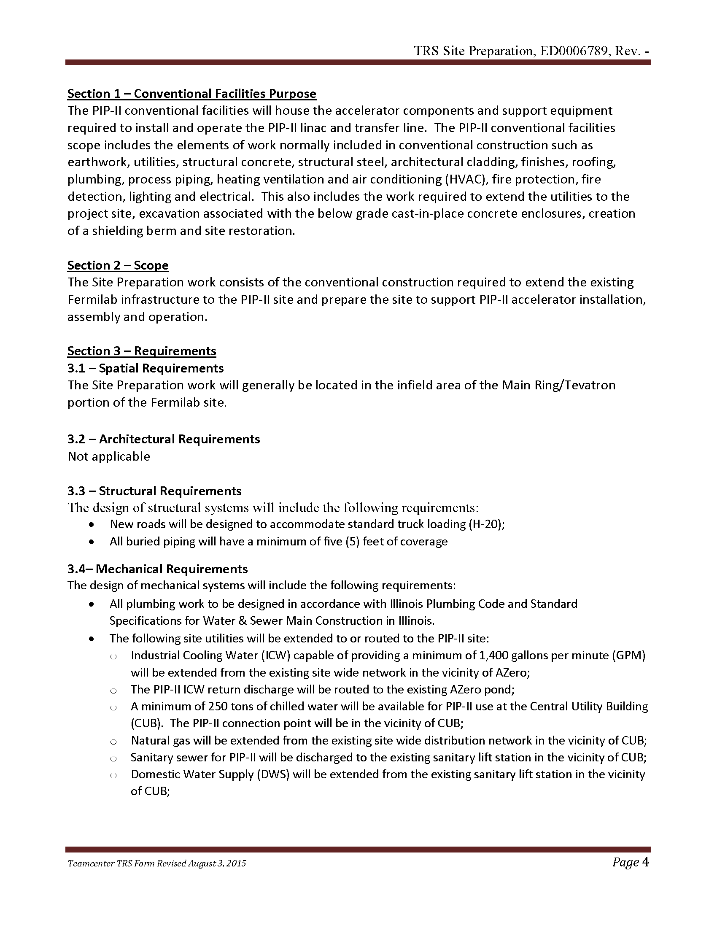
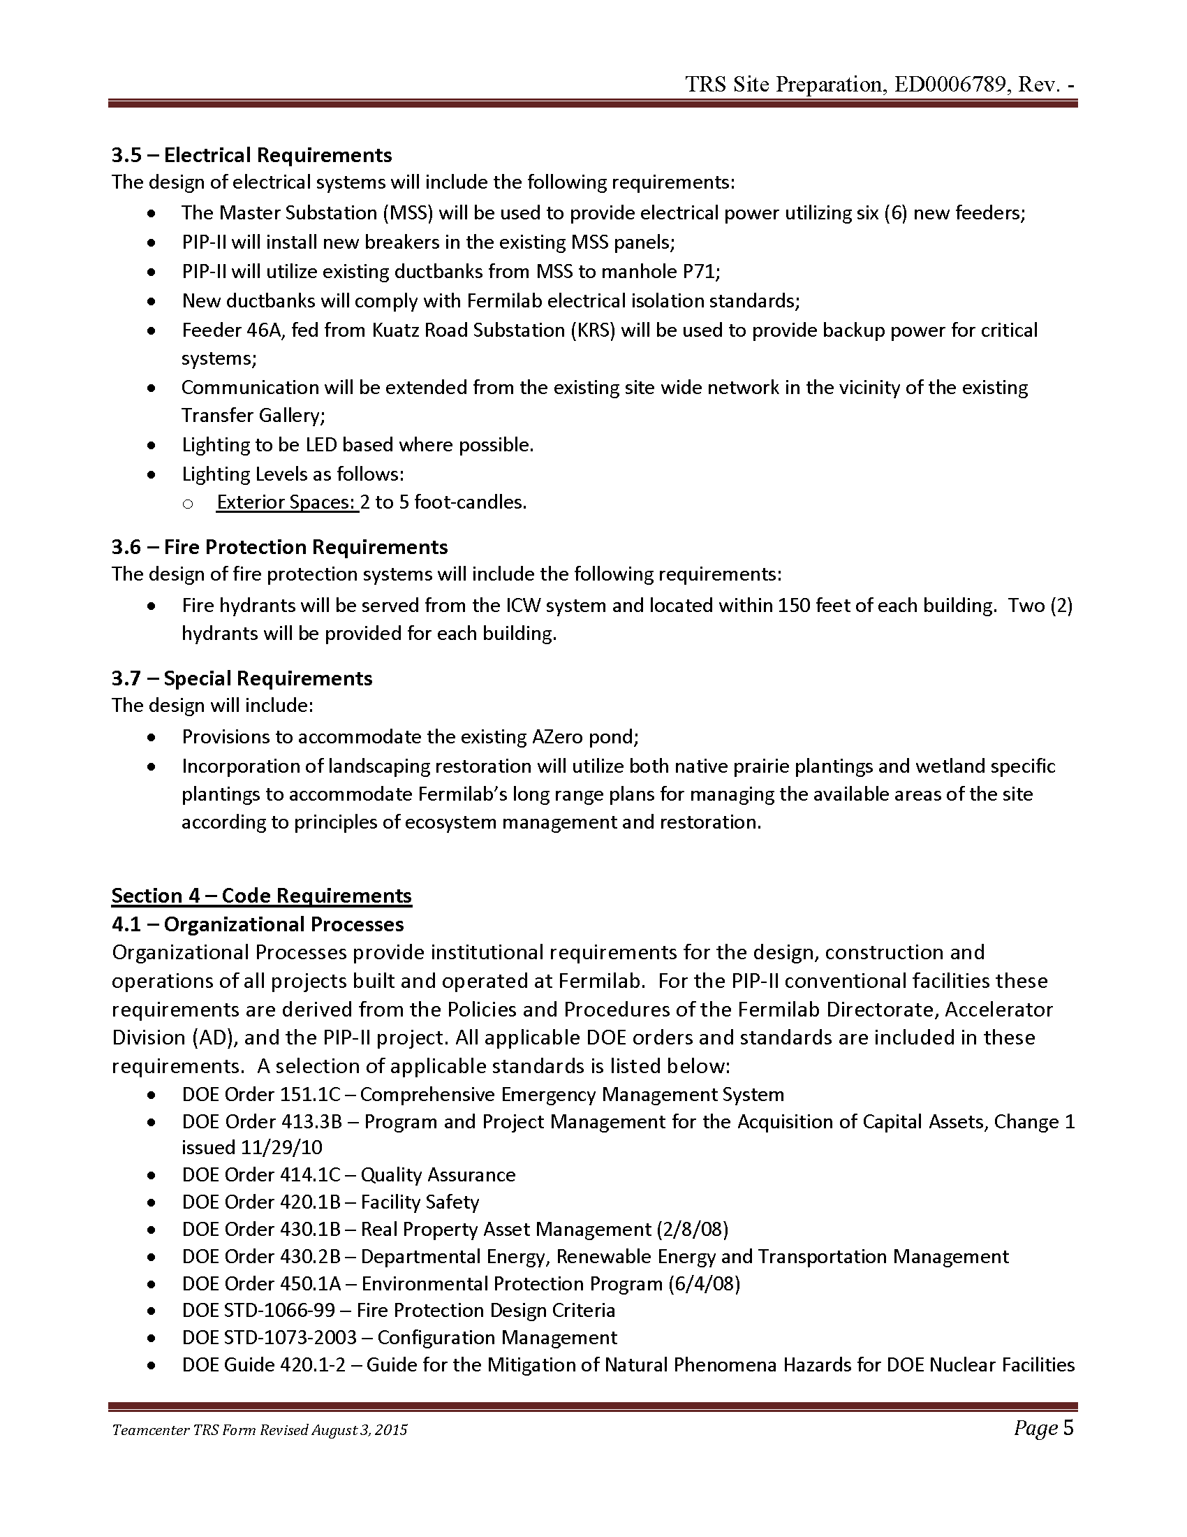
Technical Requirements
Technical Requirements Specifications ED0006789

Slide 11
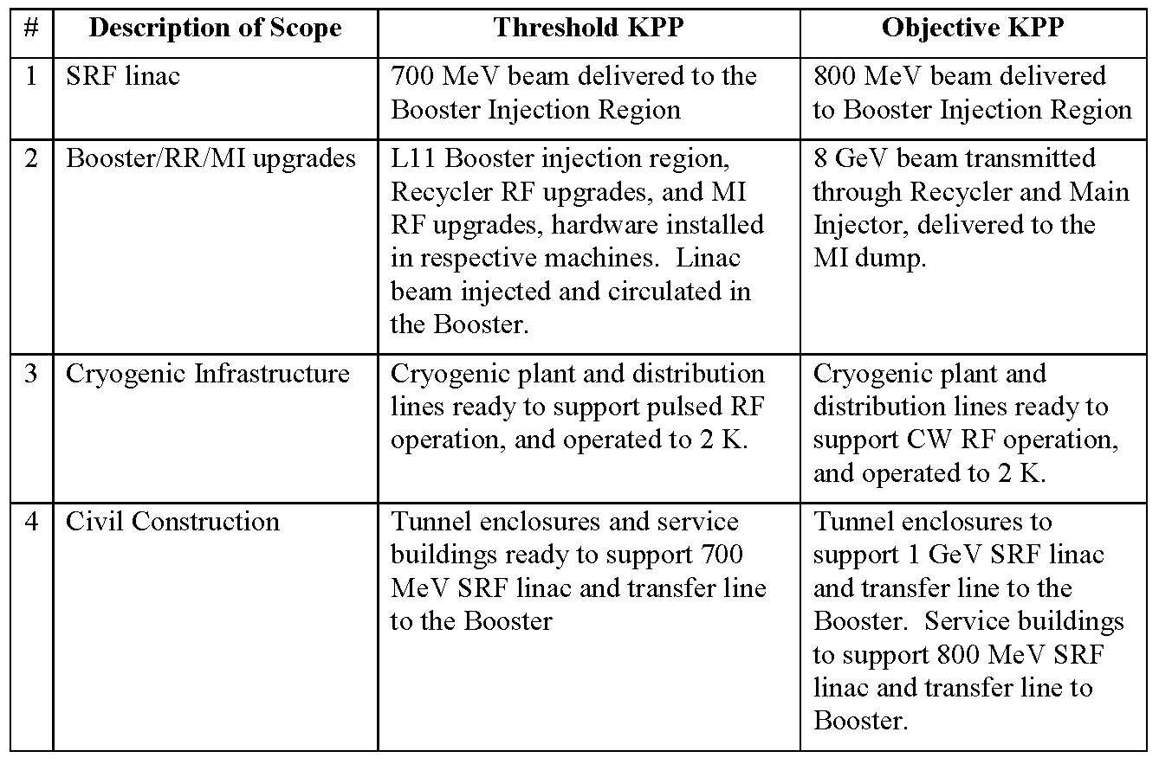
Changes to KPP
Threshold and Objective KPP – No Changes
KPP from PIP-II Preliminary Project Execution Plan (PIP-II-doc-115)

Slide 12
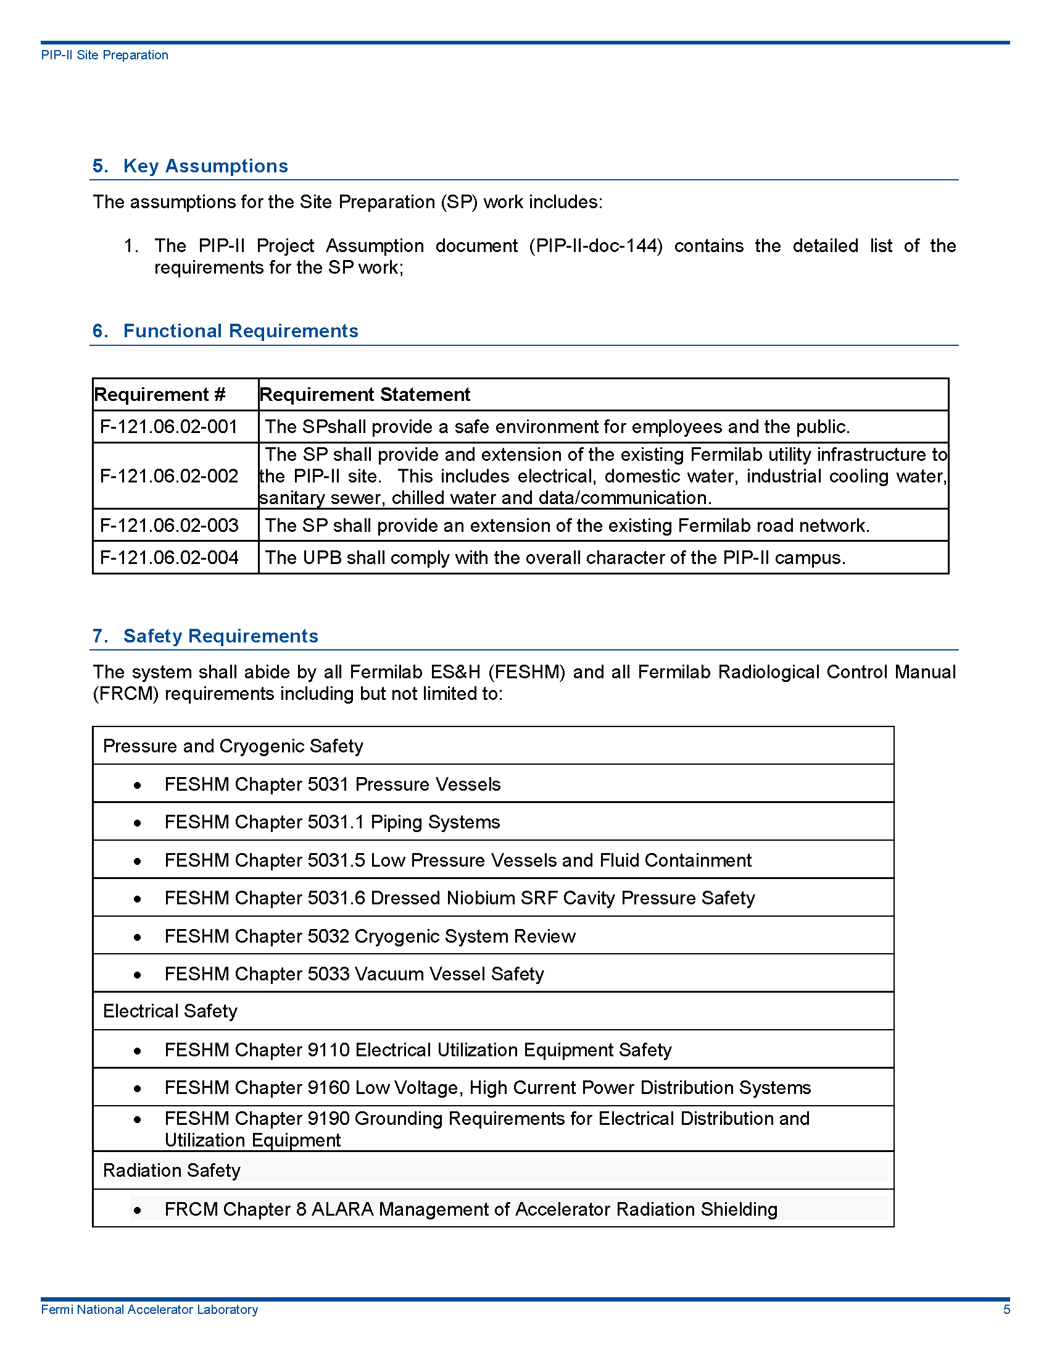
Changes to FRS - No Changes
Functional Requirements Specification can be found at TeamCenter ED0006787

Slide 13
Safety by Design

Slide 14
Code Compliance
Organizational Processes provide institutional requirements for the design, construction and operations of all projects built and operated at Fermilab. All applicable DOE orders and standards are included in these requirements.
DOE Order 151.1C – Comprehensive Emergency Management System;
DOE Order 413.3B – Program and Project Management for the Acquisition of Capital Assets, Change 1 issued 11/29/10;
DOE Order 414.1C – Quality Assurance;
DOE Order 420.1B – Facility Safety;
DOE Order 430.1B – Real Property Asset Management (2/8/08);
DOE Order 430.2B – Departmental Energy, Renewable Energy and Transportation Management;
DOE Order 450.1A – Environmental Protection Program (6/4/08);
DOE STD-1066-99 – Fire Protection Design Criteria;
DOE STD-1073-2003 – Configuration Management;
DOE Guide 420.1-2 – Guide for the Mitigation of Natural Phenomena Hazards for DOE Nuclear Facilities and Non-Nuclear Facilities;
10 CFR 835 – Radiological Protection Program;
10 CFR 851 – Worker Safety and Health Program;
10 CRF 851.23 – Safety and Health Standards;
Internal Fermilab permits and work notifications as described in the Fermilab ES&H Manual (FESHM)
Fermilab Director’s Policy Manual (http://www.fnal.gov/directorate/Policy_Manual.html);
Fermilab Engineering Manual (http://www.fnal.gov/directorate/documents/FNAL_Engineering_Manual.pdf)

Slide 15
Code Compliance
Enterprise standards from regulatory agencies, code bodies and trade organizations also provide requirements for the design and construction of the PIP-II conventional facilities.
International Building Code (IBC) – 2015 Edition
International Energy Conservation Code – 2009 Edition
International Fire Code – 2009 Edition
International Mechanical Code – 2009 Edition
Minimum Design Loads for Buildings and Other Structures – ASCE 7-05
Building Code Requirements for Structural Concrete – ACI 318-05
Specification for Structural Steel Buildings – AISC 360-05
Building Code Requirements for Structural Concrete and Commentary – ACI 318-08
Illinois Plumbing Code – 2004
Illinois Department of Public Health Codes
Illinois IEPA
NFPA 101 Life Safety Code – 2009 Edition
NFPA 24 – Standard for the Installation of Private Fire Service Mains and Their Appurtenances – 2010 Edition
NFPA 70 – National Electrical Code – 2008 Edition
NFPA 70E – Standard for Electrical Safety in the Workplace – 2009 Edition
NFPA 110 – Emergency and Standby Power Systems – 2010 Edition
ANSI/ASME B31.3 – Process Piping (2002)
ANSI 31.9 – Building Services Piping (1996)
Occupational Safety and Health Administration (OSHA)
Underwriters Laboratory
ICC/ANSI A117.1 – 2003 Standard for Accessible and Usable Buildings and Facilities Illinois Accessibility Code
ADA Accessibility Guidelines for Buildings and Facilities (ADAAG) – 2004 will be used for those areas of facility not exempted by Fermilab policy
Illinois Accessibility Code

Slide 16
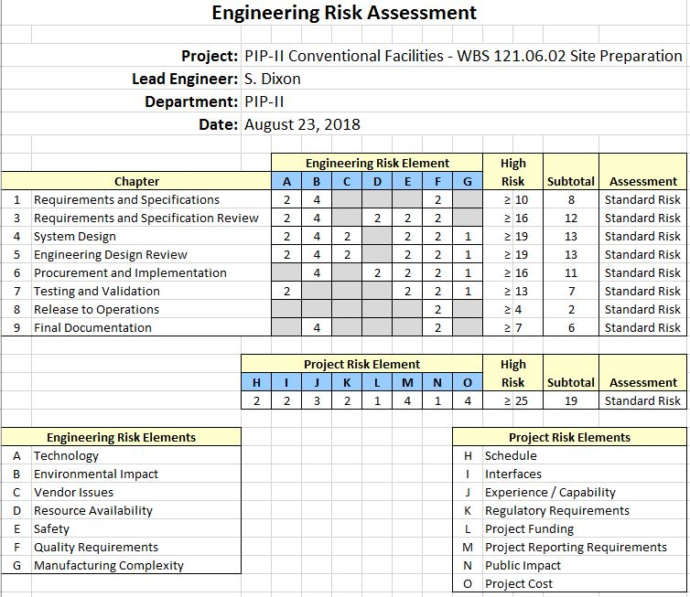
Risk Assessment
From ED0008276

Slide 17
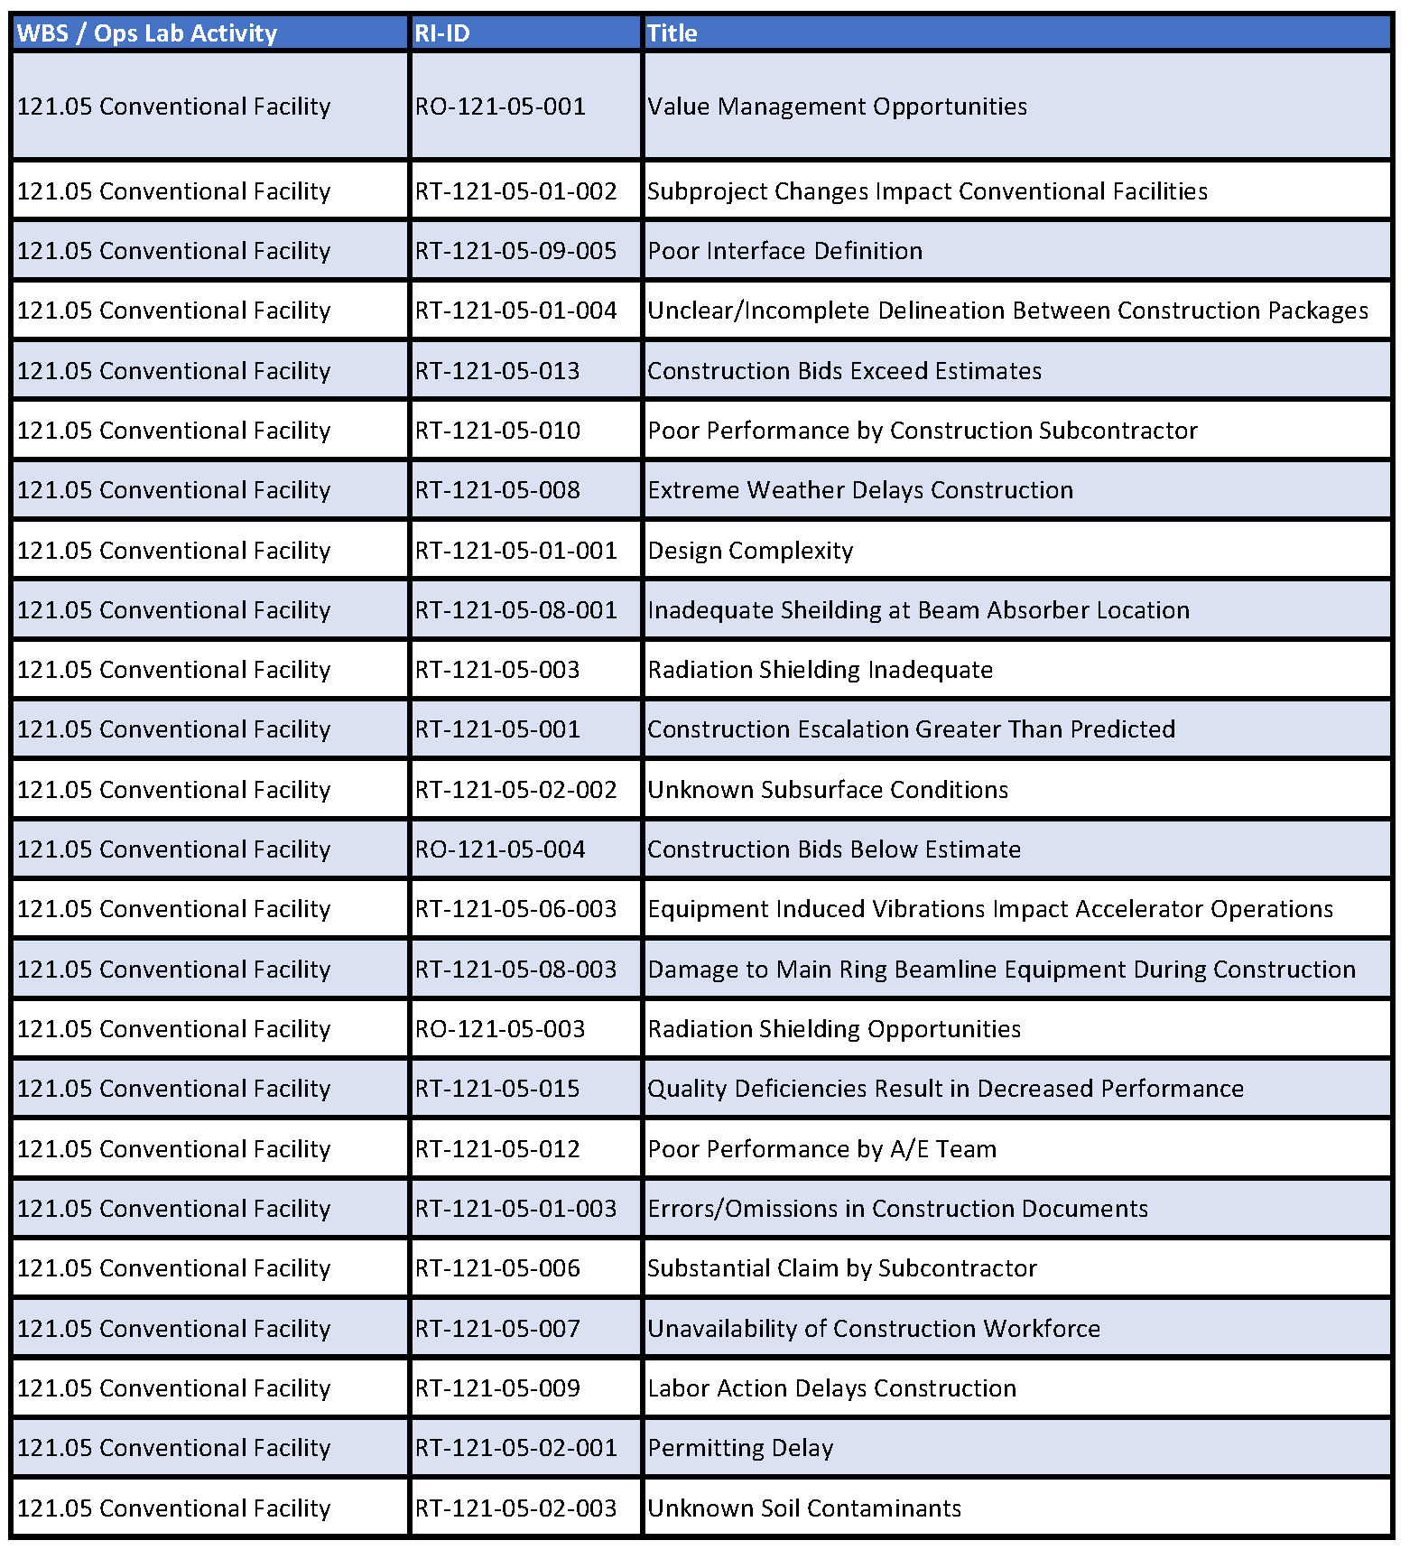
Risk Register

Slide 18
Engineering Design and Analysis
Stakeholder Requirements
A/E Design Team
Gensler - Architecture
CMT - Site Civil
TGRWW - Structural
IMEG - Electrical, Mechanical
Hoerr Schaudt - Landscape Architecture
Turner - Constructability, Cost Estimates

Slide 19
Preliminary Software Requirements
Not applicable

Slide 20
Reliability and Maintainability Requirements
Included in the Engineering Design and Analysis
Site Layout, Landscaping, Roadways, Drainage
Slopes
Drainage
Traffic
Utility Corridor
ICW, LCW, Chilled Water
Looped Systems
Isolation Valves
Material Selection
Electric Power, Communications
Ductbank & Manhole Systems
Switches
Looped Feeds

Slide 21
Plan for Obtaining Safety Approvals
Radiation Safety
Engage Radiation Safety with the Required Documentation Through FESS for Beamline Construction Approvals
Review Comments
Notice to Proceed Authorization
Quality Control Plan
Soil Erosion and Sediment Control Plan
Project Hazard Analysis

Slide 22
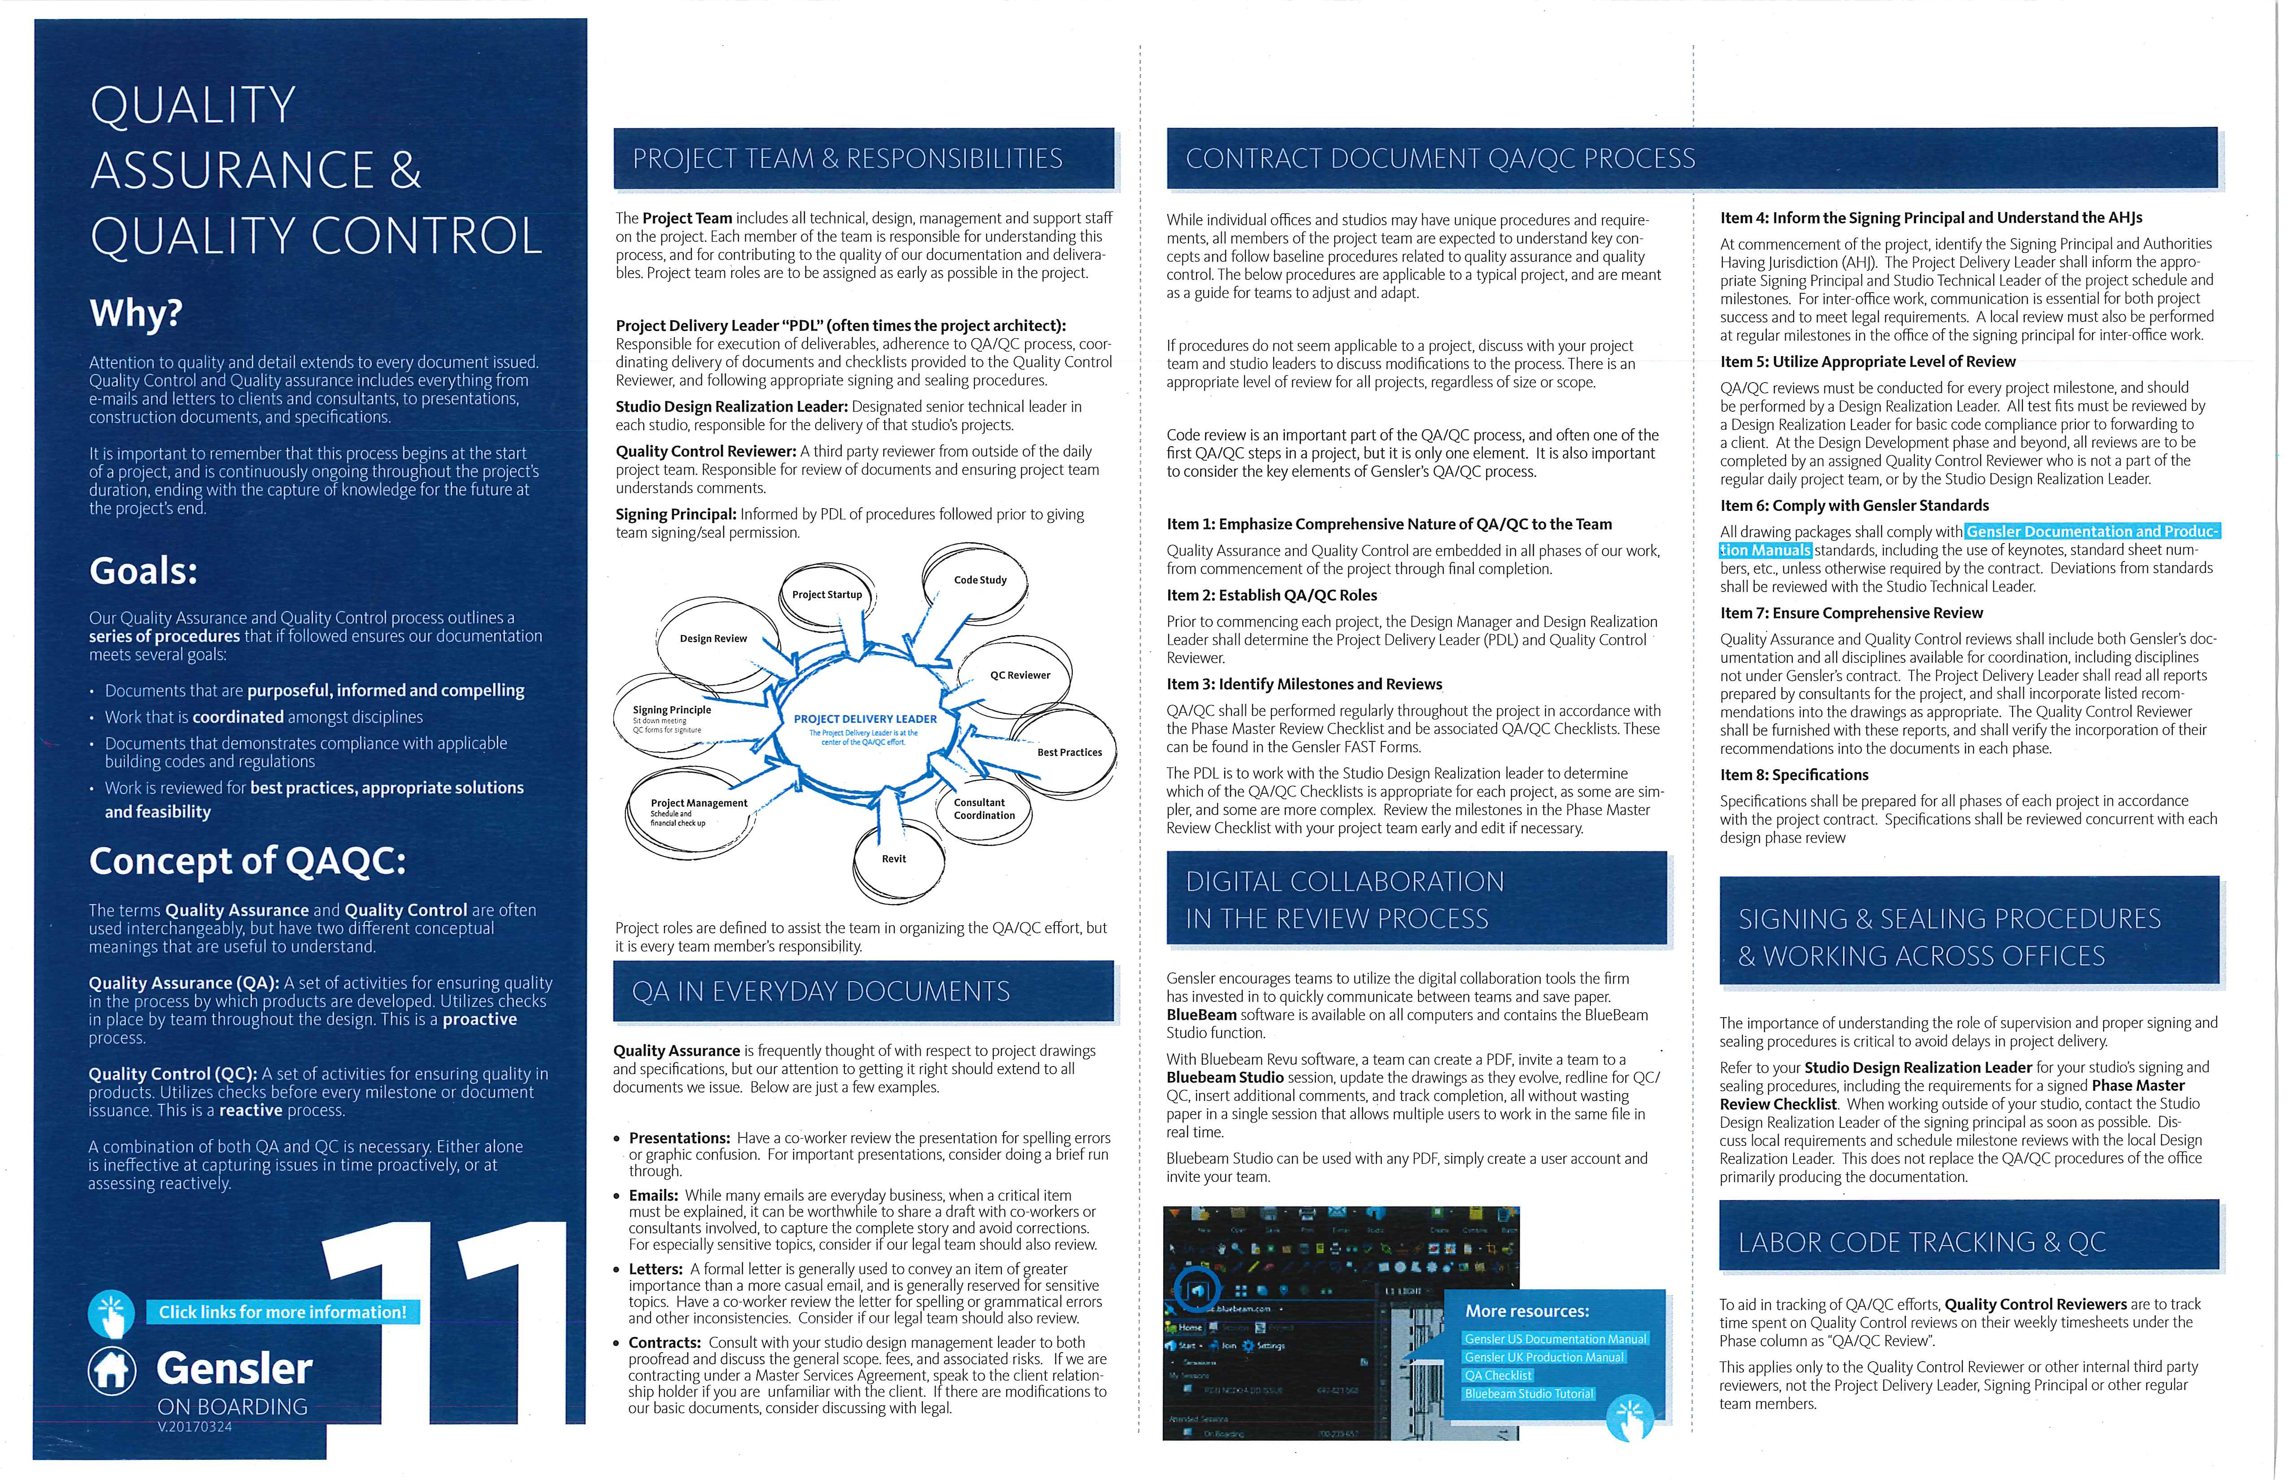
Preliminary QA/QC Plan
PIP-II Preliminary QA Program
(PIP-II-doc-142)
Design Phase
Q/A requirements are included in A/E tasking;
The Gensler team provides QA/QC following the internal corporate process;
Design Review by Fermilab Subject Matter Experts

Slide 23
Lessons Learned – Other Projects
UUP - Site Specific Construction Safety Plan
Flow down all necessary requirements of the construction project to the subcontractors during the bid phase.
UUP - Design Phase Utility Locates
It was advantageous to gather as much information of the potential utility conflicts between existing utilities (where known) and proposed piping during the design phase versus during construction.
UUP - Master Substation Excavation Limit ORPS
Work was halted immediately after a small area was dug, and an investigation took place on the cause for the overexcavation. The limits of the excavation permit were not clearly marked in the field. Additional effort will be made to mark critical areas near beamlines.
UUP - Capturing GIS Data on Utilities During Excavation
This data was then used to update existing data in the GIS Maps and will help build a robust database of information that can be used by future projects.

Slide 24
Previous Review Action Items
None

Slide 25
Preliminary Safety Hazard Assessment
Not applicable

Slide 26
Baseline Cost and Schedule
Under development, available 04SEP18

Slide 27
END

Slide 28
Backup

Slide 29
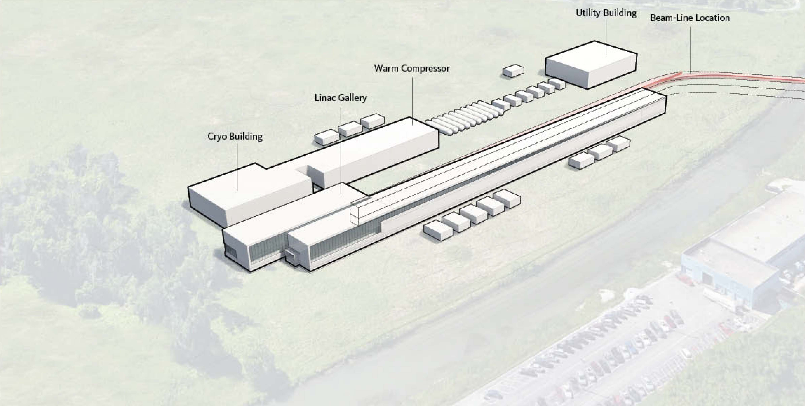
121.06 - Scope Overview – Above Grade
Utility Plant Building
LCW Equipment
Control Room
Exterior Space
Cryo Plant Building
Cold Box Station
Warm Compressor Station
Control Room
Exterior Space
Linac Gallery
General Space
Half Wave Resonator
SSR1
SSR2
LB650
HB650
Beam Transfer Line PS
Exterior Space
High Bay Building
Control Room
Computer Room/Conference Room
Tech Support Space
Upper High Bay
Lower High Bay
Mechanical/Electrical Space
Exterior Space
Space descriptions based on Room Data Sheets

Slide 30
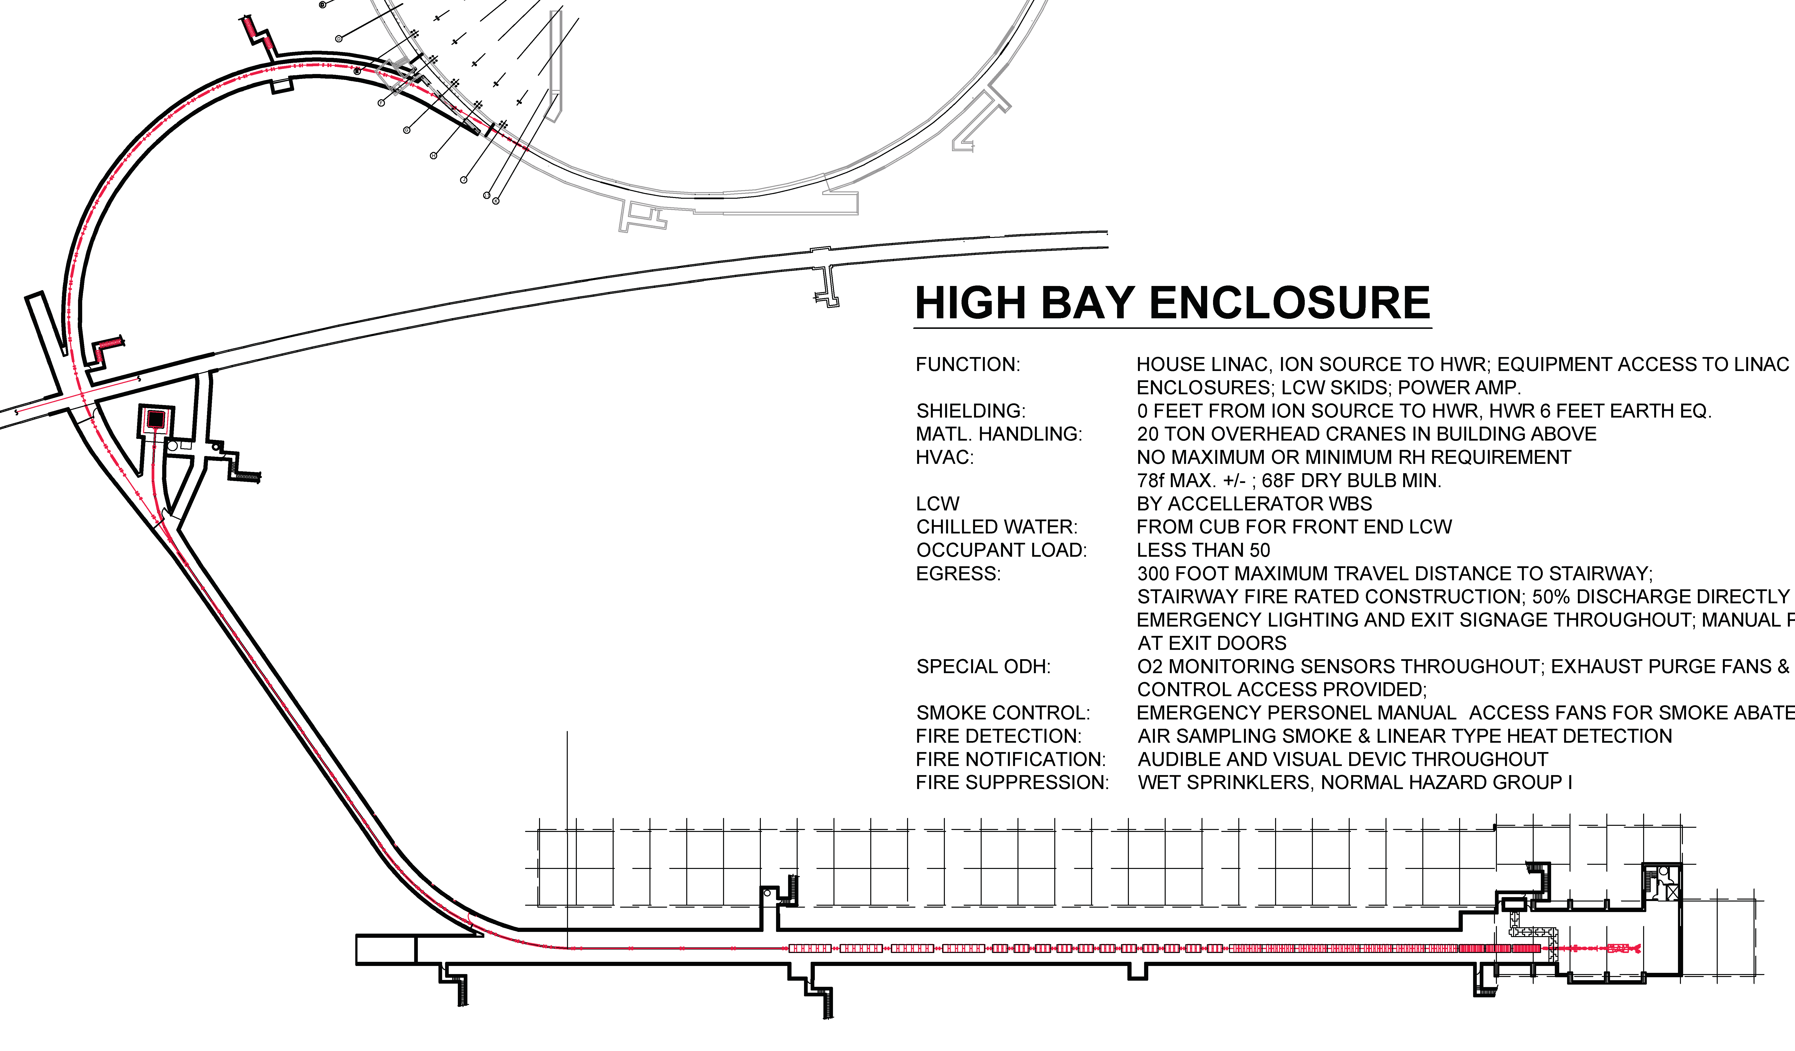
121.06 - Scope Overview – Below Grade
Booster Connection
Beamline
Beam Transfer Line
Beamline
Beam Absorber Space
Linac Tunnel
Half Wave Resonator
SSR1
SSR2
LB650
HB650
Space descriptions based on Room Data Sheets

