Slide 1
Preliminary Design Review - Overview
WBS 121.06.02 – Site Preparation
S. Dixon
Conventional Facilities
29-August-2018

Slide 2
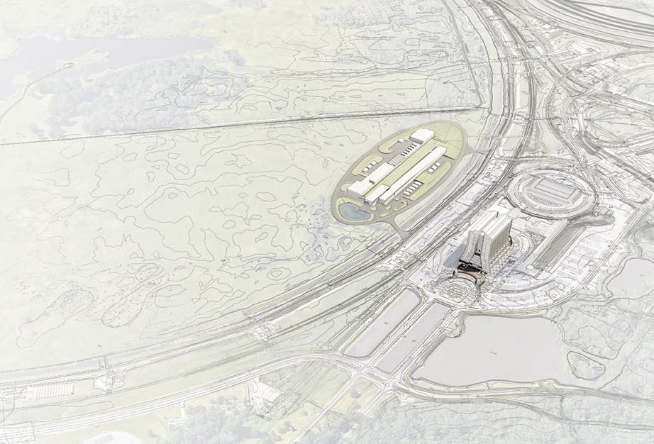
Agenda
Safety Information
Review Guiding Principles
Classes of Reviews
Schedule Overview

Slide 3
Review Guiding Principles
Project design reviews provide an assessment of the ability of the Project to meet its technical, schedule, and budget commitments. The primary goal of the Project design reviews is to increase the likelihood of success by identifying potential or actual design problems as early as possible to minimize the cost, schedule, and performance impact;
Design reviews are conducted within the framework established by the Fermilab Engineering Manual (FEM);
Reviews follow the PIP-II Design Review Plan.
From PIP-II Project Design Review Plan

Slide 4
Classes of Reviews
The level of a design review will be commensurate with complexity, cost, or safety importance of the design. The following types of project driven reviews are identified as follows:
Requirements and Specification Review (RSR)
Conceptual Design Review (CoDR)
Preliminary Design Review (PDR)
Final Design Review (FDR)
Production Readiness Review (PRR)
Transportation Readiness Review (TRR)
Installation Readiness Review (IRR)
Operations Readiness Review (ORR)
~60% Complete
~90% Complete
100% Complete
From PIP-II Project Design Review Plan

Slide 5
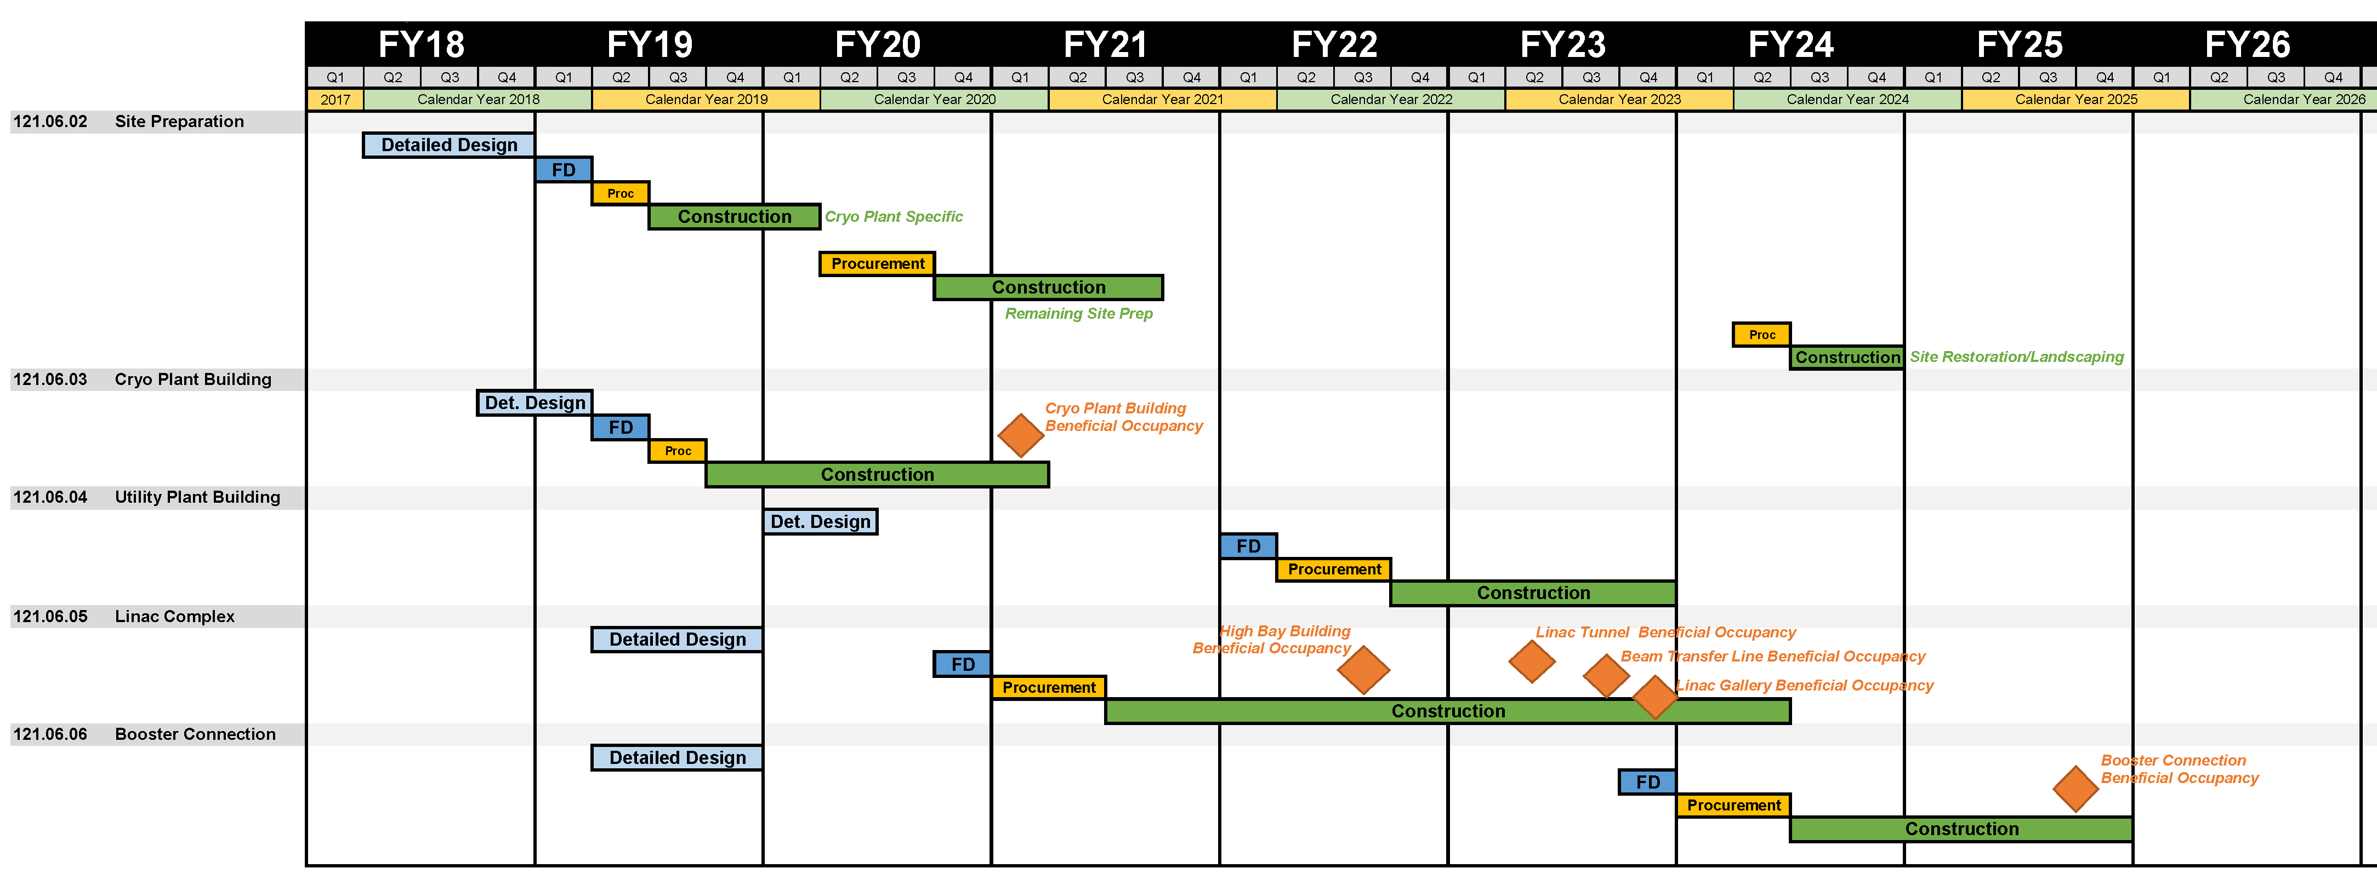
Conventional Facilities Schedule
FONSI Received
Groundbreaking Ceremony
CD-3a Approval
Now
FY19 plans include a full size Linac Tunnel Mock-up
for coordination purposes
Detailed Design Start for Linac Complex and Booster Connection

Slide 6
END

