Slide 1
ATLAS I/O Overview
Peter van Gemmeren (ANL)
gemmeren@anl.gov for many in ATLAS

Slide 2
Overview
High level overview of ATLAS Input/Output framework and data persistence.
Athena: The ATLAS event processing framework
The ATLAS event data model
Persistence:
Writing Event Data: OutputStream and OutputStreamTool
Reading Event Data: EventSelector and AddressProvider
ConversionSvc and Converter
Timeline
Run 2: AthenaMP, xAOD
Run 3: AthenaMT
Run 4: Serialization, Streaming, MPI, ESP

Slide 3
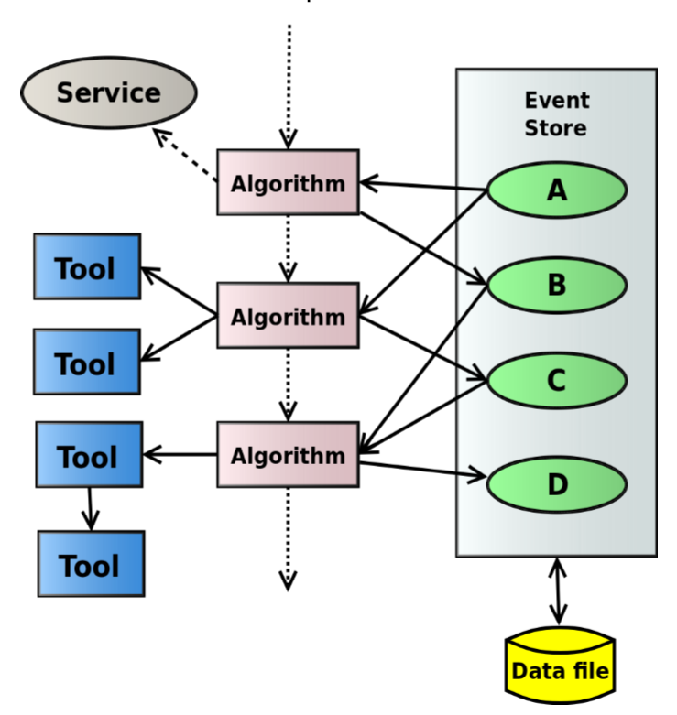
Athena: The ATLAS event processing framework
Simulation, reconstruction, and analysis/derivation are run as part of the Athena framework:
Using the most current (transient) version of the Event Data Model
Athena software architecture belongs to the blackboard family:
StoreGate is the Athena implementation of the blackboard:
A proxy defines and hides the cache-fault mechanism:
Upon request, a missing data object instance can be created and added to the transient data store, retrieving it from persistent storage on demand.
Support for object identification via data type and key string:
Base-class and derived-class retrieval, key aliases, versioning, and inter-object references.

Slide 4
Workflows
Athena is used for different workflows in Reconstruction, Simulation and Analysis (mainly Derivation).
Step | Total Read (incl. ROOT and P->T) |  | Total Write (w/o compression) |  | ROOT compression |  | Total CPU evt-loop time
EVNTtoHITS | 0.006 | 0.01% | 0.017 | 0.02% | 0.027 | 0.03% | 91.986
HITtoRDO | 1.978 | 5.30% | 0.046 | 0.12% | 0.288 | 0.77% | 37.311
RDOtoRDO-Trigger | 0.125 | 1.23% | 0.153 | 1.51% | 0.328 | 3.23% | 10.149
RDOtoESD | 0.166 | 1.88% | 0.252 | 2.85% | 0.444 | 5.02% | 8.838
ESDtoAOD | 0.072 | 23.15% | 0.147 | 47.26% | 0.049 | 15.79% | 0.311
AODtoDAOD | 0.052 | 5.35% | 0.040 | 4.06% | 0.071 | 7.24% | 0.979
RAWtoALL | N/A | N/A | 0.112 | 0.72% | 0.043 | 0.28% | 15.562

Slide 5
The ATLAS event data model
The transient ATLAS event model is implemented in C++, and uses the full power of C++, including pointers, inheritance, polymorphism, templates, STL and Boost classes, and a variety of external packages.
At any processing stage, event data consist of a large and heterogeneous assortment of objects, with associations among objects.
The final production outputs are xAOD and DxAOD, which were designed for Run II and after to simplify the data model, and make it more directly usable with ROOT.
More about this later…

Slide 6
Persistence
Store
Gate
Dynamic Attr Reader
On-demand single attribute retrieval
Conv. Service
Opt.
T/P
POOL
Svc
ATLAS currently has almost 400 petabytes of event data
Including replicated datasets
ATLAS stores most of its event data using ROOT as its persistence technology
Raw readout data from the detector is in another format.
ROOT
APR:Database
On-demand single object retrieval
APR:Database
ROOT

Slide 7
Writing Event Data
Sequence Diagram for writing Data Objects via AthenaPOOL:
The AthenaPool-OutputStreamTool is used for writing data objects into POOL/APR files and hides any persistency technology dependence from the Athena software framework.
AthenaPool
AthenaPool
AthenaPool
PoolSvc
Output
CnvSvc
Converter
StreamTool
connect
new
Data
Output()
Header
setProcess
Tag(
pTag
stream
)
Objects()
loop
createRep
(
obj
,
addr
)
createRep
(
obj
,
addr
[object in
)
DataObject
item list]
ToPool
()
T
-
P sep.
transToPers
[trans.
(
-
pers.
obj,pObj
conversion]
)
registerForWrite
(
place,
pObj
,
desc
)
registerForWrite
(place,
pObj
,
desc
)
token
token
addr
addr
insert(
addr
)
Register
DataHeader
in
POOL,
get token and insert to self
commit
commitOutput
(
Output()
outputName
, true)
alt
commit()
[full
commit]
[else]
commitAndHold
()

Slide 8
OutputStream and Output-StreamTool
OutputStreams connect a job to a data sink, usually a file (or sequence of files).
Configured with ItemList for event and metadata to be written.
Similar to Athena algorithms:
Executed once for each event
Can be vetoed to write filtered events
Can have multiple instances per job, writing to different data sinks/files
OutputStreamTools are used to interface the OutputStream to a ConversionSvc and its Converter which depend on the persistent technology.

Slide 9
Reading Event Data
Sequence Diagram for reading Data Objects via AthenaPOOL:
An EventSelector is used to access selected events by iterating over the input DataHeaders.
An Address-Provider preloads proxies for the data objects in the current input event into StoreGate.
EventSelector
PoolSvc
AthenaPool
next()
alt
getCollectionCnv
[no more
()
events in
collection]
new
Pool
CollectionCnv
initialize()
createCollection
(type,
create (type, des,
POOL::
connection, input, context)
mode, session)
ICollection
executeQuery
()
newQuery
()
iterator
iterator
[else]
next ()
iterator
loadAddr
retrieve(
iterator
,
eventRef
esses()
ref)
()
token
retrieve(token)
T
-
P sep.
persToTrans
(
ptr
[pers.
,
DataHeader
-
trans.
dataHeader
conversion]
)
setObjPtr
Element
(
ptr
, token,
dataHeader
context)
loop
getAddress
[element
()
!= end()]

Slide 10
EventSelector and Address-Provider
The EventSelector connect a job to a data sink, usually a file (or sequence of files).
For event processing it implements the next() function that provides the persistent reference to the DataHeader.
The DataHeader stores persistent references and StoreGate state for all data objects in the event.
It also has other functionality, such as handling file boundaries for e.g. metadata processing.
An AddressProvider is called automatically, if an object retrieved from StoreGate has not been read.
AddressProvider interact with ConversionSvc and Converter

Slide 11
ConversionSvc and Converter
The role of conversion services and their converters is to provide a means to write C++ data objects to storage and read them back.
Each storage technology is implemented via a ConversionSvc and Converter.
ATLAS uses ROOT via POOL/APR that is implemented via Athena/Pool Conversion
APR implements ROOT TKey and TTree technologies.
Converter dispatching done by type.
Converters can do (optional) Transient/Persistent mappings and handle schema evolution.
When writing, Converter return an externalizable reference.
Input File
Compressed baskets (b)
Baskets (B)
Persistent State (P)
Transient State (T)
read
decompress
stream
t/p conv.

Slide 12
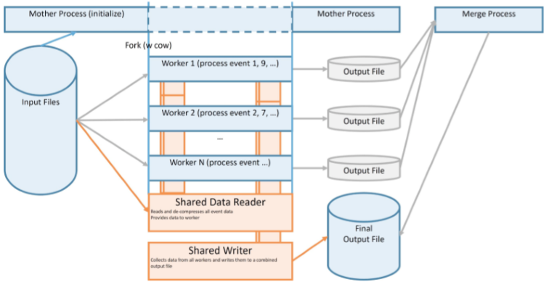
Run 2 Multi Process: AthenaMP
Since Run II, ATLAS has deployed AthenaMP, the multi-process version of Athena.
Starts up and initializes as single (mother) process.
Optionally processes events
Forks of (worker) processes that do the event processing in parallel.
Utilizes Copy On Write, thereby saving large amounts of memory.
Each worker has its own address space, no sharing of event data.
In default mode, workers are independent of each others for I/O: Read their own data directly from file and write their own output to a (temporary) file.
Input may be non-optimal as worker have to de-compress the same buffers to process different subsections of events -> cluster dispatching
output from different workers needs to be merged, which can create a bottleneck -> deployment of SharedWriter

Slide 13
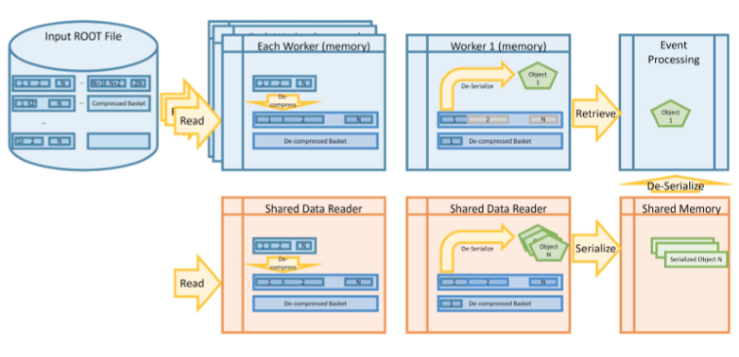
AthenaMP: Shared I/O components
SharedReader
SharedWriter
The Shared Data Reader reads, de-compresses and de-serializes the data for all workers and therefore provides a single location to store the decompressed data and serve as caching layer.
The Shared Writer collects output data objects from all AthenaMP workers via shared memory and writes them to a single output file.
This helps to avoid a separate merge step in AthenaMP processing.

Slide 14
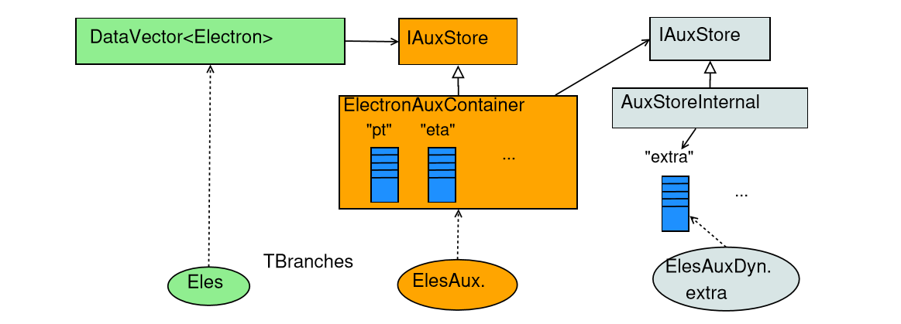
Also Run 2 xAOD Data Model
Each xAOD container has an associated data store object (called Auxiliary Store).
Both are recorded in StoreGate.
The key for the aux store should be the same as the data object with ‘Aux.’ appended.
The xAOD aux store object contains the ‘static’ aux variables.
It also holds a SG::AuxStoreInternal object which manages any additional ‘dynamic’ variables.

Slide 15
xAOD: Auxiliary data
Most xAOD object data are not stored in the xAOD objects themselves, but in a separate auxiliary store.
Object data stored as vectors of values.
(“Structure of arrays” versus “array of structures.”)
Allows for better interaction with root, partial reading of objects, and user extension of objects.
Opens up opportunities for more vectorization and better use of compute accelerators.

Slide 16
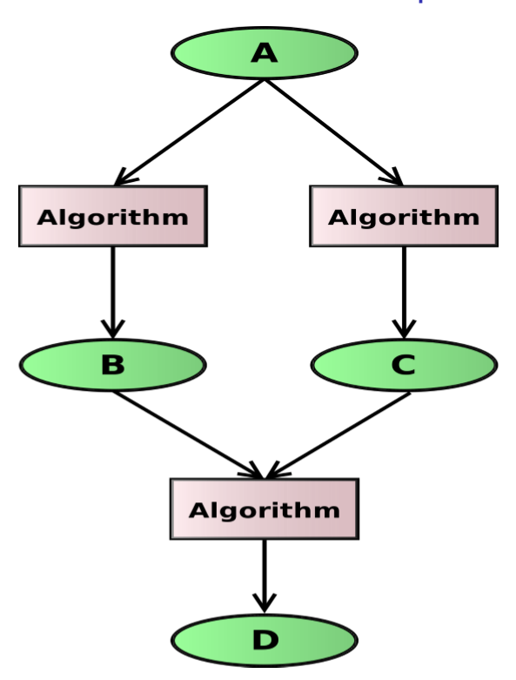
Run 3 Multi Thread: AthenaMT
Task scheduling based on the Intel Thread Building Blocks library with a custom graph scheduler.
Data Flow scheduling:
Algorithms declare their inputs and outputs. Scheduler ﬁnds an algorithm with all inputs available and runs it as a task.
Algorithm data dependencies declared via special properties (HandleKey).
Dependencies of tools will be propagated up to their owning algorithms.
Flexible parallelism within an event.
Can still declare sequences of algorithms that must execute in ﬁxed order (“control ﬂow”).
Number of simultaneous events in ﬂight is conﬁgurable

Slide 17
Things about ROOT
ROOT is solidly thread safe:
After calling ROOT::EnableThreadSafety() switches ROOT into MT-safe mode (done in PoolSvc).
As long as one doesn’t use the same TFile/TTree pointer to read an object
Can’t write to the same file
In addition, ROOT uses implicit Multi-Threading
E.g., when reading/writing entries of a TTree
After calling ROOT::EnableImplicitMT(<NThreads>) (new! in PoolSvc).
Very preliminary test show Calorimeter Reconstruction (very fast) with 8 threads gain 70 - 100% in CPU utilization
However, that doesn’t mean that multi-threaded workflows can’t provide new challenges to ROOT
ATLAS Example on the next slides

Slide 18
Enhanced data caching for multi-threaded workflows
On demand data reading (even dynamic aux store) and multi-threaded workflow can lead to non-sequential branch access, which can cause thrashing of TTreeCache.

Slide 19
Work done by ANL SULI David Clark
Forward Caching
Preloading and Retaining clusters
Setting the cache for leading branch will avoid invalidating it for late branch reads
Preloading trailing baskets can avoid reading single entries

Slide 20
Thread Safety of Athena I/O
The I/O layer has been adapted for multi-threaded environment
Conversion Service – OK
Serializing access to Converters for the same type, but converters for different types can operate concurrently
It means we can read/convert different objects types (~branches) in parallel
PoolSvc – OK
Serializing access to PersistencySvc
Can use multiple PersistencySvc for reading, but currently only one for writing
POOL/APR – OK
Multiple PersistencySvc can operate concurrently
Each has its own TFile instance with dedicated cache
FileCatalog – OK
Dynamic AuxStore I/O (reading) – OK
On-demand reading from the same file as other threads

Slide 21
Writing: Objects are to the same ROOT file and typically the same TTree, but there may be several streams…
Stream 1
Stream 2
Obj. 1
Type A
createRep
Obj. 2
Type A
createRep
Obj. 3
Type B
createRep
Obj. 4
Type B
createRep
Converter A incl. T/P
Converter B
Converter
unlocked
Obj. 3
Type B
register
Write
Obj. 1
Type A
register
Write
Converter A
unlocked
Converter A
unlocked
Obj. 2
Type A
register
Write
Obj. 4
Type B
register
Write
PersistencySvc 1 includes ROOT write
Not Yet:
PersistencySvc 2
Obj. 1
Type A
Done
PersistencySvc
unlocked
PersistencySvc
unlocked
Obj. 3
Type B
Not
Done
Obj. 2
Type A
Done
Obj. 3
Type B
Done

Slide 22
Reading: All Objects are in the same ROOT file and typically the same TTree
Obj. 1
Type A
setObjPtr
Obj. 2
Type A
setObjPtr
Obj. 3
Type B
setObjPtr
Obj. 3
Type B
setObjPtr
PersistencySvc 1 includes ROOT read
Optionally:
PersistencySvc 2
Obj. 1
Type A
createObj
PersistencySvc
unlocked
PersistencySvc
unlocked
Obj. 3
Type B
createObj
Obj. 2
Type A
createObj
Obj. 3
Type B
createObj
Converter A incl. T/P
Converter B
Obj. 1
Type A
Done
Converter
unlocked
Obj. 3
Type B
Done
Converter A
unlocked
Obj. 2
Type A
Done

Slide 23
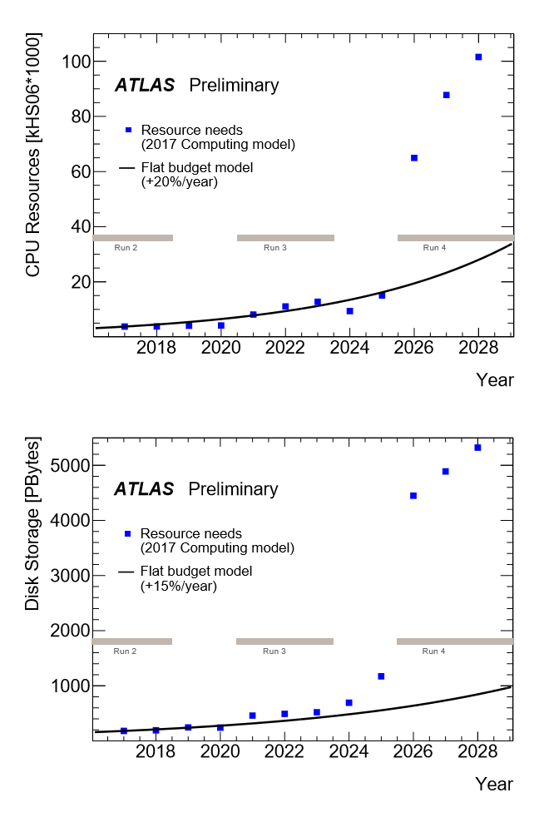
Challenge for LHC computing at Run 4
Assuming ATLAS’ current compute model, CPU and storage needs for Run 4 will increase to a factor of 5-10 beyond what is affordable.
The answer on how to mitigate the shortfall is better, wider and more efficient, use of HPC:
ATLAS software, Athena, was written for serial workflow
Migrated to AthenaMP in Run 2, but still dealing with improvements.
Required only Core and I/O software changes.
In process, but behind schedule, to move to AthenaMT for Run 3.
Limited changes non-Core software, but clients need to adjust to new interfaces.
Changes to allow efficient use of heterogeneous HPC resources (including GPU/accelerators) for Run 4 will be more intrusive.
Figures taken from:
arXiv:1712.06982v3

Slide 24
Run3 -> Run 4
ATLAS is currently reviewing its I/O framework and persistence infrastructure.
Clearly efficient utilization of HPC resources will be a major ingredient for dealing with the increase of compute resource requirements in HL-LHC.
Getting data onto and oﬀ of a large number of HPC nodes eﬃciently will be essential to eﬀective exploitation of HPC architectures.
SharedWriter already in production (e.g., in AthenaMP) and the I/O components already supporting multithreaded processing (AthenaMT) provide a solid foundation for such work
A look at integrating current ATLAS shared writer code with MPI underway at LBNL
Related work (TMPIFile with synchronization across MPI ranks) by a summer student at Argonne

Slide 25
Streaming data
ATLAS already employs a serialization infrastructure
for example, to write high-level trigger (HLT) results
and for communication within a shared I/O implementation
Developing a uniﬁed approach to serialization that supports, not only event streaming, but data object streaming to coprocessors, to GPUS, and to other nodes.
ATLAS takes advantage of ROOT-based streaming.
An integrated, lightweight approach for streaming data directly would allow us to exploit co-processing more eﬃciently.
E.g.: Reading an Auxiliary Store variable (like vector<float> directly onto GPU (as float []).

Slide 26
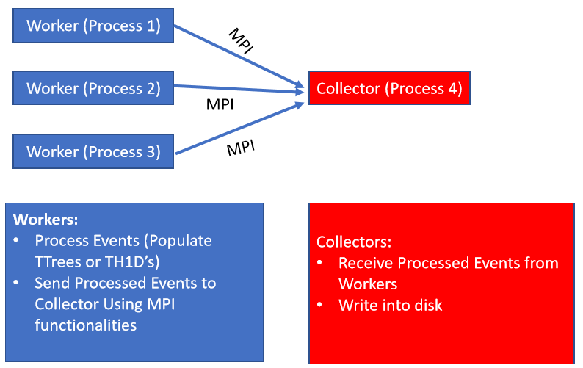
TMPI File
Work done by Amit Bashyal (CCE summer student, Advisor: Taylor Childers).
TFile like Object that is derived from TMemFile and uses MPI Libraries for Parallel IO.
Process data in parallel and write them into disk in TFile as output.
Works with TTree cluster
Worker collect events, compresses and sends to collector.

Slide 27
ALCF data and learning project for Aurora Early Science Program
Simulating and Learning in the ATLAS Detector at the Exascale James Proudfoot, Argonne National Laboratory
Co-PI’s from ANL and LBNL
The ATLAS experiment at the Large Hadron Collider measures particles produced in proton-proton collision as if it were an extraordinarily rapid camera. These measurements led to the discovery of the Higgs boson, but hundreds of petabytes of data still remain unexamined, and the experiment’s computational needs will grow by an order of magnitude or more over the next decade. This project deploys necessary workflows and updates algorithms for exascale machines, preparing Aurora for effective use in the search for new physics.

Slide 28
Conclusion
ATLAS has successfully used ROOT to store almost 400 Petabyte of event data.
ATLAS will continue to rely on ROOT to support its I/O framework and data storage needs.
Run 3 and 4 will present challenges to ATLAS that can only be solved by efficient use of HPC …
and we need to prepare our software for this.
ATLAS and ROOT

