Slide 1
Rethinking I/O: Using HPC resources within HEP
Jim Kowalkowski
Scalable I/O Workshop
23 Aug 2018

Slide 2
What we have been challenged with
Greatly increase usage of HPC resources for HEP workloads
  After all, many more compute cycles will be available in HPC than anywhere else.
Can we …
  Provide for large-scale HEP calculations
  Demonstrate good resource utilization
  Use tools available on HPC systems (we believe this is a practical decision)
Scalable I/O has been one of the major concerns
Notes:
Started looking seriously into this goal a few years back.
Here is what we’ve be presented to as a challenge …

Slide 3
Efforts have been underway to tackle challenges
Big Data explorations (SCD)
  New (to HEP) methods for performing analysis on large datasets
  Began with Spark, moved to python/numpy/pandas/MPI
HDF for experimental HEP (Fermilab LDRD 2016-010)
  Organizing data for efficient access on HPC systems (HDF)
  Organizing programs for efficient analysis of data with Python/numpy/MPI
HEP Data Analytics on HPC (SciDAC grant)
  Collaboration between DOE Office of High Energy Physics and Advanced Scientific Computing Research (ASCR supports the major US supercomputing facilities)
  Physics analysis on HPC linked to experiments (NOvA, DUNE, ATLAS, CMS)
Notes:
Project affiliations

Slide 4
Questions to be addressed
How ought data be organized and accessed?
  Assuming usual HPC facility with a global parallel file system
  A deeper memory hierarchy than we are used to
How should the applications be organized?
  Is our current programming model appropriate?
  How do we achieve necessary parallelism?
  What libraries should we be using?
How will the operating systems and run-time environment affect our computing operations and software?
  Are the software build and deployment tools we have in place adequate?
  What if we could analyze an entire dataset all at once?
  Can we benefit from tighter integration of workflow and application?
Notes:
Questions to address to see if goals can be met.
Related work: Vectorization within algorithms

Slide 5
Plan of attack
Choose representative problems to solve
  NOvA analysis workflows, LArTPC processing, generator tuning
Choose toolkits and libraries that could help
  HDF5
  ASCR data services geared towards HPC
  Python with numpy, MPI, and Pandas
  Container technology
  DIY as a solution for data parallelism
Facilities to be used initially:
  NERSC Cori (KNL and Haswell)
  ALCF Theta

Slide 6
Guiding principles, requirements, and constraints
We aim to greatly reduce the time it takes to process HEP data.
We need to redesign our workflows and code to take full advantage of HPC systems.
  to use well-established parallel programming tools and techniques
  to make sure these tools and techniques are sufficiently easy to use
  We need programs that are adaptable to different “sizes” of jobs (numbers of nodes used) without changing the code.
  We want data designed for partitioning across large machines.
We want to partition data (and processing) by things that are meaningful in the problem domain (events, interactions, tracks, wires, . . . ), not according to computing model artifacts (e.g. Linux filesystem files).
  parallelism implicit

Slide 7
Experimental contexts for our work
LArTPC wire storage, access, and processing
Event selection for neutrino analysis
Object store for physics data
Physics generator data access

Slide 8
LArTPC wire storage, access, and processing

Slide 9
Noise removal from LArIAT waveforms
LArIAT is a LArTPC (Liquid Argon Time Projection Chamber) test beam experiment
Converted all LArIAT raw data sample to one HDF5 file
  Started with 200K art/ROOT data files
  ~42 TB of digitized waveforms (4.2 TB compressed)
  15,684,689 events.
  Waveform data from u and v wireplanes (240 wires per plane, 3072 samples per wire)
Reorganized the data using HDF to be more amenable for parallel processing
Processing the entire LArIAT raw data sample
  First step of reconstruction is noise reduction using FFTs

Slide 10
Example MPI code: processing many events at one time
# first and last are calculated by library code, to tell
# this function call what part of the data set it is to
# work on.
adc_data = adcdataset[first:last] # read block of array
adc_floats = adc_data.astype(float)
# view data as an array of wires, rather than as events
adc_floats.shape = (nevts*WIRES_PER_PLANE, SAMPLES_PER_WIRE)
waveforms = transform_wires(adc_floats) # real work done here
# view the data as events again
waveforms.shape(nevts, WIRES_PER_PLANE, SAMPLES_PER_WIRE)
Parallelism is entirely implicit, and entirely data parallel.
Notes:
Point: getting data for me to process

Slide 11
Example code: processing many wires
All the real work is done in the numpy library, implemented in C.
  The library can use multithreading, or vectorization, to get the most performance from the hardware.
The script that launches the application specifies how many processes to use:
  mpirun -np 76800 python process_lariat.py <filename>
  This starts 76800 communicating parallel instances of our program — equivalent to
  running 76800 jobs all at once.
def transform_wires(wires):
ftrans = numpy.fft.rfft(wires, axis=1)
filtered = THRESHOLDS * ftrans
return numpy.fft.irfft(filtered, axis=1)
Notes:
Point: very high-level programming to do this.
This slide came from the LDRD talk …

Slide 12
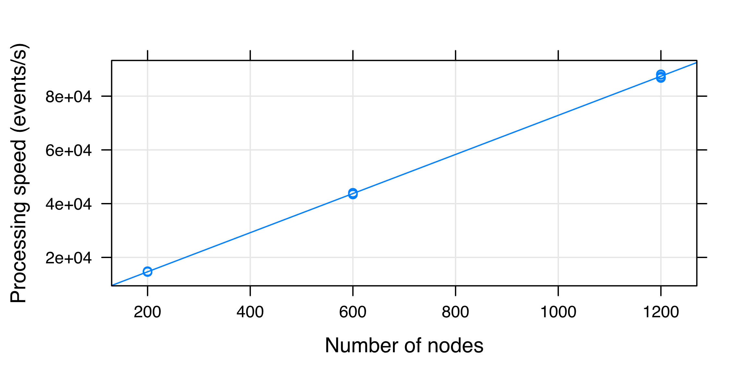
Processing speed for full analysis being done
Entire LArIAT dataset processed in three minutes (at 1200 nodes)
Shows perfect scaling
Notes:
The processing speed shows multiple measurements of the number of events/second processed by the full (many rank) program, as a function of the number of nodes. It shows the essentially perfect scaling.

Slide 13
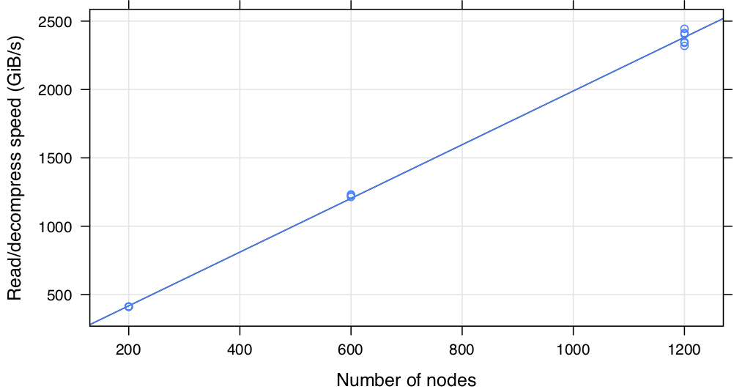
Read speed – how does the I/O scale?
Read + decompression speed for the whole application
Nearly perfect strong scaling
Notes:
The second plot shows the read+decompression speed, again for the whole program, as a function of the number of nodes. The 1200 nodes runs are at about 96% of perfect (strong) scaling. For both of these plots, the line is a fit to a straight line (R's "linear model").

Slide 14
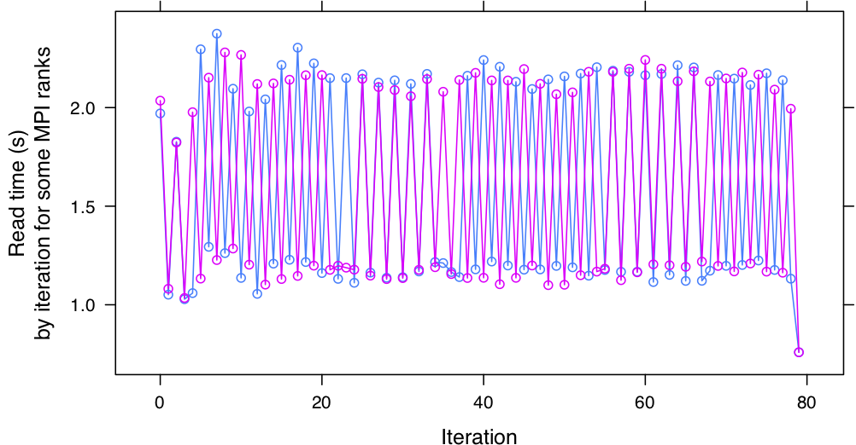
We should be able to do better …
Different colors correspond to different ranks in the application
Slower iterations within the application are twice as slow as faster ones (81 iterations in whole run)
Notes:
Weird oscillatory results.
The final plot shows some weirdness: it shows 2 ranks, and all iterations, and the time (not speed!) taken to read the set of events for that iteration. The last iteration is fast because it reads fewer events. This plot shows an oscillation of nearly a factor of two in reading speed, iteration by iteration. If we can figure out how to get the faster speed for everything, our total reading speed could increase significantly. So I think it is fair to say that when we understand the system better, we'll be able to even better than the IO shown in the second plot.

Slide 15
Event selection for neutrino analysis

Slide 16
Traditional solution for oscillation parameter measurement
Notes:
The point of this slide is to sketch the context in which the problem we’re working on sits.
BOXES indicate data to be processed.
ELLIPSES indicate processing steps
The bold elements are the ones that are part of the problem we’re working on
The rounded rectangles on the right side show the “traditional solution”; the HPC solution using a single file suitable for parallel processing, rather than thousands of small files.
Point: neutrino oscillation workflow and what we are dealing with in the event selection processing. Only working with the bolded boxes. Will will eventully going directly through parameter estimation from selection without intermediate files.

Slide 17
High-level organization of processing
We want to minimize …
  Reading
  Communication and synchronization between ranks
We organize the data into a single HDF5 file, containing many different tables
  some tables have one entry per slice
  some have a variable number of entries per slice
We want to process all data for a given slice in a single rank.
  the slice is NOvA’s “atomic” unit of processing, like a collider event.
  for data that represent per-slice information, this is trivial
  for other data, we need to do some work to ensure each rank has the correct data.

Slide 18
HPC solution
Notes:
This diagram shows the highest-level view of the HPC solution and the environment in which it sits.
The HPC system consists of a huge number of multiprocessor nodes, with a high-bandwidth interconnect
The data auomatically staged from a huge global parallel filesystem to a high-bandwidth SSD array
The single ”srun” command shown does the equivalent of launching 76800 batch jobs to process separate files.
Example performance numbers: a job this size running on Cori was able to read and decompress 42 TB of LArIAT raw data in 18 seconds.
The striping is important.
Simple to add more nodes/processes to go faster.

Slide 19
Parallel event pre-selection
Current situation
  NOvA slice data held in 17K ROOT files across
  ~27 million events are reduced to tens using ROOT macros applying physics “cuts”
New method
  Data prepared for analysis using workflow shown below
  End state: >50 groups (tables), each with many attributes
17K art/ROOT files
17K art conversion grid jobs
17K HDF files in dcache
Globus transfer NERSC
17K HDF files on Cori
MPI combine job
One HDF file on Cori
Aggregate results
MPI apply all cuts
HDF parallel read
MPI Build global index
Notes:
Major things for this slide:
How it fits into the slide 10 workflow (why it is being addressed (quickly assess goodness of a complex selection in a final analysis, explore parameter settings for selection)
The problem of reading data, alignment of data, specifying cuts, and mapping existing data
HDF and HEPnOS ideal for this kind of problem
Could use second level in workflow – showing the selection job specifics: global index build -> parallel aligned table read -> apply cuts -> “slice” summary
Pictures: The workflow and the alignment issue will be good.

Slide 20
Distributing and reading information
Each rank reads its “fair share”
of index info from each table.
  identifies which rank should handle
  which event, for most even balance
  identifies range of rows in table that
  correspond to each event (all slices)
Event “ownership” information distributed to all ranks
  this assures no further communication between ranks is needed while evaluating the selection criteria on a slice-by-slice basis.
  perfect data parallelism in running all selection code
Each rank reads only relevant rows of relevant columns from relevant tables
  all relevant data read by some rank
  no rank reads the same data as another
Notes:
This is a very high-level view of a rather complex procedure. The relevant points are:
we provide a library solution, so that physicists don’t need to code this themselves
the algorithm is designed to produce reasonable load-balancing at the event level; this is a small enough granularity to allow massive parallelism – much more so than file-level parallelism.
First selection procedure uses Python/MPI/HDF/Pandas on HPCs
Global index allow data alignment across tables within one rank
Composition of cuts using Pandas
Data parallelism implicit

Slide 21
Example selection code
def kNueSecondAnaContainment(tables):
df = tables['sel_nuecosrej’]
return (df.distallpngtop > 63.0) & \
(df.distallpngbottom > 12.0) & \
(df.distallpngeast > 12.0) & \
(df.distallpngwest > 12.0) & \
(df.distallpngfront > 18.0) & \
(df.distallpngback > 18.0)
def vtxelasticzCut(tables):
df = tables['vtx_elastic']
df['good'] =
(df.vtxid == 0) & (df.npng3d > 0)
KL = ['run', 'subRun', 'event', 'slice']
return df.groupby(KL)['good'].agg(np.any)
Selection can be done on multiple columns of a table.
Logical operations are connected by & operator.
Data parallelism is totally implicit.
Returns an array with one logical value per slice.
vtx_elastic table has one entry per vertex; may be more than 1 per slice.
groupby combines results for all vertices in one slice.
Returns an array with one logical value per slice.
Notes:
The really important point here is that the parallelism is entirely implicit – the code looks serial, but is perfectly data-parallel.
Left: simple for independent data
Right: the merge step is missing to get one row per slice. The merge step is above the currently shown function.

Slide 22
Current status
NOvA has taken ownership of our HDF “ntuple” production code
  They will use this in their own future production.
  Especially interested in using for machine learning; many tools work with HDF5 files.
We will be comparing performance with C++-MPI implementation.
Integration with larger workflow that is also part of the SciDAC project
  use of changes in event selection criteria to evaluation systematic uncertainties in the mixing parameter measurements
  one integrated MPI program, to take best advantage of HPC platform.
Notes:
Can we put the use case (larger workflow) comment up to a higher slide, and then get rid of this slide altogether?

Slide 23
Object store for physics data

Slide 24
HEPnOS: Fast Event-Store for HEP (on HPC)
Goals:
Manage physics event data from simulation and experiment
through multiple phases of analysis
Accelerate access by retaining data in the system
throughout analysis process
Reuses components from Mochi ASCR R&D project
Properties:
Write-once, read-many
Hierarchical namespace (datasets, runs, subruns)
C++ API (serialization of C++ objects)
Components:
Mercury, Argobots, Margo, SDSKV, BAKE, SSG
New code: C++ event interface
Map data model into stores
HEP Code
C++
API
BAKE
SDS-KeyVal
PMEM
LevelDB
RPC
RDMA
Notes:
Reference the workflow shown on the earlier slides.
Notes:
Common in HEP to do data analysis on millions or billions of events. Code is C++, lots of ROOT datasets
This analysis is moving to HPC systems for throughput reasons, data access is significant
What we’re doing here is shifting to a model where data is pulled into the system in bulk and kept in the system during analysis
Built C++ accessor functions that reflect how they access the data already.
Clients talk directly to BAKE for storing large C++ objects such as particle trajectories
Directly to key/value databases to store metadata information such as the parameters of the accelerator, and small C++ objects for which storing in BAKE would be an overkill.
We manage distribution.
Not much new code, more to come as we do bulk ingest and export.

Slide 25
Our first use of HEPnOS
Make high-volume reconstructed physics object data available to analysis workflows
  Use existing art framework and gallery library
  Starting point: Use actual LArSoft Tracks, Hits,and Associations from ProtoDUNE simulation
Allow HPC facility services to distribute data at any scale, using existing HEP abstractions
  Runtime ROOT File I/O replacement using HEPnOS
  Include all levels (or layers) of data aggregation with metadata
Data distribution and data parallelism implicit to user
Event currently interacts with
art/ROOT File
Notes:
HPC enable this: global file system, flexible scaling
Layers: Datasets / runs / intervals / events / physics object containers
Using tools from RAPIDS SciDAC institute

Slide 26
Current status and future direction
Prototype test programs are running:
  one to read from existing art/ROOT data files, and to write to the new data store
  one to read from the new data store, and verify the integrity of the data
We are using Docker containers for easy portability of development environment
  Some of us develop on macOS laptops, others on a variety of Linux installations
  We will deploy to NERSC (through Shifter) and ALCF (through Singularity)
The dataset (description and name) is included in the namespace
  Interesting to have direct access to any part from any process on any node
  Opens up new workflow possibilities
  Can readily represent and access things below the event, such as NOvA slices

Slide 27
Physics generator data access

Slide 28
Matrix element (ME) calculations and physics generators
Adequate predictions of many observables require input from matrix element generators
  e.g. Getting angular distribution of jets correct
ME generators (Sherpa, MadGraph) are used to generate high-multiplicity parton-level events
  LHE description is the typical representation
  Used as input to Pythia8 to get fully simulated events
XML-based LHE data format is unsuitable for HPC
Task is to write LHE data in HDF5 instead
  We can accumulated all the XML data into one HDF5 file
  Also working on writing HDF5 directly from Sherpa
Will work seamlessly with our new DIY-based generator applications that tie together Pythia8, LHAPDF, and Rivet
Notes:
1) The nature of the calculation

Slide 29
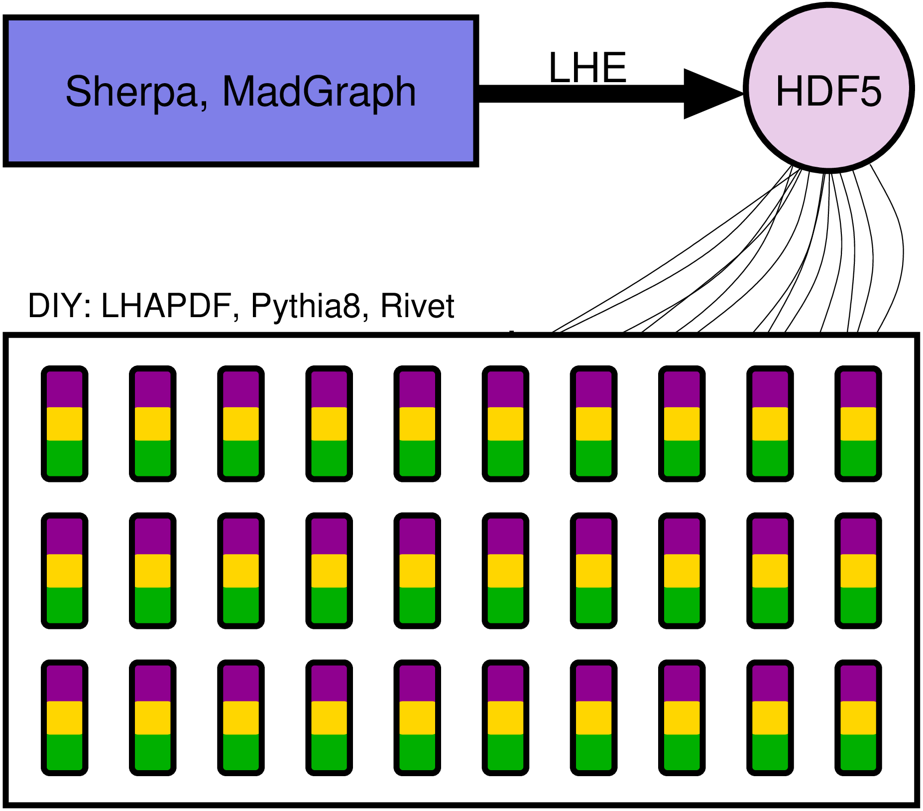
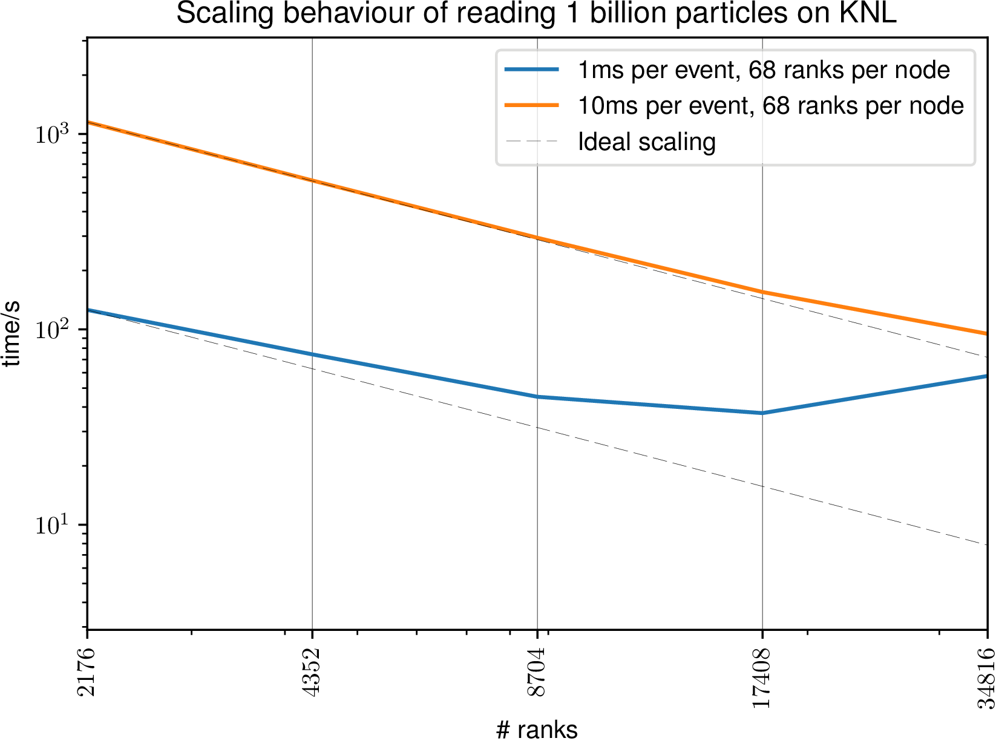
Generator data available for any size study
I/O will not be an issue
Organization of running Pythia8 on HPC facilities

Slide 30
Summary
This work may be useful to inform other projects that are ongoing or starting
NOvA has embraced the work we are doing here
  Took ownership of the HDF writer module
Converting full HEP experiment datasets has been very difficult
  Heavily influenced by ROOT tree structure (NOvA tuple organization)
  Complexity of data structures (LArSoft RawDigits class and others)
  Some data structures have been reorganized (vectorization becomes straightforward)
Python was excellent for prototyping; further work is needed to determine if we are getting the best performance possible.
  Pandas provides a powerful set of abstractions for analysis tasks
  Comparisons of C++ and python/pandas forthcoming
Notes:
As we more calculation towards reconstruction and what happens in the framework algorithms, the same techniques will be applied: reading the right information to be operated on into memory, using vectorized libraries for high-level operations on the data, using the interconnects to round up results that are distributed around the system.

Slide 31
Future directions
Performance studies and tuning will continue
Upcoming C++ codes will be using DIY, and possibly additional HPC-centric workflow tools such as Decaf
Will be working with HEPCloud on integrating dataset handling.
Looking into
  Adding Summit as a platform
  Making sure that analysis involving heterogeneous computing is handled
As we move towards working within the art framework, similar techniques will be applied:
  read the right information into memory,
  use vectorized libraries for high-level operations on the data,
  use the network to round up results that are distributed around the system

Slide 32
Acknowledgements
People involved in one or more of these projects
  M. Paterno (FNAL), T. Peterka (ANL), R. Ross (ANL), S. Sehrish (FNAL)
  C. Green (FNAL), H. Schulz (University of Cincinnati), B. White (FNAL)
  N. Buchanan (CSU, NOvA/DUNE), P. Calafiura (LBNL, LHC-ATLAS), Z. Marshall (LBNL, LHC-ATLAS), S. Mrenna (FNAL, LHC-CMS), A. Norman (FNAL, NOvA/DUNE), A. Sousa (UC, NOvA/DUNE)
  A. Austin (ANL), S. Calvez (Colorado State University), P. Carns (ANL), P.F. Ding (FNAL), M. Dorier (ANL), D. Doyle (Colorado State University), X. Ju (LBNL), R. Latham (ANL), S. Snyder (ANL)
This material is based upon work supported by the U.S. Department of Energy, Office of Science, Office of Advanced Scientific Computing Research, Scientific Discovery through Advanced Computing (SciDAC) program.

Slide 33
HEP Data Analytics on HEP: Goals
Transform how these physics tasks are carried out through ASCR math and data analytics
  High-dimensional parameter fitting,
  Workflows supporting automated optimization
  Distributed dataset management storage and access (in situ) for experiment data
  Introduction of data-parallel programming within analysis procedures
Accelerate HEP analysis on HPC platforms
Extend physics reach of LHC and neutrino experiments
  Event generator tuning
  Neutrino oscillation and cross-section measurements
  Detector simulation tuning
http://computing.fnal.gov/hep-on-hpc/
Notes:
Revolutionize how to carry out physics analysis from experiment data, including “what is needed” to discover new physics.
Here you should get an idea of what this means and how we are working towards achieving it.
Poster have more detail.
Note that all these activities are in the physics analysis realm – with tools to support many data available at scales not seen before.
From data organization view, from analysis workflow view.
Workflow not grid scheduling. Application organization. Coordination component. Iterative component.

Slide 34
Accomplishments
First NOvA neutrino oscillation analysis using NERSC
  Time-to-result improved by 50x; first round completed within 16 hours
  Used ~30M hours on Cori (and part of Edison) across two runs
  Accuracy: 8x higher resolution than any prior result
  Turnaround: 50x faster - results reviewed in <24 hours
  Scale: ~1M active cores – biggest Condor pool ever
Prototype event store (HEPnOS) built for serving data to HEP analysis codes
Data-parallel NOvA pre-analysis event selection procedure
  NOvA accepted ownership of HDF conversion software for their data
HEPnOS: https://xgitlab.cels.anl.gov/sds/HEPnOS/wikis/home
Notes:
Many of these are explained in more detail later in these slides …

