Slide 1
High-Q Performance
Martina Martinello
International Workshop on Cryomodule Design and Standardization
7th September 2018

Slide 2
Overview of state-of-the-art surface treatments for SRF cavities

Slide 3
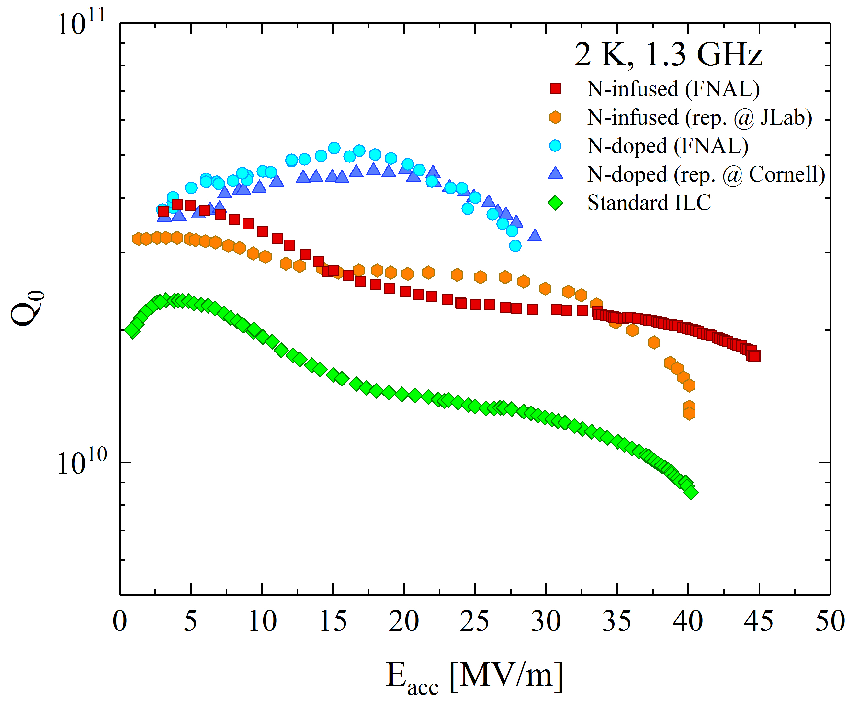
State-of-the-art treatments
High-Q₀
High-E_{acc}
(e.g. ILC)
High-Q₀
(e.g. LCLS-II)
High-E_{acc}
(e.g. ILC)

Slide 4
High-Q₀ treatments
High-Q₀
(e.g. LCLS-II)

Slide 5
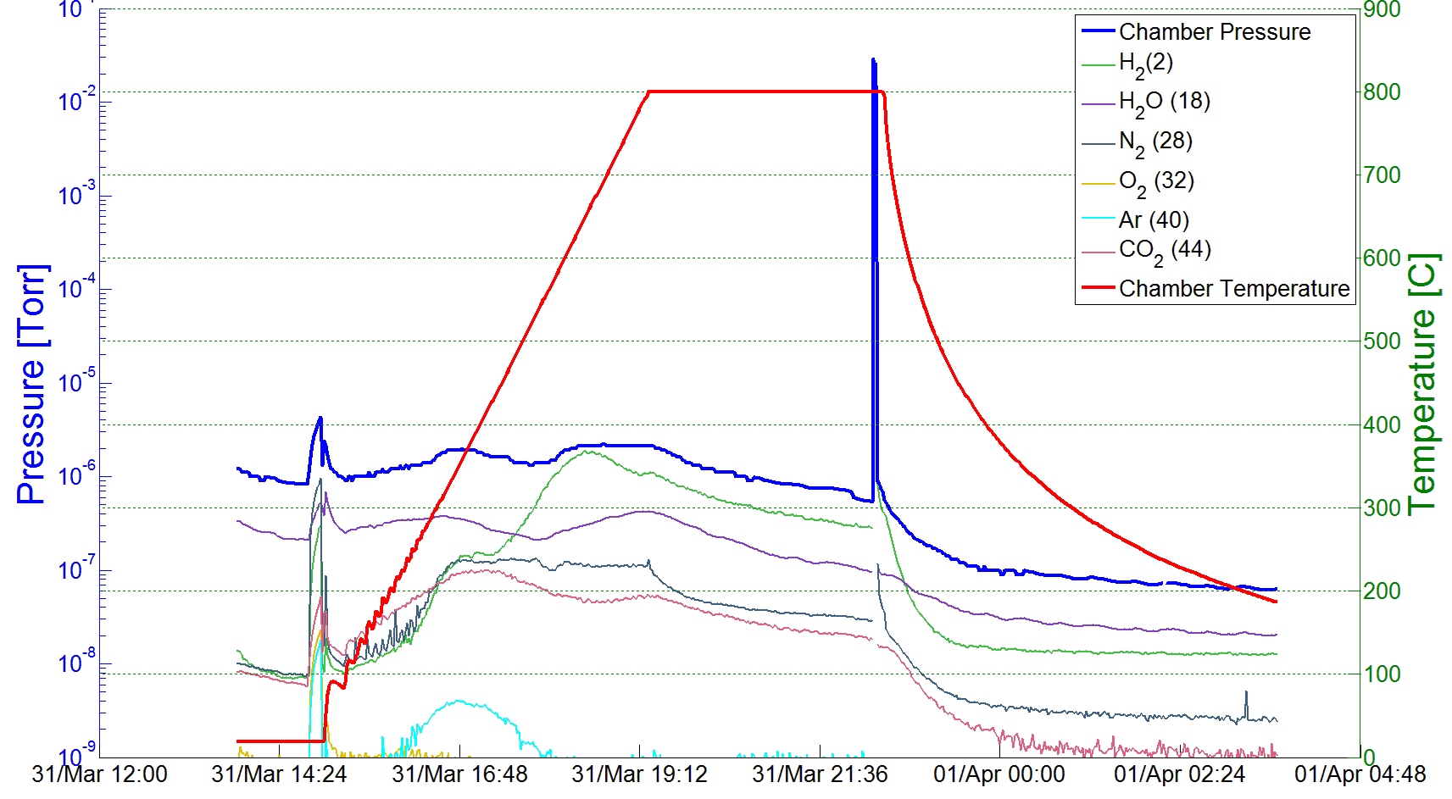
N-doping treatment
Cavity after welding
EP 140 μm
3 h at 800C UHV baking
48 h at 120C baking
N₂ injection 800C
EP 5 μm
Example of a N-doping process (2/6 recipe):
Nb bulk EP cavity annealed for 3 hours in vacuum (UHV furnace) at 800C
Nitrogen injected (25 mTorr) at 800C for 2 minutes
Cavity stays for another 6 minutes at 800C in vacuum
Cooling in vacuum
5 um electro-polishing (EP)
25 mTorr (2 minutes)
800 C (3 hours)

Slide 6
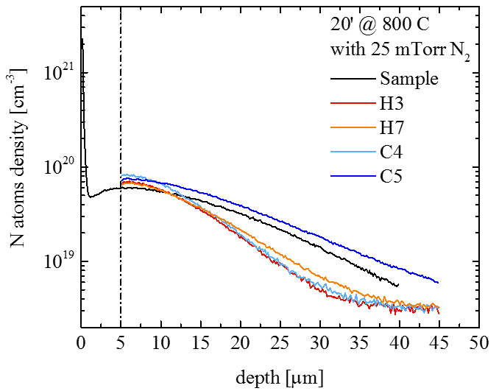
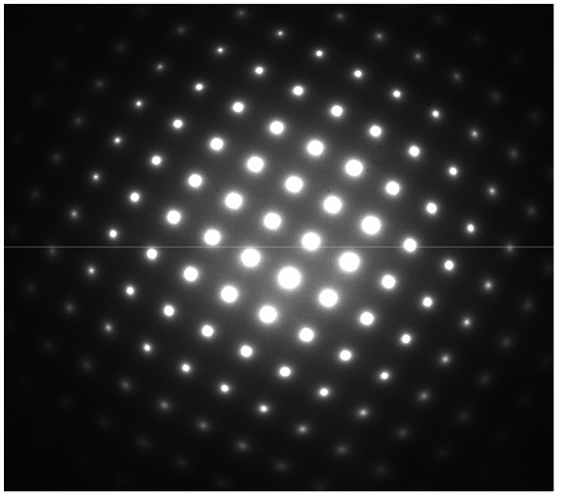
N-doping treatment (2/6 recipe)
Only Nb from TEM/NED spectra:
N must be interstitial
Y. Trenikhina et Al, Proc. of SRF 2015
Final RF Surface
Nb
N
N Interstitial

Slide 7
Origin of the anti-Q-slope
$$R_{S} \left( 2 K,B_{Trap} \right)={R_{BCS} \left( 2 K \right)+R}_{0}+R_{Fl} ( B_{Trap},l )$$
Anti-Q-slope
Anti-Q-slope emerges from the BCS surface resistance decreasing with field
A. Grassellino et al, Supercond. Sci. Technol. 26 102001 (2013) - Rapid Communications
A. Romanenko and A. Grassellino, Appl. Phys. Lett. 102, 252603 (2013)

Slide 8
High-Q₀/High-G treatments
High-Q₀
High-E_{acc}

Slide 9
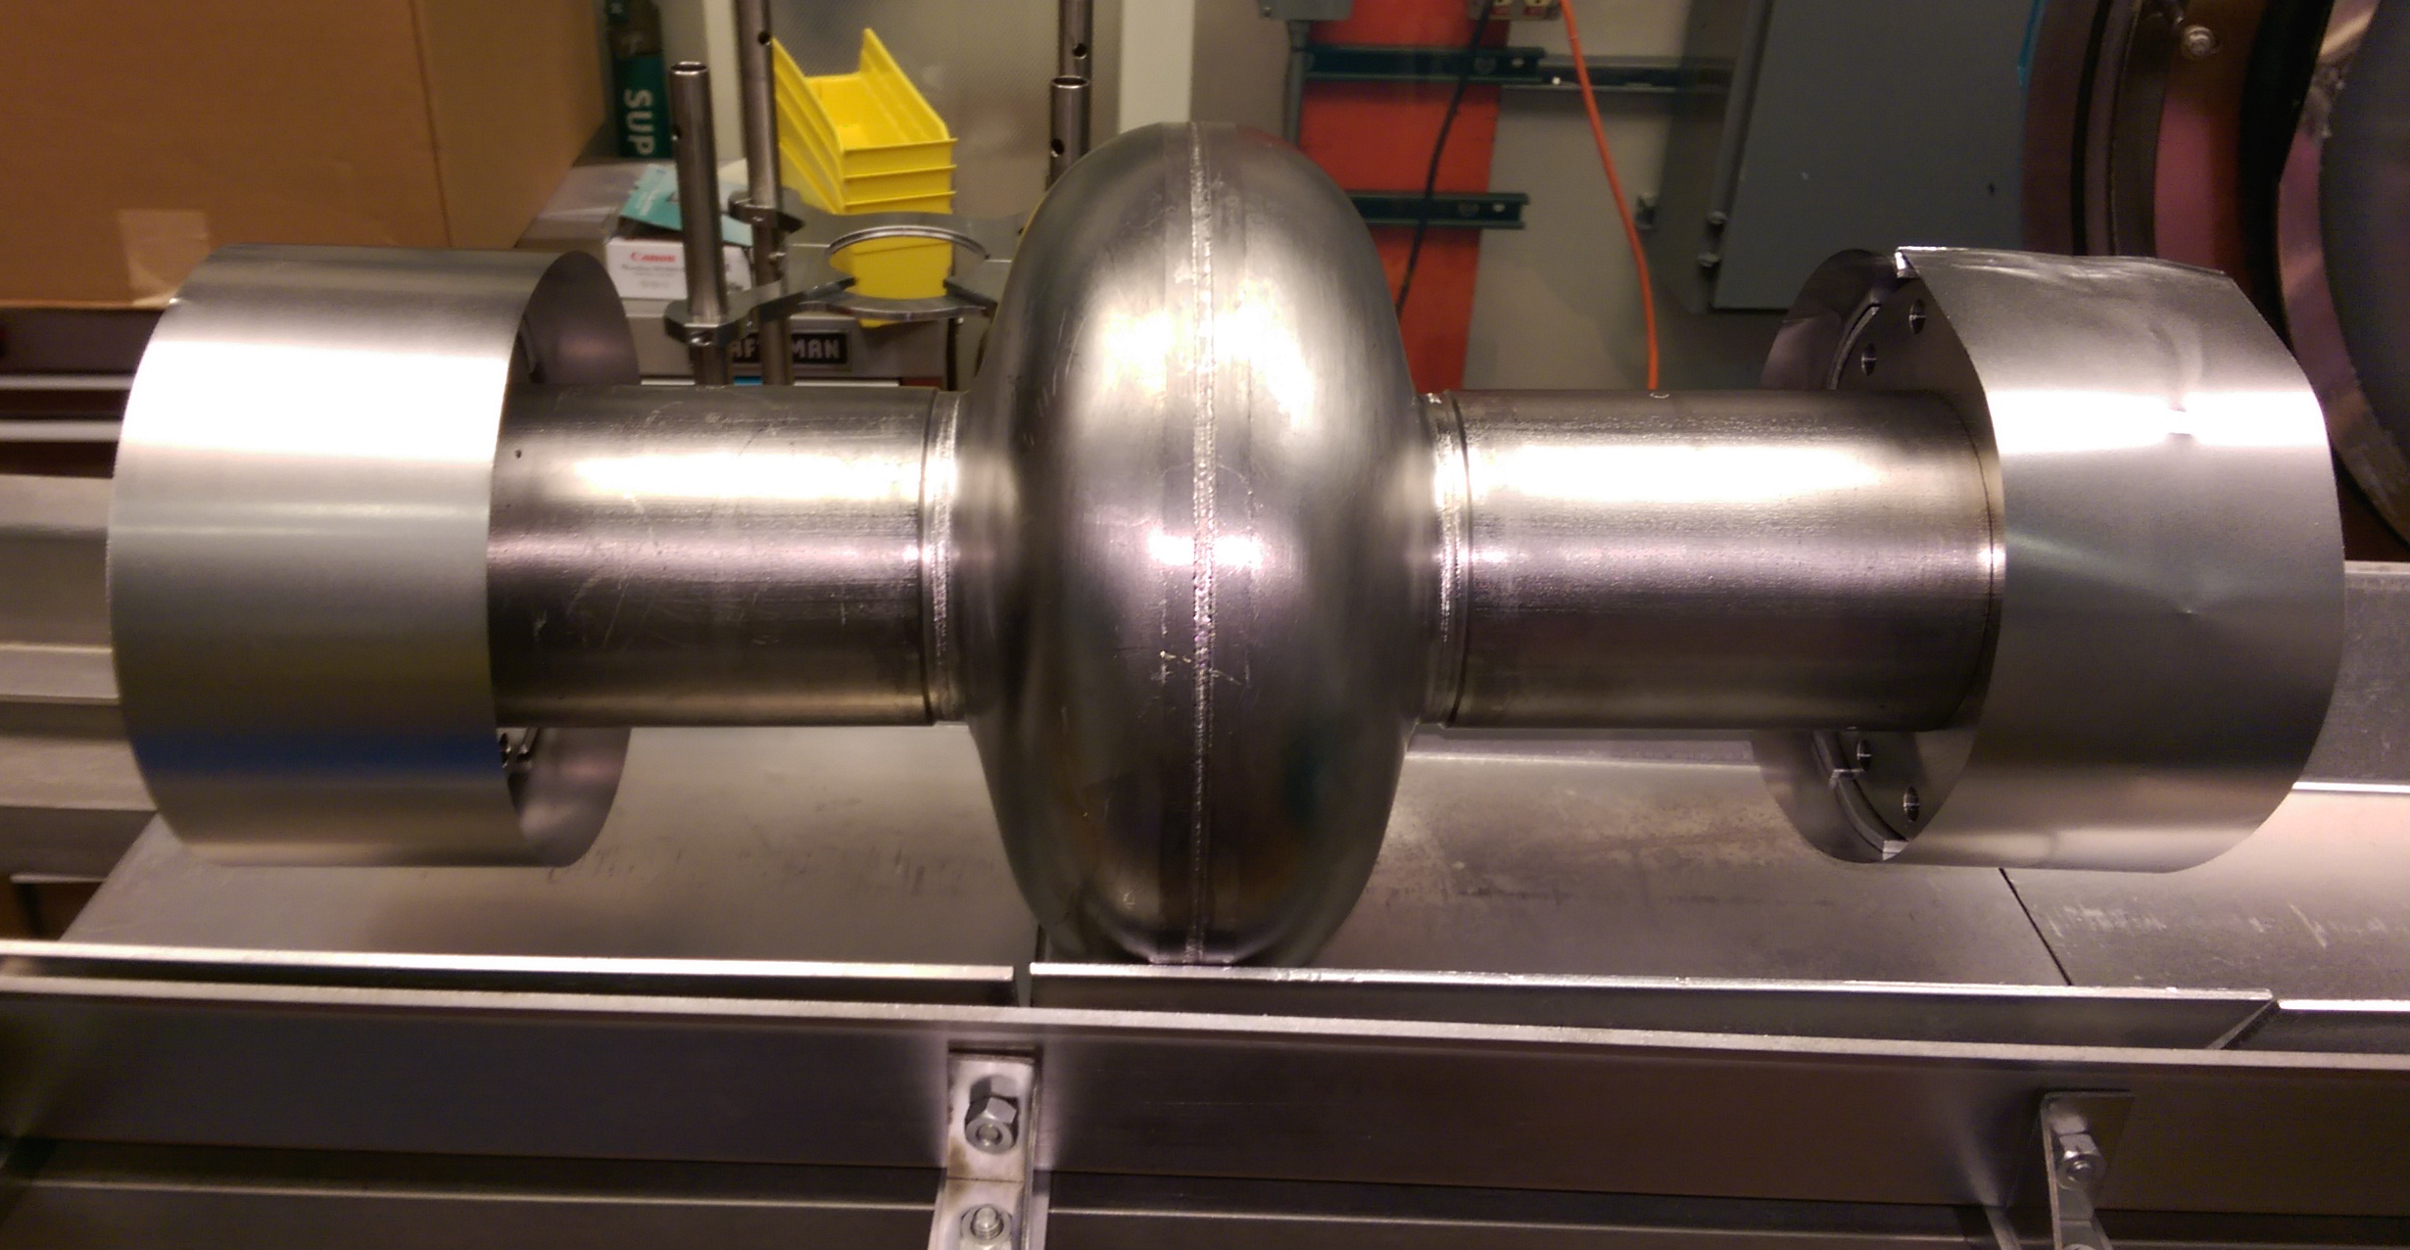
Example of N-infusion processing sequence
Bulk electro-polishing
High T furnace (with caps to avoid furnace contamination):
  800C 3 hours HV
  120C 48 hours with N₂ (25 mTorr)
NO chemistry post furnace
HPR, VT assembly
25 mTorr
10⁻⁵ mTorr
160 C
48 h
96 h
Protective caps and foils are BCP’d prior to every furnace cycle and assembled in clean room, prior to transporting cavity to furnace area
A. Grassellino et al., arXiv:1305.2182
A. Grassellino et al 2017 Supercond. Sci. Technol. 30 094004

Slide 10
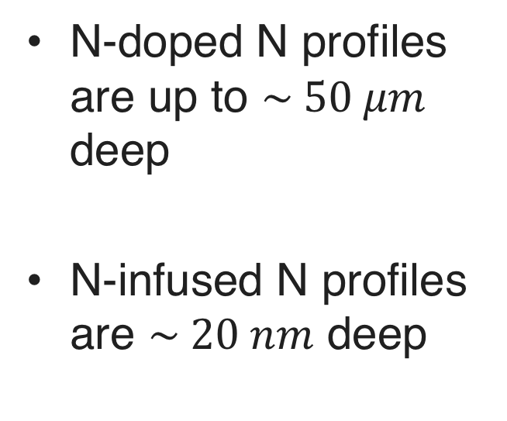
Comparison N-doped vs N-infusion
N-doped
N-doped N profiles are up to $\sim 50 μm$ deep
N-infused N profiles are $\sim 20 nm$ deep
N-infusion

Slide 11
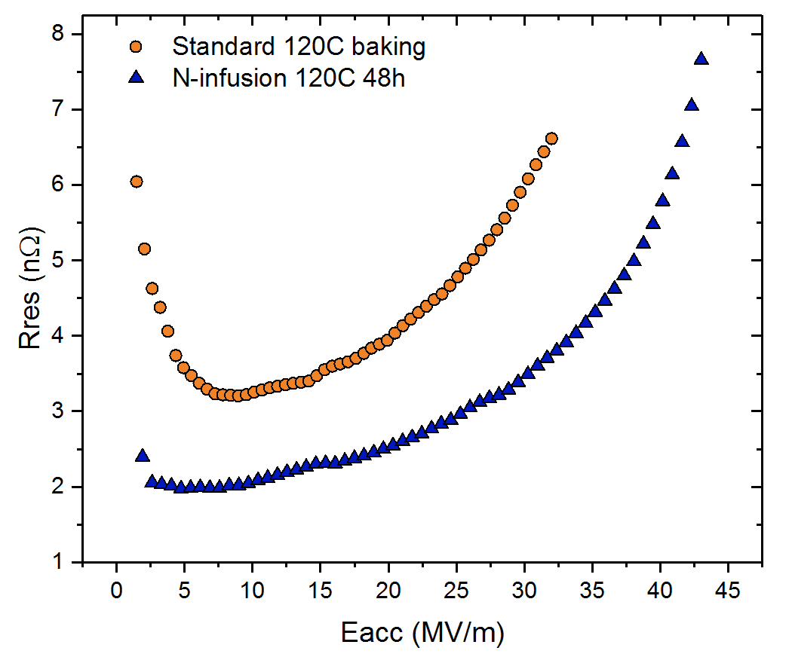
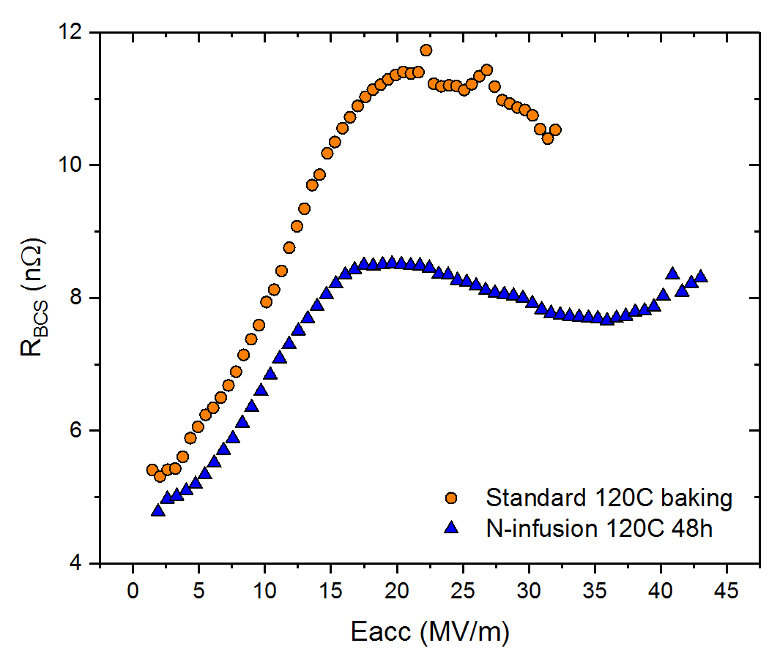
What gives the Q improvement at high field with 120C infused?
Improvement stems from both lower residual and lower BCS surface resistance
Standard
120C baking
Standard 120C baking
120C N-infusion
120C N-infusion
A. Grassellino et al 2017 Supercond. Sci. Technol. 30 094004

Slide 12
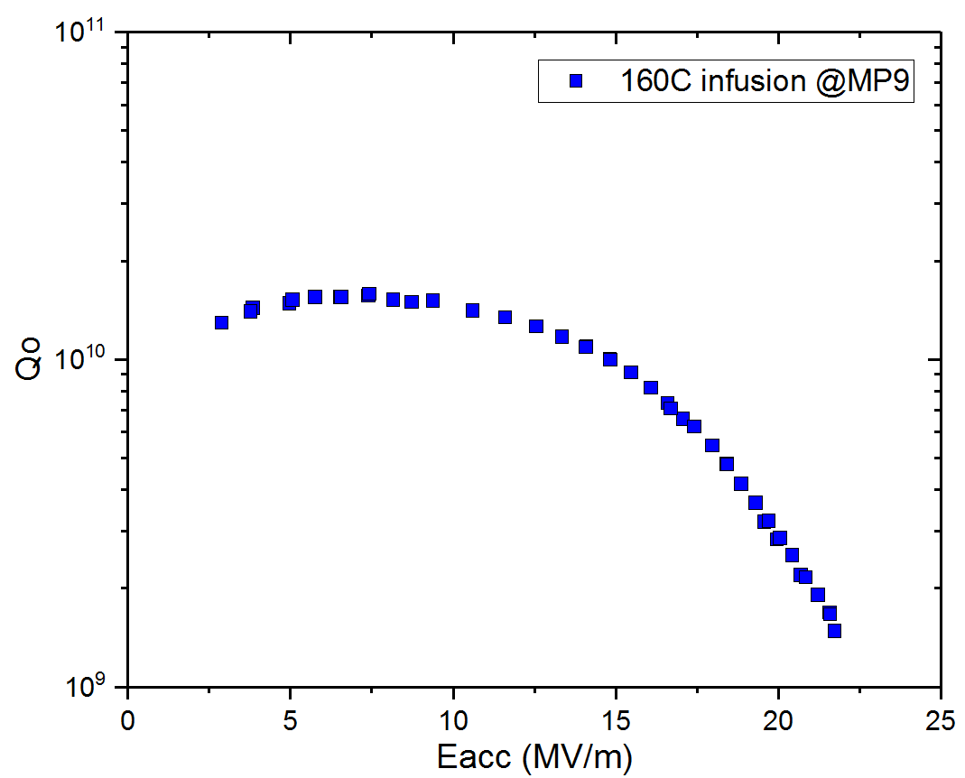
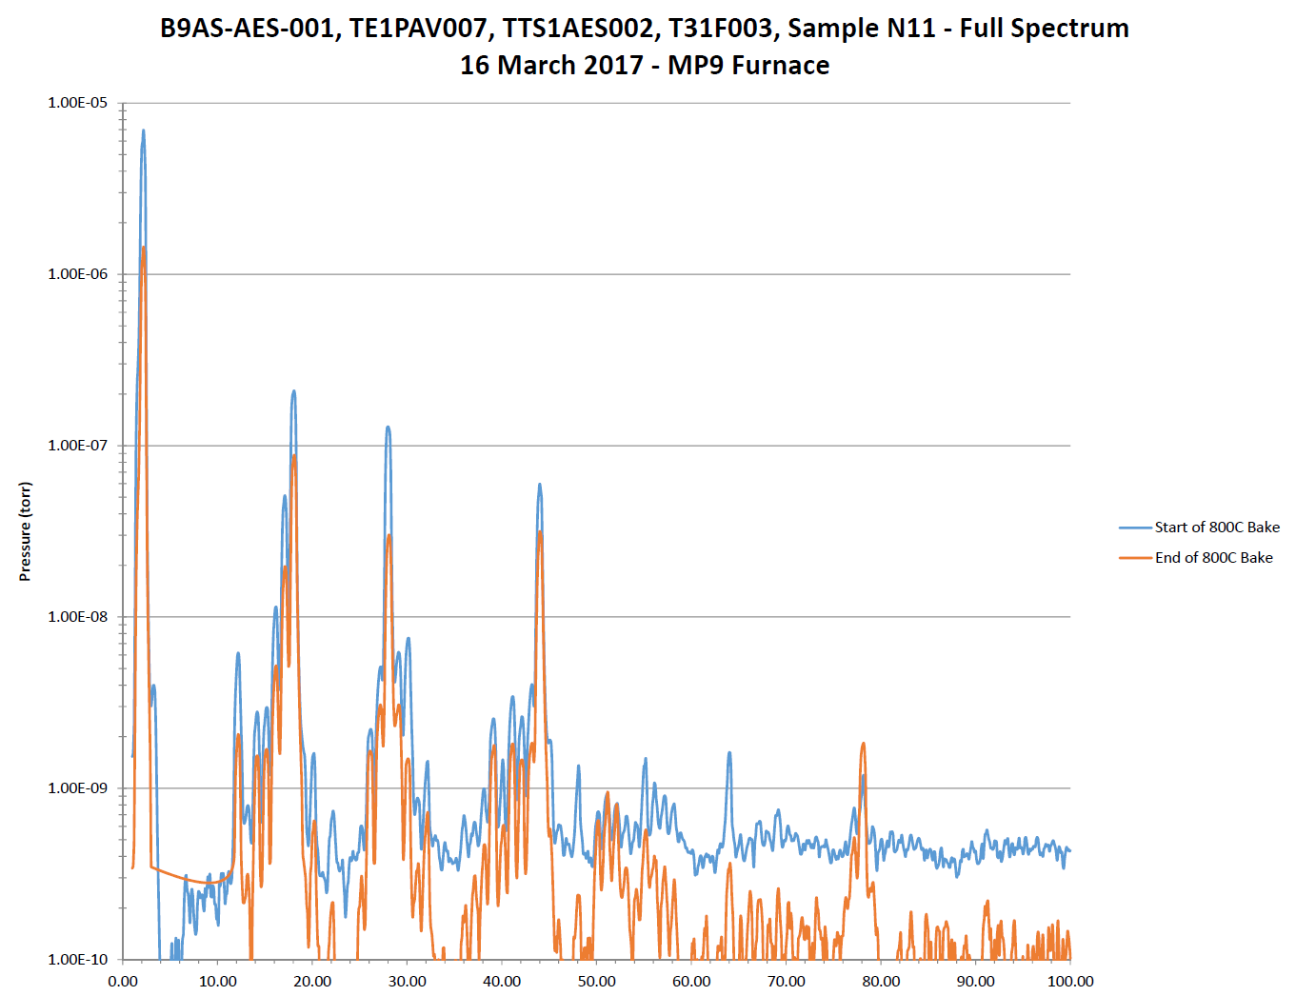
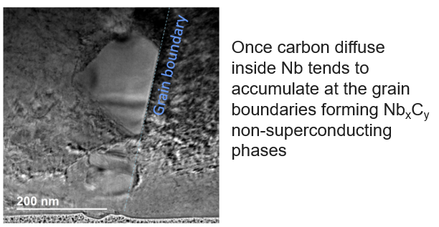
N-infusion easily affected by furnace contamination
Quite high level of hydrocarbons may be absorbed by the cavity
Example of N-infused cavity contaminated by furnace environment
Notes:
We’re doing cost savings studies to try to make the ILC more affordable and increasing the gradient has the largest impact, but Q0 also has a strong impact

Slide 13
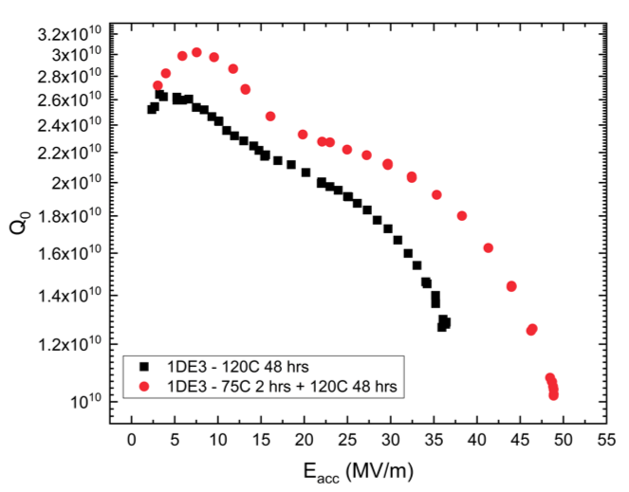
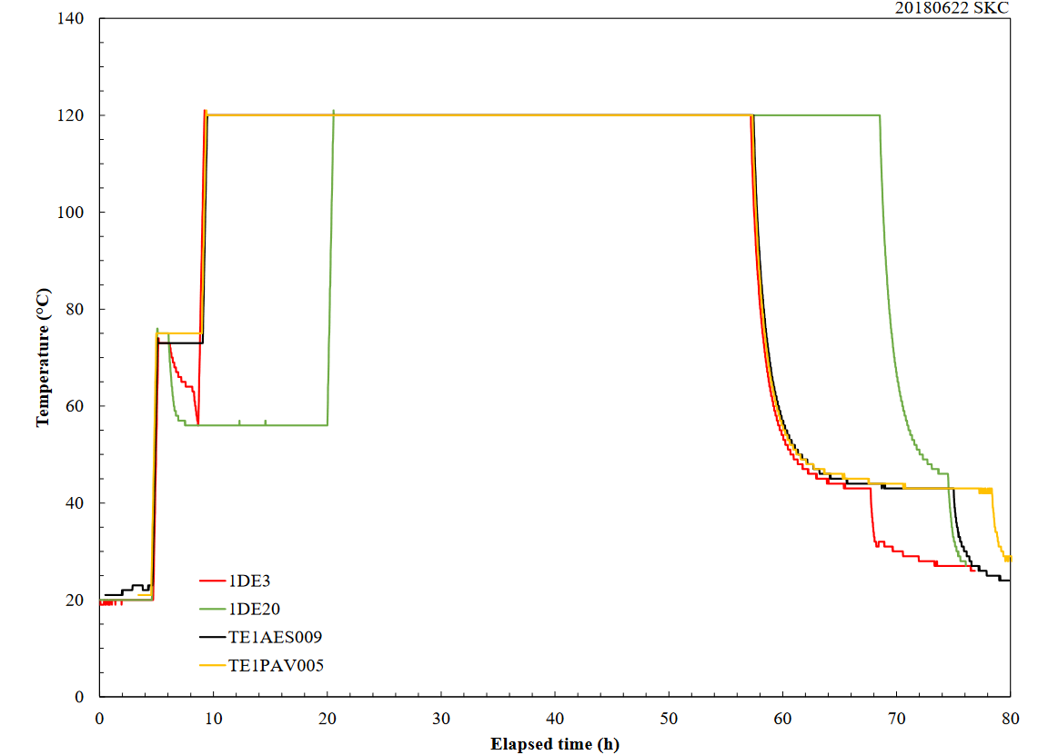
Modified 120C baking: 4h at 75C + 48h at 120C
A thermocouple went faulty and oven went to standby. Cavity lingered around 75C for about 2 hours, then resumed the 120C 48 hours -> increase in both Q and gradient observed
Several cavities made after that, adding the 75C step for 4 h, confirming the results -> work in progress to better understand treatment repeatability and physics

Slide 14
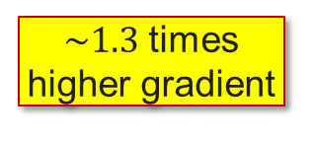

120 C modified baking: new discovery
UP TO $\sim 49 MV/m$
$\sim 1.3$ times higher gradient
A. Grassellino et al., to be published (2018)

Slide 15
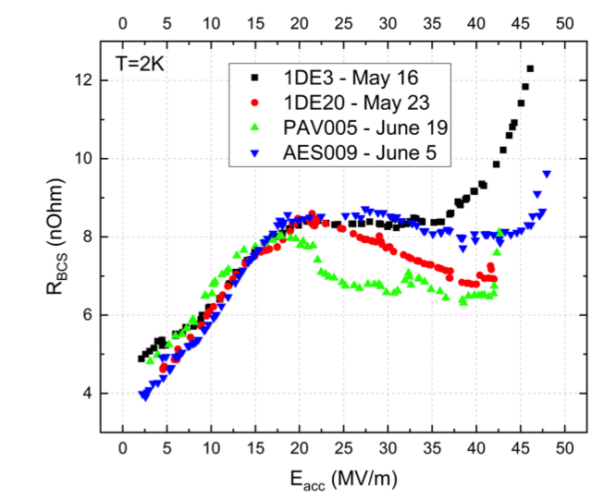
Next surprise: the BCS resistance is ~ as 120C N infused
A. Grassellino et al, https://arxiv.org/abs/1806.09824
BCS surface resistance is lowered compare to standard 120C baking
Residual resistance comparable with standard 120C baking

Slide 16
High-Q preservation: from vertical test to cryomodule

Slide 17
Surface resistance contributions
$$R_{s}\left(T, B\right)=R_{BCS}\left(T\right)+R_{0}{+ R}_{fl}\left(B\right)$$

Slide 18
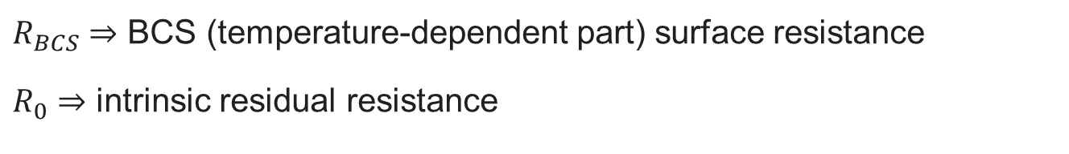
Surface resistance contributions
$$R_{s}\left(T, B\right)=R_{BCS}\left(T\right)+R_{0}{+ R}_{fl}\left(B\right)$$
$R_{BCS}$ ⇒ BCS (temperature-dependent part) surface resistance
$R_{0}$ ⇒ intrinsic residual resistance
These contributions don’t change from vertical test to cryomodule, they only depends on material properties, surface treatment and temperature

Slide 19
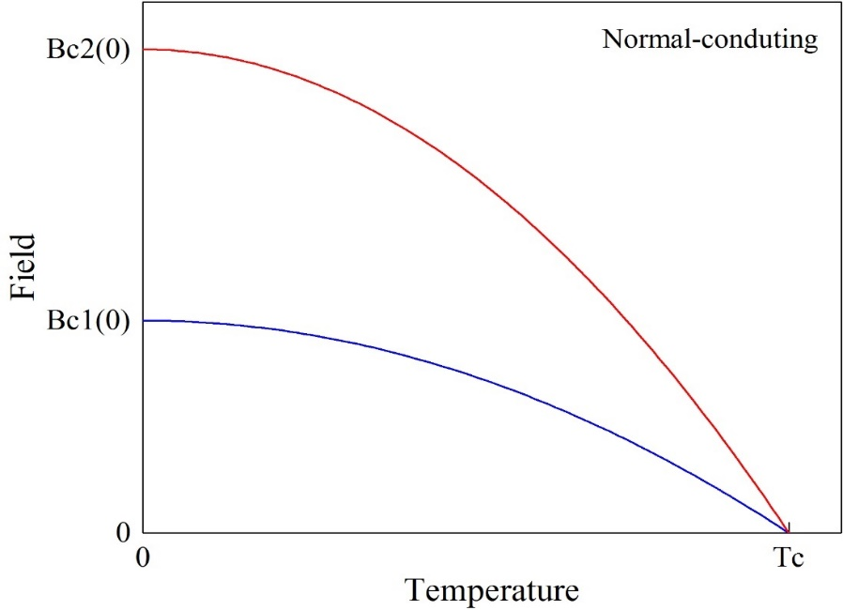
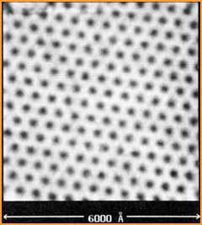

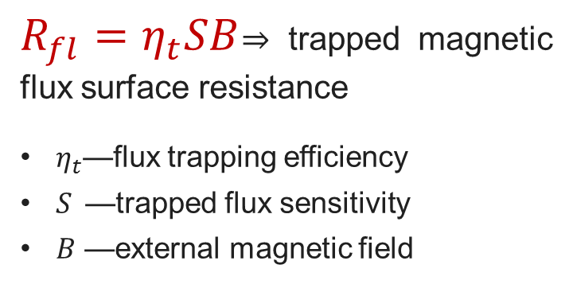
Surface resistance contributions
$$R_{s}\left(T, B\right)=R_{BCS}\left(T\right)+R_{0}{+ R}_{fl}\left(B\right)$$
$R_{fl}=η_{t}SB$⇒ trapped magnetic flux surface resistance
$η_{t}$—flux trapping efficiency
$S$—trapped flux sensitivity
$B$ —external magnetic field
H. F. Hess et al., Phys. Rev. Lett. 62, 214 (1989)
$$B$$
Cooldown
Flux trapping efficiency and the amount of external magnetic field can significant change from vertical test to cryomodule, affecting the surface resistance depending on the trapped flux sensitivity

Slide 20

Trapped flux surface resistance
$$R_{s}\left(2 K,B\right)={R_{BCS}\left(2 K\right)+R}_{0}+R_{fl}(B)$$
$$R_{fl}={B η}_{t} S$$
These losses can be reduced by minimizing these contributions:
$$B$$
𝐵
Magnetic shielding/hygiene improvement
$$η_{t}$$
𝜂_𝑡
Fast Cooling
Material Optimization
S
Optimizing surface treatment (mean free path)

Slide 21

Trapped flux surface resistance
$$R_{s}\left(2 K,B\right)={R_{BCS}\left(2 K\right)+R}_{0}+R_{fl}(B)$$
$$R_{fl}={B η}_{t} S$$
These losses can be reduced by minimizing these contributions:
External magnetic field
$$B$$
𝐵
Magnetic shielding/hygiene improvement
$$η_{t}$$
𝜂_𝑡
Fast Cooling
Material Optimization
S
Optimizing surface treatment (mean free path)

Slide 22
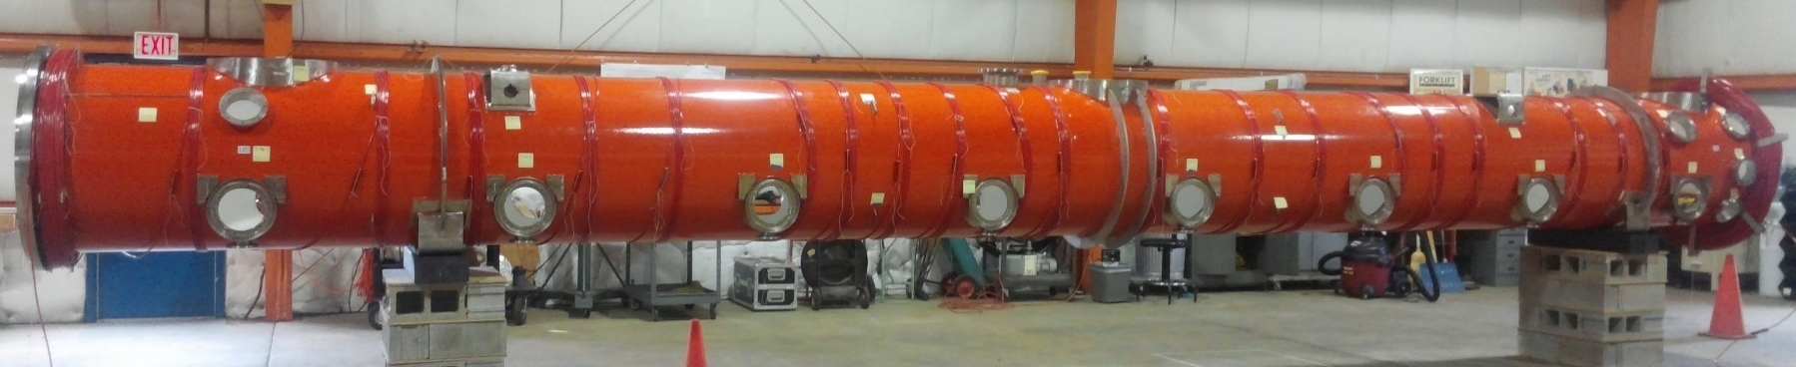
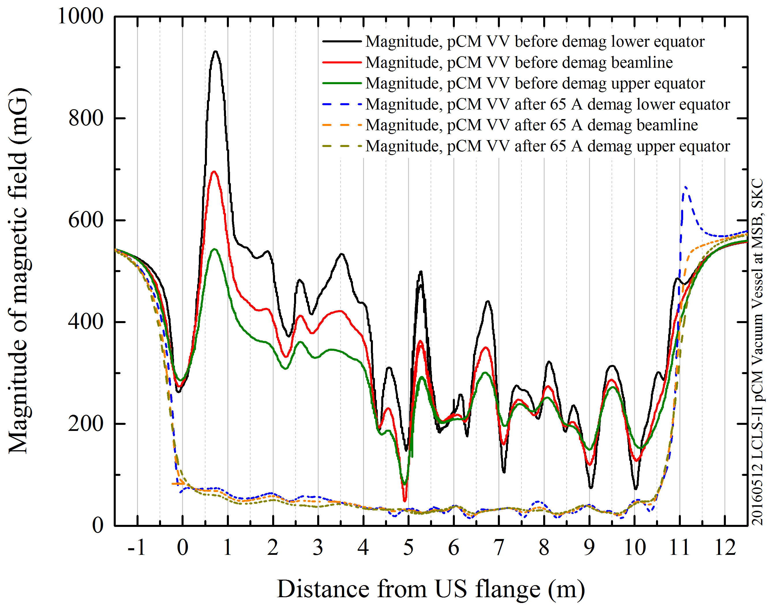
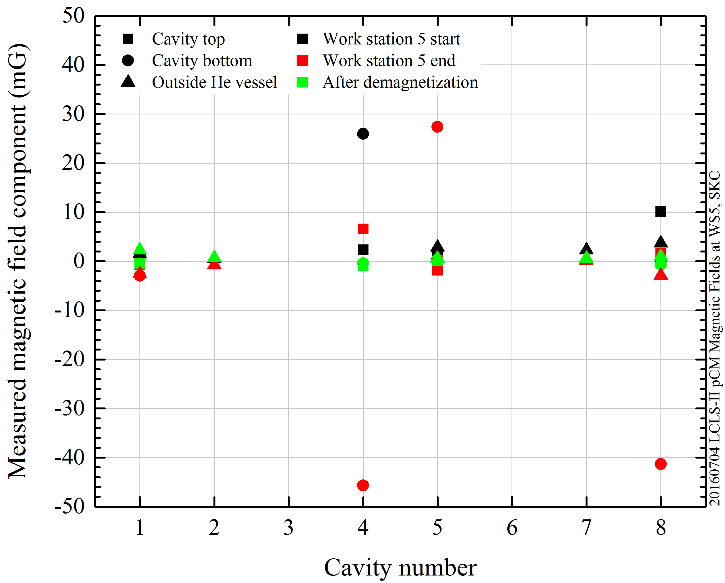
Minimization of remnant field in LCLS-II pCM
Coils for magnetic field demagnetization
Empty vacuum vessel
Assembled Cryomodule
Demagnetization
Demagnetization

Slide 23
Trapped flux surface resistance
$$R_{s}\left(2 K,B\right)={R_{BCS}\left(2 K\right)+R}_{0}+R_{fl}(B)$$
$$R_{fl}={B η}_{t} S$$
These losses can be reduced by minimizing these contributions:
$$B$$
𝐵
Magnetic shielding/hygiene improvement
$$η_{t}$$
𝜂_𝑡
Fast Cooling
Material Optimization
S
Optimizing surface treatment (mean free path)
Flux Trapping Efficiency

Slide 24
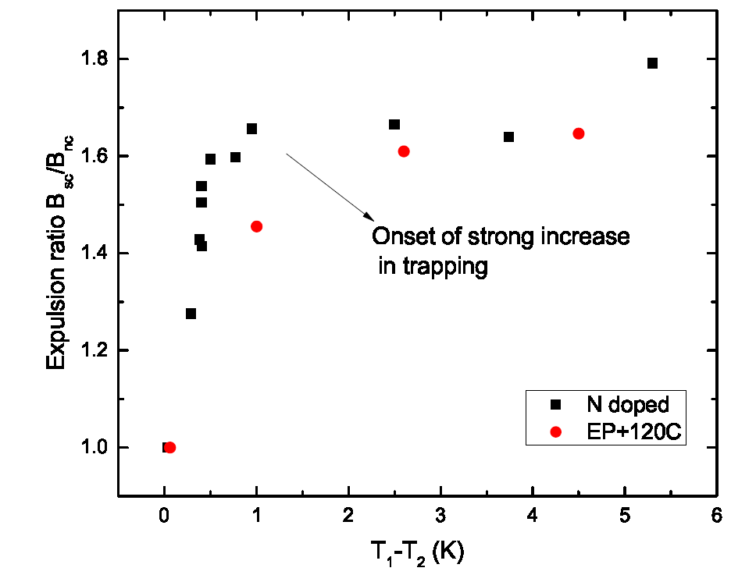
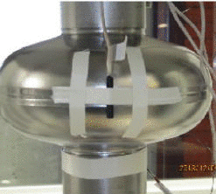
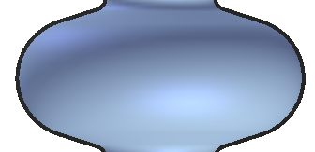
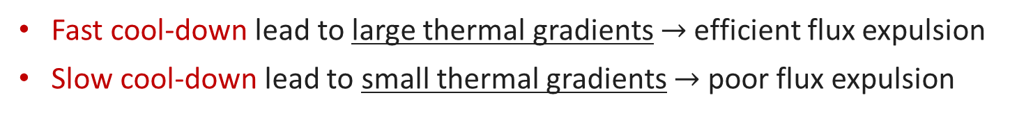
Fast cooldown helps flux expulsion
Fast cool-down lead to large thermal gradients $→$ efficient flux expulsion
Slow cool-down lead to small thermal gradients $→$ poor flux expulsion
T₁
B_{sc}/B_{nc}
Q₀
T₂
Efficient flux expulsion
All flux trapped
B_{sc}/B_{nc}=1.74 after complete Meissner effect
A. Romanenko et al., Appl. Phys. Lett. 105, 234103 (2014)
A. Romanenko et al., J. Appl. Phys. 115, 184903 (2014)
D. Gonnella et al, J. Appl. Phys. 117, 023908 (2015)
M. Martinello et al., J. Appl. Phys. 118, 044505 (2015)
S. Posen et al., J. Appl. Phys. 119, 213903 (2016)
S. Huang, Phys. Rev. Accel. Beams 19, 082001 (2016)
B_{sc}/B_{nc}=1 after full flux trapping

Slide 25
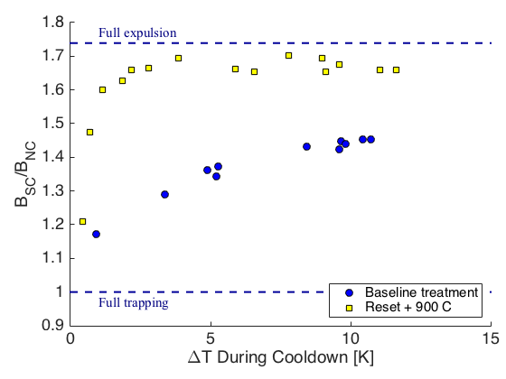
High T baking for flux expulsion improvement
Not all materials show good flux expulsion even with large thermal gradient
High T treatments are capable to improve materials flux expulsion properties
Full expulsion
Full expulsion
Full trapping
Full trapping
S. Posen et al., J. Appl. Phys. 119, 213903 (2016)

Slide 26
High T baking for flux expulsion improvement
Not all materials show good flux expulsion even with large thermal gradient
High T treatments are (usually) capable to improve materials flux expulsion properties
Full expulsion
Full expulsion
After 900C
After 1000C
Full trapping
Full trapping
S. Posen et al., J. Appl. Phys. 119, 213903 (2016)

Slide 27
Trapped flux surface resistance
$$R_{s}\left(2 K,B\right)={R_{BCS}\left(2 K\right)+R}_{0}+R_{fl}(B)$$
$$R_{fl}={B η}_{t} S$$
These losses can be reduced by minimizing these contributions:
$$B$$
𝐵
Magnetic shielding/hygiene improvement
$$η_{t}$$
𝜂_𝑡
Fast Cooling
Material Optimization
S
Optimizing surface treatment (mean free path)
Trapped Flux Sensitivity

Slide 28
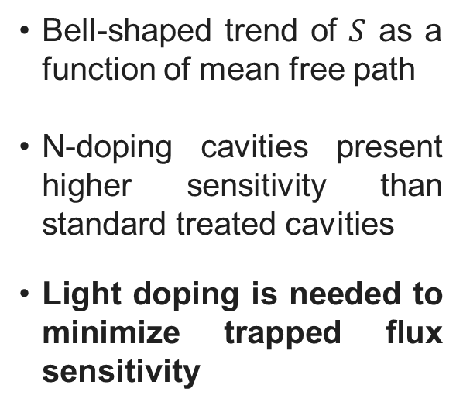
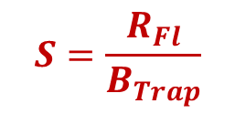
Light doping to minimize trapped flux sensitivity
Trapped flux sensitivity:
$$S=\frac{R_{Fl}}{B_{Trap}}$$
Bell-shaped trend of $S$ as a function of mean free path
N-doping cavities present higher sensitivity than standard treated cavities
Light doping is needed to minimize trapped flux sensitivity
M. Martinello et al., App. Phys. Lett. 109, 062601 (2016)

Slide 29
Status of SRF Technology for PIP-II

Slide 30
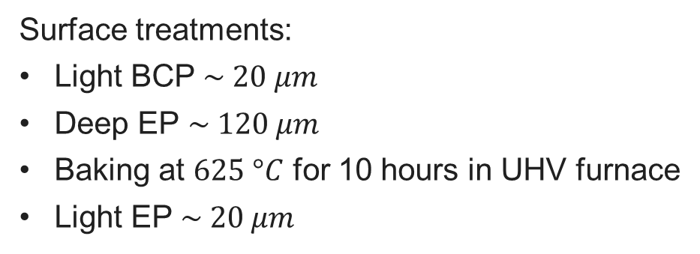
162.5 MHz Half-Wave Resonators
Surface treatments:
Light BCP $\sim 20 μm$
Deep EP $\sim 120 μm$
Baking at $625 °C$ for 10 hours in UHV furnace
Light EP $\sim 20 μm$
Bare HWR before jacketing
Bulk and light EP of jacketed HWR @ ANL
*HWR technology developed at ANL via ANL/FNAL PIP-II Collaboration.
Z. Conway, A. Barcikowski, S. Gerbik, C. Hopper, M.P. Kelly, M. Kedzie, S. Kim, P. Ostroumov, T. Reid.

Slide 31
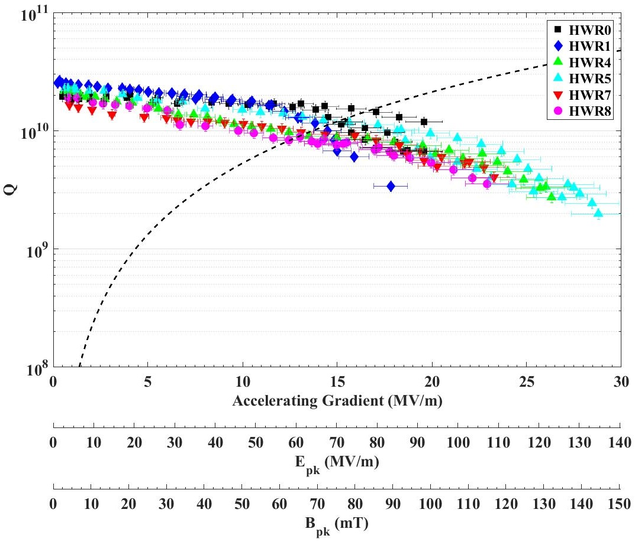
HWR 2 K Test Results
Curtesy of A. Lunin and Z. Conway
PIP-II specs

Slide 32
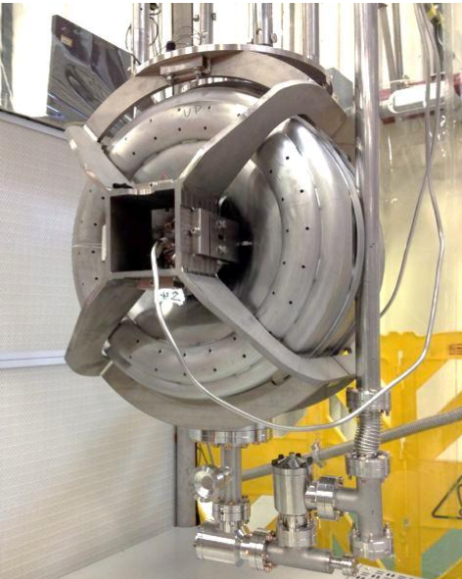
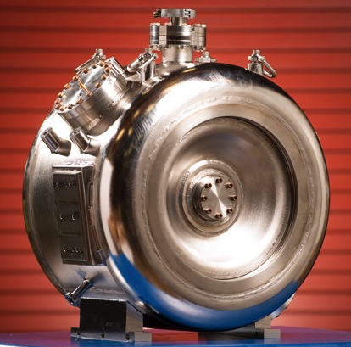
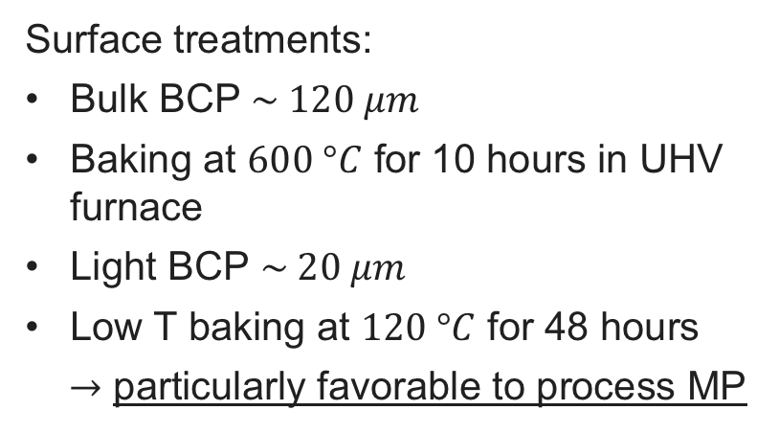
SSR1: 325 MHz Single Spoke Resonators
Surface treatments:
Bulk BCP $\sim 120 μm$
Baking at $600 °C$ for 10 hours in UHV furnace
Light BCP $\sim 20 μm$
Low T baking at $120 °C$ for 48 hours
$→$ particularly favorable to process MP
L. Ristori, M.H. Awida ,P. Berrutti, T.N. Khabiboulline, M. Merio, D. Passarelli, A. Rowe, D.A. Sergatskov, A.I. Sukhanov, Proc. of IPAC 2013, Shangai, China

Slide 33
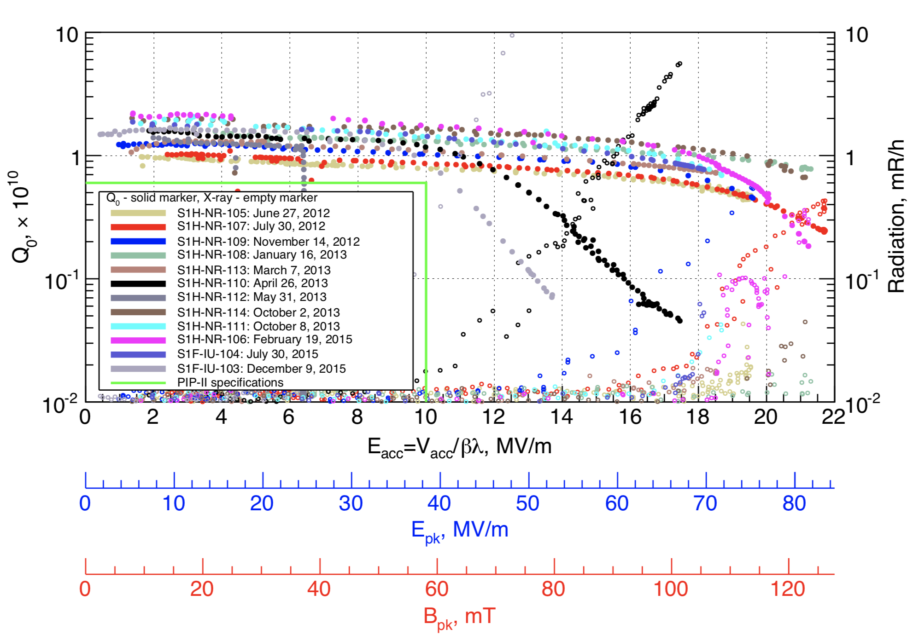
SSR1 VTS Test Result
Curtesy of A. Sukanov
PIP-II
specs

Slide 34
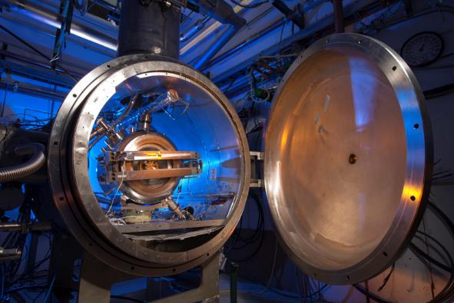
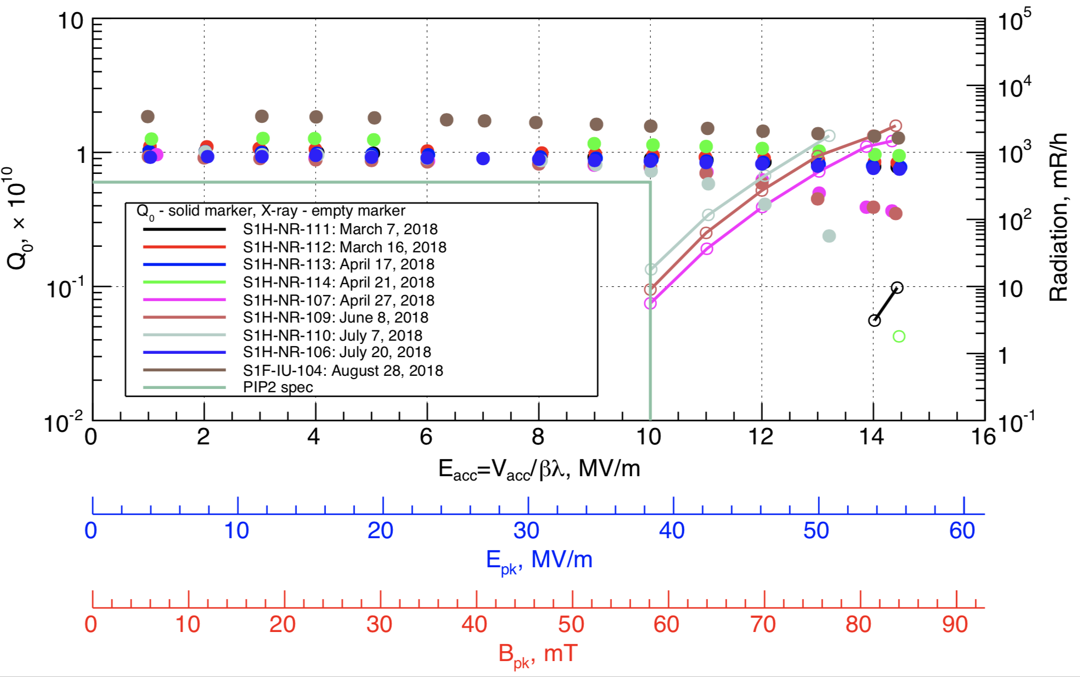
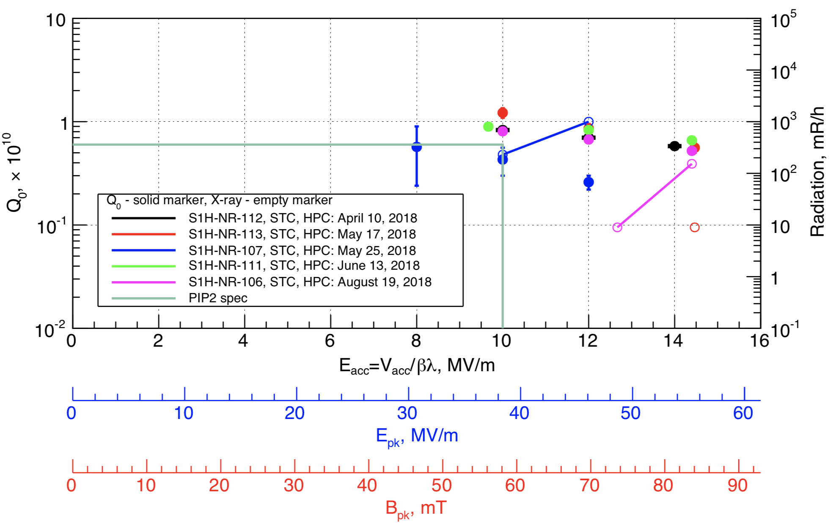
Fully-Integrated Tests in STC
9 cavities pre-qualified after test at STC with low power coupler
Some degradation observed between VTS test and STC test that may be due to flux trapping -> some studies are being carried out to better understand trapped flux sensitivity in SSR cavities
5 cavities tested with high power coupler → cavities meet spec and are now waiting for string assembly
STC tests with low power coupler
STC tests with high power coupler
PIP-II
specs
Courtesy of A. Sukhanov

Slide 35
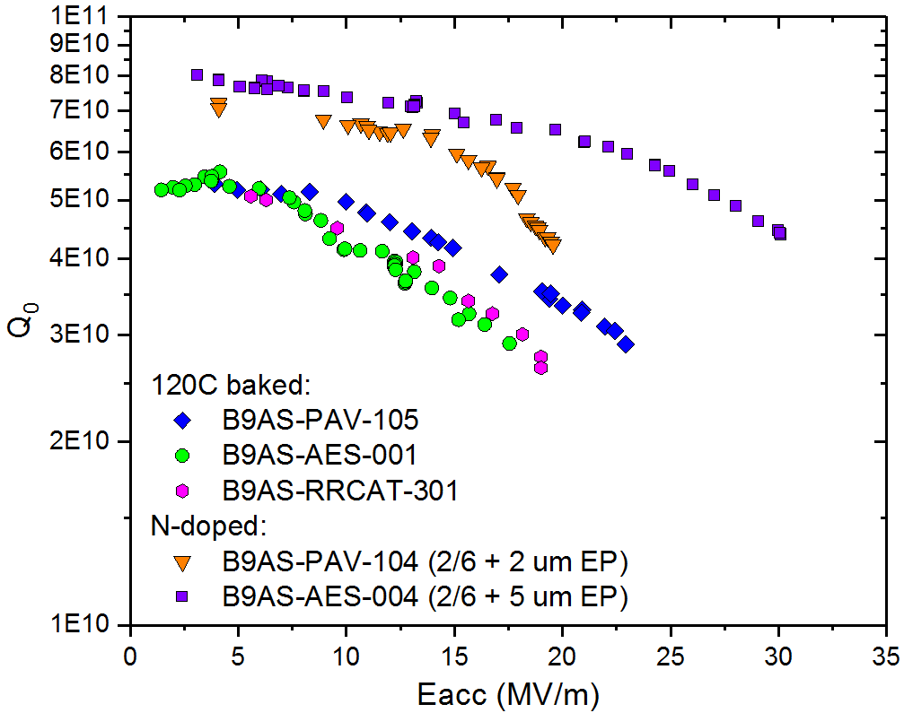
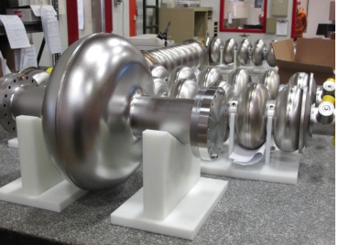
HB650 Single-cell Test Results
120C baked cavities not always meet specs
N-doping capable to double the Q-factor at medium field, sometimes affected by early quench
World record Q-factor of 7e10 at 2K,17 MV/m and 650 MHz with N-doping
PIP-II
specs

Slide 36
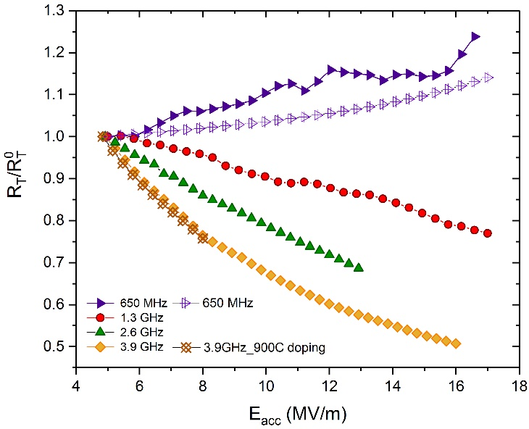
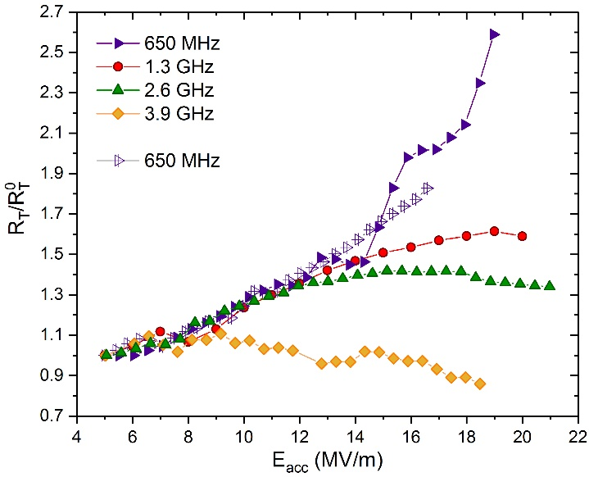
Frequency dependence of R_{BCS}(Eacc)
N-doping
650 MHz cavities
N-doped cavities at 650 MHz do not show the R_{T} reversal (anti-Q-slope) typically observed at 1.3 GHz
The physical mechanism underneath the reversal of R_{BCS} (here called R_{T}) has a stronger effect at high frequencies
120C baking
Also for 120C baked cavities, the field dependence of R_{T} is unfavorable at low frequencies
M. Martinello et al. SRF 2017 (TUYAA02), IPAC 2018 (WEPML013)

Slide 37
HB650 Single-cell R&D program
Because of the recent significant improvement in the SRF technology, now we started an intensive R&D program for 650 MHz cavities
  GOAL: reach the highest possible Q at medium/high field for 650 MHz cavities
  Flux expulsion and trapped flux sensitivity will be also taken into account for Q preservation in cryomodule
Surface treatments under studies: EP, BCP for baseline and modified 120C (75-120C baking), N-doping, N-infusion for Q improvement
Trapped flux sensitivity will be acquired for each treatment to understand magnetic flux shielding requisition in cryomodule

Slide 38
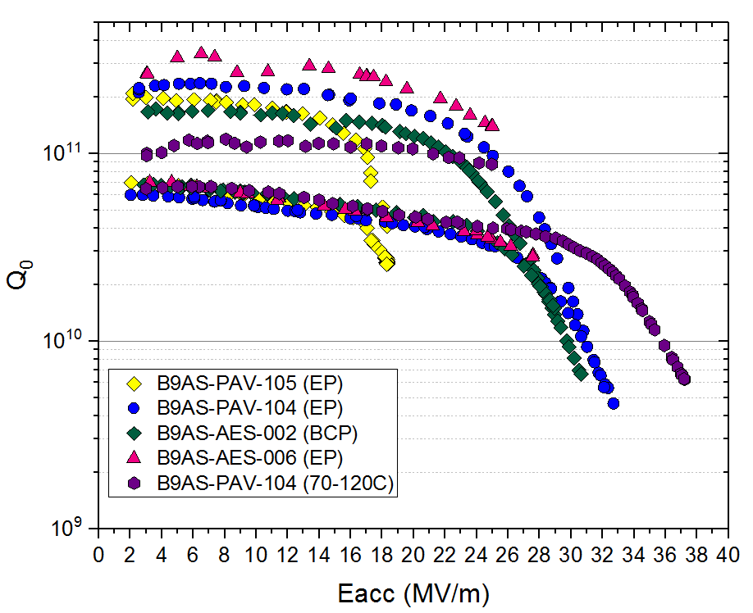
Summary RF results of 650 MHz cavities new R&D program
T=1.4 K
T=2 K

Slide 39
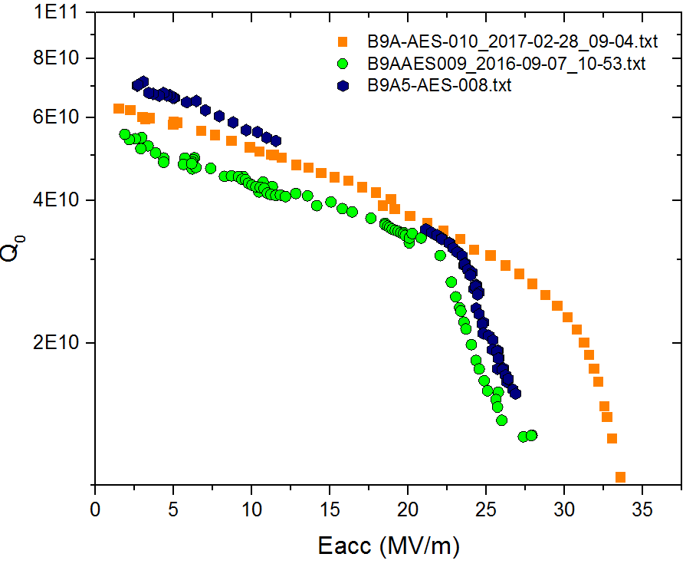
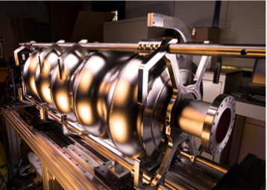
HB650 5-cells Tests Results (all N-doped + “heavy” EP)
Light N-doping applied to 650 MHz cavities
3 N-doped 5-cells 650 MHz cavities meet PIP-II specification
B9A-AES-010 is now being dressed with He vessel
B9A-AES-010
B9A-AES-009
B9A-AES-008
PIP-II
specs

Slide 40
Conclusion and Future plan
Thanks to recent advance in the SRF technology, several treatments are suitable for high-Q at medium/high gradient
Since the field dependence of Rbcs strictly varies with frequencies, N-doping in 650 MHz cavities is not as effective as in 1.3 GHz cavities
The optimal surface treatment for 650 MHz cavities is therefore under investigation, taking into account the needed for low trapped flux sensitivity at medium field
Trapped flux sensitivity and flux expulsion to be studied to set specification of magnetic field shielding
HWR and SSR cavities meet PIP-II spec with standard BCP/baking treatment -> R&D is planned to further improve Q in SSR2 cavities

Slide 41
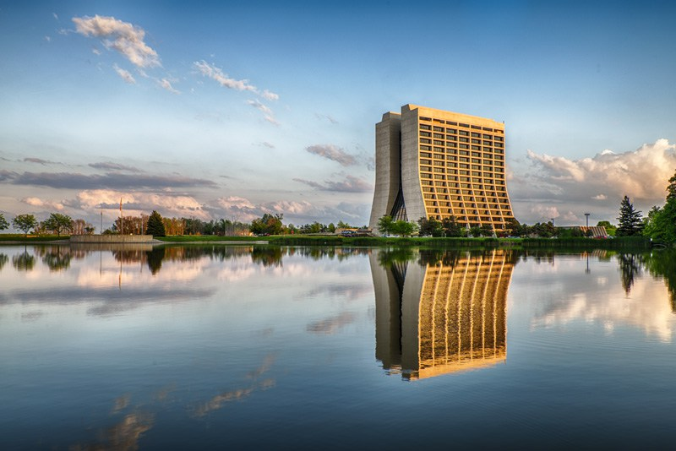
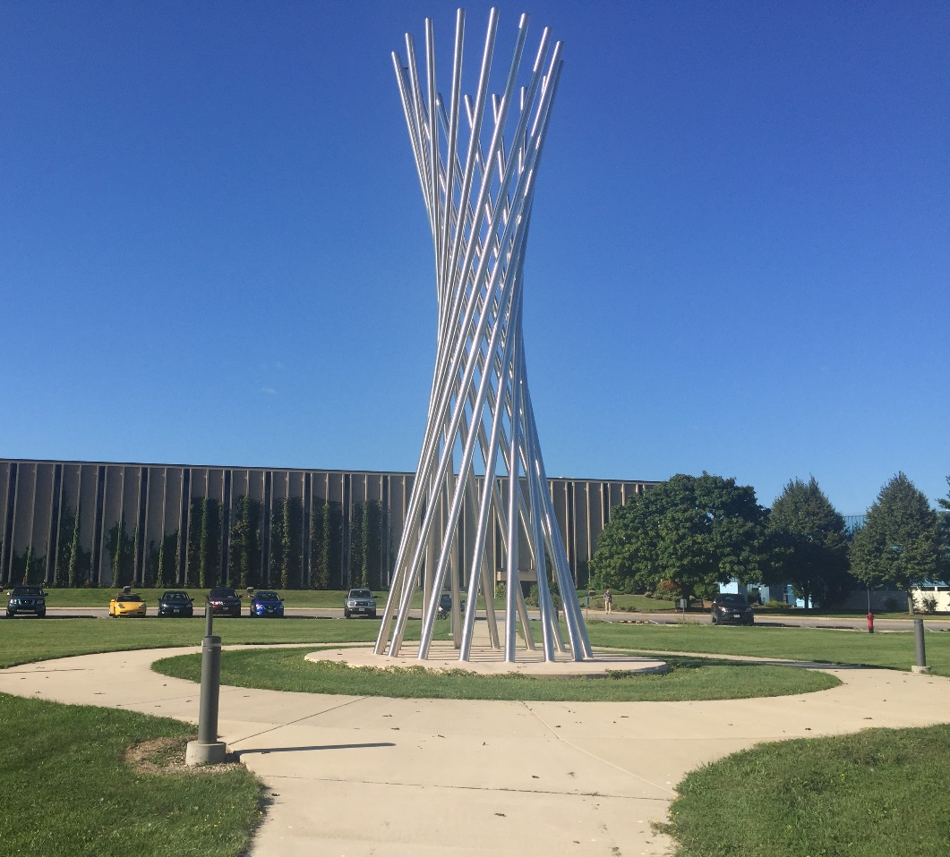

Thank you for your attention!

