Slide 1
SSR1 Cryomodule String Assembly
Leonardo Ristori – on behalf of the SSR1 team
Slides by Mattia Parise
International Workshop on Cryomodule Design and Standardization
BARC, Mumbai 4-7 September 2018

Slide 2
Outline
String overview
Rail system
Beamline bellows
Assembly of solenoid-BPM group
Nitrogen purging studies
Recent improvements

Slide 3
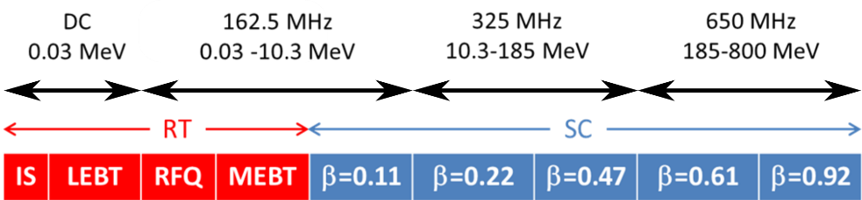
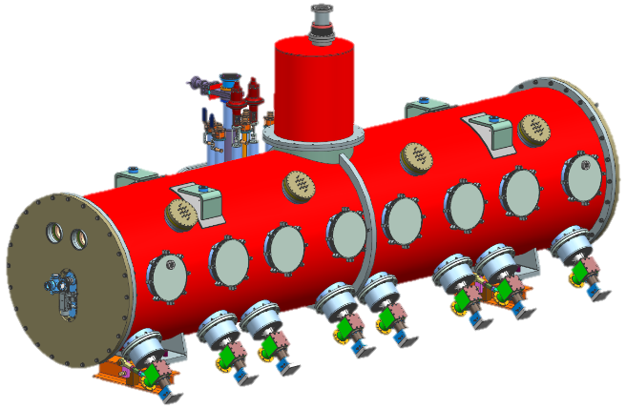
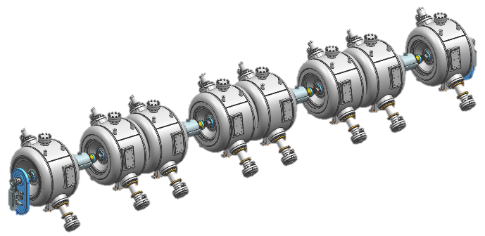
SSR1 cryomodule for PIP-II
PIP-II Linac
SSR1
SSR1 cryomodule
SSR1 cavity string

Slide 4
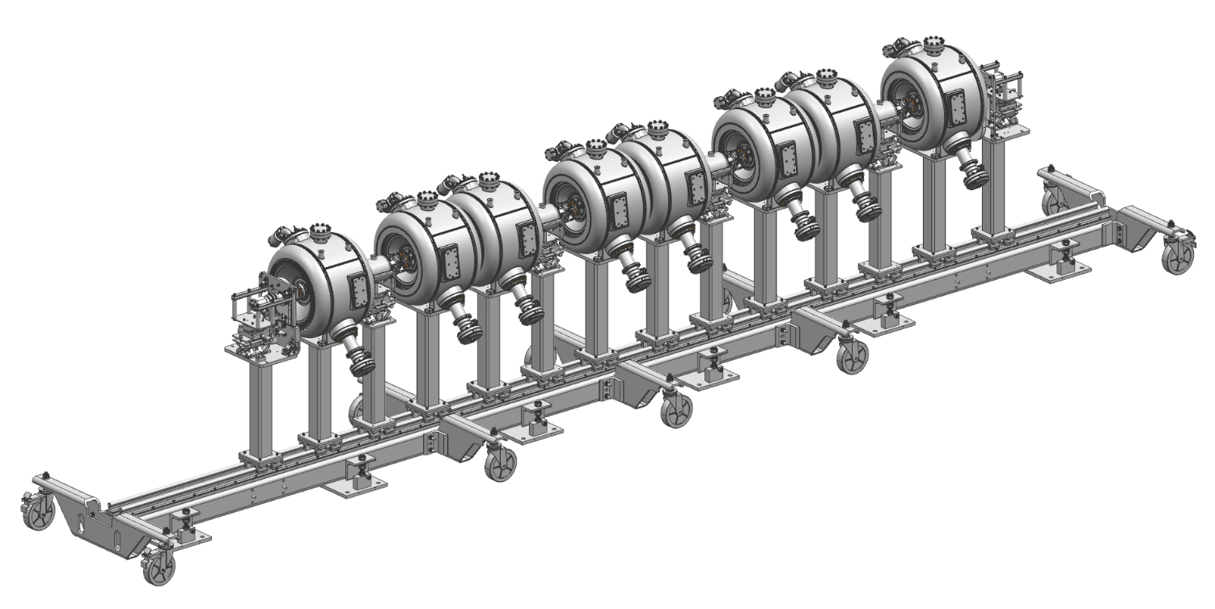
SSR1 string overview – Rail system
Completed string ready to roll out of cleanroom
Rail system is new design adapted for SSR and new facility
Load, deflection and moving tests all successful

Slide 5
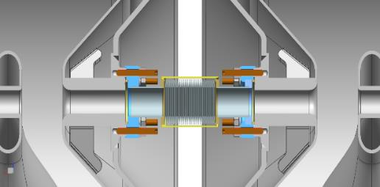
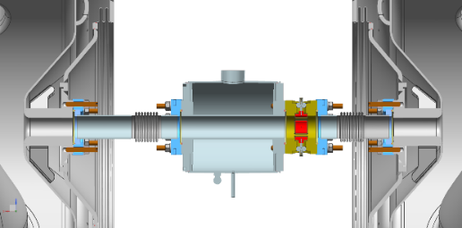
SSR1 string overview – Assembly oriented design
20
mm
Interconnection cavity-cavity
Type
B
Gate Valve
Type
B
Type
A
Edge-welded bellows
Type
B
Type
A
Type
A
Type
B
Type
A
Gate Valve
Vacuum-end coupler
Movable rail system
Solenoid
BPM
Solenoid-BPM subassembly

Slide 6
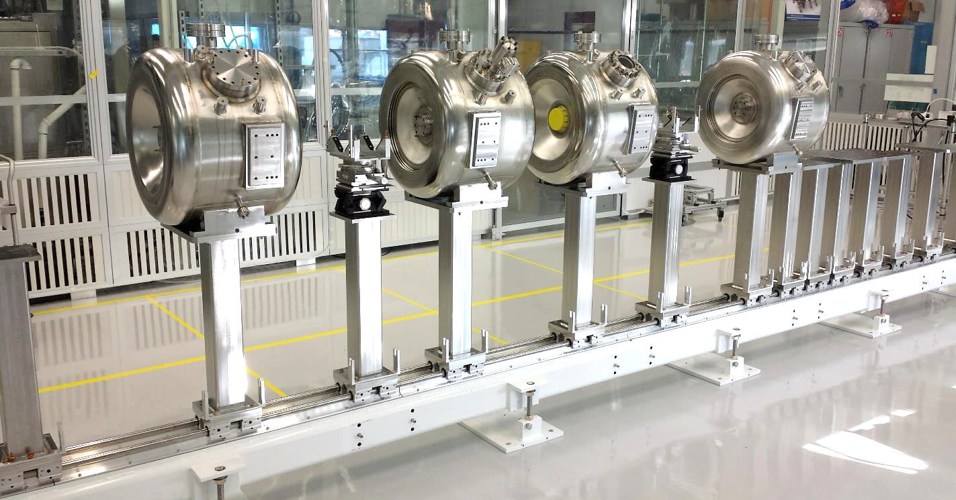
SSR1 string assembly dry-run
Dry-run of SSR1 string assembly is carried out on a half cavity string
The goal is to assess the feasibility of a cleanroom-compatible assembly

Slide 7
SSR1 string assembly dry-run
Solenoid-BPM-Bellows
Cavity connection
Cavity-cavity connection
Dry-run of SSR1 string assembly is carried out on a half cavity string
The goal is to assess the feasibility of a cleanroom-compatible assembly

Slide 8
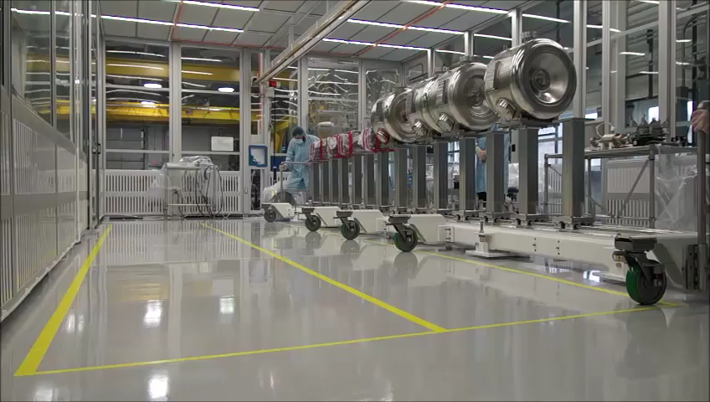
SSR1 string assembly dry-run – Movable Rail System
Rail system with string weight can be successfully moved to the desired location. The process has been repeated 5 times and final position can be achieved with an uncertainty of ~ 5 mm

Slide 9
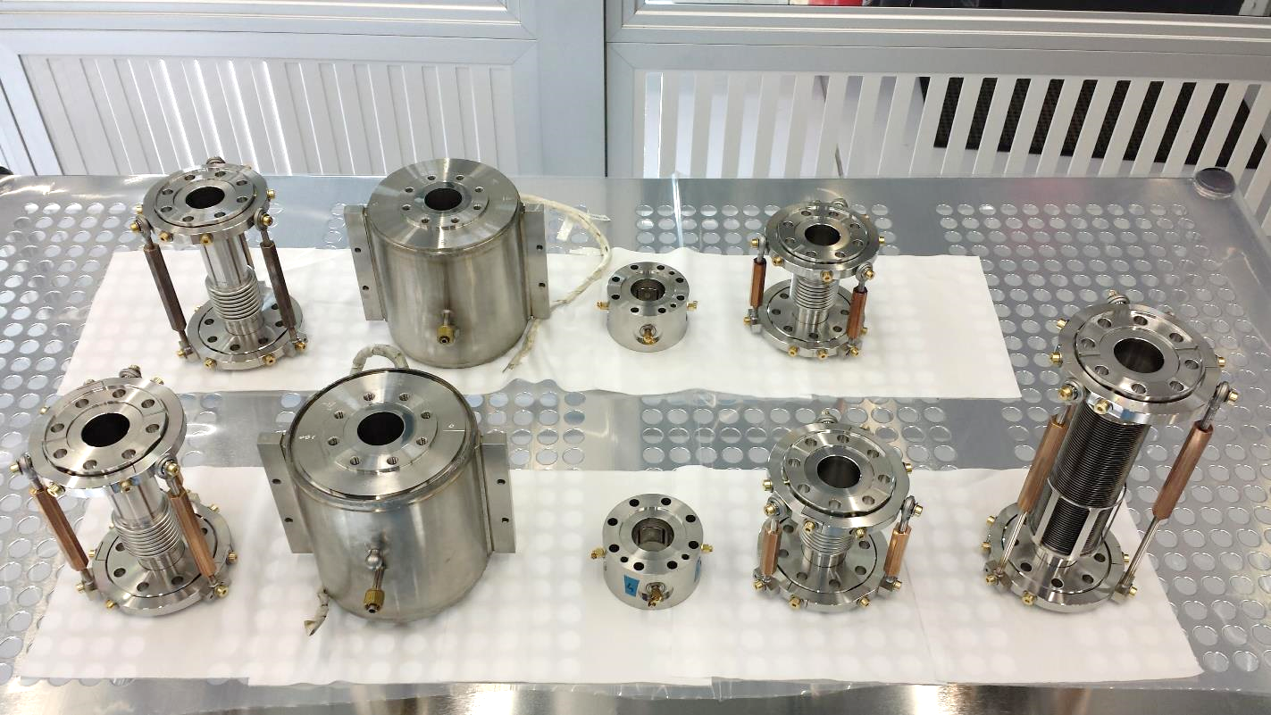
SSR1 string assembly dry-run
Cavity to solenoid bellows
Cavity to BPM bellows
Cavity to cavity bellows
Solenoids
BPMs

Slide 10
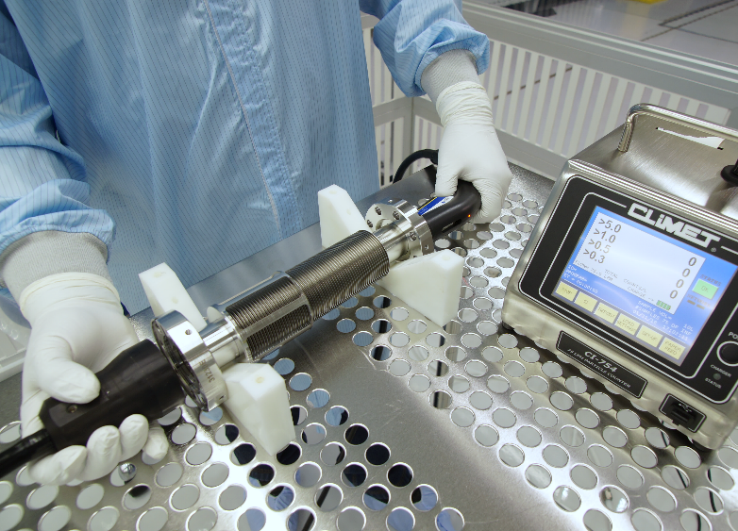
Edge welded bellows particle counts
Edge welded bellows was cleaned and brought inside class 10 cleanroom:
  30 min Liquinox (1%) + DI water ultrasonic cleaning at 50 °F
  30 min Citranox (2%) + DI water ultrasonic cleaning at 50 °F
  30 min DI water ultrasonic cleaning at 50 °F
  Handheld HPR
Particle counts of the nitrogen dried bellows approach 0 particles > 0.3 μm in less than 1 minute
3 cycles compression and extension (10 liters sample)
Time [s] | > 0.3 μm | > 0.5 μm | > 1 μm
7 | 2 | 0 | 0
14 | 2 | 1 | 0
21 | 3 | 1 | 0
28 | 1 | 0 | 0
35 | 3 | 0 | 0
42 | 1 | 0 | 0
49 | 1 | 0 | 0
56 | 1 | 0 | 0
63 | 1 | 0 | 0
70 | 1 | 0 | 0
77 | 1 | 0 | 0
84 | 0 | 0 | 0
91 | 2 | 1 | 0
Particle counts during contraction are acceptable

Slide 11
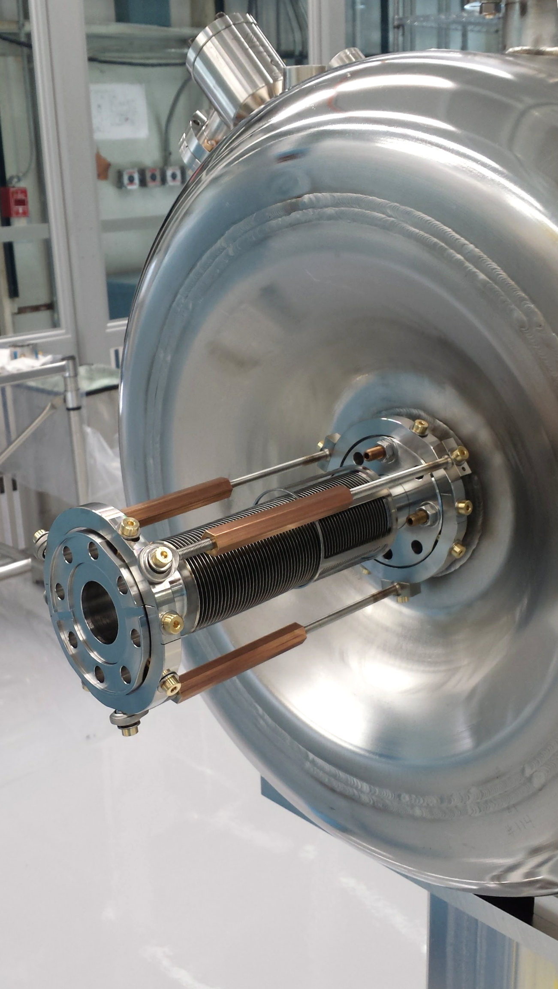
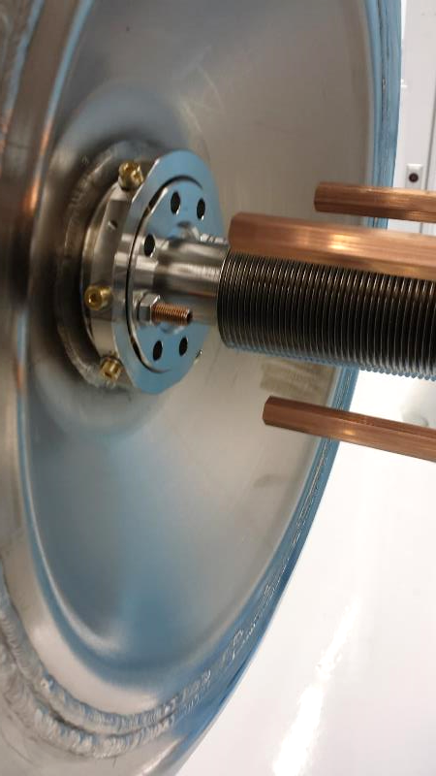
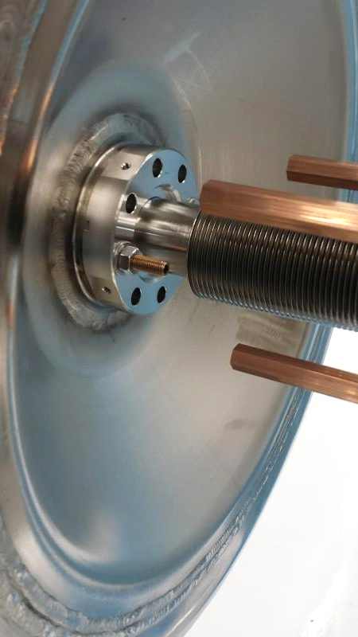
SSR1 string assembly dry-run
Bellows cage is disassembled once the cavity-cavity connection is completed

Slide 12
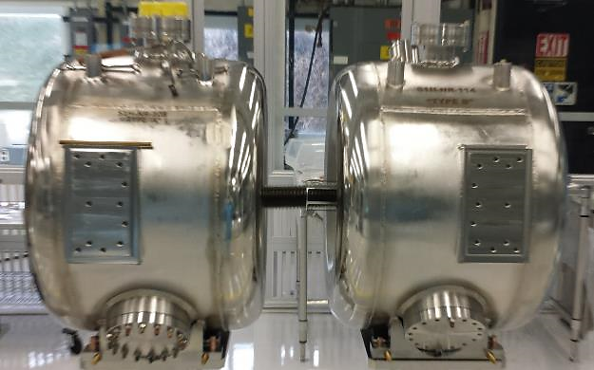
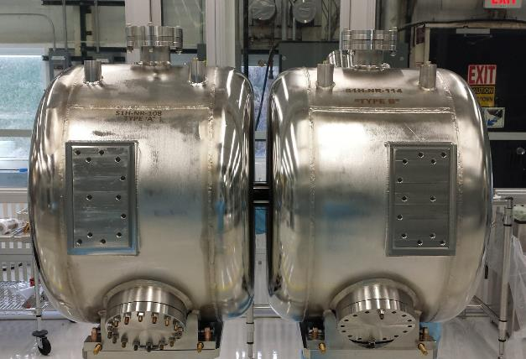
SSR1 string assembly dry-run
Edge welded bellows can be successfully assembled and bellows cage can be removed

Slide 13
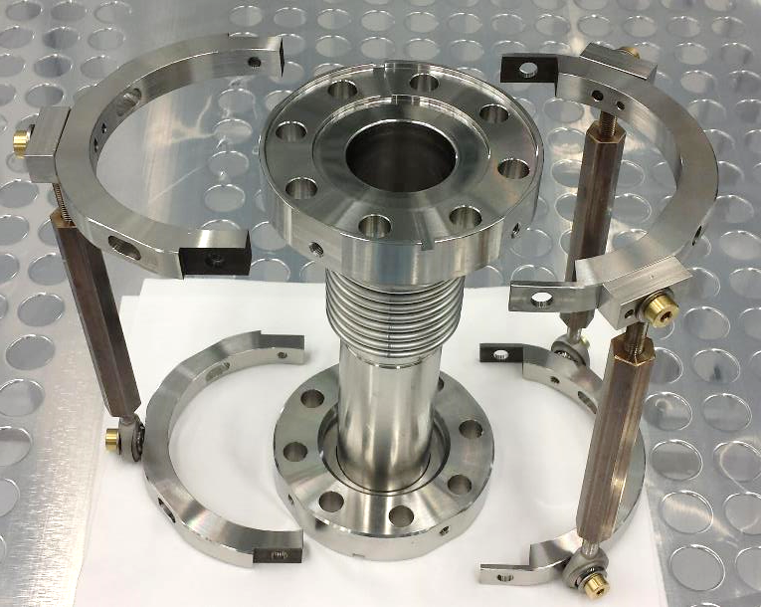
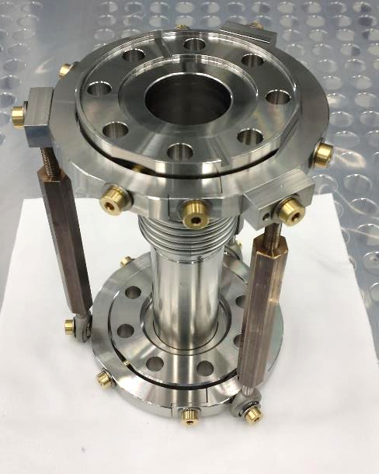
SSR1 string assembly dry-run
Bellows cages provides 2 rotational degrees of freedom at the end flange
Can be splitted in 2 halves so that can be removed prior cryomodule assembly

Slide 14
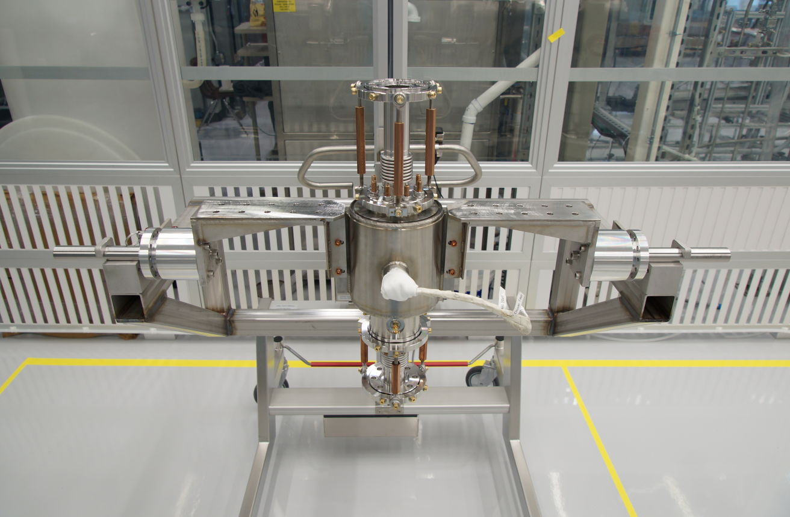
Solenoid-BPM Group
Vertical assembly facilitates handling of components
Sub-assembly can rotate 360 degrees for an easy assembly
The movable cart allows easy handling of the heavy sub-assembly

Slide 15
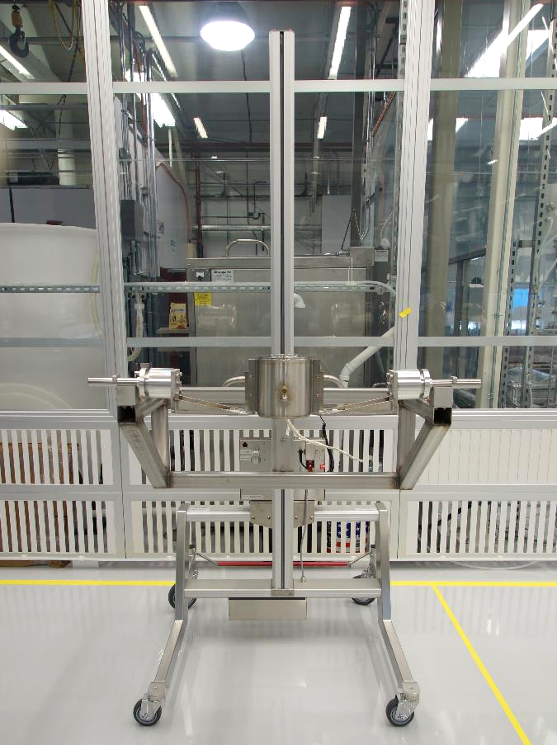
Assembly of Solenoid-BPM Group

Slide 16
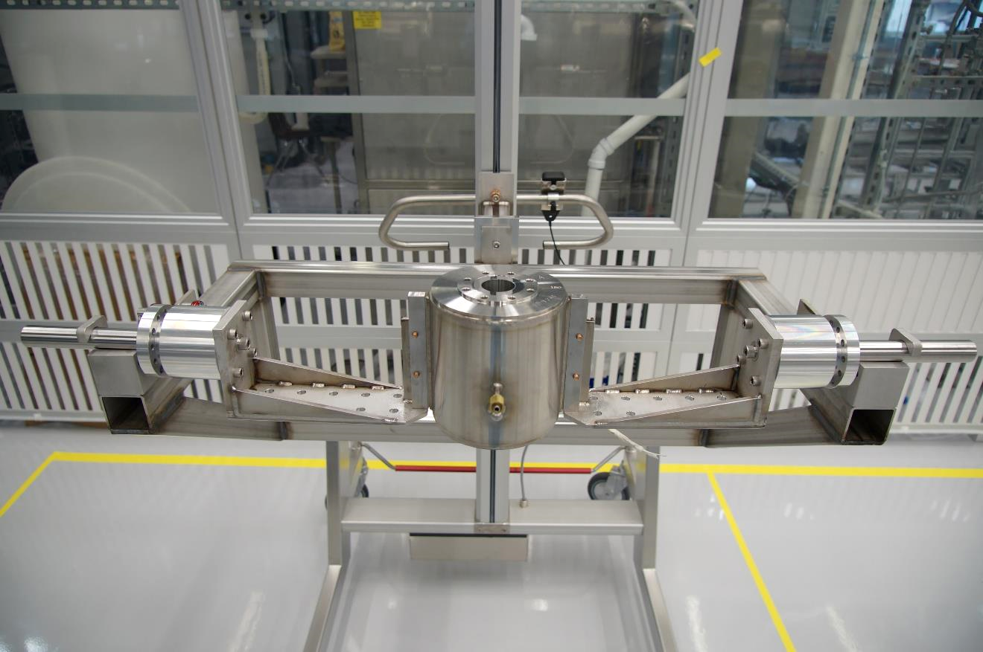
Assembly of Solenoid-BPM Group

Slide 17
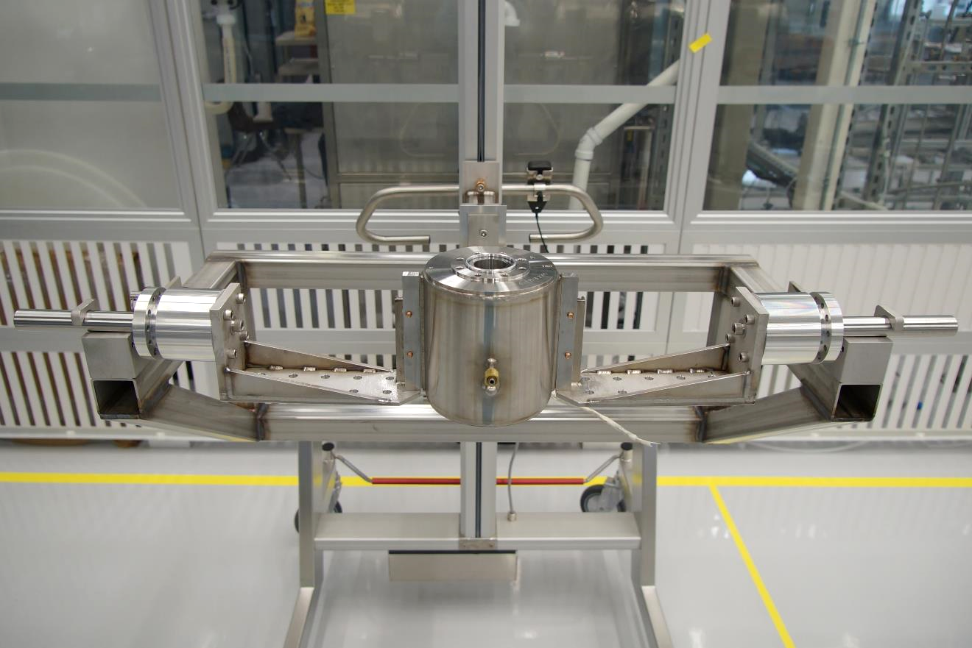
Assembly of Solenoid-BPM Group
Diamond aluminum seal

Slide 18
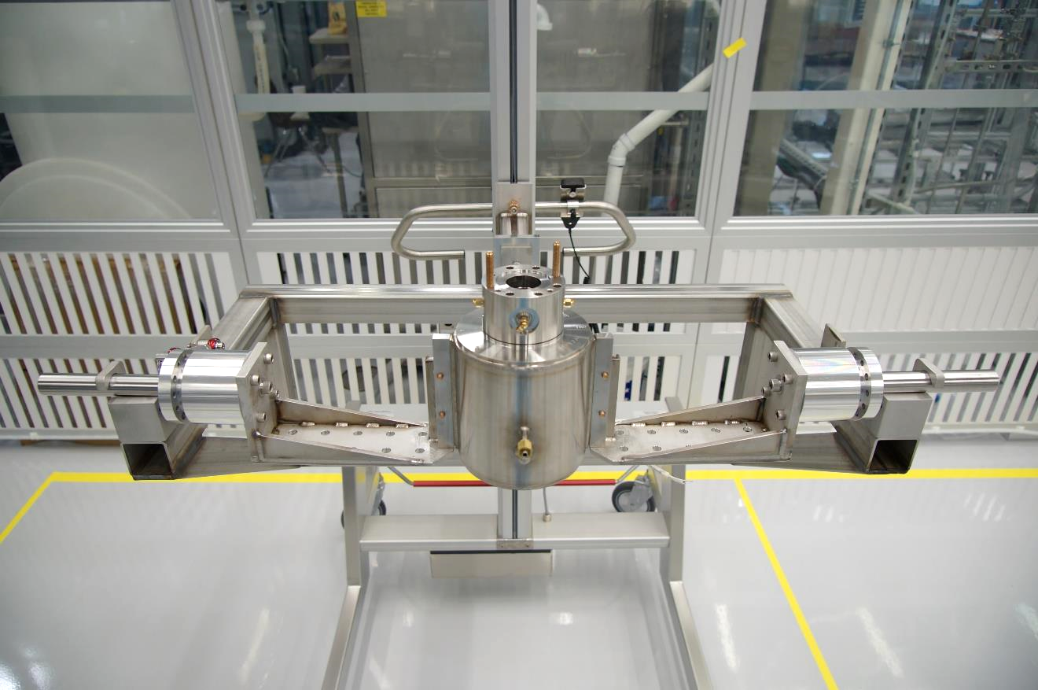
Assembly of Solenoid-BPM Group
BPM

Slide 19
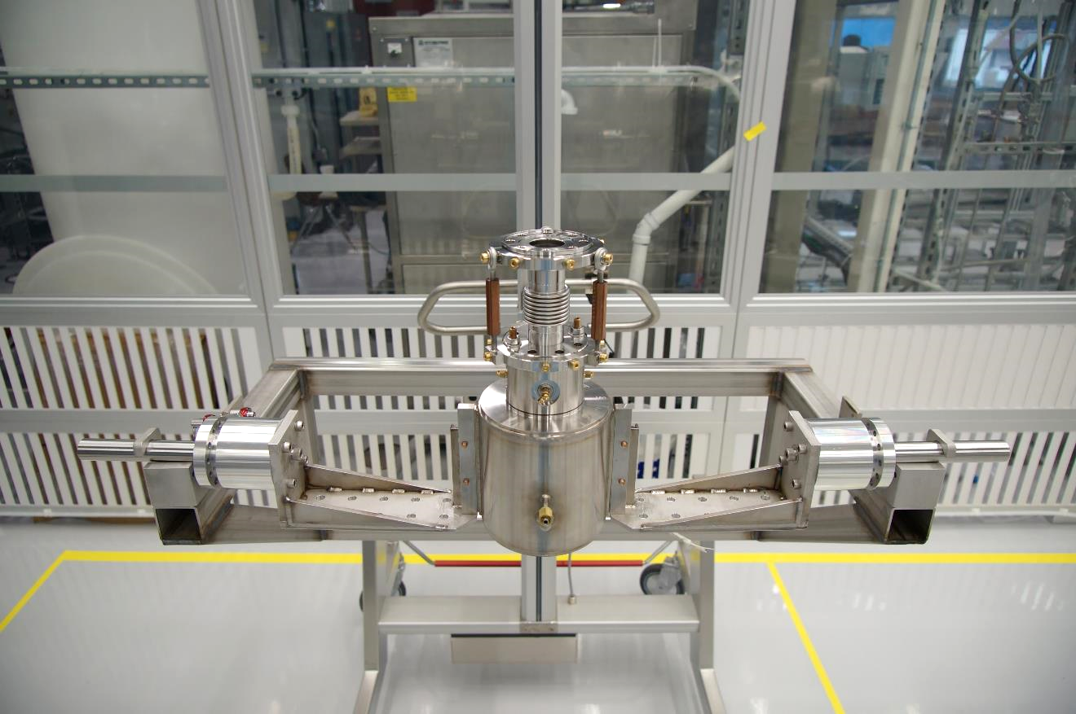
Assembly of Solenoid-BPM Group
Cavity to BPM bellows

Slide 20
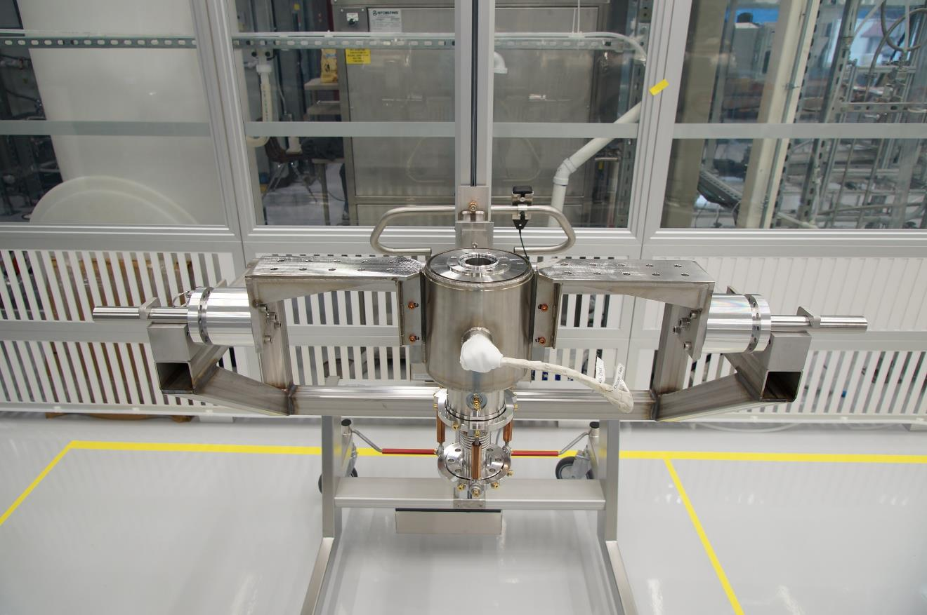
Assembly of Solenoid-BPM Group

Slide 21
Assembly of Solenoid-BPM Group

Slide 22
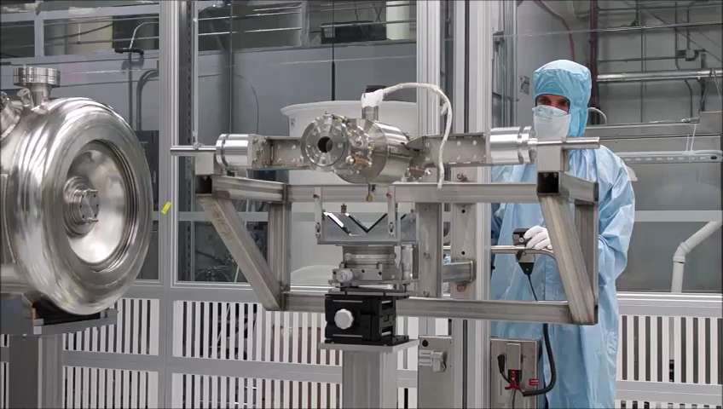
Preparation of the SSR1 string assembly dry-run
Link

Slide 23
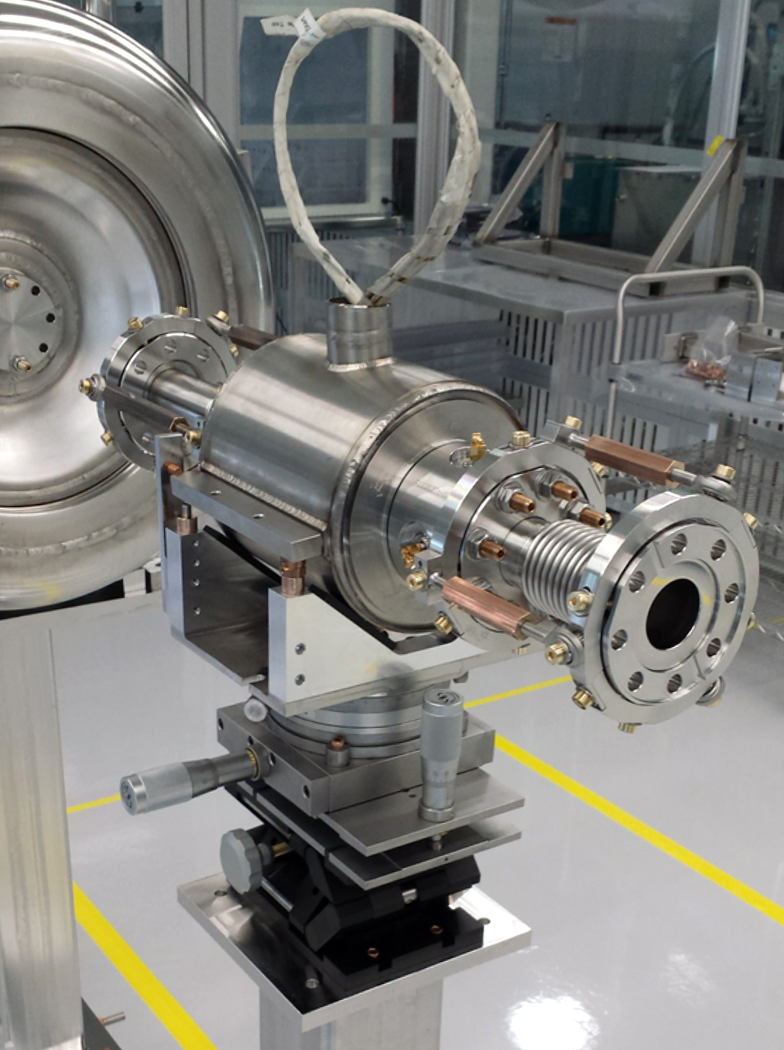
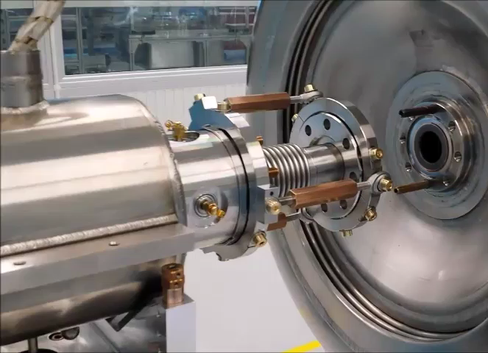
Preparation of the SSR1 string assembly dry-run
Sub - millimeter precise and reliable alignment
Easy to use system
Link

Slide 24
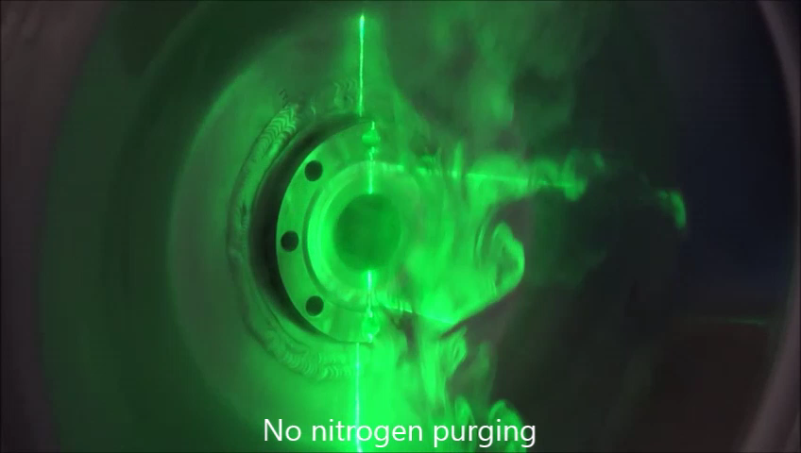
Nitrogen purging studies
Link

Slide 25
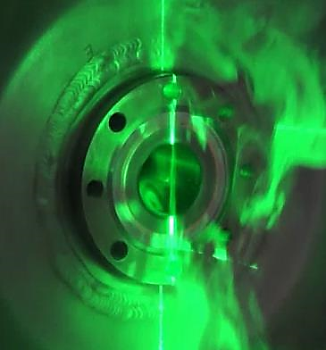
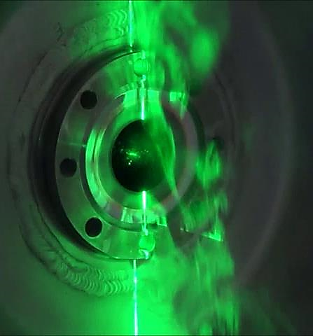
Nitrogen purging studies
No Nitrogen purging applied
Nitrogen purging at 4 SLPD purge flow speed 0.1 m/s

Slide 26
Nitrogen purging studies
No Nitrogen purging applied
Nitrogen purging at 4 SLPD purge flow speed 0.1 m/s
Back flow inside the beam pipe

Slide 27
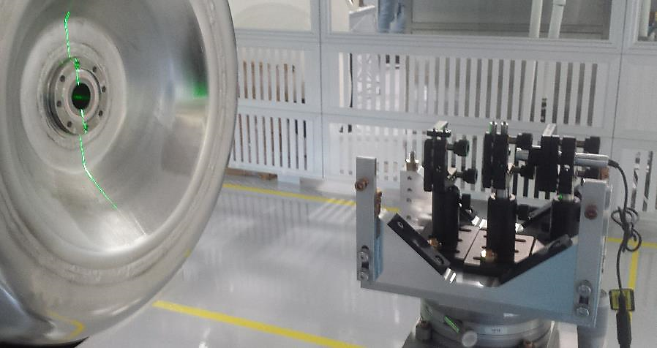
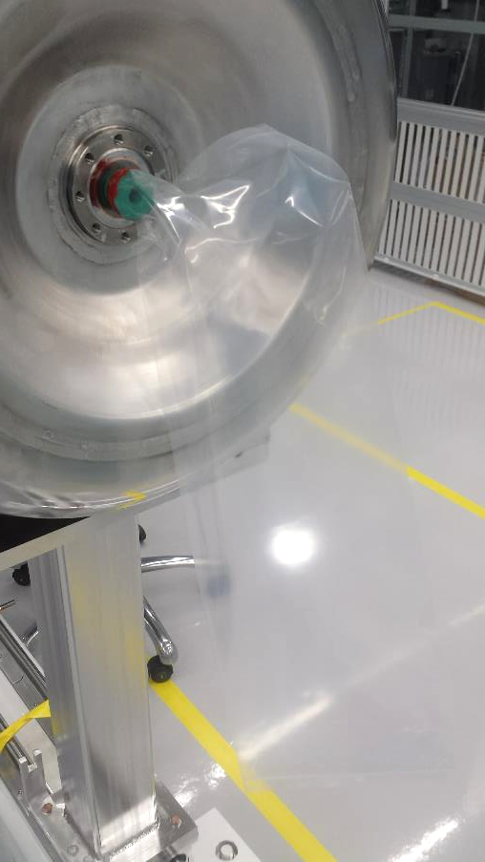
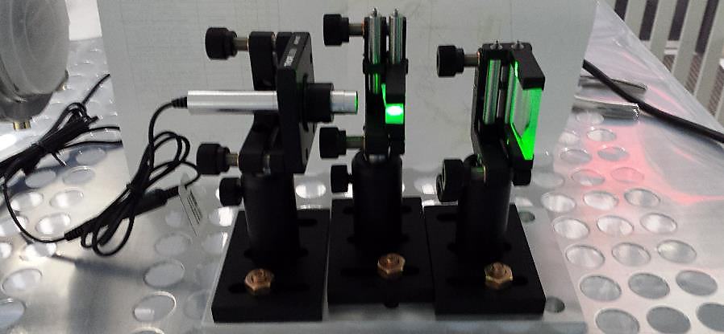
Experimental setup for purging studies

Slide 28
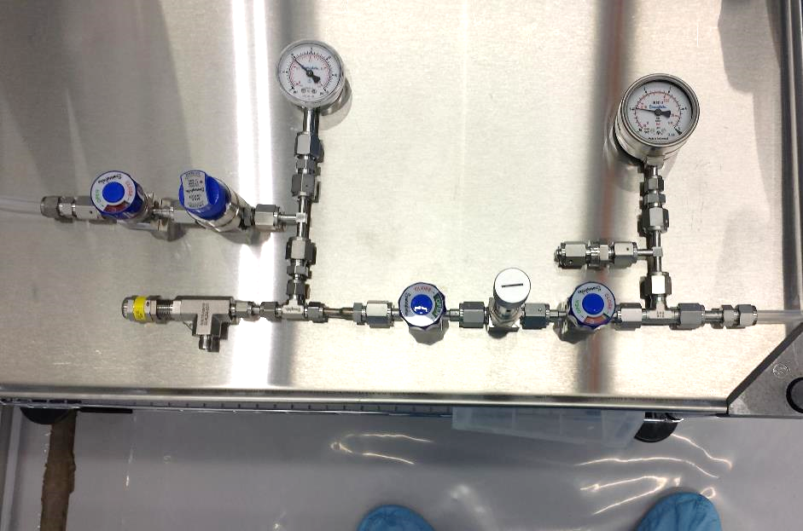
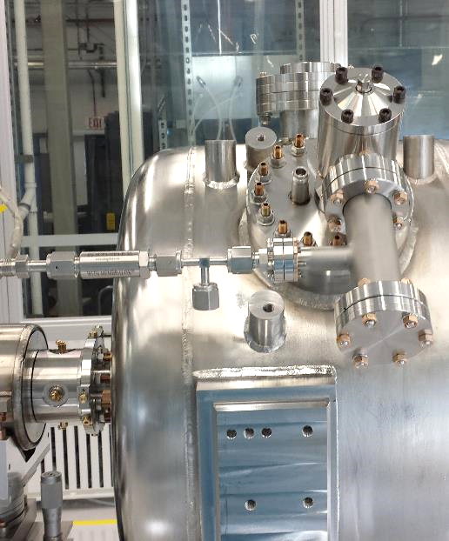
Nitrogen purging line
Nitrogen purging line can provide up to 20 SLPM
Filter is located on the cavity as last element to avoid cavity contamination
Can be manually operated
Mass Flow Controller can substitute the metering valve for a reliable soft start
High pressure gauge
Low pressure gauge
Shut-off valve
Pressure regulator
High purity filter
Pressure relief valve
Shut-off valve
Metering valve
Shut-off valve
To vacuum cart

Slide 29
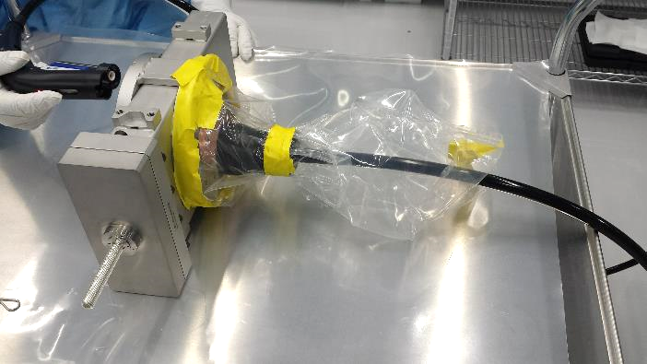
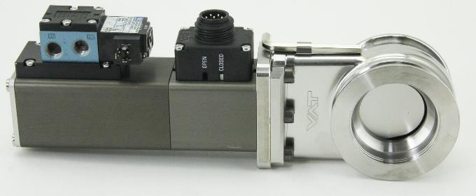
Gate valves particle counts: all metal vs Viton sealed
SSR1 Gate Valve
LCLSII All-Metal Gate Valve
Viton sealed
Pneumatic actuation (<1 sec for opening and closing)
Viton may degrade due to radiation
All metal construction
Manual actuation (~ 5 min for opening and for closing)
Radiation resistant

Slide 30
Gate valves particle counts: all metal vs Viton sealed
SSR1 Gate Valve
LCLSII All-Metal Gate Valve
2x better!
SSR1 Viton sealed pneumatic actuated gate valve performed better than the all-metal gate valve in terms of particle counts
SSR1 cryomodule is located at the early stage of the LINAC
Damaging of the Viton due to beam radiation is limited at this stage
SSR1 Viton sealed gate valve is compact, generate less particulate, reliable (does not depend on the operator to be actuated) and can be opened/closed in <1 sec

Slide 31
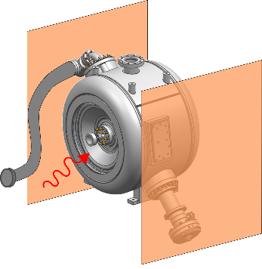
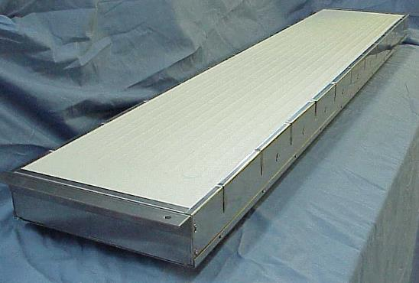
Low-Temp bake with Space Heaters: a new approach
Quartz fabric Faced Heater
Infrared
heaters
to
vacuum
cart
Able to reach 120°C in 2 hours
90% energy efficient
Can reach 815°C
Output power can be controlled through cavity temperature
Cavity never leaves the cleanroom facility

Slide 32
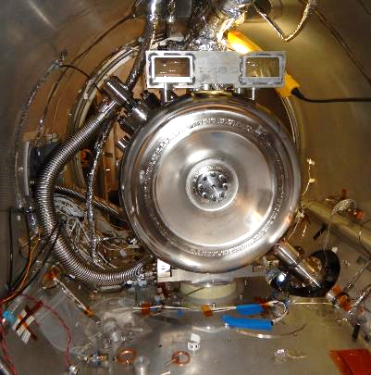
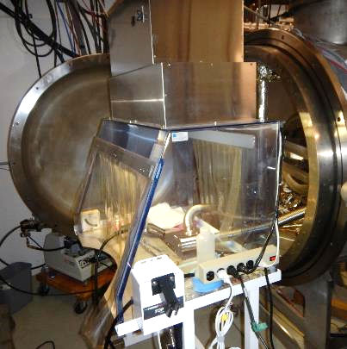
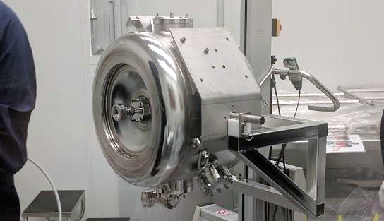
Avoid active pumping: burst disk
With active pumping:
Connection to the vacuum cart was done in a portable glove box
2 days required
Environment is not ideal for a clean connection
Without active pumping: Burst Disk
Avoid potential contaminations during the connection and from the vacuum cart
Installation time into the test cave is substantially reduced

Slide 33
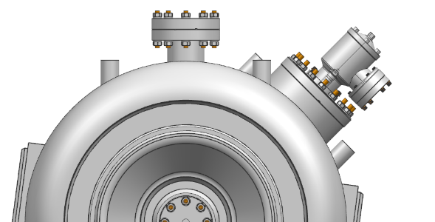
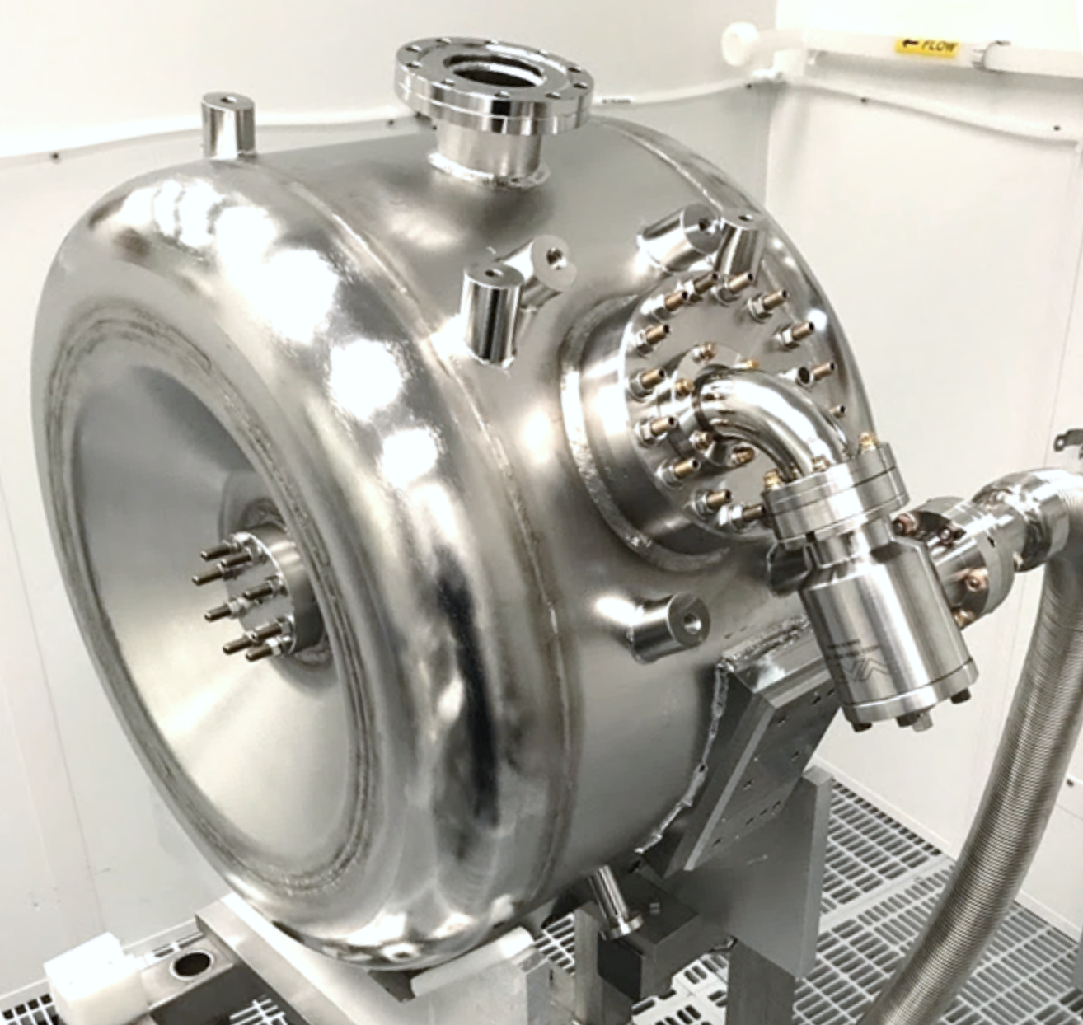
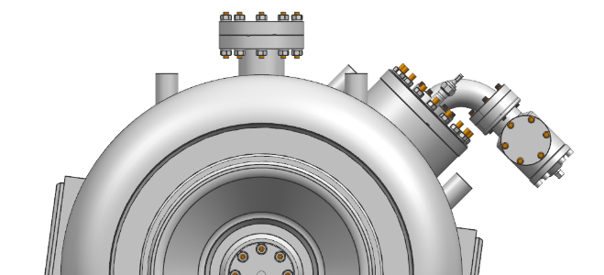
Right Angle Valve (RAV) to cavity connection
RAV was directly located on top of the cavity beam volume
High risk of particles generated during valve actuation. Gravity force or bad venting procedure can move such particles inside the cavity beam volume
Gravity

Slide 34
Summary
SSR1 String designed with assembly in mind
String is segmented in sub-systems for particle-free assembly
Edge-welded bellows a necessary and understood risk
6 degree supports for all components
Nitrogen purging optimized for SSR1 reentrant walls
Several improvements adopted during R&D and dry-run
String assembly of pSSR1 CM to start soon!

Slide 35
