Slide 1
Experience in the design
of
fundamental couplers.
S. Kazakov
09/04/2018

Slide 2
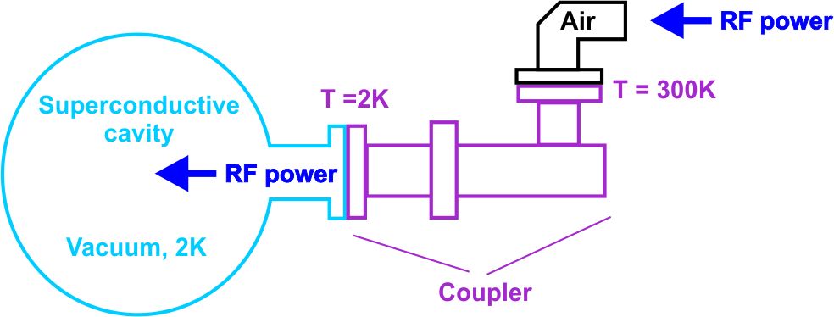
What is the main coupler of superconducting cavity and what is its purpose?
The coupler is device between RF source and superconductive cavity.
One side of coupler is connected to RF source at room temperature and atmospheric pressure. Another side of coupler is connected to cavity at temperature ~ 0K (typically 2K-4K) and vacuum.
Purpose of coupler is very simple: is to delivery RF power from RF sources into superconductive cavity.
In spite of tis very simple purpose the coupler of the most critical and complicated device of superconducting accelerator. Why so?

Slide 3
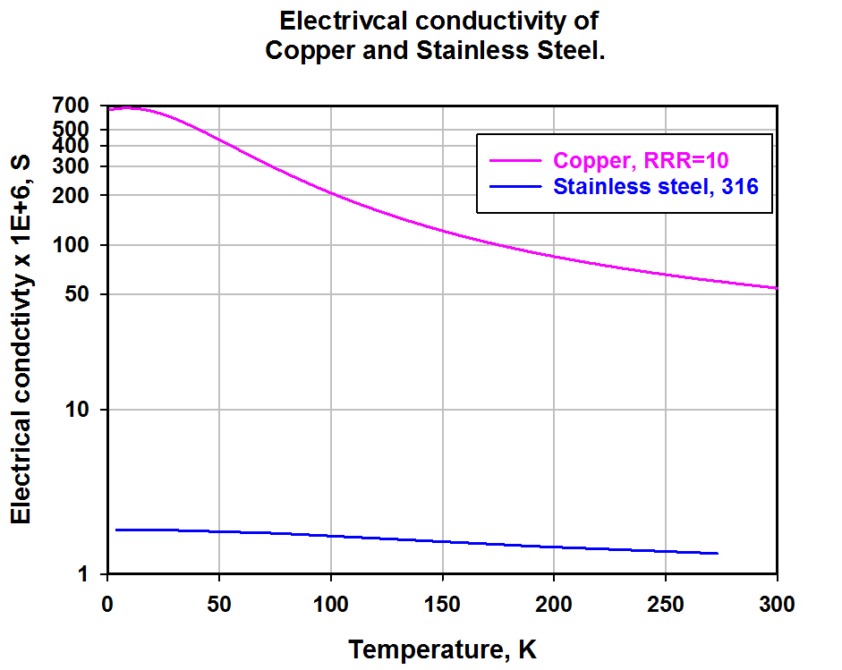
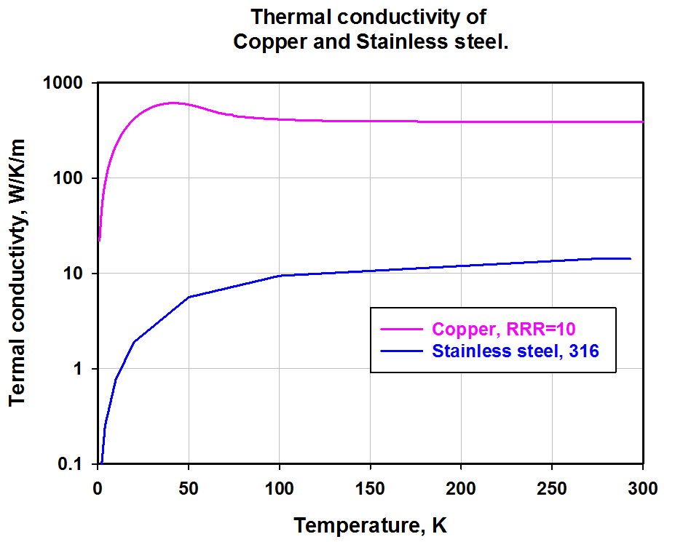
This is because the requirements for a coupler are contradictory.
Coupler has to transmute RF power into a cavity with minimum RF losses and not transmit a heat from room temperature to cold cavity to keep cavity in superconductive state.
But the less an electrical losses of material the higher a thermal conductivity.
Reducing an electrical loss we increase the thermal loading of cavity by heat flow from room temperature environment and vice versa. Graph of copper and SS electrical conductivity.
Thermal conductivity of SS is about hundred time less then t. conductivity of copper (at 50 K), but electric conductivity is about two hundred time less as well.

Slide 4
To reduce the thermal heat flow from room temperature the walls of coupler have to be as thin as possible. Reducing a wall thickness we reduce a mechanical strength of coupler.
Coupler should be short enough to fit into cryomodule and should be long enough to have high thermal resistance.
Coupler has to transmit RF power with minimum losses and isolate vacuum of cavity from atmosphere. So we need to use material which is transparent for RF and vacuum tight. Typically it is alumna ceramics (Al₂O₃). Ceramics has to be reliably joined with metal environment (brazed). The purer the ceramics, the lower RF the losses. The purer the ceramics, the harder it is to braze.
During cool down and warming up the parts of coupler (and cavity) change the sizes. Coupler has to include bellows which changes sizes and isolate cavity or cryomodule vacuum form atmosphere.
Superconductive cavity is sensitive to magnetic field. Coupler has to made of non-magnetic material.
Etc. , etc.
Coupler design is finding compromises.

Slide 5
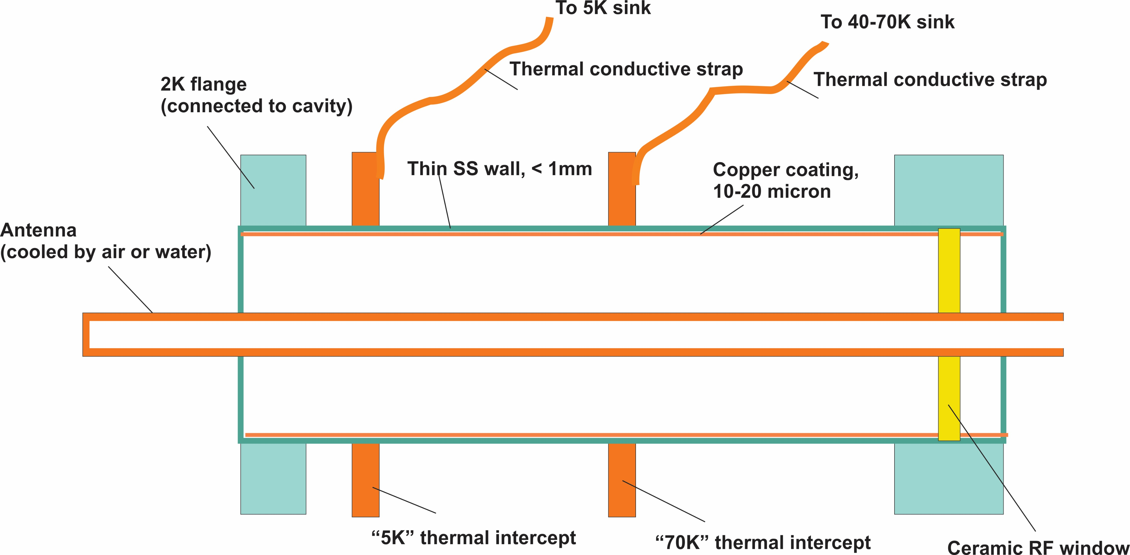
Typical solution for coaxial coupler, vacuum part:
Thickness of SS wall should be as thin as possible (but enough for mechanical strength) to reduce a heat flow from room temperature to superconductive cavity (typically < 1mm).
Thickness of copper plating should be a thin as possible for the same reason, typically ~10 ~20 microns – several skin depth.
Ceramic diameter (depend on frequency and power) ~ 40 ~ 200mm.

Slide 6
Why we need thermal intercepts?
Cryo-plant efficiency drops rapidly at low temperature:
at 70 efficiency ~ 5%, at 5K ~ 0.5%, at 2K ~ 0.1%
To accommodate 1W of heat power at 70K a cryo-plant spends ~ 20W.
To accommodate 1W of heat power at 5K a cryo-plant spends ~ 200W.
To accommodate 1W of heat power at 2K a cryo-plant spends ~ 1000W.
Heat flow from room temperature to cryogenic temperature(s) without RF power we call “static cryo-loading”.
Coupler without thermal intercept will have very high static cryogenic loading at 2K-4K. It will require a lot of power of cryo-plant and can cause probably a quench of superconductive cavity (cavity lost a superconductivity).
For example, our 325 MHz coupler, power of cryo-plant to compensate static loading
Without thermal intercepts 980 W
With “70K” thermal intercept 215 W
With “70K” and “5K” thermal intercepts 160 W
Thermal intercepts reduce the necessary power of cryo-plant ~ 6 times.
Position of thermal intercepts must be optimized.

Slide 7
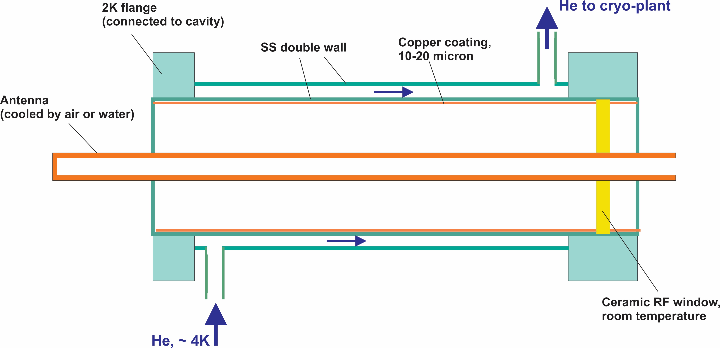
Another possible solution is double wall outer conductor.
Advantages - simpler (?).
Disadvantages – efficiency is lower(?), double wall is thicker, no 70K intercept.

Slide 8
What impedance the coaxial coupler has to have?
Or how thick should be antenna?
Typically the people making the couplers with impedance ~ 50 ~75 Ohm (following to optimal impedance for cables).
But, we think, in case of couplers for superconductive cavity the higher impedance the better.
There two reasons: higher impedance means less current for the same power. If the diameter of outer conductor is fixed, the RF losses will be less in outer conductor and cryogenic loading (dynamic and total) will be less because only an outer conductor is connected to the cavity.
$$I −wall current, P_{rf}−RF power, Z −coaxial impedance, P_{loss}−power of losses in outer conductor wall, R_{w}−wall resistanse,$$
$$I2=\frac{2∗P_{rf}}{Z}, P_{loss}=I2∗\frac{R_{w}}{2}; { P}_{loss}\sim \frac{1}{Z}$$
For example, the impedance of our couplers ~ 105 Ohm.

Slide 9
Losses in antenna will be higher, but antenna is not connected to cavity directly and can be cooled by air or water. Limitation of impedance increasing is a difficulty of antenna cooling.
$$P_{ant}\sim \frac{1}{r_{ant}∗ln⁡\left(\frac{r_{out}}{r_{ant}}\right)}; r_{ant} −radius of antenna, r_{out}−radius of outer conductor$$
Second reason to increase impedance: multipactor power threshold becomes higher.
What is multipactor? It is the scourge of God of vacuum electronic devices.
Multipactor is avalanche of electrons:
Two side multipactor
One side multipactor

Slide 10
When electron with energy ~0.05 ~1.5 kV hit a surface of materials, it knocks out a few secondary electrons (n>1). These electrons are accelerated by alternative electrical field and hit the same (one surface multipactor) or opposite side (two side multipactor). Electrons knock out more electrons and under some condition (combination of frequency, electromagnetic field strength, secondary electron yield (SEY), distance between surfaces) an electron avalanche (n>> 1) can be formed. Moving electrons (current) can absorb essential part of RF energy and heat surfaces and can destroy the device.
How to avoid a multipactor?
Use materials with low SEY.
Avoid multipactor conditions (combination of frequency, power and sizes)
Destroy multipactor conditions by applying DC electric field (bias)
SEY of different materials:
Typically metals have SEY > 1 and dielectrics SEY >>1
SEY depends on surface condition. Typically pure metal surface has less SEY then contaminated or oxidized surface. As result, multipactor can be conditioning. Election bombardment clean the surface and SYE gradually decrease. Finally multipactor can disappear. We call this procedure “conditioning”.

Slide 11
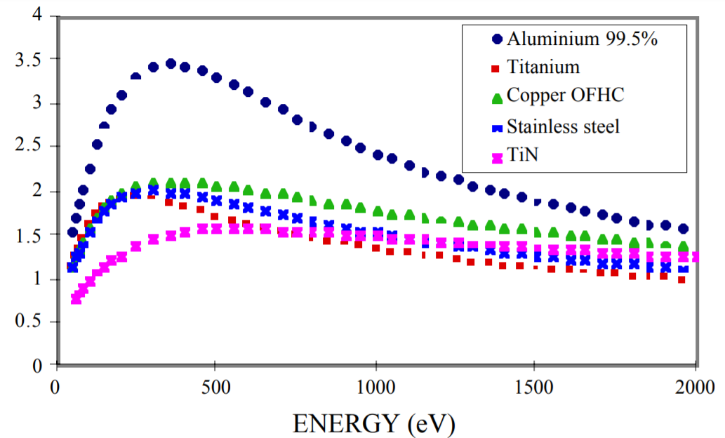
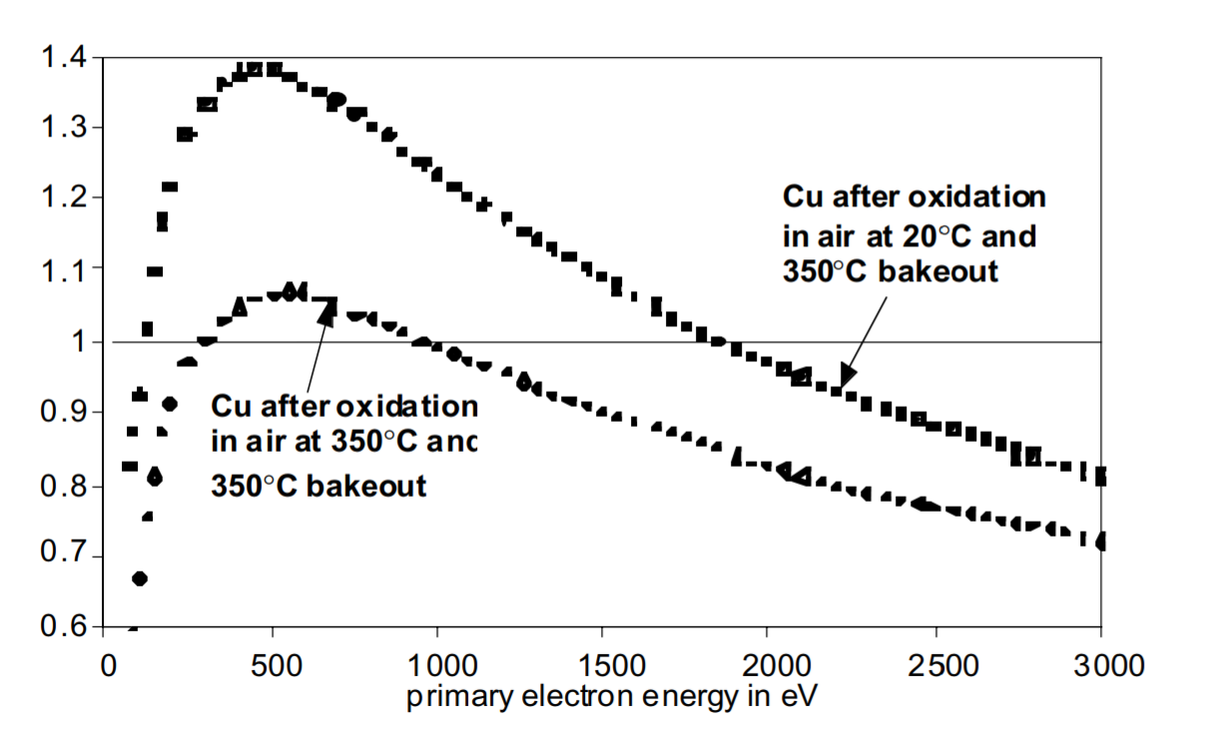
“THE SECONDARY ELECTRON YIELD OF TECHNICAL MATERIALS AND ITS VARIATION WITH SURFACE TREATMENTS” V. Baglin, J. Bojko1 , O. Gröbner, B. Henrist, N. Hilleret, C. Scheuerlein, M. Taborelli CERN, Geneva, Switzerland
SEY of different materials
SEY
SEY oxidized and pure copper
SEY

Slide 12
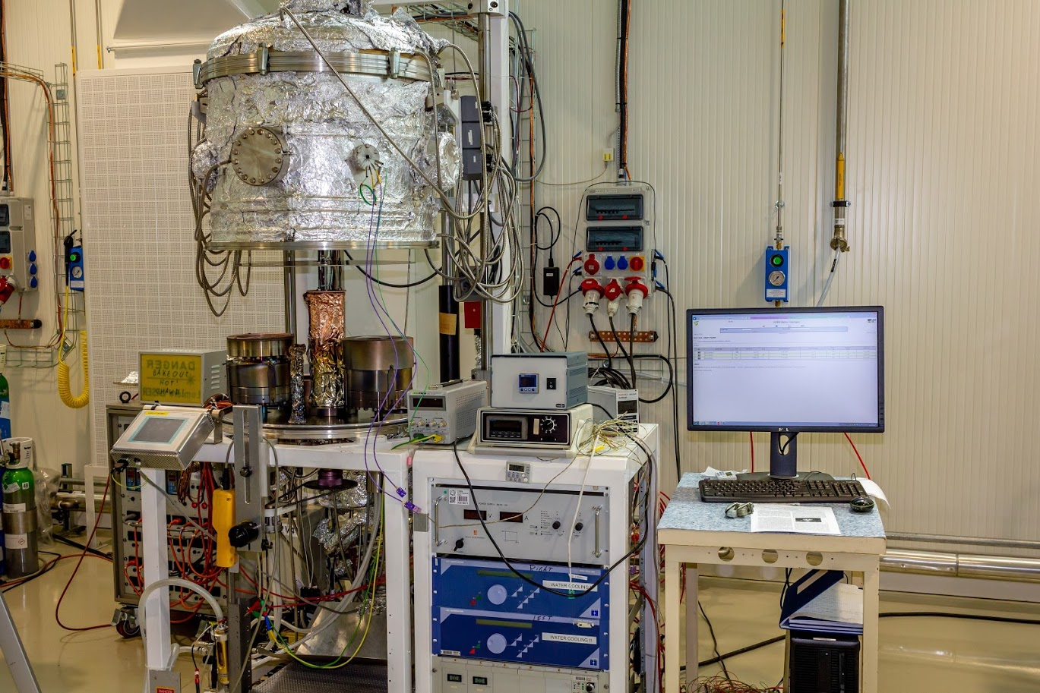
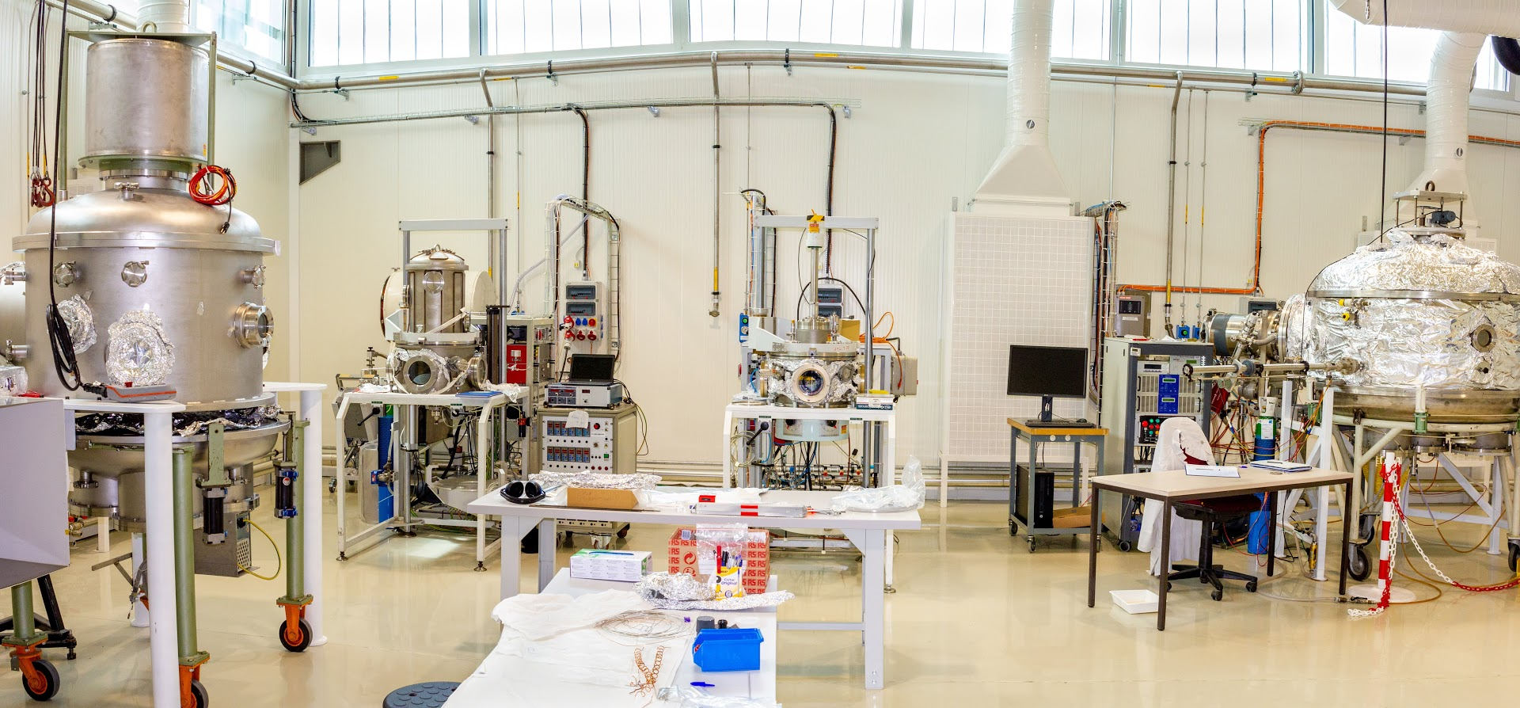
For successful conditioning it is important to have the surface clean as much as possible from the beginning. Baking before an operation helps much. It reduces number of molecules of residual gases and water on the surfaces.
We do 120C baking x 48 hours of cavity and couplers before operation.
The typical material for RF window is alumina ceramics (aluminum oxide). It is dielectric and has rather big SEY ~5 ~10. It makes a surface of ceramics the most probable place of multipactor. To avoid this the surface of ceramics is coated with materials with low SEY. The most commonly used material is Titanium nitride, TiN.
TiN is conductor and film on the ceramic must be rather thin, ~ 1 ~10nm to avoid additional RF losses on the ceramic surface.
CERN uses TiO₂ instead of TiN. Surface is coated by pure Ti in vacuum. Then surface is exposed to atmosphere and Ti is oxidized.
CERN facility for surfaces coating:

Slide 13
We prefer to using a different approach – our couplers works always under high voltage (HV) bias. HV bias suppresses multipactor at the ceramic surface and other parts of coupler.
Advantages: technology is simpler, coupler is a bit less expensive. Coupler does not requers conditioning – coupler starts work immediately. The most important thing the strong bias suppress multipactor completely (according to simulations). Without bias a mulipator can be tiny and unrecognizable (it did not disappear completely after conditioning, for example). But during the years of operation it can contaminate the ceramics (evaporating materials from place of multipactoring ) and reduce life time of coupler.
Disadvantage: coupler needs a fast interlock of high voltage bias. RF power must be switched off immediately if high voltage bias disappears for some reasons (failure of HV source, for example). Without HV bias a heavy multipactor can start and can destroy coupler.

Slide 14
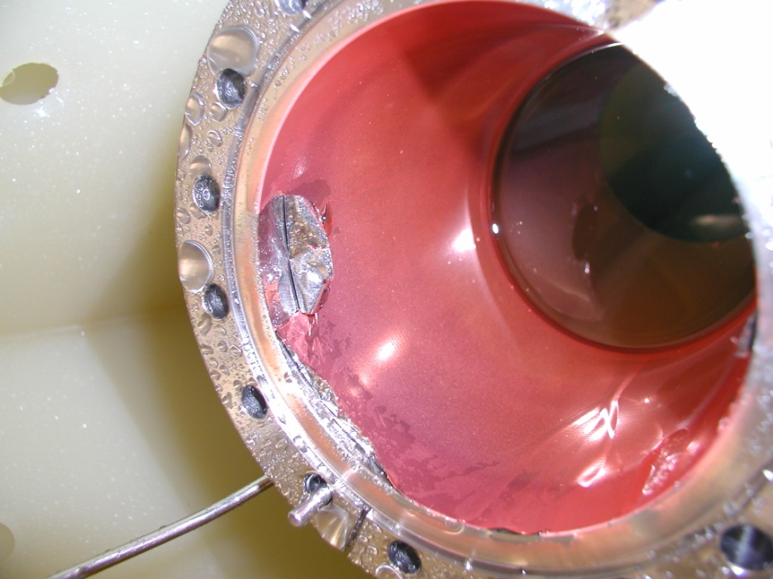
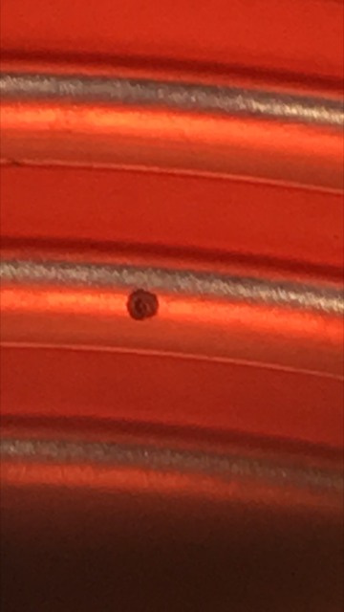
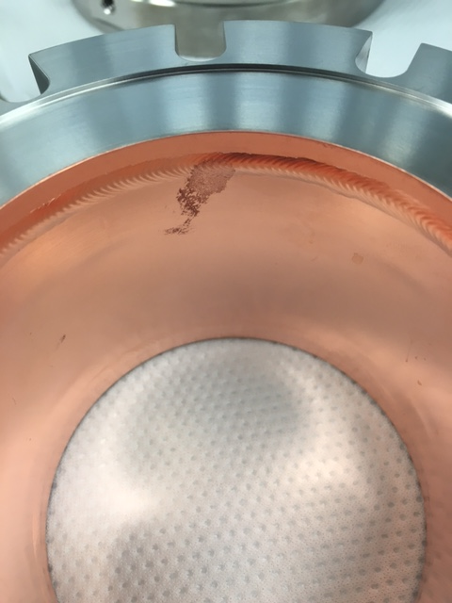
Copper plating of stainless steel.
Some parts of couplers (outer conductors, antenna, bellows…) are made of stainless steel. These parts must be coated with copper to make RF losses acceptable. Copper cplating is another pain of couplers production.
The requirements to copper coating in case of coupler for superconducting cavities are much more tougher then for room temperature device. Any copper flake dropped into a superconducting cavity from kills the cavity. Coating must be extremely reliable and strong. Technology of coating still is needed to be developed and improved.
Examples of not successful coating:
We are trying to avoid a copper coating as much as we can.
How we are doing this?

Slide 15
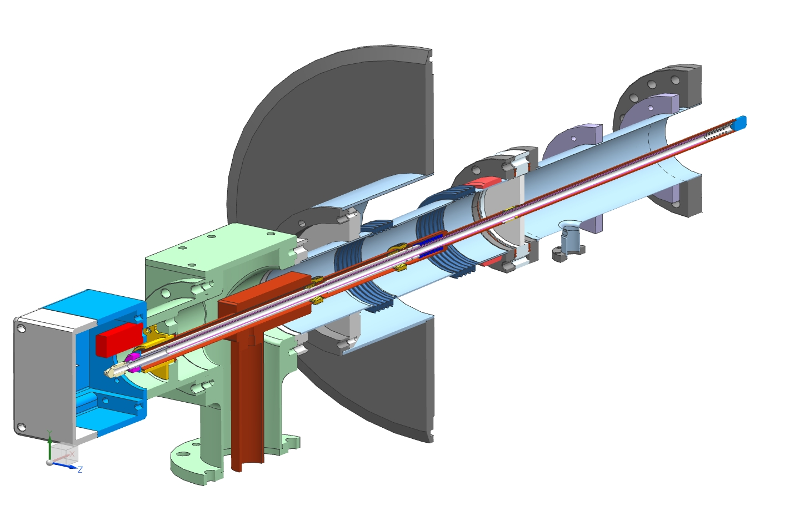
In case of moldered power and not to high frequency it is enough to increase the impedance of coaxial coupler. Example is our 325 MHz coupler for SSR1 and SSR2 cavities.
Cryomodule flange
Spring to compensate
thermal expansion
“5K” intercept
“70K” intercept
Ceramic window
Antenna, 0,5’’
Matching bump
Arc detector
Cold flange
e-pickup port
3’’x 0.0158’’
stainless steel tube, 0,4mm -> 0.8mm
Ni-Cu bellows
Heater
Air inlet
3-1/8’’ coaxial input

Slide 16
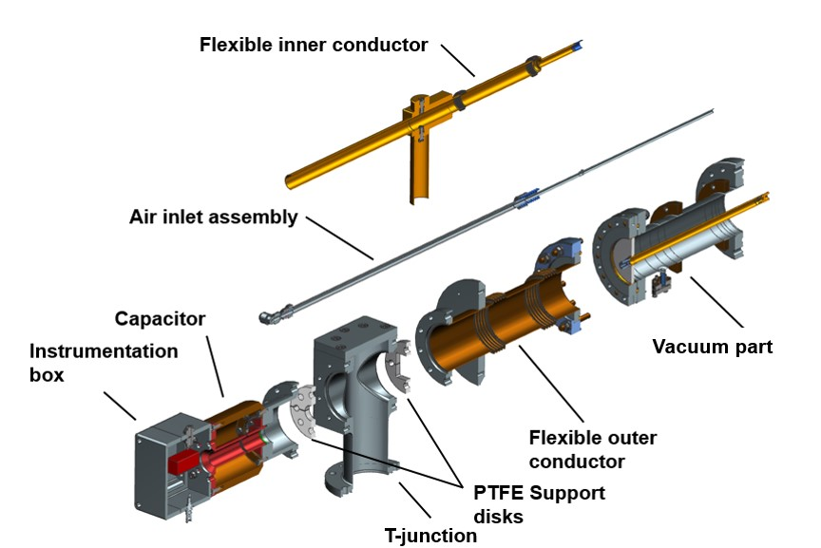
Exploded view of 325 MHz coupler

Slide 17
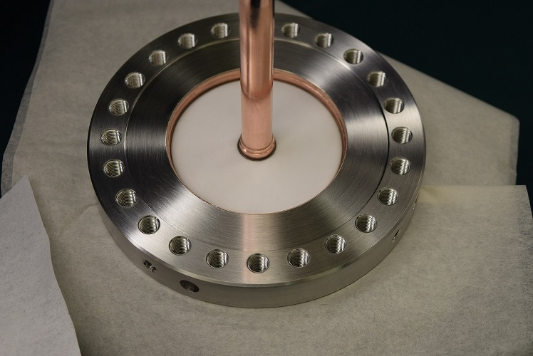
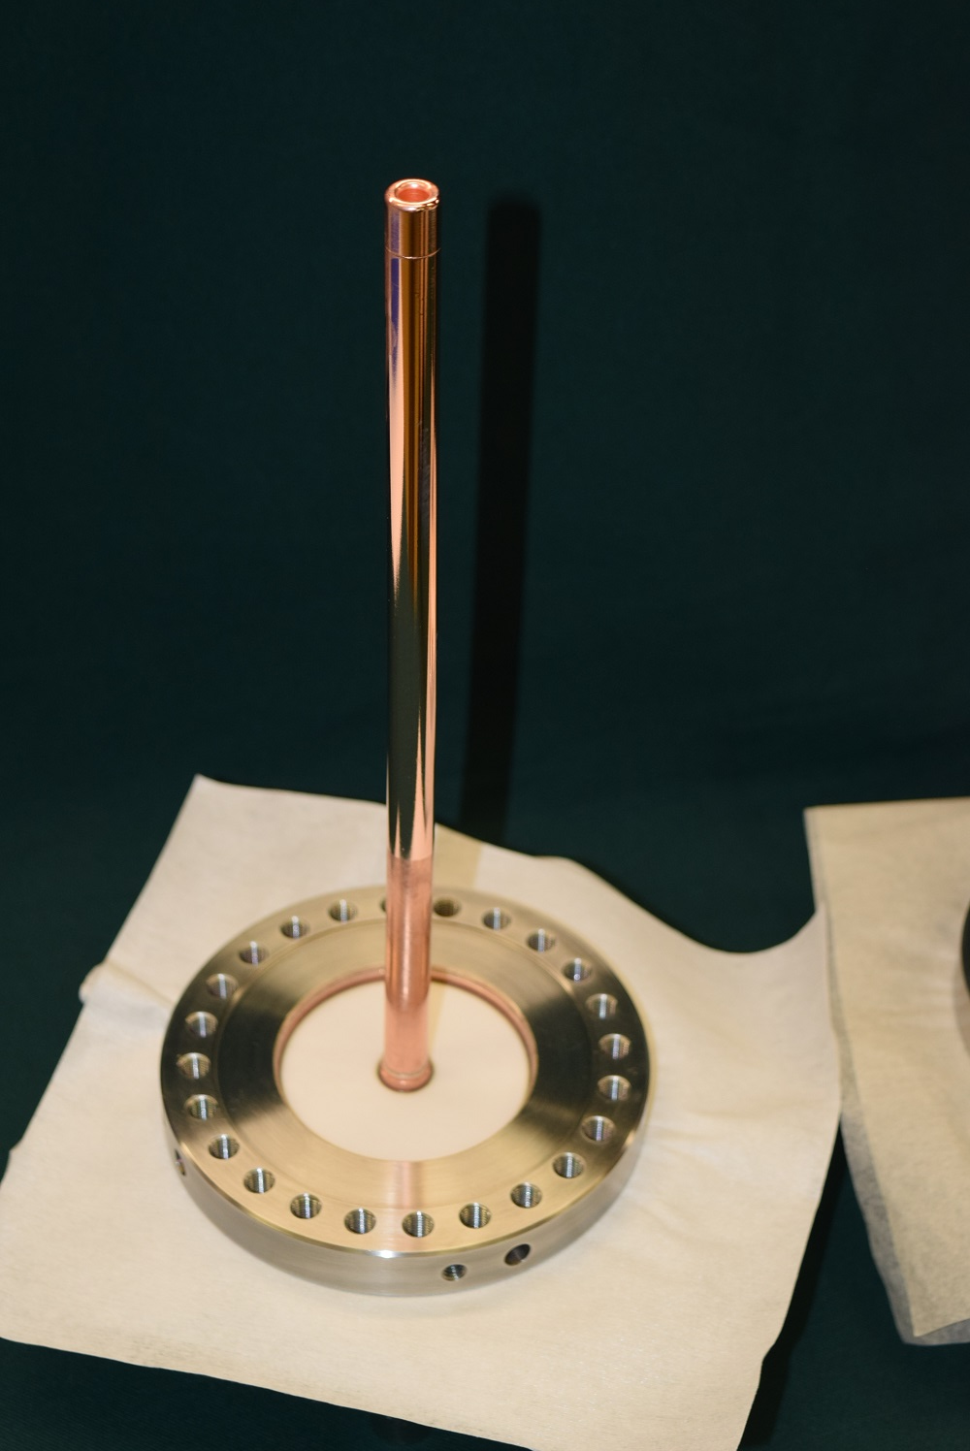
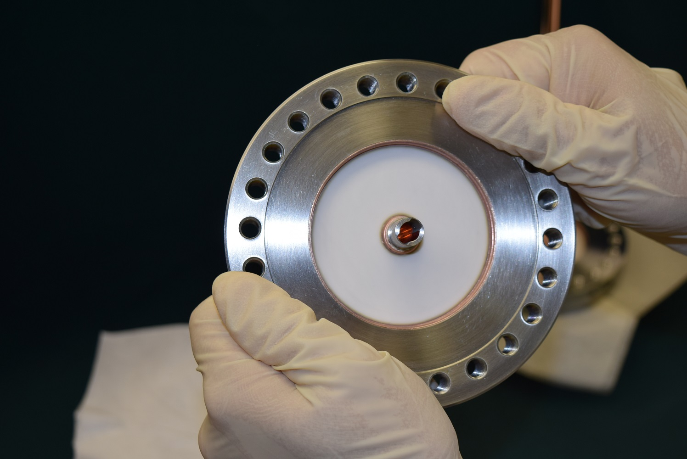
Antenna of 325 MHz coupler made by CPI
Antenna is electropolished to reduce a thermal radiation into the cavity.

Slide 18
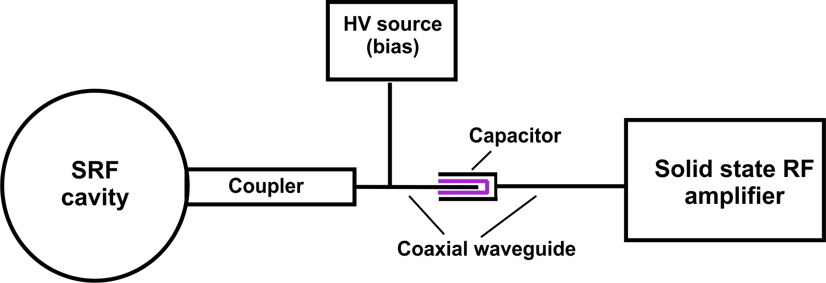
To apply HV bias to coupler antenna, we need to isolate RF source (solid state) from High Voltage ( not to destroy an amplifier). Coupler and amplifier can be connected through capacitor, which is transparent for RF and isolate HV.
The problem of this scheme: If the capacity is broken, a high voltage will be applied to the amplifier and amplifier will be destroyed (very expensive device). Additional protection is needed. We use so called “ DC block” (it blocks DC voltage and transmits RF).

Slide 19
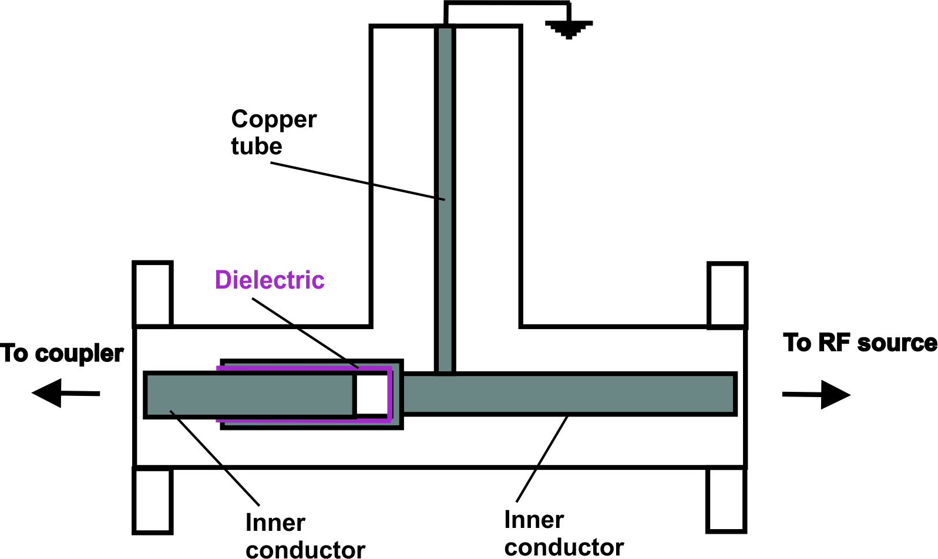
Configuration of DC block
$$\frac{λ}{4}$$
Inner conductor, which is connected to amplifier, is grounded.
In case of dielectric breakdown, the high voltage will not be applied to amplifier.

Slide 20
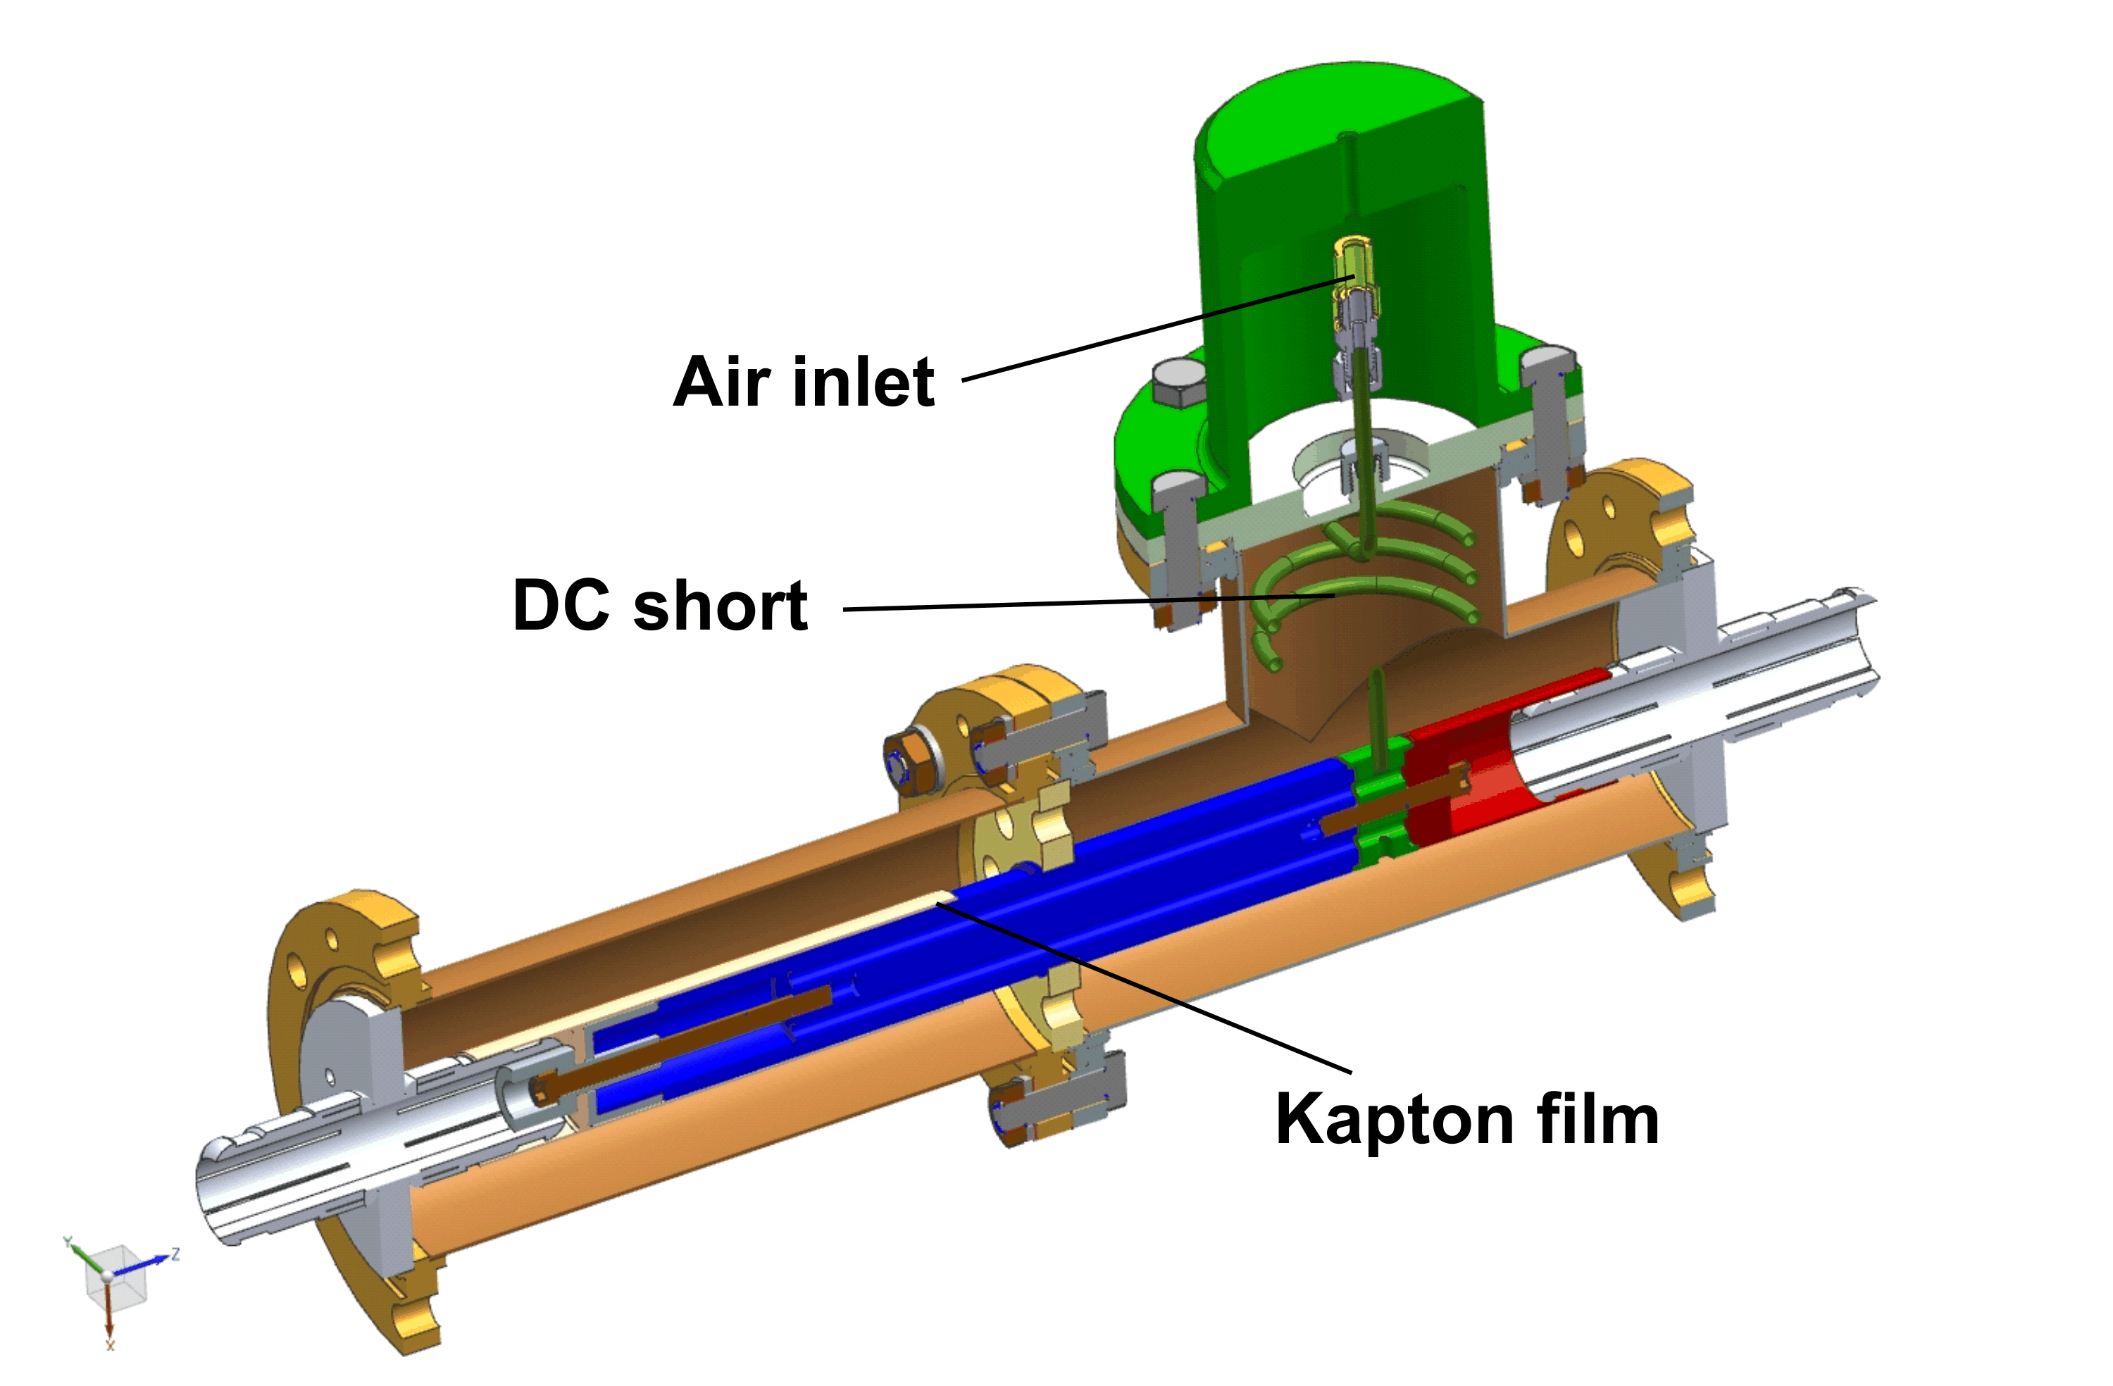
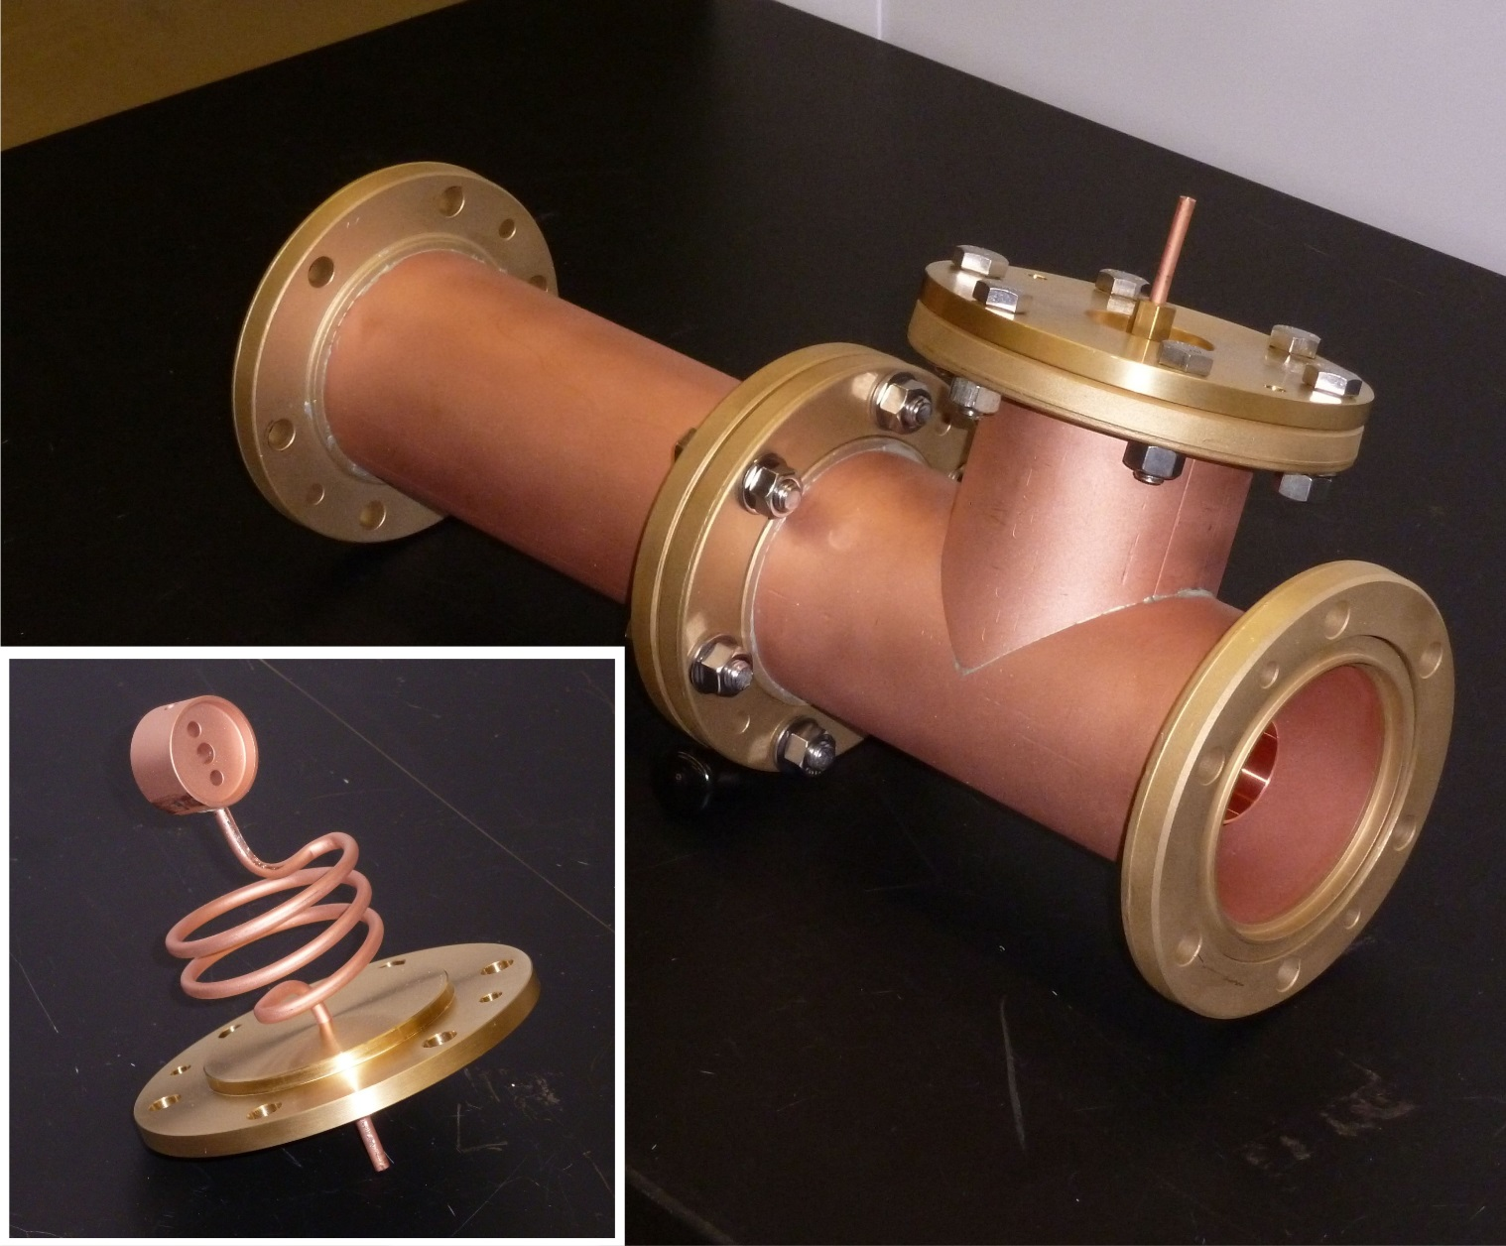
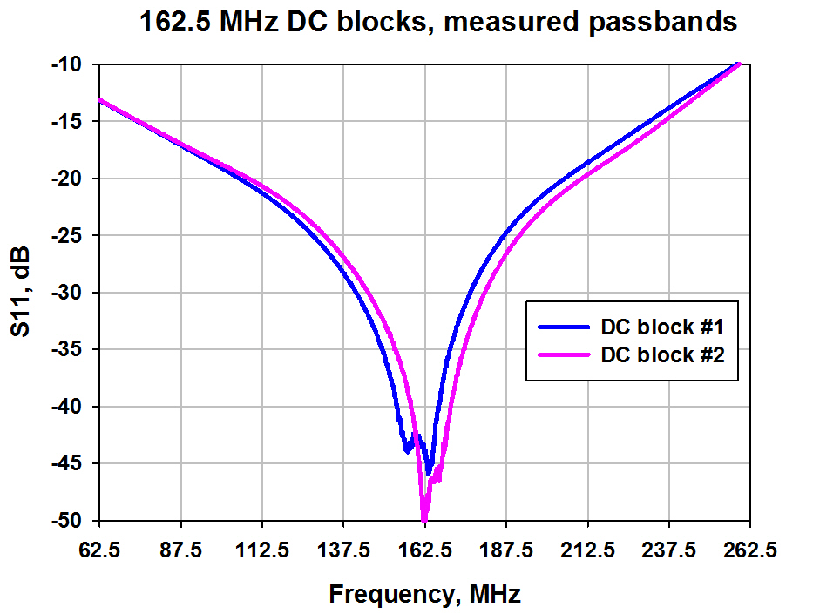
Firs version of DC block for 162.5 MHz RFQ.
325 MHz DC block has the same configuration but number of coil turns is less.
There were problems with breakdowns between
Coils turns and outer conductor. New version was designed and built.

Slide 21
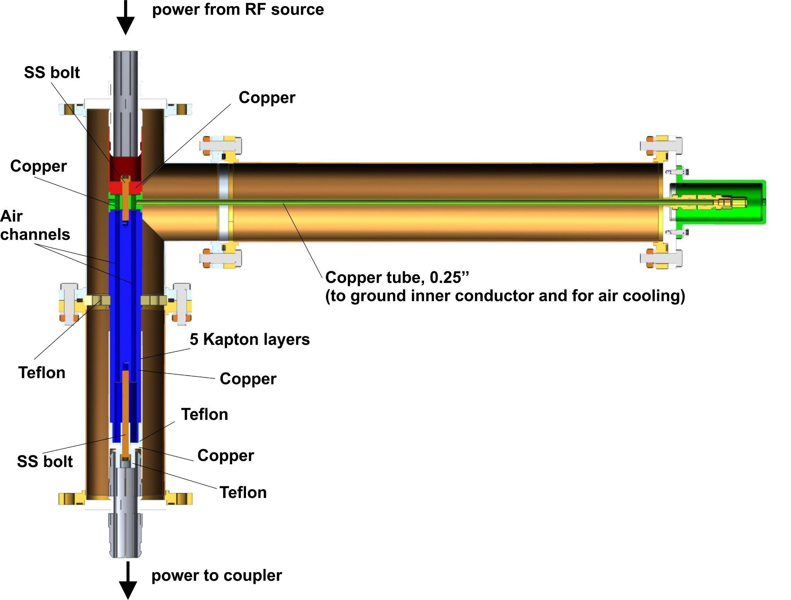
Second version of DC block. Coil was replaced by straight waveguide.
DC block was tested up to 5 kV and more then 50 kW, CW RF power (162 and 325 MHz)

Slide 22
We know how to avoid a copper plaiting in case of coupler for moderate power and frequency. How to avoid copper coating in case of more powerful couplers.
For example, PIP-II 650 MHz coupler has higher frequency, higher power.
Outer conductor cannot be made of pure SS.
New approach was developed, which allows to avoid a copper coating and improves cryogenic properties of couplers.

Slide 23
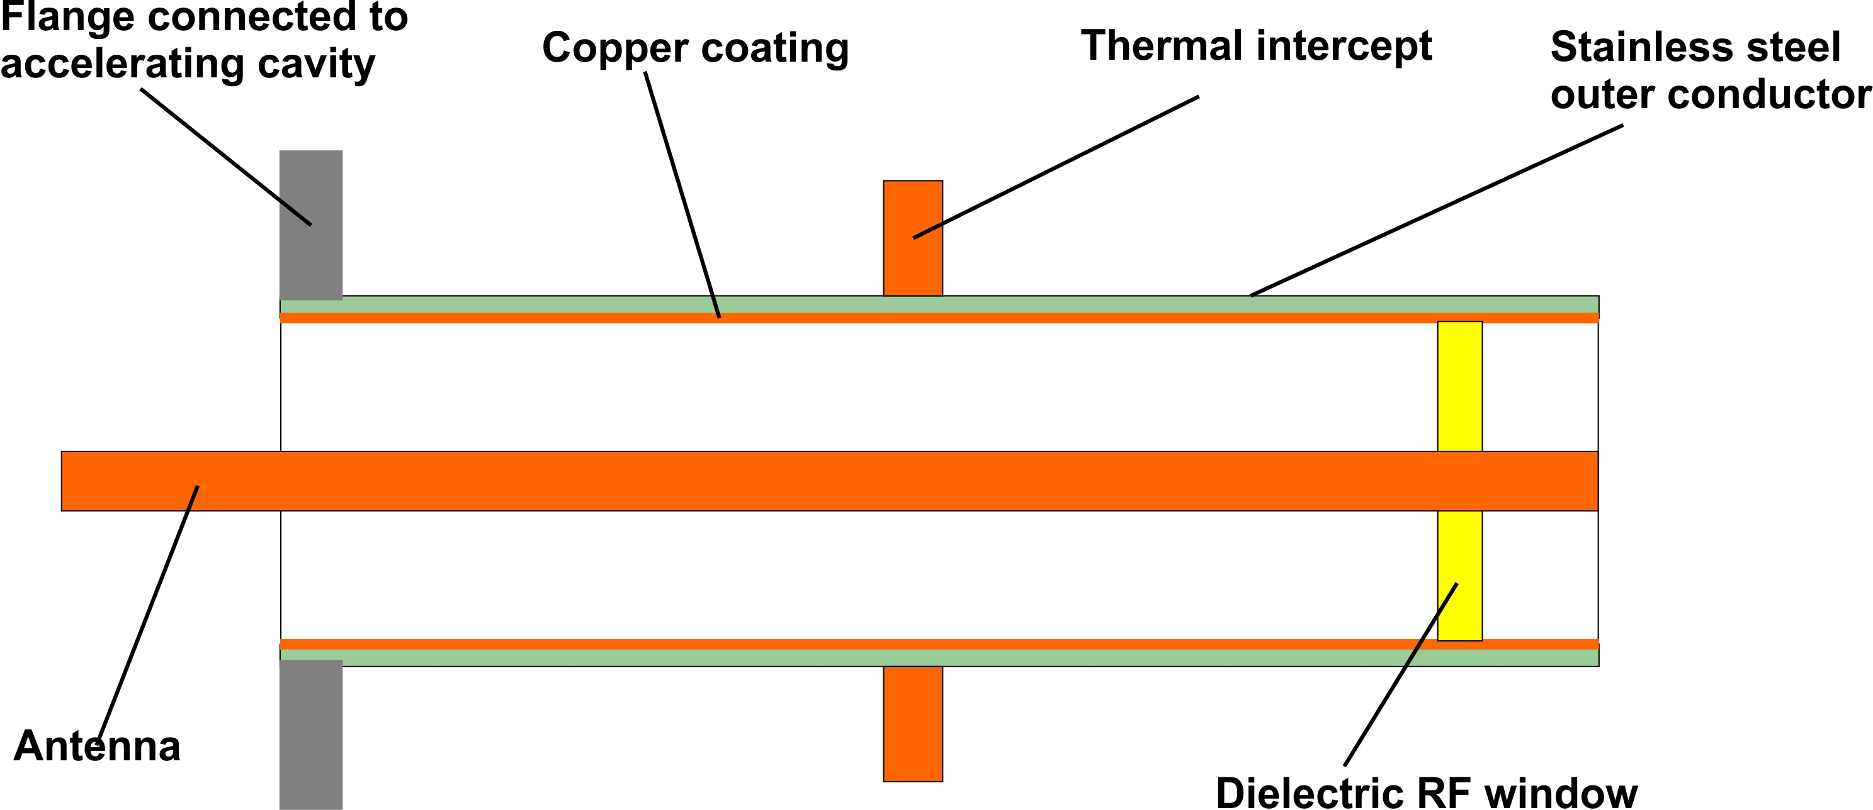
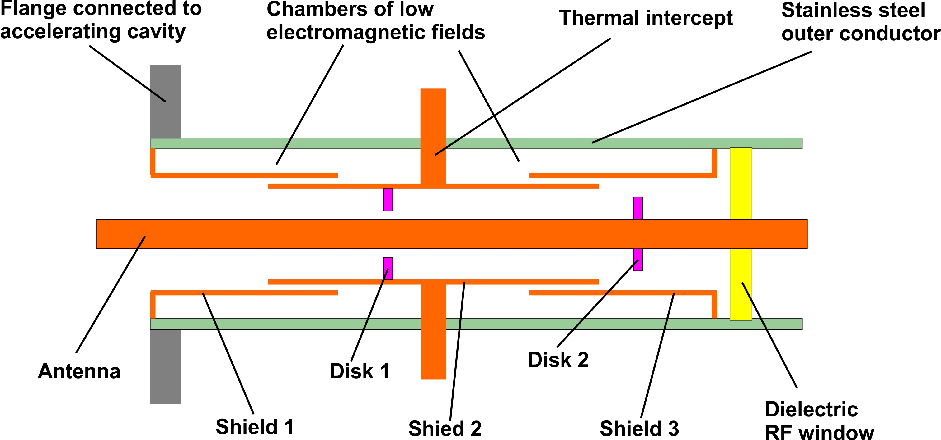
Conventional coupler
New approach

Slide 24
Idea is to replace a copper coating with electromagnetic shields made of solid copper.
Advantages:
Avoiding not well developed technology of copper coating. The is no problem with copper flacking.
Shields are made of solid copper with high RRR. As result, the RF loses are less.
Main part of RF loses are translated to 70K (from 5K and 2K).
As result, total cryo-loading of new coupler is less then conventional coupler.
Possible problem:
Configuration is more complicated, higher probability to generate particles during assembling.
Gaps between shields must be small, < 1mm, to avoid a multipactor in the gaps.
(There is no multipactor in the chambers between SS wall and shields - EM fields are too low. Multipactor in other parts is suppressed by HV bias.)

Slide 25
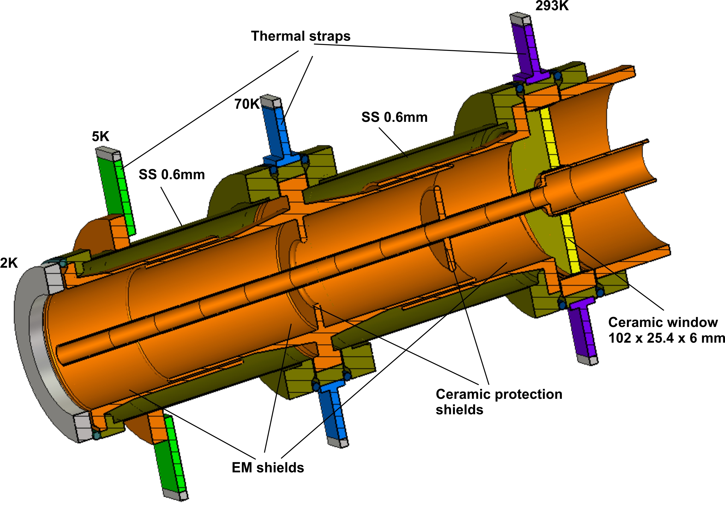
Vacuum part of 650 MHz coupler, new design
(configuration for EM and thermal simulation).

Slide 26
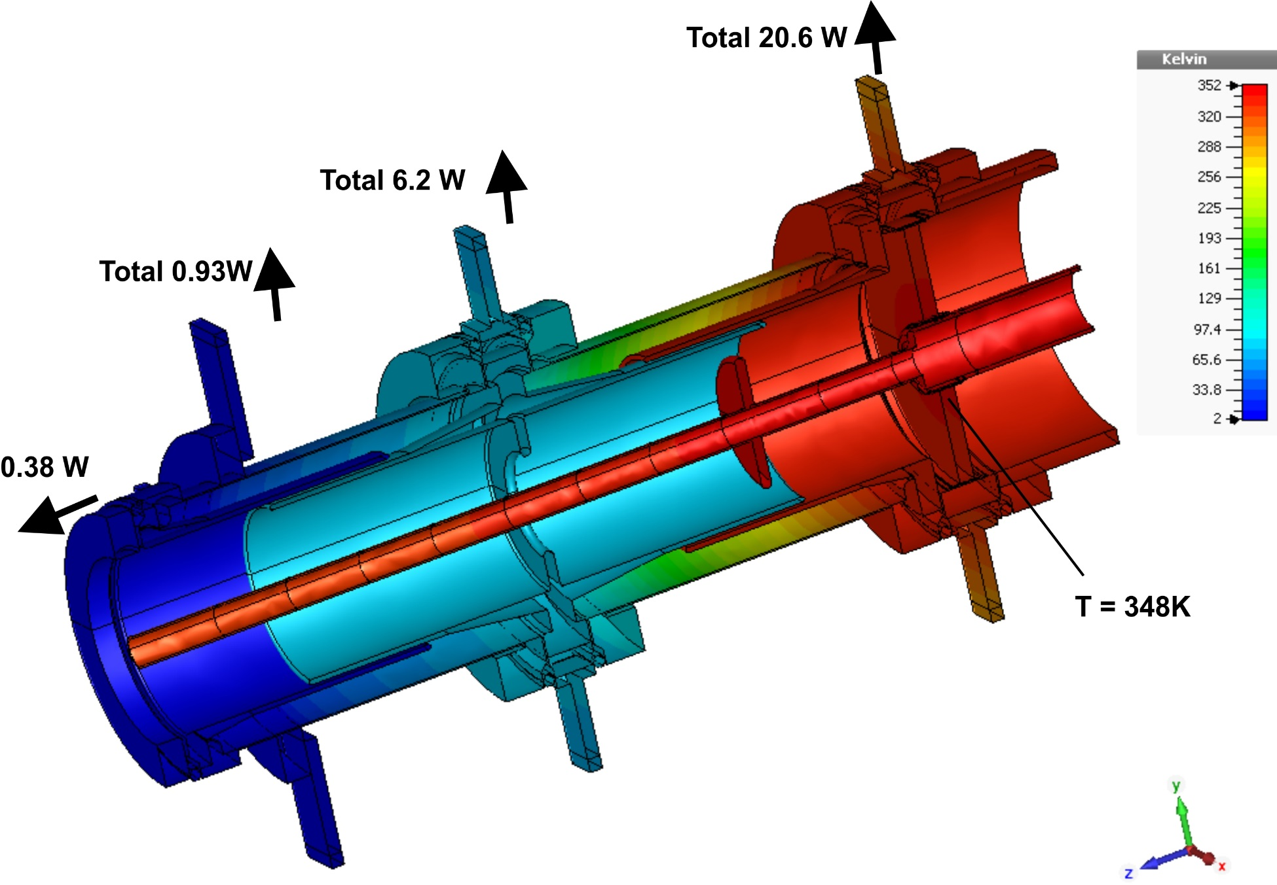
Results of simulations for P =100 kW, TW
(cooling air rate 3 g/s)
Loss in antenna = 97W
ΔT_air ≈ 38C
Temperature of antenna tip T_tip ≈ 34C
Thermal radiation of antenna, P_rad = 0.17W

Slide 27
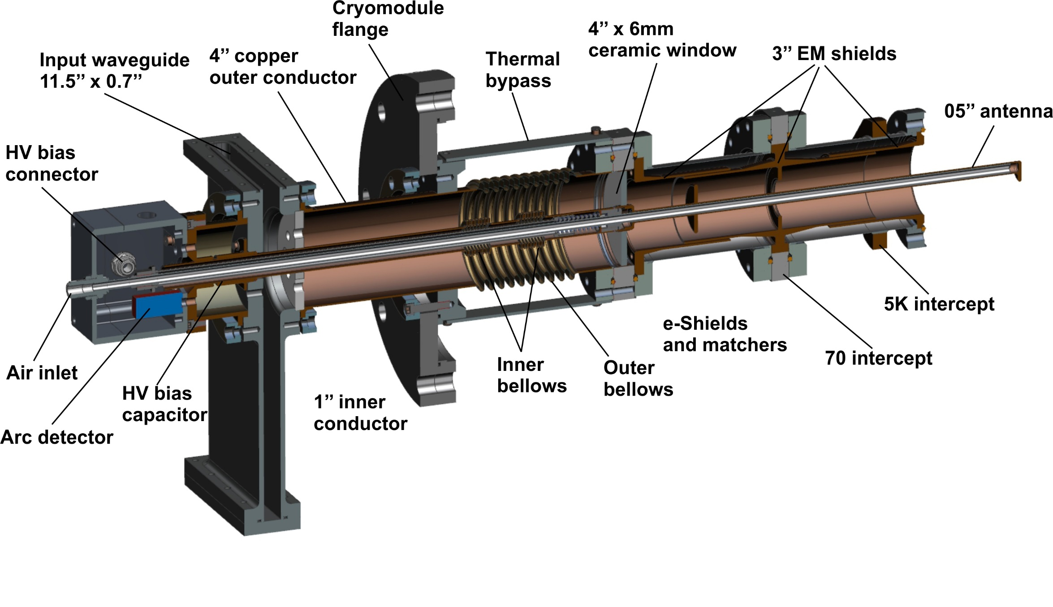
Configuration of 650 MHz couplers, new design.
Main features of new design:
no copper coating
ceramics is protected by shields
better cryogenics properties

Slide 28
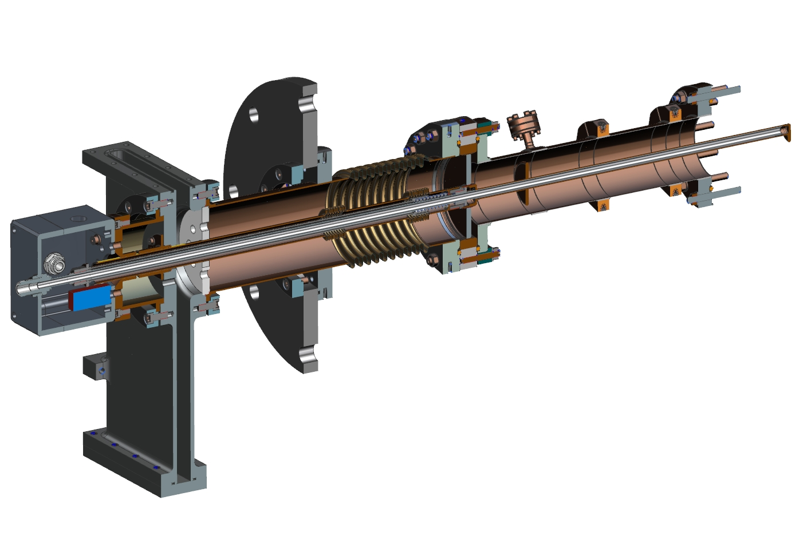
650 MHz coupler, conventional (backup) design.
In backup design the vacuum outer conductor is ‘conventional’ type: SS tube coated by copper.

Slide 29
Thermal properties of 650 MHz couplers
 | 2K, W | 5K, W | 70K, W | 293K, W
New, 0 kW | 0.15 | 0.6 | 3.3 | -2.7
New, 100 kW | 0.55 | 0.93 | 6.2 | 21
Bckp, 0 kW | 0.41 | 1.46 | 3.0 | -3.1
Bckp, 100 kW | 0.97 | 4.1 | 11.4 | 20
100 kW:
New = 0.55*960 + 0.93*220 + 6.2*20 = 857 W of cryo-plant
Bckp = 0.97*960 + 4.1*220 + 11.4*20 = 2061 W of cryo-plant
New design requires ~ 2.4 times less power of cryo-plant.

Slide 30
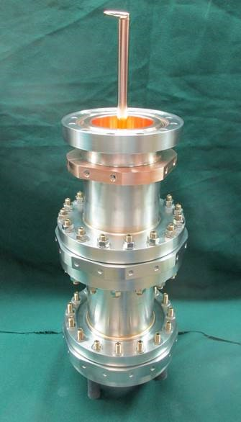
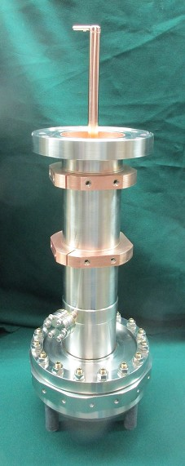
Vacuum parts of 650 MHz couplers made by CPI.
New
Conventional

Slide 31
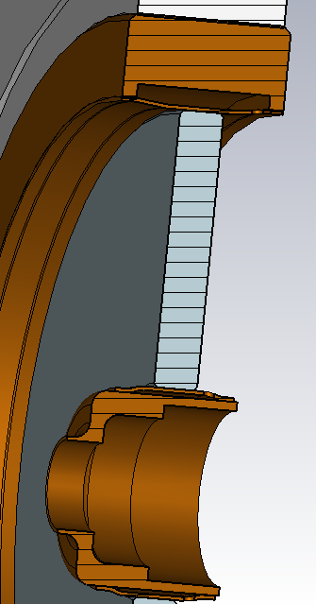
The critical part of coupler, which determines the reliability, is ceramics window. Ceramics brazed into metal shell and metal antenna. Problem is that thermal expansions of ceramic and metal are different and ceramics is brazed to metal through thin flexible sleeves. Sleeves accommodates relative ceramics and shell displacement.
Sleeves are made of copper typically.
Ceramics
Sleeves

Slide 32
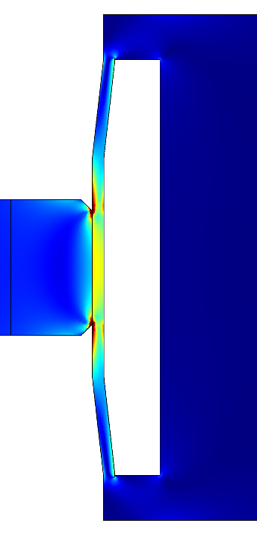
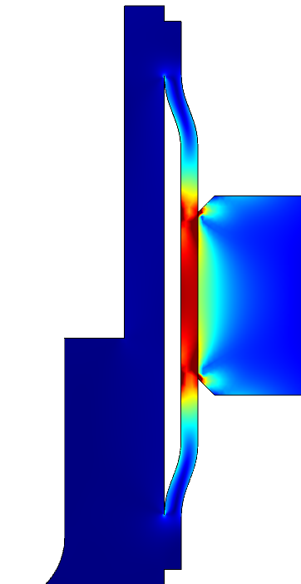
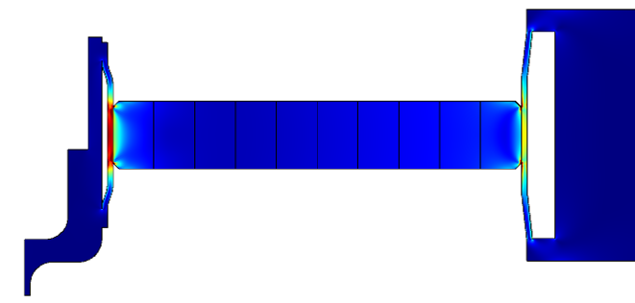
Simulation shows that maximum mechanical stresses, which determine window reliability and lifetime, are localized in place of ceramic-metal brazing. Stresses are caused by changing temperature during operation.
What level of stresses are acceptable?
Points of max. strength
(values are in the table)

Slide 33
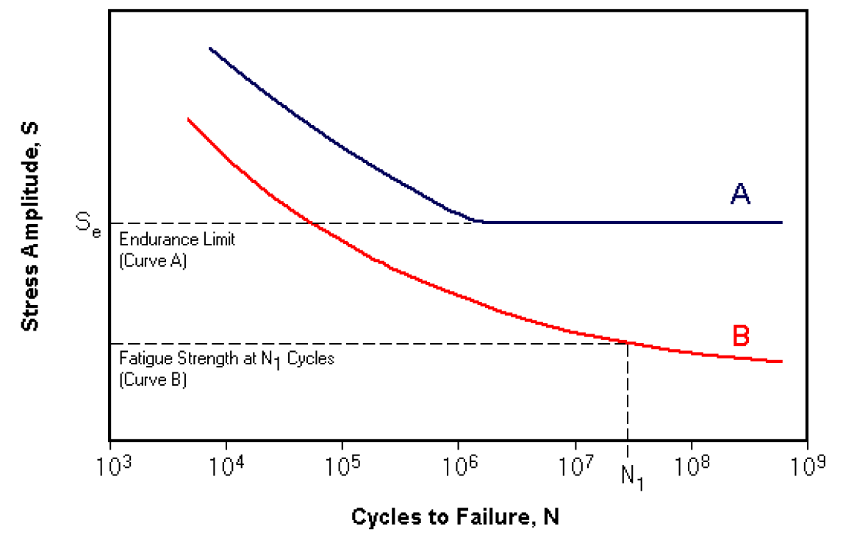
Window ceramics and sleeves experience periodical stresses even in case of accelerator works in CW mode. For example, life time of accelerator 20-30 years. If accelerator experience 1 trip per day, total number of on/off cycles will be ~ 1e+4. 1 trip per 2 hours corresponds ~ 1e+5 cycles. CW accelerator is pulse accelerator with very long pulses. So, coupler has to be able to sustain ~ 100 thousands on/off cycles.
Cycling stresses caused material fatigue.
Typical S-N fatigue curves
Aluminum, copper – B, no endurance limit.
Steel - A
In case of cycling stress the copper sleeve will be broken soon or later. It is important that this will not happen within the life time of the accelerator.

Slide 34
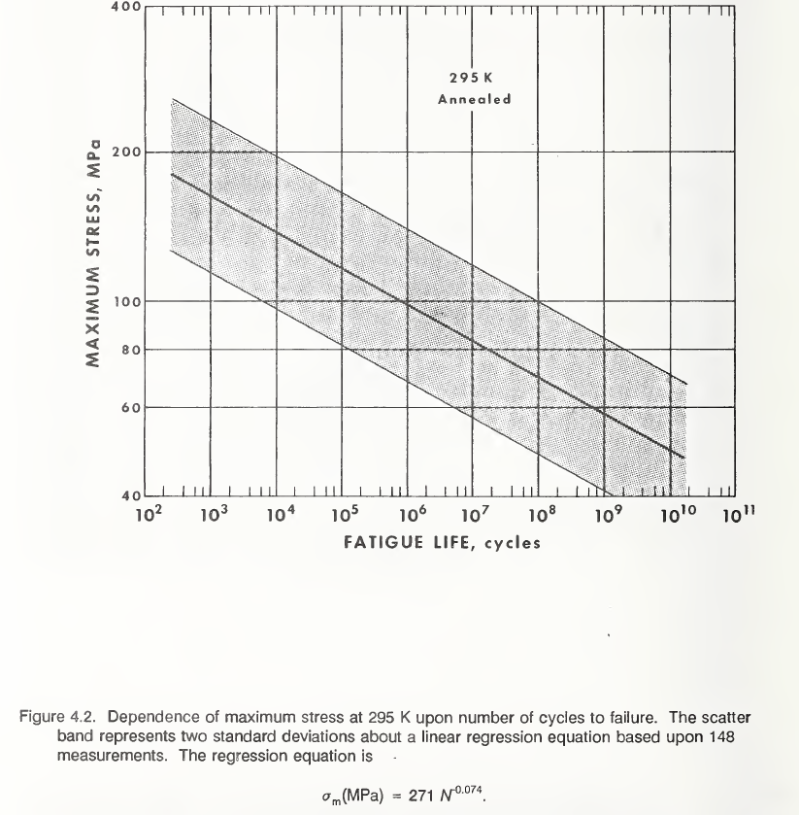
Copper fatigue
S-N depends on some parameters:
temperature, grain sizes, frequency of cycles.
Average (148 measurements) for
annealed copperat 295K:
S(MPa) = 271*N^(-0.074)
or
N = (S(Mpa)/271)^(-13.514)
Worst:
S(MPa) = 192*N^(-0.074)
or
N = (S(Mpa)/192)^(-13.514)

Slide 35
Example of window stresses of 650 MHz coupler
Stresses in copper and ceramics for 100kW and 300kW, TW, CW
Power, Air rate | Inner, Cu | Inner, Cer | Outer, Cu | Outer, Cer
100 kW, TW, 3g/s | 87 MPa, T = 74C | 100 MPa | 125 MPa, T = 60C | 160 MPa
100 kW, TW, 4g/s | 65 Mpa, T = 65C | 92 MPa | 97 Mpa, T = 55C | 128 MPa
300 kW, TW, 5g/s | 160 Mpa, T = 124C | 220 MPa | 280 Mpa, T = 112C | 250 MPa
Design is good for 100 kW, TW, CW.
For 300 kW it has to be improved.

Slide 36
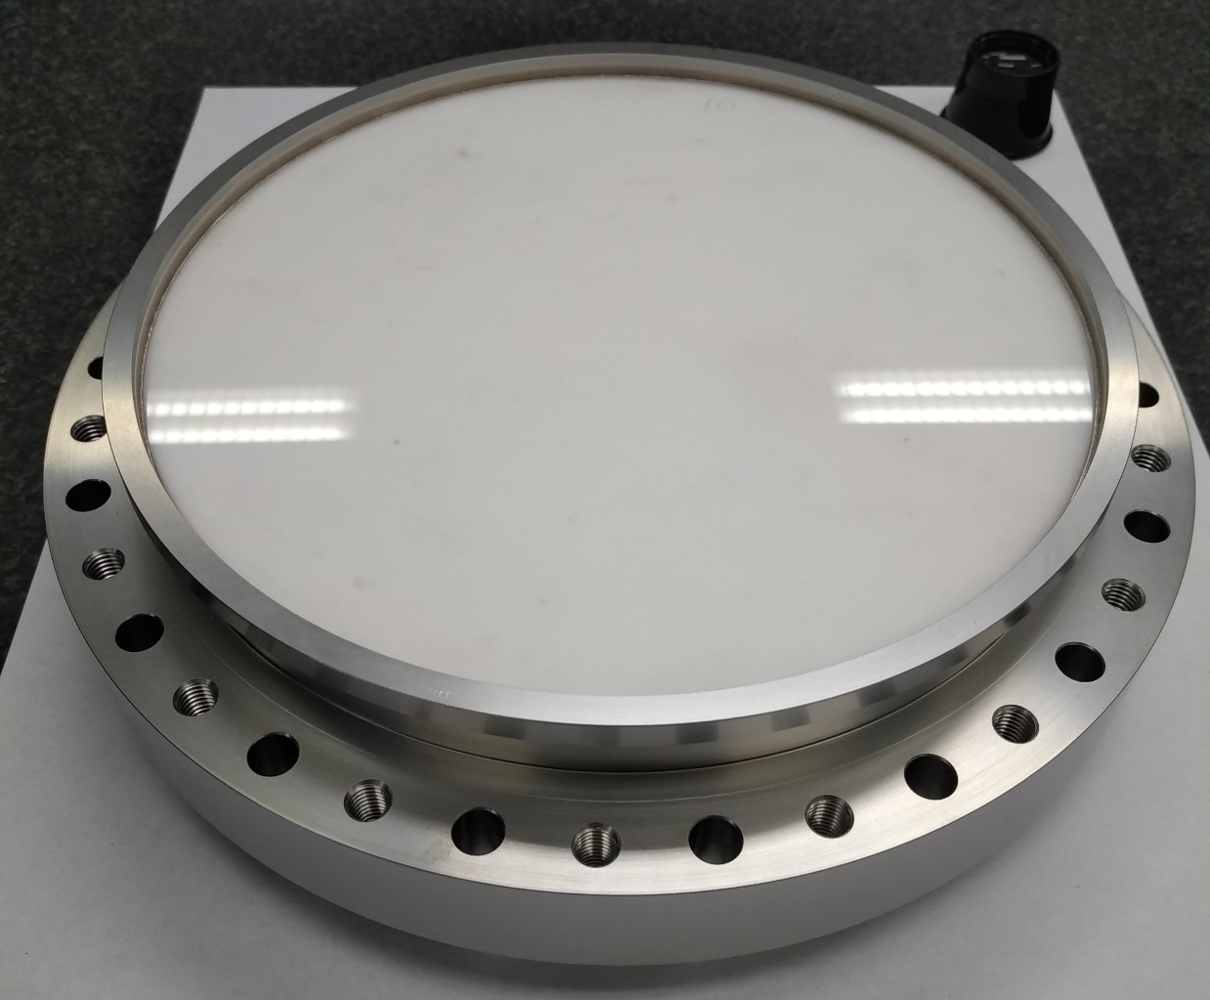
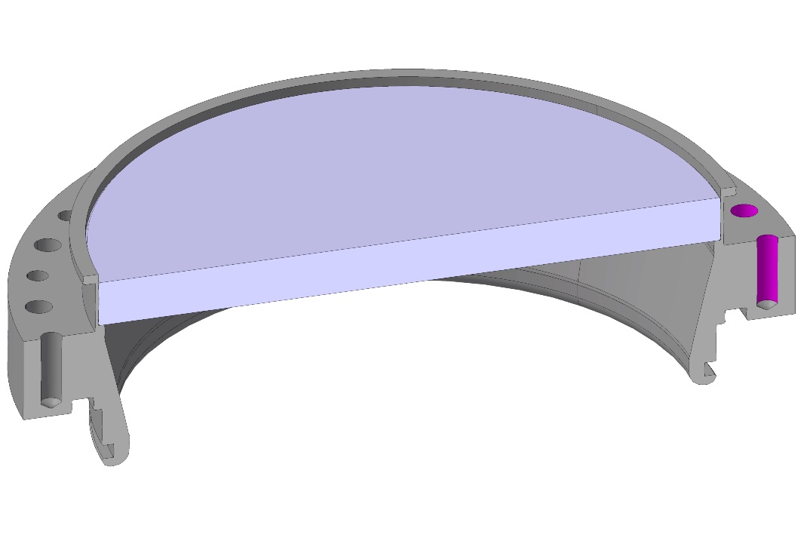
Another approach is use for shell materials with the thermal expansion close to ceramic thermal expansion. Example – RF window for SPS 200, CERN. Shell made of Titanium. Ceramics is brazed directly into shell without sleeves.
(eric.montesinos@cern.ch, CERN FPC status and perspectives)

Slide 37
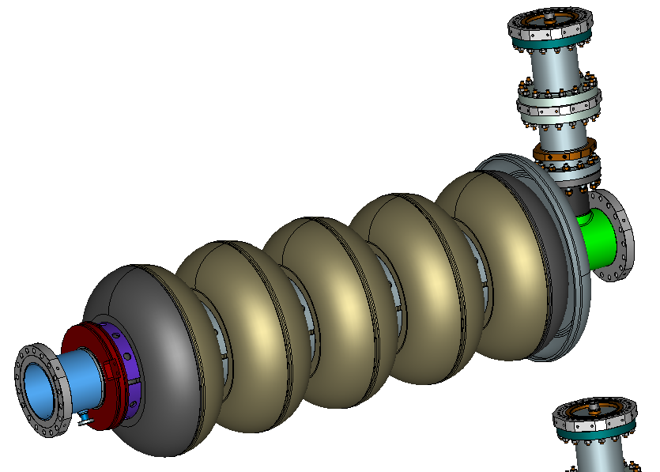
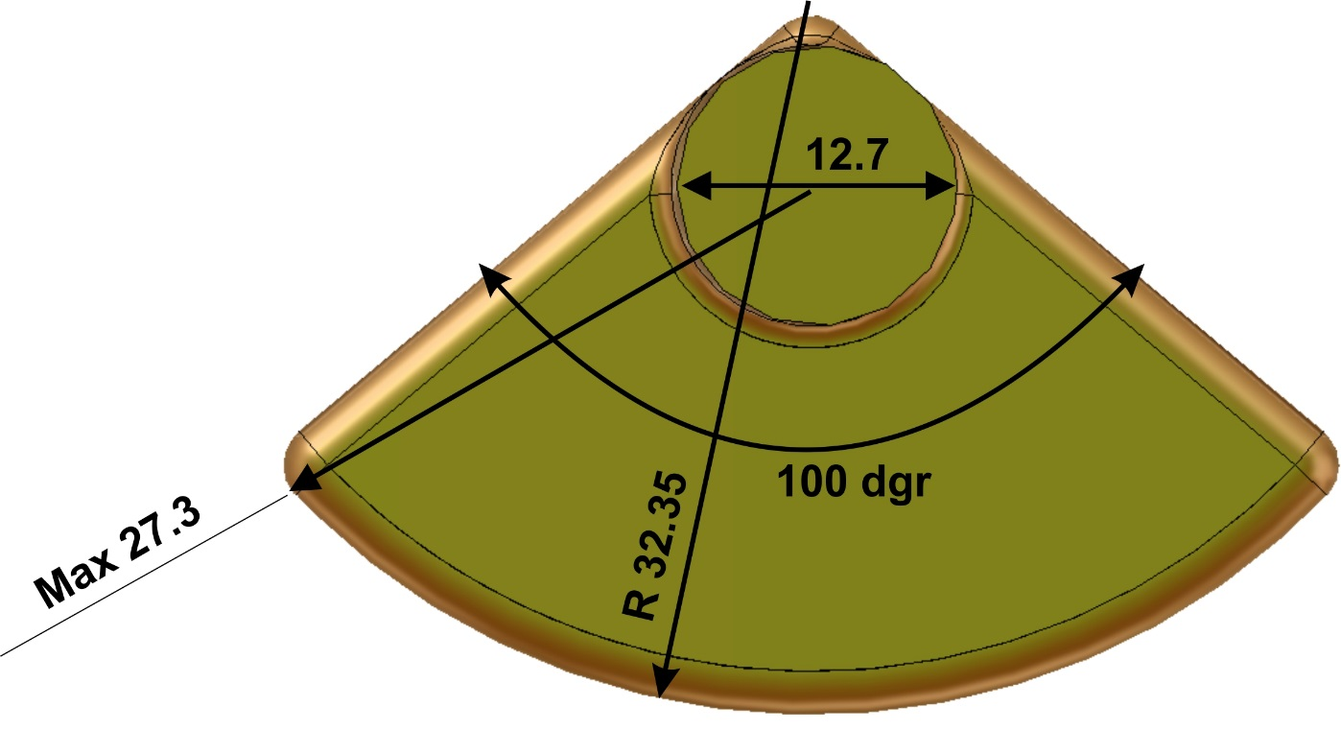
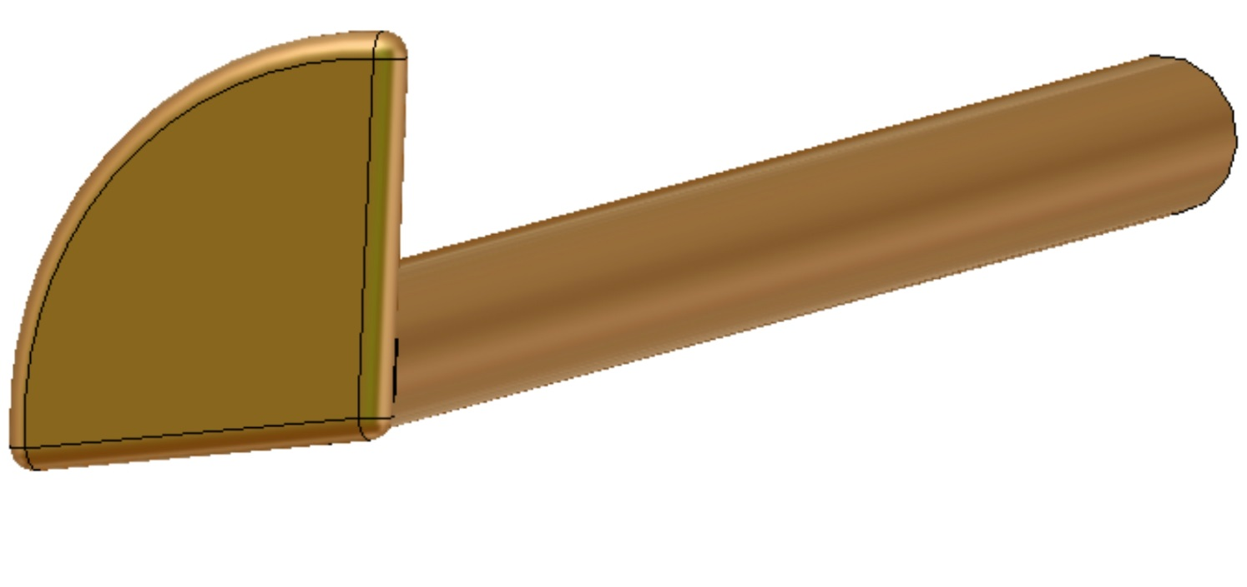
Antenna tip and coupling.
Configuration of 650 MHz cavity and coupler is not axial symmetrical ( relative to axis of antenna).
axis
We found that optimal (maximum coupling) shape of antenna tip should be non axial symmetrical as well. Optimal shape, “goose foot”, is presented on drawing.

Slide 38
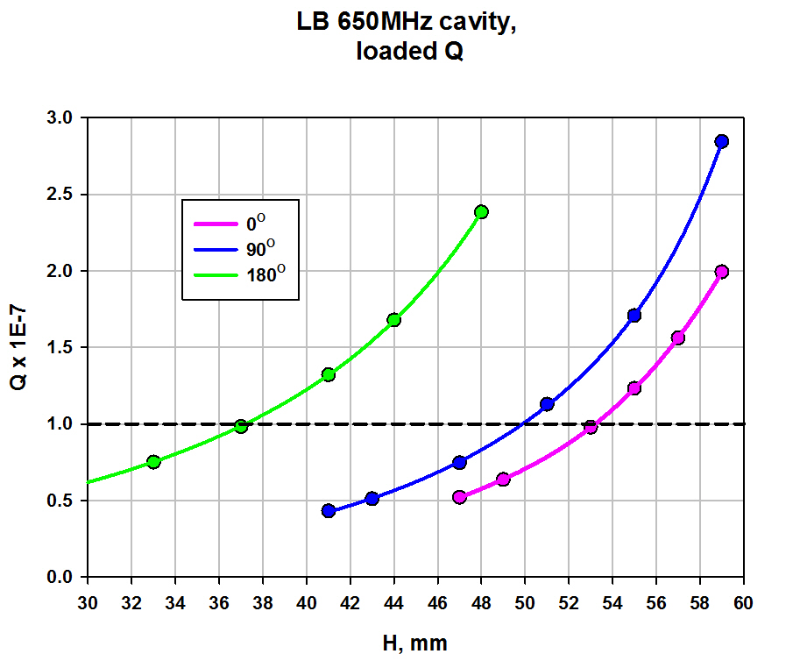
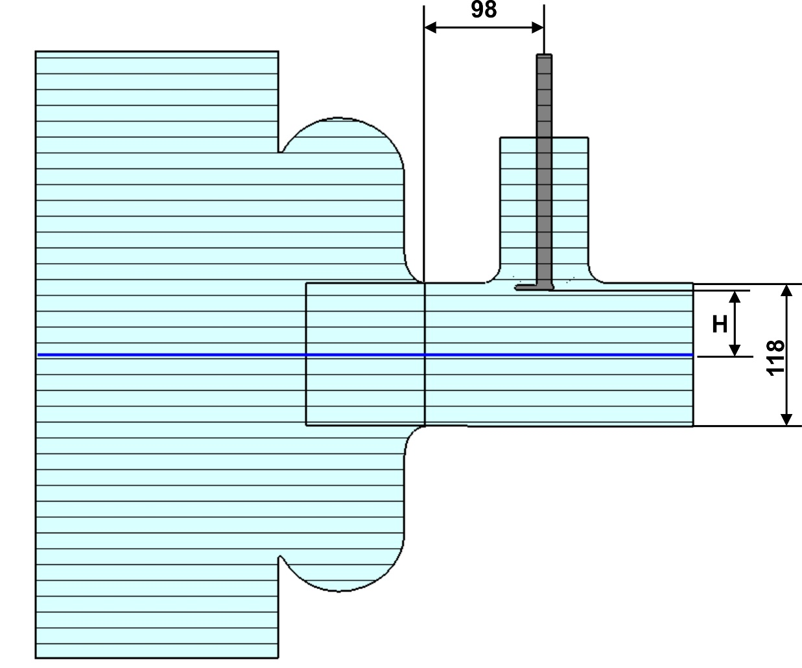
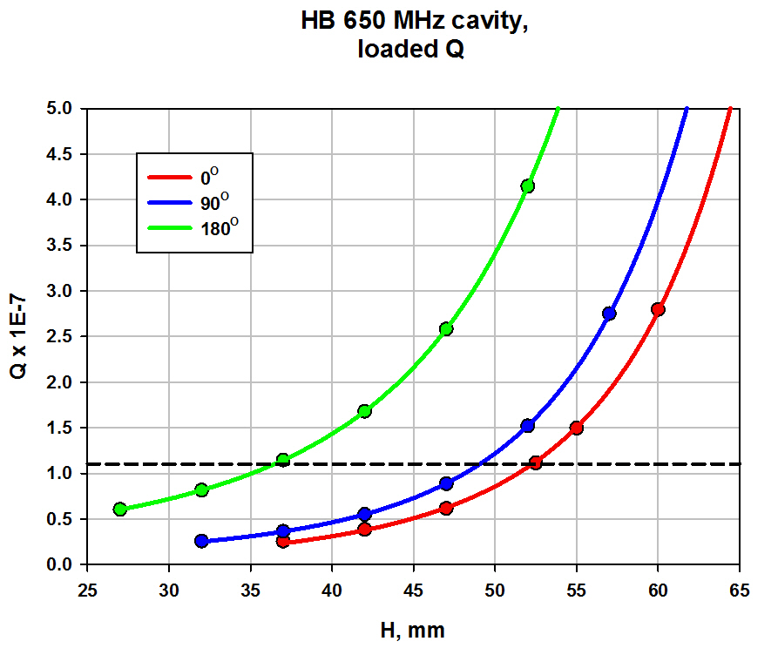
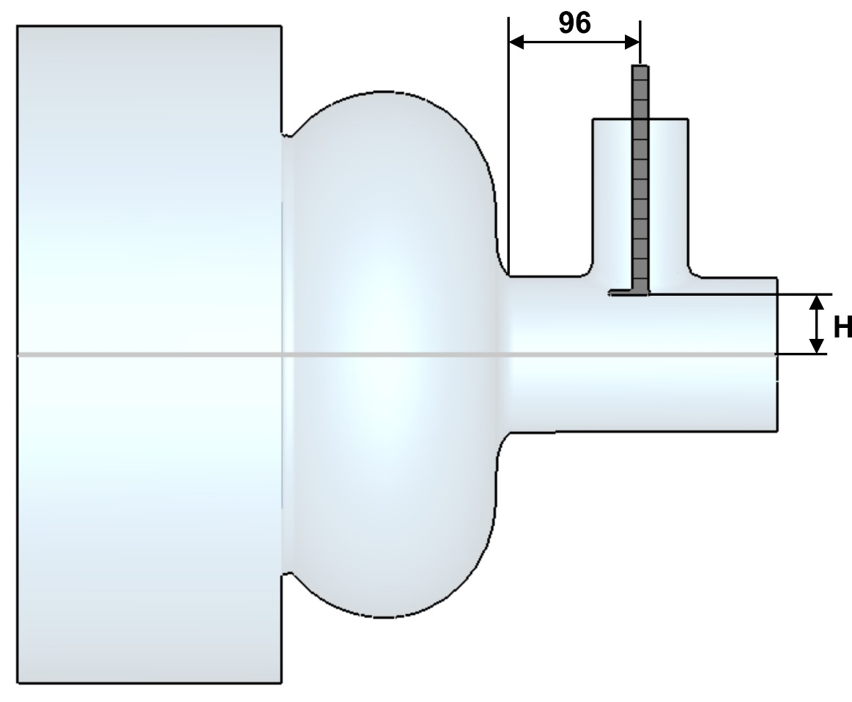
“Goose foot” increase coupling, decries antenna penetration and heating, allow to change coupling by antenna rotation. As simulations show the coupling can be change by more then 4 times.
LB 650 MHz cavity coupling:
HB 650 MHz cavity coupling:

Slide 39
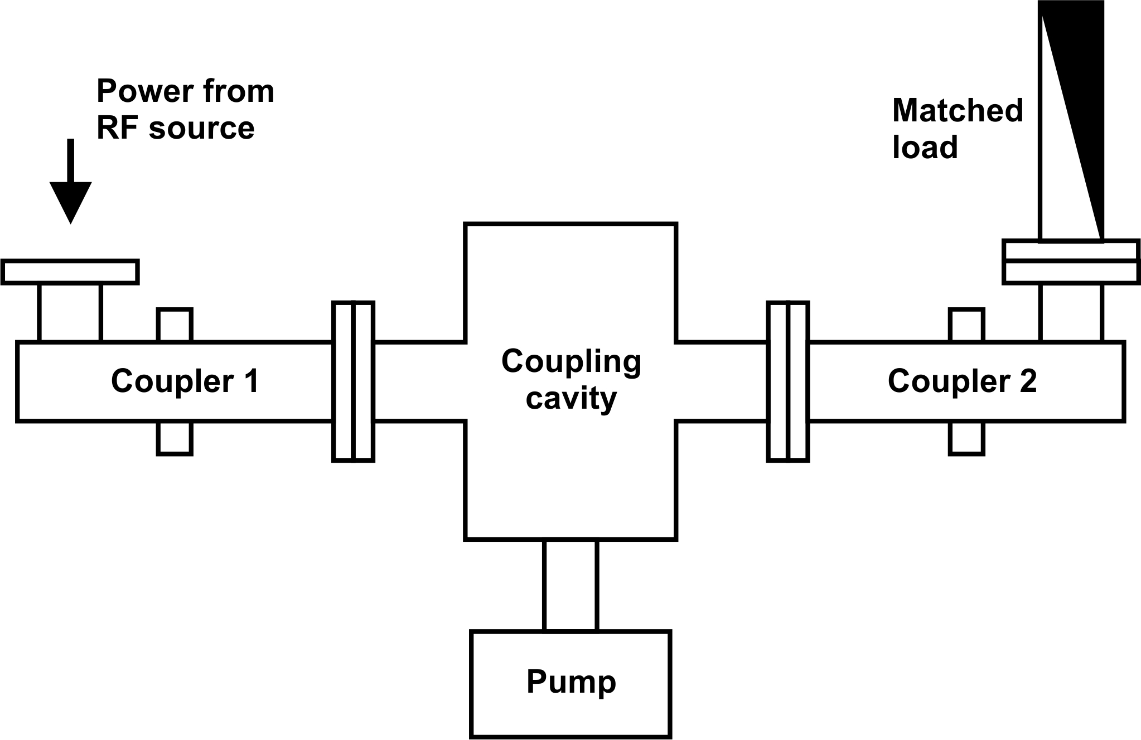
Coupler testing.
Usually couplers are tested in pairs to provide vacuum between couplers.
Typical configuration is presented at the drawing:

Slide 40
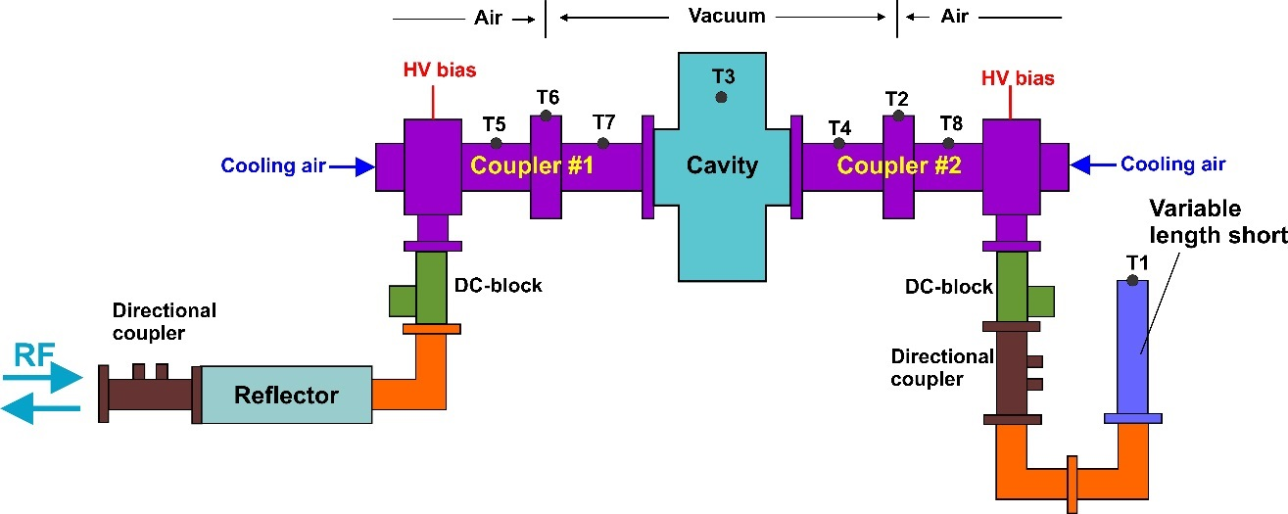
In our test of 325 MHz couplers we use the similar configuration, but instead of matched load we use movable short and installed the mobile reflector between RF source and test setup. Reflector partly transmits RF power and partly reflects. This configuration allows to organize a resonance between short and reflector. It increases testing power by several times, about 5 times in our case. Using 10 kW solid state amplifier we can test couplers up to 50 kW, full reflection.

Slide 41
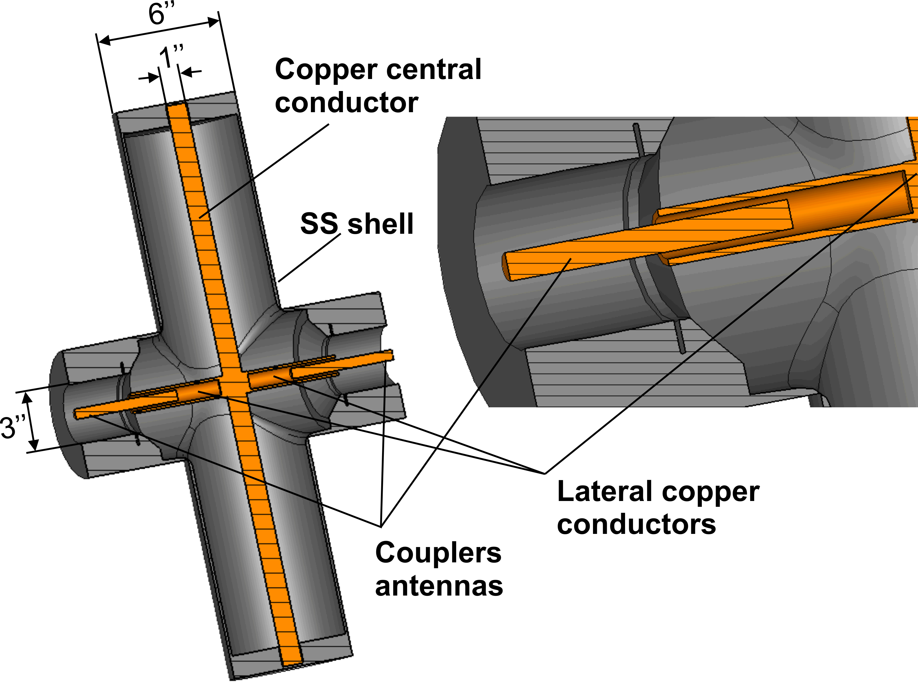
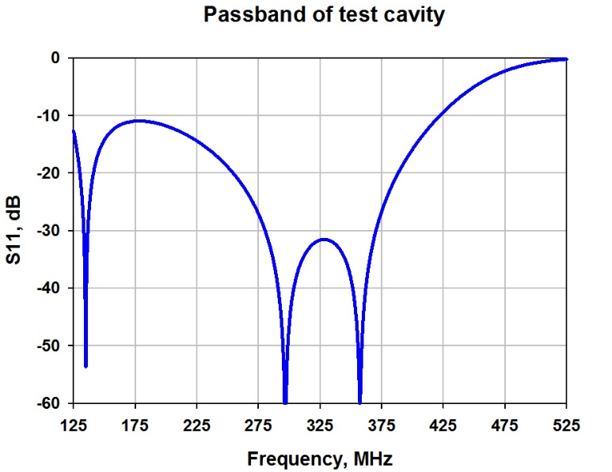
In our case the coupling cavity is rather transmission line with two quarter–wave supports then cavity. It provide wide passband, low fields and losses. Cavity made of pure stainless steel (no copper coating). Internal rods and supports are made of copper. Antennas of couplers have no mechanical contacts with internal copper rods. Electrically they connected through small capacitive gaps. Diameter of cavity was chosen as 6’’ to avoid multipactor in operating range of power.
Configuration of coupling cavity.

Slide 42
325 MHz coupler test stand

Slide 43
Coaxial reflector. It allows to increase testing power up to 5 times.
RF source: SS, 10 kW, CW, 325 MHz.
Testing power: up to 50 kW, CW

Slide 44
650 MHz coupler test stand.
In case of 650 MHz test stand the couplers will be connected mechanically to make things easer and less expensive.

Slide 45
650 MHz couplers test bench.
Couplers will be tested in resonance mode with full reflected power. It will allow to increase the level of testing power more then 100 kW using 30 kW RF source.
Waveguide reflector

Slide 46
Quality of ceramics is very impotent for reliable operation of coupler. We verify the loss tangent of each ceramic dick. Disk is placed in special copper cavity and quality factor of resonance is measured. Based on this value the loss tangent is calculated.
Cavity has the special shaper to move side resonances form operating resonance. Operating resonance is TE_011 type. TE_011 most sensitive to loss tangent of ceramic and has no angle variation. It increase the accuracy of measurements (no double peaks).
Measures are performed at different temperatures to verify dependence of loss tangent on temperature. Measurements are performed at not operating frequency of coupler but several times higher ~ 2.5 GHz.
Cut view of cavity with ceramic disk.
Electric field of measured mode

Slide 47
Measurements of loss tangent of ceramics disks.

Slide 48
Example of results of measurements
CoorsTek ceramic measurements, F ~ 2.7 GHz
Some times ceramics is extremely good: loss tangent ~ 1.5E-5 at 2.7 GHZ

Slide 49
Thank you for attention!

