Slide 1
CM Workshop: SRF Cavity Processing Tutorial
Allan Rowe
PIP-II Project Engineer
3 September 2018

Slide 2
Outline
Intro/Bio
What is SRF cavity processing?
Processing steps and functions

Slide 3
Introduction/Biography
Current – PIP-II Project Engineer
Past
  L2 Manager for PIP-II SRF Systems
  L3 Manager for PIP-II 650 MHz Sub-system
  Deputy Dept. Head of SRF Department
  Group Leader for SRF Cavity Processing and Facilities
  ….

Slide 4
What is SRF cavity processing?
Steps required to prepare the inner conductive layer of a Superconducting radio frequency (SRF) resonator to enable very high electric and magnetic surface fields while achieving very low surface resistance and minimal field emission.
Main processing requirements:
Damaged layer removal via chemical etching or polishing.
Hydrogen degasification via high-temperature vacuum heat treatment.
Particulate and surface residue removal via ultra-clean high-pressure water rinsing.
Evacuation.
Surface water removal and surface oxide modification via low-temperature vacuum heat treatment.

Slide 5
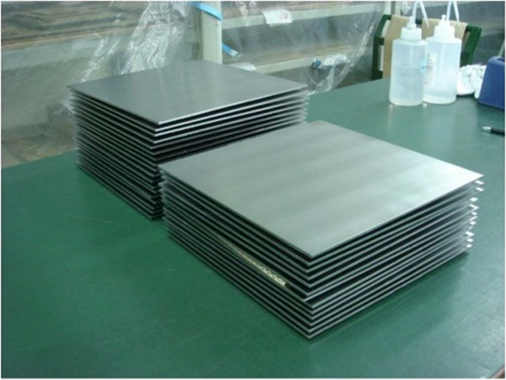
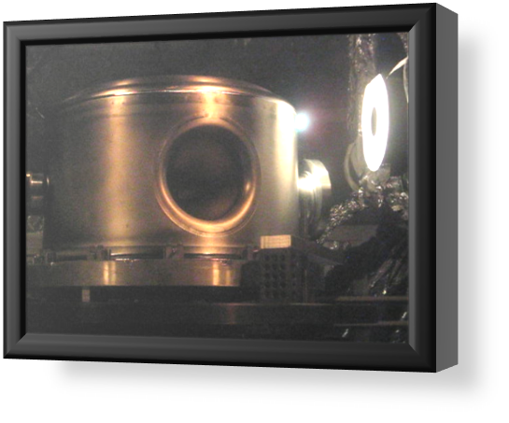
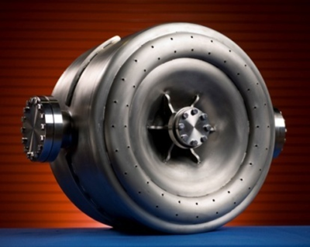
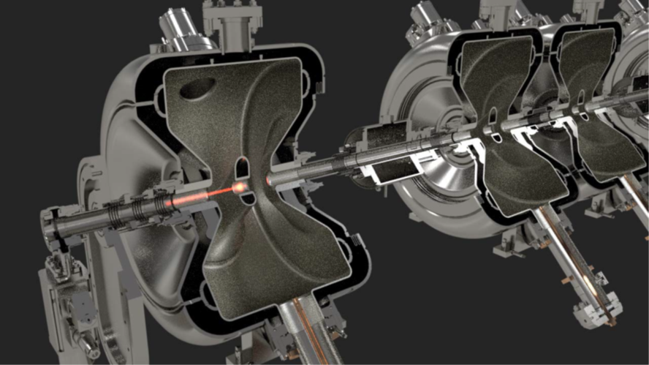
From sheet metal to SC particle accelerator.
Cavity Processing & Qualification

Slide 6
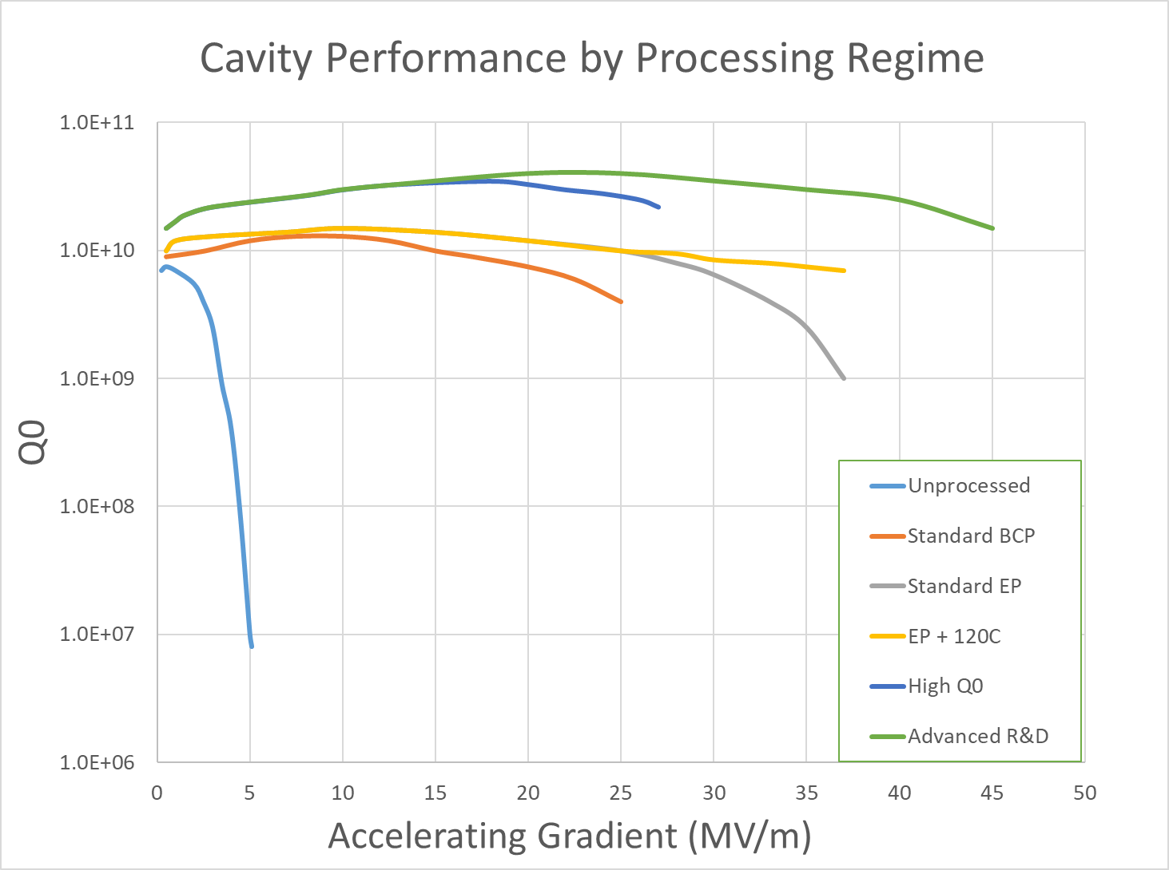
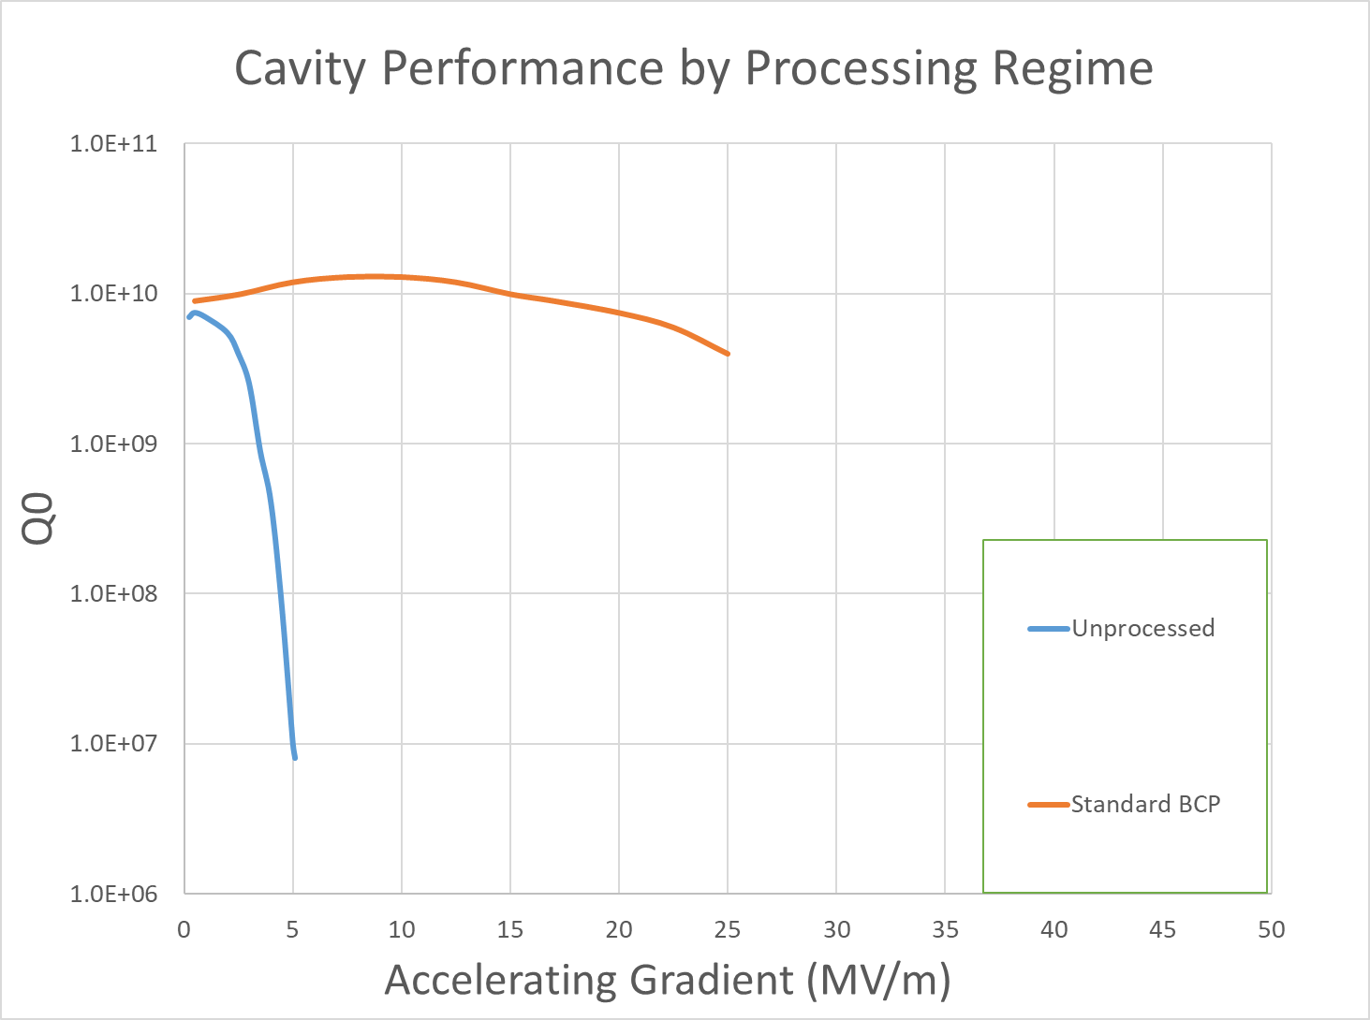
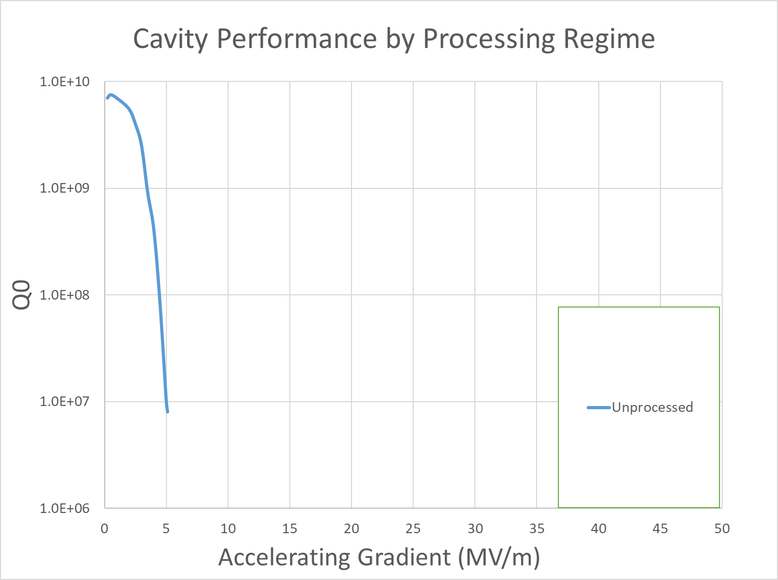
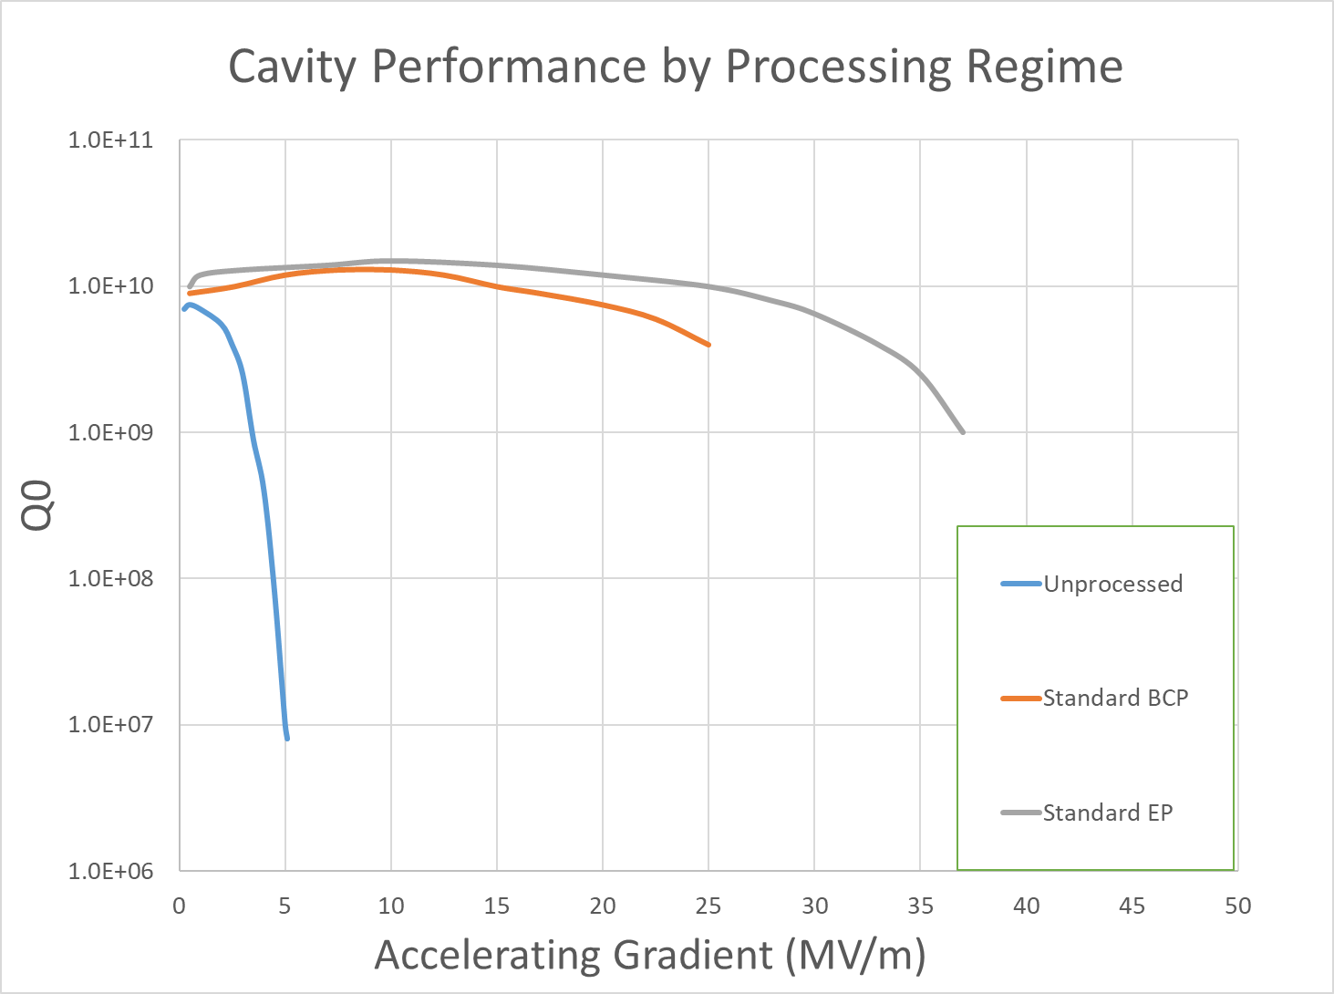
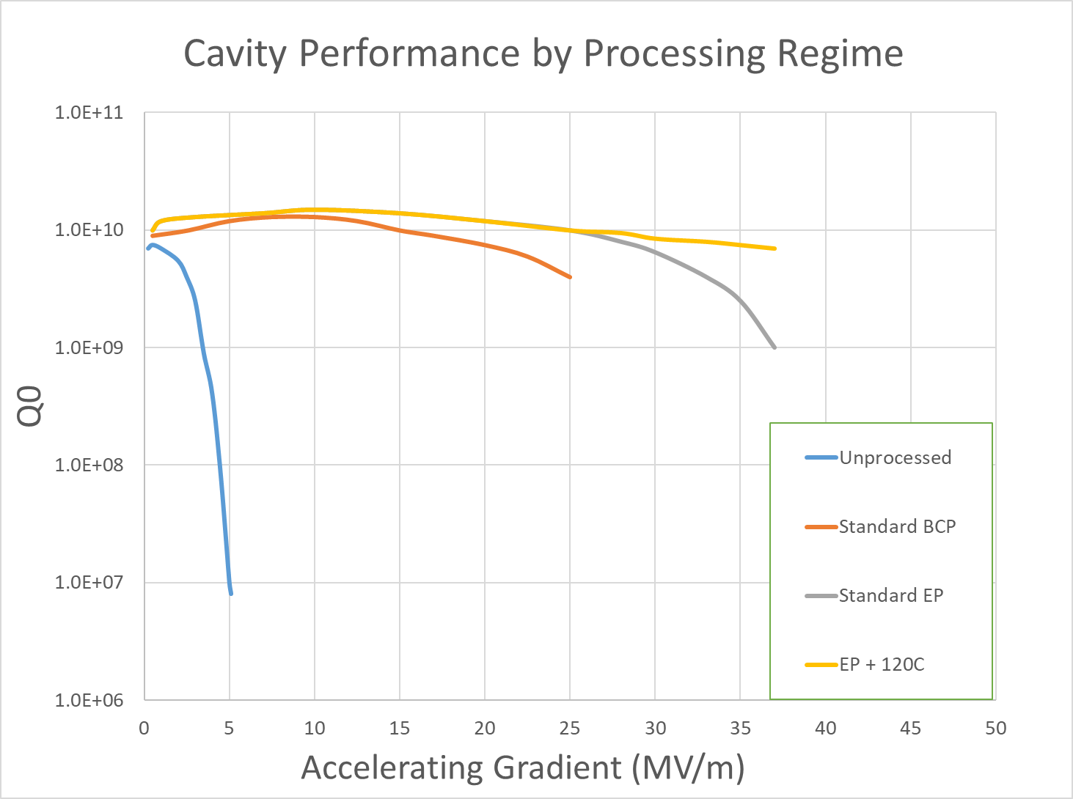
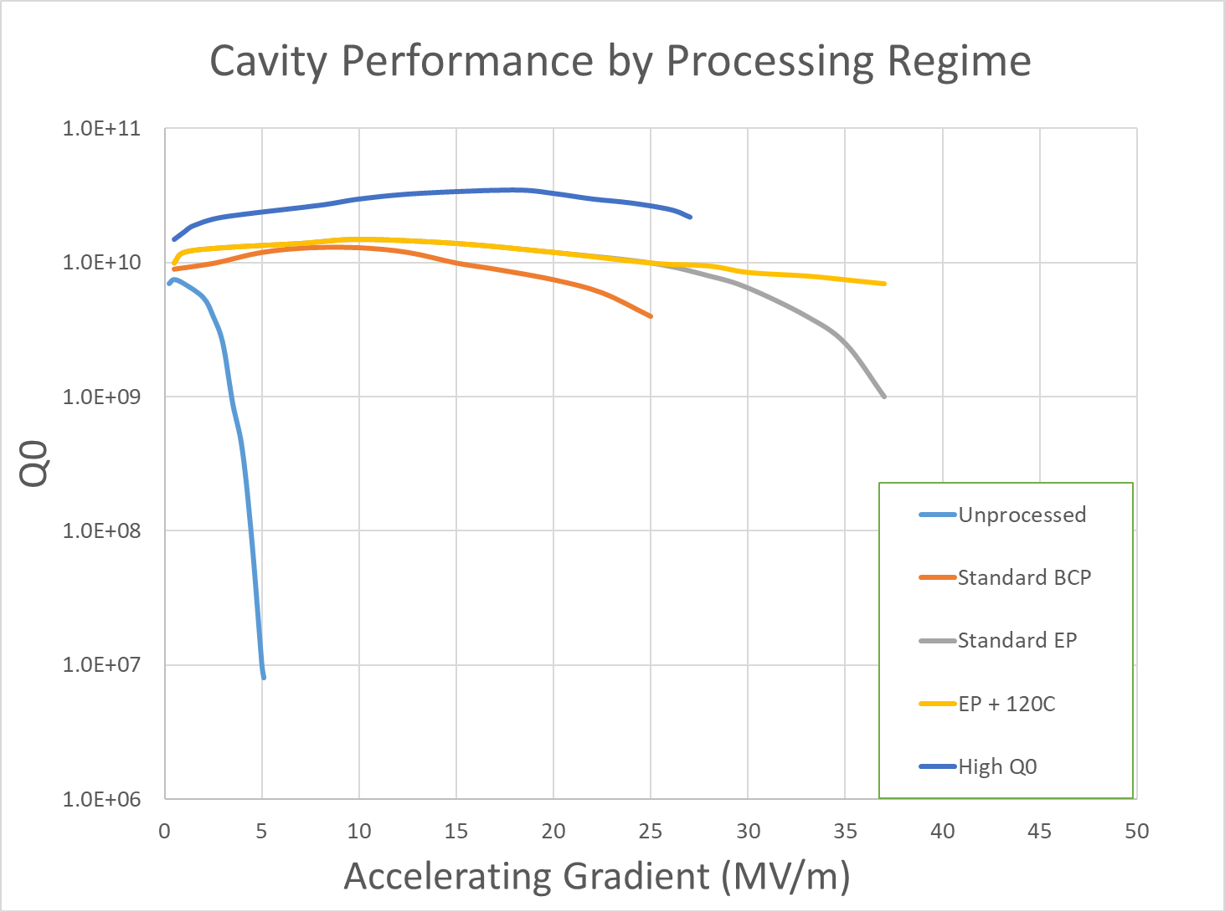

Slide 7
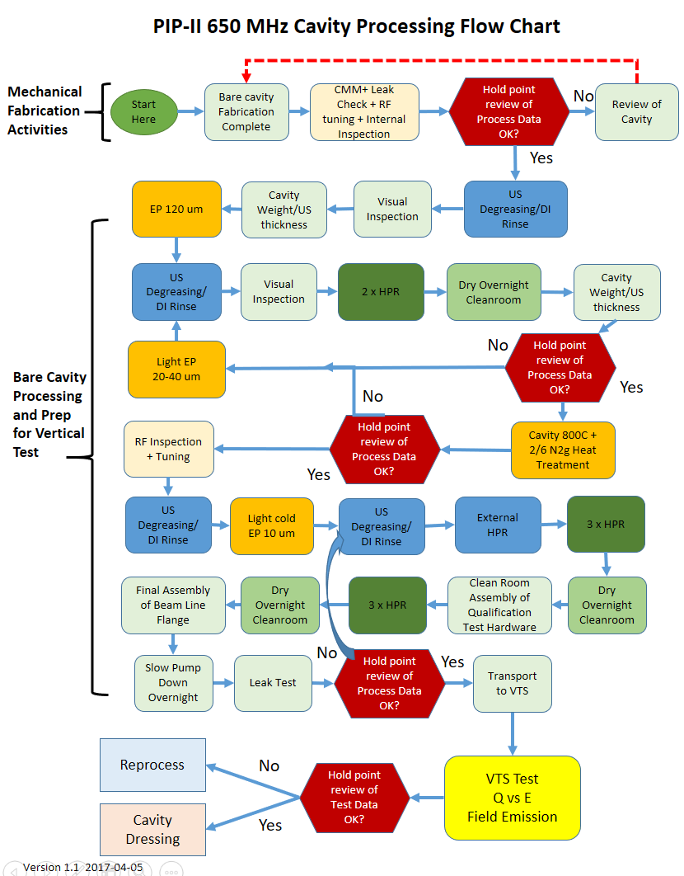

Slide 8
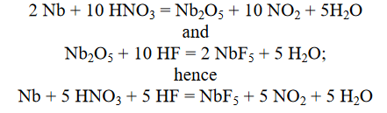
Bulk Chemistry – Buffered Chemical Polishing
Damaged layer removal caused by manufacturing
  Requires 120-200 um material removal from the RF carrying surface
Two primary techniques: BCP and EP
  Buffered Chemical Polishing (BCP) – an etching process
    Oxidation – Reduction cycle
    1:1:2 Ratio - 48.5% HF : 70% HNO₃ : 85% H₃PO₄
    Reaction surface temperature controlled: 12-15C
    Best for asymmetrical/complex cavity geometry + lower gradient and quality factor requirements
    Relatively simple process setup
    Extremely hazardous due to HF and noxious fumes

Slide 9
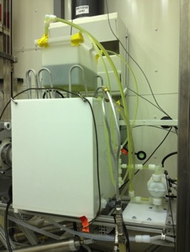
BCP – Bare cavity setup
Exterior surface temp control
BCP solution is chilled to < 5C
Gravity filled and dumped
Pneumatic pumps slowly circulate solution
Agitation via flows tailored to resonator geometry
Ultrapure water rinsing following etching to remove residual salts
Transfer to cleanroom while surfaces are still wet

Slide 10
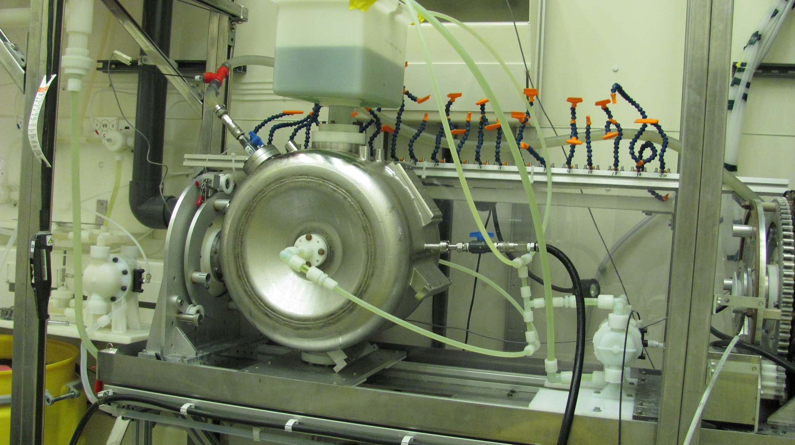
Jacketed SSR1 BCP Setup
Reaction temperature and fluid flows are carefully controlled

Slide 11
Bulk and Fine Chemistry: Electropolishing
Damaged layer removal + light polishing for surface optimization.
Much more complex than BCP.
Ideal for azimuthally symmetrical resonators like elliptical structures.
Can be implemented if considered during the cavity design phase.
Generally required for gradients > 25 MV/m.
Required for very high Q0 applications (N2 doping recipes).
Tight process controls essential to achieving high quality surface polishing results.
Process extremely hazardous due to HF

Slide 12
Electropolishing Principals
10:1 Volumetric Ratio of 96% H2SO4 : 49% HF (other ratios exist)
Anthony C. Crawford https://www.sciencedirect.com/science/article/pii/S0168900217300086
H. Diepers, O. Schmidt, H. Martens, F. Sun, A new method of electropolishing
niobium, Phys. Lett. 37A (2) (1971) 139

Slide 13
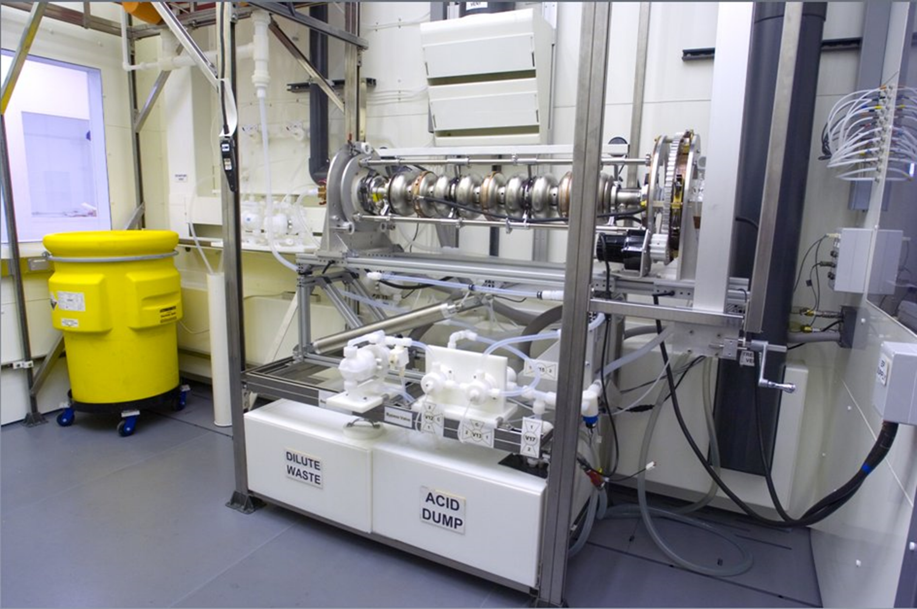
Electropolishing Facility at Argonne Nat’l Lab

Slide 14
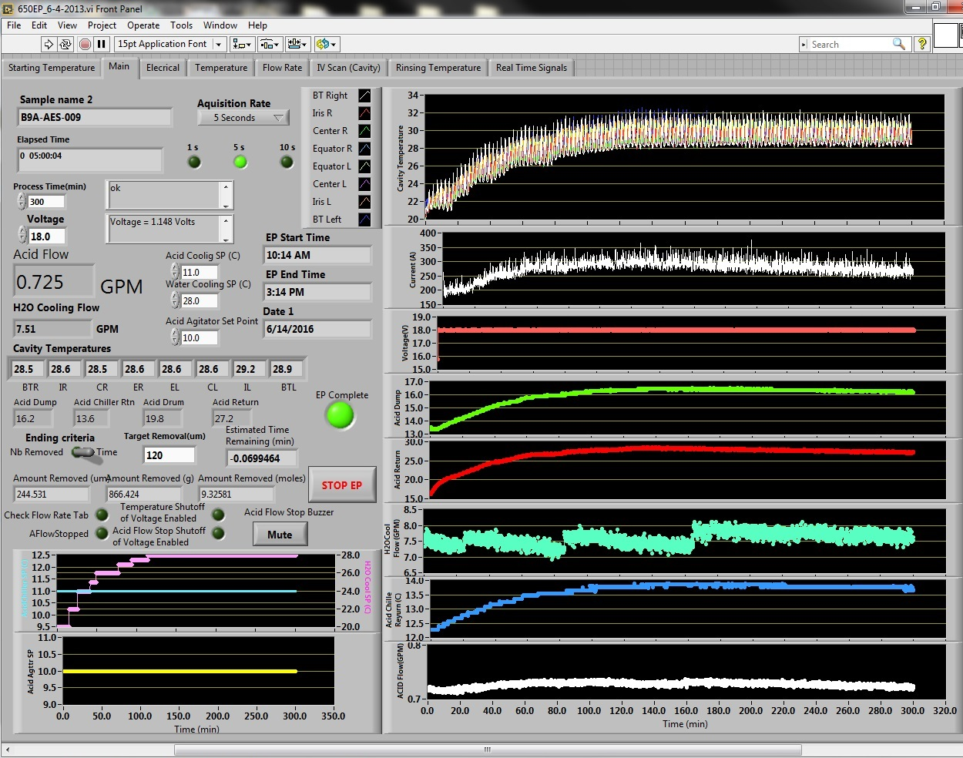
Electropolishing Tool Interface

Slide 15
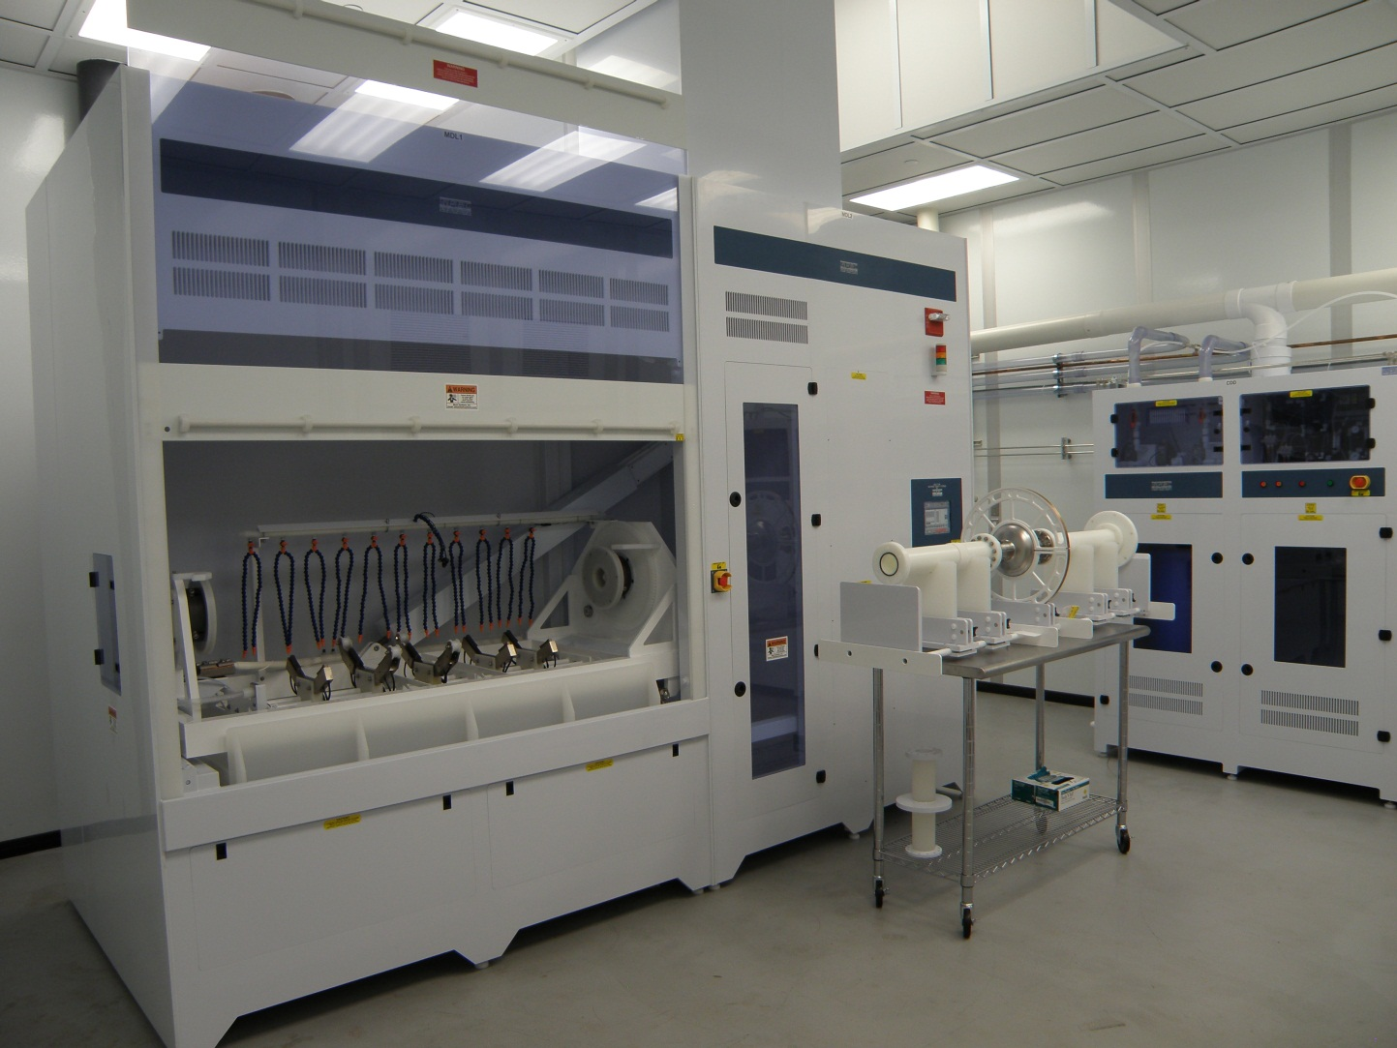
Commercial-style Electropolishing Facility

Slide 16
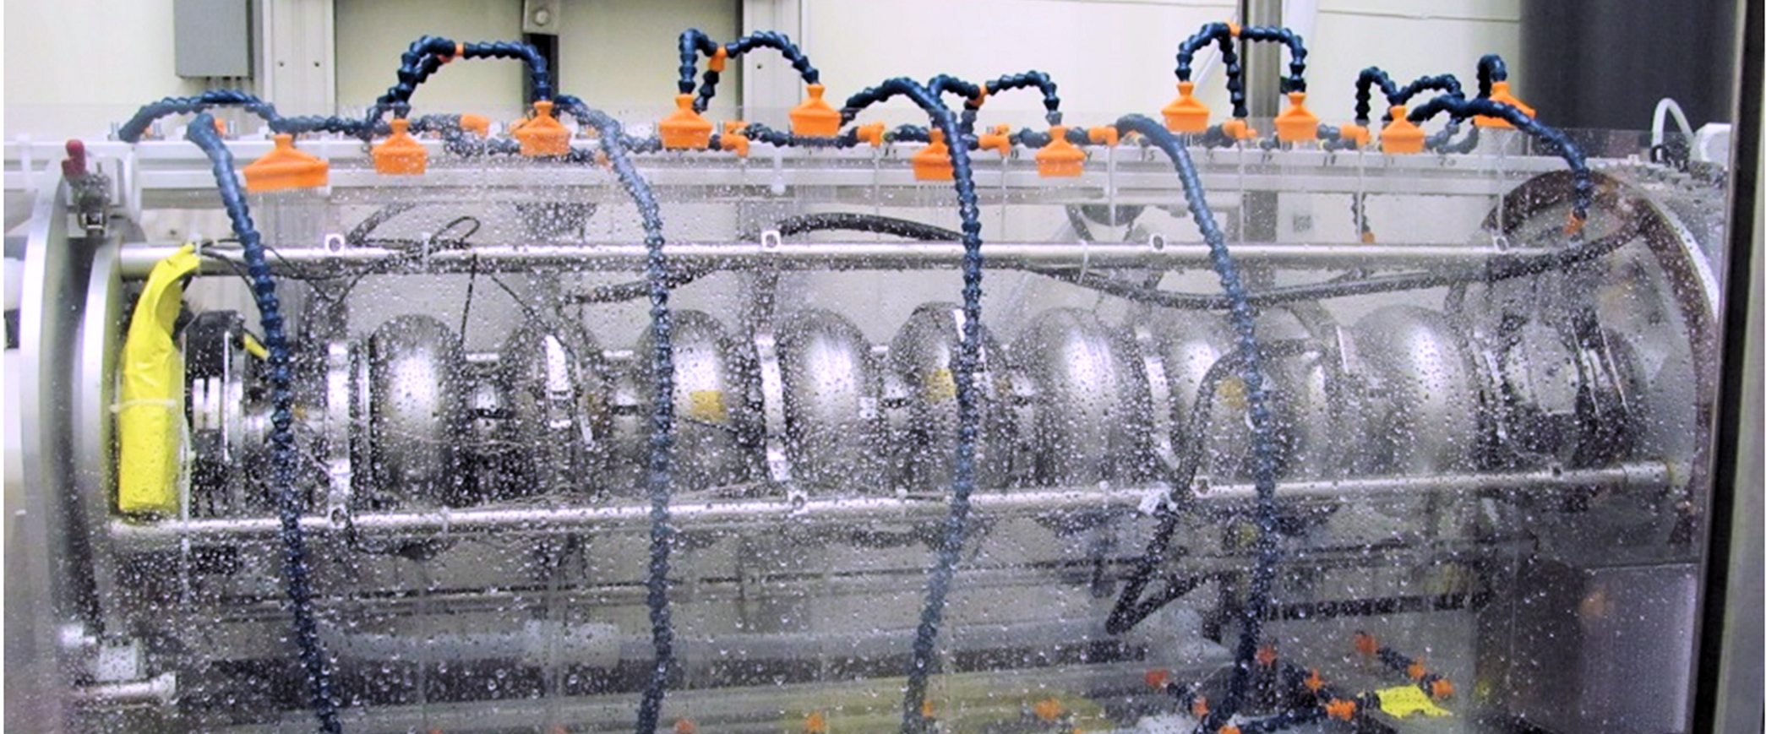
ILC/XFEL/LCLS-II Bare Cavity Electropolishing
External water cooling, in particular at the irises, is used to control material removal rates and reduce polishing depth ratios between the irises and equators.

Slide 17
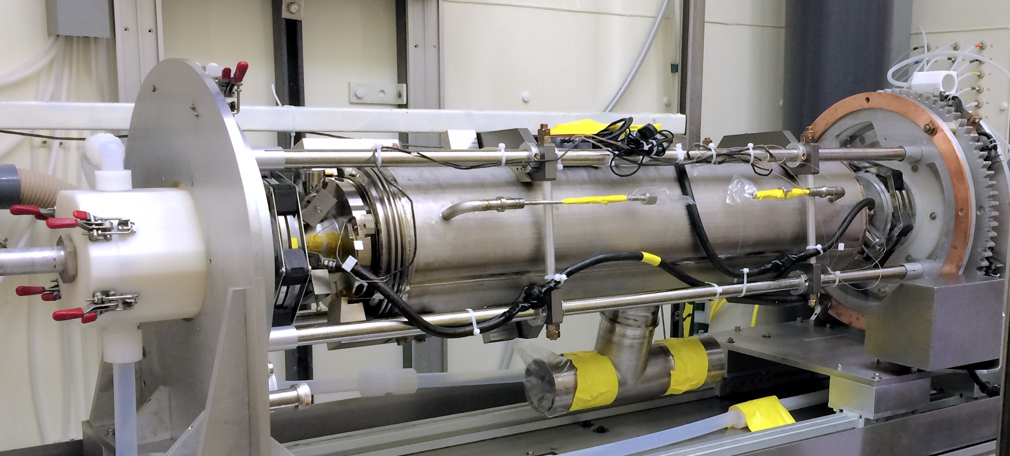
ILC/XFEL/LCLS-II Jacketed Cavity Electropolishing
Helium vessel used as cooling jacket.
Modest removal amounts (5-15 um) acceptable up to the field flatness requirement limits.

Slide 18
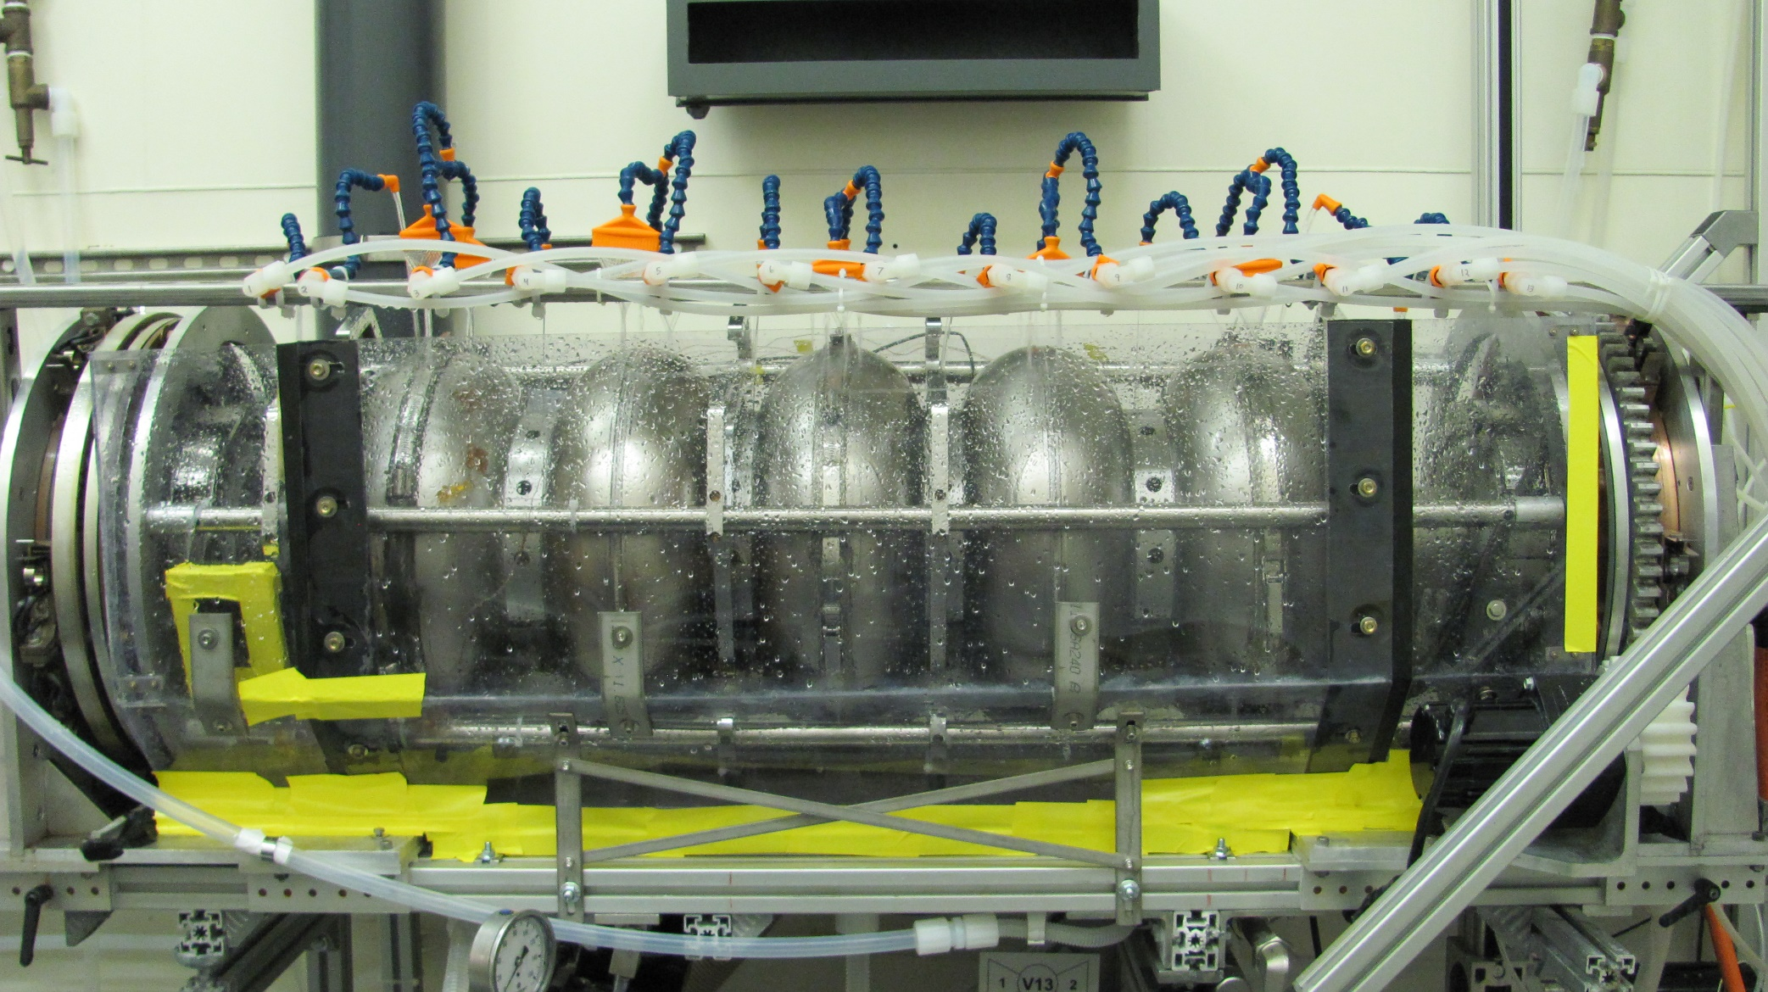
650 MHz Electropolishing

Slide 19
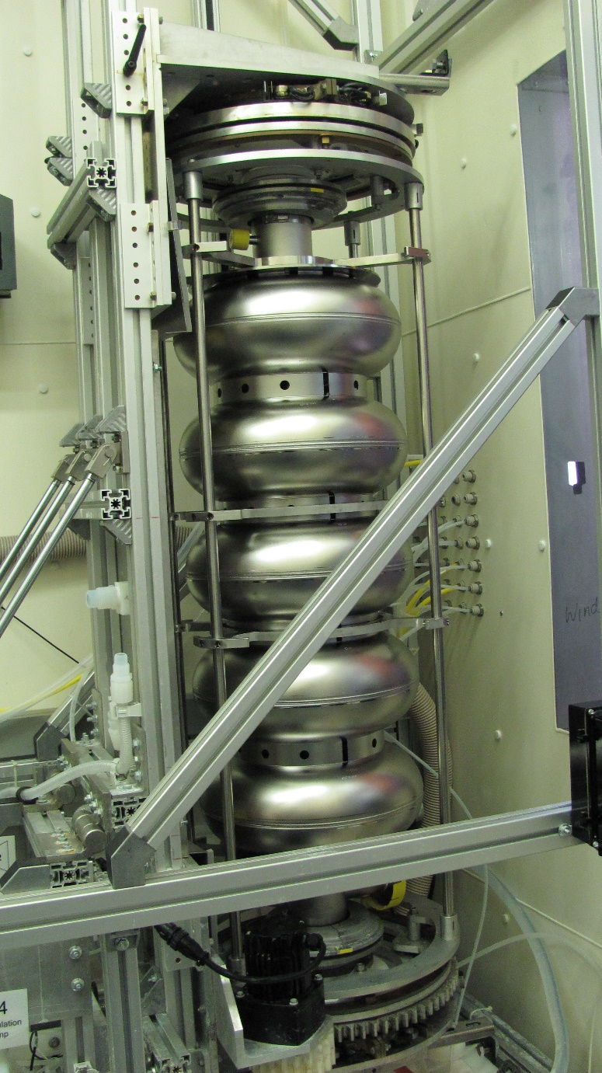
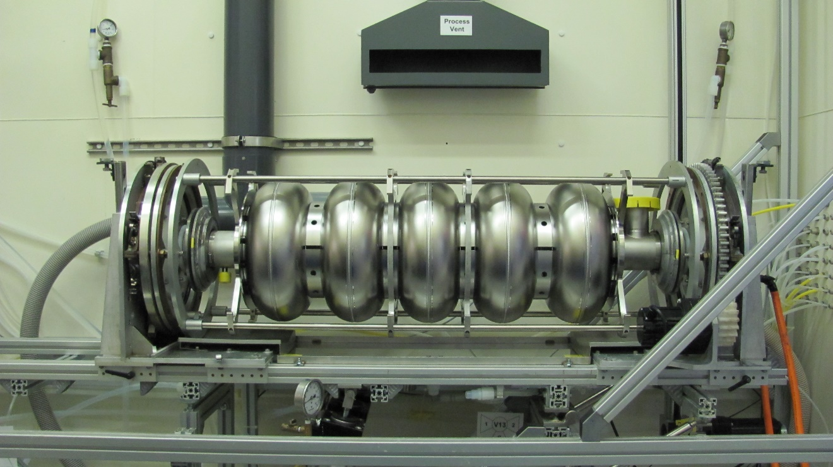
Draining electrolyte + rinsing
After EP, the cavity is rinsed several times with ultra-pure water to remove chemical salts.

Slide 20
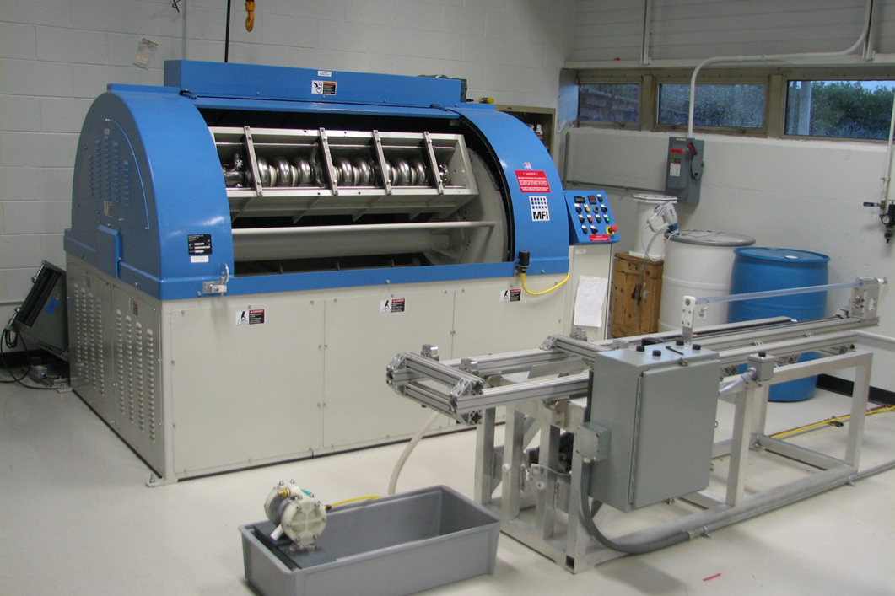
Centrifugal Barrel Polishing
IB4 High centrifugal barrel polishing tool repairs 1.3 GHz inner surfaces when defects appear. Two 9-cell 1.3 GHz cavities can be tumbled simultaneously.

Slide 21
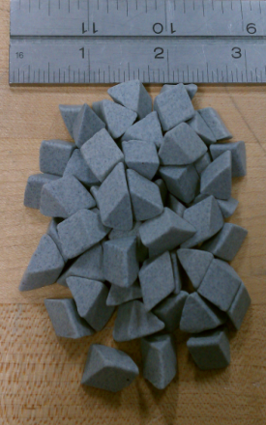
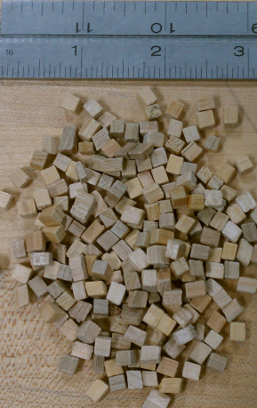
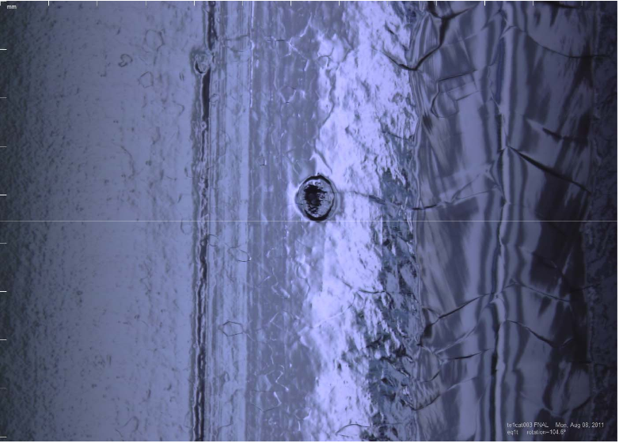
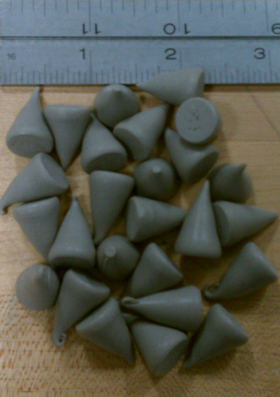
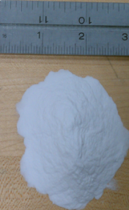
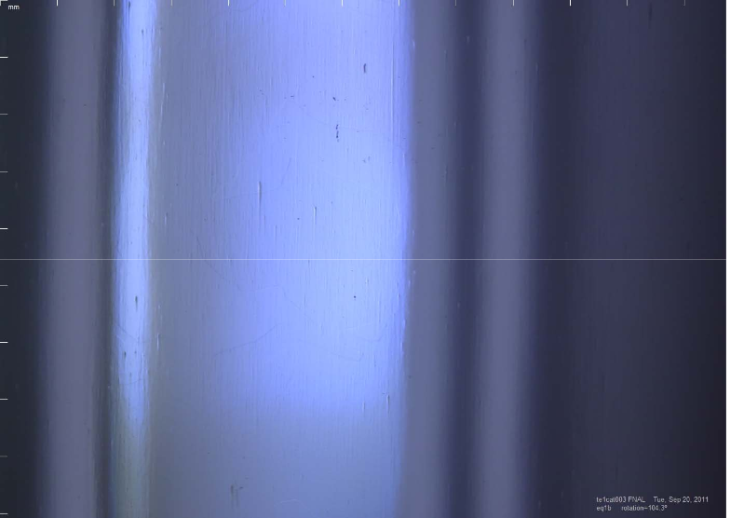
Centrifugal Barrel Polishing
Implemented for Elliptical cavities
Primarily used to repair large defects in welds/HAZ
Can be used as a bulk chemistry replacement
Requires EP to remove residual contamination left by CBP media
Defect after EP
Cutting and Polishing Media
No defect after CPB + EP

Slide 22
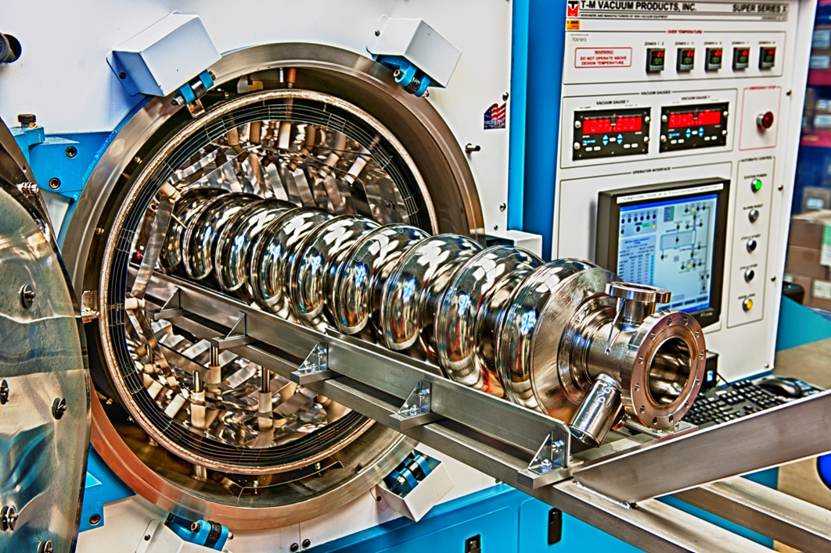
Hydrogen Degasification
IB4 High temperature vacuum furnace being loaded with a 1.3 GHz 9 cell cavity. The maximum operating temperature is 1200 C and the base vacuum is 10⁻⁸ Torr. High temperature furnaces are used to degas and dope cavities.

Slide 23
Hydrogen Degas and N2 Doping Cycle

Slide 24
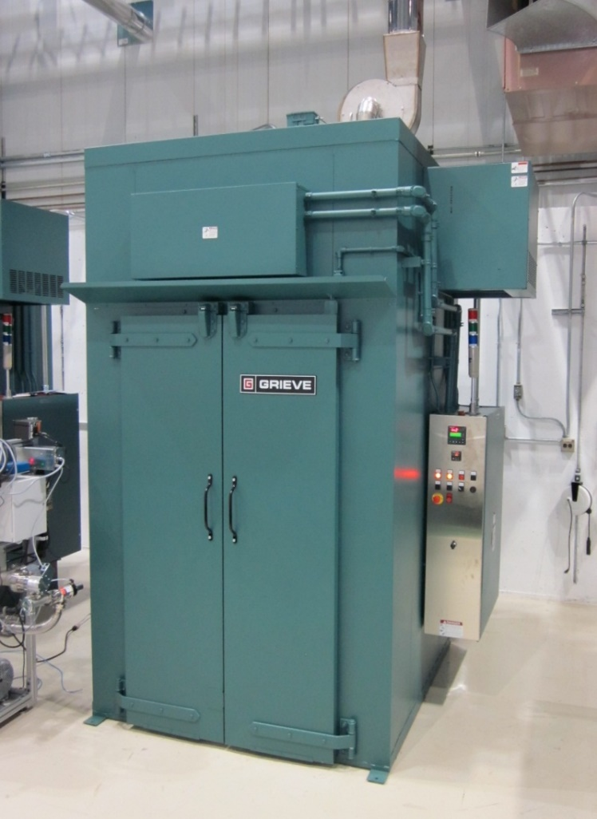
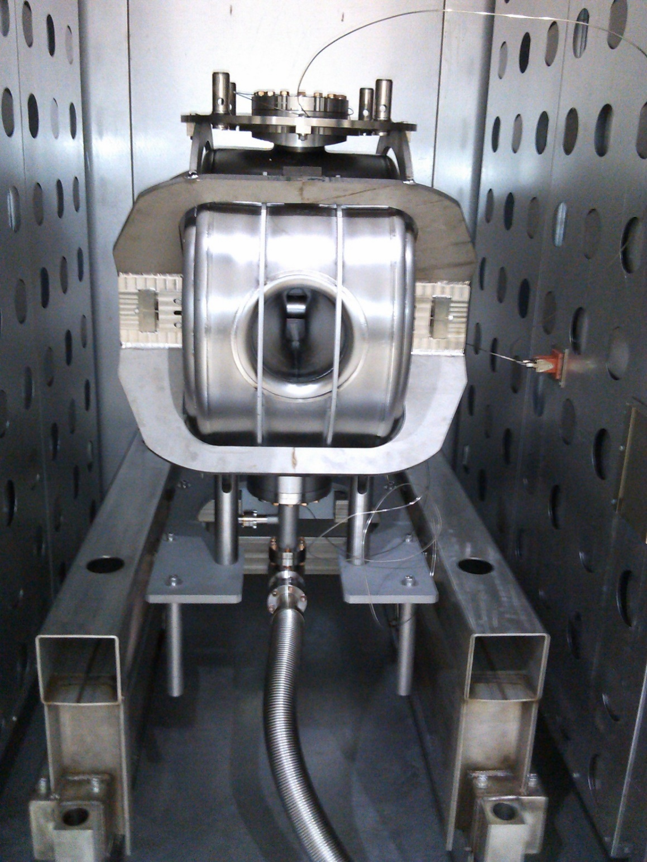
Low Temperature Baking
Low temperature (<300C) ovens use hot-air circulation to heat cavities.
UHV system maintains cavity vacuum and prevents particle migration.
Used to mitigate multipacting and correct high-field Q-slope.

Slide 25
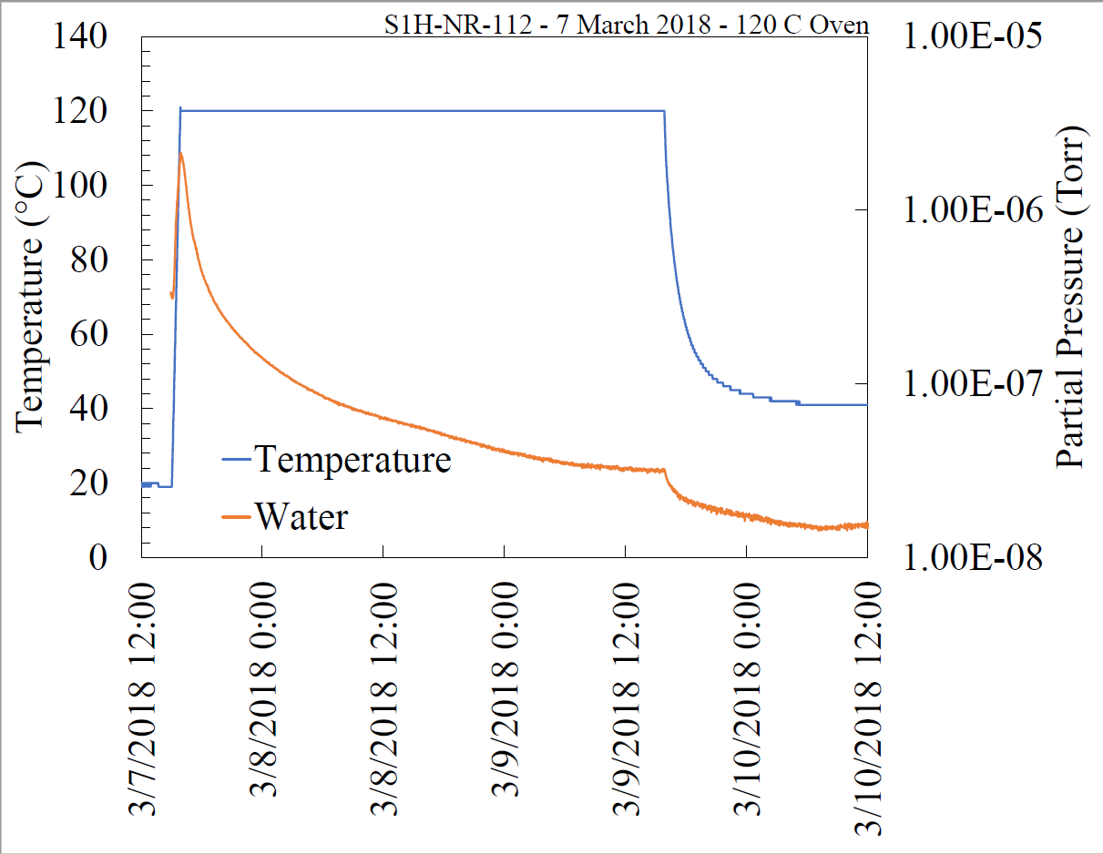
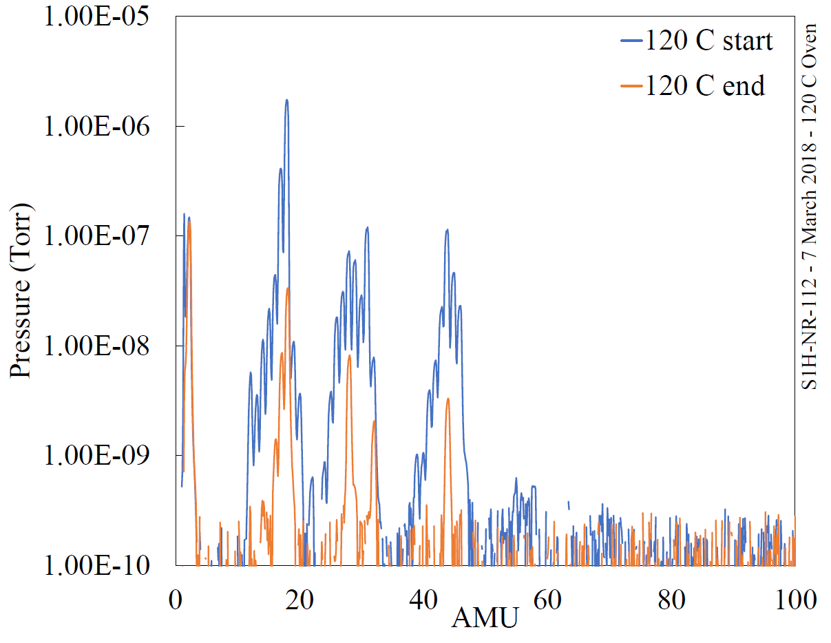
48 hour 120C Bake Cycle
Residual water removal
Before/after 120C RGA spectrum

Slide 26
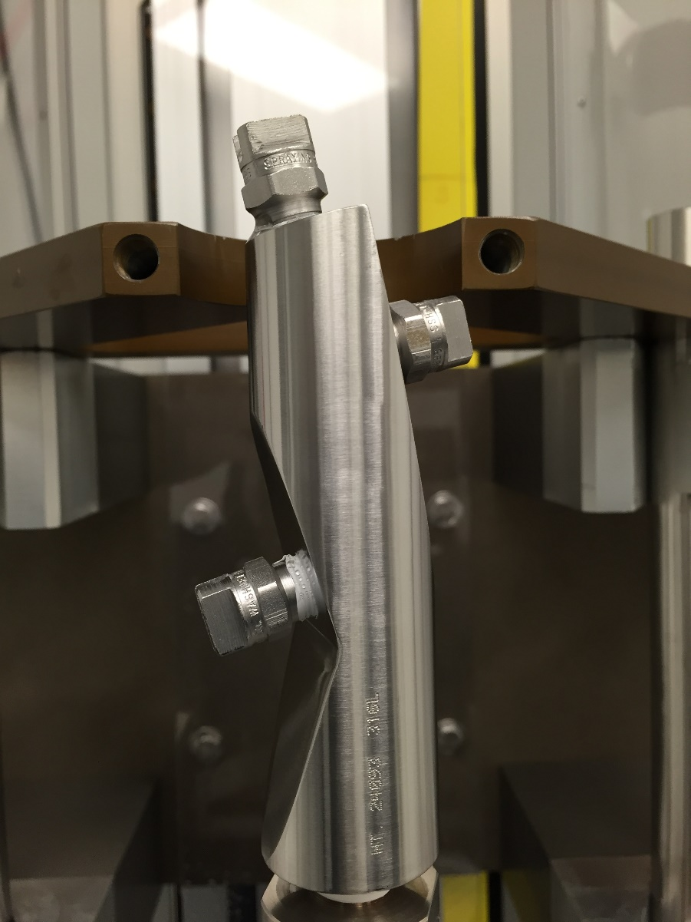
High-pressure Rinsing (HPR)
Basic Parameters
ISO Class 4 Cleanroom
100 ATM Pressure
8-20 L/min
Ultrapure water
  Semi-conductor quality
  >18 MOhm
  0.05 um filtration
  < 10 ppb TOC
8-24 hour rinse cycles
10-30 sec. integrated dwell times
Fan-jet or circular orifice nozzles
All wetted materials SRF compatible.
650 MHz HPR nozzle

Slide 27
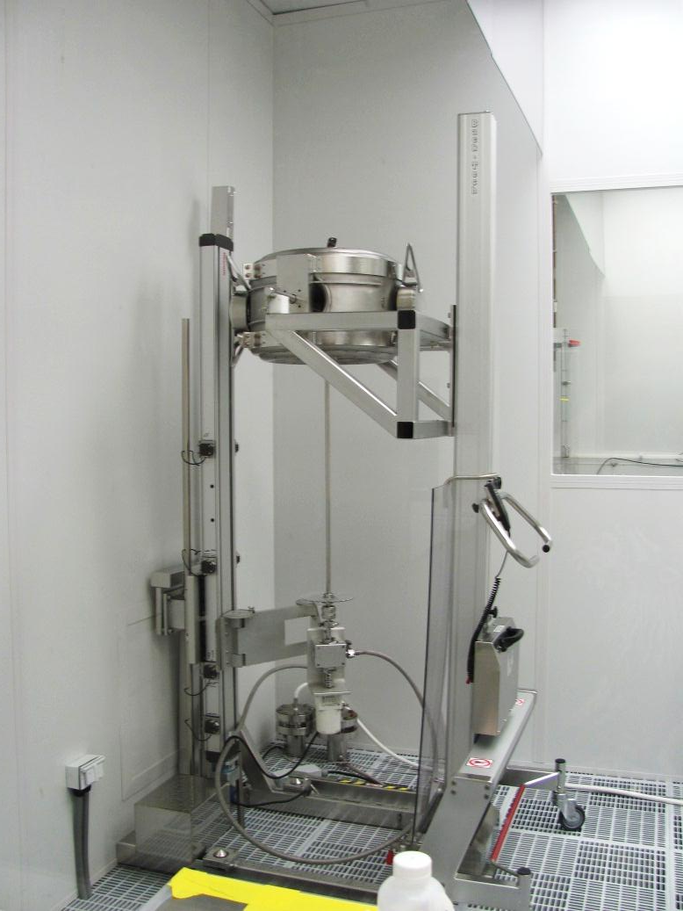
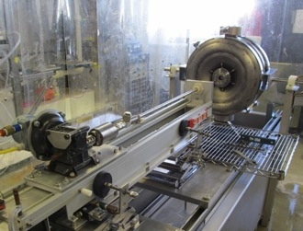
Spoke Cavity High Pressure Rinsing
Multiple rinse passes and orientations
Complex geometry requires caution
Horizontal orientation
Vertical orientation

Slide 28
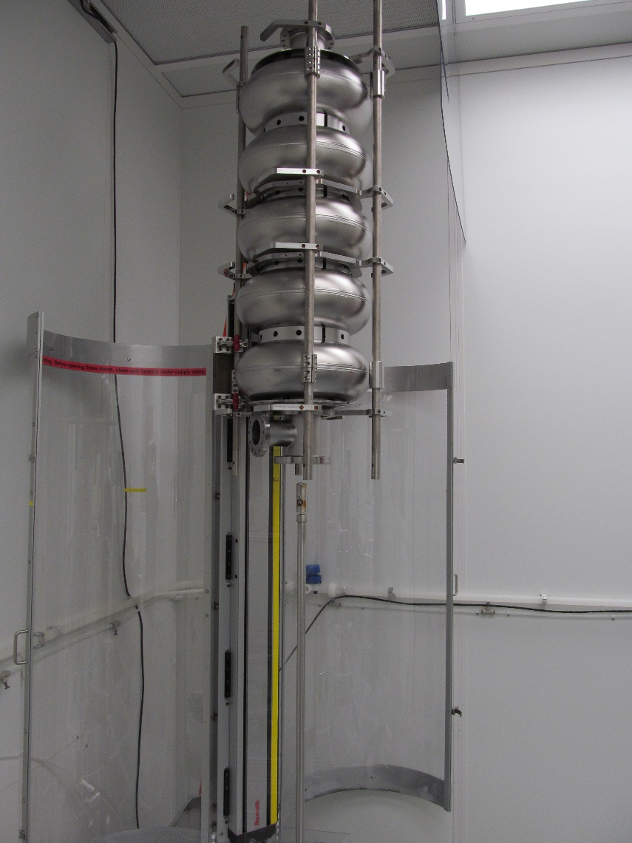
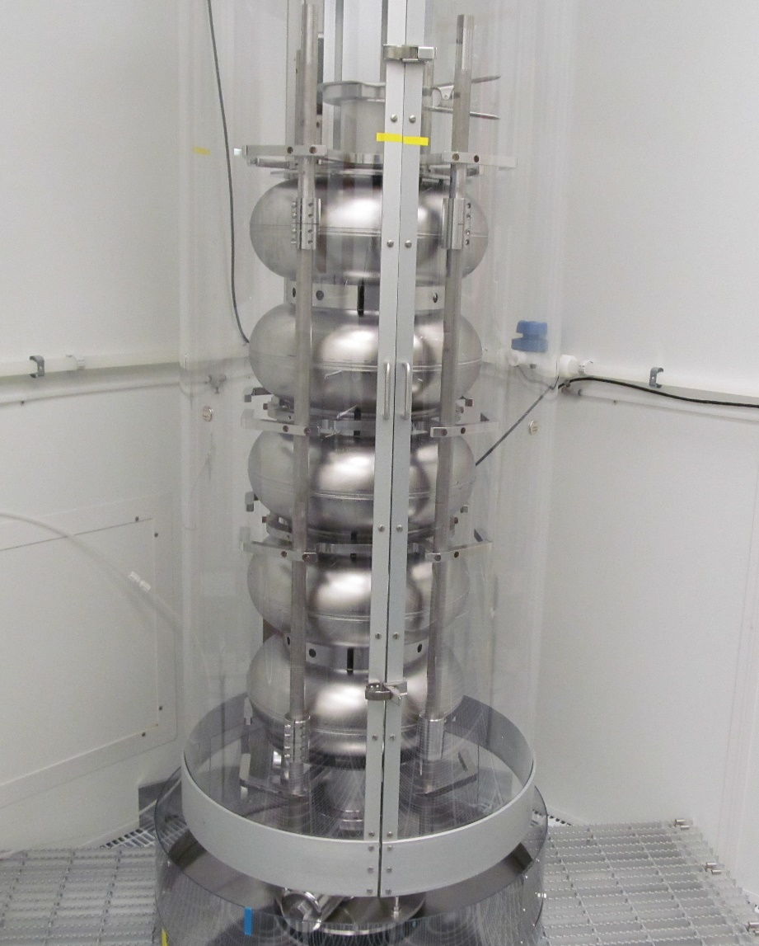
650 MHz Elliptical Cavity High Pressure Rinsing
Cavity in top position
Cavity in bottom position

Slide 29
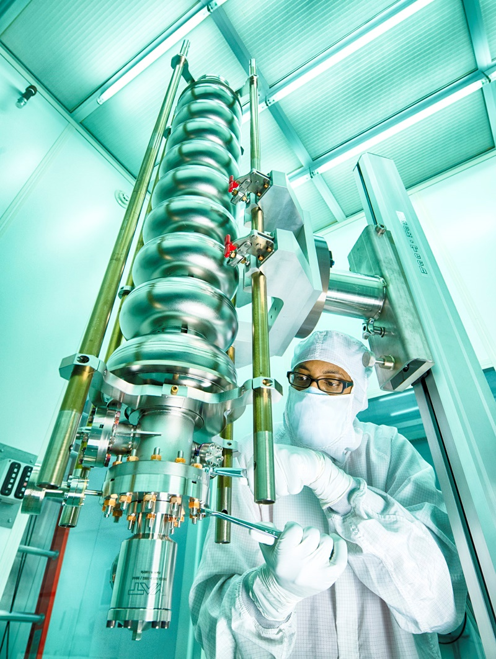
Cleanroom Assembly
Requirements
ISO Class 4 or better environment
High-level technical skills
Patience
Precise process controls
  Component preparation
  Assembly planning
  Clear rejection criteria
  Work-location monitoring
Component compatibility
  CR environment
  SRF use
  Ease of assembly
Slow evacuation
Culture of SRF Technology

Slide 30
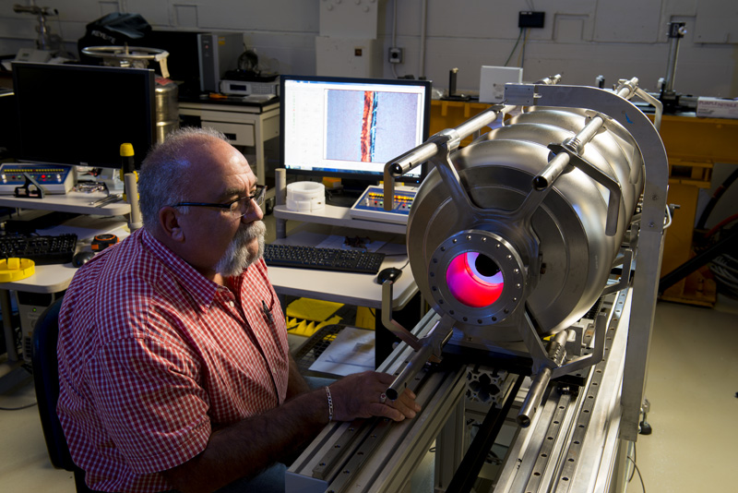
Optical Inspection Setup

Slide 31
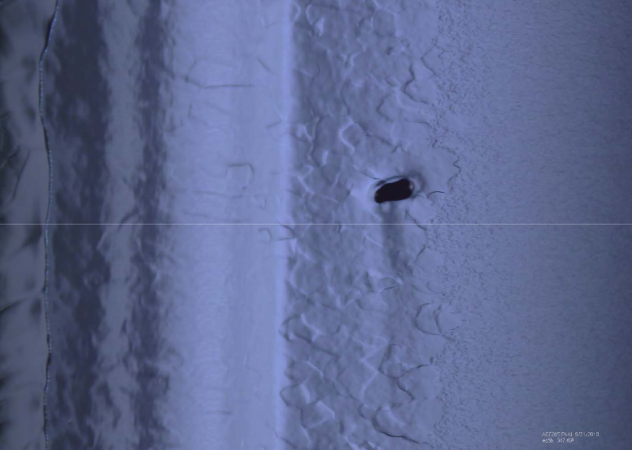
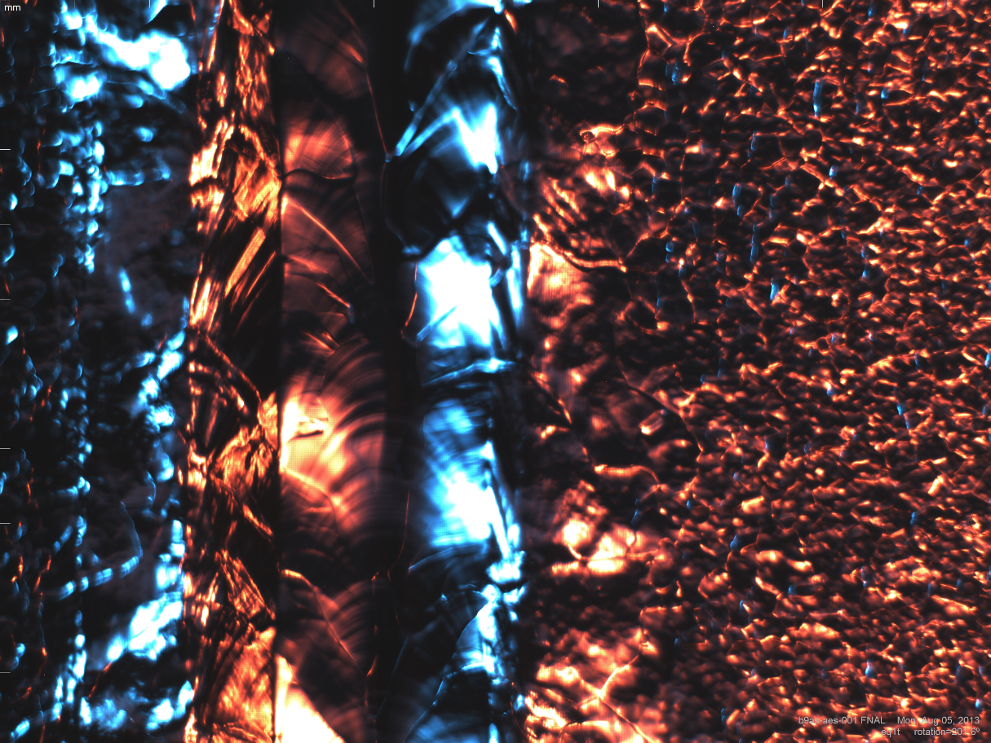
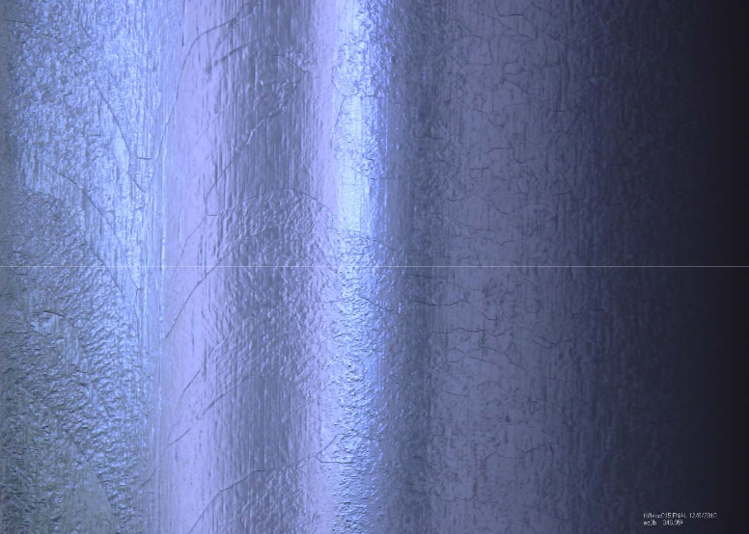
Optical Inspection Purpose
Used as diagnostic
Defect identification
Repair technique guide
Surface feature historical tracking
Optimized for elliptical cavities
Defect
Confirmed repair

Slide 32
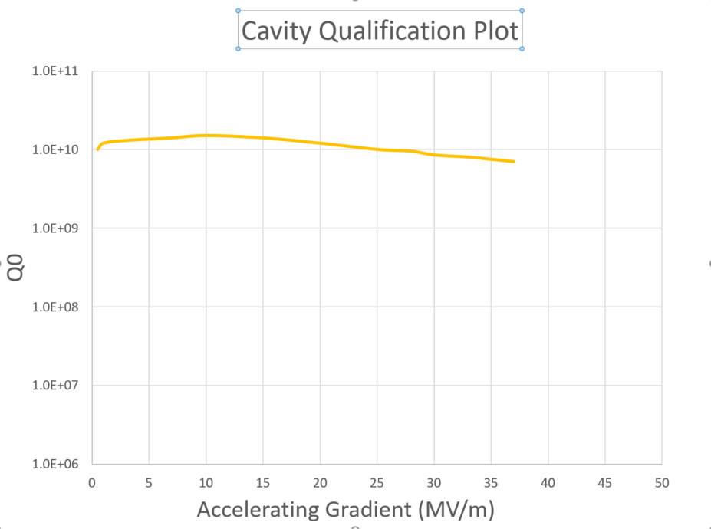
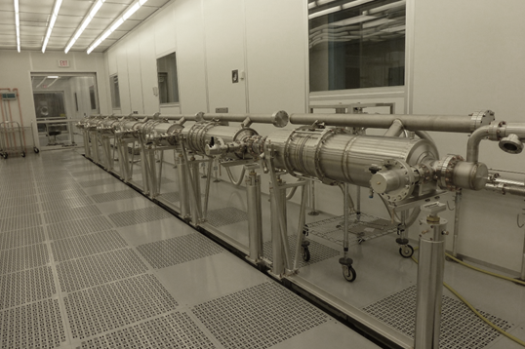
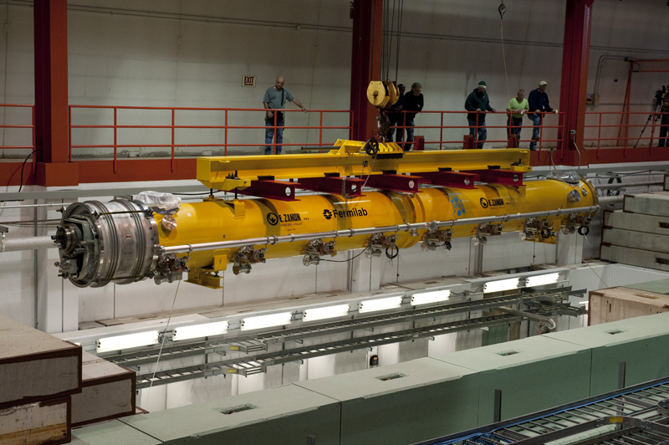
End Game
Specification
* n_{string} Cavities

Slide 33
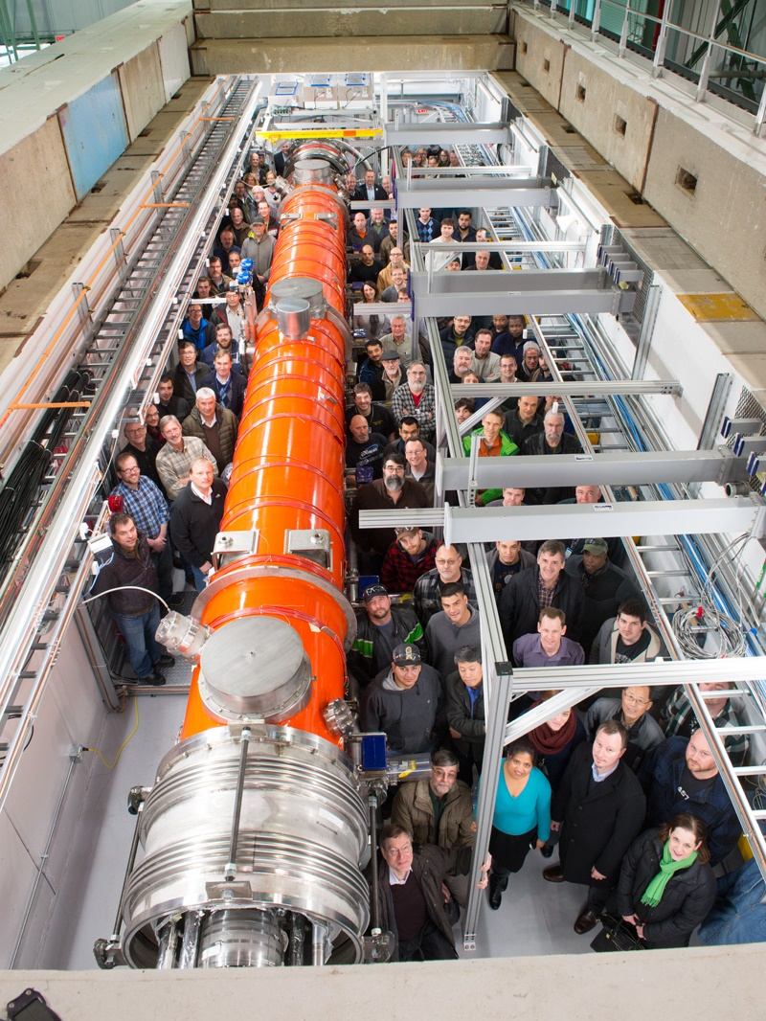
The Reward – A high-performance cryomodule!

