Slide 1
PIP-II Cryomodules Design Overview
Vincent Roger
International workshop on cryomodule design and standardization
6th September 2018

Slide 2
Layout
Introduction
Design strategy
Strong-back concept
2.1 SSR Configuration
2.2 650 Configuration
2.3 Assembly process
Cryogenic layout of the cryomodules
Interfaces
Alignment

Slide 3
Introduction
The PIP II Superconducting Linac is composed of 5 types of cryomodules. All have been designed for CW operation.
New Functional Requirements Specifications will be out in the next weeks.

Slide 4
1. Design strategy
To decrease the design effort and the cost of the project, our idea was to design all the cryomodules with the same design concept: the strong-back, and then to have one configuration for the single spoke cryomodules, and one for the elliptical cryomodules.
SSR1 & SSR2 Cryomodules
LB650 & HB650 Cryomodules
Similar cavity design
Similar tuner
Same coupler
Similar configuration:
SSR1: C-S-C-C-S-C-C-S-C-C-S-C SSR2: S-C-C-S-C-C-S-C
Similar solenoid
Similar BPM
Similar current leads
Same cryogenic layout
Similar cavity design
Similar tuner
Same coupler
Similar configuration
LB650: C-C-C
HB650: C-C-C-C-C-C
Same cryogenic layout

Slide 5
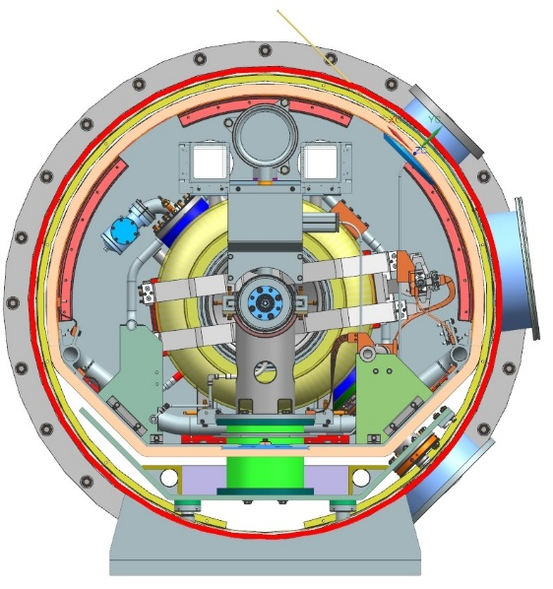
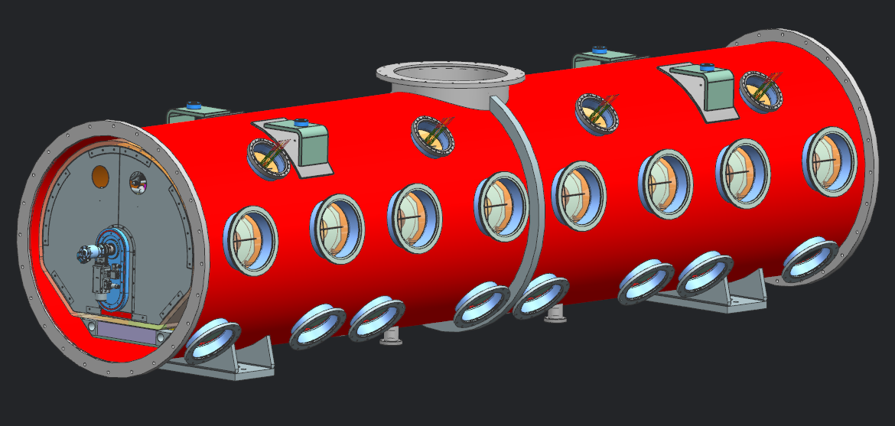
2. Strong-back concept
All cryomodules are based on a strong-back at room temperature. Calculations have been done in order to warrant that the strong-back will be still warm after the cool down of the cryomodule.

Slide 6
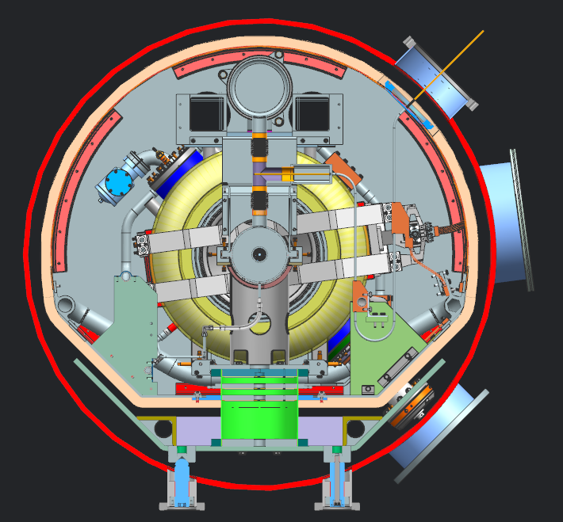
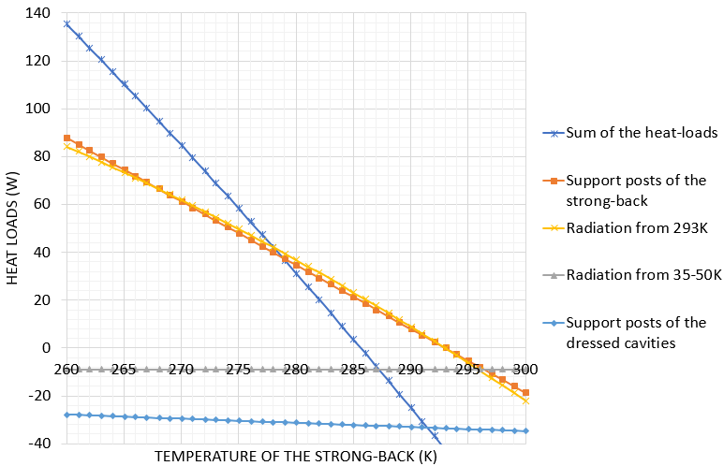
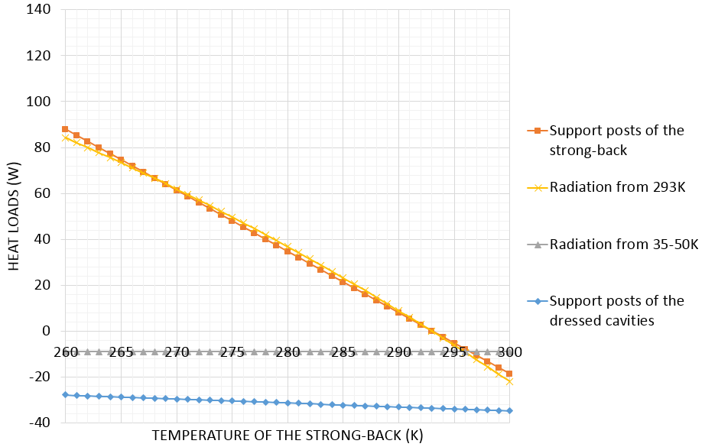
2. Strong-back concept
All the heat-loads applied on the strong-back can be estimated analytically according to the temperature of the strong-back. Then applying the 1st law of thermodynamics, the equilibrium temperature can be calculated.
T equilibrium : 286 K
Max vertical displacement : 2 μm
This variation of temperature is not an issue for the alignment.
ED0005286
4-7 September 2018

Slide 7
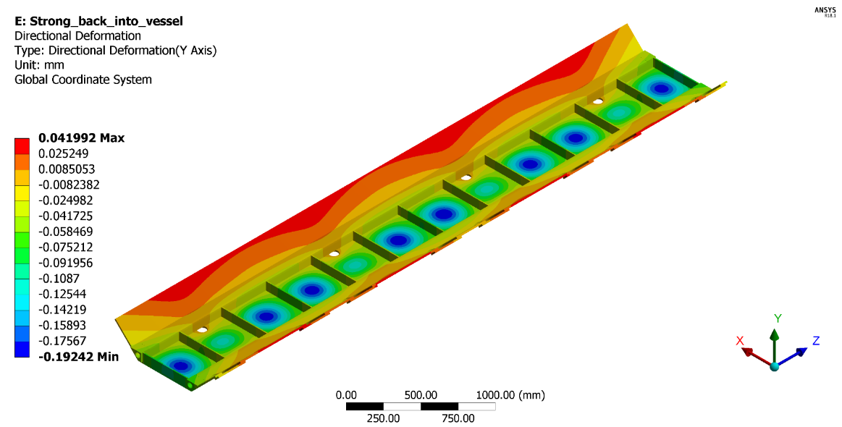
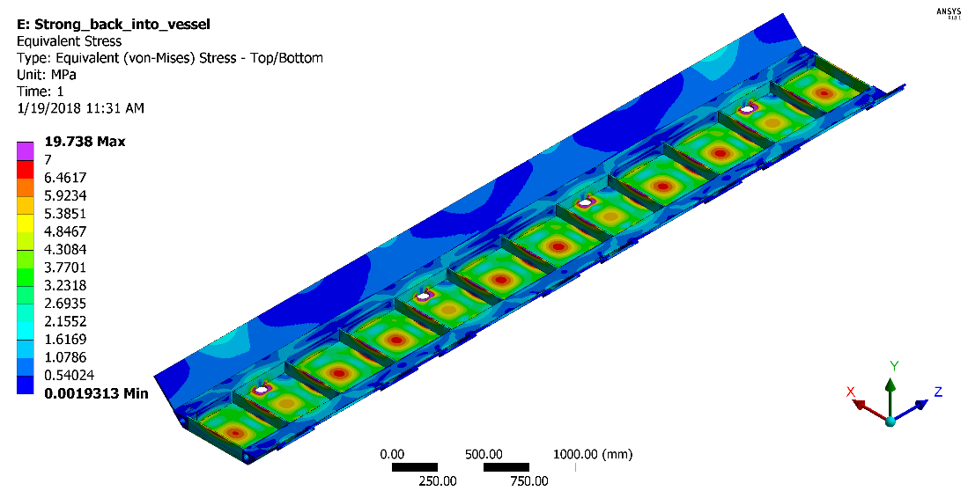
2. Strong-back concept
Structural and thermal analysis have been done in order to estimate the stress and the displacement.
The vertical displacement of the strong-back is very low around 0.2 mm and the max Von Mises stress is around 20 MPa compared to 55 MPa the max allowable stress for welded aluminum 6061-T6.

Slide 8
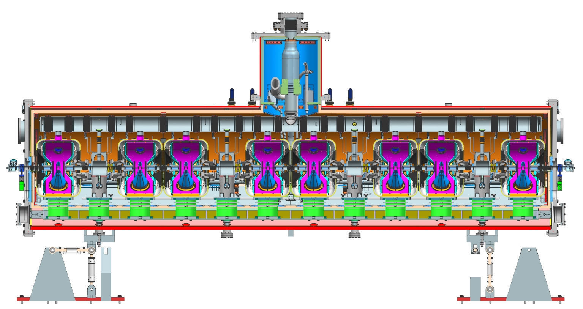
2. Strong-back concept
2.1 SSR configuration
SSR configuration - One support post per cavity and per solenoid

Slide 9
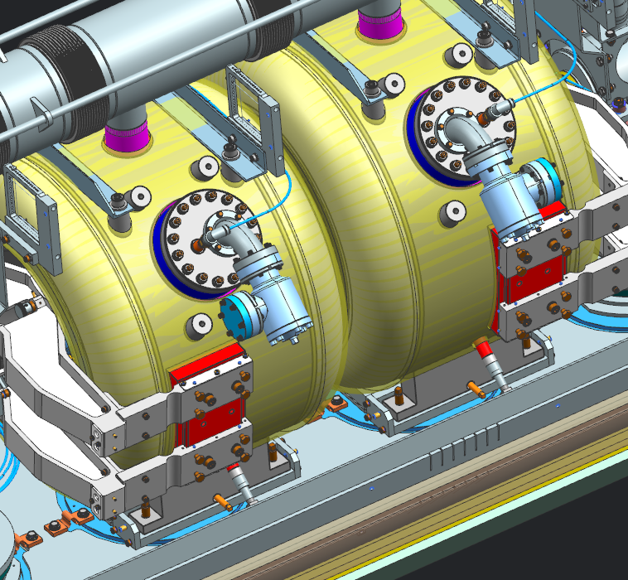
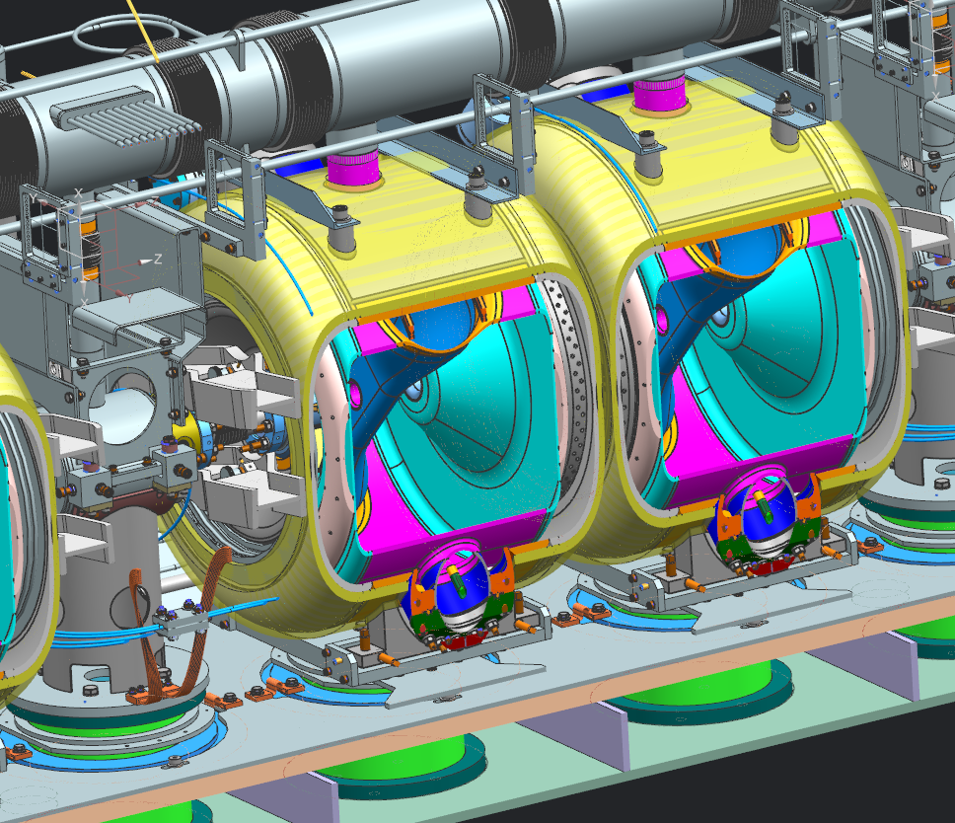
2. Strong-back concept
2.1 SSR configuration
With several sets of screws, we control the location of each cavity. Then each cavity are secured with nuts.

Slide 10
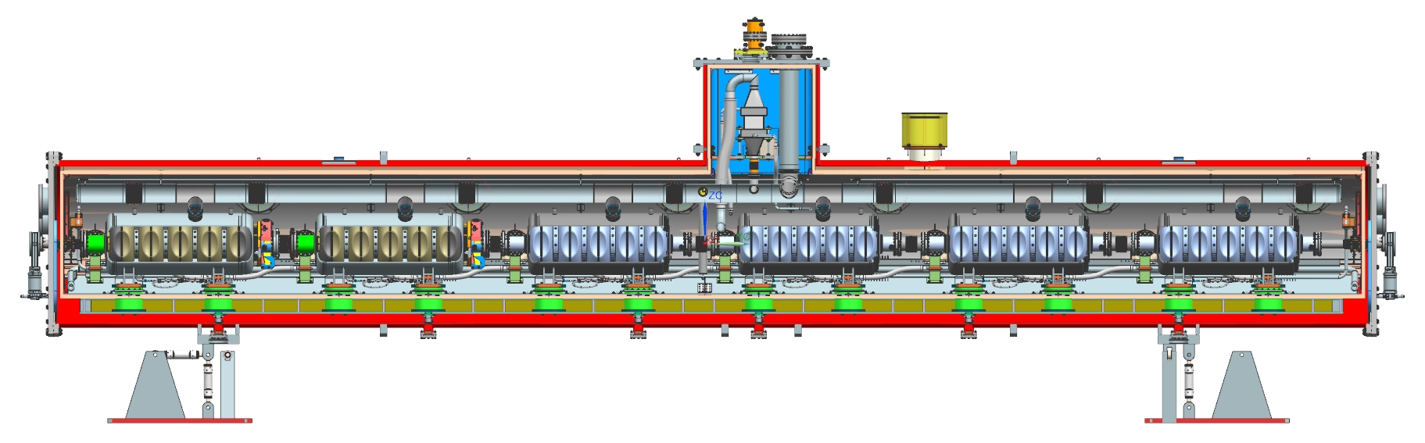
2. Strong-back concept
2.2 650 configuration
650 configuration - Two support posts per cavity

Slide 11
2. Strong-back concept
2.2 650 configuration
4 Lugs are welded on each cavity as LCLS II cavities. But, there is no invar rod inside the coldmass, the alignment is exclusively done using the C clamps. With several sets of screws and springs, we control the location of each cavity.
Z
X
Y

Slide 12
2. Strong-back concept
2.3 Assembly process
The assembly process is the same for SRR and 650 configurations:
Workstation 1: Assembly of the cavity string in the clean room
Workstation 2: Lifting of the string assembly
Welding of the cool-down / warm up line
Moving down the string assembly on the strong-back assembly
Workstation 3: Assembly of the cold-mass
Workstation 4: Insertion of the cold-mass in the vacuum vessel
Completion of the cryomodule

Slide 13
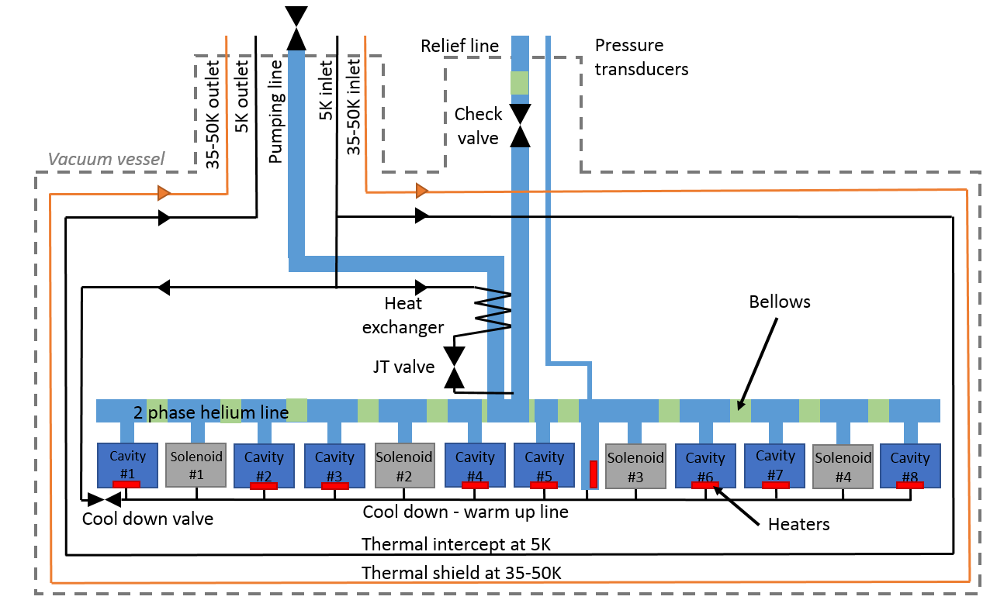
3. Cryogenic layout of the cryomodules
SSR1 cryomodule

Slide 14
3. Cryogenic layout of the cryomodules
All cryomodules have the same layout and the same pressure design values.
All cryomodules need to be compatible with a fast cool down:
• Above 20 K/hour through the Q-disease regime 90 - 175 K.
• Above 120 K/hour through the superconducting transition at 9.2 K
Pipe B - Pumping line
MAWP: 2.05 bar warm, 4.1 bar cold
Pipe G - 2 phase He & chimney
MAWP: 2.05 bar warm, 4.1 bar cold
Pipe I - Helium guard of the current leads
MAWP: 4.1 bar
Pipe A - 2 K supply
MAWP: 20 bar
Pipe C & D - 5 K line
MAWP: 20 bar
Pipe H - Cool down /
warm up line
MAWP: 20 bar
Pipe E & F - 35-50 K line
MAWP: 20 bar

Slide 15
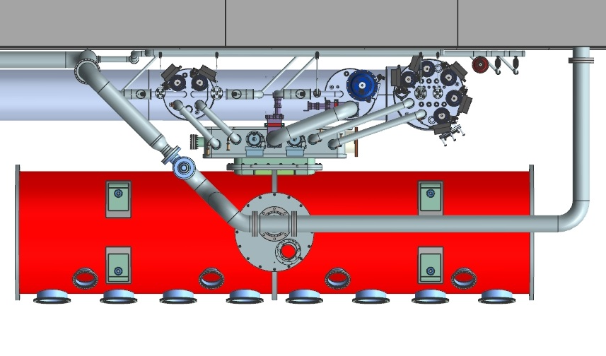
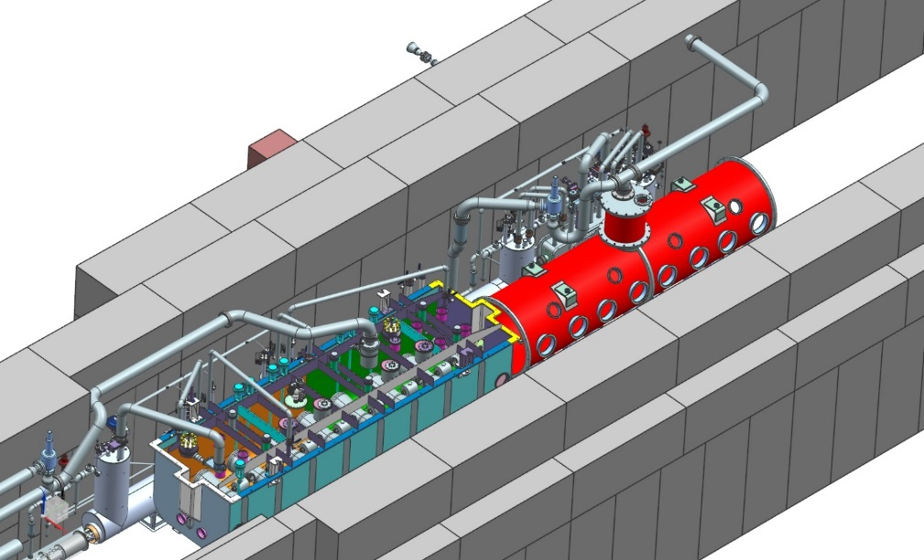
4. Interfaces
Cryomodules will be tested at PIP2IT and then they will be set up in the PIP2 Linac. Therefore it is essential to have a common interface.
The transverse envelope and the weight of each cryomodule as specified in the Functional Requirements Specification cannot be exceed (max 14 000 kg Cryomodule + lifting fixture)
Identical cryogenic side port, will simplify a lot the design of PIP2IT and PIP2 Linac.

Slide 16
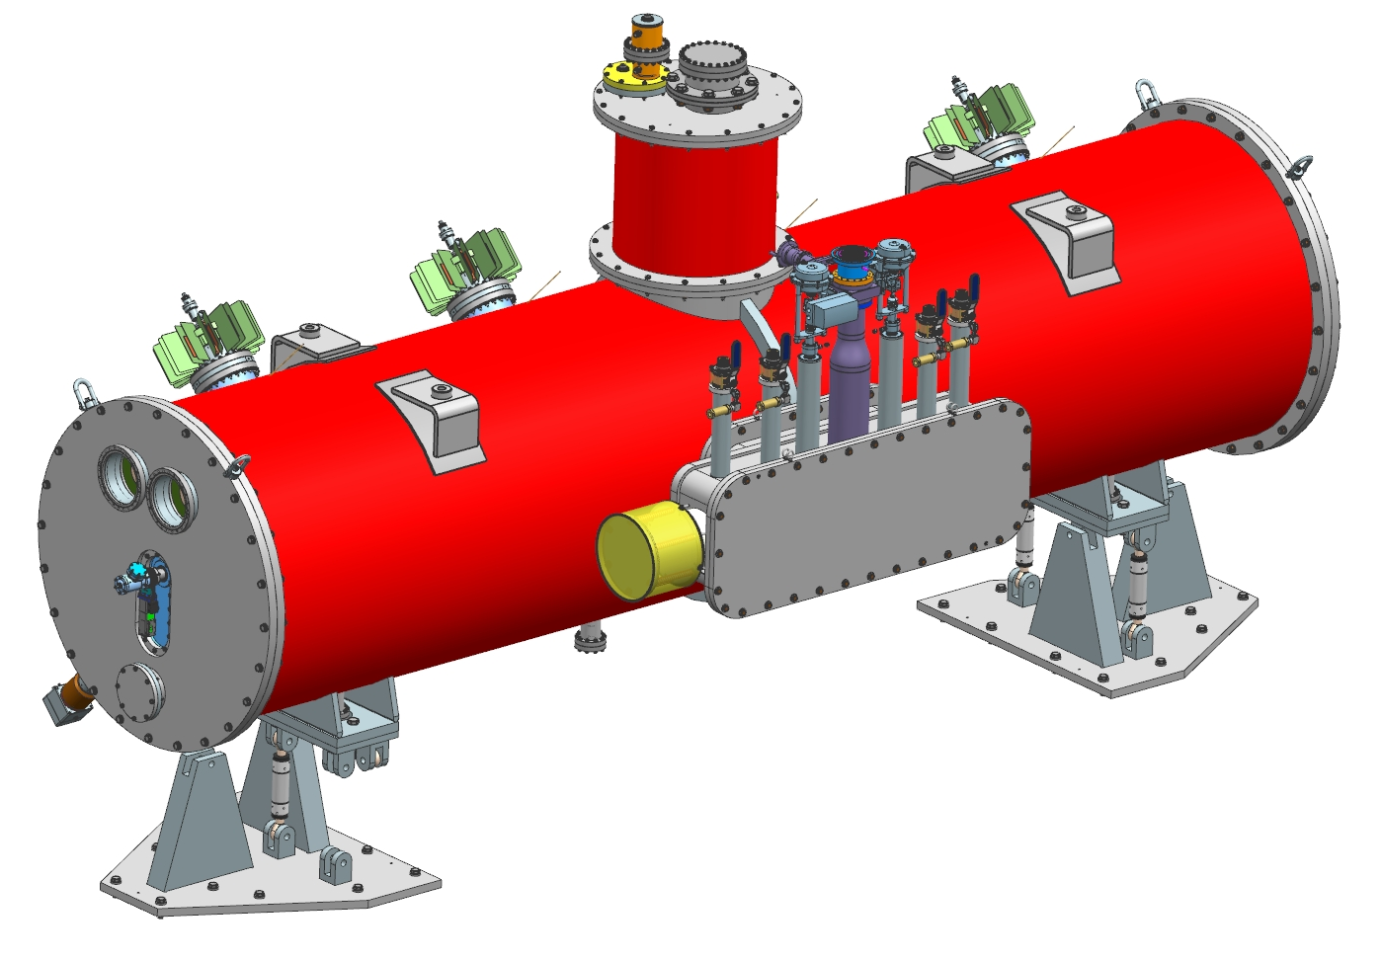
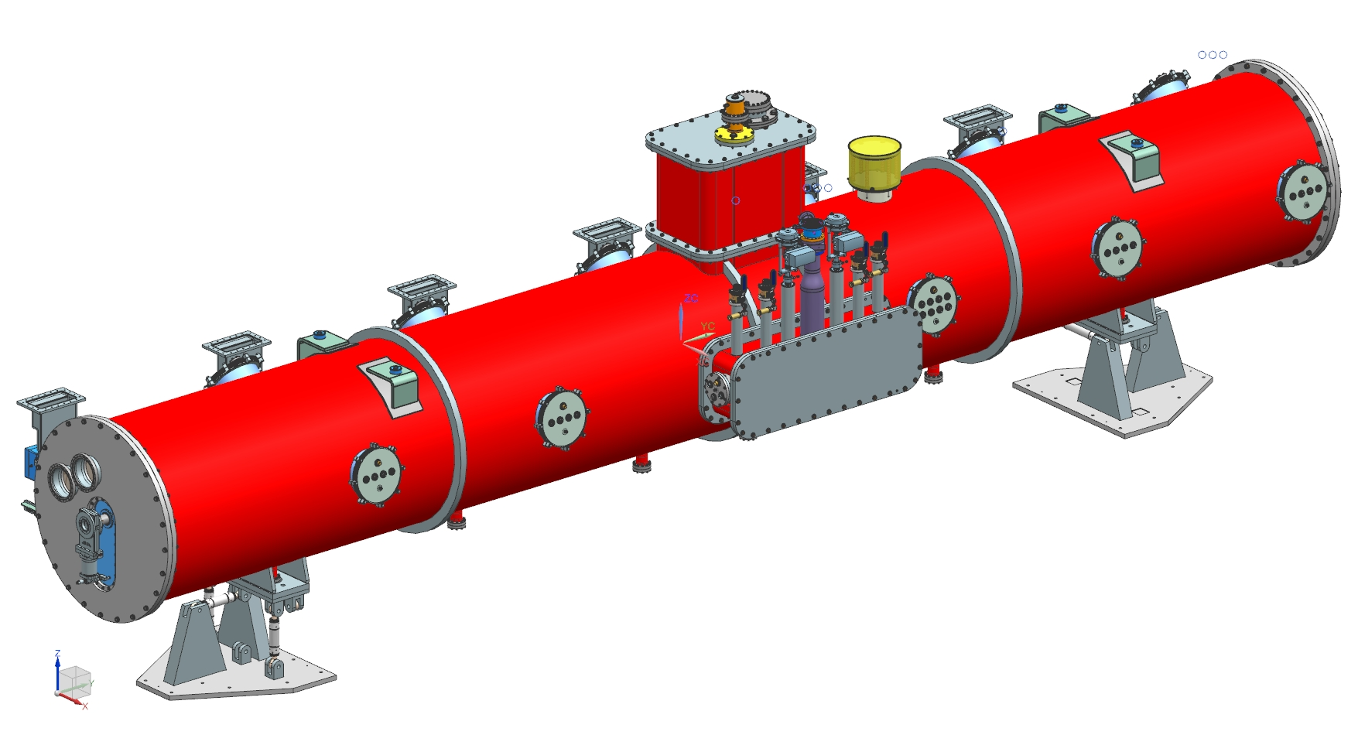
4. Interfaces
Cryomodules will be tested at PIP2IT and then they will be set up in the PIP2 Linac. Therefore it is essential to have a common interface.
Cryomodules need to be designed in order to accommodate the same cryomodule stands. These stands allow a movement of +/- 30 mm in all directions

Slide 17
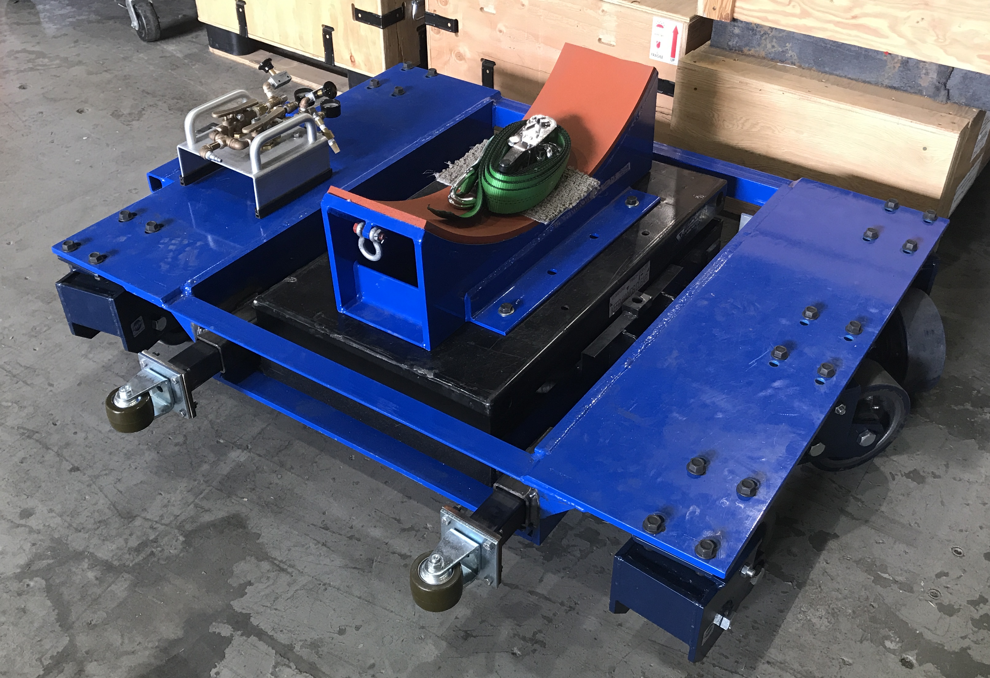
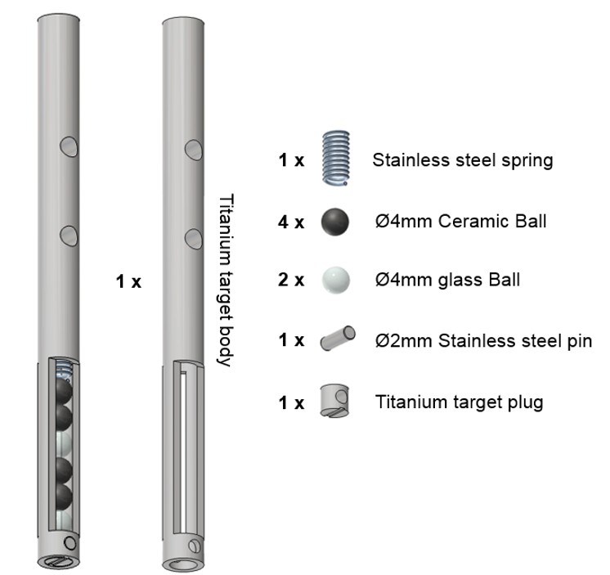
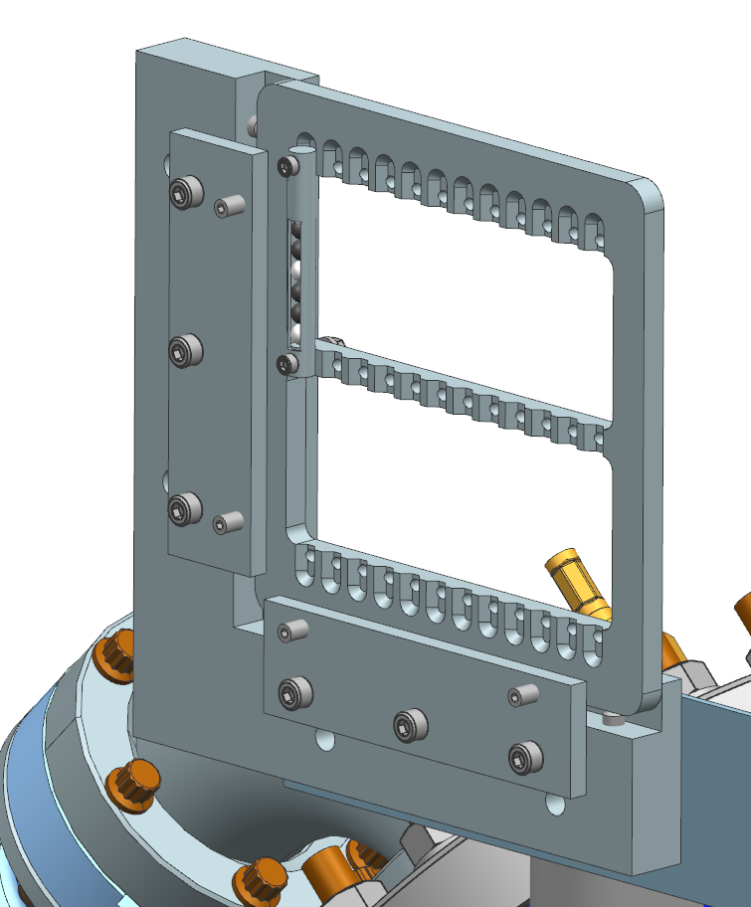
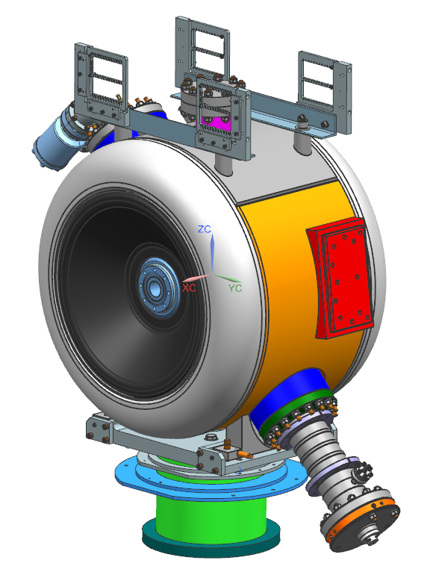
4. Interfaces
Cryomodules will be tested at PIP2IT and then they will be set up in the PIP2 Linac. Therefore, it is essential to have a common interface.
It will be better to use the same cryomodule movers.
Instrumentation connector need to be standardized. Detoronics or Ceramtec connectors will be used.
The same fiducials on each cavity and solenoid will be used

Slide 18
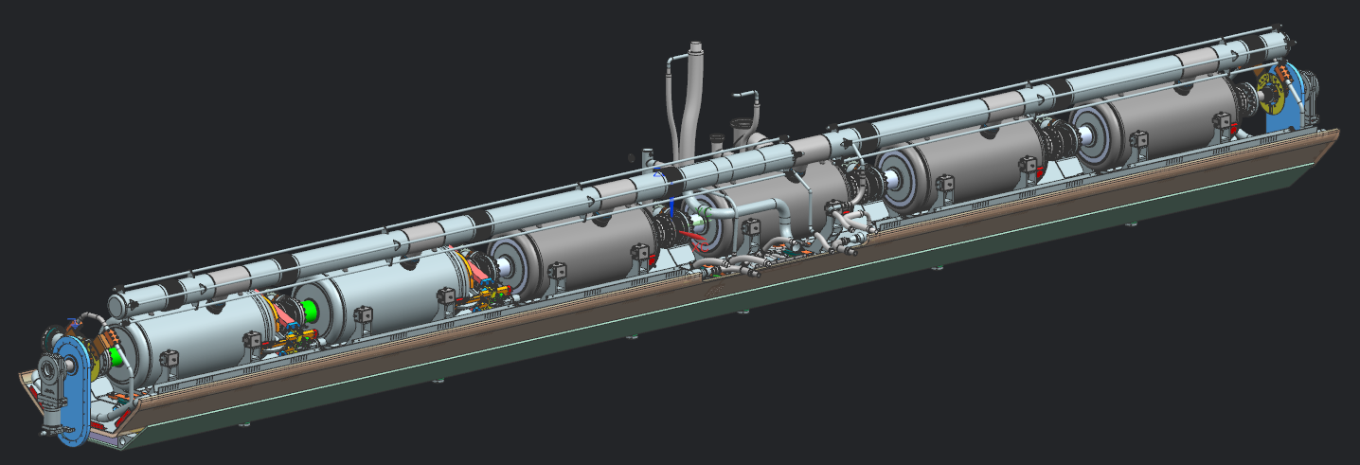
5. Alignment strategy
1. Cavities will be measured in order to record their geometrical, electric and magnetic axis wrt fiducials placed on their top.
2. During the assembly of the beam line, inclinometers will be placed on each cavity to get a rough alignment and avoid stress on the bellows.
3. Once the beam line moved down on the strong-back, a rough alignment of the cavities will be done taking into account the shift due to the thermal contraction during the cool-down. After welding the two-phase helium pipe, 4 fiducials will be set up on each cavity and the final alignment will be done.

Slide 19
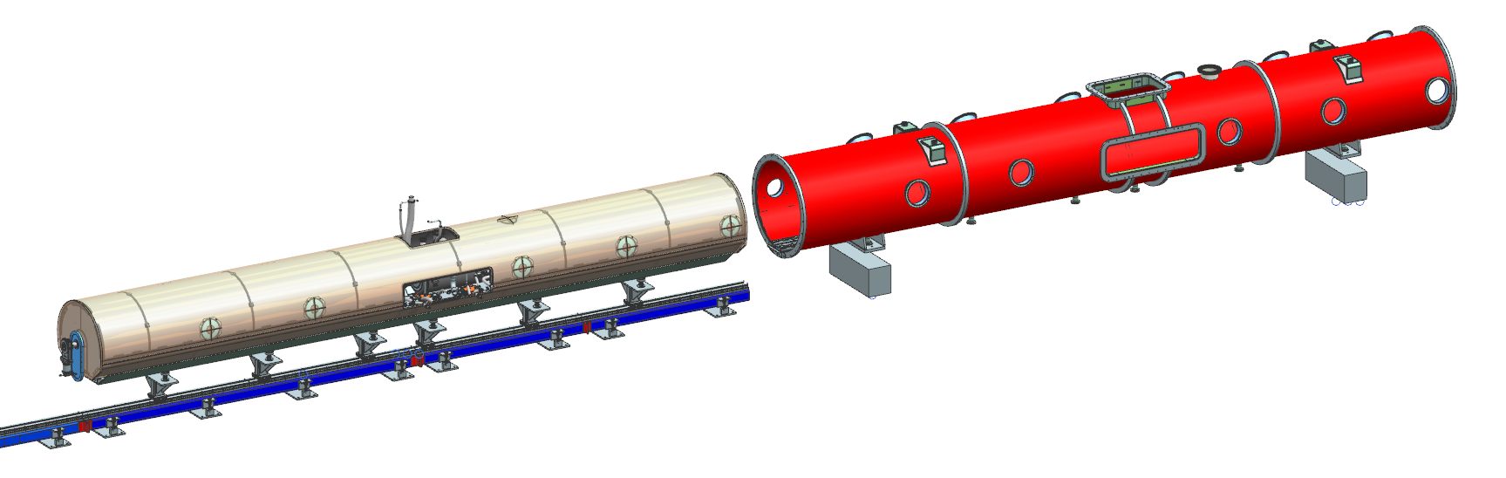
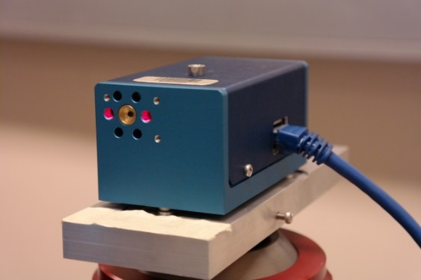
5. Alignment strategy
The key of the strong-back strategy is to support the strong-back in the same way on the insertion tooling and inside the vacuum vessel.
4. The coldmass will be inserted in the vacuum vessel slightly below the nominal position. Rollers located below the strong-back will be used. Then the coldmass will be lift up using several set of screws. Finally the alignment will be transferred to the vacuum vessel. (The insertion tooling is still under-designed).
5. After the insertion, the alignment of all the cavities will be checked using HBCAM.
6. Finally the alignment will be transferred to the vacuum vessel.
7. View ports will allow to control the location of the cavities during transport, and cool down.

Slide 20
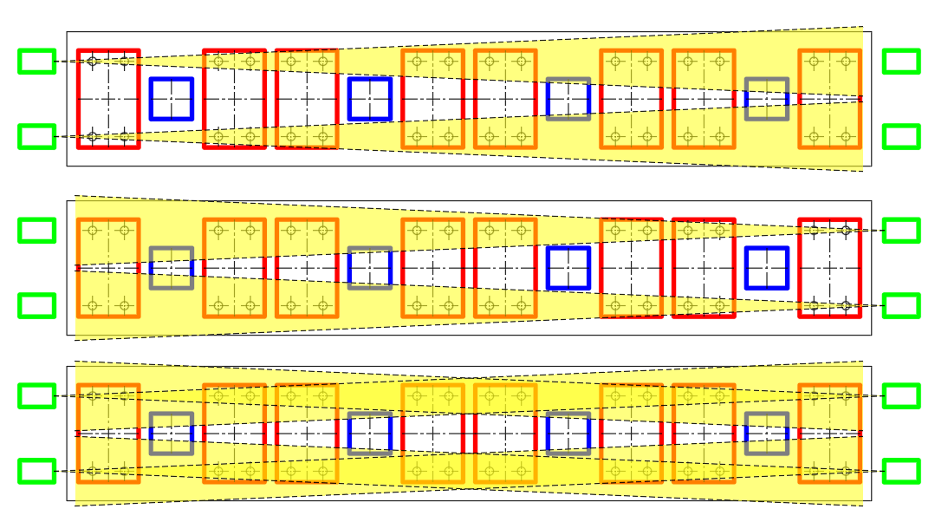
5. Alignment strategy / SSR1 cryomodule
BCAM: at least 20m range with active targets
Minimum distance: 80cm

Slide 21
Conclusion
SSR1 & SRR2 Cryomodules
Since all SSR cryomodule will be fabricated at Fermilab, less analysis will be necessary and dedicated to the transport.
SSR1 prototype cryomodule will validate the strong-back concept.
If the strong-back concept is validated, the strong-back will be also used for SSR1 & SSR2 cryomodules.
LB650 & HB650 Cryomodules
Our design strategy was so far to use the feedback of SSR1 cryomodule to design the 650 cryomodules
However, the 650 configuration is different from SSR configuration especially the way how the cavities are hold and aligned.
Due to the fact that main of these cryomodules will be assembled in Europe, the transport is an important topic for which no calculations have been done so far.

