Slide 1
Cryomodule Lessons Learned
A. Klebaner, G. Wu
International Workshop on Cryomodule Design and Standardization
September 7, 2018

Slide 2
Outline
  Introduction
  Lessons Learned during Cavity Production
  Lessons Learned during String Assembly
  Lessons Learned during Cryomodule Testing
  Lessons Learned from Cryomodule Transportation (skipped, see Peterson presentation)
  Summary
Major Lessons Only
2018-09-07
International Workshop on Cryomodule Design and Standardization

Slide 3
Outline
  Introduction
  Lessons Learned during Cavity Production
  Lessons Learned during String Assembly
  Lessons Learned during Cryomodule Testing
  Lessons Learned from Cryomodule Transportation (skipped, see Peterson presentation)
  Summary
2018-09-07
International Workshop on Cryomodule Design and Standardization

Slide 4
LCLS-II Cryogenic Systems overview:
35 Cryomodules
(+2 3.9GHz CM)
Cryoplant:
2 x 4 kW@2.0K
3.7 kW nom. load
2018-09-07
International Workshop on Cryomodule Design and Standardization

Slide 5
Some Changes during the Production
Added 5 additional 1.3 GHz CMs
  1 spare + 4 production extras
Added 1 spare 3.9 GHz CM
  Goal to select best 35 of 40 – 1.3 GHz and 2 of 3 3.9 GHz CMs for linac
  Maintain extras for field replacement as necessary
Ordered additional cavities to account for production yield
Installation of fluxgate magnetometers in all CMs
Optimized cavity processing recipes for cavity production
Added cryomodule test cycles for cooldown optimization
Increased vendor oversight for cavity production
2018-09-07
International Workshop on Cryomodule Design and Standardization

Slide 6
Cryomodule Progress
  1.3 GHz CM Production
    29 of 35 1.3 GHz CMs are in production or complete
    Six broken for various reasons
  1.3 GHz CM Testing
    11+10 CM tests complete
    Average Q₀ > 2.7e10
    Average Gradient > 16 MV/m
2018-09-07
International Workshop on Cryomodule Design and Standardization
6

Slide 7
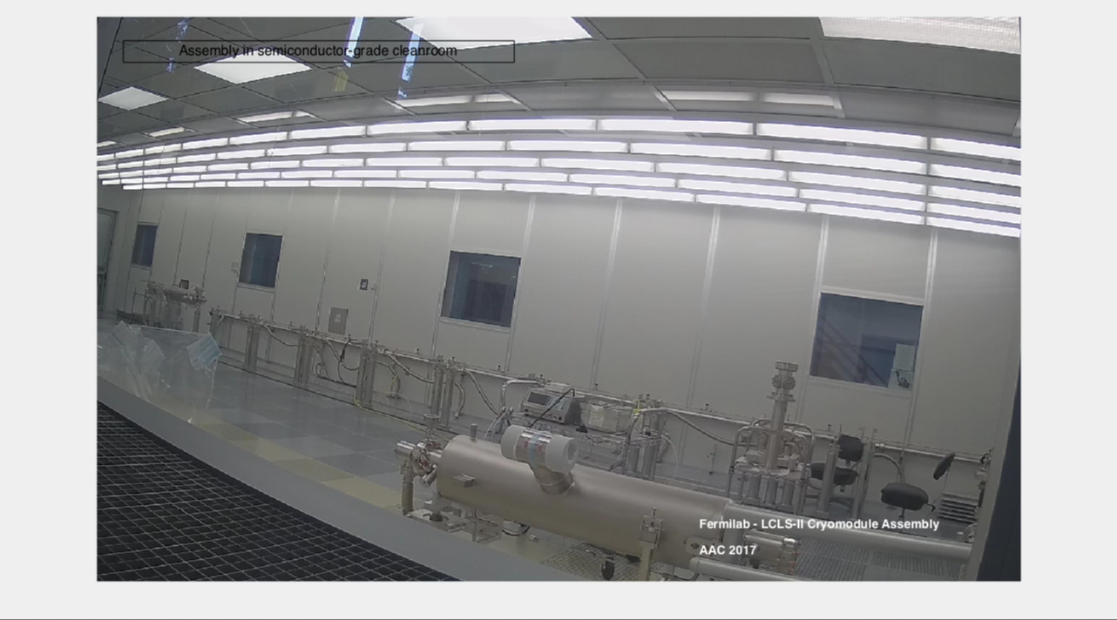
Cryomodule Production at Fermilab
Courtesy of Sam Posen
2018-09-07
International Workshop on Cryomodule Design and Standardization

Slide 8
Key Technical Challenges
CM Assembly
  Tight Schedule
  Design changes
  String leaks outside of the cleanroom
CM Testing
  Maintaining high Q₀ in the CM
  Field emission
  Microphonics mitigation
  HOM tuning / end group heating
  Cooldown optimization
  String leak after warm-up
  Transportation
2018-09-07
International Workshop on Cryomodule Design and Standardization

Slide 9
Outline
  Introduction
  Lessons Learned during Cavity Production
  Lessons Learned during String Assembly
  Lessons Learned during Cryomodule Testing
  Lessons Learned from Cryomodule Transportation (skipped, see Peterson presentation)
  Summary
2018-09-07
International Workshop on Cryomodule Design and Standardization

Slide 10
Nitrogen Doped Cavity Challenges
Cavity production issues:
  Poor flux expulsion material resulted cavity performance below specification in cryomodule
Lessons learned
  Improved understanding of niobium flux expulsion
  Improved material/cavity processing recipe to recover flux expulsion capability.
2018-09-07
International Workshop on Cryomodule Design and Standardization

Slide 11
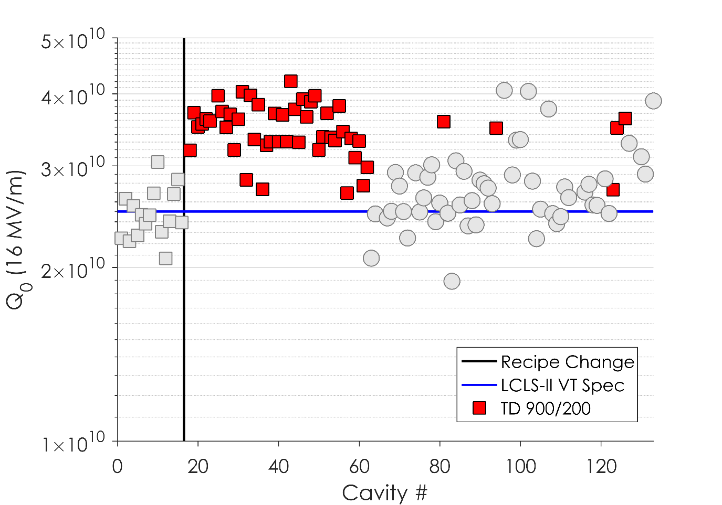
RI: Q₀ Results
RI has completed fabrication of original order of 133 cavities
121 cavities have been tested so far at JLab and Fermilab
TD Cavities 900/200 preparation consistently exceed LCLS-II spec
Slide by Dan Gonnella of SLAC
2018-09-07
International Workshop on Cryomodule Design and Standardization

Slide 12
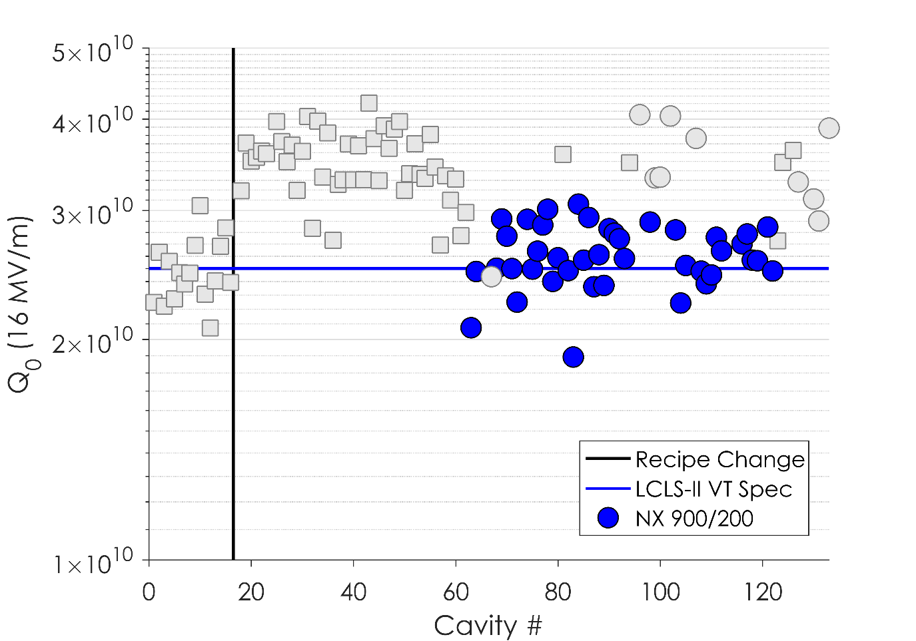
RI: Q₀ Results
RI has completed fabrication of original order of 133 cavities
121 cavities have been tested so far at JLab and Fermilab
TD Cavities 900/200 preparation consistently exceed LCLS-II spec
NX Cavities at 900ºC have middling results
Slide by Dan Gonnella of SLAC
2018-09-07
International Workshop on Cryomodule Design and Standardization

Slide 13
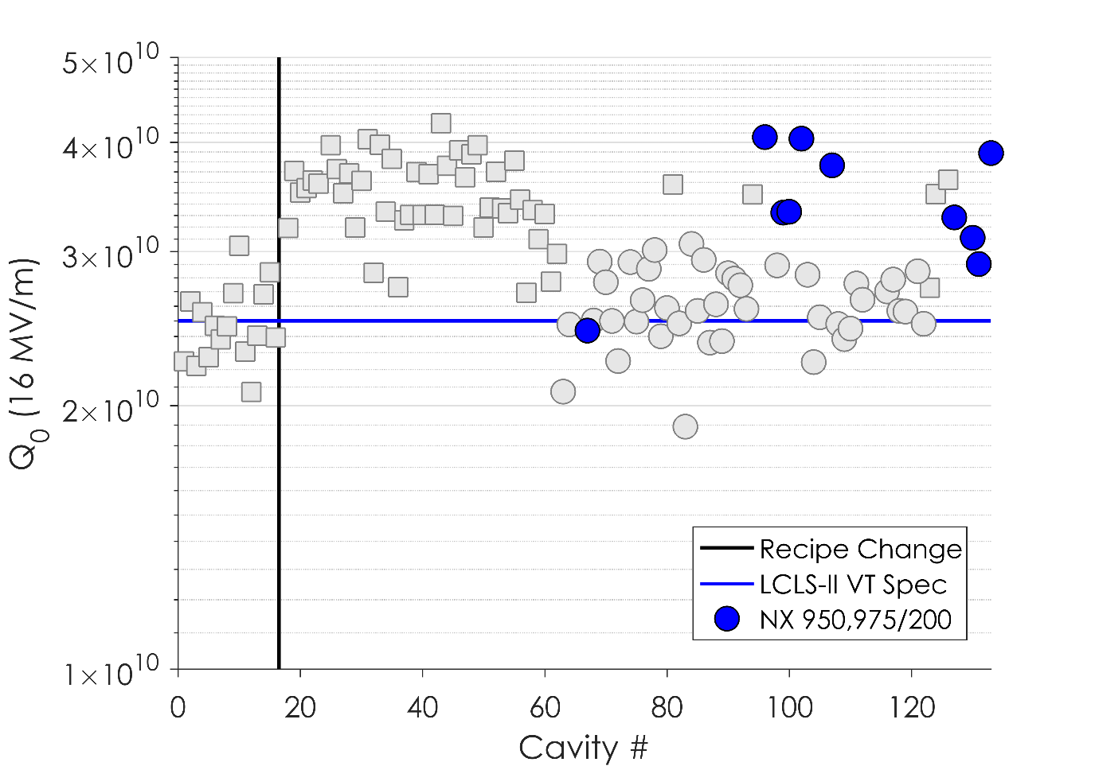
RI: Q₀ Results
RI has completed fabrication of original order of 133 cavities
121 cavities have been tested so far at JLab and Fermilab
TD Cavities 900/200 preparation consistently exceed LCLS-II spec
NX Cavities at 900ºC have middling results
950 and 975ºC have further improved upon the NX cavities’ performance
Slide by Dan Gonnella of SLAC
2018-09-07
International Workshop on Cryomodule Design and Standardization

Slide 14
Outline
  Introduction
  Lessons Learned during Cavity Production
  Lessons Learned during String Assembly
  Lessons Learned during Cryomodule Testing
  Lessons Learned from Cryomodule Transportation (skipped, see Peterson presentation)
  Summary
2018-09-07
International Workshop on Cryomodule Design and Standardization

Slide 15
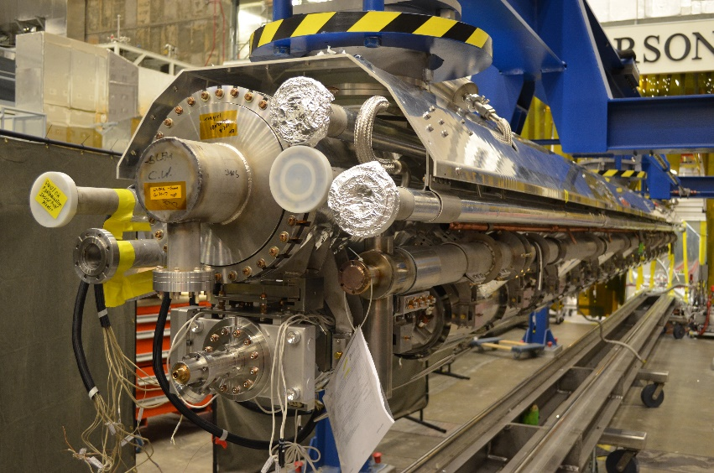
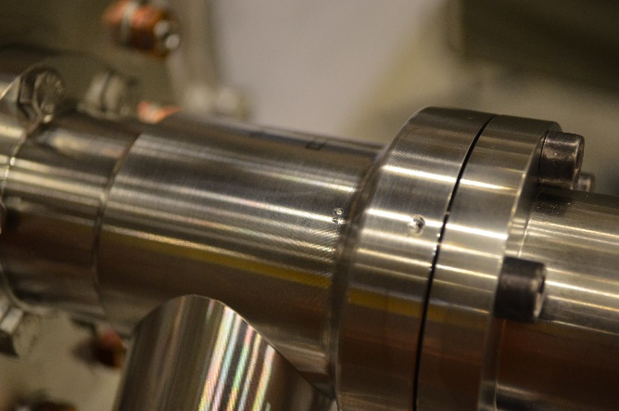
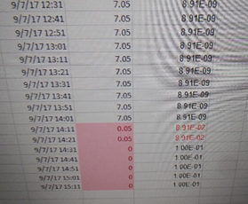
J1.3-06 Status
J1.3-6
Accidentally vented during preparation for leak check of 2 phase circuit
  GHRP cap slipped and impacted right angle valve
  String fast bled up to just under 100 torr.
J1.3-06
Cavity and couplers will require reprocessing
Courtesy of Bob Legg of JLAB
2018-09-07
International Workshop on Cryomodule Design and Standardization

Slide 16
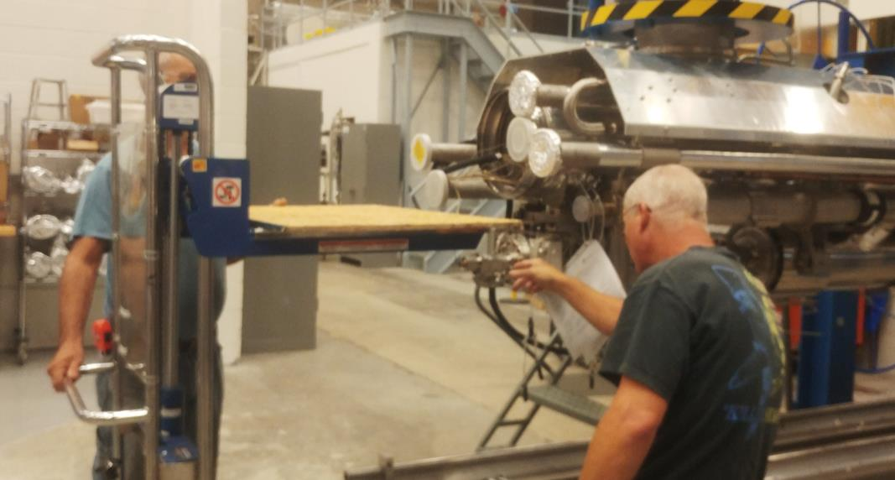
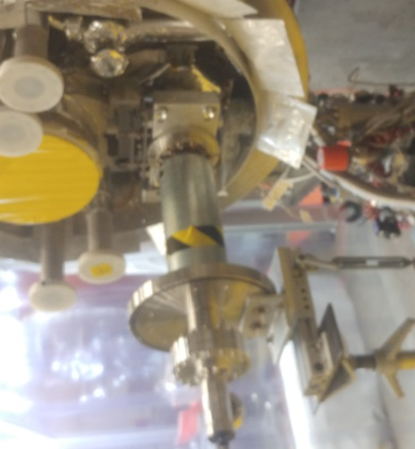
J1.3-06 Lessons Learned
New assembly procedure and tooling for GHRP cap installation at WS3 and WS5.
Portable lift used to both lift GHRP cap and protect the Right Angle Valve; Safer for both employees and equipment.
Looking into a plug with o-ring to replace GHRP cap for vacuum leak checks. Lighter, safer.
J1.3-06
Metal bellows covers put in place to prevent accidental venting during prep for testing.
Courtesy of Bob Legg of JLAB
2018-09-07
International Workshop on Cryomodule Design and Standardization

Slide 17
F1.3-03 HOM Feedthrough Thermal Strap Loose
F1.3-03
CAV3 quenched prematurely at 11 MV/m.
  HOM end group heating.
  One bolt thread damaged and provided false torque number.
Washer loose
Thermal braid head completely loose
2018-09-07
International Workshop on Cryomodule Design and Standardization

Slide 18
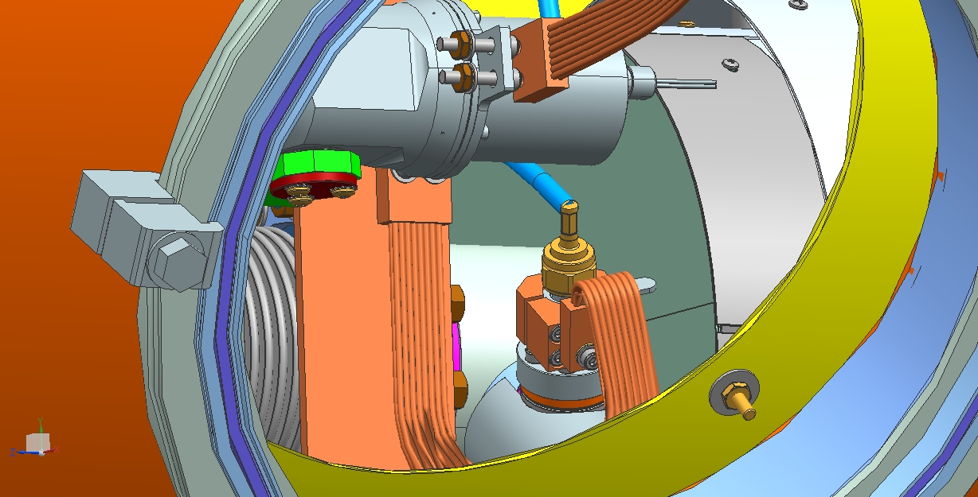
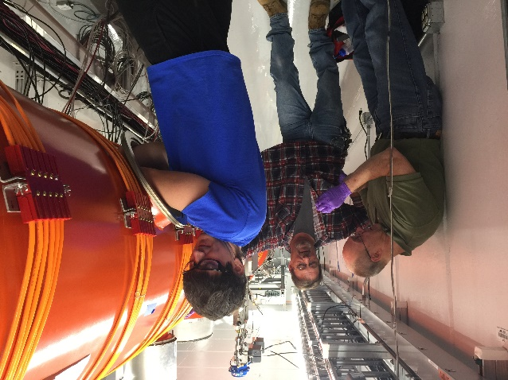
F1.3-03 Lessons Learned
F1.3-03
Improved procedure to double check the integrity of the HOM thermal Straps
Improved procedure to inspect bolts quality
2018-09-07
International Workshop on Cryomodule Design and Standardization

Slide 19
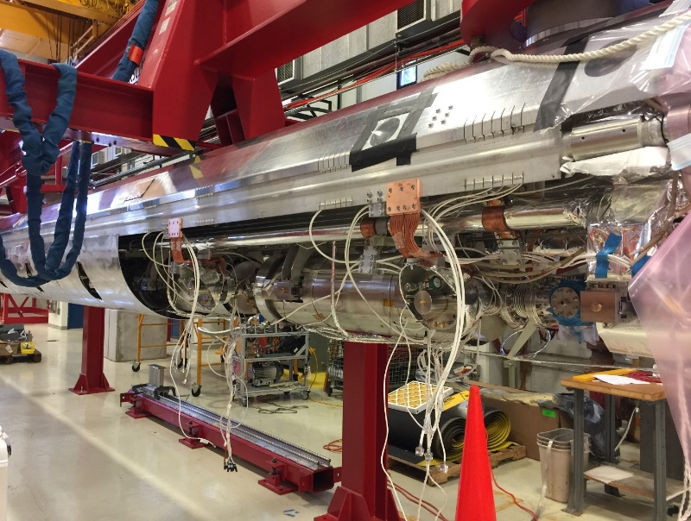
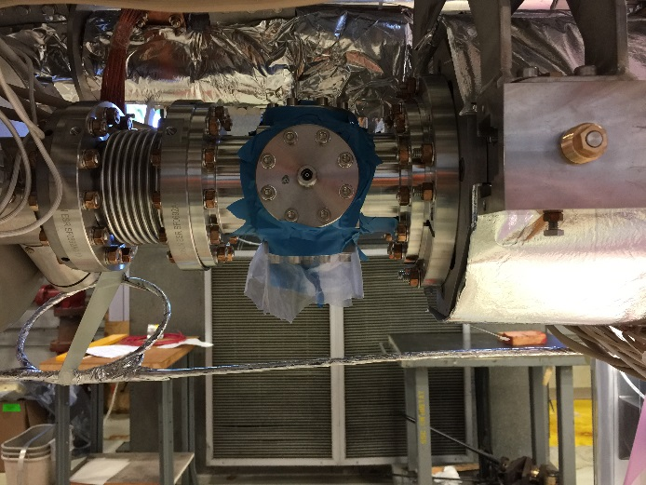
F1.3-03 Cold Leak Developed
F1.3-03
Cold Leak Discovered during Cryomodule Warm up
BPM Feedthrough flanges leaked
  Three out of four seals leaked
  Leak rate was ~8.5e-5 mbar.L/sec
    Leak was considered too big for clean beam line.
    Decision was made to dis-assemble
Grade 2 Titanium bolts did not provide sufficient sealing force.
2018-09-07
International Workshop on Cryomodule Design and Standardization

Slide 20
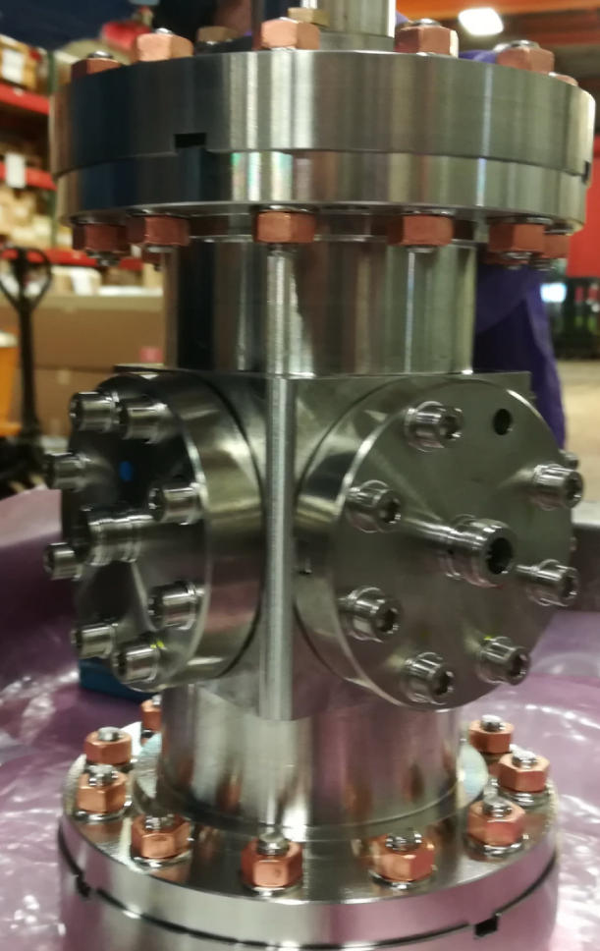
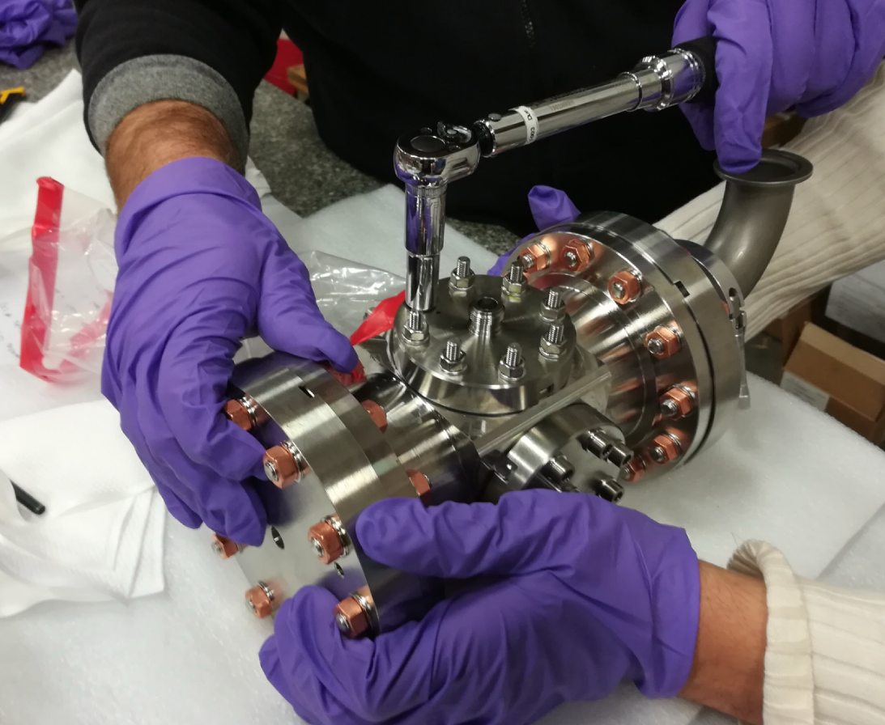
F1.3-03 Lessons Learned
F1.3-03
Replaced Grade 2 titanium bolts with Gr5 titanium studs.
Increase the torque strength from 12 to 16 N.m
Measure seal crush to ensure sufficient sealing cross section
2018-09-07
International Workshop on Cryomodule Design and Standardization

Slide 21
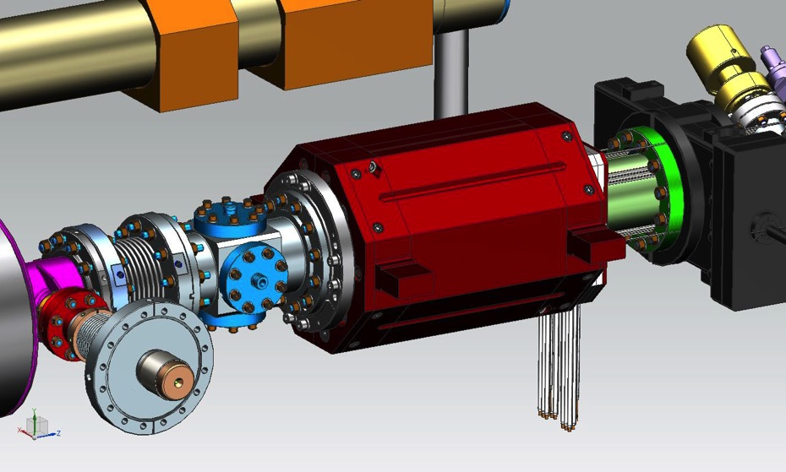
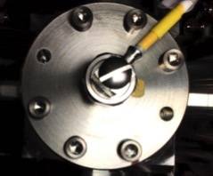
F1.3-06 Fasteners Loosened
Washers not installed and one bolts dis-lodged and one completely loosened.
Several other fasteners loosened
in upper cold mass assembly
Courtesy of A. Burrill of SLAC
2018-09-07
International Workshop on Cryomodule Design and Standardization

Slide 22
F.13-06 Fastener Lessons Learned
In addition to lessons learned as in F1.3-03:
Added QC step in traveler to inspect all fasteners and their torques both in component level, as well as completed string assembly.
Established a comprehensive fastener torque table and included into all the relevant travelers.
Improved fastener design with lock washers or loc-tite application.
Increased vendor oversight.
2018-09-07
International Workshop on Cryomodule Design and Standardization

Slide 23
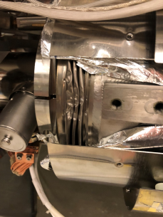
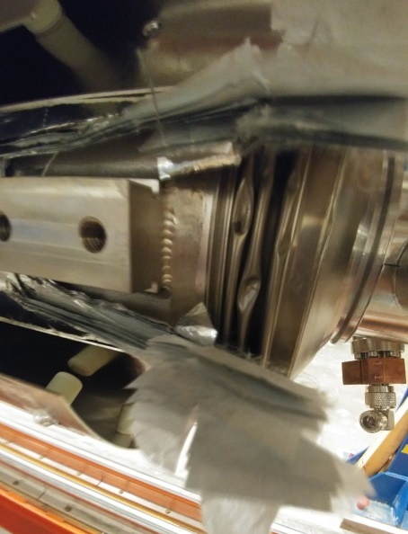
J1.3-09 and J1.3-11 Helium Vessel Bellows Damaged
J1.3-09 Bellows was found damaged on 5 July,
  Visual inspection of all bellows on in process cryomodules (J1.3-09-11-12-13) followed
  We found one additional bellows damaged on J1.3-11
  Completed cryomodules (J1.3-02 – J1.3-07) will be inspected during subsequent work
  JL1.3-08 and JL1.3-10, were in the process of acceptance testing, no leaks found
J1.3-09 damage was found after a failed leak check and disassembly of the cryomodule
J1.3-11 was in an earlier stage of assembly and the damage was found during a visual inspection
J1.3-09
J1.3-11
Courtesy of E. Daly of JLAB
2018-09-07
International Workshop on Cryomodule Design and Standardization

Slide 24
J1.3-09 and J1.3-11 Lessons Learned
The JLab team has extended the risk matrix to all bellows in the cryomodule
  Continuous improvement extends this to the cryomodule as a whole
  FNAL will be included
Apply lessons learned to other cryomodule production activities
  CEBAF cryomodule production and rework
  Cryomodules for other projects (SNS PPU, LCLS-II HE)
Training matrix developed as part of the improved work controls identifies individual’s qualifications
Matrix is now the basis for staff development plans and will be a continuing part of the cryomodule production at JLab
  Every supervisor has the matrix and only assigns work to qualified technicians
  Every technician and supervisor has their own qualification matrix
  Each individual is expected to know their qualifications and work only those activities they are qualified for
Courtesy of E. Daly of JLAB
2018-09-07
International Workshop on Cryomodule Design and Standardization

Slide 25
Outline
  Introduction
  Lessons Learned during Cavity Production
  Lessons Learned during String Assembly
  Lessons Learned during Cryomodule Testing
  Lessons Learned from Cryomodule Transportation (skipped, see Peterson presentation)
  Summary
2018-09-07
International Workshop on Cryomodule Design and Standardization

Slide 26
Microphonics Sources and Mitigations
Cryogenic Valve Plumbing
  Thermal Acoustic Oscillations in the Valve Stems
  Helium Leakage into Cooldown Circuit
Cavity 1 Mechanical Support
  Modification and Retrofit Options
2018-09-07
International Workshop on Cryomodule Design and Standardization

Slide 27
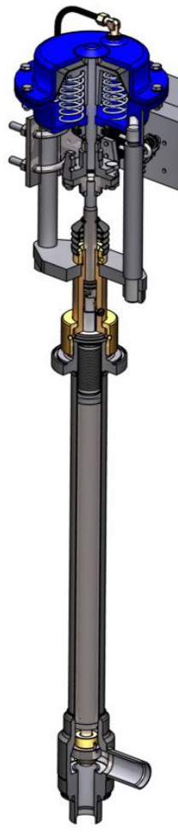
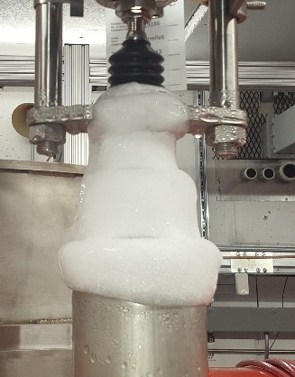
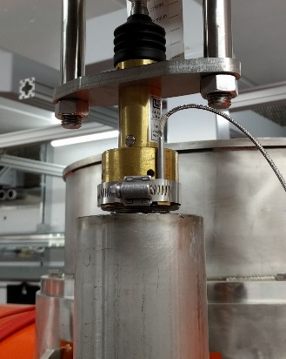
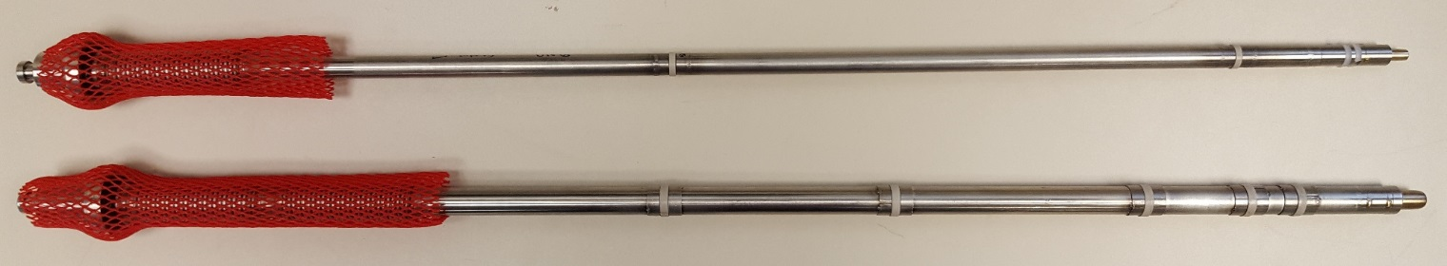
Cryogenic Valve Plumbing – Improved Valve Stems
TAOs are a pressure/temperature oscillation in cryogenic lines (in this case, valve stems)
  During testing, wipers were added to close space in valve stem, acting as a damping term for the TAOs
  Significant improvement in heat load and microphonics levels and stability for both F1.3-01 and J1.3-01
  Optimized valve stems with wipers were used during F1.3-02 testing, and will be used going forward for both labs
    4-5 wipers, positioned to keep temperature ratio <4 as recommended by literature
    Radiation hard material (PEEK)
Before
After
DN6
DN10
Optimized wiper placement going forward
27
2018-09-07
International Workshop on Cryomodule Design and Standardization
Slide by Jeremiah Holzbauer

Slide 28
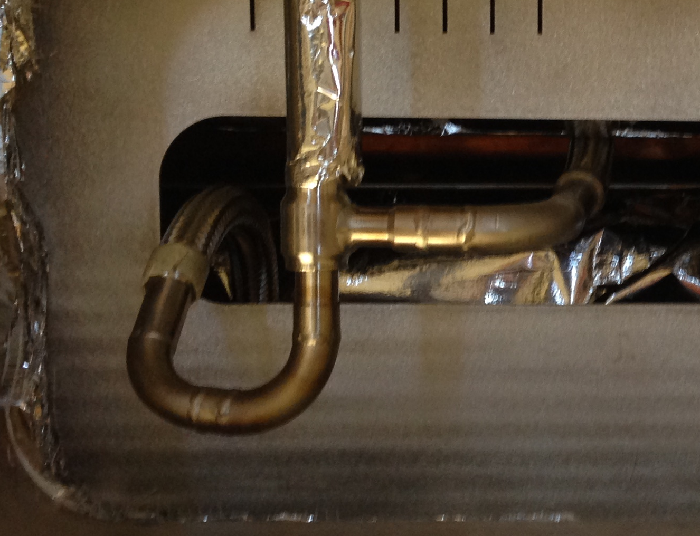
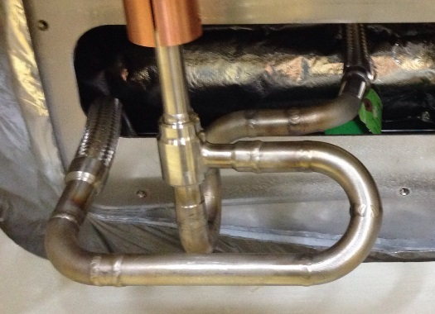
Cryogenic Valve Plumbing – Reverse Flow Path
  Test results show valve reversal (lower press in stem) significantly reduces/eliminate TAOs there
    F1.3-01 configuration has valve stem at supply pressure (~3 bar)
    Reversing flow will lower this pressure to sub-atmospheric, requiring guard gas to prevent contamination
    All cryomodules will have guard gas, reversed valves
  Additional effort to mitigate TAOs in cryogenic distribution system should improve inlet temperature at test stand
pCM Flow Pattern
3 bar Supply
Reversed Flow Pattern (CM2)
3 bar Supply
~23 Torr
~23 Torr
28
2018-09-07
International Workshop on Cryomodule Design and Standardization
Slide by Jeremiah Holzbauer

Slide 29
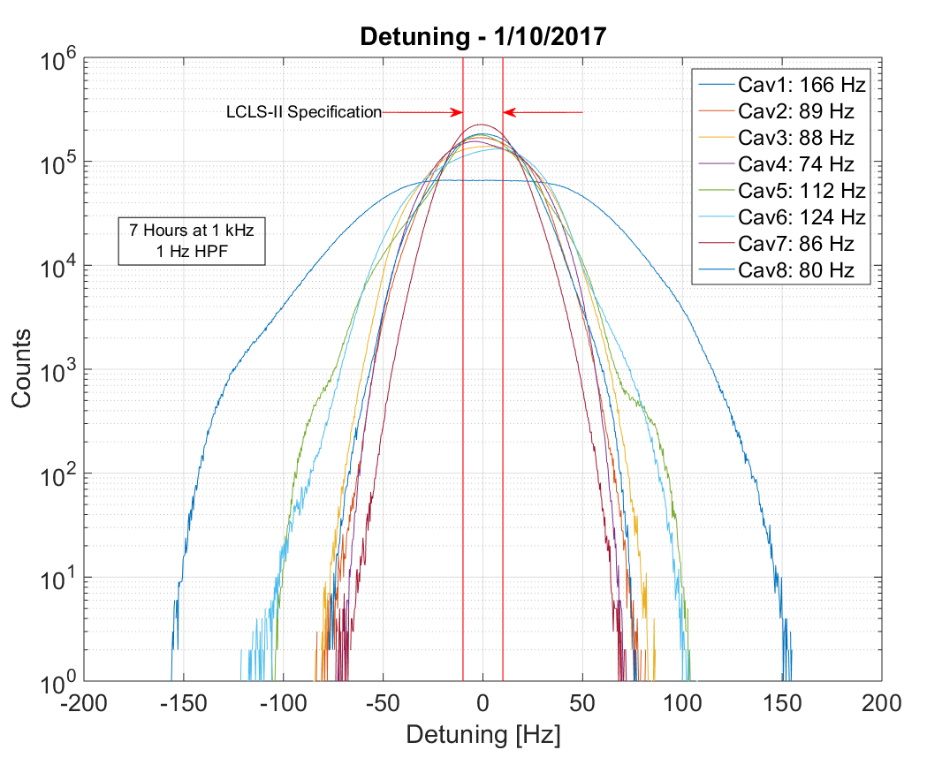
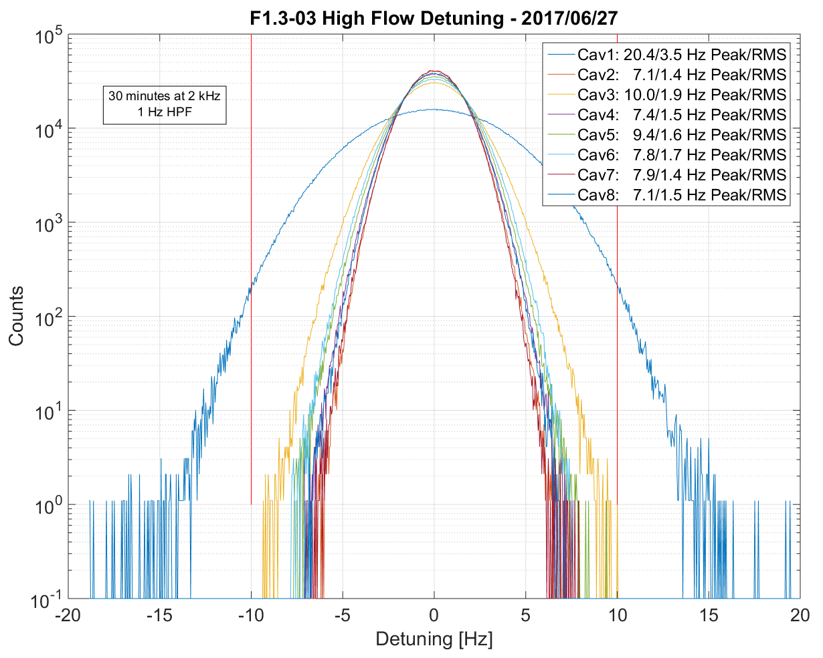
Valve Modification Improvement
Comparing performance of the standard cryogenics configuration, the microphonics environment in the F1.3-02/03/04 is a factor of ~10 improved
Significant improvements in stability of the system, leading to a far more predictable detuning environment
pCM As Cooled Down
F1.3-03
After Improvements
29
2018-09-07
International Workshop on Cryomodule Design and Standardization
Slide by Jeremiah Holzbauer

Slide 30
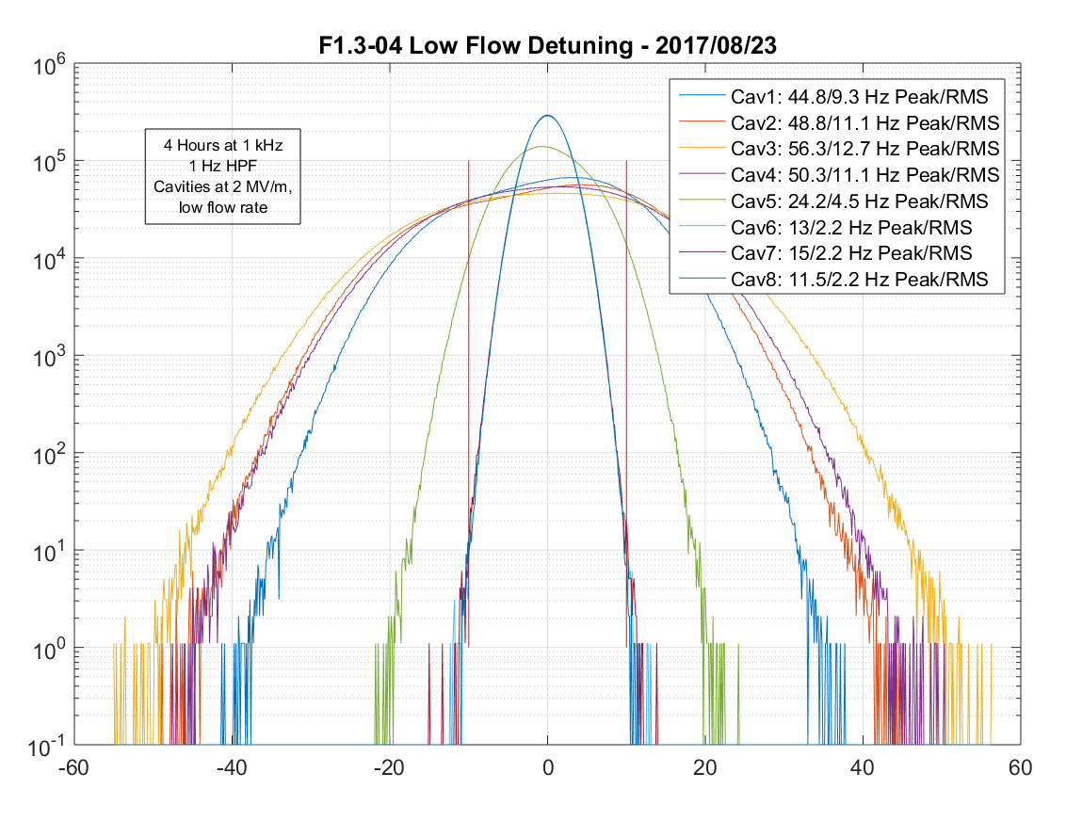
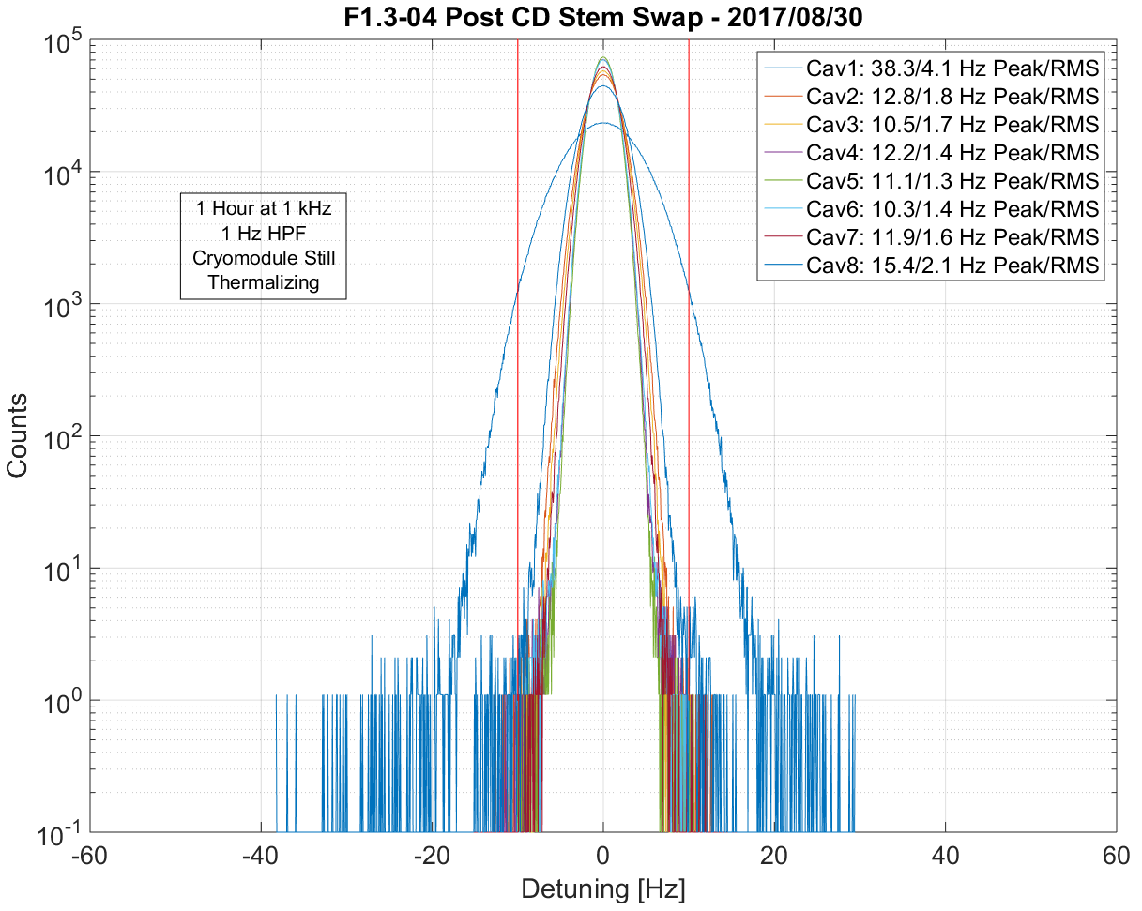
Cryogenic Valve Plumbing – Cooldown Valve Leakage
F1.3-04 presented with higher than expected microphonics, worsening as the cryomodule thermalized
Noise was narrowband and showed complex spatial and spectral distribution in cryomodule
Testing showed strong correlation with cooldown circuit, eventually proven to be coherent bubbling due to cooldown valve leakage
Swapping valve stem returned expected performance, although testing schedule prevented detailed studies
Tails seen in ‘post-swap’ data are likely due to continued thermalization of cryomodule after cooldown
Additional QA check step now included to prevent valve leakage in the future
Thermalized Detuning
Post CD Stem Swap
2018-09-07
International Workshop on Cryomodule Design and Standardization
Slide by Jeremiah Holzbauer

Slide 31
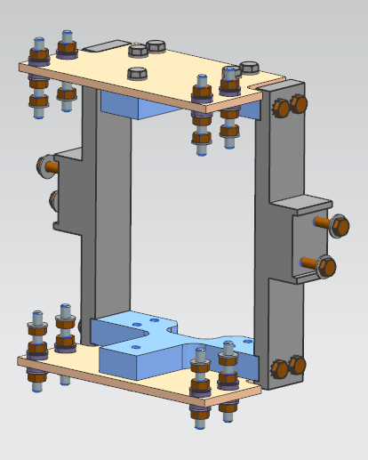
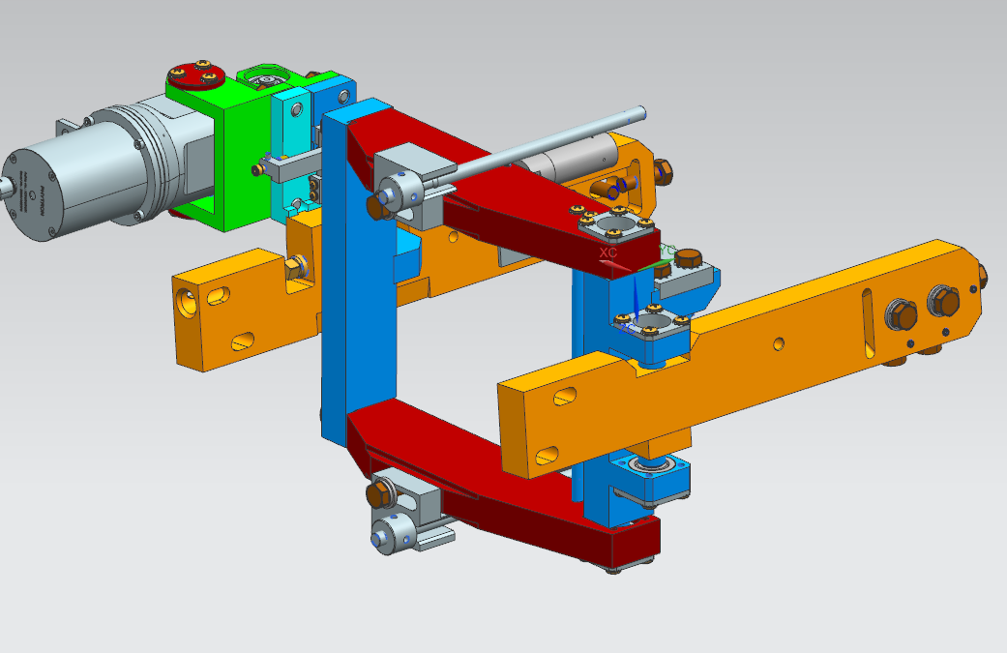
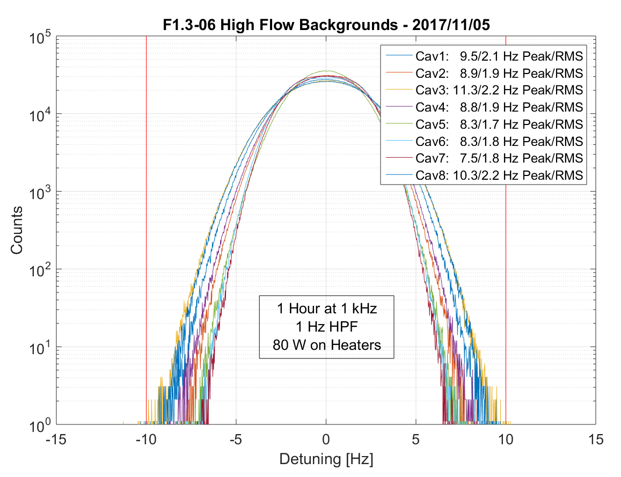
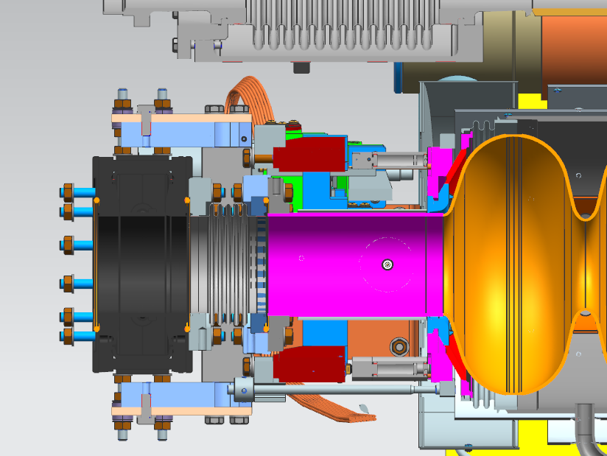
Cavity 1 Mechanical Connections – Mitigation
Beamline Gate Valve Bellows
Replacing spool piece between cavity 1 and gate valve with a bellows is non-trivial
Corrective fix includes extending tuner arms with fixture to connect to gate valve
  When replacing spool piece with bellows, fixture fully supports gate valve
  Current supports are long arms connected to the 300 mm pipe with needle bearing for the longitudinal motion
With gate valve is supported by frame/helium vessel, the spool piece can be replaced with a bellows to separate mass from cavity/tuner system
First cryomodule with bellows to be tested will be F1.3-06 (on deck at FNAL)
Extended Tuner Arms
Fixture with Bellows
2018-09-07
International Workshop on Cryomodule Design and Standardization
Slide by Jeremiah Holzbauer

Slide 32
Outline
  Introduction
  Lessons Learned during Cavity Production
  Lessons Learned during String Assembly
  Lessons Learned during Cryomodule Testing
  Lessons Learned from Cryomodule Transportation (skipped, see Peterson presentation)
  Summary
2018-09-07
International Workshop on Cryomodule Design and Standardization

Slide 33
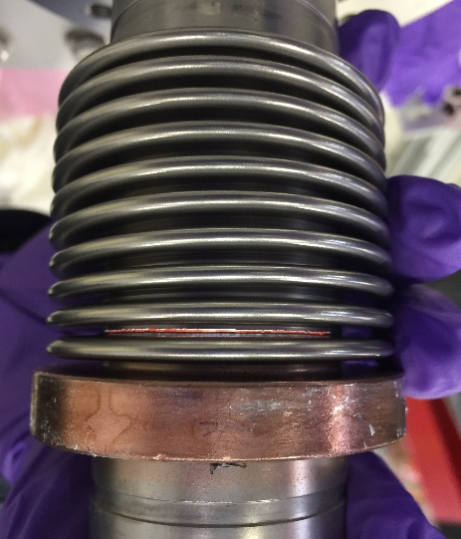
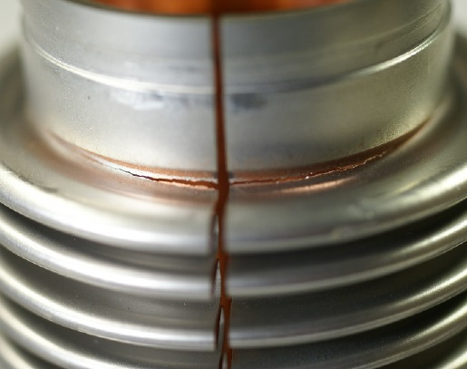
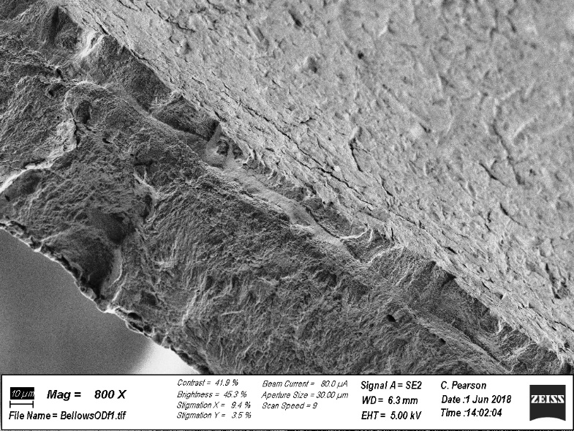
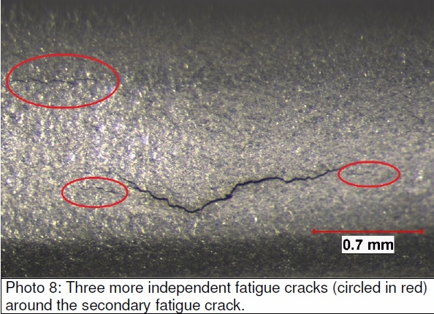
F1.3-05 and F1.3-06 Coupler Bellows Cracked during Transportation
Cavity 4
Cavity 5
Failed bellows examined after sectioning them:
SLAC (Chris Pearson) Report on Cavity 4 Bellows: “This is an example of high stress low cycle fatigue. That is, the material at the fracture location experienced multiple bending stress cycles at or above the yield strength, work hardening locally and eventually failing in a brittle manner.”
SGS report on Cavity 5 Bellows: “Fatigue fracture initiated on the outside surface at multiple locations at grain boundaries that were infiltrated with braze metal. Uni-directional bending stresses initiated and propagated the multiple fatigue cracks completely through the bellows.”
Courtesy of C. Adolphsen of SLAC
2018-09-07
International Workshop on Cryomodule Design and Standardization

Slide 34
F1.3-05 and F1.3-06 Lessons Learned
See Tom Peterson’s slides.
2018-09-07
International Workshop on Cryomodule Design and Standardization

Slide 35
Summary
A few significant cryomodule incidents have occurred during LCLS-II Cryomodule production.
Incidents have been addressed.
Lessons learned greatly benefit future projects such as PIP-II.
2018-09-07
International Workshop on Cryomodule Design and Standardization

