Slide 1
WA105 LRO mezzanine STATUS
Modification input ADC (full-scale)
Spare
Use in 6x6m Dune prototype
Cyril Drancourt, LAPP
Light Detection System Meeting Thursday, August 30, 2018

Slide 2
Actual design of PMT signal on FE_LRO WA105 board
HT
Power
FE_LRO
splitter
AD8137 ampli
Unipolair > differential
ADC AD9249
14bits
+
-
PMT
Offset = Vocm
= 0,9v
0v
V-
1,4v max
Differential offset = 0v
0,9v
Common mode
Offset
V+
0,9v
-Vmax = -1V
0,4v min
ADC value from 11111111111111 to 10000000000000 unused
Pb: Half dynamic range ADC used
V+ - V- =0
ADC value
=10000000000000
V+ - V- =-Vref
ADC Value
=00000000000000
30 aout 2018, cyril.drancourt@lapp.in2p3.fr

Slide 3
Upgrade: ADC input modification for full dynamic scale
Alim HT
FE_LRO
splitter
AD8137 Ampli
Unipolar > differential
ADC AD9249
14bits
+
-
PMT
ADDED Attenuator
Micro-circuit
ADDED Offset
= -Vref=-1v
Offset = Vocm
= 0,9v
0v
0v
V+
1,4v
Added Offset
-Vref = -1v
0,9v
Unchanged
Common mode
Offset
V-
0,4v
-Vmax = -2V
-Vmax_PMT
(depending
Attenuator value)
V+ - V- =Vref
ADC Value
=11111111111111
V+ - V- =0
ADC Value
=10000000000000
V+ - V- =-Vref
ADC Value
=00000000000000
Full dynamic range ADC used
30 aout 2018, cyril.drancourt@lapp.in2p3.fr

Slide 4
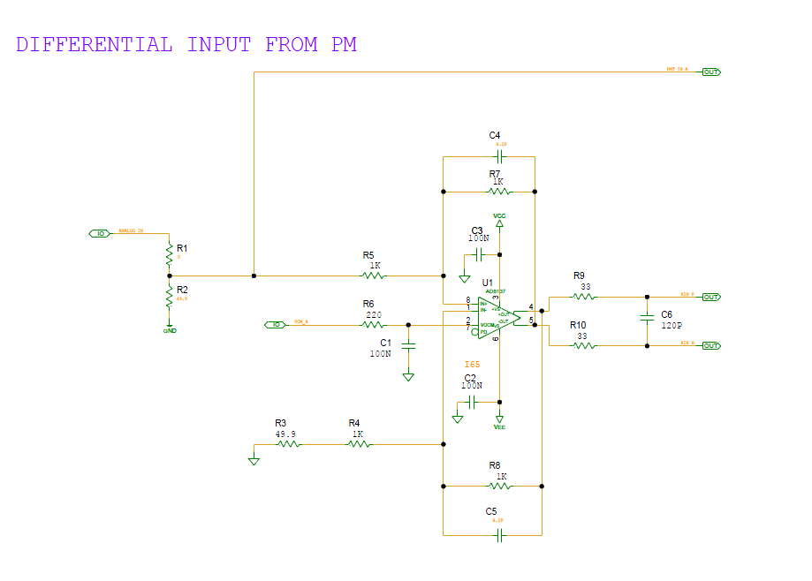
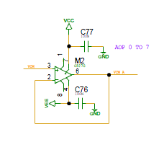
Ampli: actual schematic
output 0,9v
From ADC
Common mode
Offset
0,9v
30 aout 2018, cyril.drancourt@lapp.in2p3.fr

Slide 5
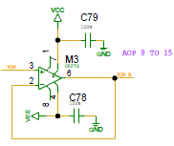
Schematic upgrade (hardware modification)
unchanged
0v
output 0,9v
From ADC
-Vmax = -2V
unchanged
0,9v
-1v
output 1v (Vref)
From ADC
Dual ampli added
100nF
10ΚΩ
AOP 0 to 7
AOP 8 to 15
10ΚΩ
100nF
OPA2227UA
(2 inverter amplificators because current constraint )
30 aout 2018, cyril.drancourt@lapp.in2p3.fr

Slide 6
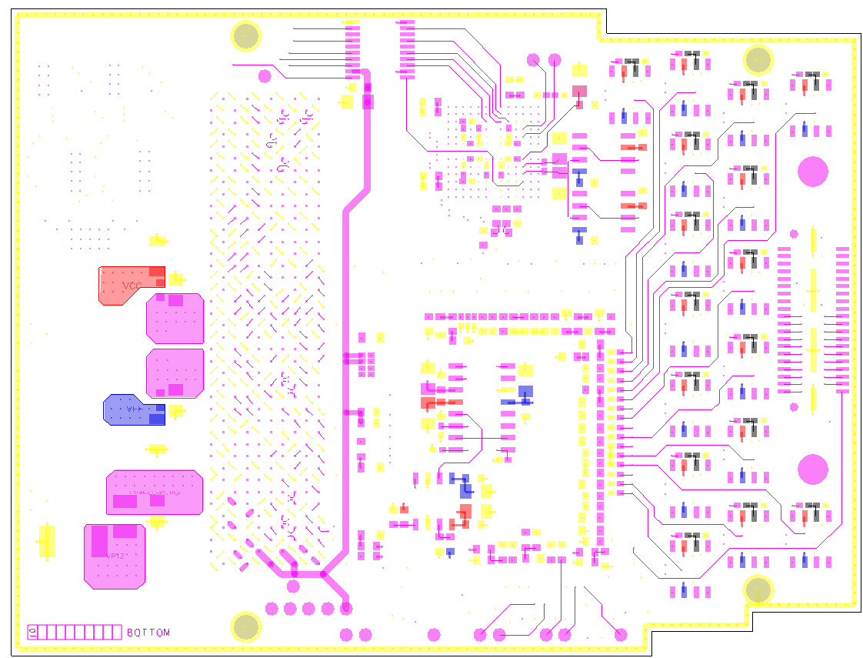
Modification –BOTTOM cabling
Vref wire

Slide 7
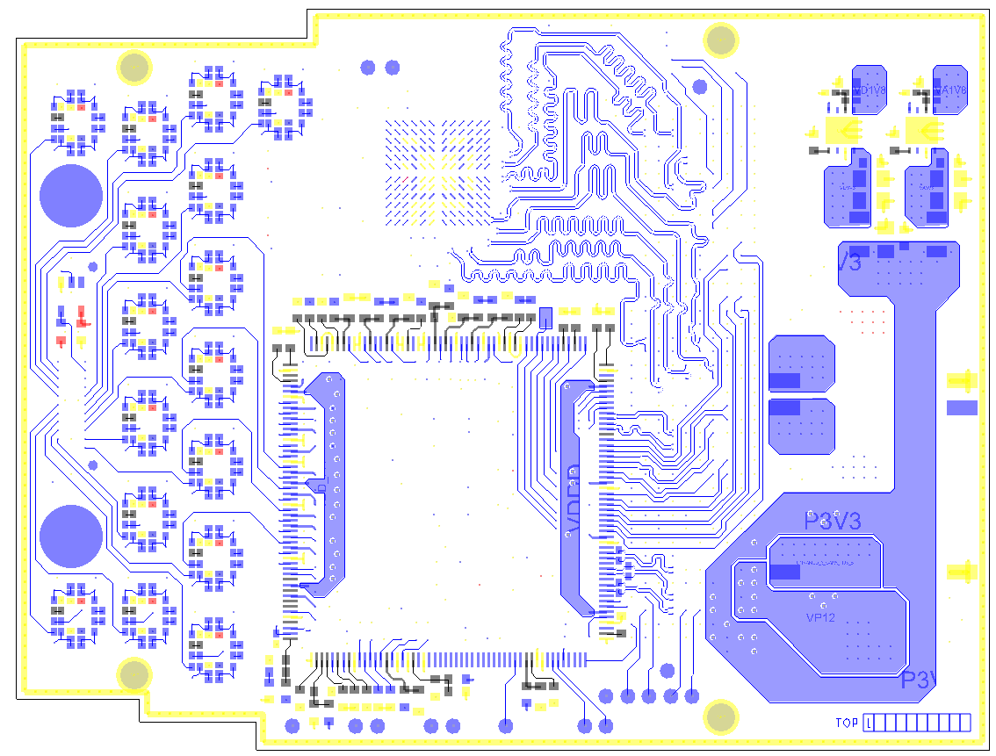
Modification – TOP cabling
Vref wire
R3
-1v
OPA2227
OPA2227UA ampli
Glue on top OPA2227
on free pcb space
+ 4 10K resistor
+ 3 100nF capacitor
-1v
4 x 10ΚΩ
3 x 100nF
alim
Wire to link 8 resistors(R3)
R3 cabling in vertical (manhattan if cms package) : link to R4 unchanged on pcb, link by wire on « -1V » from OPA2227

Slide 8
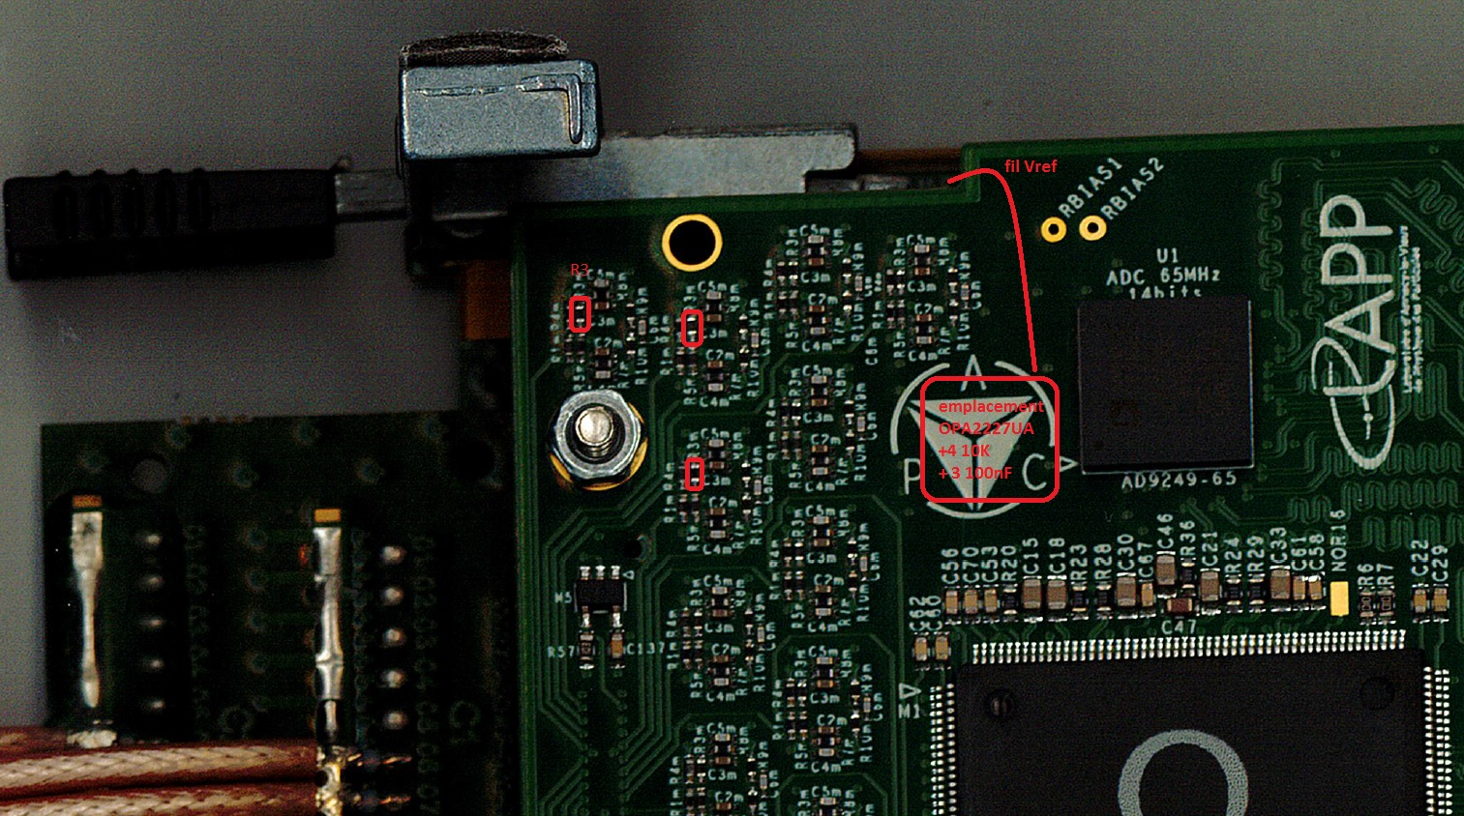
Modification – TOP cabling
OPA2227UA ampli
Glue on top component
on free pcb space
+ 4 10K resistor
+ 3 100nF capacitor
R3 cabling in vertical (manhattan if cms package) : link to R4 unchanged on pcb, link by wire on « -1V » from OPA2227

Slide 9
Upgrade Status
APC team august decision
No cabling modification
Only attenuator used to adapt PMT range
30 aout 2018, cyril.drancourt@lapp.in2p3.fr

Slide 10
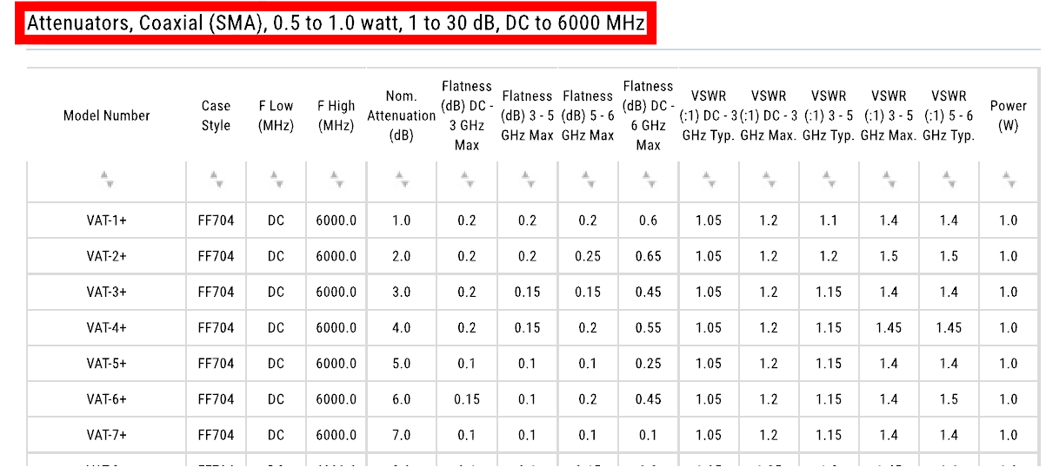
Attenuator choise : mini-circuit product
30 aout 2018, cyril.drancourt@lapp.in2p3.fr

Slide 11
LRO mezzanine(V2) spare
No spare in product, because no july confirmation from financer
Components in LAPP stock:
2 pcb
2 samtec board with 20 wires with SMA-connector
2 catiroc
Some component rest from the previous cabling (no inventory)
Cost estimation to have 2 spares (without modification):
Cabling: 800€ (if same manufacture to reuse tools)
Components: (see APC 2016 command) – 50%
30 aout 2018, cyril.drancourt@lapp.in2p3.fr

Slide 12
Next LRO board
Actual Mezzanine Board:
Permit to validate the front end LRO design
Aquisition standalone
To include in global WA105 DAQ, many constraint :
MCH2 slot occuped by white rabbit slave
Fine / stratix communication on bittware board in this case must be used
-> a lot of work, no implementation available by IPNL.
Link 1Mb/s must be change to 10Mb/s (port 4,5,6,7 on µTCA)
-> complex changment.
Next LRO board
Permit to have facility to include LRO in global WA105 DAQ
Must be start after front end LRO design validation
CAO in standby since january 2018, ready to start.
30 aout 2018, cyril.drancourt@lapp.in2p3.fr

