Slide 1
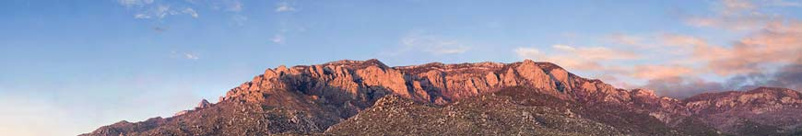
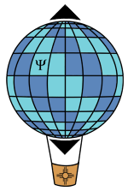

Pondering squeezed-light interferometry
Carlton M. Caves
Center for Quantum Information and Control, University of New Mexico
Gravitational-wave astronomy
Squeezed states and optical interferometry
The future and the lessons
http://info.phys.unm.edu/~caves
Center for Quantum Information and Control
TexPoint fonts used in EMF.
Read the TexPoint manual before you delete this box.: AAA

Slide 2
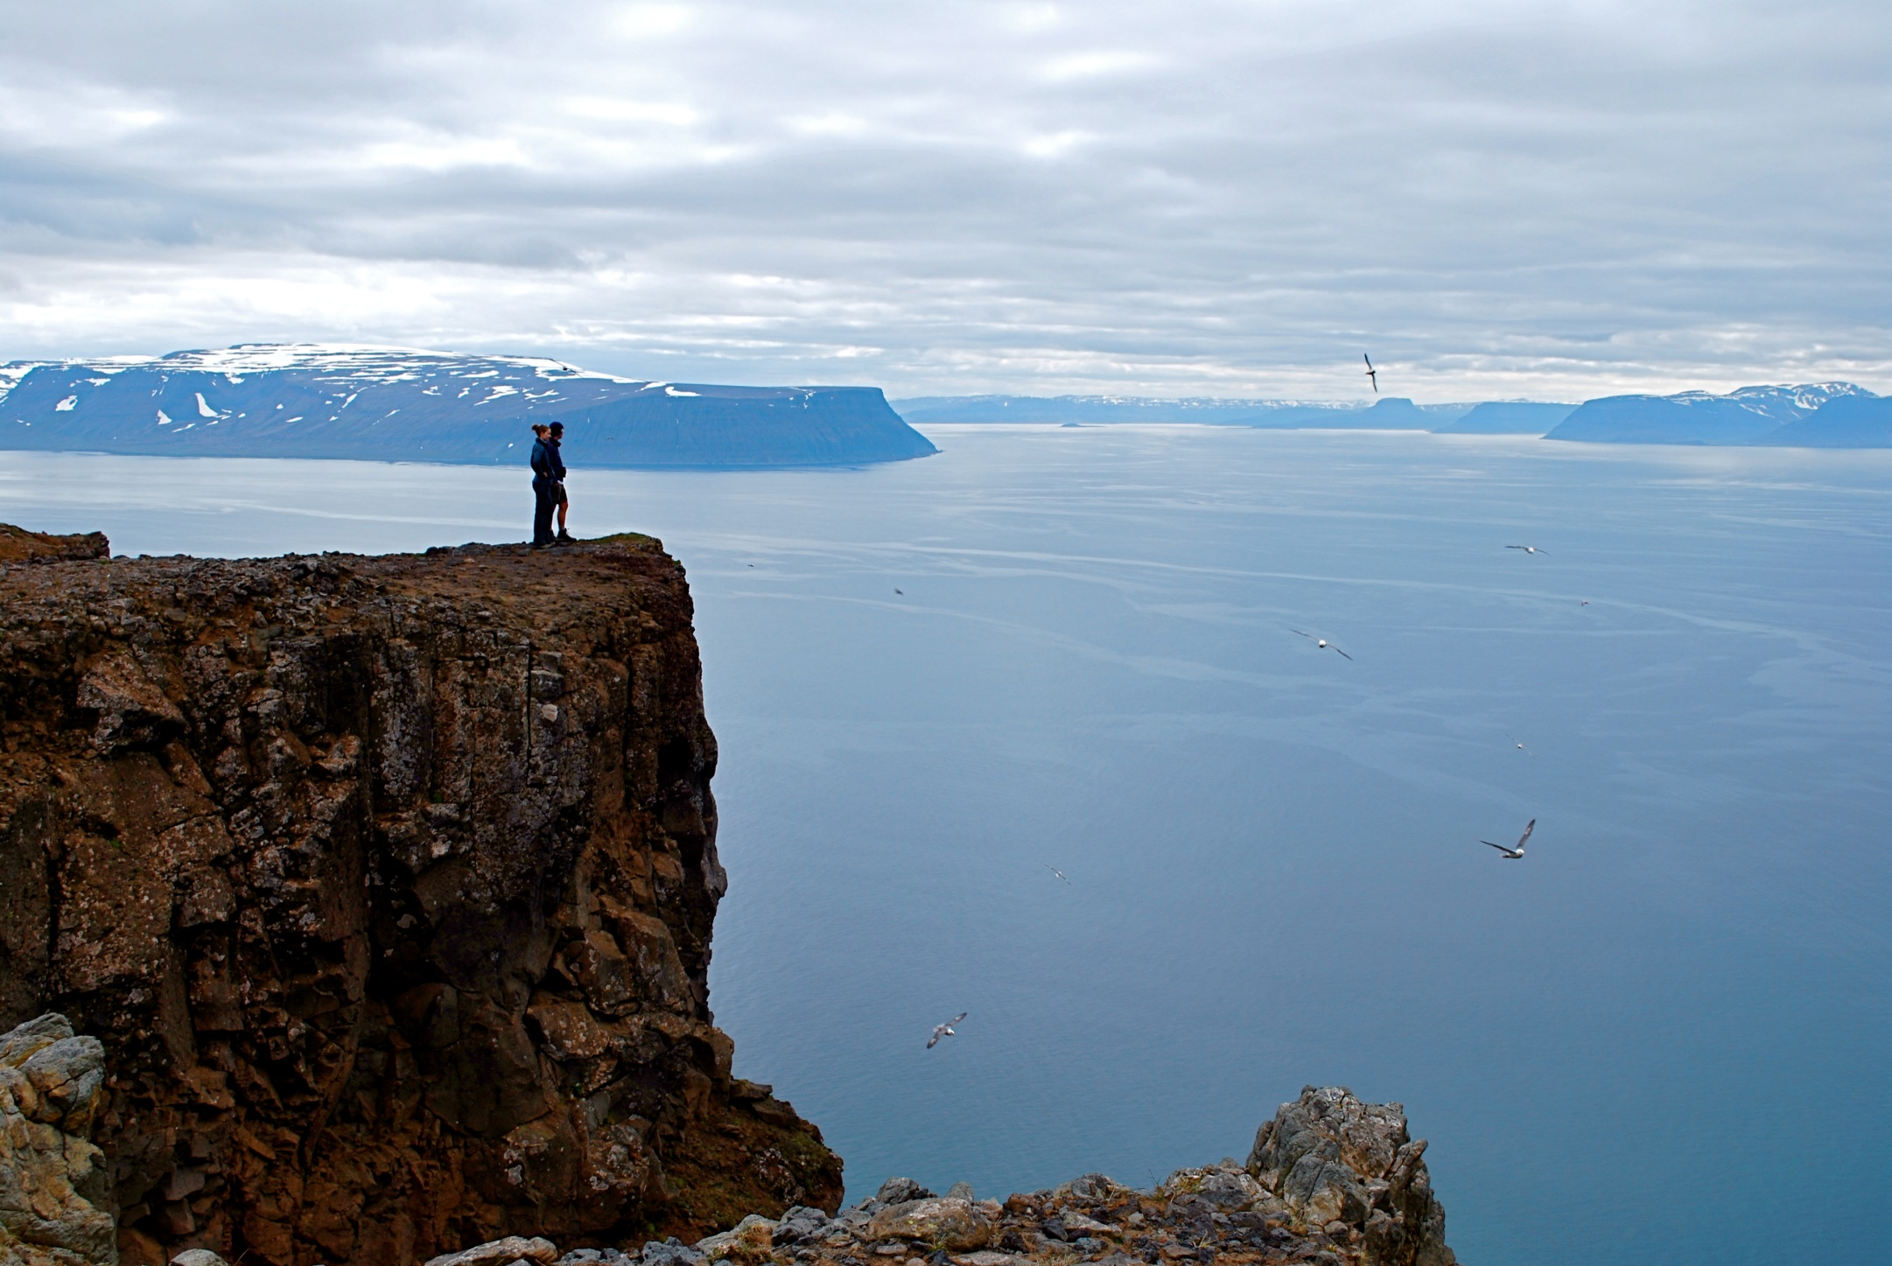
I. Gravitational-wave astronomy
Holstrandir Peninsula overlooking Ísafjarðardjúp
Westfjords, Iceland

Slide 3
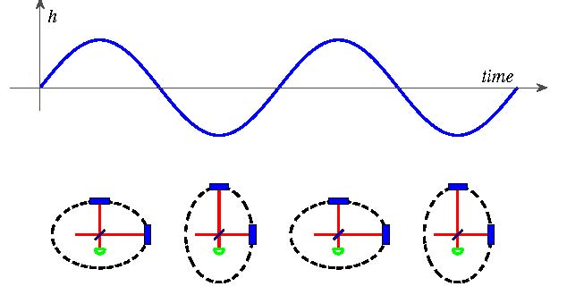
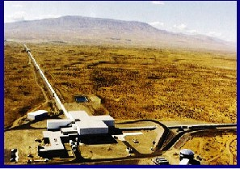
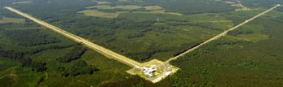
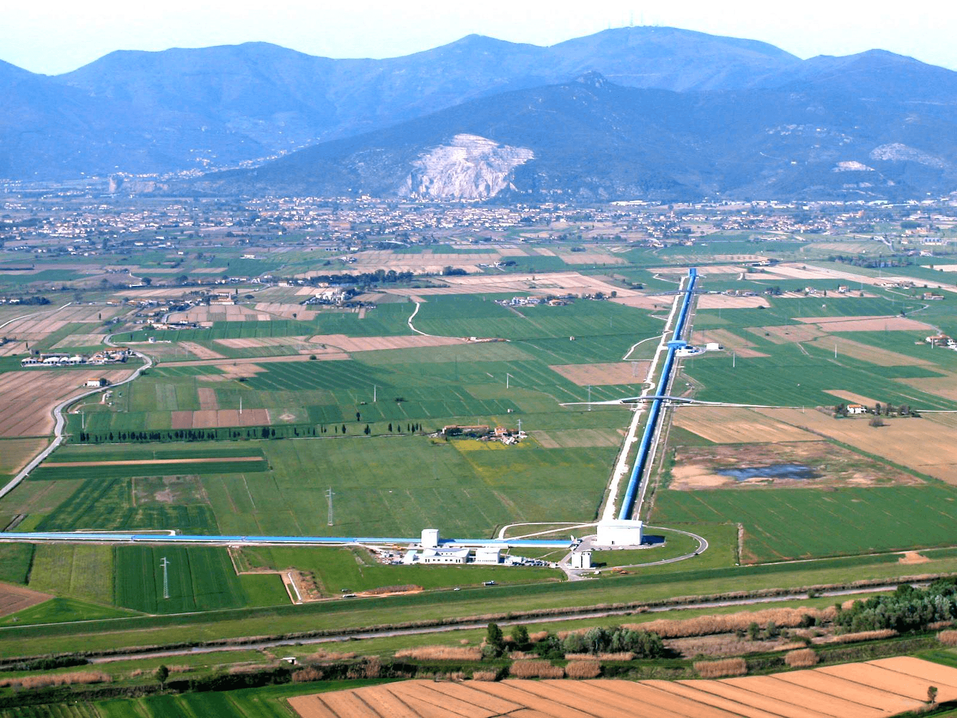
(Absurdly) high-precision interferometry
Hanford, Washington
The LIGO Scientific Collaboration, Rep. Prog. Phys. 72, 076901 (2009).
Laser Interferometer Gravitational Observatory (LIGO)
4 km
3 km
Livingston, Louisiana
VIRGO
Cascina, Italy

Slide 4
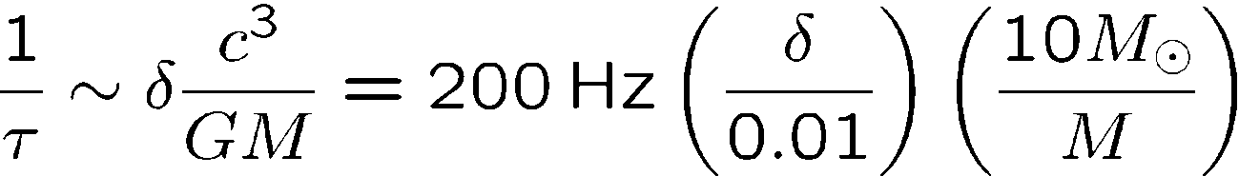
Gravitational-wave astronomy
Strong-field burst sources

Slide 5
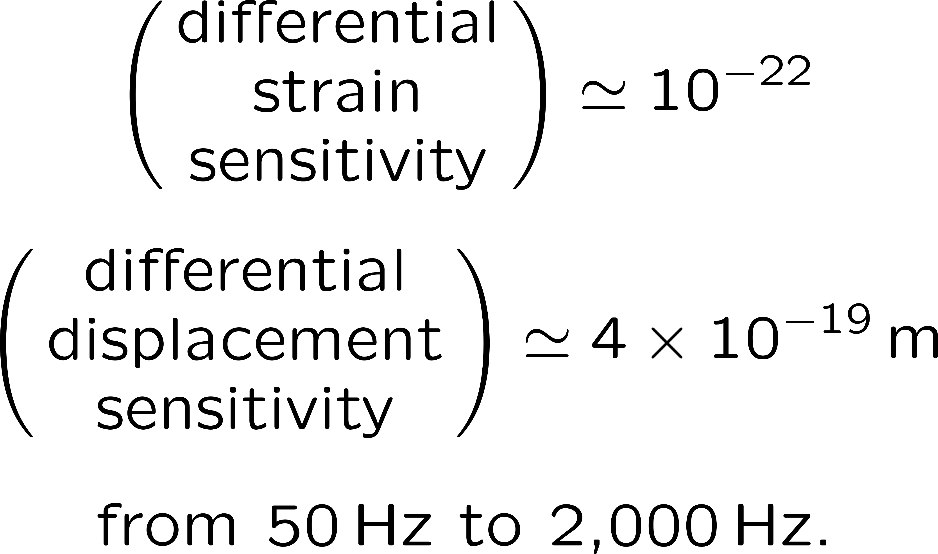
(Absurdly) high-precision interferometry
Advanced LIGO
Hanford, Washington
Laser Interferometer Gravitational Observatory (LIGO)
4 km
3 km
Livingston, Louisiana
VIRGO
Cascina, Italy

Slide 6
(Absurdly) high-precision interferometry
Advanced LIGO
(O1 and O2) High-power, Fabry-Perot Michelson (multipass), power-and signal-recycled, and
(O3) squeezed-light
interferometers

Slide 7
(Absurdly) high-precision interferometry
Advanced LIGO
Hanford, Washington
Laser Interferometer Gravitational Observatory (LIGO)
High-power, Fabry-Perot Michelson (multipass), power-and signal-recycled, squeezed-light (O3) interferometers
4 km
Livingston, Louisiana

Slide 8
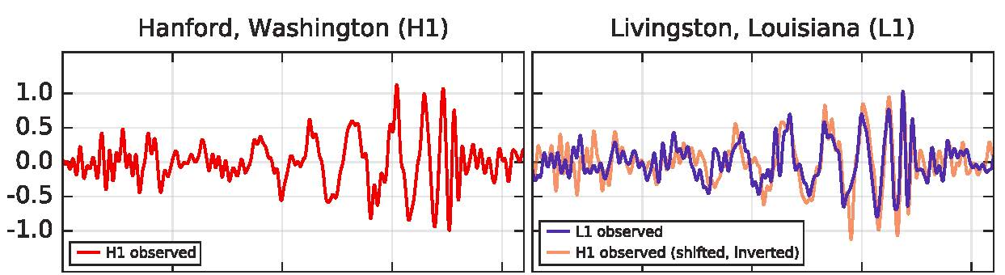
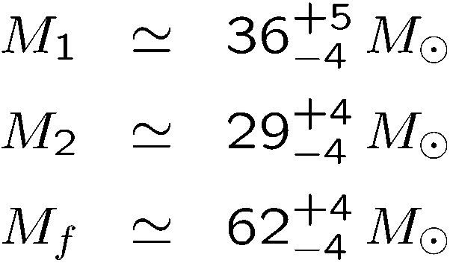
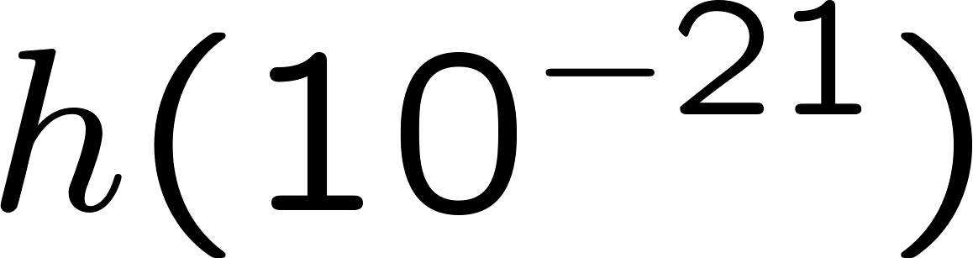
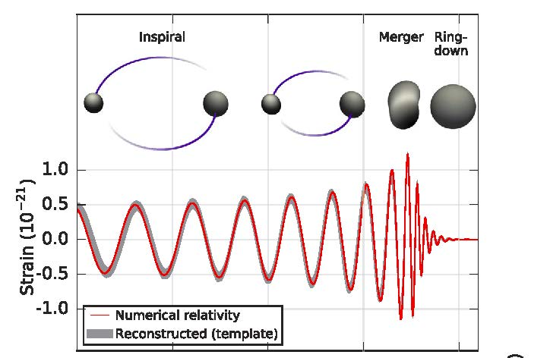
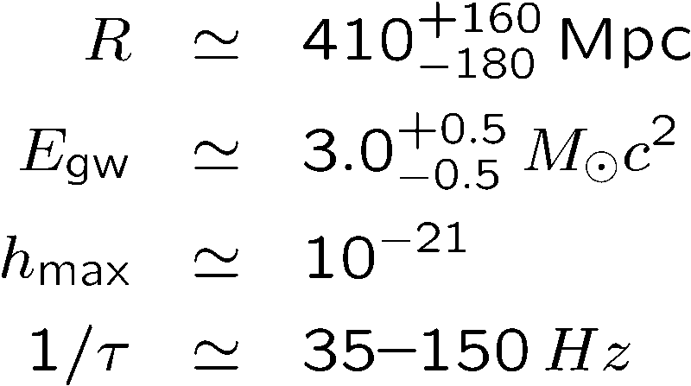
Gravitational-wave astronomy
Strong-field burst sources
Coalescence of two black holes
The LIGO Scientific Collaboration and Virgo Collaboration, PRL 116, 061102 (2016).
0.30s
0.35s
0.40s
0.45s
0.30s
0.35s
0.40s
0.45s

Slide 9
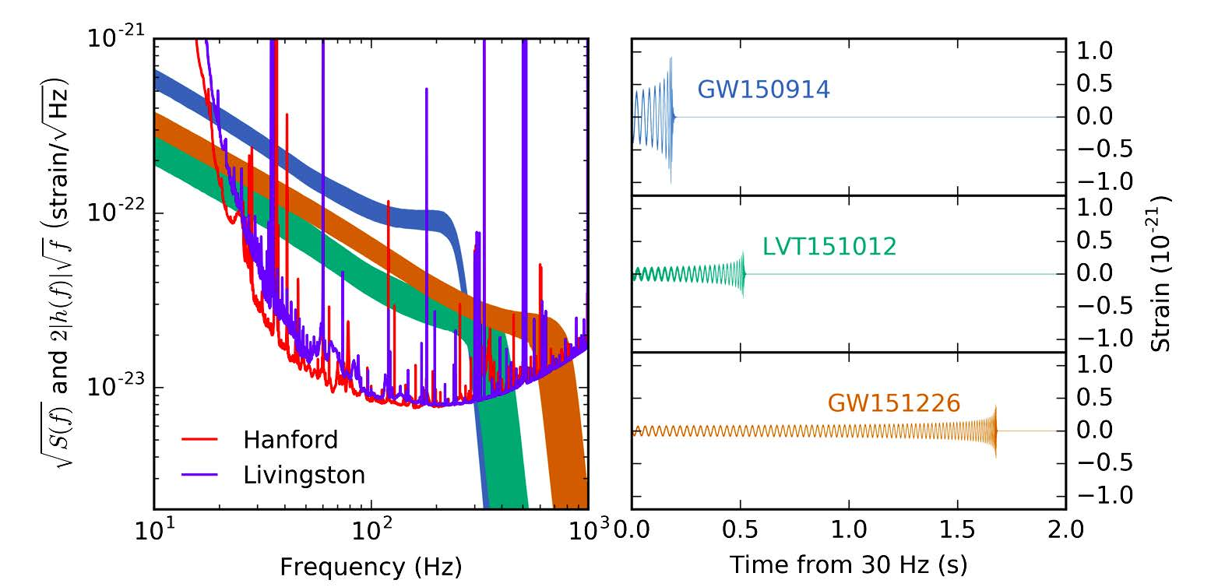
Gravitational-wave astronomy
Coalescences of two black holes
(3 in O1)
The LIGO Scientific Collaboration and Virgo Collaboration, PRX 6, 041015 (2016).

Slide 10
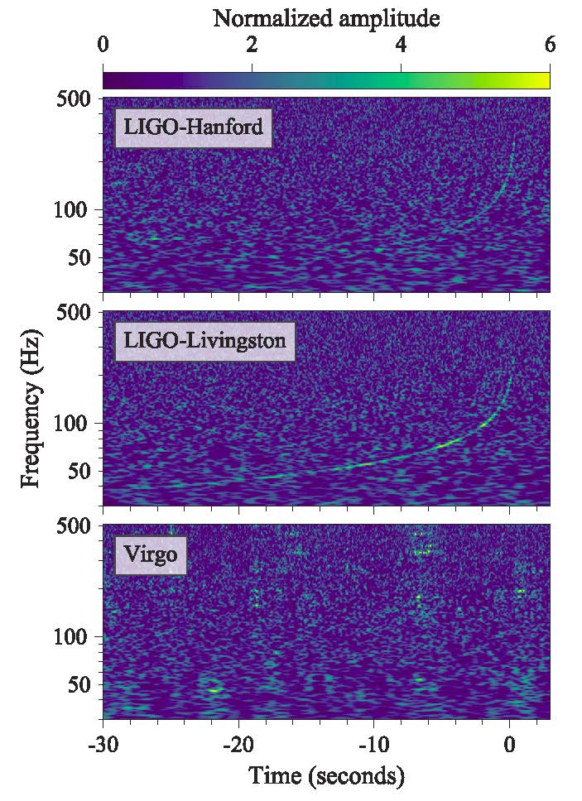
Gravitational-wave astronomy
Coalescence of two neutron stars
(in O2)
The LIGO Scientific Collaboration and Virgo Collaboration, PRL 119, 161101 (2017).

Slide 11
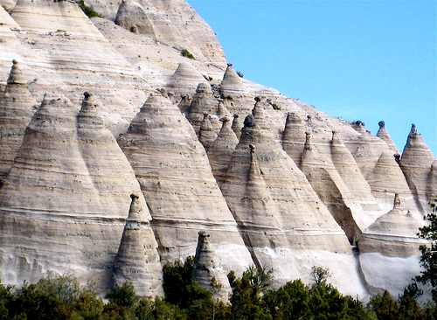
Squeezed states and optical interferometry
Tent Rocks
Kasha-Katuwe National Monument
Northern New Mexico

Slide 12
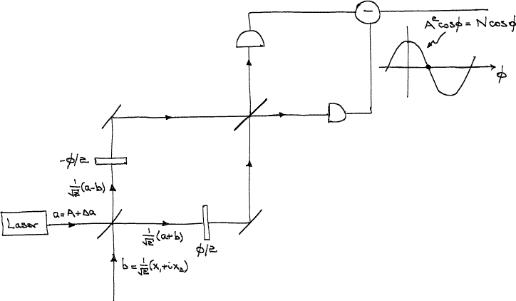
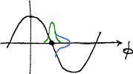
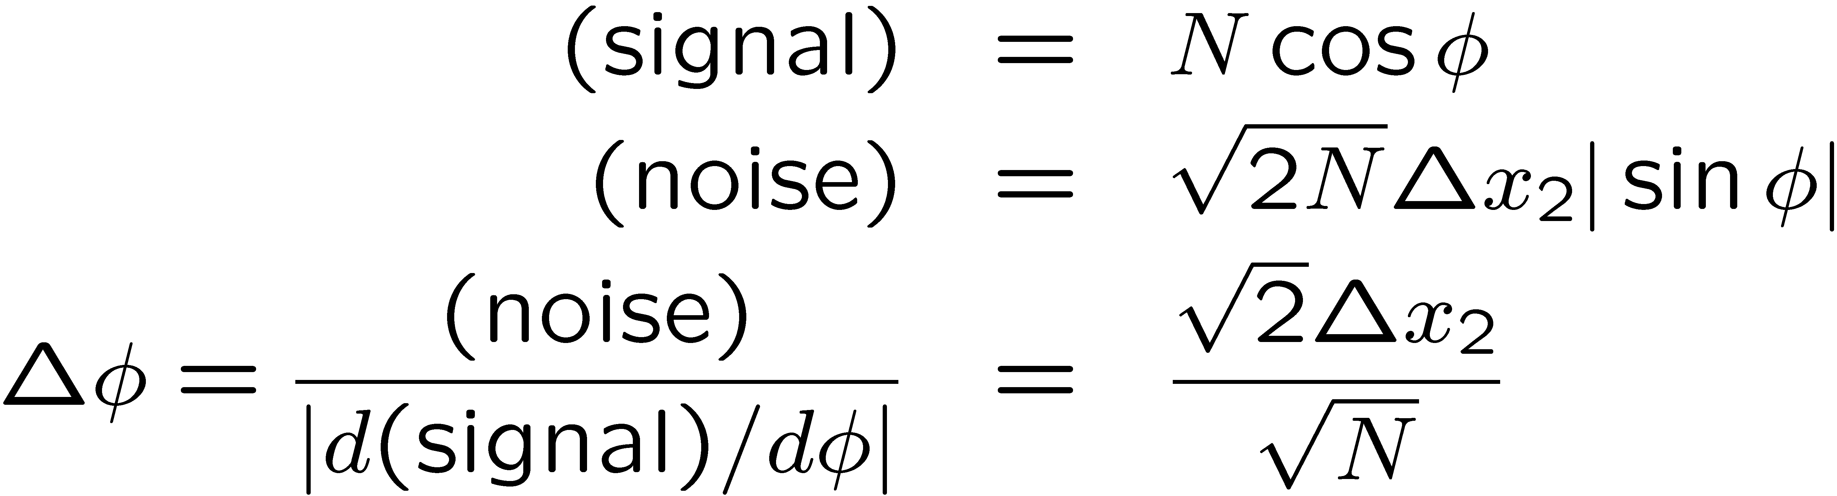
Mach-Zehnder interferometer
C. M. Caves, PRD 23, 1693 (1981).
What about back action (radiation-pressure noise)?

Slide 13
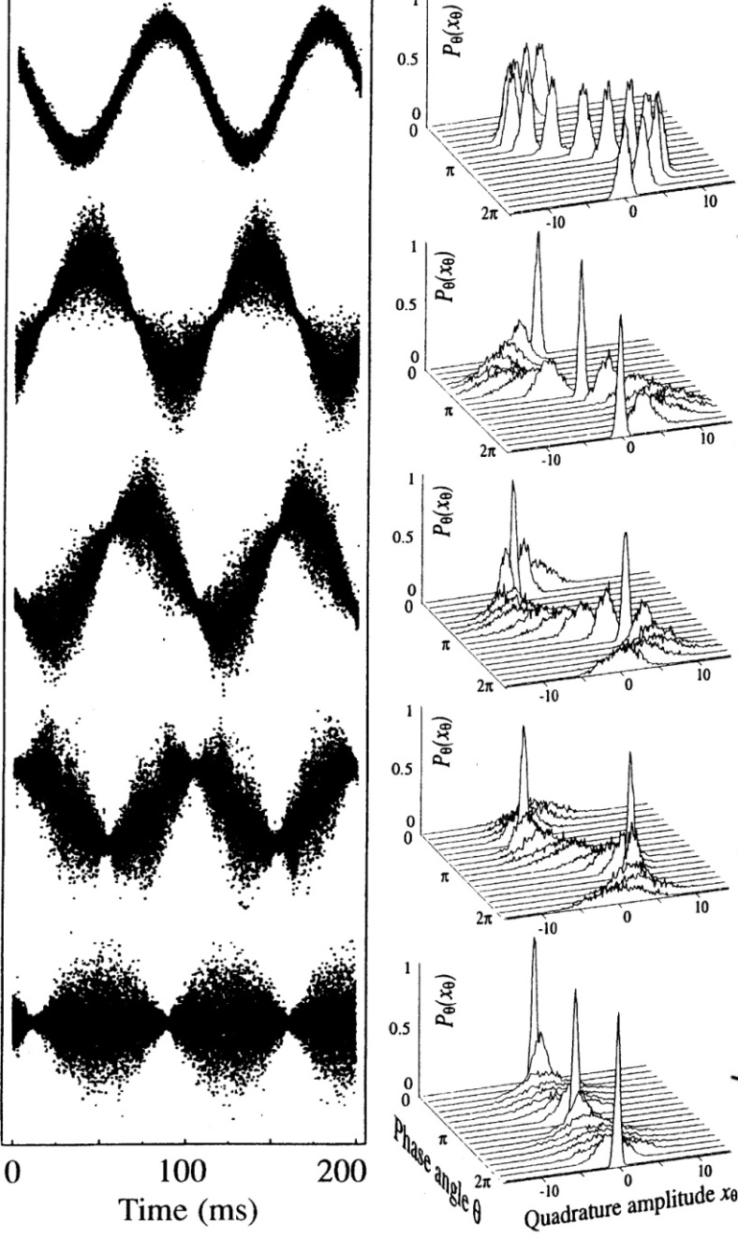
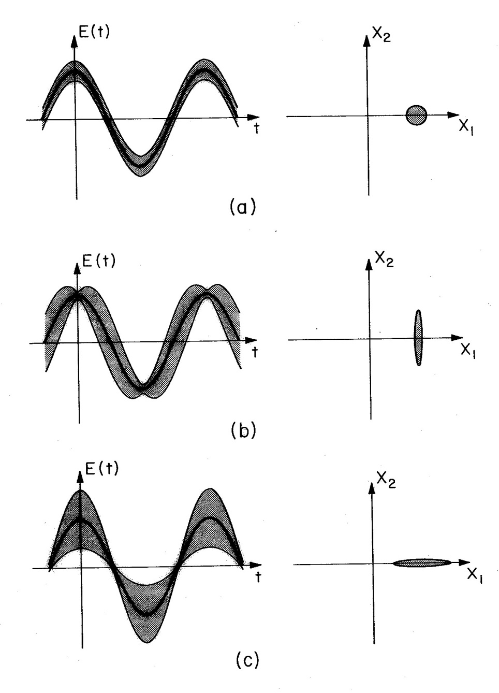
Squeezed states of light
Groups at ANU, Hannover, Tokyo, and MIT continued to push for greater squeezing (at audio frequencies) for use in Advanced LIGO, VIRGO, and GEO and other quantum metrology and quantum information jobs.
Squeezing by a factor of about 3.5
G. Breitenbach, S. Schiller, and
J. Mlynek, Nature 387, 471 (1997).

Slide 14
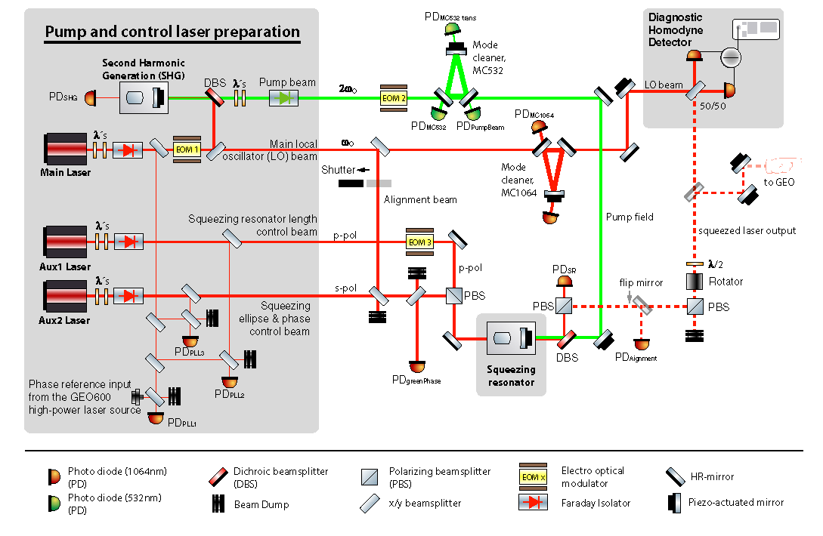
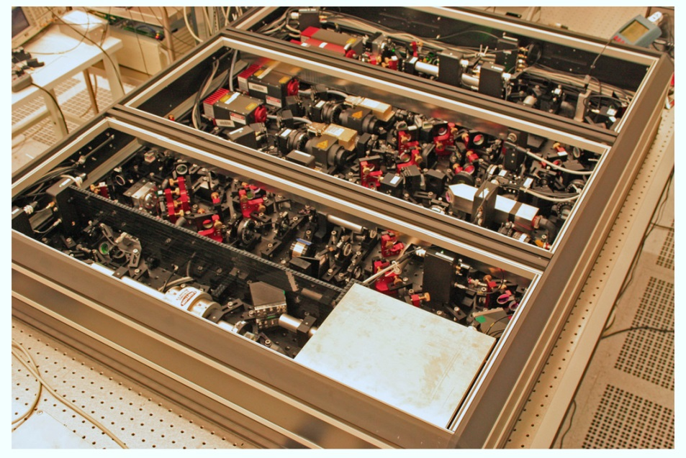
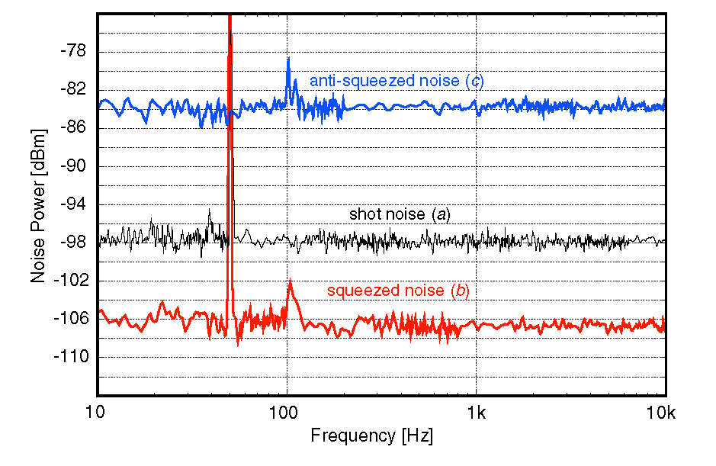
Squeezed states of light
Squeezed light in Hannover
H. Vahlbruch et al., Class. Quant. Grav. 27, 084027 (2010).
8–9 dB below shot noise at audio frequencies

Slide 15
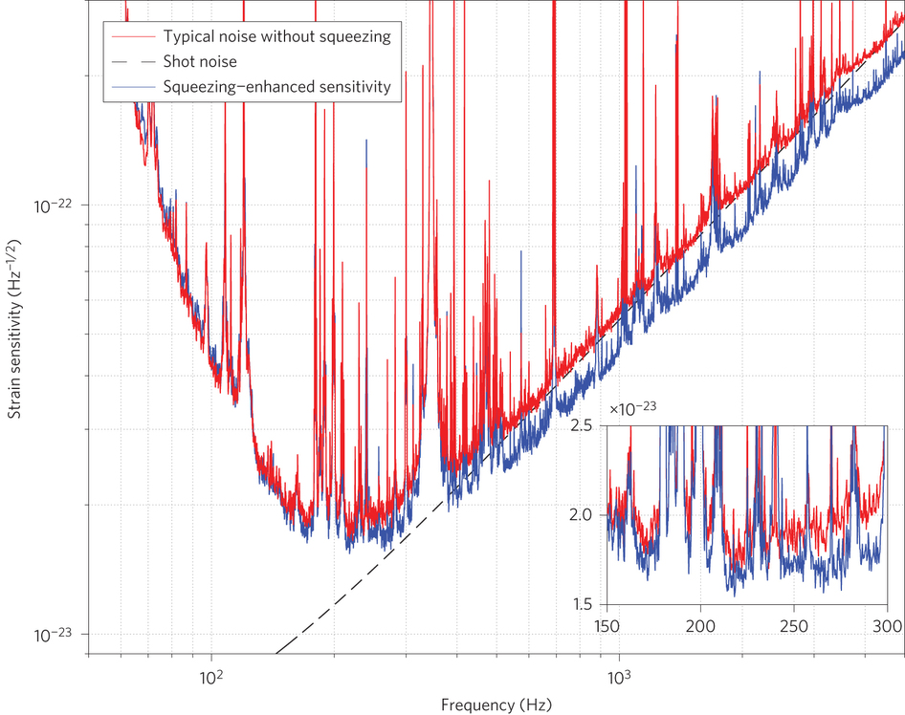
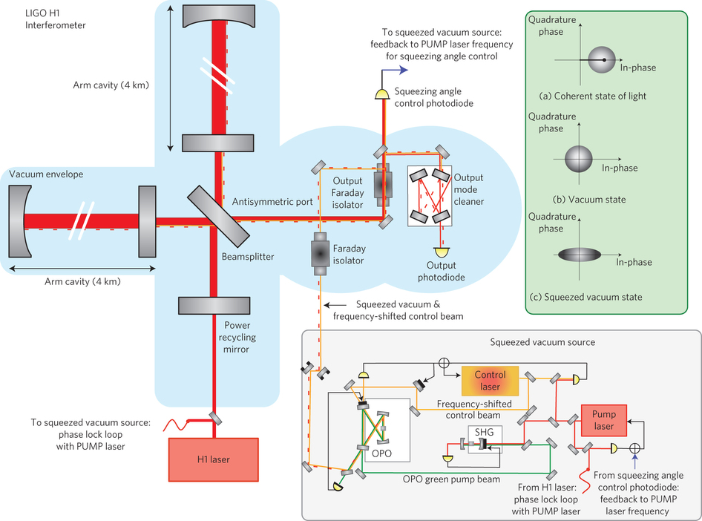
Quantum metrology (nearly) making a difference
Squeezed light in the
LIGO Hanford detector
The LIGO Scientific Collaboration, Nat. Phot. 7, 613 (2013).
~ 2 dB of shot-noise reduction

Slide 16
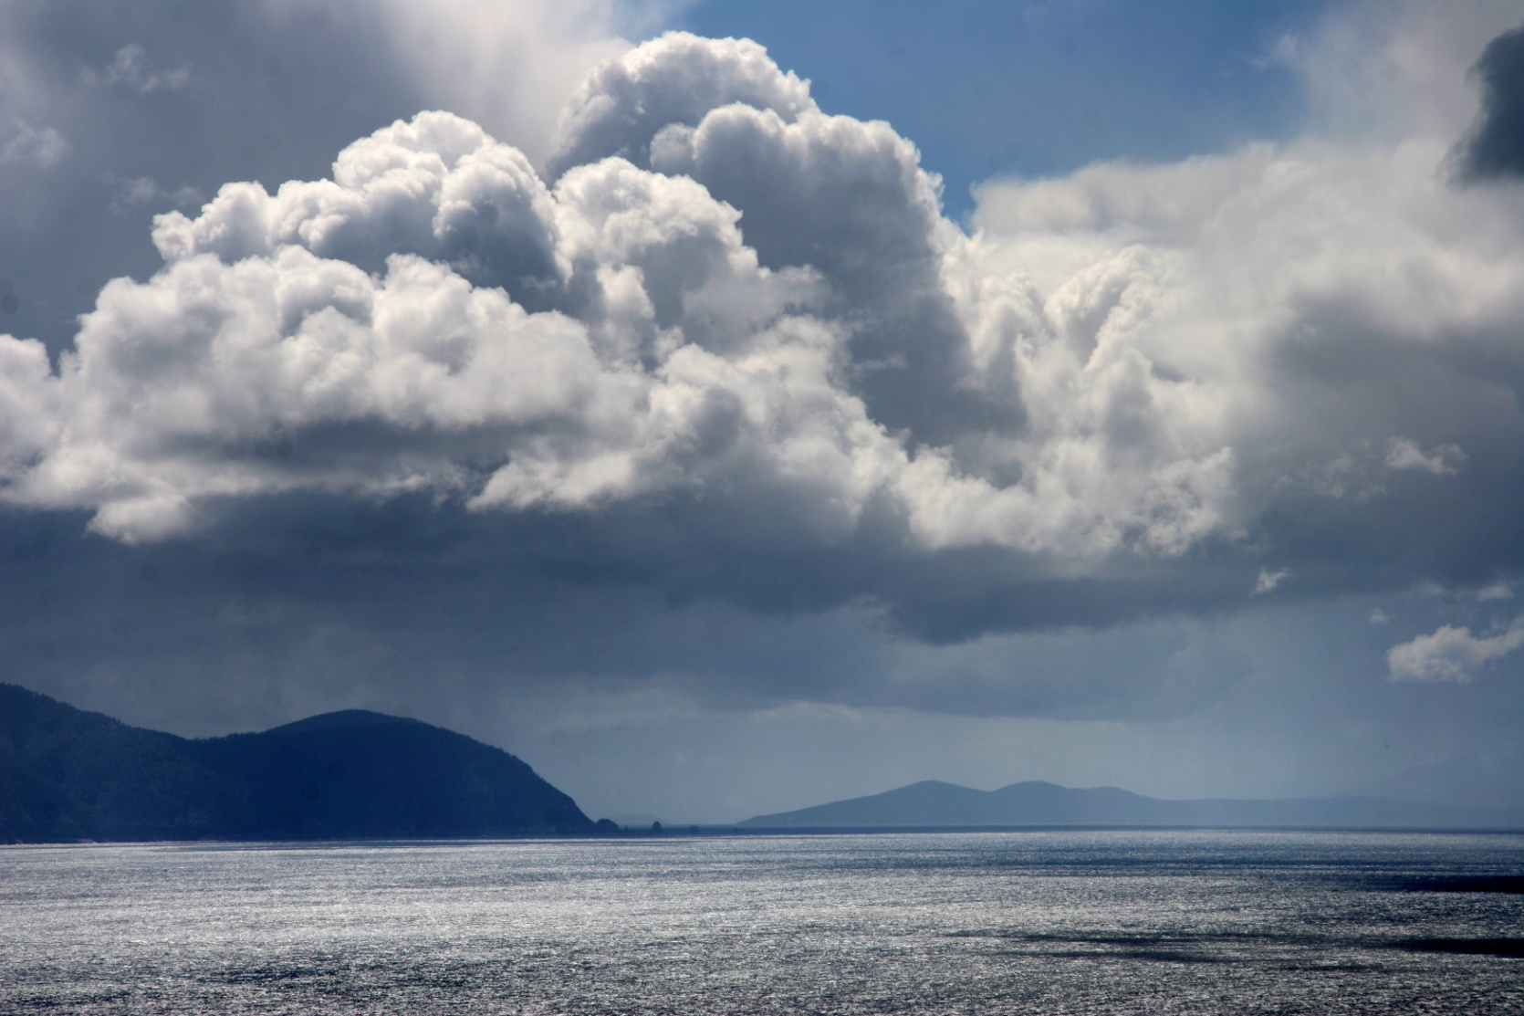
III. The future and the lessons
View from Cape Hauy
Tasman Peninsula, Tasmania

Slide 17
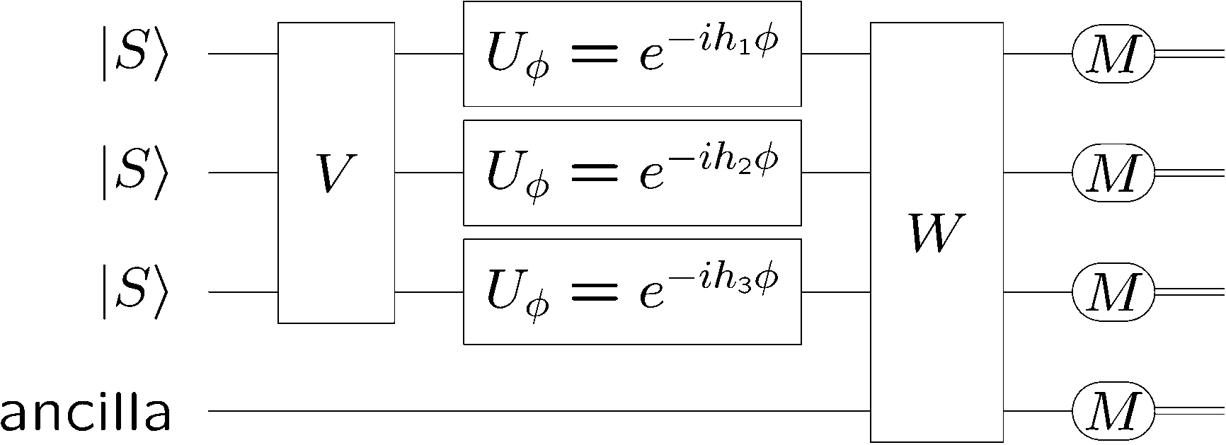
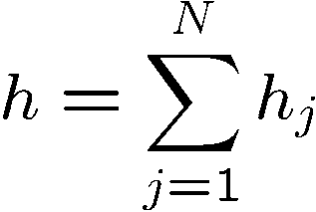
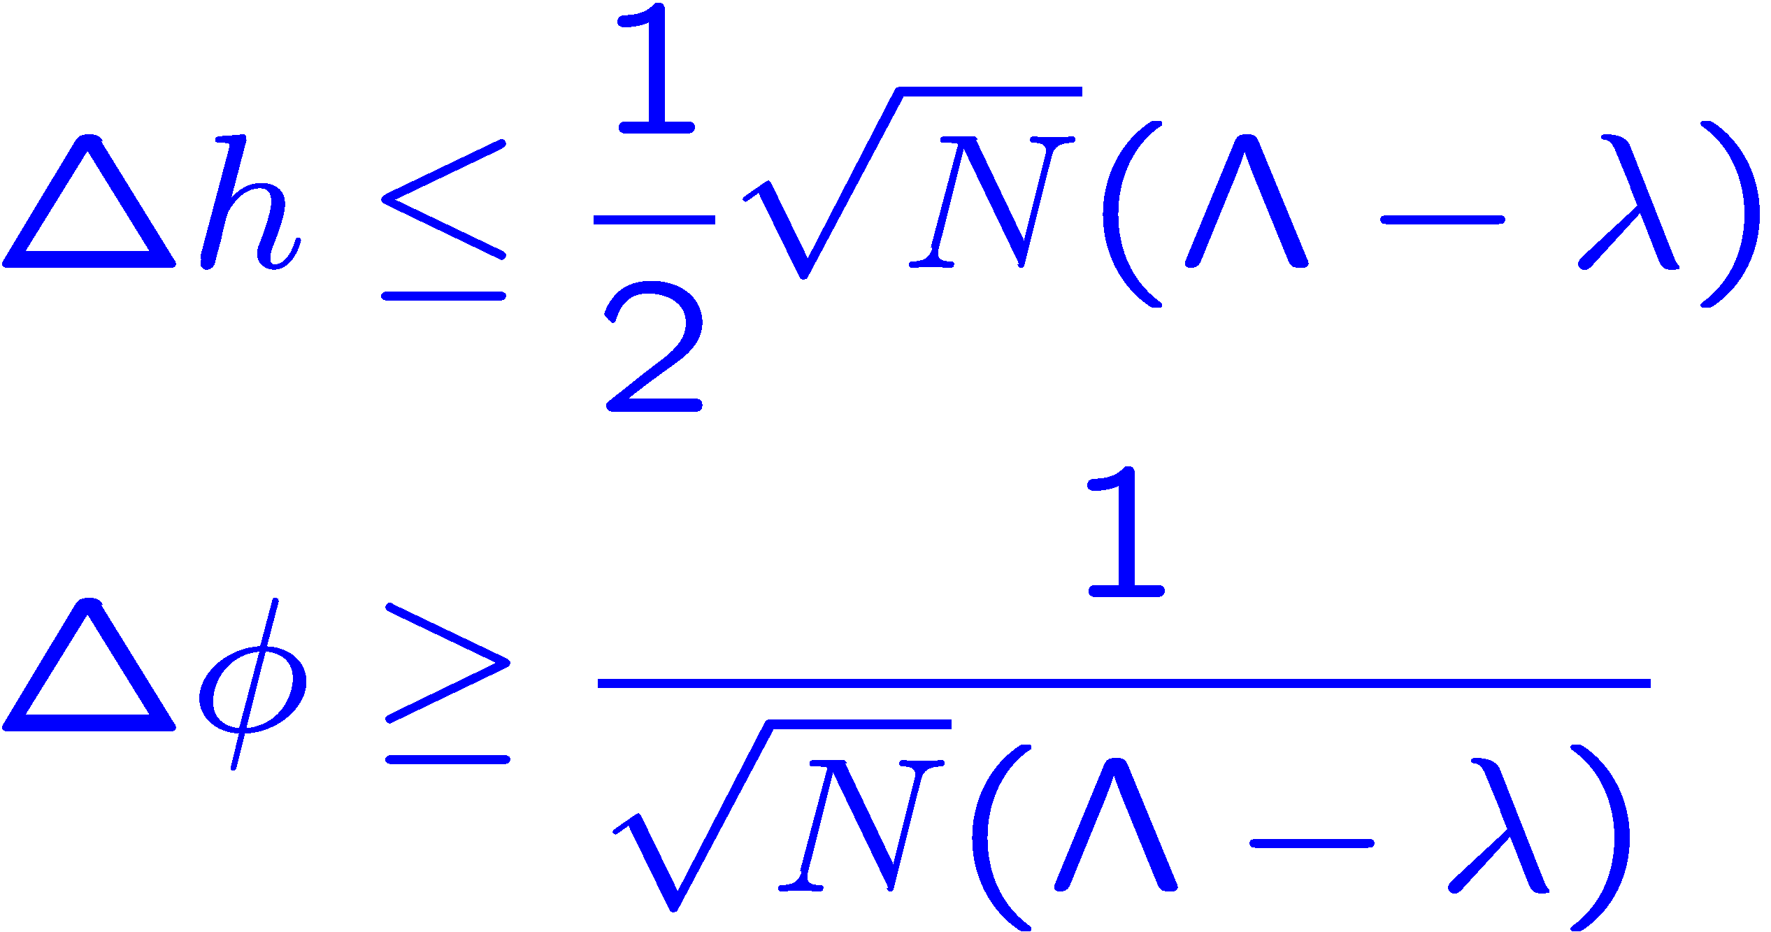
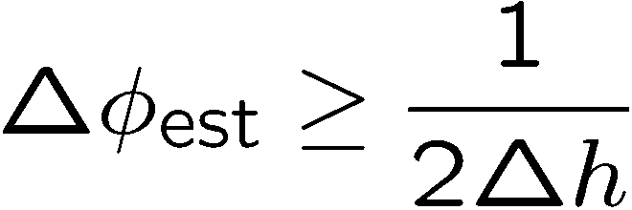
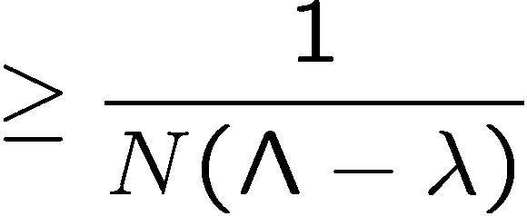
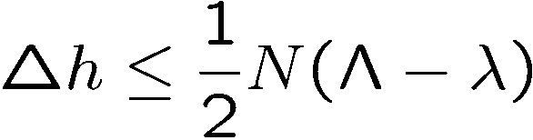
Quantum
limits
S. L. Braunstein, C. M. Caves, and G. J. Milburn, Ann. Phys. 247, 135 (1996).
V. Giovannetti, S. Lloyd, and L. Maccone, PRL 96, 041401 (2006).
S. Boixo, S. T. Flammia, C. M. Caves, and JM Geremia, PRL 98, 090401 (2007).
Dynamics
Product inputs
Generalized
uncertainty principle
Quantum Cramér-Rao bound

Slide 18
Problems with this QCRB
Instructs to make the generator noisy, but fails to notify you that some conjugate quantity, which it leaves to you to determine and to measure, provides the low-noise way of estimating the parameter.
Assumes an (unrealistic) fixed number of photons.
Does not include losses.
Ignores the imperative to get more photons by failing to incorporate the only practical way to do that, by using a laser source.

Slide 19
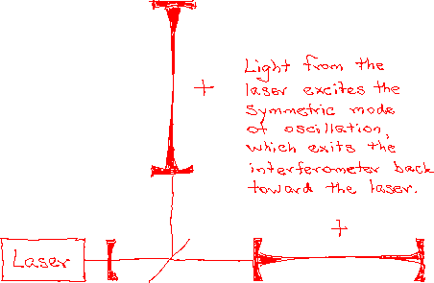
Fabry-Perot Michelson interferometer
20-30W
700W-1kW
100-150kW circulating; design ~ 1MW
10dB squeezing
Motion of the mirrors produced by a gravitational wave induces a transition from the symmetric mode to the antisymmetric mode; the resulting tiny signal at the vacuum port is contaminated by quantum noise that entered the vacuum port.

Slide 20
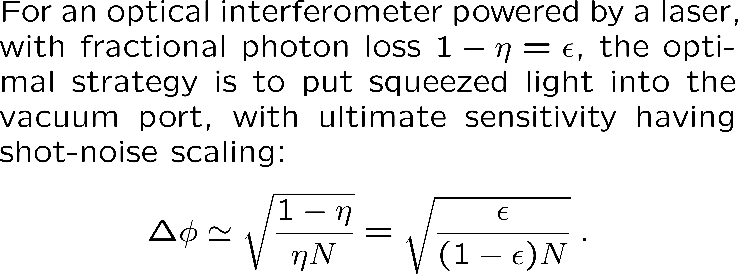
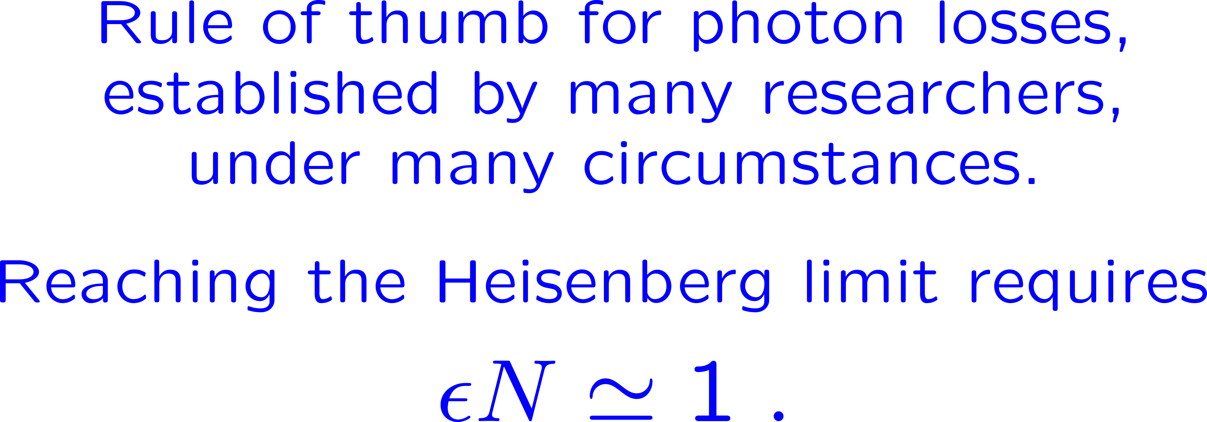
Real-life quantum Cramér-Rao bound
M. D. Lang, UNM PhD dissertation, 2015.
Z. Jiang, PRA 89, 032128 (2014).

Slide 21
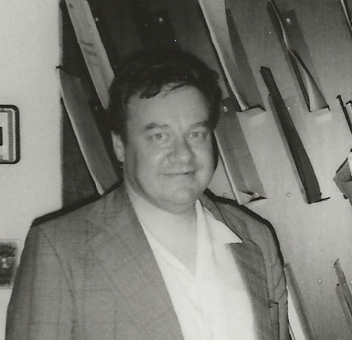
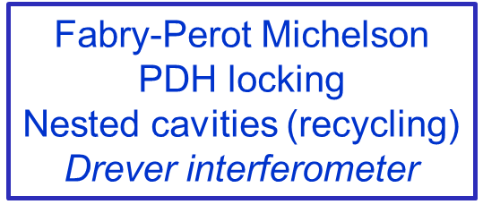
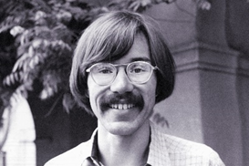

CMC
Can’t integrate longer without sacrificing bandwidth.
Very difficult to get more power for technical reasons.
Squeezed-light interferometry
When Ron’s ideas run out of gas (after 35 years, they have),
Experimenters might then (now) be forced to learn how to very gently squeeze the vacuum before it can contaminate the light in their interferometers.

Slide 22
But why? The lessons
For optical interferometry
The classical imperative is to get more photons and more bang from the buck from each photon. Clever people like Ron Drever will figure out how to do this in ways you never dreamed of.
Quantum techniques will be adopted only when there is nowhere else to go.
Generally
When you propose a piece of quantum technology, clever classical people will try to do better without your quantum technology. This is good for everyone.

Slide 23
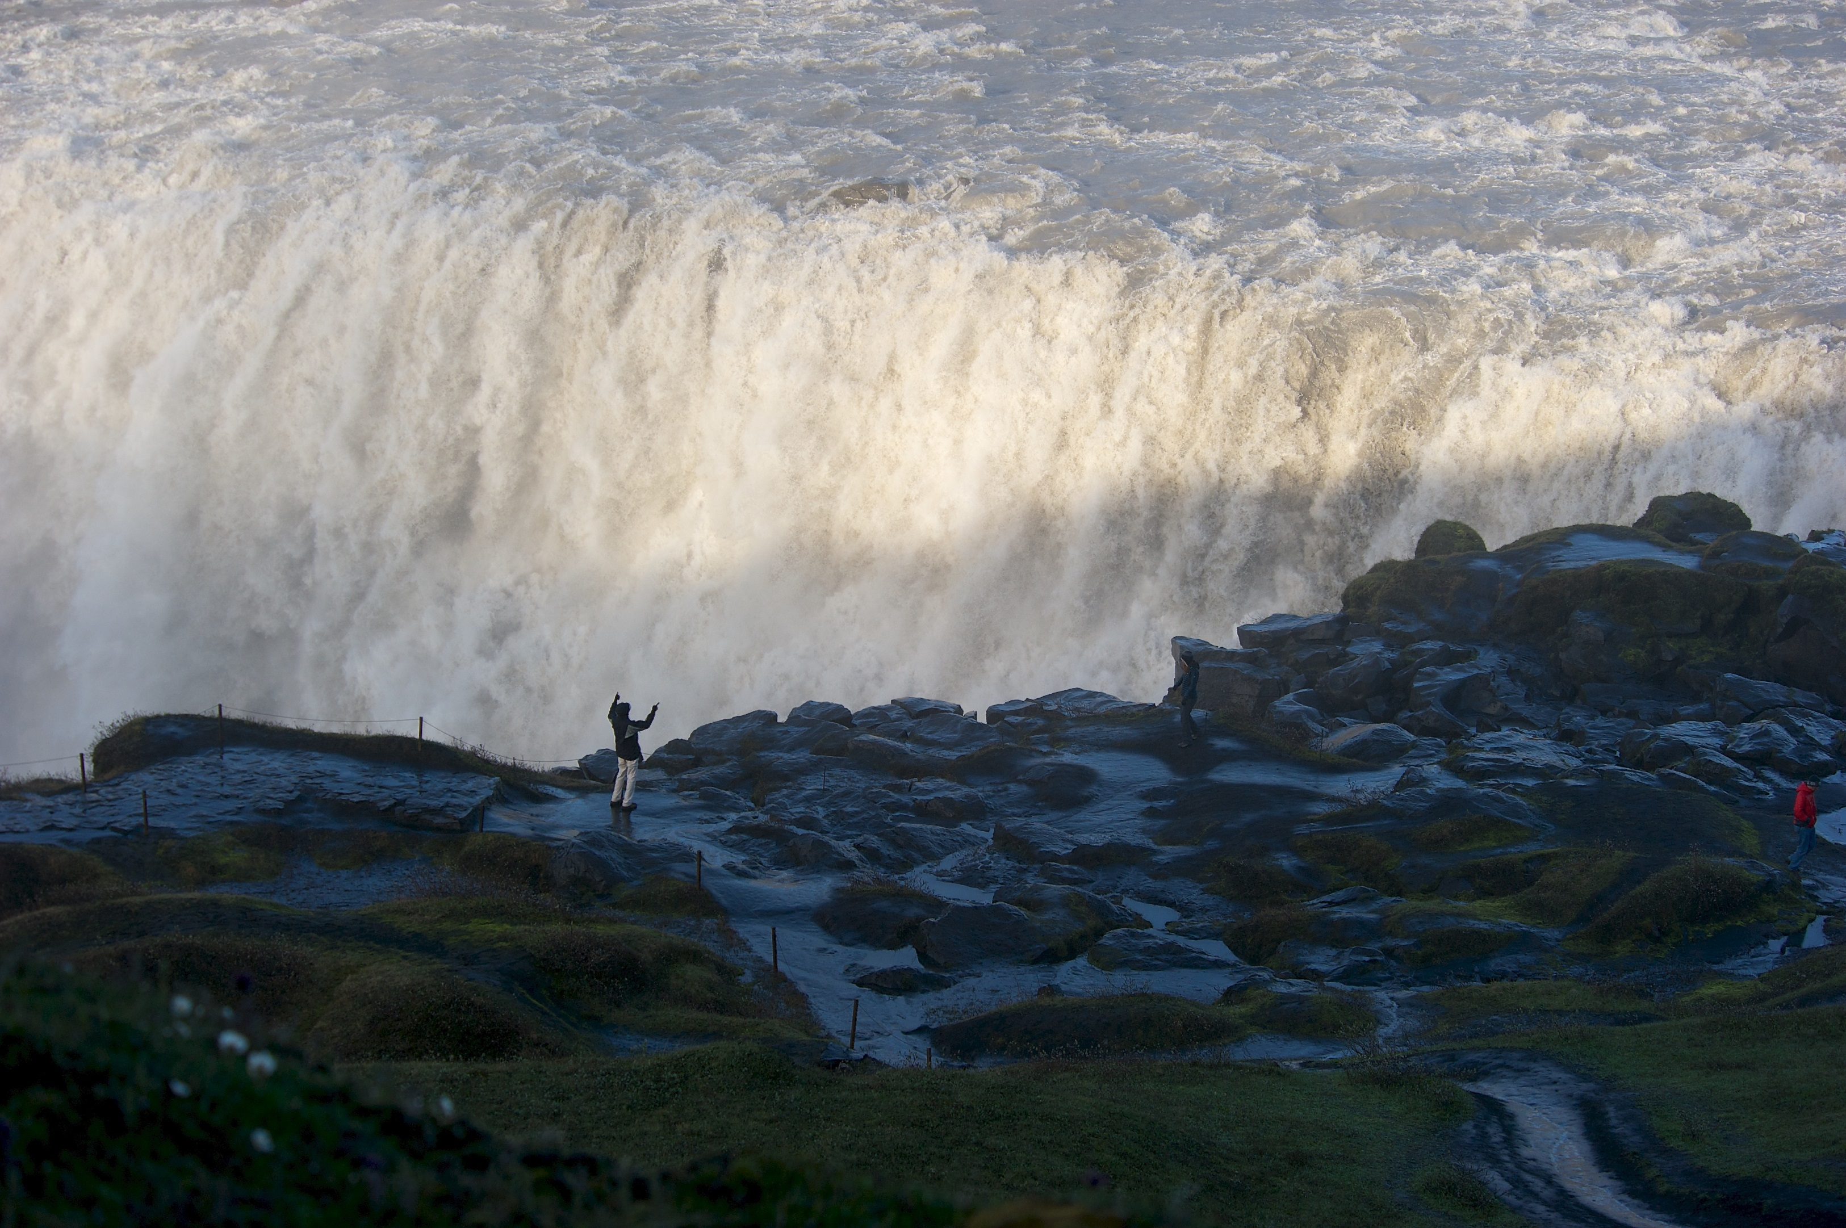

Thanks for your attention.
Dettifoss
Iceland

