Slide 1
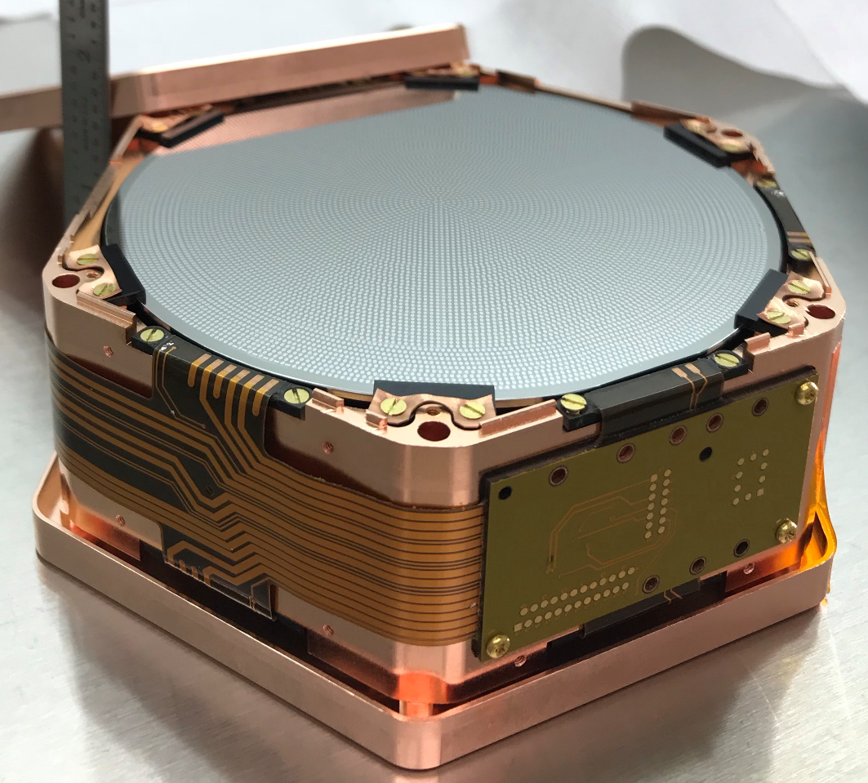
Searching for 10meV-1GeV Dark Matter with Athermal Phonon Detectors
Matt Pyle
UC Berkeley
CPAD 18/12/09

Slide 2
Outline
Experimental Design Drivers for Light Mass Dark Matter
Other interactions: Getting Around Kinematic Constraints
  Offshell 2-phonon production
  Optical phonons
Athermal Phonon Detectors
  Proposed Experiments That Use Athermal Phonon Readout
    Small volume semiconductor detectors
    GaAs based scintillator
    Al₂O₃ and other polar crystals
    Molecular Vibrational/Rotational Excitation
    Superfluid Helium
  Detector Physics
  R&D Progress
  Future R&D Needed

Slide 3
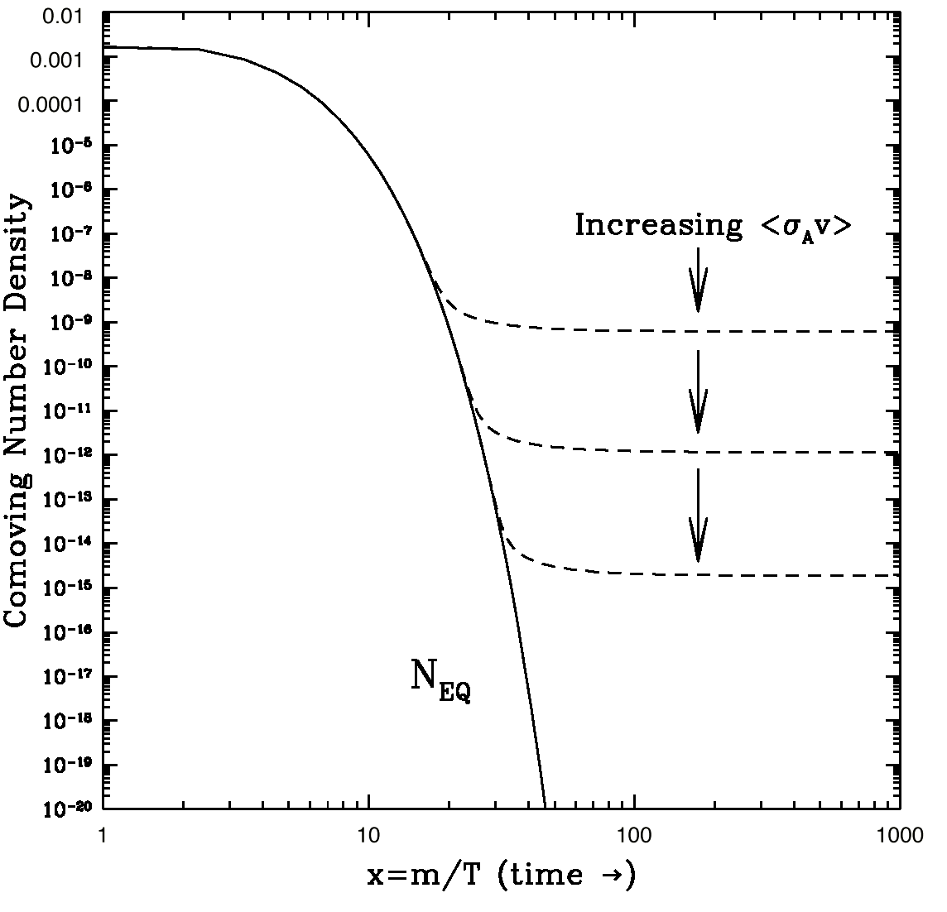
10 Years Ago: A Focus on WIMPs
(Planck)
keV
10 GeV
10¹⁹ GeV
10⁻²² eV
WIMPS
Relic DM density suggests weak-scale cross sections
New physics (and particles) at the weak scale could solve the hierarchy problem
Notes:
Main idea: 10 years ago the majority of the experimental community was searching for WIMPs
DM Constraints:
10^-22 eV: size of the galaxy
< 100 eV: Fermions are degenerate
< 3 keV: warm DM limit
WIMPs: 10GeV < M < 100TeV (above 100TeV WIMP won’t freeze out)
Hiearchy problem:
- Why do different forces have such enormously different strengths
- Why is the Higgs mass so much lighter than the plank scale

Slide 4
Today: Search for DM Everywhere
keV
10 GeV
10¹⁹ GeV
10⁻²² eV
WIMPS
Dark Sectors: DM + New Mediators
US Cosmic Visions: New Ideas in Dark Matter: 1707.04591
Many Well Motivated DM Models at Light Mass

Slide 5
Light Mass Dark Matter
Experimental Design Drivers

Slide 6
Light Mass DM Design Drivers: Exposure
Interaction Rate scales with 1/M_{DM}
LZ needs 10 tons to get to 10⁻⁴⁷ cm² at 100GeV, Light Mass DM searches only needs 10kg to reach the same level at 100MeV

Slide 7
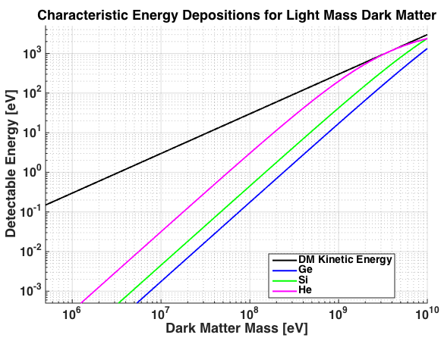
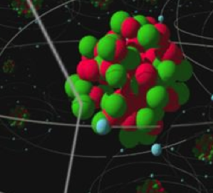
Elastic Nuclear Scattering
DM
<v>
Transfer of DM kinetic energy inefficient when M_{n} >> M_{DM} for elastic scatters
The primary design driver for Light Mass DM Experimental Searches is Energy Sensitivity!

Slide 8
Nuclear Recoils from M_{DM}<200 MeV:
No Ionization
DM
For 200 MeV DM Characteristic Recoil Energy
He: E_{r} ~10eV
Si: E_{r} ~2eV
Ge: E_{r} ~ 700 meV
Elastic Nuclear Recoil Scattering will not produce ionization for <200 MeV DM
(actual threshold may be much higher due to Lindhard suppression)
<v>

Slide 9
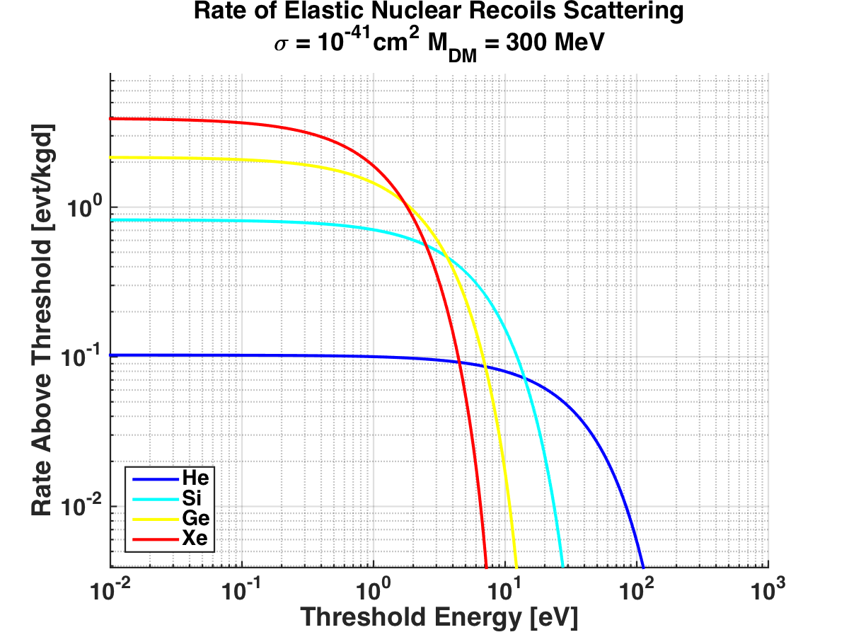
Low Z vs High Z Absorbers: Threshold vs Rate Tradeoff
Higher Z absorbers have smaller characteristic recoil energies ☹
Higher Z absorbers have more coherent rate enhancement ☺

Slide 10
Light Mass Design Drivers: Energy Sensitivity
The primary design driver for Light Mass DM Experimental Searches is Energy Sensitivity

Slide 11
?
Can we use other DM interactions that more efficiently transfer kinetic energy to target for M_{DM}<100MeV?

Slide 12
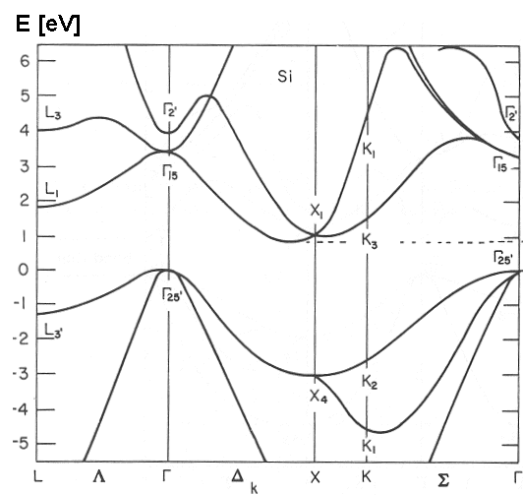
Trick 1) Use Bandgaps!
Inelastic e⁻ Recoils in Semiconductors
DM
E= ½ v_{DM} P
v_{DM} ~ O(10⁻³ c)
E=1eV P~2keV/c
Essig et al: 1108.5383
Band Diagram for Si
Energy [eV]
v_{esc}
Momentum
<v>
P
1/4.5x10⁻¹⁰ m= 3 keV/c
Crystal e⁻ Momentum and Energy Scales Match MeV DM
4.5x10⁻¹⁰ m

Slide 13
Smaller Excitation Energies are Better
(Ultra-light Mediator)
Essig et al
1108.5383

Slide 14
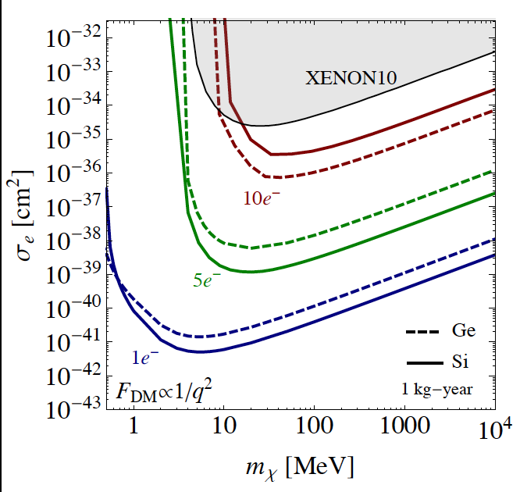
Sensitivity depends on Threshold
(Ultra-light Mediator)
Essig et al
1509.01598

Slide 15
Ultralight Vector Boson Absorption
Semiconductors are a great target material for low energy dark photon absorption searches due
direct gap semiconductors (GaAs) preferable to indirect gap
Intuition -> photon absorption
Pc = Mc² (v/c)
Momentum << Energy

Slide 16
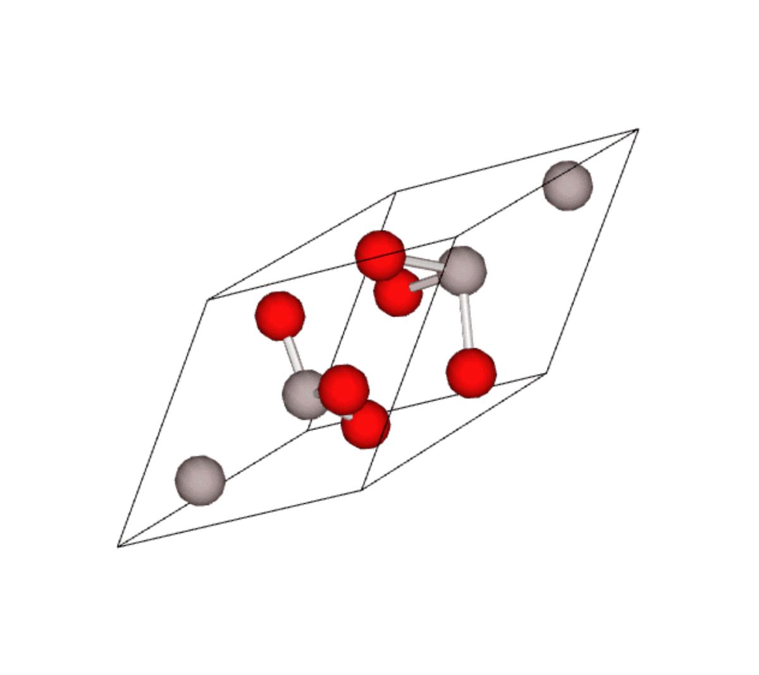
Trick 1b: Optical Phonon Production
Acoustic:
Optical:
Sapphire
An optical phonon excitation has a bandgap too … it kinematically matches light mass DM
Knapen, Lin, Pyle, & Zurek: 1712.06598
Energy [meV]
Momentum

Slide 17
Dark Photon Couplings: Polar Crystals
In ionic crystals, optical phonons are oscillating electric dipoles!
Very large coupling to photons (black in the IR)… Very large coupling to the dark photons
Sapphire

Slide 18
Sapphire: Lot’s of Optical Phonon Bands
Sapphire is a complex crystal with 10 atoms in its unit cell. Dark Matter can interact with lots of different modes
To search for thermal DM down to keV masses via scattering and ultracold bosonic DM to 30 meV, we need a detector sensitive to a single optical phonon

Slide 19
Trick 1b: Bandgaps: Optical Phonons
Acoustic:
Optical:
Optical phonon excitations kinematically match light mass DM
Knapen, Lin, Pyle, & Zurek:
1712.06598

Slide 20
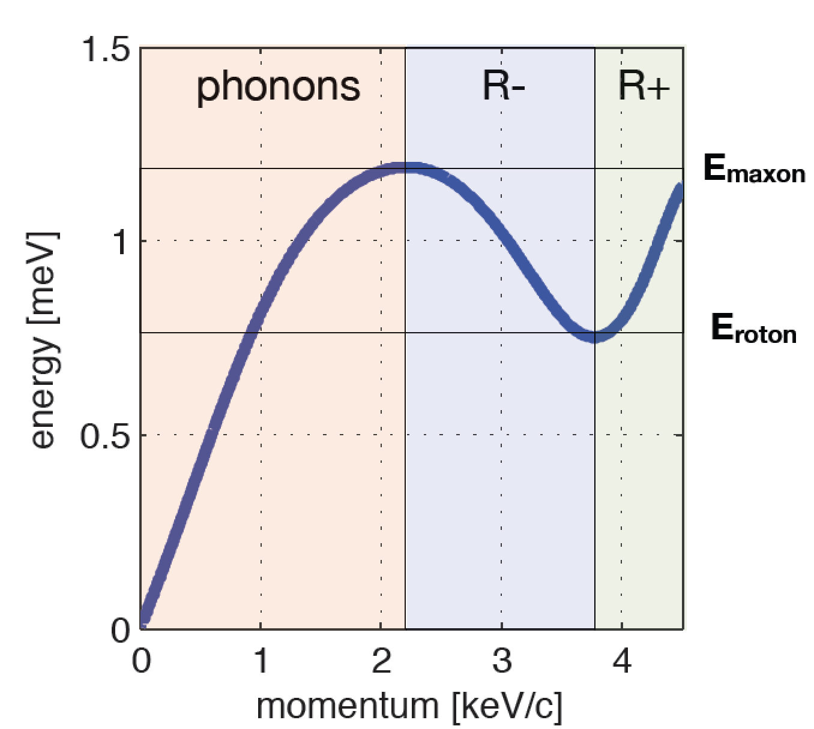
Trick 2: Offshell 3 body scatters
DM can scatter via production of 2 nearly back to back excitations
1604.08206: Schutz and Zurek
rate somewhat suppressed since offshell
Calculated for superfluid He only so far …
M_{n}
M_{n}
Offshell
M_{DM}
Helium Coherent
Vibrational Modes
Hertel/McKinsey

Slide 21
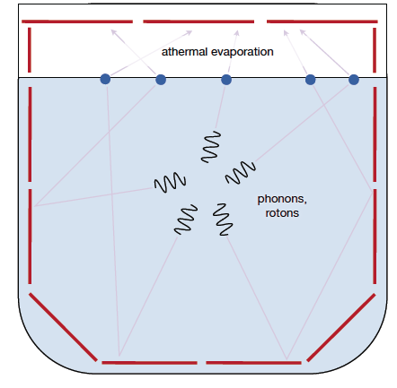
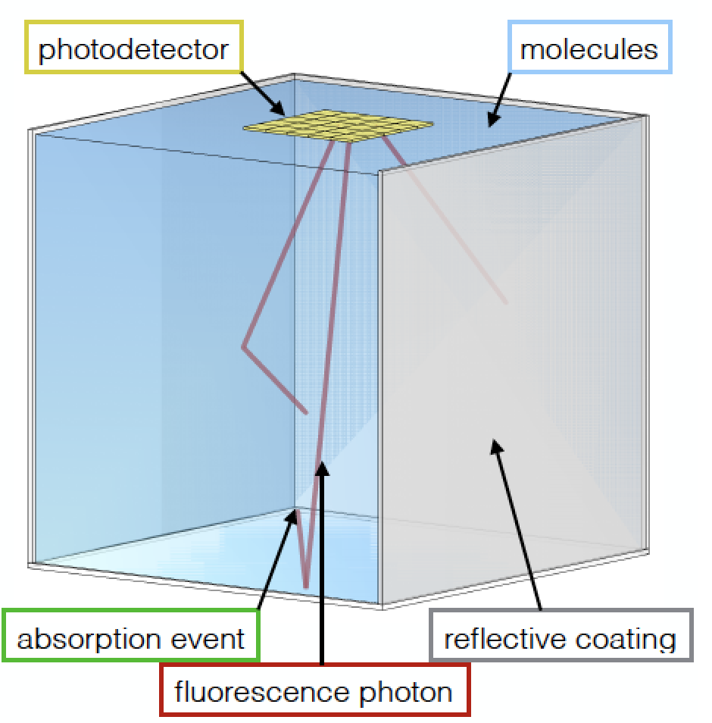
Proposed Experiments Using Athermal Phonon Readout
1cm³ Polar &
Semiconducting Crystal
1712.06598
GaAs
Scintillation
Superfluid Helium
1802.09171
1607.01009
Molecular Absorption and Scattering
SuperCDMS SNOLAB
Upgrade
1709.05354

Slide 22
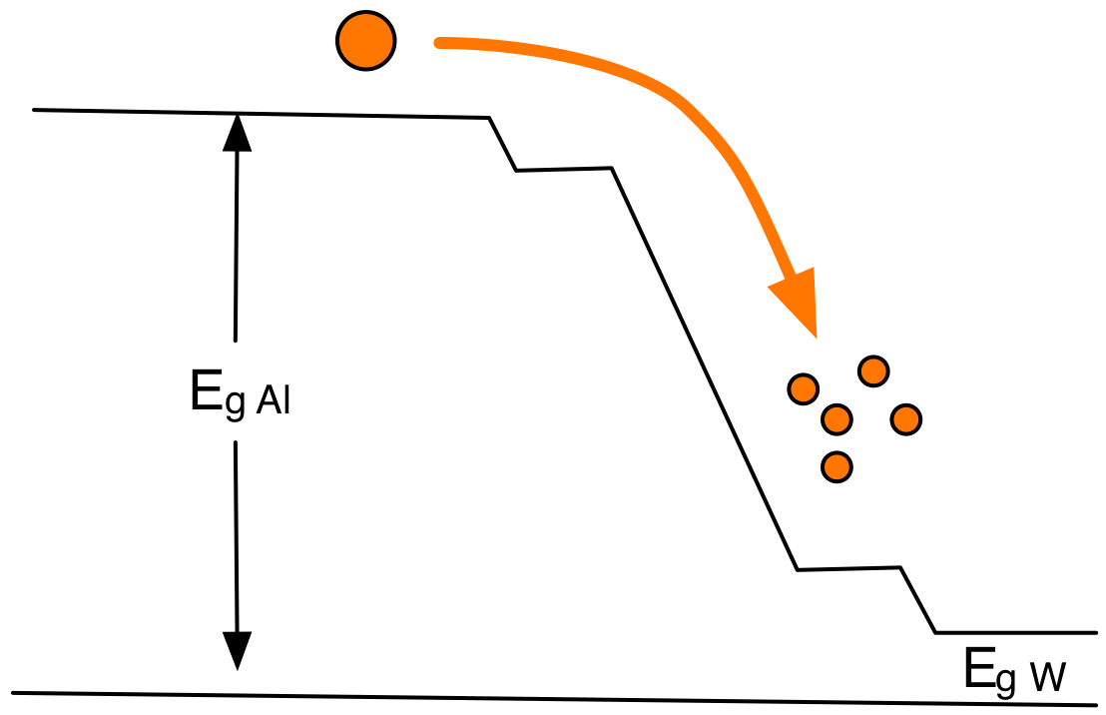
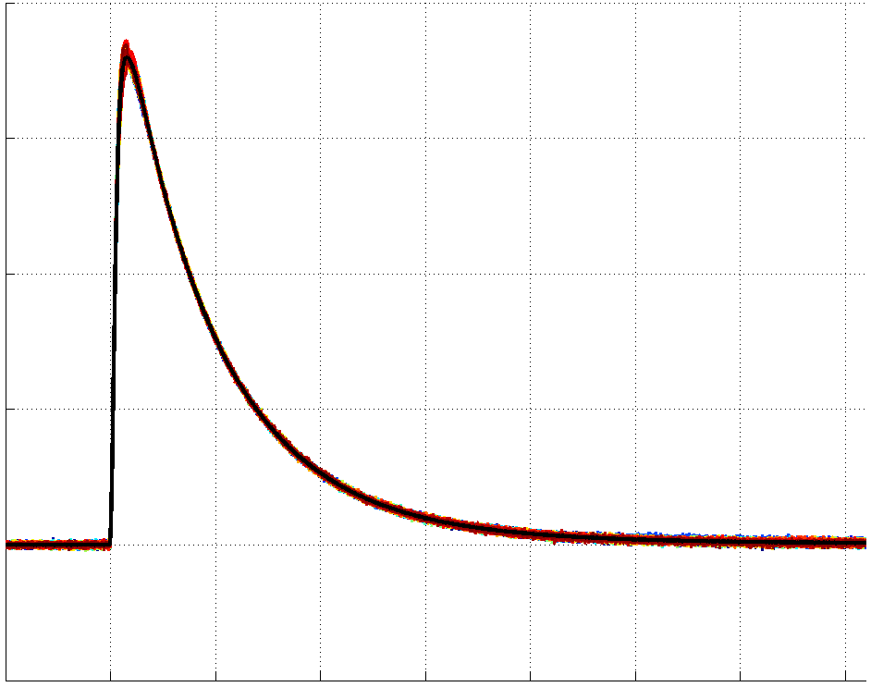

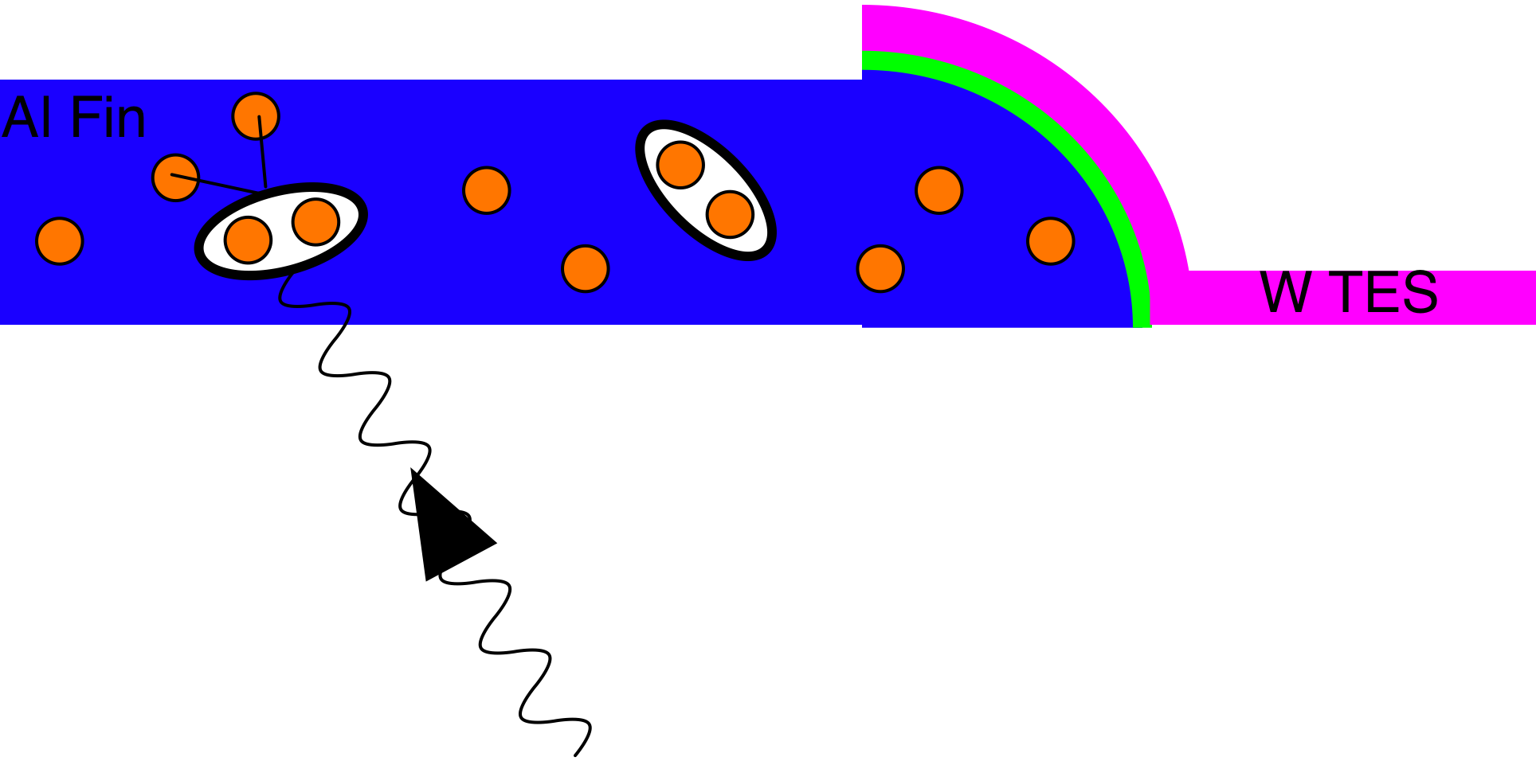
Athermal Phonon Sensor Technology
Collect and Concentrate Phonon Energy into W TES
(Transition Edge Sensor)
R
T

Slide 23
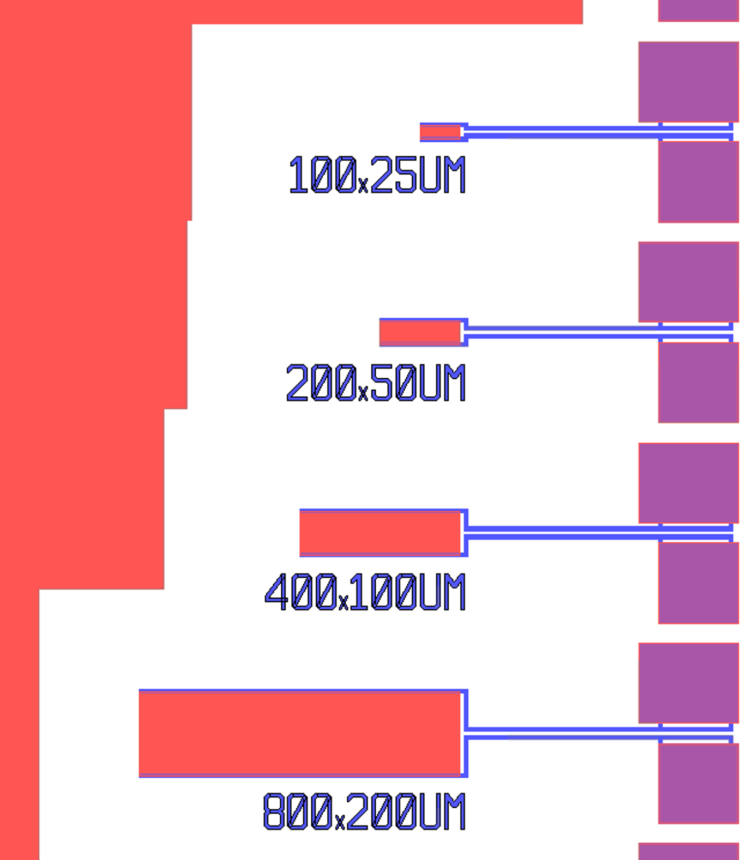
Step 1)Make An Ultra-Sensitive TES
Build and test simple TES test structures for noise is performance
  small volume TES more sensitive to both DM and environmental backgrounds (RF and vibrations)
Tc =68mK (a bit high)
Didn’t run the smallest TES … we were too conservative

Slide 24
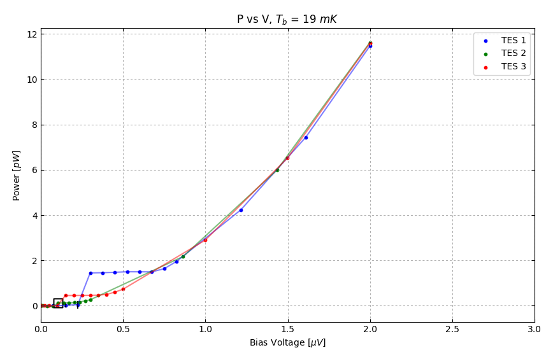
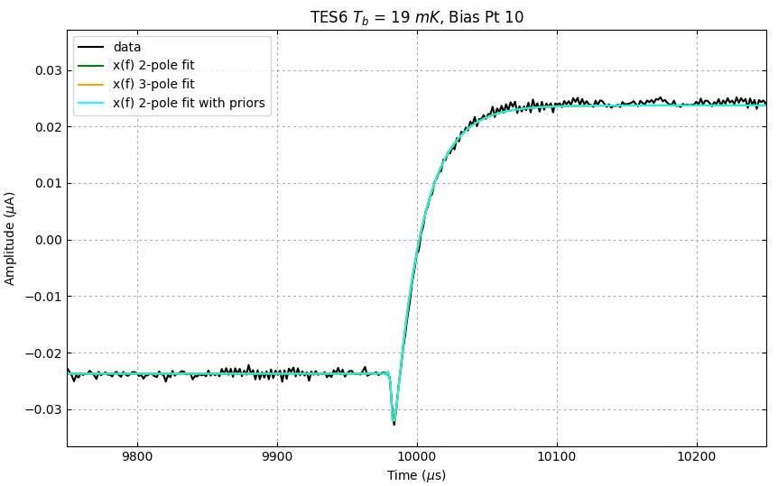
50um x200um TES Characterization
TES Power vs TES Bias Voltage
Bias Power: 0.25 pW
TES Response to Square Wave Jitter
Time Response:
Simple 2 pole TES dynamical model perfectly fits response
TES falltime: ~20us (8kHz)
  we need to slow this down by x10 to match phonon collection bandwidth

Slide 25
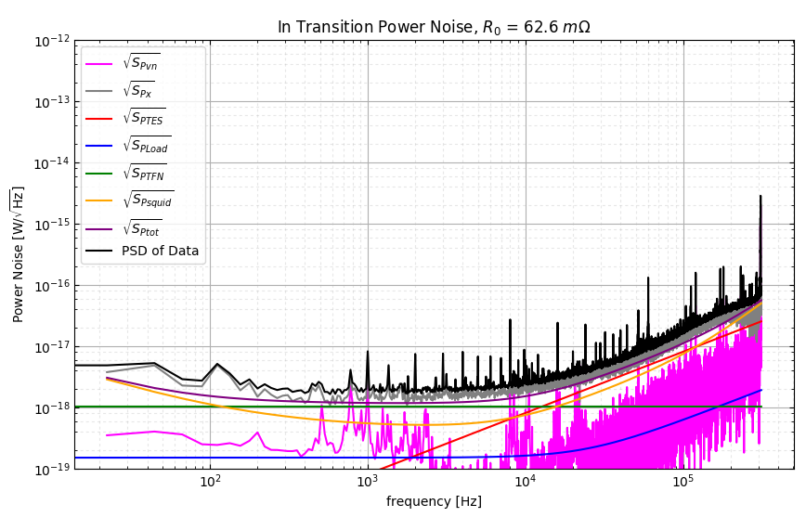
50um x200um TES Noise
Noise matches theory to within x1.4
  S_{ptot} = 2x10⁻¹⁸ W/rtHz
𝝂_{sensor} ~ 8kHz
𝛔_{E} = 72 meV (without collection losses …~20%)

Slide 26
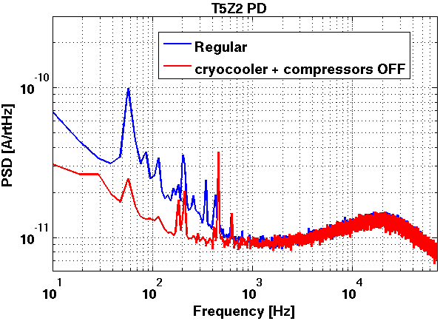
TES R&D
Energy Sensitivity: 40meV -> 1meV
R&D Work Plan
  Lower Tc from 40mK -> 10mK. Since intrinsic theoretical noise, S_{p}= 4k_{b}T²G ∝T⁶, energy sensitivity should improve by x4³= x64
  Decrease TES linewidth
  Decrease environmental noise susceptibility

Slide 27
Step 2: Make the Athermal Phonon Sensor
Measured Phonon Collection Efficiency = 20% -> 40% (theoretical limit)
R&D Work Plan
  Optimize Collector/TES (W/Al) interface
  Improve quasi-particle trapping in collector fin

Slide 28
Step 3: Fabricate Sensors on Crystal

Slide 29
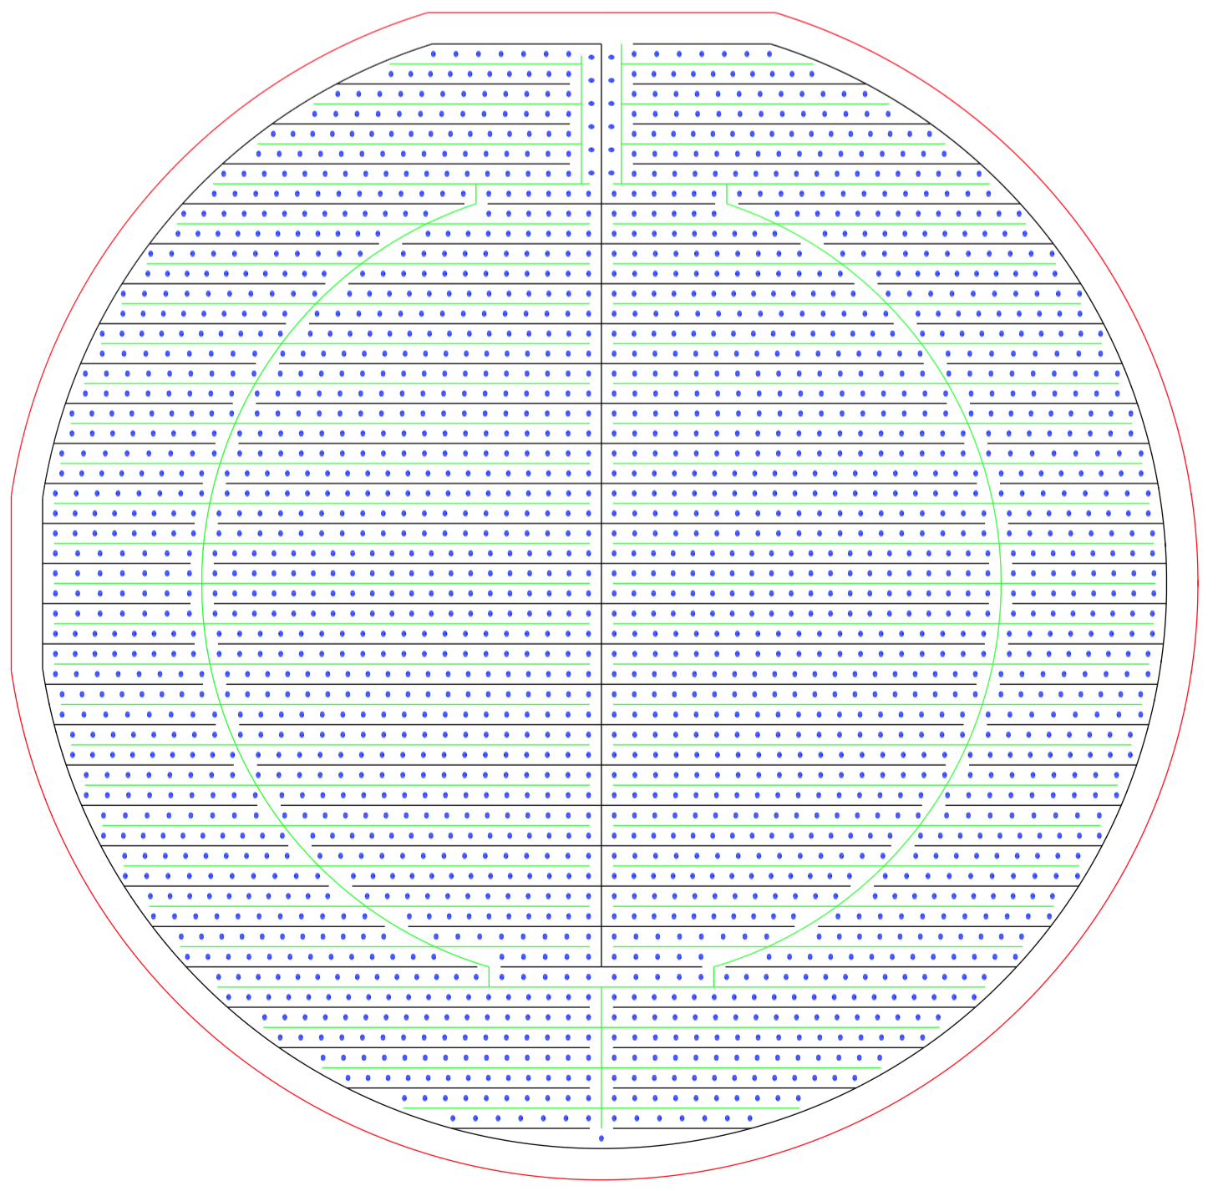
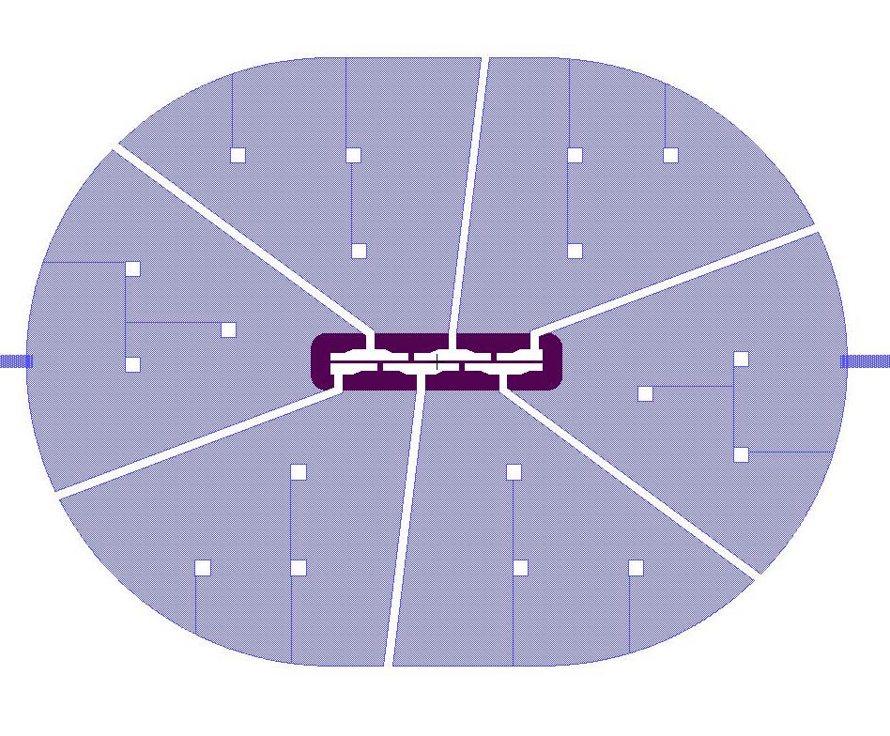
Current Progress: Large Area Photon Detector
  3” diameter Si wafer (45.6 cm^2)
  1mm thick
  Distributed athermal phonon sensors minimize phonon collection time (as fast as it can be for its size)
    Athermal Phonon collection time estimated to be ~20us
    2.5% sensor coverage

Slide 30
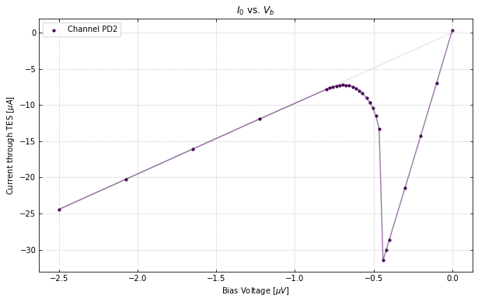
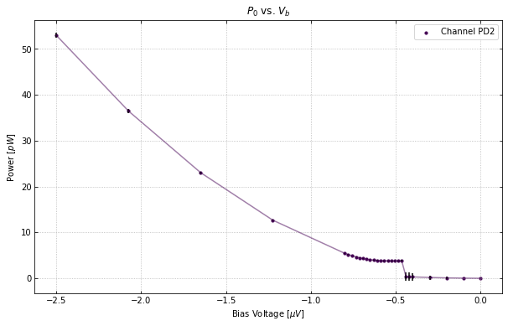
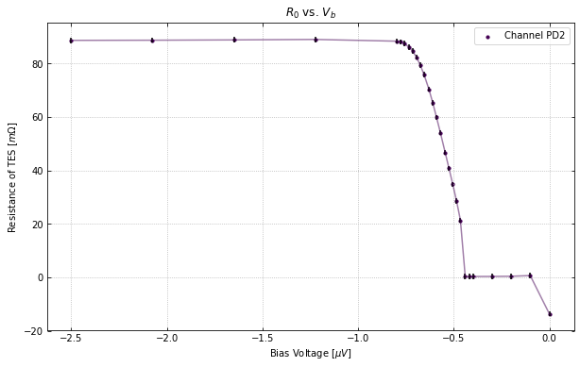
Measured Performance: Tc & IV
  T_{c}= 41.5mK
  IV curves show that the detector and electronics are behaving well
    Rn = 88 mOhms (300mOhm Expected … TES too wide!)
    Rp = 8 mOhms
    Bias Power (P₀) = 3.9 pW (1.4pW expected)
    Rn does not vary as a function of QET bias
Bias power flat in transition

Slide 31
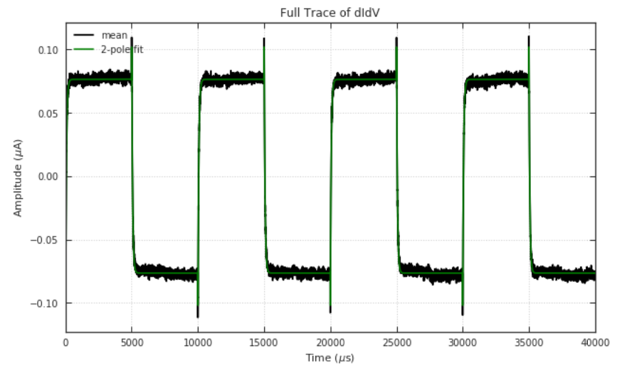
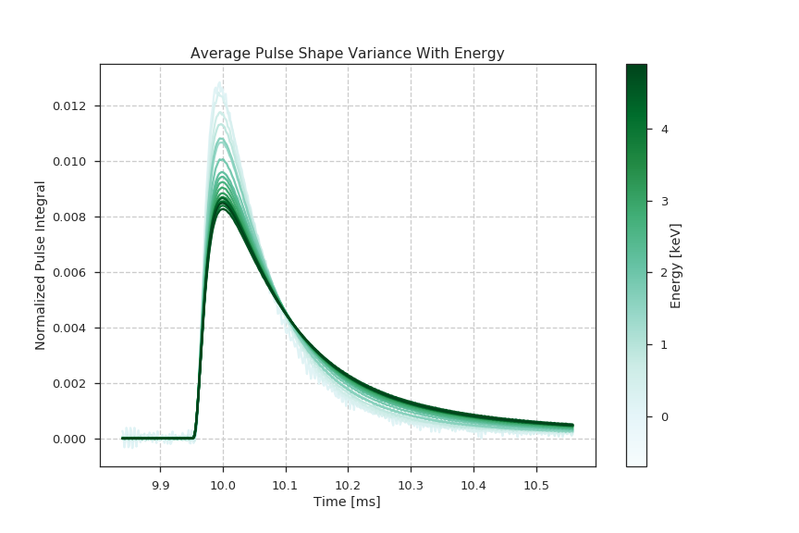
Measured Performance: dIdV
TES sensor pretty fast @ 60us. However, it’s not as fast as the estimated athermal phonon collection (20us)
Therefore, we expect phonon signals to have a 20us rise time (athermal phonon collection) and a 60us fall time. Seen for low energy comptons in average pulse shape!
Pulse shape varies with energy due to local TES saturation.

Slide 32
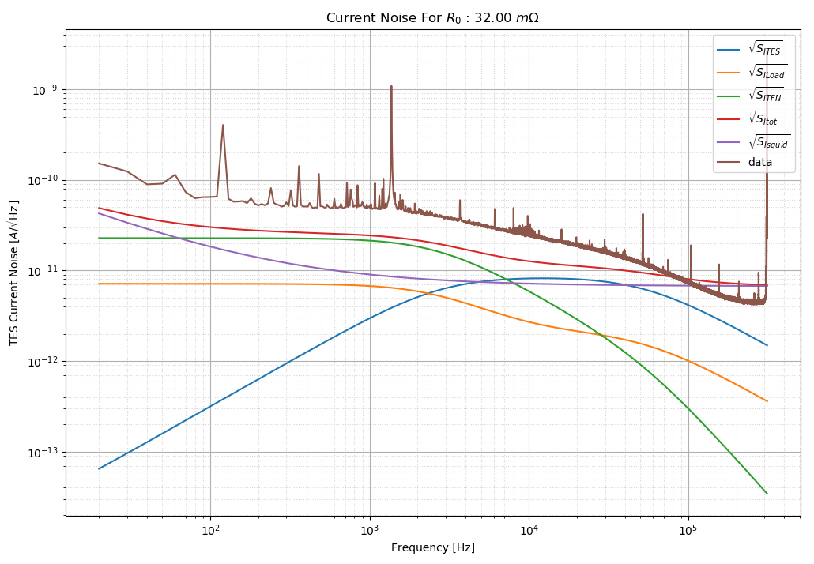
Measured/Theoretical Noise
Noise ~x1.5 worse than theoretical expectations
Lots of lines from pulse tube and turbo pump
TFN seems too large …

Slide 33
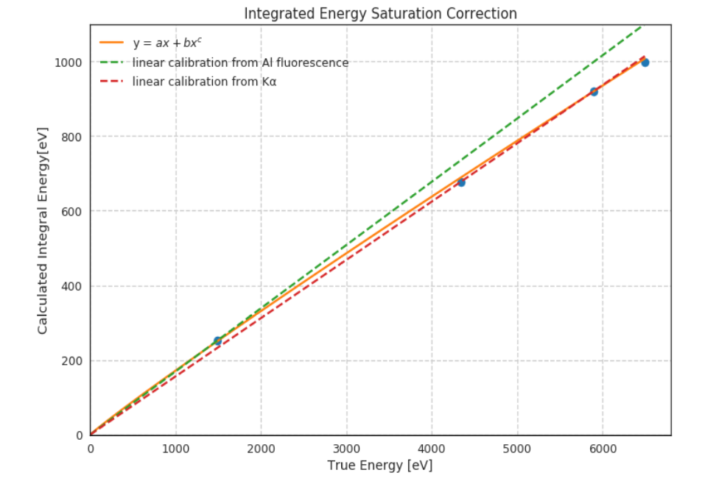
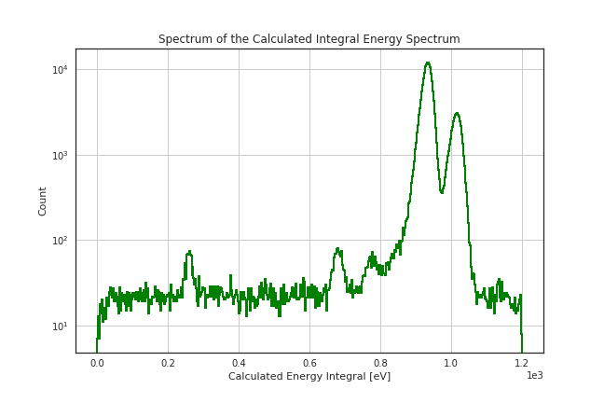
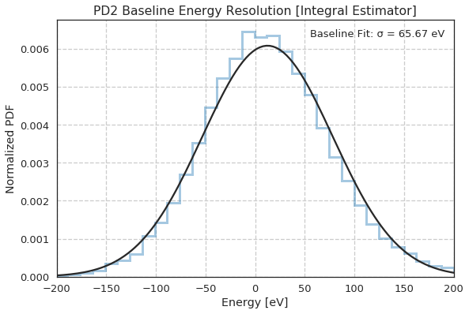
Integral Estimators for relative ⁵⁵Fe calibration
Since pulse shape has significant variation with energy, we must use noisy but minimally biased DC estimators to fit the ⁵⁵Fe calibration lines
⁵⁵Fe K_{𝛼}
@5.9keV
17% Athermal Phonon Collection Efficiency
Al Fluoresence @ 1.49 keV

Slide 34
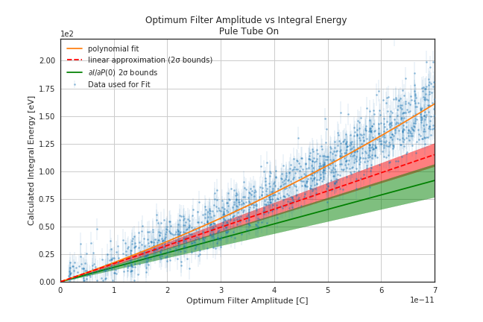
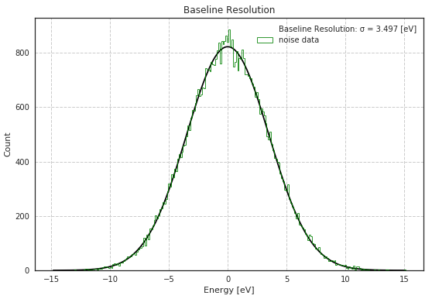
Calibrating Pulse Shape Dependent Energy Estimators to the DC estimator (Pulse Tube On)
_{+0.0}
𝜎_{E} =3.5 ± 0.25 eV (stat)_{-0.7} (sys)
Baseline Resolution
Significantly Surpasses all Neutrinoless Double Beta Decay Performance Requirements of 10-20eV

Slide 35
Prototype Design Estimated Sensitivities
New 1cm³ Prototype Test Design
# TES | 100
TES Dimensions | 50um x 2um x40 nm
TES Rn | 320mOhm
Fin Length | 125um
W/Al Overlap | 15um
Fractional Al Coverage | 1%
Tc | 40mK
Bias Power | 48fW
Power Noise | 5.1e-19 W/rtHz
Phonon absorption time | 106us
Sensor fall time | 97us
Collection efficiency | 19%
σ_{E} | 219 meV
With a Si Absorber: single e/h sensitivity without Luke-Neganov gain. Can be used for inelastic electronic recoil DM
World Leading Elastic Nuclear Recoil DM search potential

Slide 36
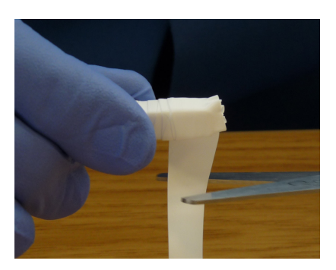
Excitation Detectors & Volume Scaling
Scintillator
PMT
Scintillator
Reflector
PMT
Will these detectors have the same energy sensitivity?
Yes, if:
Lifetime of the athermal excitation (photon) is really long
Excitation absorption dominated by sensor
Position Sensitivity

Slide 37
Optimizing the Athermal Phonon Excitation Detectors
Absorber
Absorber
TES
TES
Minimize the number/volume of the TES sensors instrumented on the surface to the point that you begin to see the bare surface thermalization rate

Slide 38
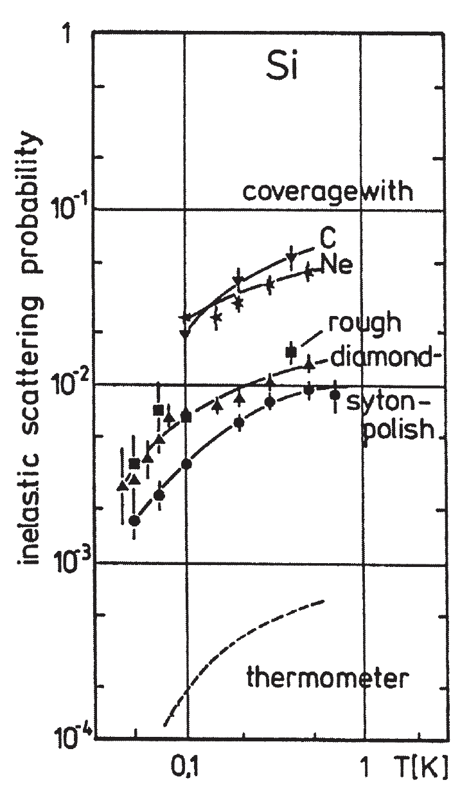
Athermal Phonon Thermalization at Surfaces
Athermal phonon surface thermalization probability found to depend upon
  Crystal
  Surface roughness
  Surface cleanliness
(W. Knaak et al, Phonon Scattering in Condensed Matter V,1986)
0.1%-1% of the crystal surface covered with athermal phonon sensors … 1/1000-1/100 thermalization probability needed

Slide 39
Crystal R&D
Fabricate phonon sensors on variety of new substrates:
  Sapphire
  Niobium
  ?
Measure phonon themalization probability vs surface roughness

Slide 40
Summary:
Athermal Phonon Detectors are a promising technique to search for 10meV-1GeV Dark Matter
Current Progress:
  3” large are photon detector 3.5eV resolution
  100x400um TES test chip: 40meV resolution
R&D Plan:
  Increase TES sensitivity: lower Tc
  Improve Collection efficiency: optimize W/Al interface
  Fabricate on a variety of crystal substrates
  Study how phonon surface themalization depends on surface roughness.

Slide 41
Backup

Slide 42
Calorimeter Sensitivity
~ Intrinsic Thermal Noise of Calorimeters

Slide 43
Calorimeter Optimization
Minimize T
  Dilution Refrigerators can cool detectors to 5mK
Minimize C
  Small Volume
  Low T
  Insulators
}
Freeze out

Slide 44
Engineering Blunder: Decoupling between the Sensor and Absorber
e⁻/phonon thermal conductance scales as T⁴
Kapitza boundary conductance scale as as T³
As T is decreased, it’s harder and harder to keep the sensor thermally coupled to the absorber
Energy leaks out of the absorber through G_{ab} before its measured
TES sensitive to power fluctuations through G_{tb}
Physical clamps that support the absorber

