Slide 1
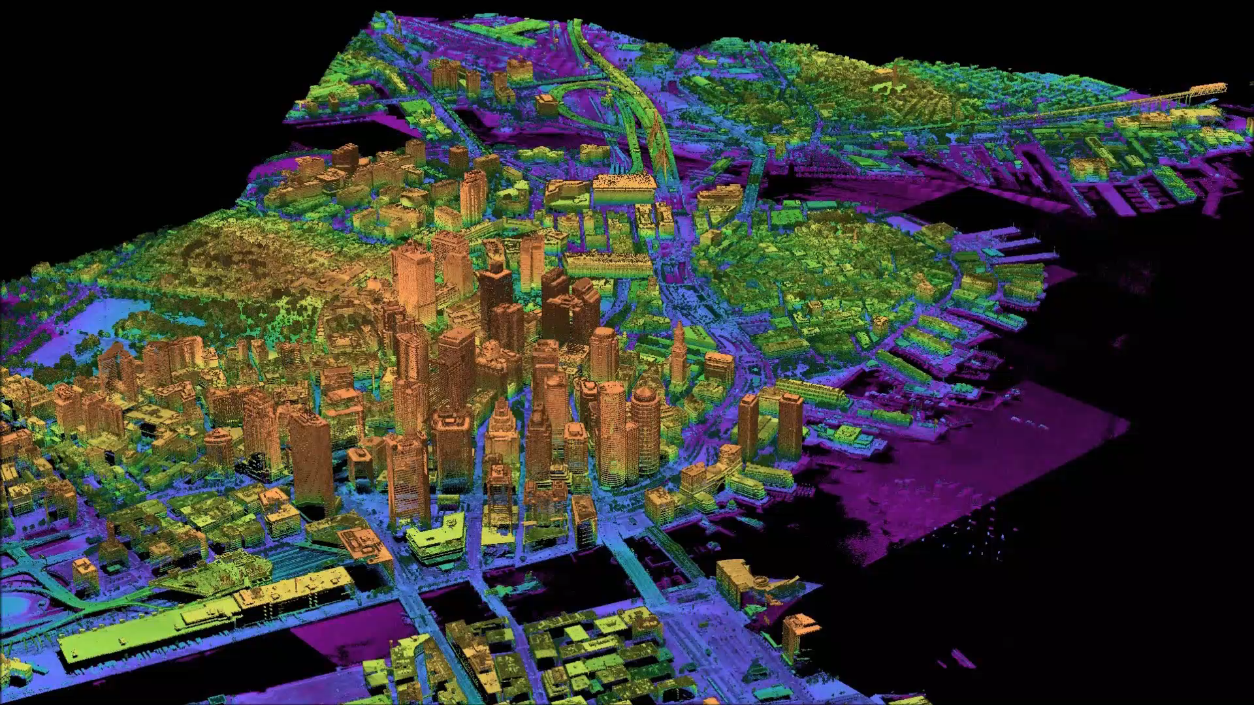
Example 3D Imagery

