Slide 1

Quantum sensing with large 2D crystals of trapped-ions
Kevin Gilmore
NIST Boulder
Ion Storage Group
Elena Jordan, Matthew Affolter, Justin Bohnet (Honeywell), Brian Sawyer (GTRI),
Joseph Britton (ARL), John Bollinger

Slide 2

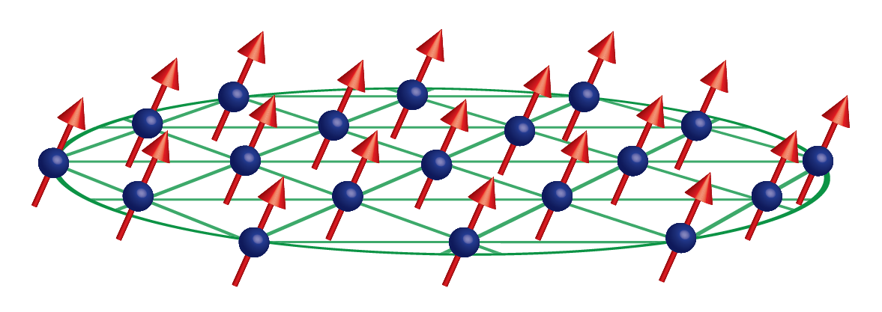
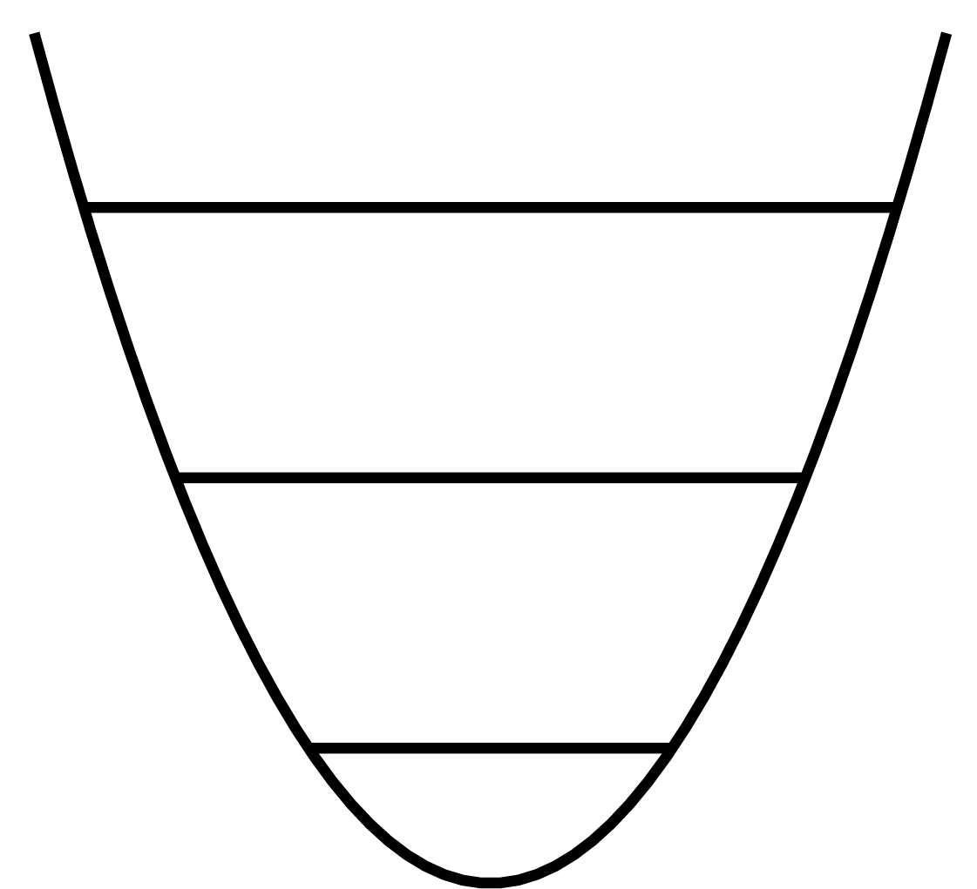
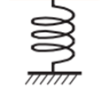

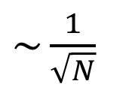

Quantum sensing with trapped ions
Control spin and motional degrees of freedom of individual atoms
Atomic two-level system
Quantum harmonic oscillator
$$\left|\left.↑\right\rangle \right.$$
$$\left|\left.↓\right\rangle \right.$$
More is better!
Less projection noise
Smaller zero-point motion
$\sim \frac{1}{\sqrt{N}}$

Slide 3
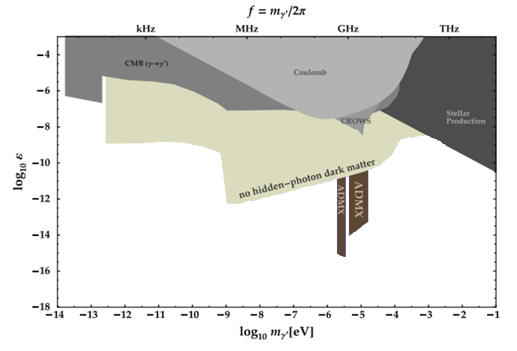



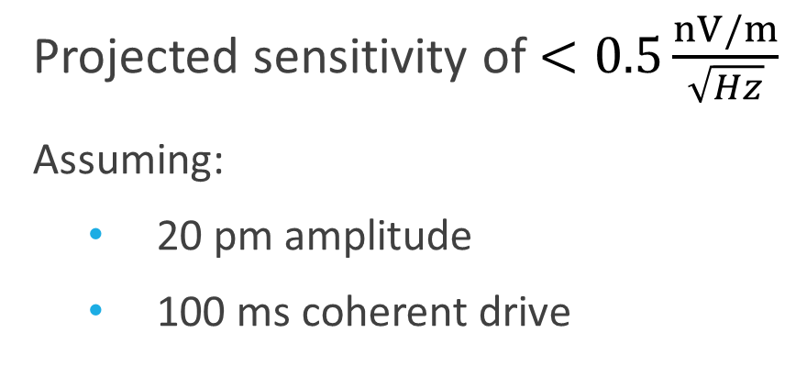
Force sensing and dark matter
Projected sensitivity of $<0.5\frac{nV/m}{\sqrt{Hz}}$
Assuming:
  20 pm amplitude
  100 ms coherent drive
Search for hidden photon dark matter
kHz
MHz
GHz
THz
$$\log_{10}{ε}$$
Trapped ions
  Long interrogation times
  High Q oscillator
  Sensitive to E-fields
  Mature metrological program
$$ε=\frac{E}{3.3\frac{nV}{m}}∗{10}^{−12}$$
S. Chaudhuri, et al., Phys. Rev. D (2015)
$$\log_{10}{m} [eV]$$

Slide 4
Overview: NIST Penning trap sensing project
Objective: Measure weak electric fields/forces
Method: Map motional amplitude onto spin-state of ions
Outline
Overview of Penning trap
Overview of measurement method
Amplitude displacements far from oscillator resonance
Current work: implement phase control
Future work: sensing forces on resonance with oscillator

Slide 5
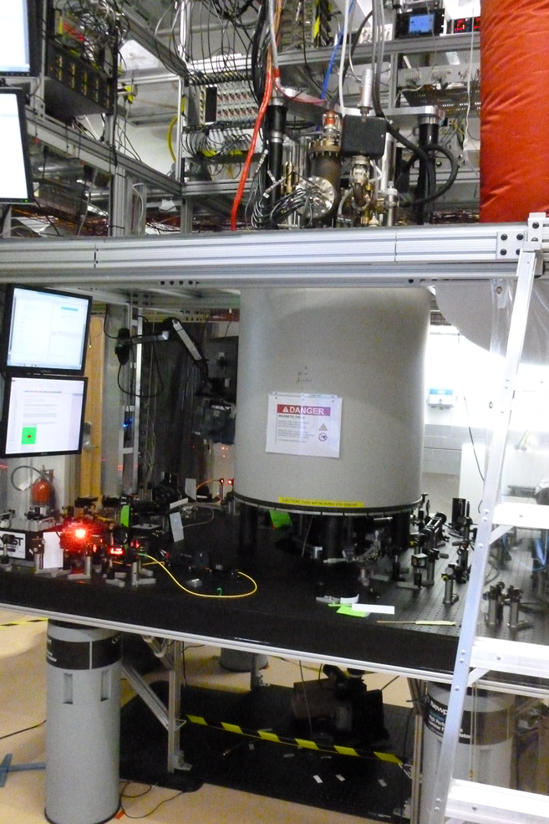
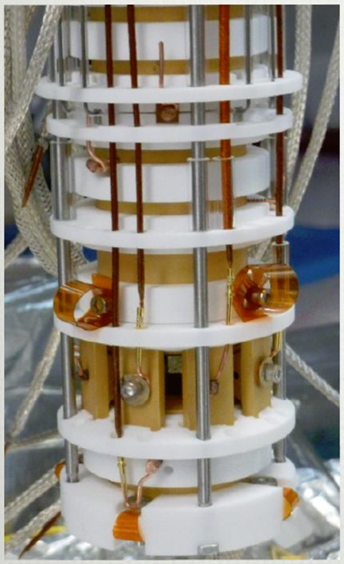
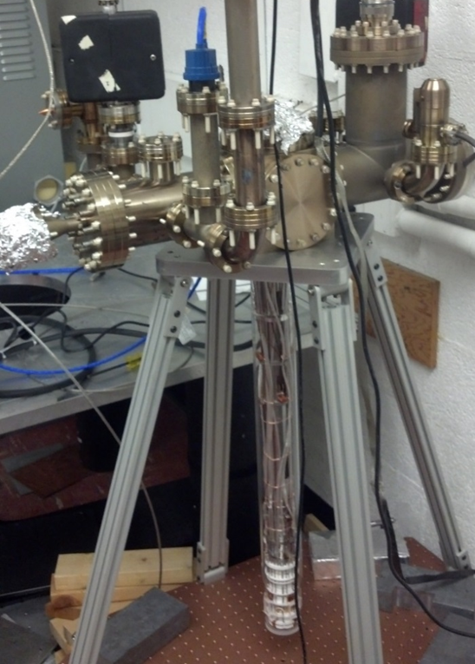
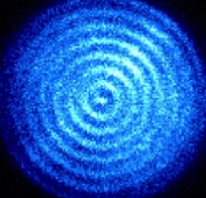
NIST Penning trap
2.0 cm

Slide 6



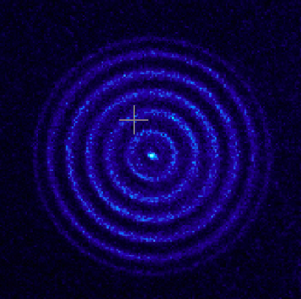

2D ion arrays in a Penning trap
90º
$φ=$0º
$$\vec{B}$$
180º
270º
270º
180º
360º
90º

Slide 7






Motional modes in a Penning trap
$E×B$ modes
Axial modes
Cyclotron modes
Frequency $→$
$\frac{ω_{m}}{2π}\sim$ 160 kHz
$\frac{ω_{z}}{2π}\sim$ 1.6 MHz
$\frac{Ω_{c}}{2π}\sim$ 7.6 MHz

Slide 8
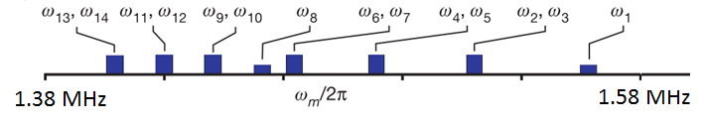
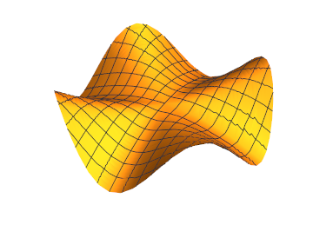
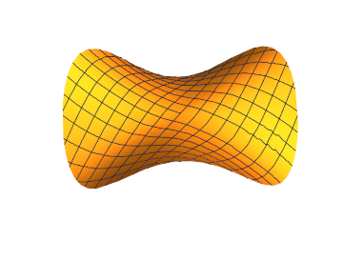
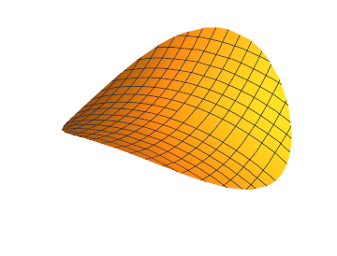
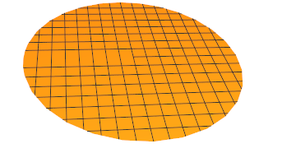
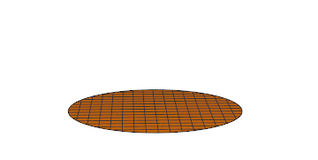
Drumhead modes
Eigenmodes of high frequency drumhead modes
Center Of Mass
(COM) mode

Slide 9









High field (4.5 Tesla) ⁹Be⁺ qubit
$$m_{j}=+\frac{3}{2}$$
$$Δ$$
$$\vec{B}$$
$$m_{j}=−\frac{3}{2}$$
ODF
EIT
Doppler cooling
Cooling
$λ≈313$ nm
ODF
EIT
ODF
EIT
Doppler cooling
$$m_{j}=+\frac{1}{2}$$
$$\left|\left.↑\right\rangle \right.$$
$$m_{j}=−\frac{1}{2}$$
$$\left|\left.↓\right\rangle \right.$$

Slide 10
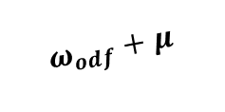

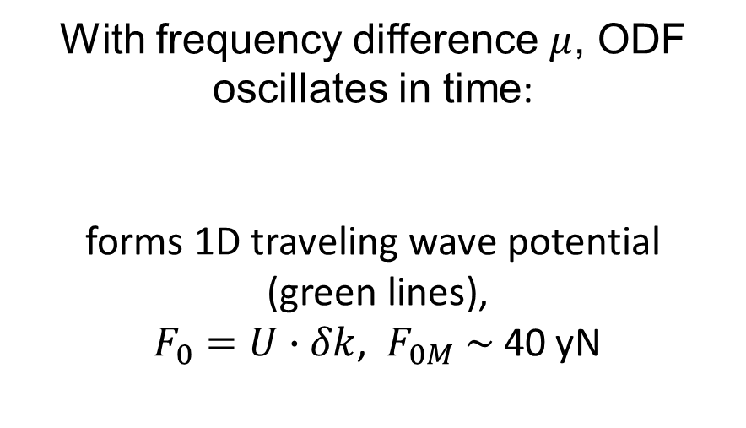
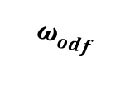

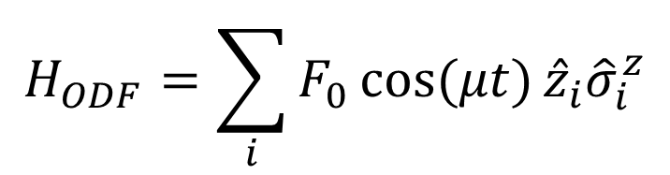



Optical-dipole force
Spin-dependent optical dipole force (ODF)
Spatially dependent AC Stark Shift
$$\hat{z}$$
$$\hat{y}$$
With frequency difference $μ$, ODF oscillates in time:
forms 1D traveling wave potential
(green lines),
$F_{0}=U∙δk$, ${ F}_{0M} \sim \text{40}$ yN
$$\hat{x}$$
$$ω_{odf}$$
$$δk$$
$$20°$$
900 nm
$$ω_{odf}+μ$$
$$H_{ODF}=\sum_{i}{F_{0}\cos{(μt)}{{\hat{z}}_{i}\hat{σ}}_{i}^{z}}$$

Slide 11

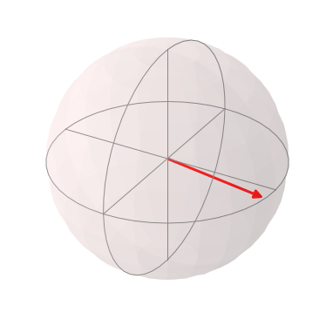
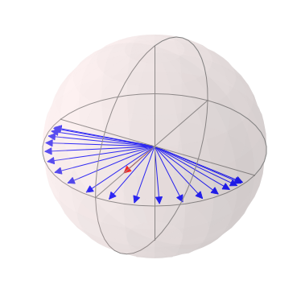

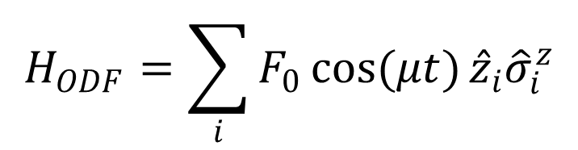
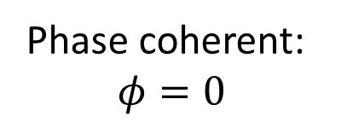

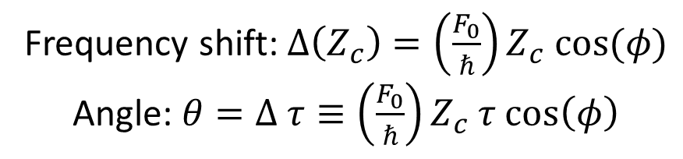
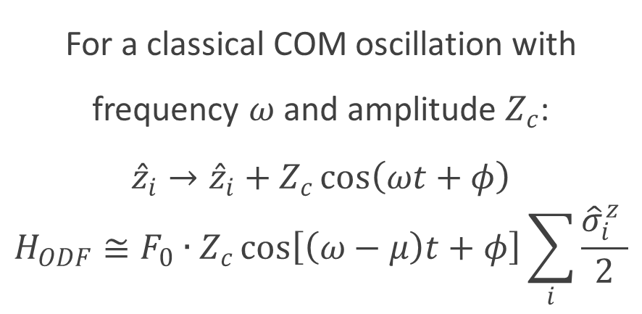
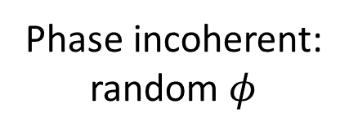


Spin precession due to axial oscillation
$$H_{ODF}=\sum_{i}{F_{0}\cos{(μt)}{{\hat{z}}_{i}\hat{σ}}_{i}^{z}}$$
$$ω$$
For a classical COM oscillation with frequency $ω$ and amplitude $Z_{c}$:
$${\hat{z}}_{i}→{\hat{z}}_{i}+Z_{c}\cos\left(ωt+φ\right)$$
$$H_{ODF}≅F_{0}∙Z_{c}\cos\left[\left(ω−μ\right)t+φ\right]\sum_{i}{\frac{{\hat{σ}}_{i}^{z} }{2}}$$
Phase coherent:
$$φ=0$$
Phase incoherent: random $φ$
$$θ_{max}$$
$$θ$$
Frequency shift: $Δ\left(Z_{c}\right)=\left(\frac{F_{0}}{ℏ}\right)Z_{c} cos(φ)$
Angle: $θ=Δ τ≡\left(\frac{F_{0}}{ℏ}\right)Z_{c} τ cos\left(φ\right)$
$θ_{max}=F_{0}∙Z_{c}∙τ$

Slide 12
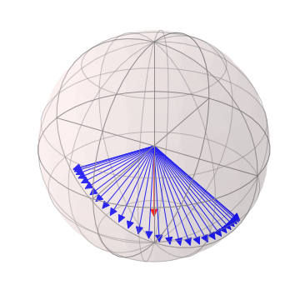
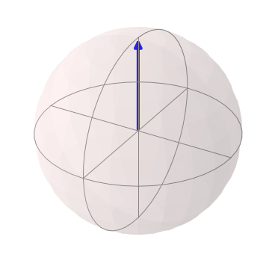
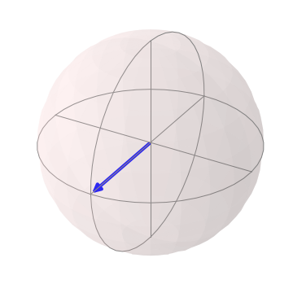
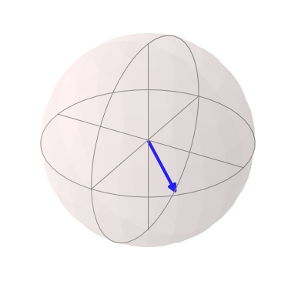
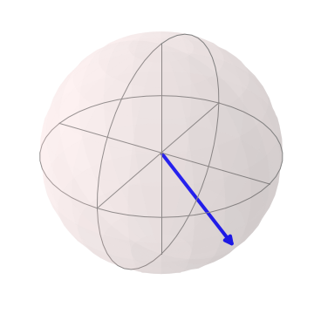
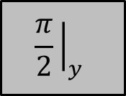





Measuring spin precession
COM motion driven off-resonance to steady state amplitude
Cool & Prepare
$$\frac{π}{2}{\left.​\right|}_{y}$$
ODF
$$\frac{π}{2}{\left.​\right|}_{y}$$
Detect
$$τ$$
$$θ$$
$$θ$$
Probability of measuring spin up:
$$\left\langle P_{↑}\right\rangle = \frac{1}{2}\left(1−e^{−Γτ}\left\langle \cos{θ}\right\rangle \right)$$
$= \frac{1}{2}\left(1−e^{−Γτ}J_{0}\left(\frac{F_{0}}{ℏ}Z_{c}τ\right)\right)$

Slide 13
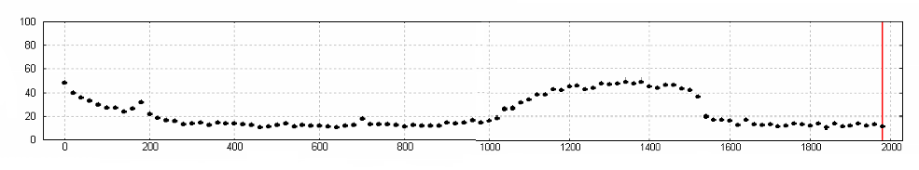
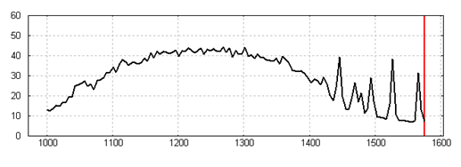






Applied off-resonance drive
4 ms ODF interaction time
$\left\langle P_{↑}\right\rangle$ (%)
$$ω$$
$$\hat{z}$$
ODF Difference Frequency $μ$ (kHz)
COM mode
$$\hat{y}$$
$$ω$$
$$\hat{x}$$
$\left\langle P_{↑}\right\rangle$ (%)
ODF Difference Frequency $μ$ (kHz)
COM mode

Slide 14
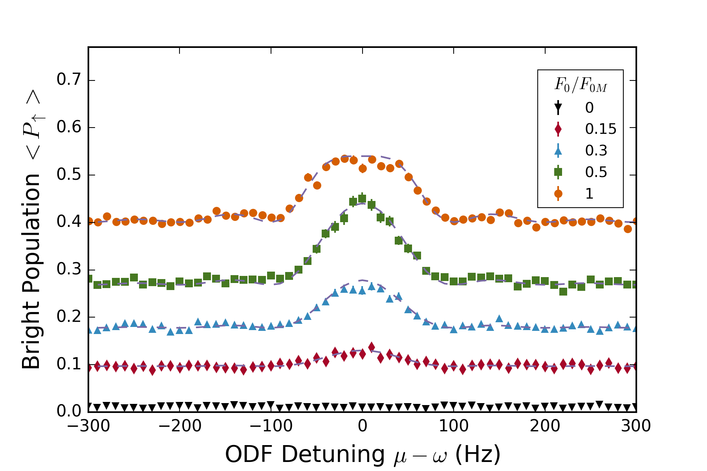
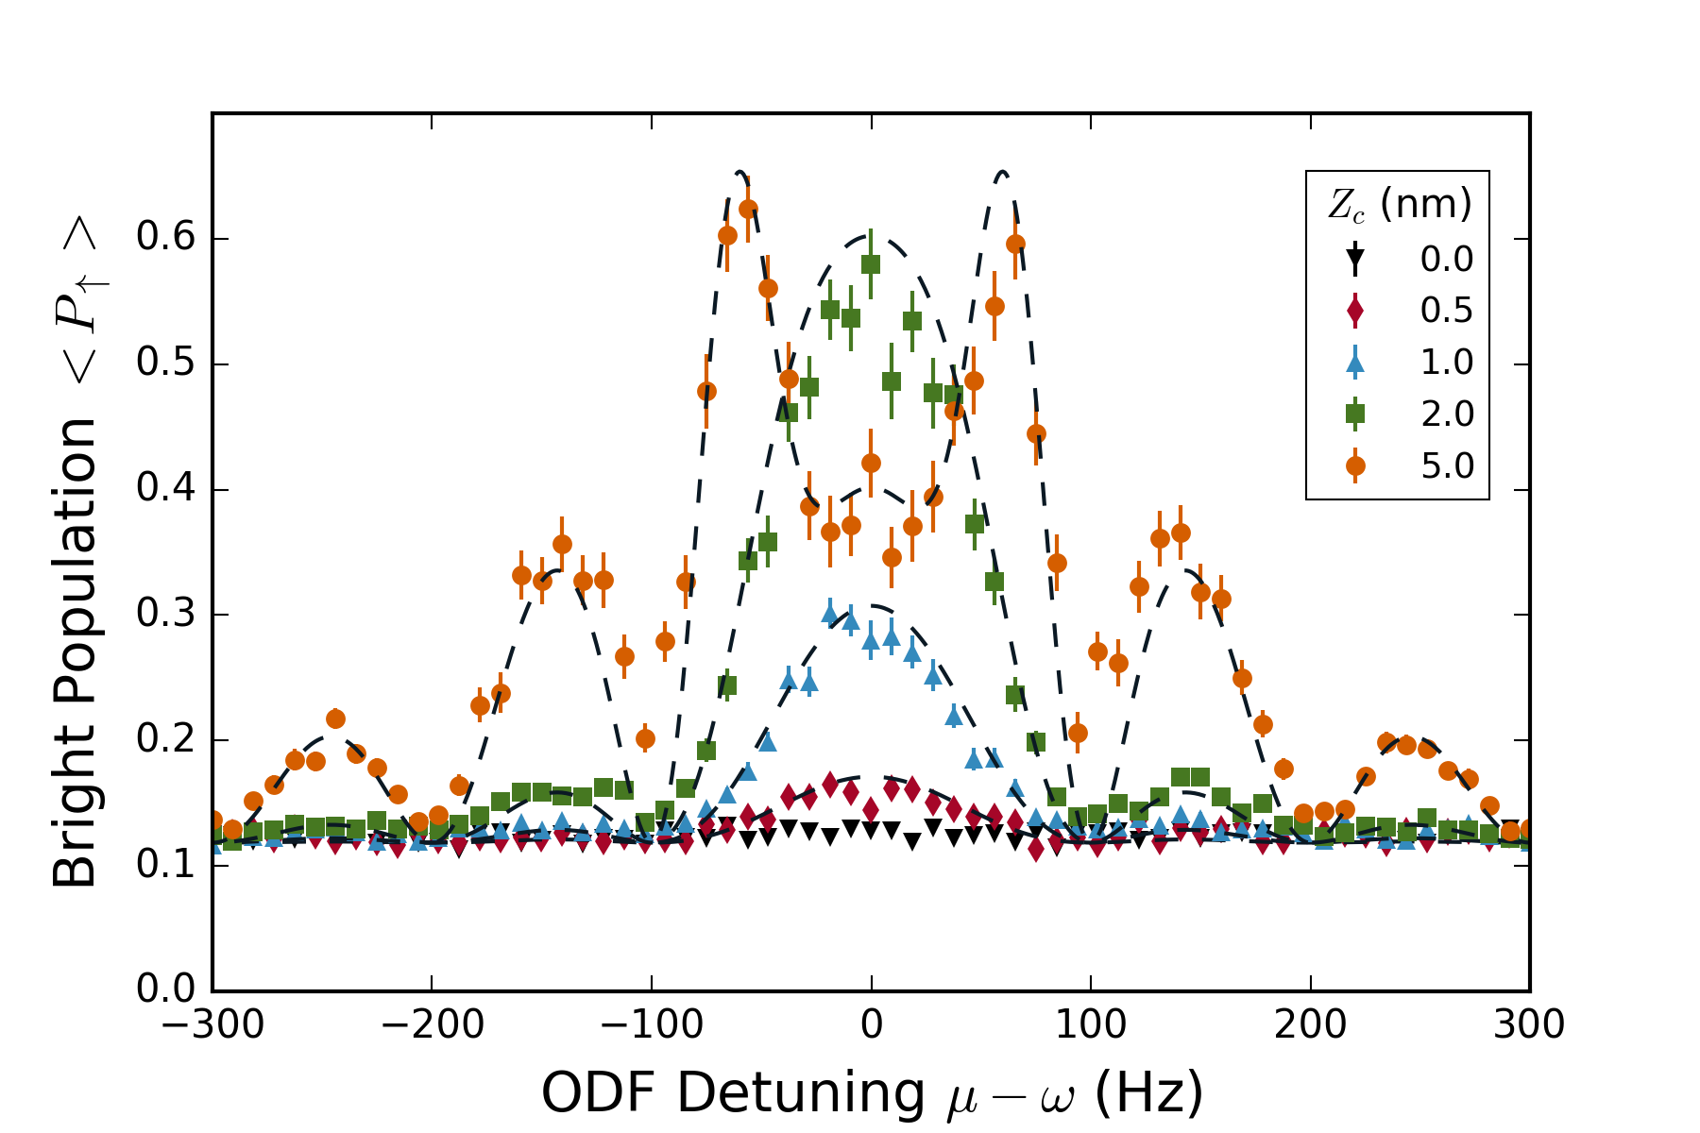





Lineshape is well understood
$${F_{0}/F}_{0M}=0.2$$
$Z_{c}=500$ pm
Gilmore et al., PRL 118, 263602 (2017).
$θ_{max}=F_{0}∙Z_{c}∙τ$

Slide 15
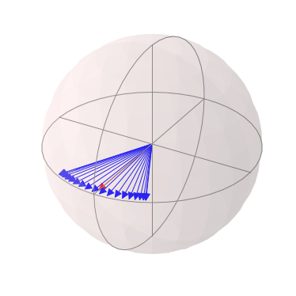
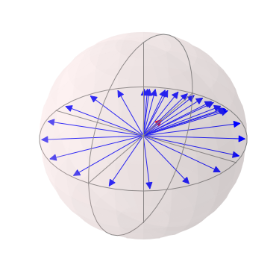
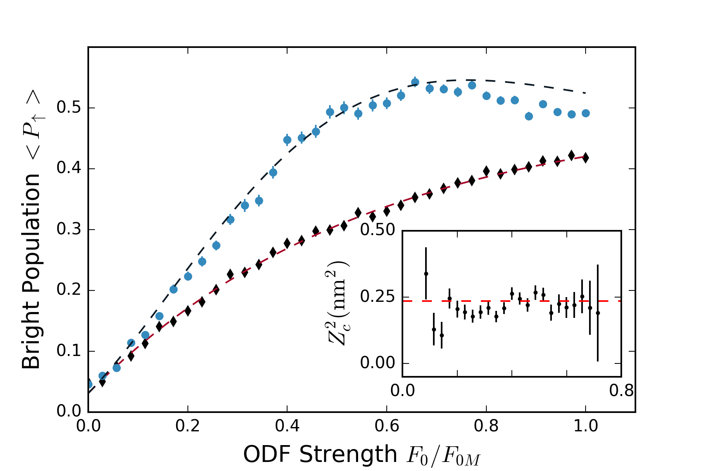

Spin dephasing vs measurement strength
$Z_{c}=500$ pm
`
Gilmore et al., PRL 118, 263602 (2017).

Slide 16
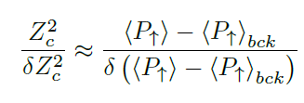
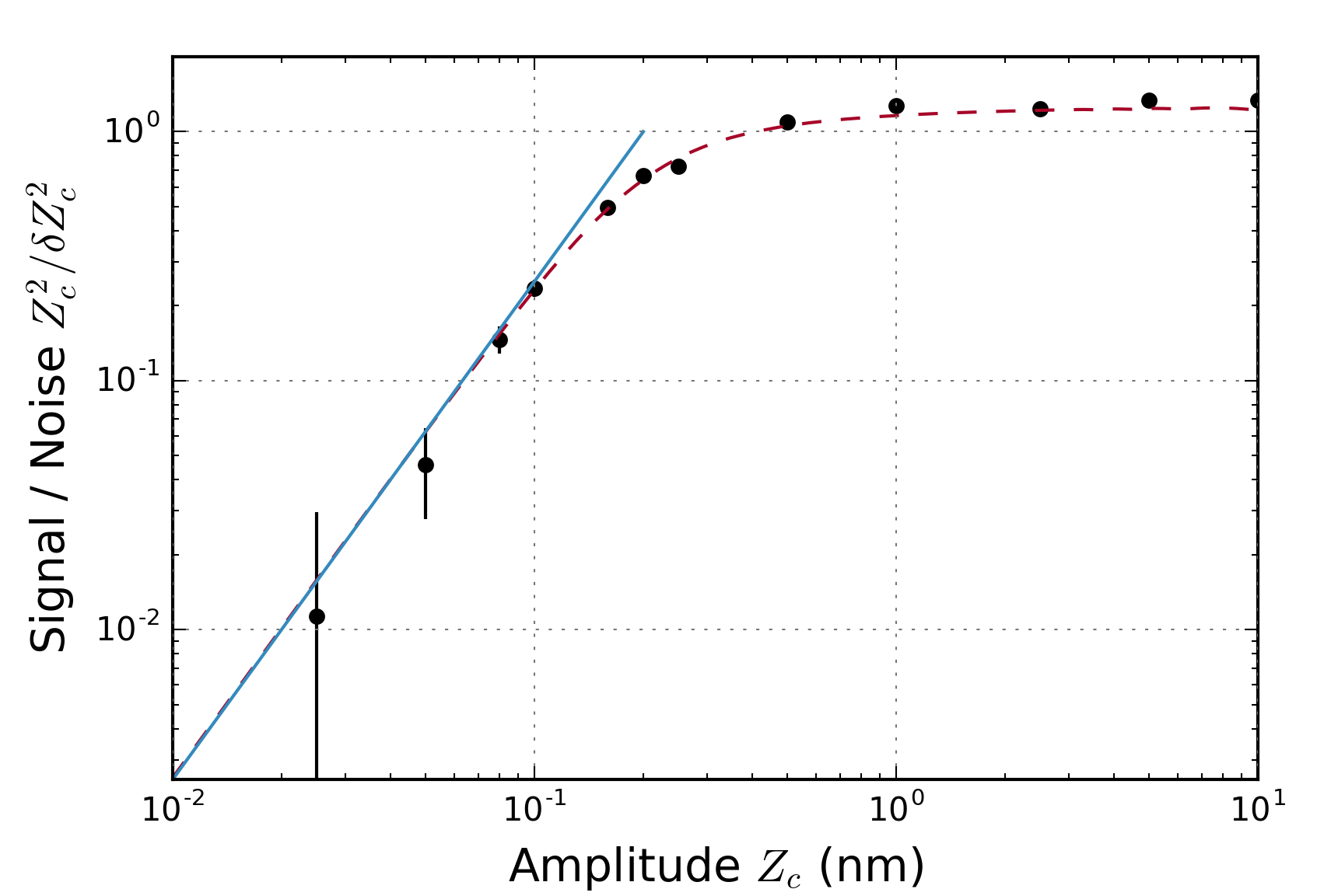
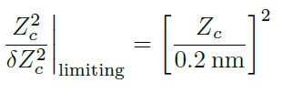

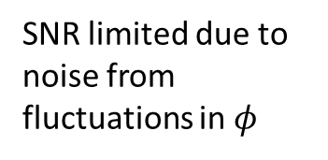
Limits to sensitivity / signal-to-noise
SNR limited due to noise from fluctuations in $φ$
SNR for a single trial
500 pm amplitude detected with S/N = 1
Projection noise / spontaneous emission limit
50 pm – smallest detected amplitude
$z_{zpt}=2$ nm
Gilmore et al., PRL 118, 263602 (2017).

Slide 17



Off-resonant amplitude sensing
In the absence of thermal phonons/zero point motion, what is the limit to our measurement sensitivity?
50 pm – 40x smaller than the ground state wavefunction size $z_{zpt}=2$ nm
Sensitivity limited by projection noise and spontaneous emission
Single quadrature measurement
$\left\langle P_{↑}\right\rangle$ (%)
$$ω$$
ODF Difference Frequency $μ$ (kHz)
COM mode

Slide 18
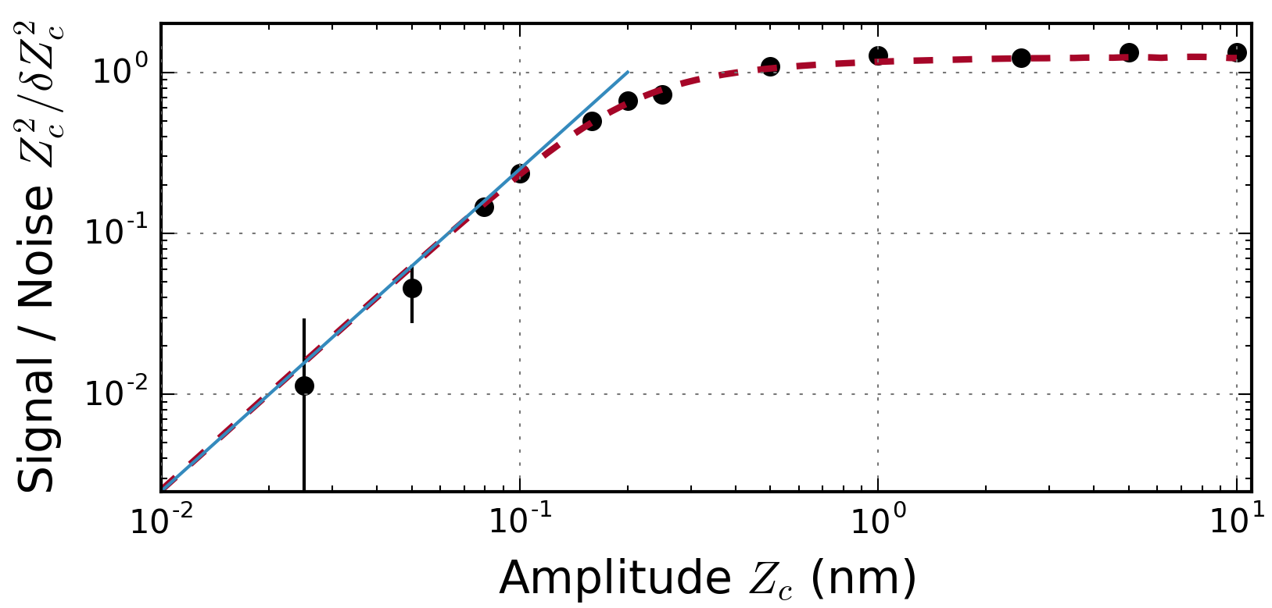




Current and future work
Phase coherent sensing off-resonance
  74 pm in single experimental trial
  $18 pm/\sqrt{Hz}$
  Exploit spins: squeezed states
On-resonance with COM mode
  Enhance force and electric field sensitivities by $Q\sim {10}^{6}$
    $E<0.5\frac{mV}{m}→E<0.5\frac{nV}{m}$
    $<0.5\frac{nV/m}{\sqrt{Hz}}$
  Sub-Doppler cooling
  Backaction?
COM mode
$\left\langle P_{↑}\right\rangle$ (%)
$$ω$$
ODF Difference Frequency $μ$ (kHz)

Slide 19

Coherent and incoherent phase
$$ω$$
Phase coherent:
$$φ=0$$
Phase incoherent: random $φ$
$$θ_{max}$$
$$θ$$
Frequency shift: $Δ\left(Z_{c}\right)=\left(\frac{F_{0}}{ℏ}\right)Z_{c} cos(φ)$
Angle: $θ=Δ τ≡\left(\frac{F_{0}}{ℏ}\right)Z_{c} τ cos\left(φ\right)$
$θ_{max}=F_{0}∙Z_{c}∙τ$
Phase incoherent: measured 500 pm displacement in a single shot
Phase coherent projection: measure 75 pm displacement in a single shot

Slide 20




Current work: phase coherent sensing
Cool & Prepare
$$\frac{π}{2}{\left.​\right|}_{y}$$
ODF
$$\frac{π}{2}{\left.​\right|}_{x}$$
Detect
$$θ$$
$$θ$$
Probability of measuring spin up:
$$\left\langle P_{↑}\right\rangle = \frac{1}{2}\left(1−e^{−Γτ}\sin{θ}\right)$$
1st order sensitive to $Z_{c}$

Slide 21


Preliminary coherent sensing results
230 pm amplitude detected with S/N > 1

Slide 22

















On resonance sensing scheme
$$\frac{π}{2}{\left.​\right|}_{y}$$
$$π{\left.​\right|}_{x}$$
$$\frac{π}{2}{\left.​\right|}_{y}$$
$μ=ω_{com}$:
$$\hat{D}(α)$$
$ω=ω_{com}$:
$$\hat{D}(α_{D})$$
$μ=ω_{com}$:
$$\hat{D}(α)$$
$$p_{z}$$
$$α_{D}$$
$$z$$
$$\left|\left.↓\right\rangle \right.$$
$$\left|−\left.α\right\rangle \right.$$
$$\left|\left.↑\right\rangle \right.$$
$$\left|\left.α\right\rangle \right.$$
C. Hempel et al., Nat. Photonics 7, 630 (2013).

Slide 23




Thank you!
NIST Ion Storage Group
Penning Trap Team
Joe Britton
Army Research Lab
Justin Bohnet
Honeywell
Brian Sawyer
Georgia Tech Research Inst.
Alumni:
Current: Elena Jordan, Matt Affolter, John Bollinger

Slide 24


3D crystals of trapped ions
Can trap > 1,000 ions
And make 3D Coulomb crystals
Attempt EIT cooling on 3D crystal - could cool all 3N motional modes simultaneously
Open question: Lamb-Dicke regime?
Low or zero frequency axial motion could be a problem

Slide 25












Ring down: a practical application
$$Δφ=\frac{π}{2}$$
$$T$$
$$T$$
Drive
Wait
$$\frac{π}{2}{\left.​\right|}_{y}$$
ODF
$$\frac{π}{2}{\left.​\right|}_{x}$$
$$\frac{π}{2}{\left.​\right|}_{y}$$
ODF
$$Q\sim {10}^{6}$$
Center (segmented) electrode (Vc)
Middle electrodes (Vm)
$$qϕ_{trap}\left(r,z\right)\text{=}\frac{1}{2}mω_{z}^{2}\left(z^{2}−\frac{r^{2}}{2}+C_{4}\left(z^{4}−3z^{2}r^{2}+\frac{3}{8}r^{4}\right)\right)$$

Slide 26

















On resonance sensing scheme
$$\frac{π}{2}{\left.​\right|}_{y}$$
$$π{\left.​\right|}_{x}$$
$$\frac{π}{2}{\left.​\right|}_{y}$$
$μ=ω_{com}$:
$$\hat{D}(α)$$
$ω=ω_{com}$:
$$\hat{D}(α_{D})$$
$μ=ω_{com}$:
$$\hat{D}(α)$$
N = 1
N > 1
$$p_{z}$$
$$p_{z}$$
$$α_{D}$$
$$α_{D}$$
$$z$$
$$\left|\left.m\right\rangle \right.$$
$$\left|\left.α_{m}\right\rangle \right.$$
$$z$$
$$\left|\left.↑\right\rangle \right.$$
$$\left|\left.α\right\rangle \right.$$
$$\left|\left.−m\right\rangle \right.$$
$$\left|−\left.α_{m}\right\rangle \right.$$
$$\left|\left.↓\right\rangle \right.$$
$$\left|−\left.α\right\rangle \right.$$
$$\hat{D}\left(α\right)=\prod_{i=1}^{N}{exp(\left[α{\hat{a}}^{\text{†}}−α^{∗}\hat{a}\right]{\hat{σ}}_{i}^{z})}$$
$$m=0,…,\frac{N}{2}$$
$$α_{m}=mα_{0}$$
C. Hempel et al., Nat. Photonics 7, 630 (2013).

Slide 27























Near term extensions: spin squeezing
$$\frac{π}{2}{\left.​\right|}_{y}$$
$$φ{\left.​\right|}_{x}$$
$$π{\left.​\right|}_{x}$$
$$\frac{π}{2}{\left.​\right|}_{x}$$
ODF
ODF
Drive
ODF
$$μ=ω_{com}+δ$$
$μ=ω_{com}$:
$$\hat{D}(α)$$
$ω=ω_{com}$:
$$\hat{D}(α_{D})$$
$μ=ω_{com}$:
$$\hat{D}(α)$$
Prepare squeezed state
Coherent spin state
Squeezed spin state
$$p_{z}$$
$$p_{z}$$
-$α$
$$α$$
$$z$$
$$−α$$
$$α$$
$$z$$
$$\left|\left.↓\right\rangle \right.$$
$$\left|\left.↑\right\rangle \right.$$
$$\left|\left.↓\right\rangle \right.$$
$$\left|\left.↑\right\rangle \right.$$
J. G. Bohnet et al., Science 352, 1297 (2016)

Slide 28






Near term extensions: spin squeezing
$$\frac{π}{2}{\left.​\right|}_{y}$$
$$φ{\left.​\right|}_{x}$$
$$π{\left.​\right|}_{x}$$
$$\frac{π}{2}{\left.​\right|}_{x}$$
Cool & Prepare
ODF
ODF
Drive
ODF
Detect
$$\hat{D}(α_{0})$$
$$\hat{D}(α_{0})$$
Prepare squeezed state
$$θ$$
$$θ$$

Slide 29














Near term extensions: spin squeezing
$$\frac{π}{2}{\left.​\right|}_{y}$$
$$\frac{π}{2}{\left.​\right|}_{x}$$
$$π{\left.​\right|}_{x}$$
$$\frac{π}{2}{\left.​\right|}_{x}$$
ODF
ODF
Drive
ODF
ODF
$$μ=ω_{com}+δ$$
$$\hat{D}(α_{0})$$
$$\hat{D}(α_{0})$$
$$μ=ω_{com}−δ$$
Prepare squeezed state
$$θ$$
$$θ$$
$$Gθ$$
E. Davis et al, Phys. Rev. Lett. 116, 053601 (2016)

Slide 30

















Mapping both quadratures to spin
$$Δφ=\frac{π}{2}$$
$$T$$
$$T$$
ODF
$$\frac{π}{2}{\left.​\right|}_{x}$$
Detect
Detect
Detect
$$\frac{π}{2}{\left.​\right|}_{y}$$
ODF
$$\frac{π}{2}{\left.​\right|}_{y}$$
$$\frac{π}{2}{\left.​\right|}_{x}$$
$$θ_{1}$$
$$θ_{1}$$
$$θ_{1}$$
$$θ_{2}$$
Measure each quadrature of motion with half of ions
$$θ_{1}=θ_{max}cos\left(φ\right)$$
$$θ_{2}=θ_{max}sin\left(φ\right)$$
Directly measure $θ_{max}$ for small $θ_{1}$, $θ_{2}$:
$\left\langle P_{↑}\right\rangle = \frac{1}{2}\left(1−e^{−Γτ}\left\langle cos({θ_{1})}\cos{(θ_{2})}\right\rangle \right)≈$ $\frac{1}{2}\left(1−e^{−Γτ}\cos{{(θ}_{max}})\right)$
$θ_{max}=F_{0}∙Z_{c}∙τ$

Slide 31






In-plane modes
Freericks group, PRA 87 (2013)
$E×B$ modes
transverse modes
cyclotron modes
$$ω_{m}$$
$$ω_{z}$$
$$Ω_{c}$$
Lowest frequency ExB modes
Lowest frequency cyclotron modes

Slide 32


Background characterized by spontaneous emission
$${\left\langle P_{↑}\right\rangle }_{bck}= \frac{1}{2}\left(1−e^{−Γτ}\right)$$
$Γ$ is the decay rate ($1/s$) due to spontaneous emission

Slide 33









Cooling via Electromagnetically-Induced Transparency
$Λ$-shape level structure
$$m_{j}=+\frac{1}{2}$$
$$Δ$$
Challenges:
Coherently spanning 124 GHz qubit frequency
Doppler shifts due to ion crystal rotation
Alignment of $δ\overset{⃑}{k}$ normal to plane of ions
Many ions?
$$m_{j}=+\frac{1}{2}$$
$$\left|\left.↑\right\rangle \right.$$
$$m_{j}=−\frac{1}{2}$$
$$\left|\left.↓\right\rangle \right.$$
A. Shankar et al., submitted to PRA.

Slide 34





Temperature measurement
Cool & Prepare
$$\frac{π}{2}{\left.​\right|}_{y}$$
ODF
$$π{\left.​\right|}_{x}$$
ODF
$$\frac{π}{2}{\left.​\right|}_{y}$$
Detect
$$P\left(|↑\right\rangle )=\frac{1}{2}[1−\exp\left(−Γτ\right)exp\left(−2 | {α|}^{2}\left( 2\overline{n}+1\right)\right){\cos\left(4J\right)}^{N−1}]$$
Spontaneous emission
Spin-motion coupling Spin-spin interaction
ODF detuning from mode frequency (kHz)
ODF detuning from mode frequency (kHz)

Slide 35




EIT cooling results
COM mode
All drumhead modes
N $=105±10$ ions
N $=158±10$ ions
Jordan, Gilmore et al., Submitted to PRL.
.

