Slide 1
Highly-multiplexed superconducting resonator readout using the SLAC Microresonator Radio Frequency (SMuRF) Electronics
Shawn Henderson for the SMuRF Team
The CPAD Instrumentation Frontier Workshop 2018
December 10, 2018

Slide 2
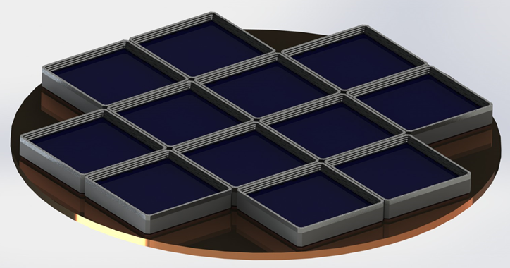
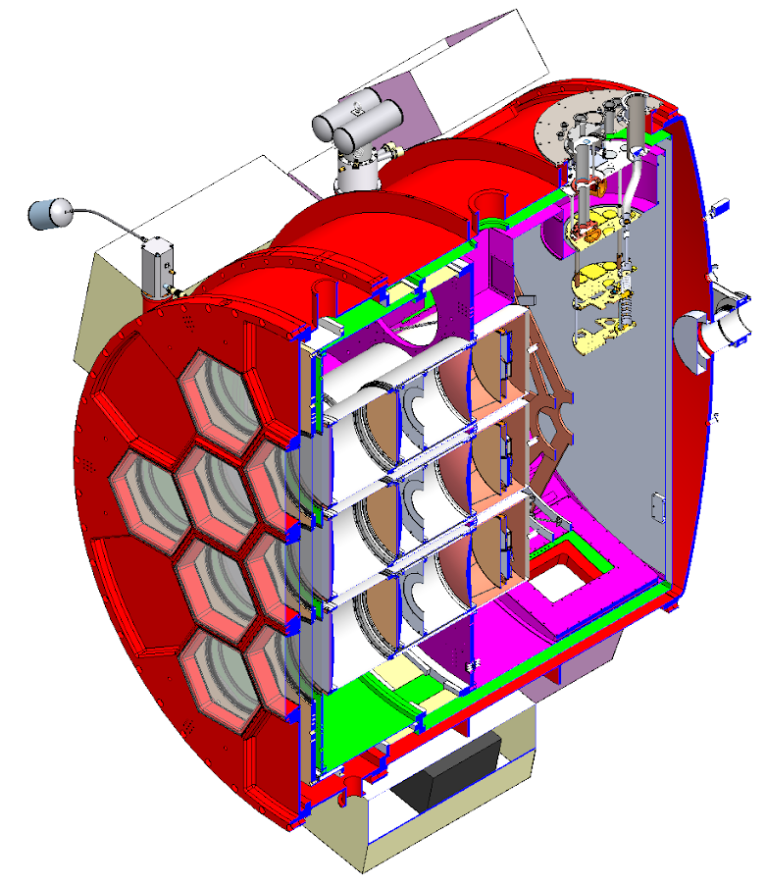
SMuRF - Warm Electronics Development for CMB
BICEP Array ~30,000 TESs
Next generation CMB surveys (BICEP Array, Simons Observatory, CMB-S4) require orders of magnitude more sensors to achieve science goals.
Microwave SQUID multiplexing (uMUX) - MKID multiplexing factors with TES performance
However existing warm readout for uMUX is not designed to exploit the full multiplexing potential.
~0.5m
SO
~70,000 TESs
2.4m
CMB S4: 500,000+ TESs!
Notes:
Plot 1 sensitivity vs year, scale with # detectors – mores law for # detectors
Necessary to scale to 2000 sensors
TDM TES on second plot – TES have nice flat spectrum

Slide 3
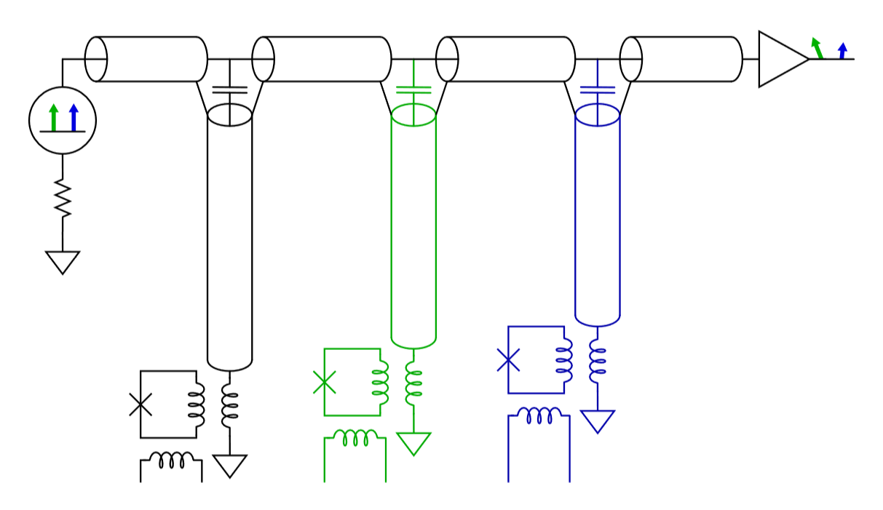
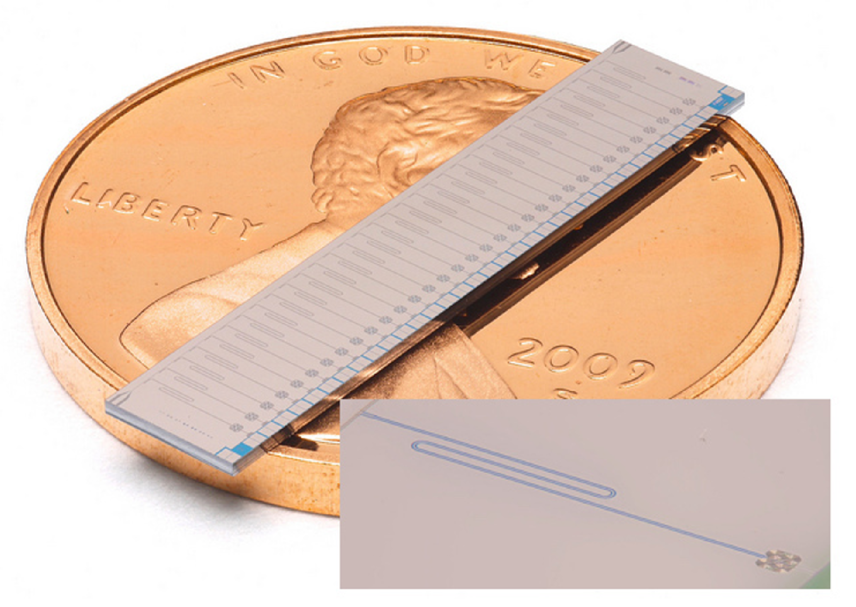
Microwave SQUID Multiplexing (uMUX)
Microwave resonators to multiplex TES
TES inductively couples to RF-SQUID, screen a GHz resonator
Signal in TES changes inductance, frequency of resonance
B. Mates PhD Thesis (2011)
Dober et al., Appl. Phys. Lett. 111, 243510 (2017)
CPW resonator
rfSQUID
Notes:
Add flux ramp line

Slide 4
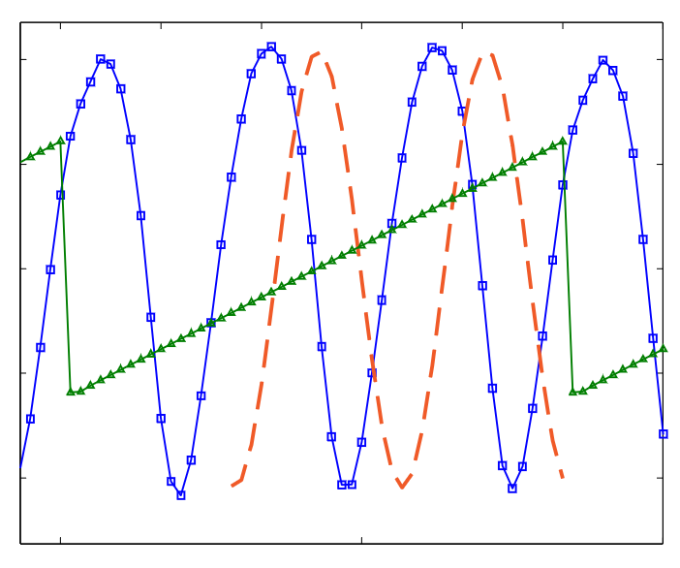
uMUX Flux Ramp Modulation
Flux ramp modulation linearizes SQUID response, overcomes TLS noise
MUX factor: 1000s
Signal is phase shift of modulated SQUID response
B. Mates PhD Thesis (2011)
Phase
Time
Dober et al., Appl. Phys. Lett. 111, 243510 (2017)
CPW resonator
rfSQUID

Slide 5
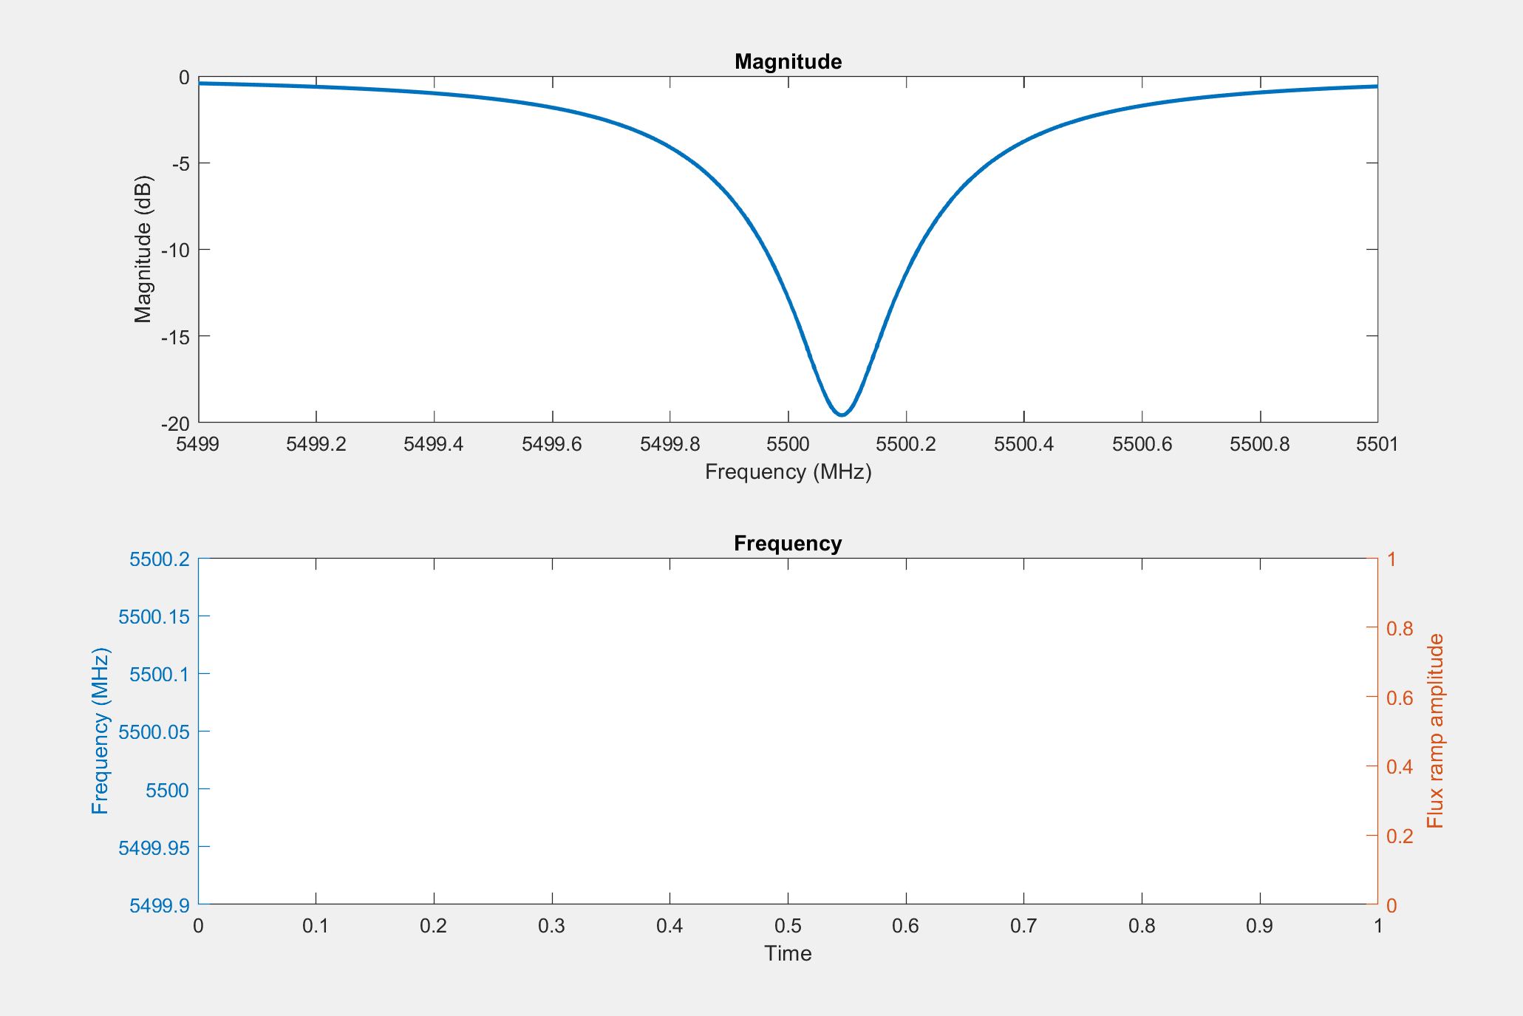
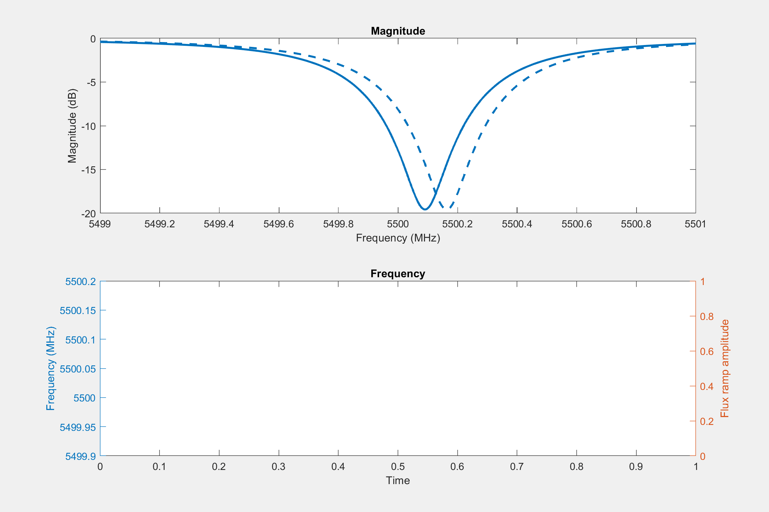
uMUX Flux Ramp Modulation

Slide 6
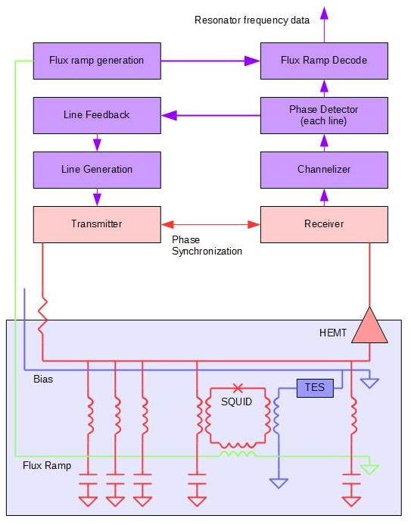
SMuRF Readout for uMUX
  Everything except cryogenic system
    Generate a set of tones to excite micro-resonators
    Detect phase shifts due to resonator frequency changes
    Drive flux ramp, provide TES biases
  Technical challenges
    Dynamic range
      Noise
      Linearity
    Wide bandwidth
    Compute power
  SMuRF
Notes:
Simplify
SMURF box around top half
Cartoon box, step through signal receive to data stream

Slide 7


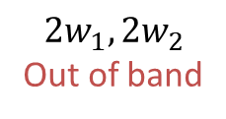
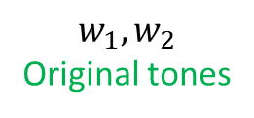


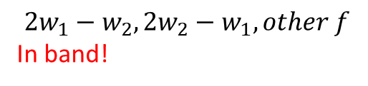
Noise and Dynamic Range
  Maximum signal is limited by dynamic range
    Nonlinear effects in RF components
    Intermodulation distortion (IMD) looks like broadband noise!
$$X=A+B, A=\sin\left(w_{1}t+φ\right), B=sin⁡(w_{2}t+φ)$$
$$Y=C_{1}A+C_{2}B$$
+ $C_{3}A^{2}+C_{4}B^{2}+C_{5}AB$
+ $C_{6}A^{2}B+C_{7}AB^{2}+…$
$$w_{1}, w_{2}$$
Original tones
$$2w_{1}, 2w_{2}$$
Out of band
$$w_{1}+w_{2},$$
$$w_{1}−w_{2}$$
Out of band
$$2w_{1}−w_{2}, 2w_{2}−w_{1}, other f$$
In band!
Signal band
~N³ 3rd order terms!
256³ or 2000³ is a big number!
Looks like broadband noise
Notes:
Spurious free dynamic range
Amplifier starts acting like a mixer

Slide 8
Noise and Dynamic Range
  Electronics dBc/Hz translates directly to measurement noise. CMB needs ~100dBc/Hz per detector
SFDR = Spurious-Free Dynamic Range
Noise floor
Notes:
Spurious free dynamic range
Amplifier starts acting like a mixer

Slide 9
Maximizing Dynamic Range
  HEMT is normally the limit to system dynamic range.
    Replace HEMT with low gain modification and add 50K amplifier stage
  Dynamically track resonance dips to reduce power in HEMT an additional ~15dB without reducing signal to noise
Notes:
HEMT – cold amplifier

Slide 10
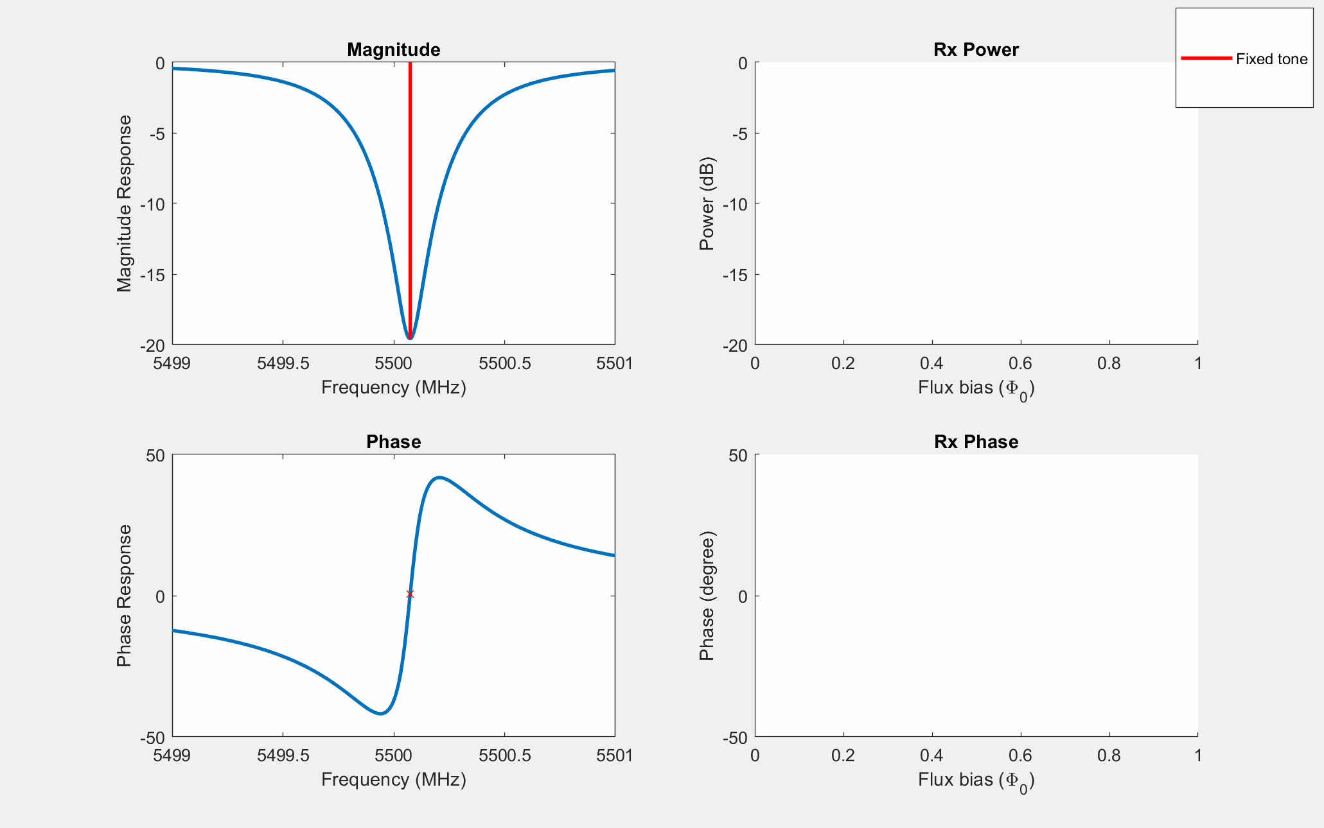
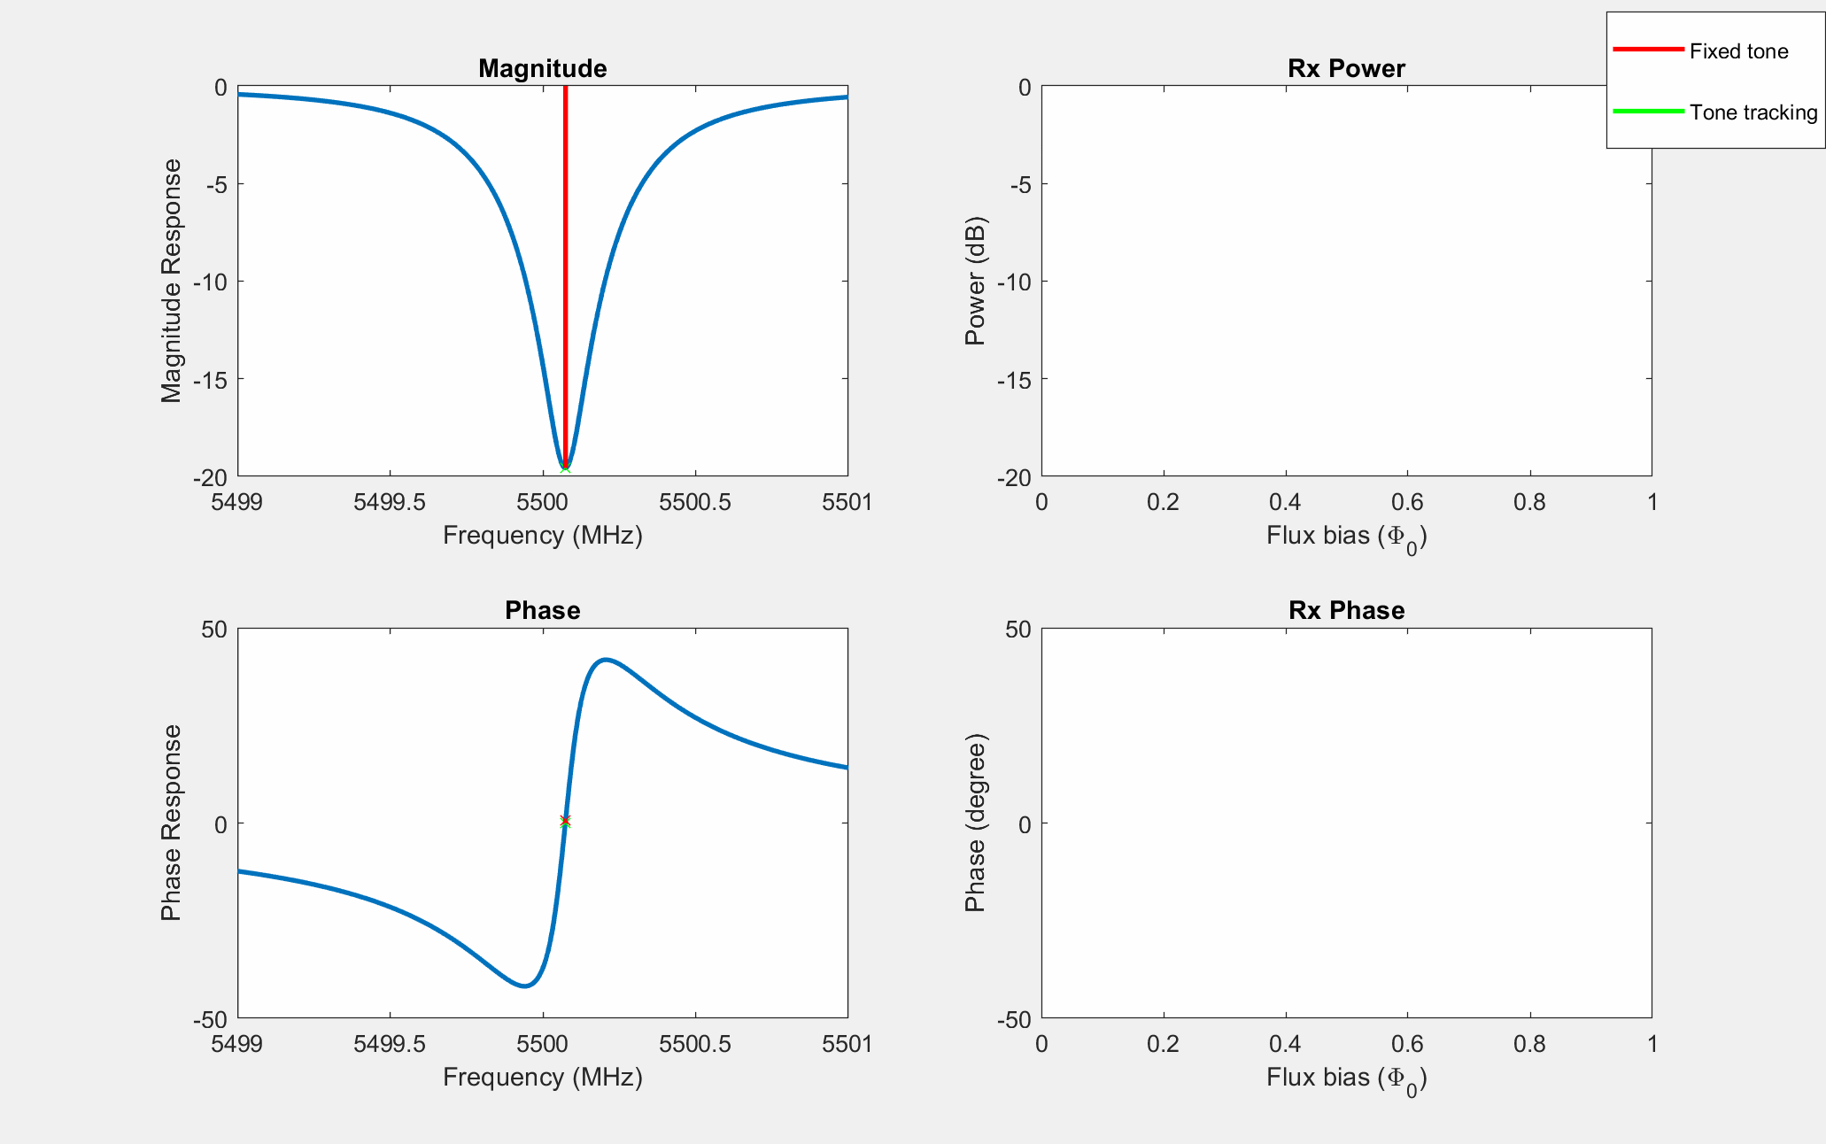
Tone Tracking – Interrogate at Resonance
Notes:
Figure labels larger font

Slide 11
The SLAC Microresonator RF Electronics (SMuRF)
  RF system
    Frequency range 4-8GHz (other frequencies possible)
    Generate and readback up to 4000 RF lines in this range
    Feedback to track resonances, decode flux ramp
    >100dBc/Hz dynamic range relative to a single line (2MHz line spacing)
  Additional features
    Flux ramp drive for uMUX systems (50MS/s low noise DAC)
    TES bias for uMUX systems (up to x32 lines)
    RF amplifier and cold HEMT power/bias supply
    Firmware to decode data into frequency per pixel
    10G Ethernet communication for data and control
    Designed for high density (1 rack unit/system) for large installations

Slide 12
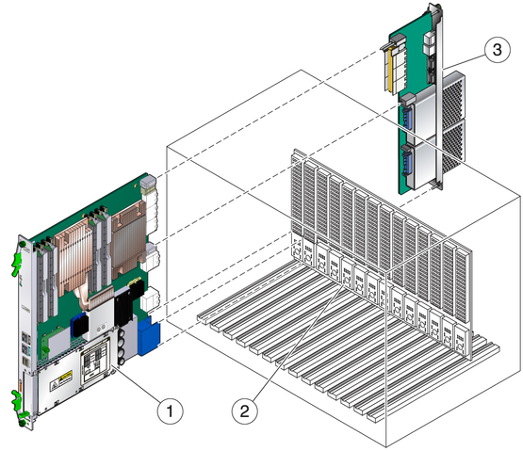
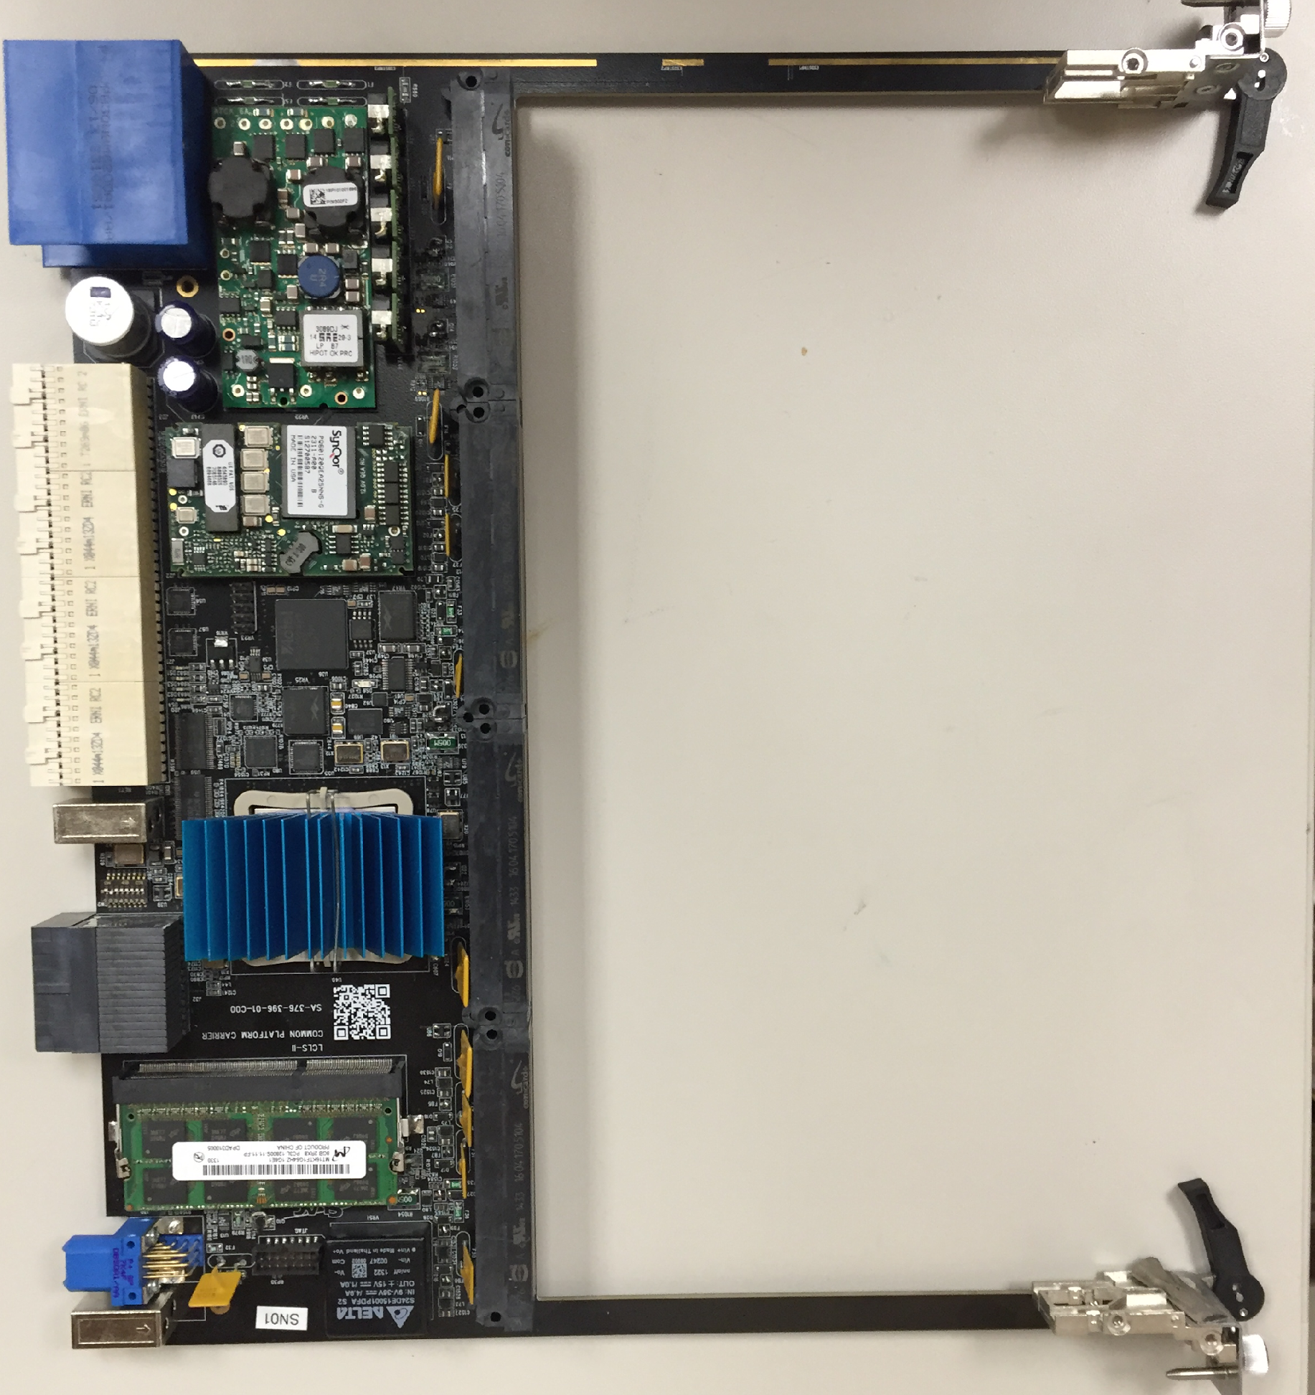
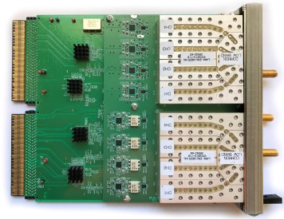
The SLAC Microresonator RF Electronics (SMuRF)
1: Carrier Card (Xilinx KU060, 2.7K slices)
2: Crate (ATCA, 1-14 slot available)
3: RTM
Each carrier supports 2 AMC application cards
Carrier card: FPGA, memory, backplane connections
AMC cards: (double-wide full height) ADCs, DACs, high performance front end electronics
RTM: General purpose IO, extra networks, miscellaneous

Slide 13
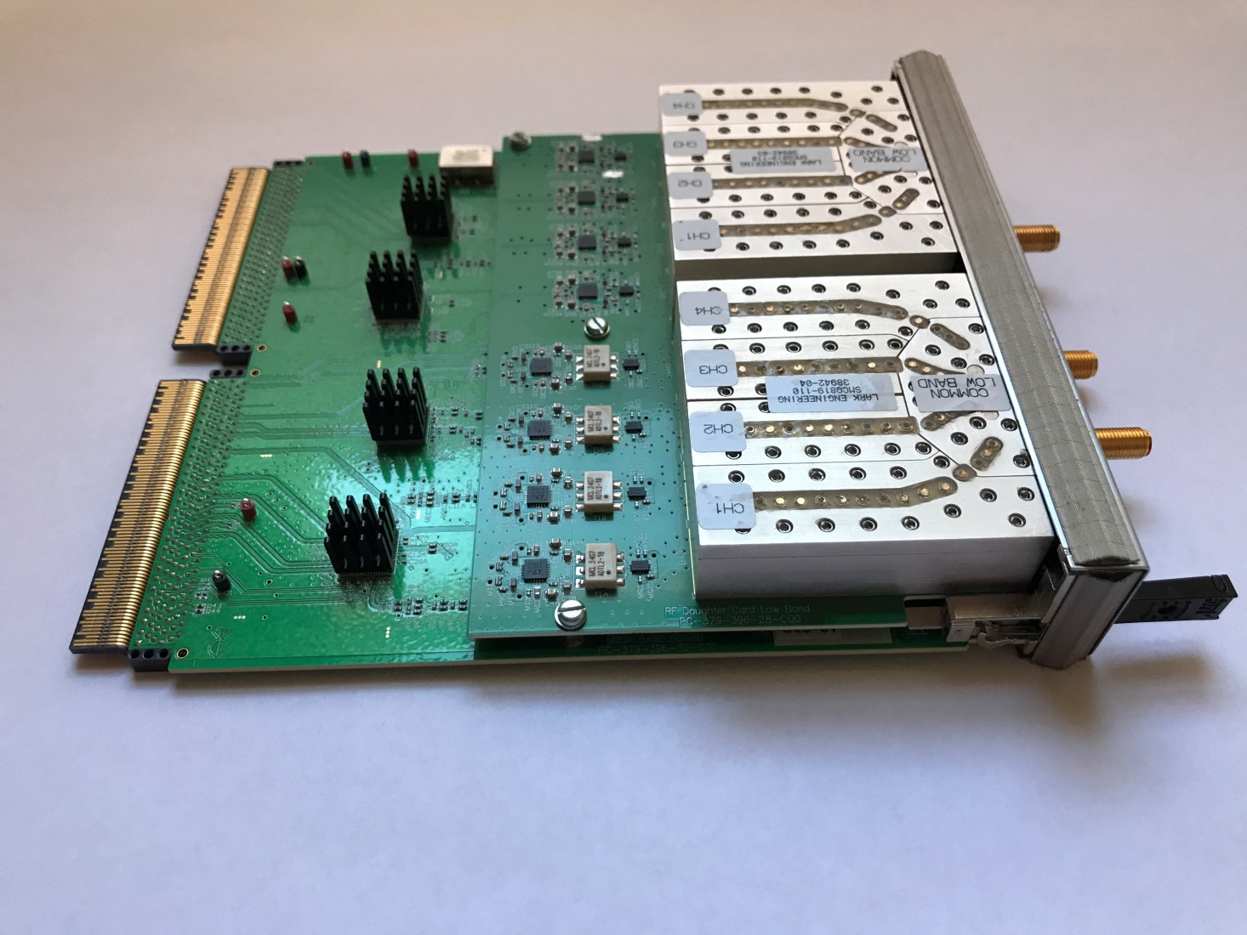
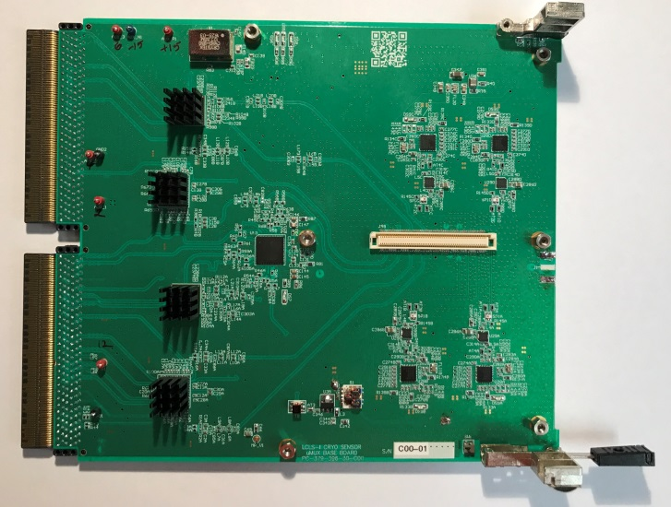
AMC Cards – RF/ADC/DAC
Mixers
Daughter Card
1:4 multiplexing filters
ADCs 2.5Gs/s 14 bit
Multiplexer filter
DACs
2.5Gs/s 16 bit
LO generators
2GHz bandwidth/AMC – 2 per carrier
AMC Card

Slide 14
DAC and Upmix System
  Full AMC card (1/2 SMuRF) generating 1000 lines in 2GHz bandwidth from 4-6 GHz
  This is after the last active device and filter in the system.
    Mixers only exposed to 500MHz bandwidth
    High linearity components used everywhere
  Electronics dBc/Hz translates directly to measurement noise. CMB needs ~100dBc/Hz per detector
Notes:
Why 100dBc/Hz:
TES 100mK – thermal fluctuations appear like power signal
Readout added noise << detector noise < sky noise

Slide 15
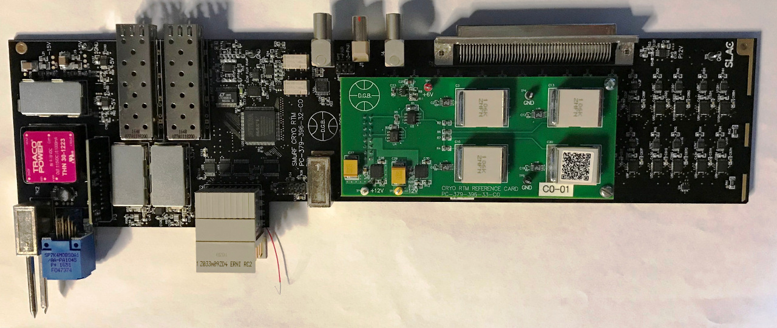
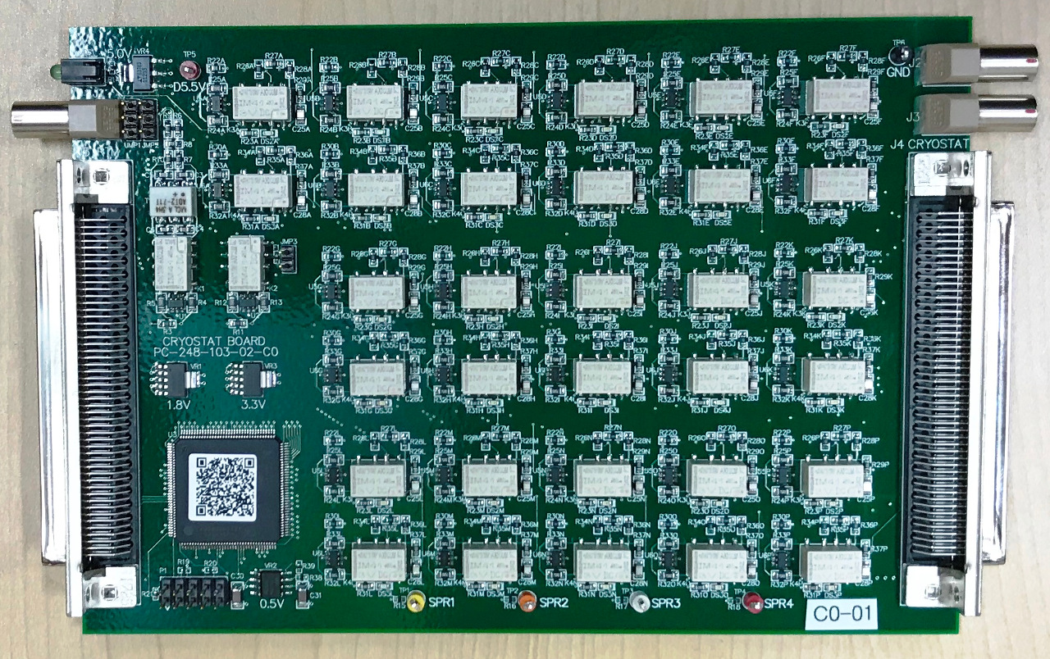
Low Frequency System
Communication
to FPGA
RTM board (ATCA crate)
TES Bias DACs
Flux ramp DACs
18 bit DACs (X3) TES bias
Flux ramp
DAC
Voltage Reference
Multi-pin cable
Cryostat board
TES Bias resistors
De-latch relays
Mounted to cryostat
Filtering
To Cryostat

Slide 16
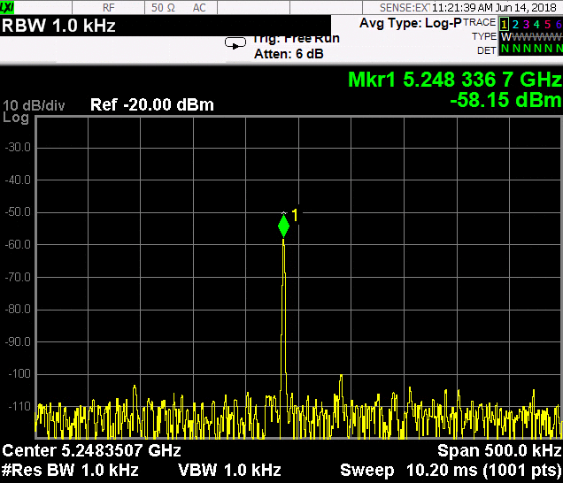
Flux Ramp – Tone Tracking

Slide 17
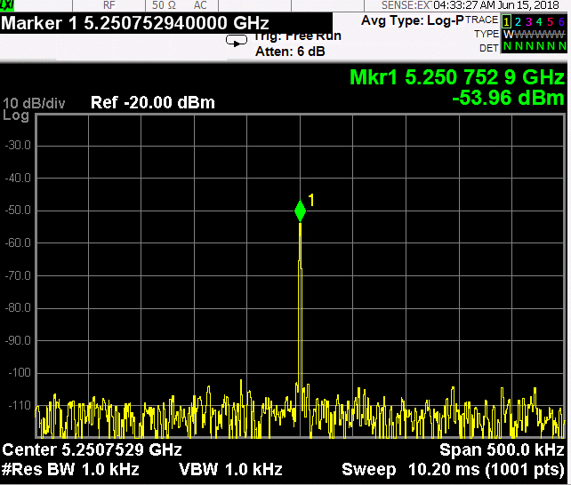
Flux Ramp – Open Loop

Slide 18
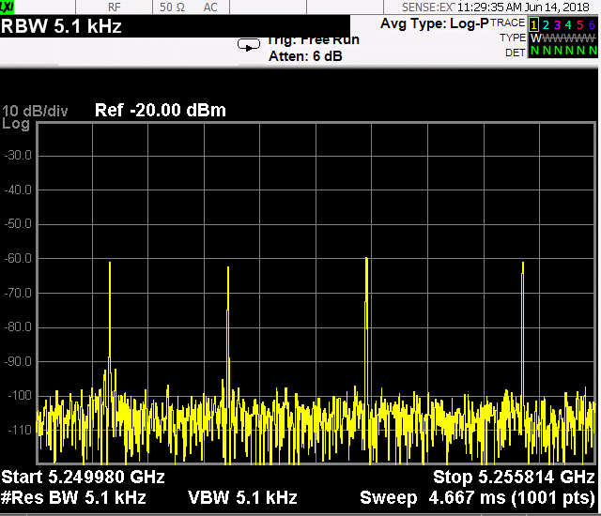
Flux Ramp – 4 Tones Tracking

Slide 19
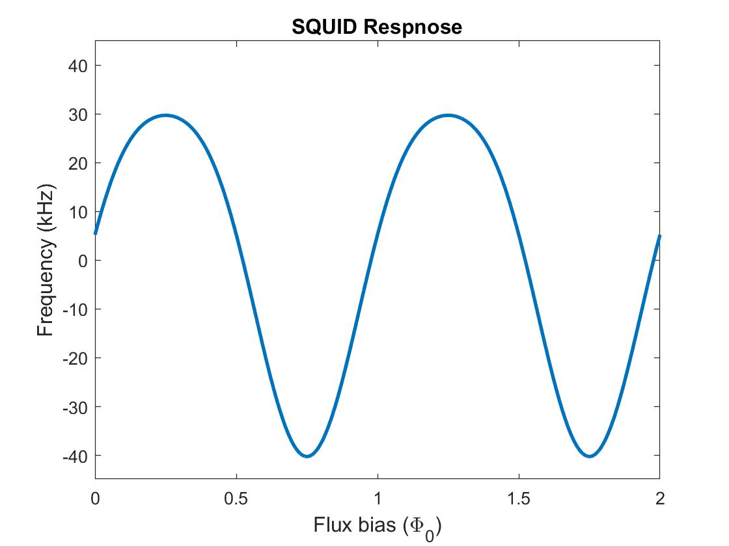
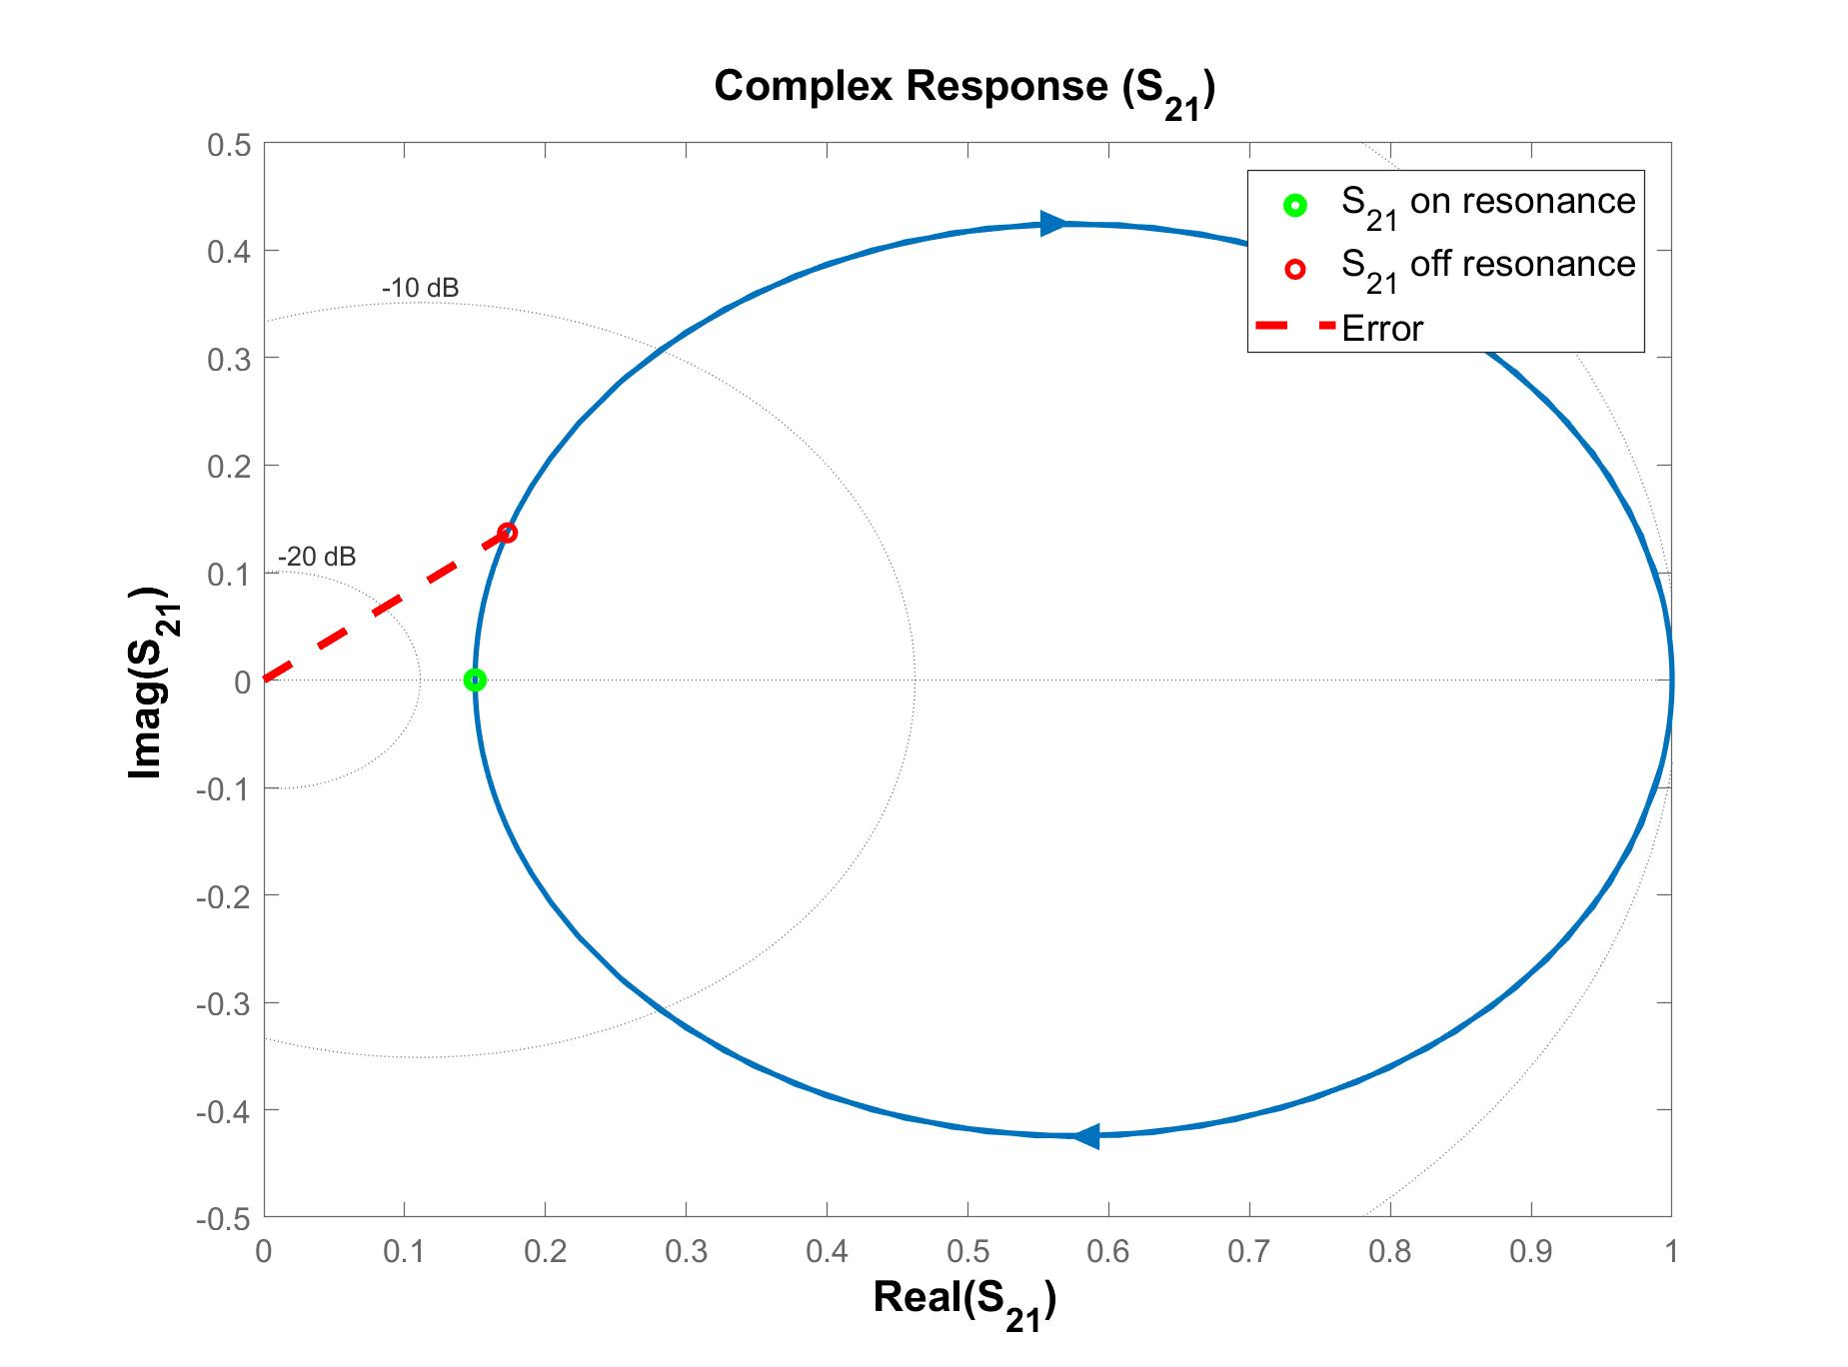
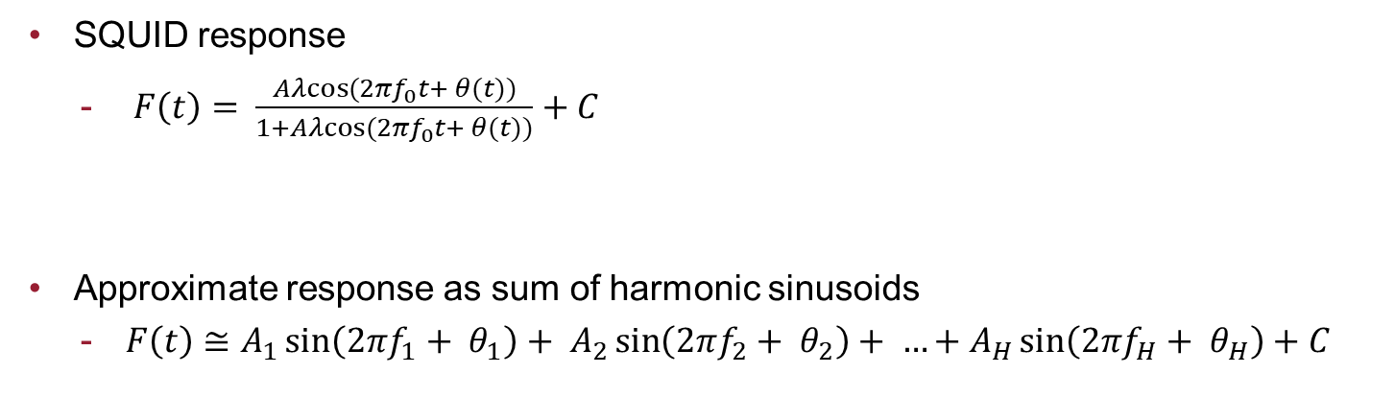
Tone Tracking Algorithm – Feedback
  SQUID response
    $F\left(t\right)= \frac{Aλcos⁡(2πf_{0}t+ θ(t))}{1+Aλcos⁡(2πf_{0}t+ θ(t))}+C$
  Approximate response as sum of harmonic sinusoids
    $F\left(t\right)≅A_{1}\sin\left(2πf_{1}+ θ_{1}\right)+ A_{2}\sin\left(2πf_{2}+ θ_{2}\right)+ …+A_{H}\sin\left(2πf_{H}+ θ_{H}\right)+C$
  Adaptive feedback for phase/amplitude of sinusoids
    Demodulated flux ramp phase comes out of tracking algorithm

Slide 20
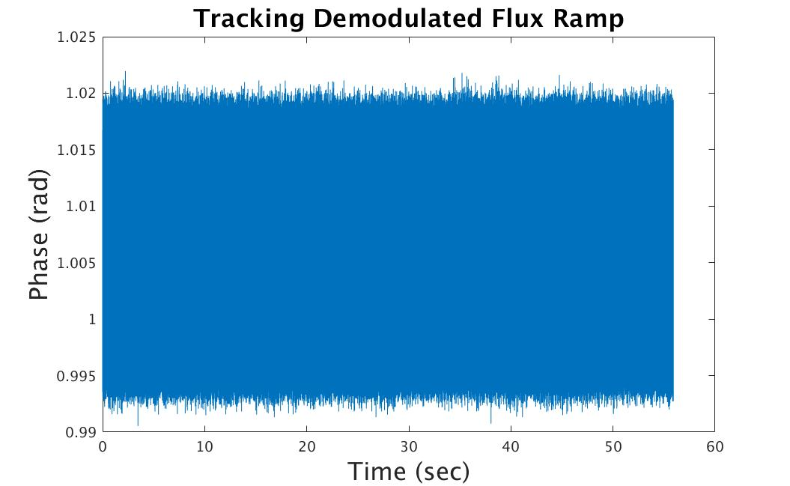
Tone Tracking Algorithm
  Demodulated flux ramp phase is physics signal
Notes:
Labels for colors
Flux phi0 diagram where flux ramp goes into SQUID
Continuous demodulation
Flip the order, turning on tracking
Fixed tone all in error

Slide 21
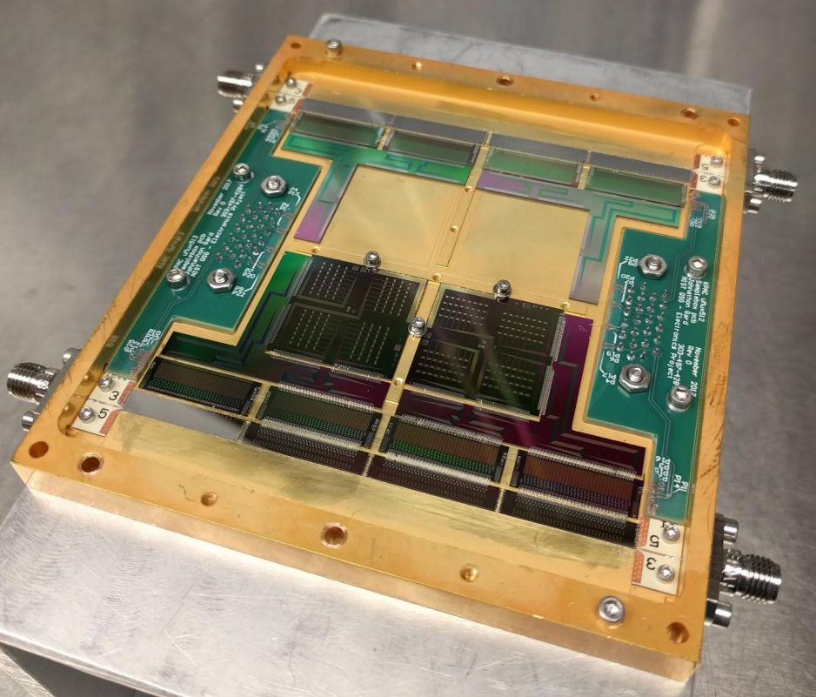
NIST 528 Test Box
Dober et al., Appl. Phys. Lett. 111 (2017)
  528 uMUX resonator channels
    Distributed between 5-6 GHz
    Not all coupled to TESs
  High linearity cold RF circuit
    Two-amplification stages – one at 4K and one at 50K.
    Necessary to readout O(100) tones or more without degradation in performance.
Notes:
Not connected to TES – mux readout only

Slide 22
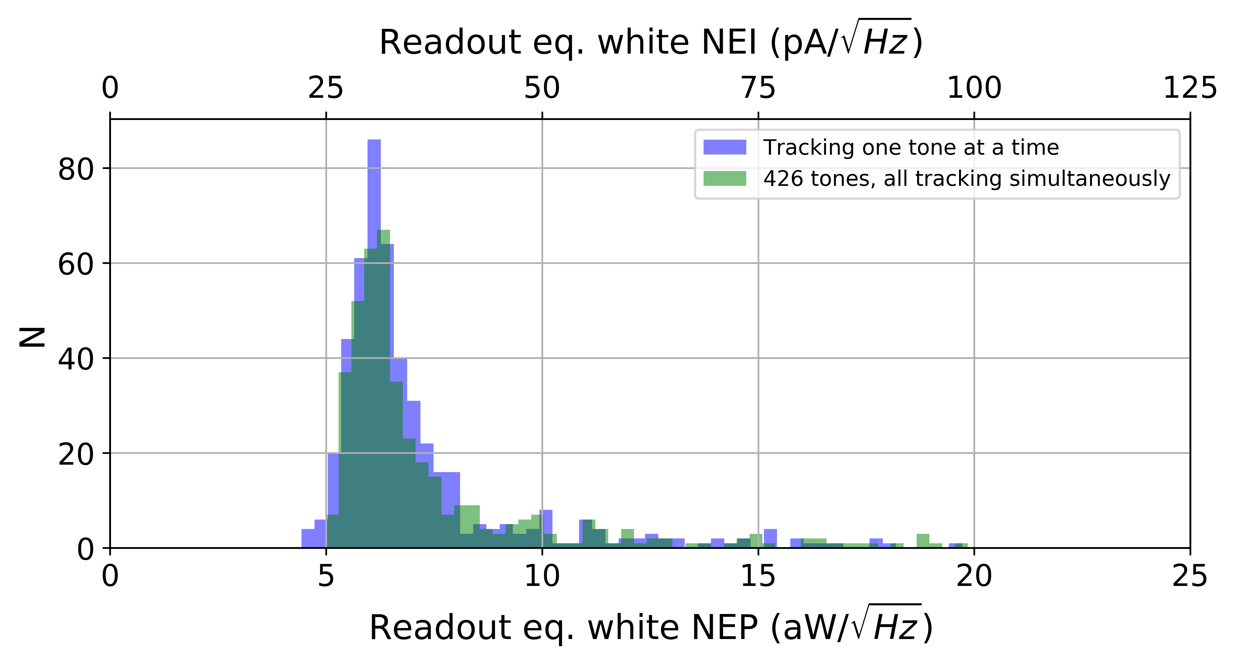
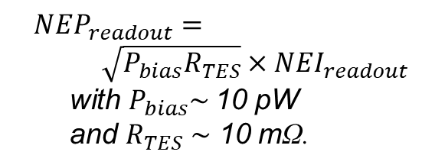
SMuRF Noise Multiplexing O(500) Channels
  Negligible degradation in S/N reading 1 vs 𝒪(500) channels!
  Readout NEP suitable for CMB receivers – meets S4 performance requirements.
Henderson et al., Proc. SPIE 10708 (2018)
Not coupled to TESs
Assuming
  ${NEP}_{readout}= \sqrt{P_{bias}R_{TES}}{×NEI}_{readout}$with $P_{bias}\sim$10 pW and $R_{TES} \sim$ 10 mΩ.

Slide 23
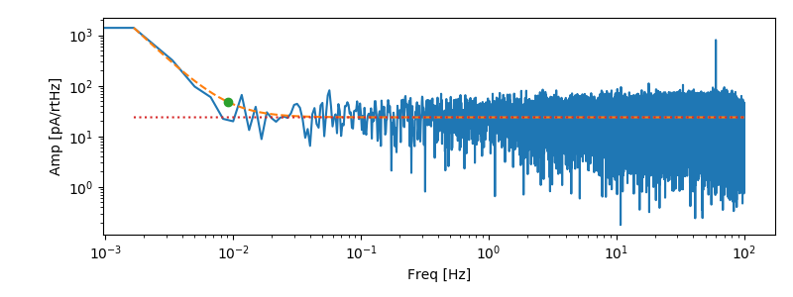
SMuRF Noise Multiplexing O(500) Channels
  Negligible degradation in S/N reading 1 vs 𝒪(500) channels!
  Readout NEP suitable for CMB receivers – meets S4 performance requirements.
  Excellent low frequency 1/f performance.
Henderson et al., Proc. SPIE 10708 (2018)
Not coupled to TESs
Typical Readout Noise PSD
Assuming
1/f knee at ~10mHz
  ${NEP}_{readout}= \sqrt{P_{bias}R_{TES}}{×NEI}_{readout}$with $P_{bias}\sim$10 pW and $R_{TES} \sim$ 10 mΩ.
Eq. TES Current Noise
~30 pA/rtHz
Not coupled to a TES

Slide 24
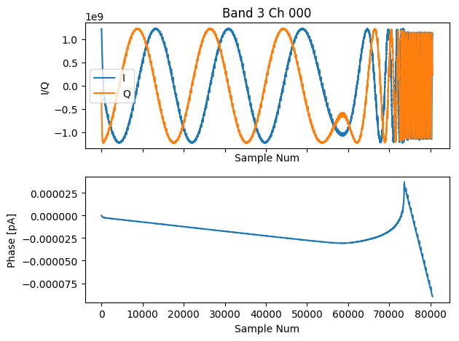
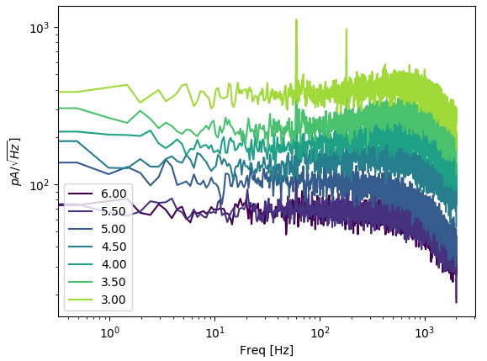
SMuRF Noise Multiplexing O(500) Channels
  Negligible degradation in S/N reading 1 vs 𝒪(500) channels!
  Readout NEP suitable for CMB receivers – meets S4 performance requirements.
  Low noise TES bias DACs performing as expected.
SPIDER TES IV taken with SMuRF
normal
superconducting
TES current
in transition
TES bias voltage
Example noise PSDs vs voltage bias for a SPIDER 280ghz test bolometer :
R_{n} ~ 10mΩ, T_{c} ~ 420mK
Hubmayr et al., Proc. SPIE 9914 (2016)
TES bias
V
V
V
V
V
V
Measured with SMuRF!
V

Slide 25
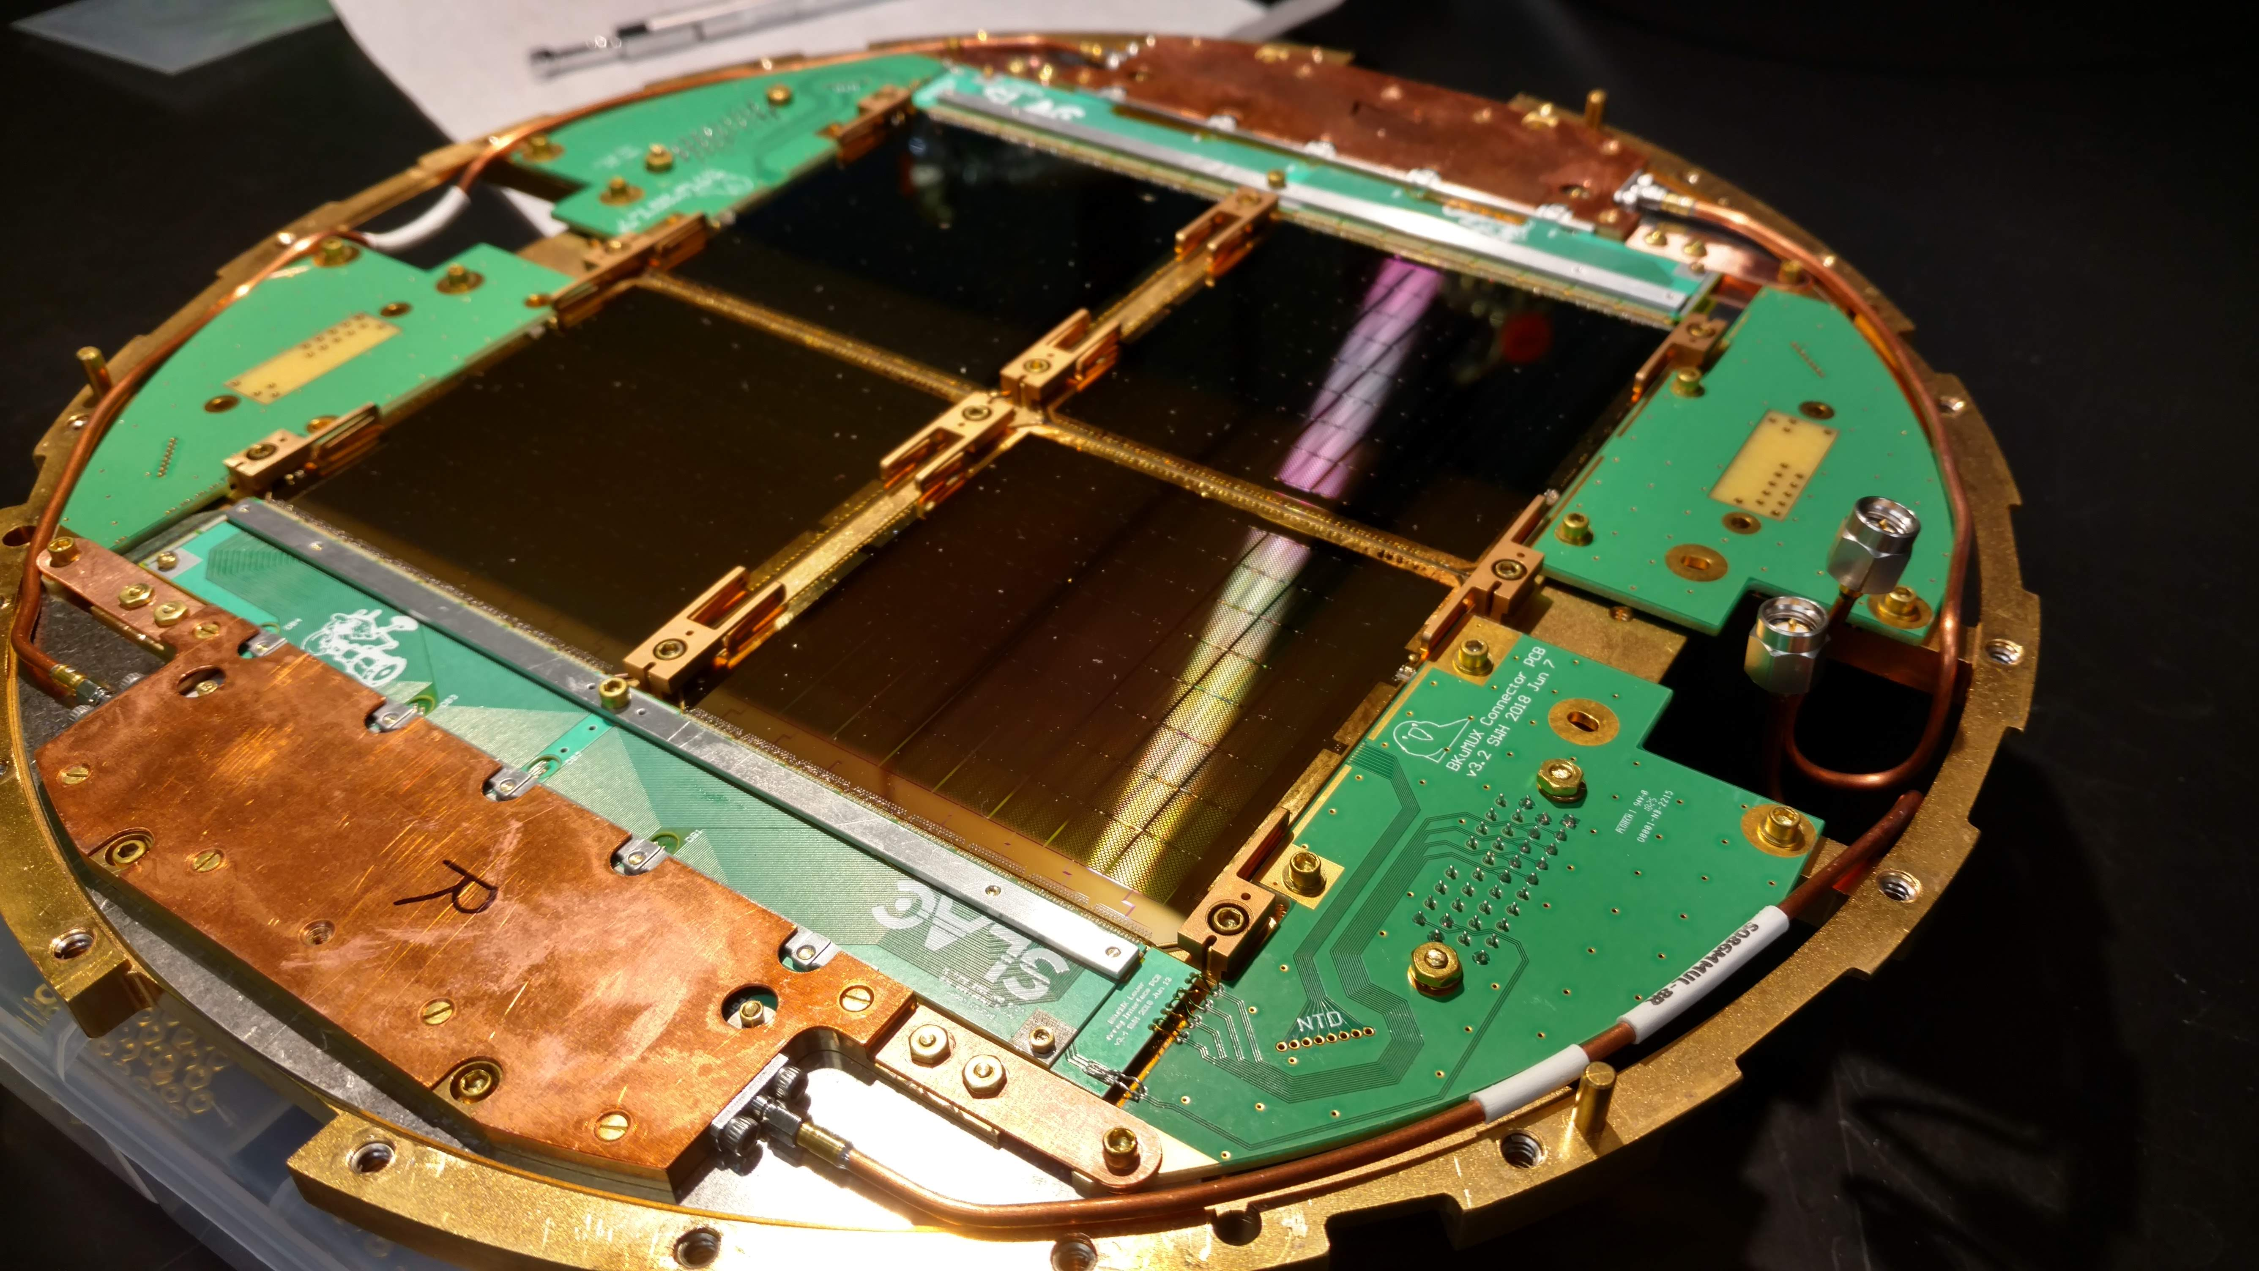
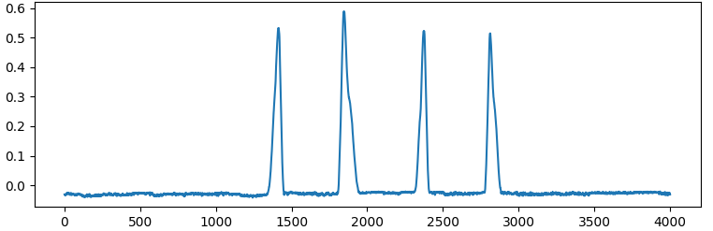
BICEP/Keck uMUX Demonstration
  Retrofitting a science grade BICEP/Keck 150ghz camera with the NIST 528 uMUX multiplexer.
    These exact arrays were previously deployed at Pole!
  512 optically coupled TESs.
Kernasovskiy et al, Proc. SPIE 8452 (2012)
Waiving eccosorb in front of cryostat window
1x Al TES biased on transition
Phase (rad)
Sample number

Slide 26
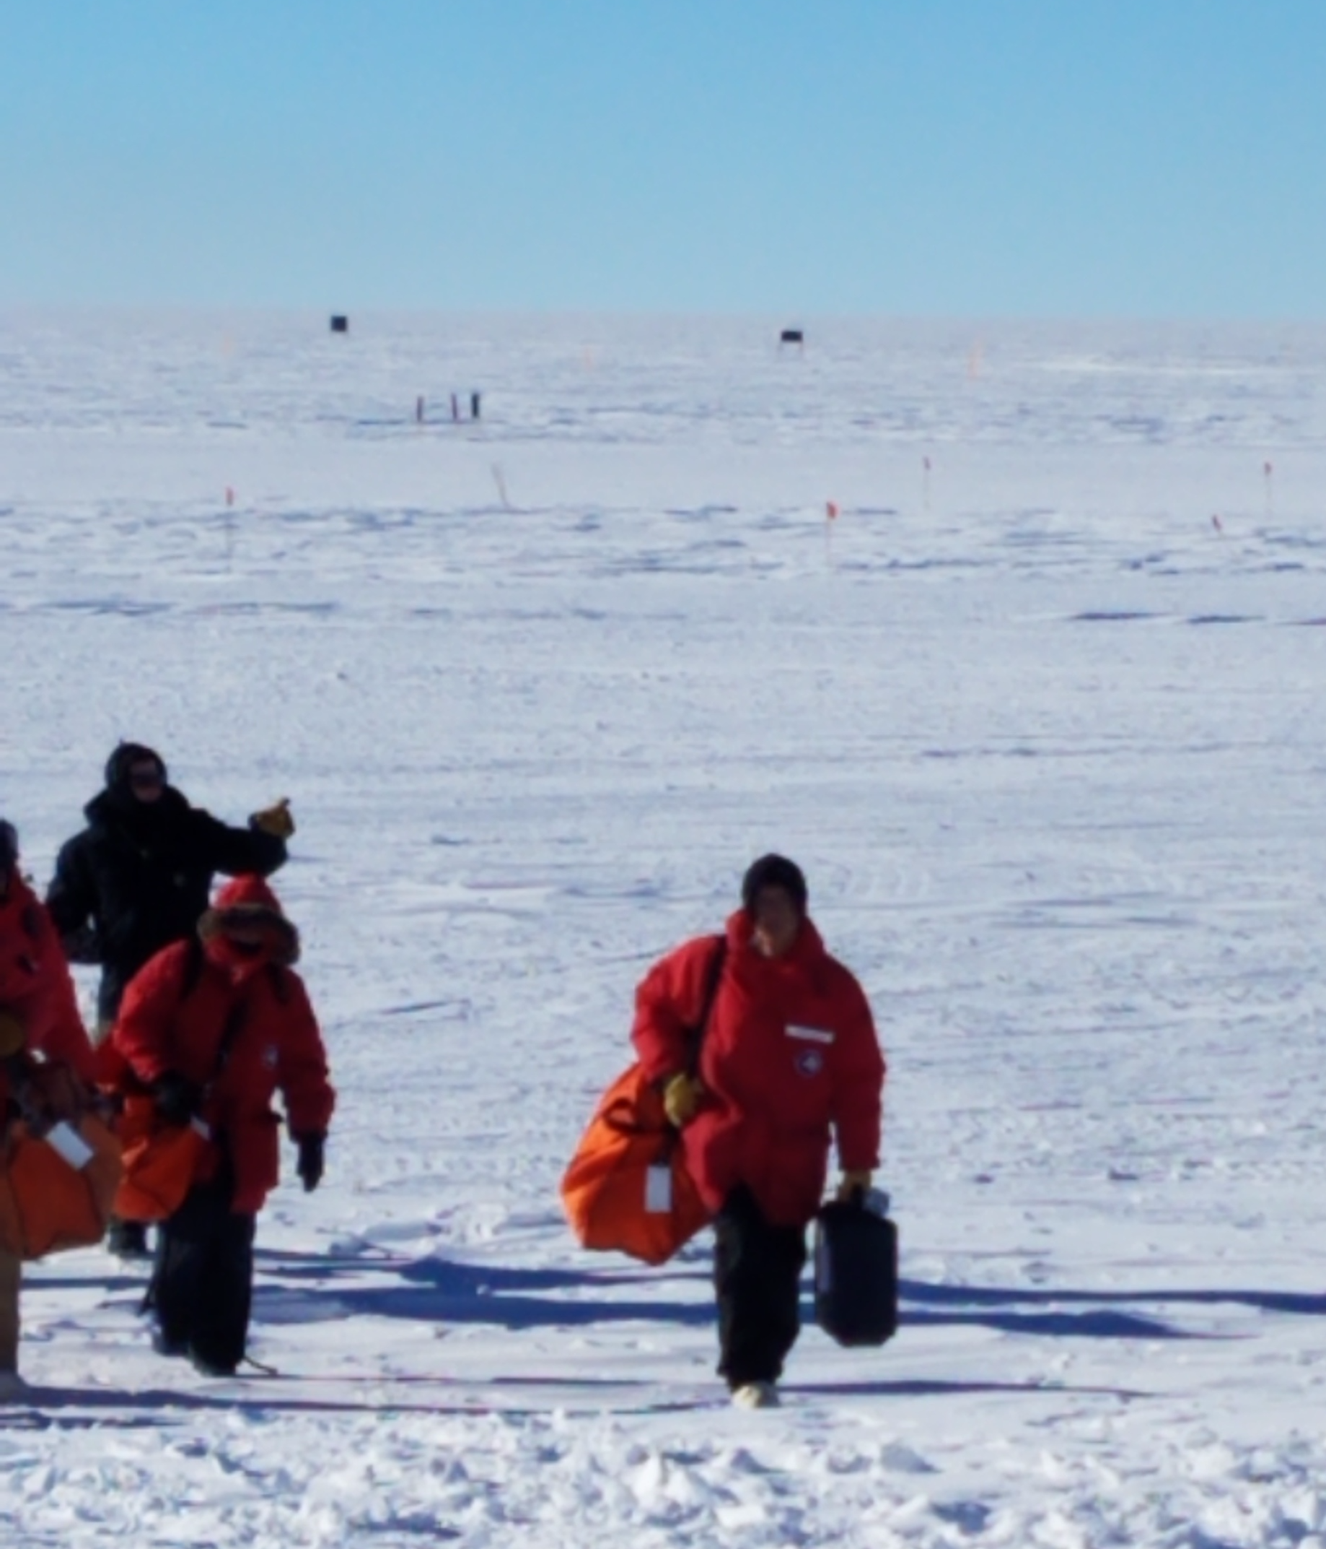
BICEP/Keck uMUX Demonstration
  Retrofitting a science grade BICEP/Keck 150ghz camera with the NIST 528 uMUX multiplexer.
    These exact arrays were previously deployed at Pole!
  512 optically coupled TESs.
  Largest MUX factor TES demonstration for uMUX to date – on sky!
  Ideal platform to study SMuRF performance and systematics.
At Pole now for engineering run on sky in the Keck Array mount!
Kernasovskiy et al, Proc. SPIE 8452 (2012)
Edward Young, Postdoc
Camera
Not shown: Cyndia Yu, Joe Frisch, Ari Cukierman, Denis Barkats, Marion Dierickx, Tyler St. Germaine, Dan Van Winkle, Mitch D’Ewart, +More!

Slide 27
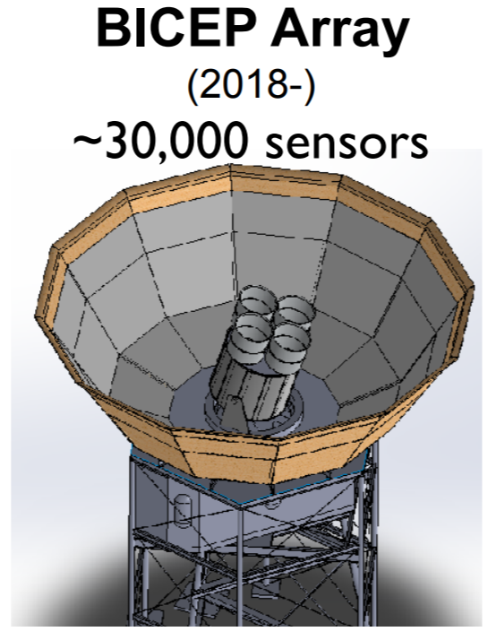
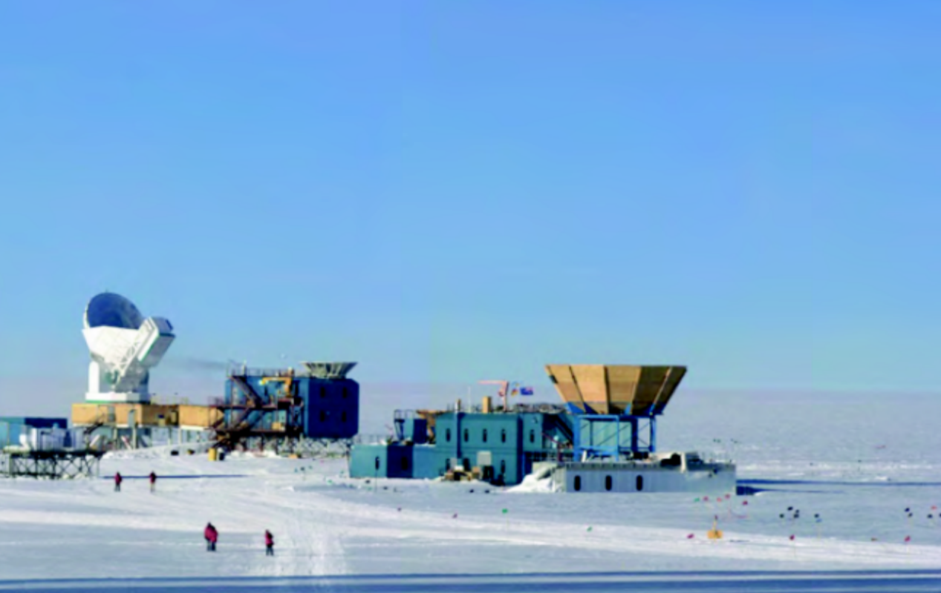
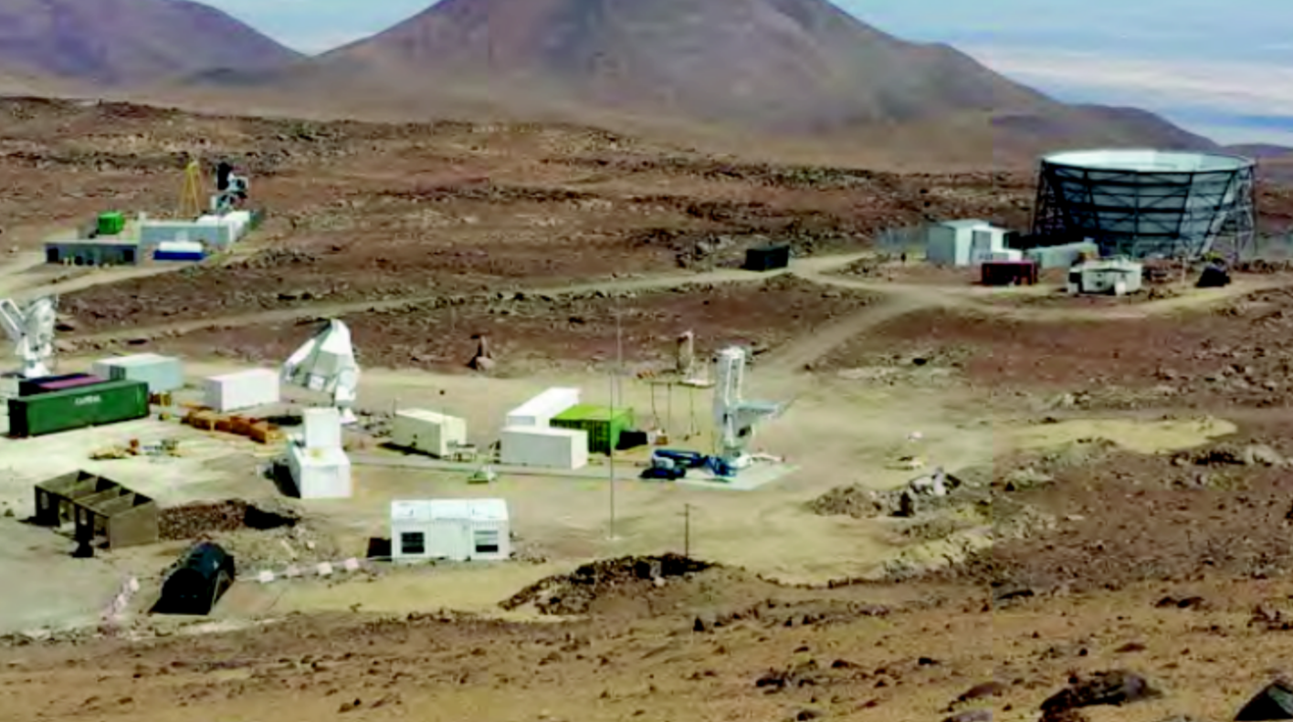
Conclusion
  Compact, well engineered solution for reading out modern CMB detectors
  On track to multiplex 2000 channels/4GHz (cold & warm)
    1000 MUX factor NIST/SMuRF demonstration in progress!
  Applications for SMuRF
    CMB
      BICEP Array
      Simons Observatory
      Ali-CPT
    X-Ray
      LCLS-II
    You?
      Not just for uMUX – also MKIDS, Metallic Magnetic Calorimeters, …
Notes:
150mm wafers – 2000channels/wafer
Top line – on track to multiplex 150mm wafer

Slide 28
Backup Slides

Slide 29
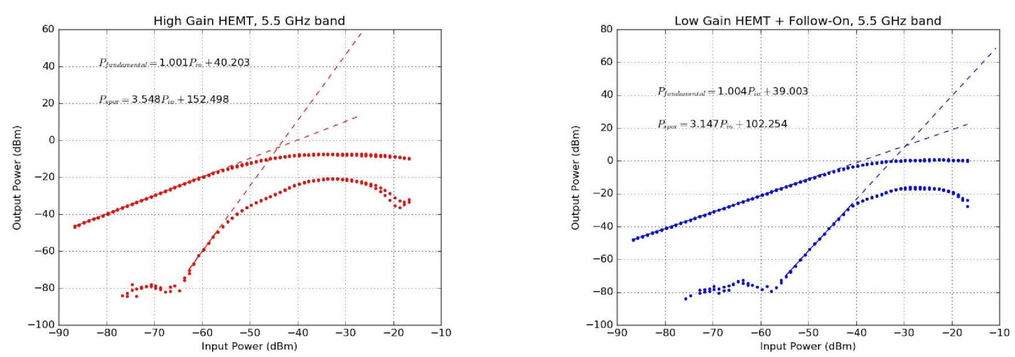
Improved HEMT Linearity
  HEMT has low noise (-194dBm/Hz) but poor linearity -44.1dBm input IP3
  Low gain HEMT: HEMT IP3 is limited by the output stage, so by removing one stage (out of 3 total) and get 13dB less gain, 13dB higher input IP3 and the same noise -29.5dBm input IP3
  Line tracking reduces signal by ~15dB due to resonator dips
  For 2000, -70dBm input lines, reduces to -85dBm by line tracking
    Original HEMT: 83dBc/Hz (want total system > 85dBc/Hz on receiver)
    Low gain HEMT: 113dBc/Hz – no longer limiting!
High Gain, IIP3 = -44.1dBm
Low Gain, IIP3 = -29.5dBm

Slide 30
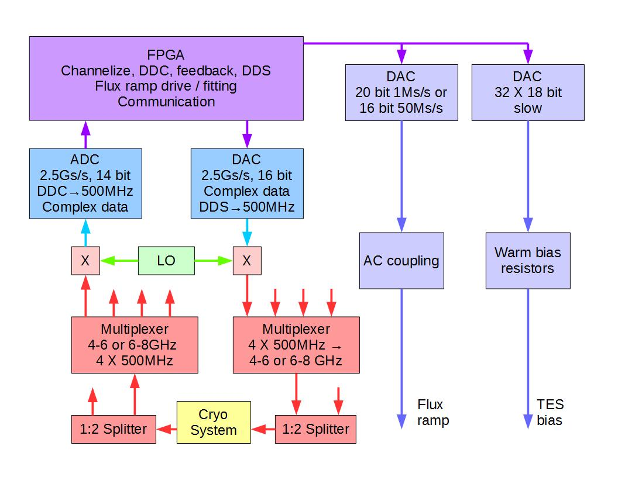
SMuRF Block Diagram
Notes:
Too complicated

Slide 31
Nonlinear Effects in RF Components
  Linearity can become limiting factor for large number of tones (microwave resonators)
A
x
y
y
  Ideal A
  Real A - Nonlinear
x
Notes:
Dynamic range
Amplifier starts acting like a mixer

Slide 32
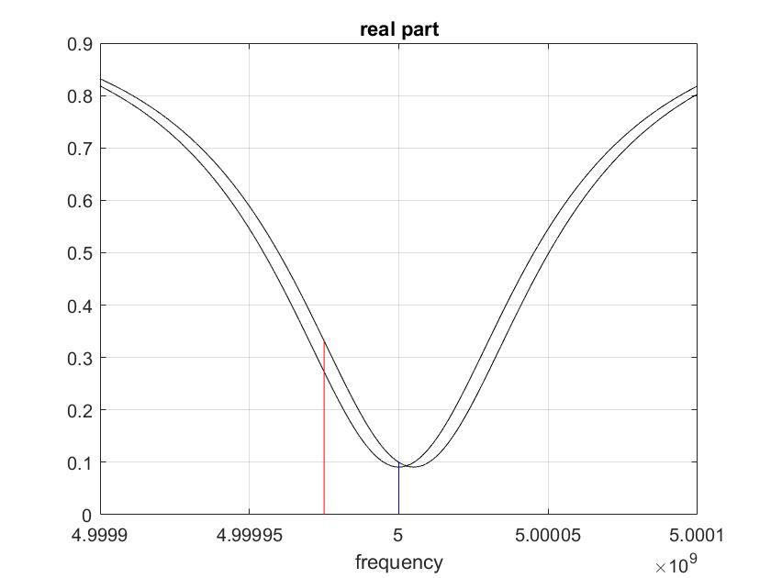
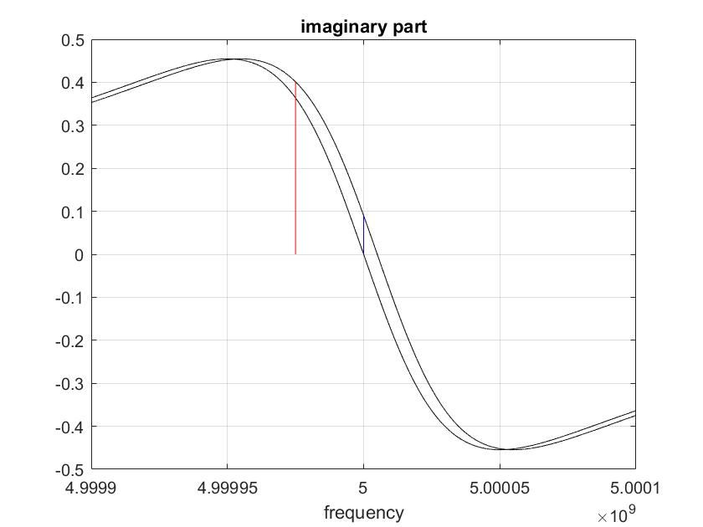
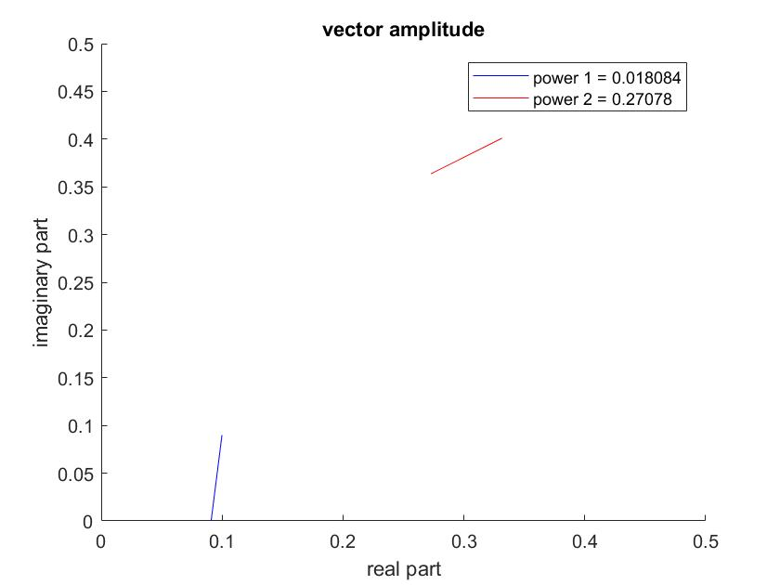
Tone Tracking
RF away from resonance
With line tracking, RF is always operating at the resonance dip
Line tracking reduces RF power, but does not decrease vector signal response to frequency change
This reduces the required dynamic range of the electronics.
No effect on HEMT noise requirement
RF at resonance
RF amplitude not tracking
RF amplitude tracking

Slide 33
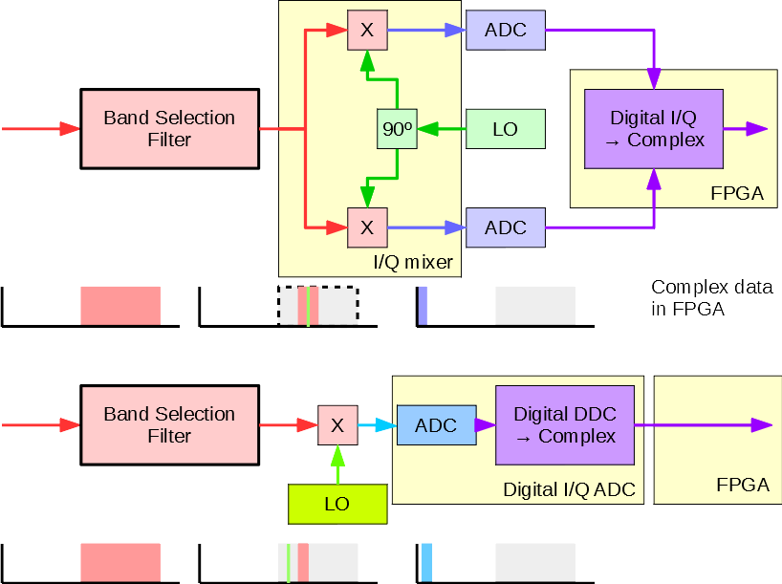
Analog IQ vs Digital IQ
  Analog IQ used in many systems
    Requires continuous calibration of IQ mixer to reject out of band signals
  Digital IQ used by SMuRF
    Eliminate calibration complexity

Slide 34
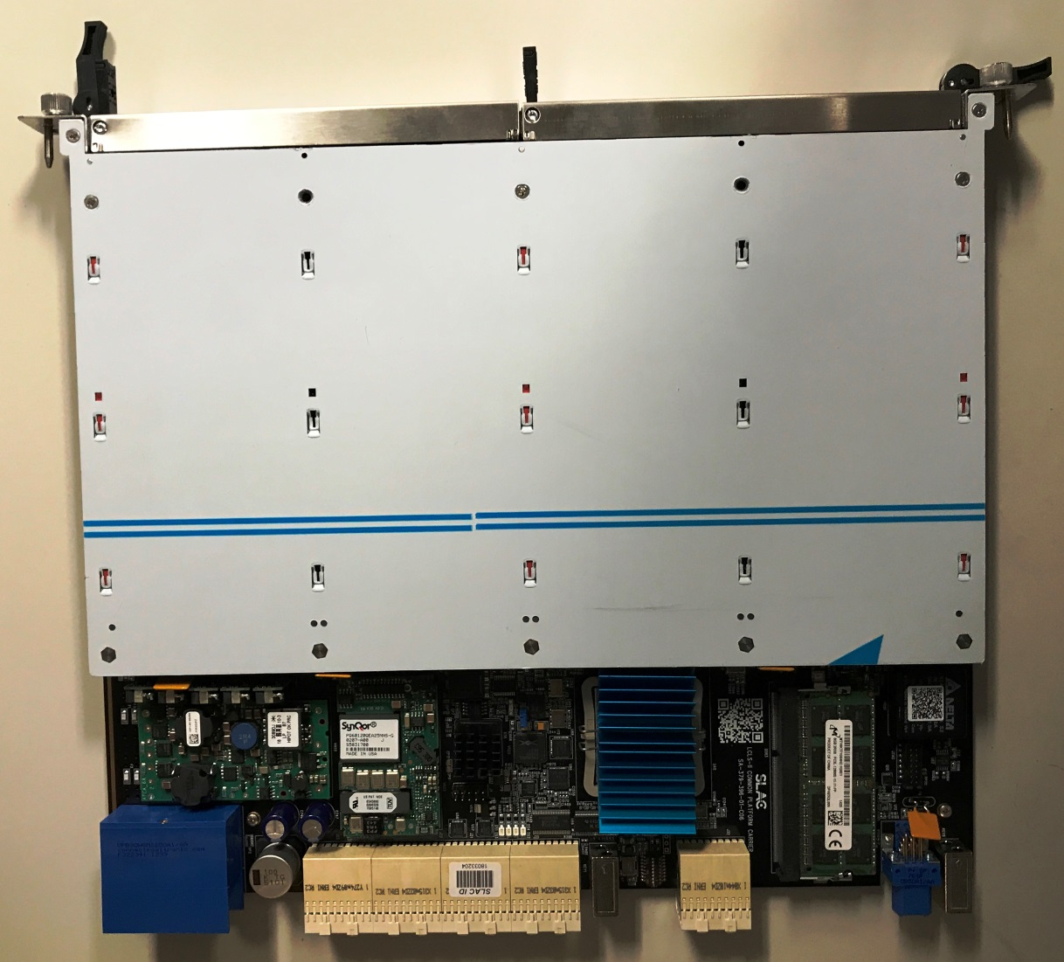
SLAC Common Carrier
  FPGA
    Existing: Xilinx Kintex Ultrascale KU060
    Upgrade Kintex Ultrasclae+ KU15P
  8GB DRAM
  10G backplane Ethernet
  Power supplies
  16x bidirection JESD204B links at 12.5Gbit
  ATCA compliant card
Backplane connector
FPGA
DRAM

Slide 35
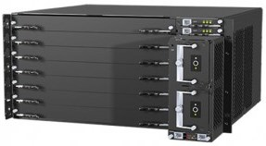
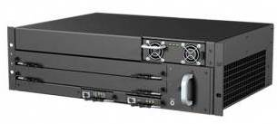
ATCA Crate
ATCA crates are available in a variety of configurations.
Example: 7 slot, 5U crates.
  1 slot for network switch, 6X SMuRF systems
Crates rated at 450W / slot. Should be OK at 5200M altitude with <250W/Slot SMuRF load
  Need to test
Crate power is -48V DC to avoid hazardous voltage in cable trays
Crate includes all system management (IPMI) functions, designed for high reliability telecom use
Output of crate is 10G / 40G ethernet.

Slide 36
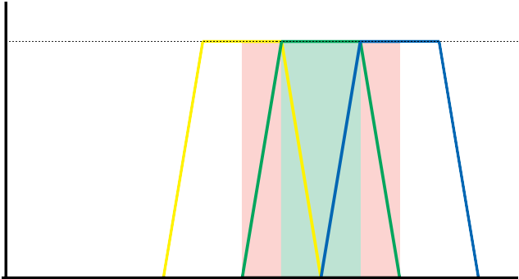



RF Band-Splitting and Digitizer Bandwidth
Signals after filters to digitizers
0dB
SMuRF filter plots
-60dB
You want this band
Digitizer needs to correctly measure (not alias) signals leaking through filters from these bands
With sufficiently fast digitizers to process a single 4GHz block, a band select filter isn’t needed.
For SMuRF:
Bandwidth = 500MHz / ADC
ADC rate =2.5Gs/s, to provide 1.25GHz antialias bandwidth
2.5X what you would naively expect with “perfect” (non-physical) filters.

Slide 37
TES Bias and Flux Ramp Generation
  TES bias noise looks like signal, so noise requirements are extremely stringent
  TES use low noise DACs on RTM card with bias resistors located on “cryostat” card close to the cryostat feedthrough
  TES need ability to send high current to “delatch” the TES sensors if they go hard superconducting
  Flux ramp needs to generate saw tooth with low noise, synchronized to timing system
    Noise on flux ramp sawtooth also looks like signal in demodulated flux ramp response

Slide 38
Processing Firmware Overview
  Drive flux ramp
  Process ADC data into individual channels
    Requires efficient algorithm to process data into frequency blocks (interleaved polyphase analysis filter bank)
  Calculate line resonance frequencies
  Measure line frequency vs flux ramp phase
  Adaptive feedback to track SQUID response
    Detector response slow compared to flux ramp rate
  Synthesize tones at the tracked frequency
    Requires efficient algorithm to combine tracked frequencies (interleaved polyphase synthesis filter bank)
  Decode into per-pixel flux ramp data

Slide 39



Tone Tracking Algorithm Comparison

Slide 40

Tone Tracking Algorithm Comparison

Slide 41



Tone Tracking – Low Frequency Phase Noise Rejection
  Low frequency phase shifts go into DC offset term
    Temperature
    Microphonics
Same, but with offline Hilbert demod
Notes:
More breakout of algorithm – flux decodes separately
Think about this slide

Slide 42


Tone Tracking Power Reduction
  Dynamically track resonance dips to reduce power in HEMT an additional 10-15 dB without degrading signal to noise
  Reduces dynamic range requirements for the electronics
Kernasovskiy et al (2018)
https://arxiv.org/abs/1805.08363
Notes:
Plug the paper

