Slide 1
OSG-aligned (DOE HEP funded) work at FNAL & BNL during Y7
Burt Holzman

Slide 2
OSG at Fermilab
My guidance from above has been: we work on things that are aligned with our (DOE HEP) program.

Slide 3
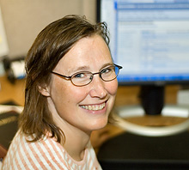
Quote from Margaret Votava
“But everything we do [with OSG] is already aligned with our program - is there effort we are worrying about?"

Slide 4
OSG-aligned effort at Fermilab
Monitoring
  Expert troubleshooting/consulting
    Various bumps as services were migrated from IU
  Development as needed (e.g. RabbitMQ -> Kafka transition?)
  Archiving of monitoring data

Slide 5
OSG-aligned effort at Fermilab
Software
  glideinWMS
    Mostly development, but cross-over operations with OSG and CMS glideinWMS operators
  Singularity
    Ensure we are in sync upstream (and they break stuff – recently refactored everything to Go). Particularly important now that they’ve gone corporate
  CVMFS
    Occasional pull requests – and new tools the community is interested in (like creating images from CVMFS as a 1st class citizen)
    Expert consulting advice on software and Stratum 1s

Slide 6
OSG-aligned effort at Fermilab
Security
  ”Skin in the game”
  Providing operational security, revising documentation
    Want to focus on proactive security (threat intelligence), strengthening contacts with WLCG
    Want to participate in security R&D like SciTokens

Slide 7
OSG-aligned effort at Fermilab
Containers Containers Containers
  Container-building service
    Dockerhub/Dockercloud equivalency
  Jupyter(lab) notebooks as a service
    i.e. LSST online analysis platform

Slide 8
OSG-aligned effort at Fermilab
Common services for data placement/management
  Rucio?

Slide 9
OSG-aligned effort at Fermilab
User Support
  Already covered in Ken and Rob G’s talk

Slide 10
OSG-aligned effort at Fermilab
HEPCloud

Slide 11
What is HEPCloud
HEPCloud is a science gateway providing access as a virtual facility to a diverse set of resources: cloud, on-premises, HPC

Slide 12
HEPCloud Architecture
Workflow
(resource provisioning trigger)
Facility Interface
Authentication and Authorization
Monitoring takes input from all components
Monitoring
Decision Engine
Facility Pool
Provisioner
Cloud Resources
Cloud Resources
Cloud Resources
Local
Resources
HPC
Resources
Grid Resources

Slide 13
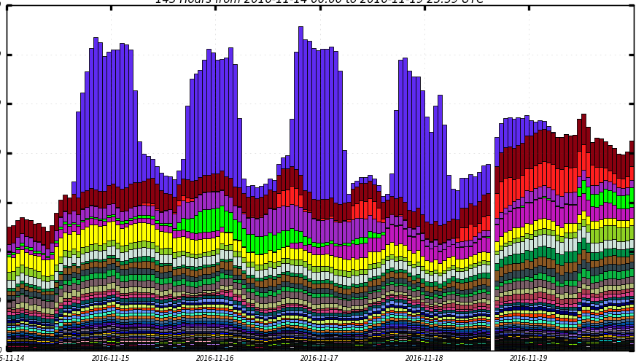
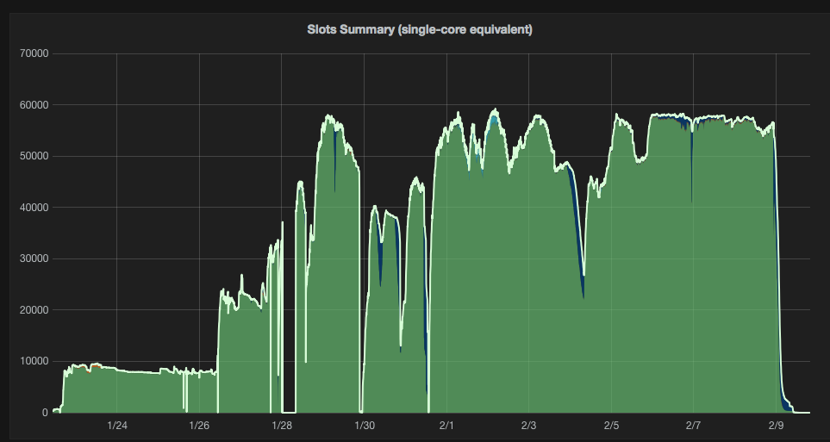
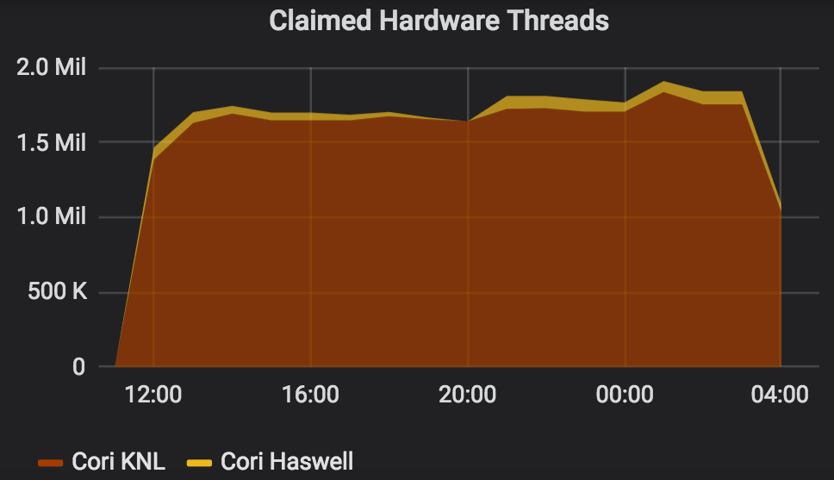
HEPCloud at Scale
160k cores @ GCE
60k cores @ AWS
~2M threads @ NERSC

Slide 14
HEPCloud @ BNL
BNL is collaborating on components of the Decision Engine
BNL plans package, test, deploy HEPCloud at BNL
  Provide access to diverse set of on-premises resources to BNL

Slide 15
HEPCloud @ FNAL – OSG related work
Providing access to commercial cloud and NERSC
  Onboarding experiments in 2019
  Developing, testing decision engine algorithms
Hosted CEs at NSF HPC sites
  Can contribute to support
DOE HPC sites (ALCF, ORNL)
  Will integrate and test HTCondor-based solutions
Containers

