Slide 1
Study of the field-dependency of surface resistance for SRF cavities
Thomas Smart
University of St Andrews
Mentor: Dr Mattia Checchin

Slide 2
Project Overview
Weeks 1 - 2 | Initial reading
Weeks 2 - 5 | AES022 first test – 120°C bake
Weeks 6 - 8 | Romanenko Hydride model
Weeks 9 - 10 | AES022 second test – modified 120°C bake Final Report and Presentation

Slide 3
The problem to be addressed…
Future accelerators (i.e ILC and FCC) rely on an efficient acceleration of particles to minimize size and cost.
Key factor in this is a high Q₀ and high E_{acc}
Wish to test different surface treatments on the same cavity to see if improvements are possible -> RF characterization & T-map

Slide 4
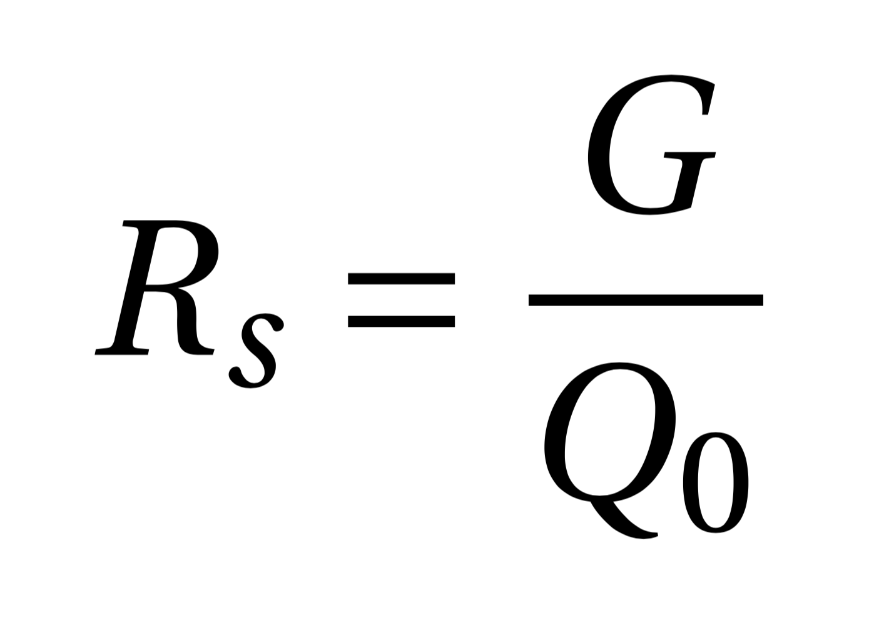
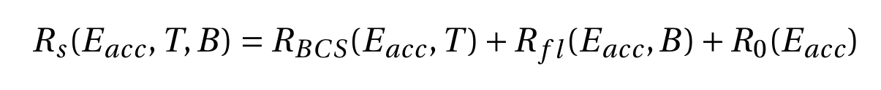
Surface Resistance
G = 270Ω
‘Geometry factor’

Slide 5
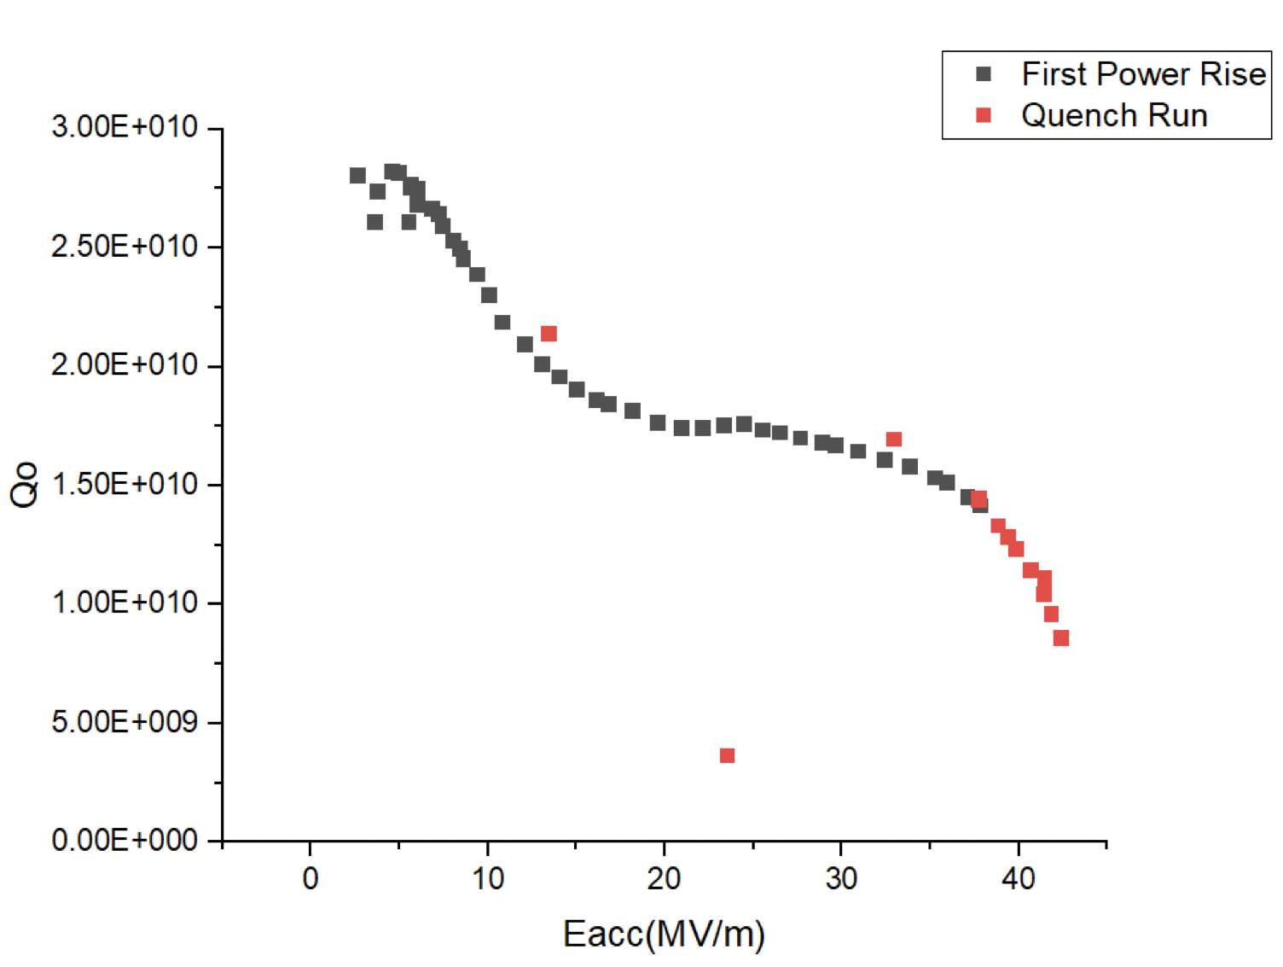
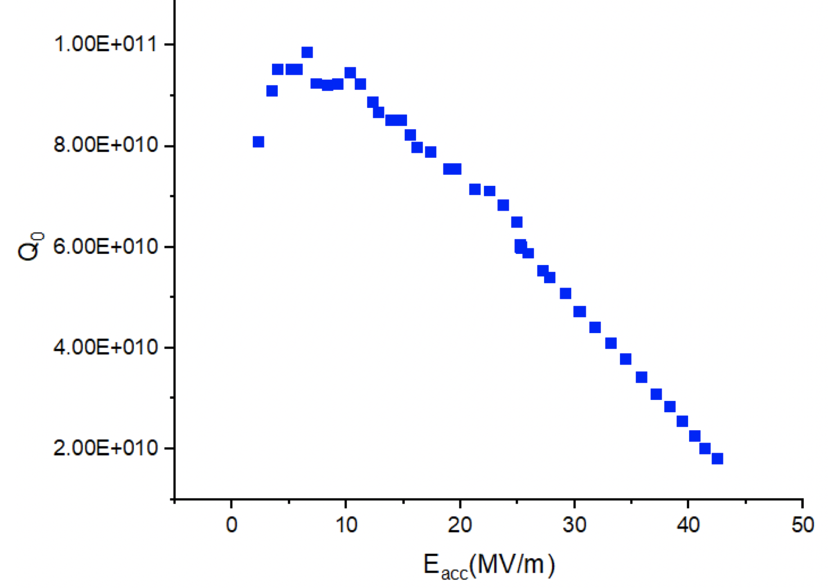
AES022 – First Test (standard 120°C bake)
120°C bake:
150μm EP
800C HV for 3h
HPR and VTS assembly
120C for 48h in situ HV
AES022 – 1.3GHz, single cell
Heavily understood within SRF
2K
1.5K

Slide 6
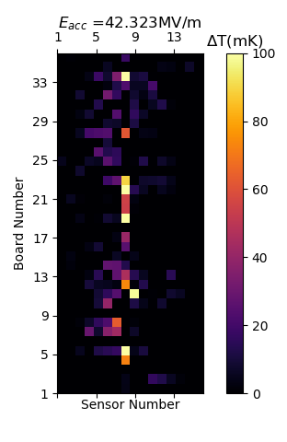
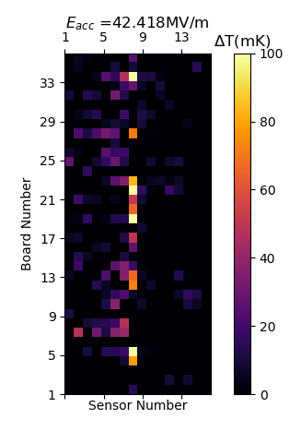
Temperature mapping in AES022
Strong heating along column 8 (equator), some effect of weld?
Characterise via hydride heating model?
2K
1.5K

Slide 7
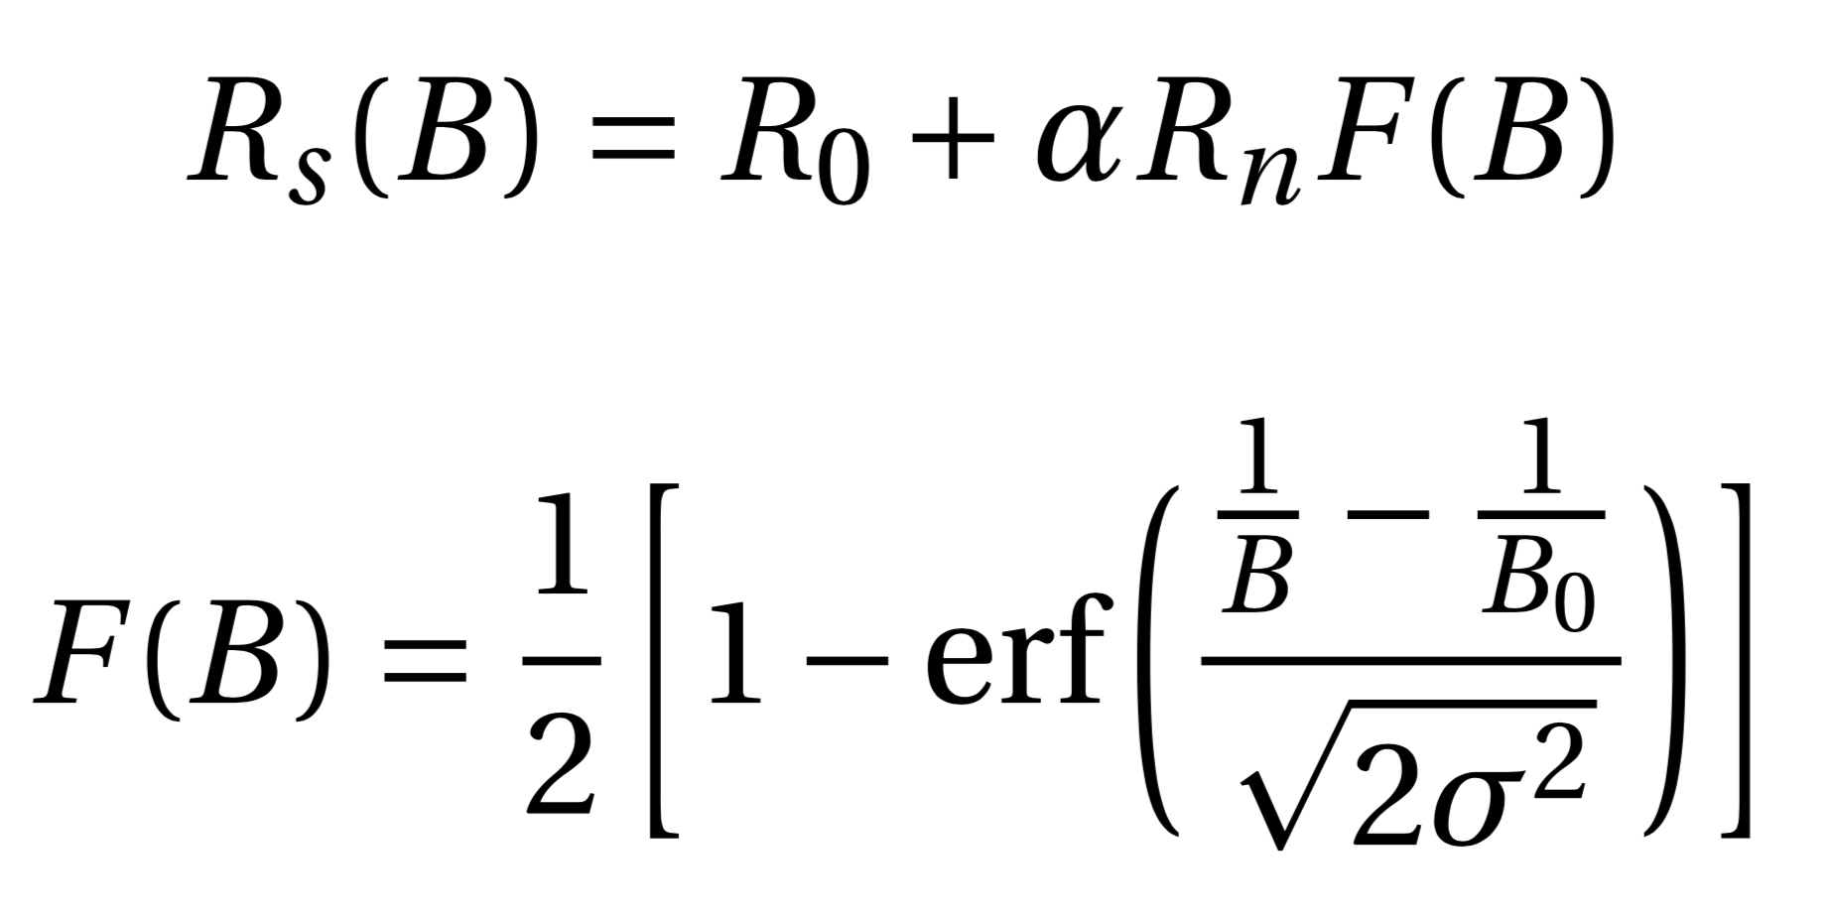
Modelling the heating on T-Map
Now try and model the local heating of AES022 using Romanenko EP model.
Use 4D parameter search (B₀, ⍺R_{n}, R₀, σ) using custom Python script.
Model should not work globally for AES022 but this model has not been readily tested locally.
Model assumes heating due to the formation of nano-hydrides within the Nb bulk.
Model for heating for HFQS proposed by A. Romanenko et al (2013)
SC
SC
NH
Proximity Effect
A.Romanenko and F.Barkov, “Proximity breakdown of hydrides in superconducting niobium cavities,” Superconductor Science and Technology 26 (2013) .

Slide 8
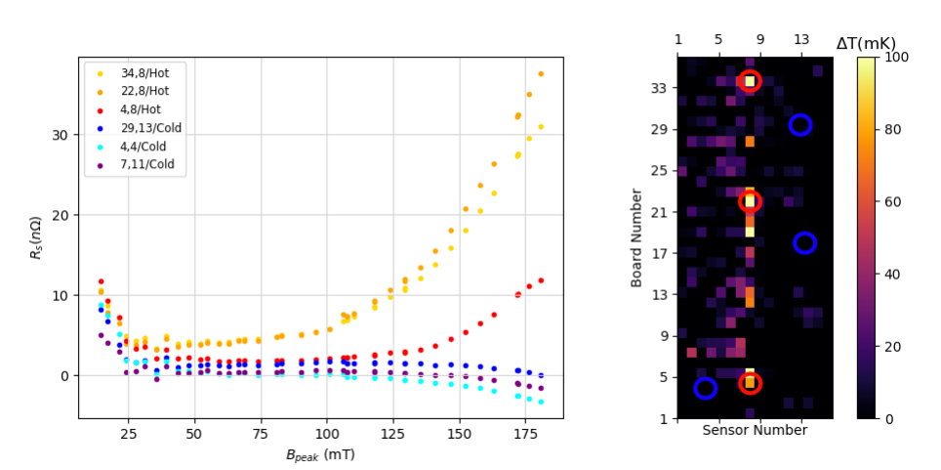
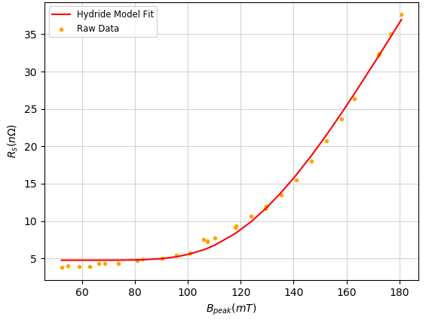
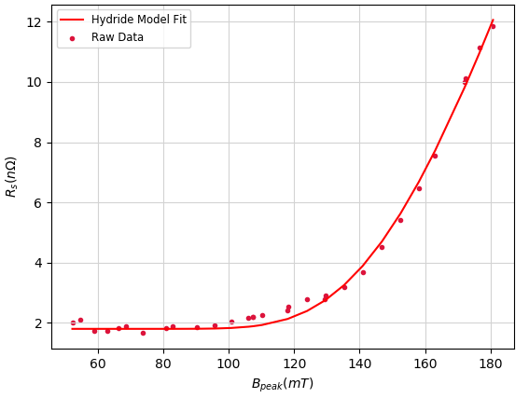
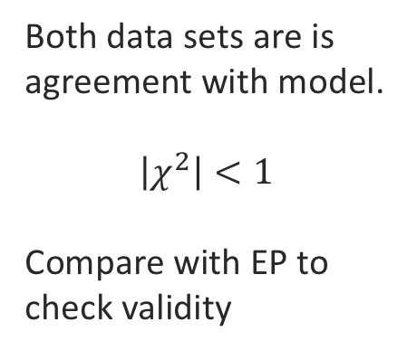
120°C bake
Both data sets are is agreement with model.
$$\left|χ^{2}\right|<1$$
Compare with EP to check validity

Slide 9
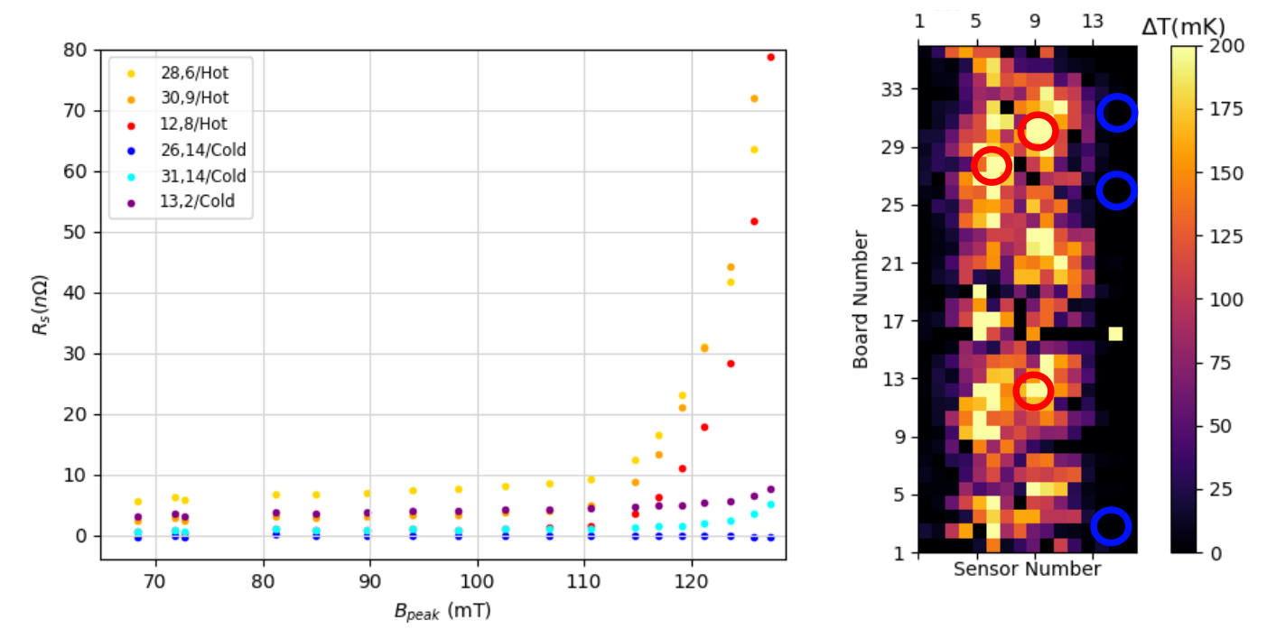
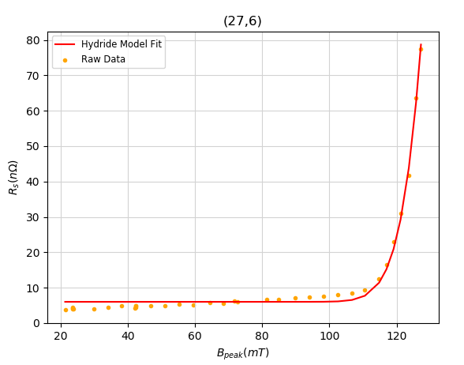
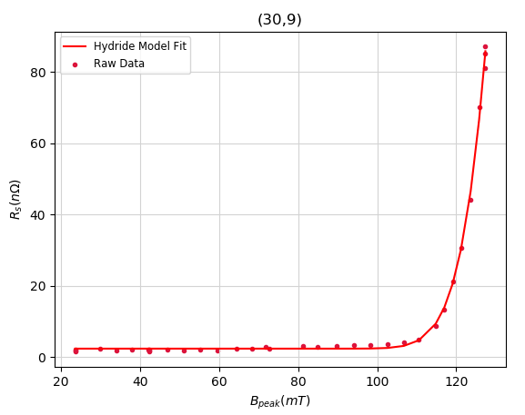
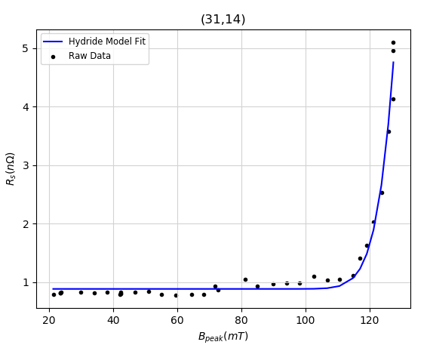
EP
Global presence of hydrides indicated from fits
Local modelling of R₀ valid

Slide 10
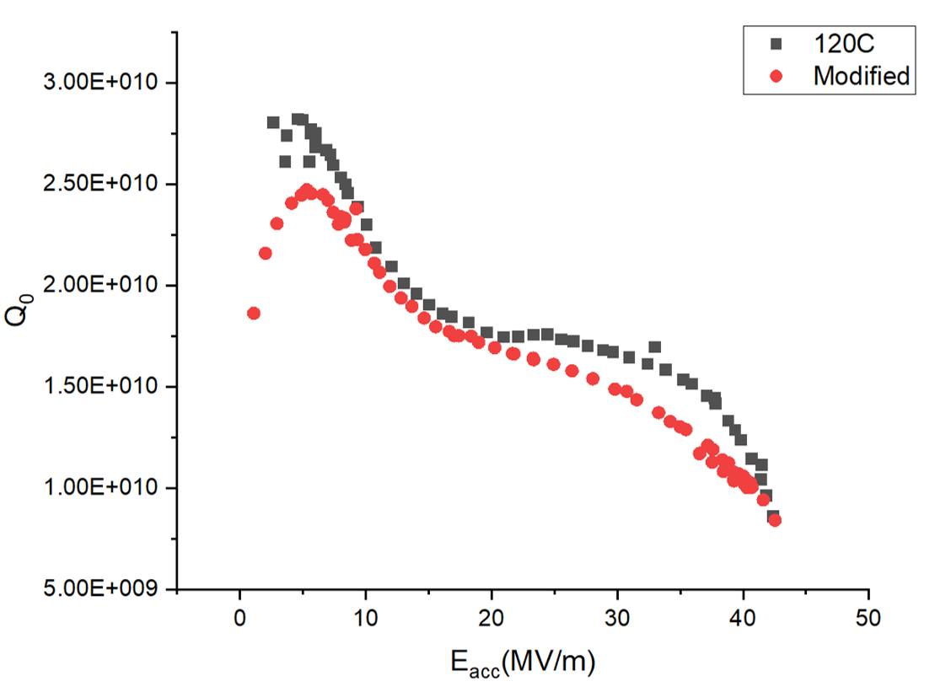
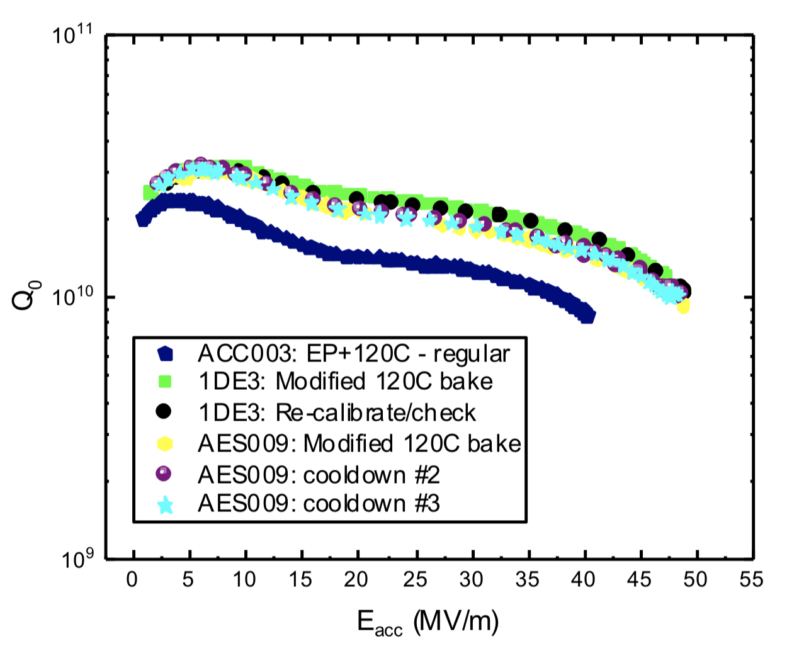
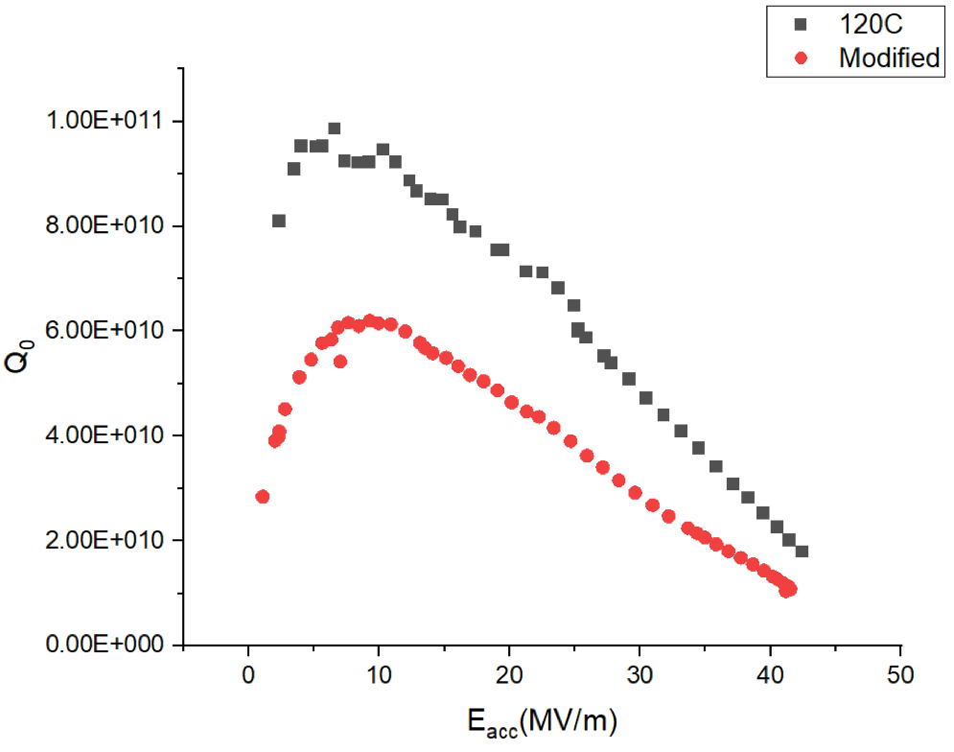
AES022 – Second Test (modified 120C bake)
2K
Modified 120°C Bake:
40μm EP
HPR and VTS assembly
75°C 4h bake HV
120°C 48h in situ HV
Only discovered a few months ago
1.5K
Previous data taken by A. Grassellino et al (2018)
A.Grassellino et al.,“Accelerating fields upto 49MV/m in TESLA-shape superconducting RF niobium cavities via 75C vacuum bake,” arXiv:1806.09824

Slide 11
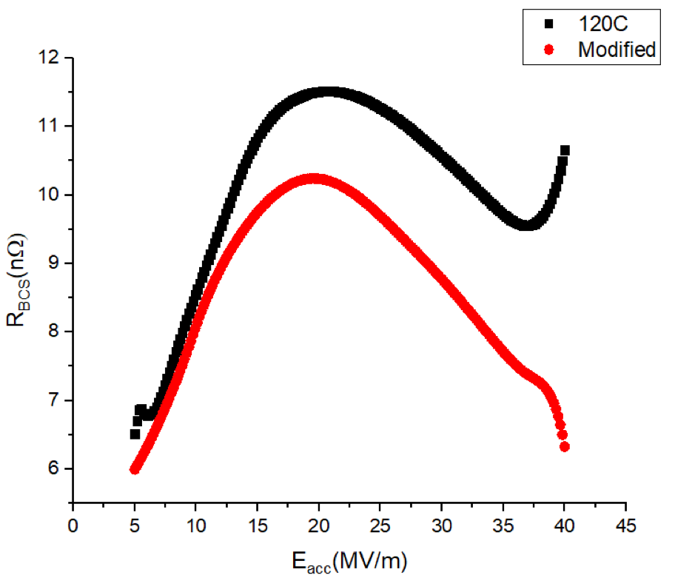
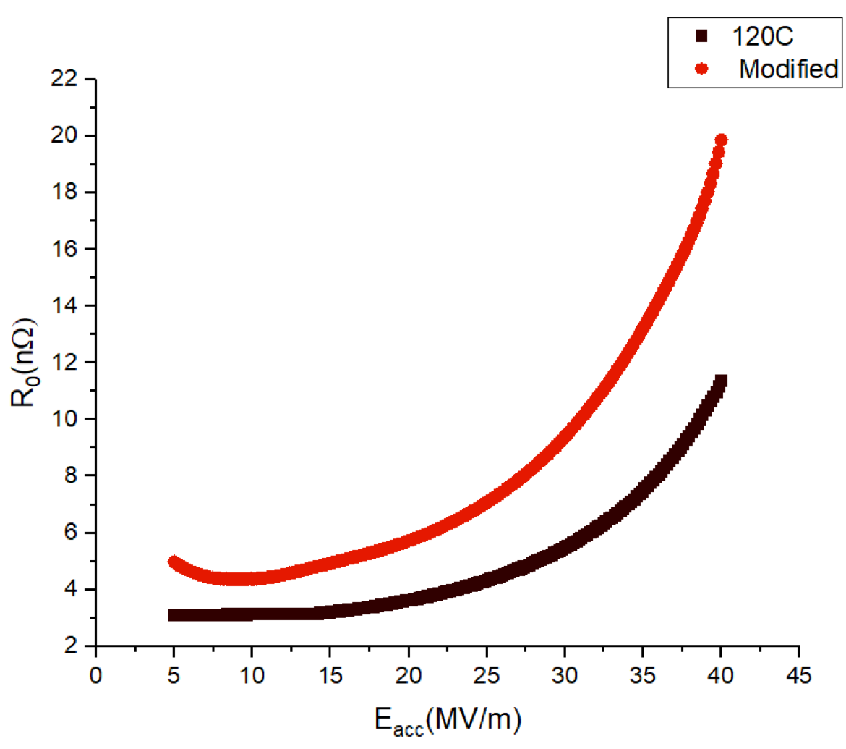
AES022 – Second Test (modified 120C bake) continued…
The quench field for collected data is ~42MV/m compared to fields ~50MV/m achieved in earlier data. R_{s} change also odd.
Material problem?
Hydride formation of different phases (⍺, ε, δ etc.) ?
Cooldown speed? Higher sensitivity to temperature ?

Slide 12
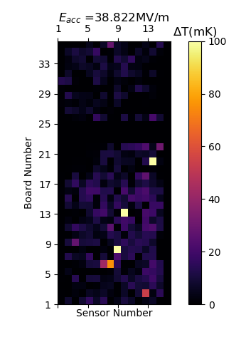
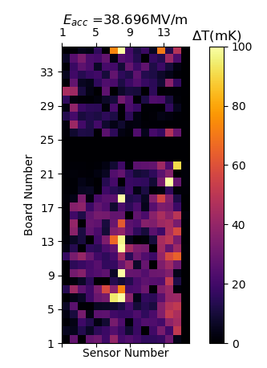
Temperature Mapping in AES022 – second test
Global heating observed
Hydrides still along weld?
2K
1.5K

Slide 13
Conclusion
Modified 120°C bake has the potential for v high accelerating fields (~50MV/m) -> Many more factors at work?
Presence of hydrides can be predicted locally using model proposed by A. Romanenko et al.
More investigations need to be performed on the modified 120°C bake before it can be adequately used in future colliders
Further investigations into hydride formation during electro-weld process need to be performed

Slide 14
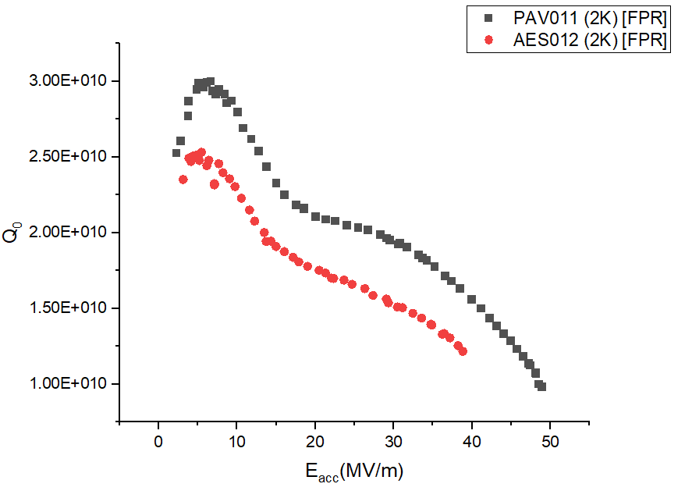
Quench ~ 41MV/m

