Slide 1
ICARUS Wire Connectivity Test
Mark Convery
September 19, 2018

Slide 2
Wire Connectivity Test Campaign
Goal of the test:
  Inject pulses on every wire of ICARUS and measure pulse on output cable
  Check for disconnected cables or other major problems
Many people contributed from Aug. 27- Sep. 7:
  Donatella, Angela: shift planning and overall coordination
  Shift-takers:
    V. Paolone, Y.T. Tsai, I. Caro, G. Petrillo, G. Diaz, T. Cai, H. Budd, A. Wickremasinghe, H. Rogers, C. Hilgenberg, T.Boone, B. Biswaranjan, B. Gomez, M. Kornfeld, Z. Williams,
  Offline Data Analysis: Yun-Tse and Gianluca P.
Results confusing and hard to interpret at first
  Fortunately, we saved the data to disk and offline analysis was much more clear
  With offline-analysis (pattern recognition), I believe we would identify disconnected cables or major problems with high efficiency or major problems with high efficiency (probably not 100%)

Slide 3
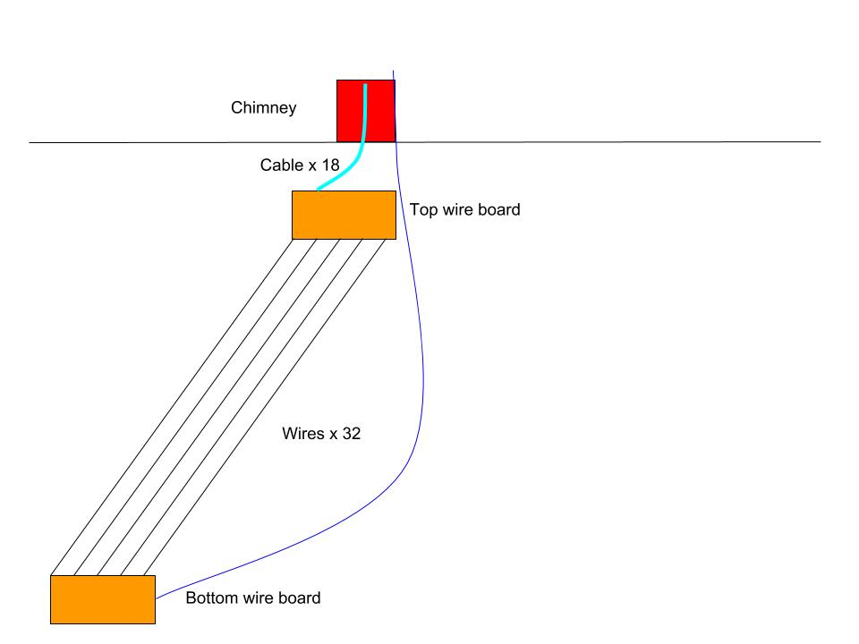
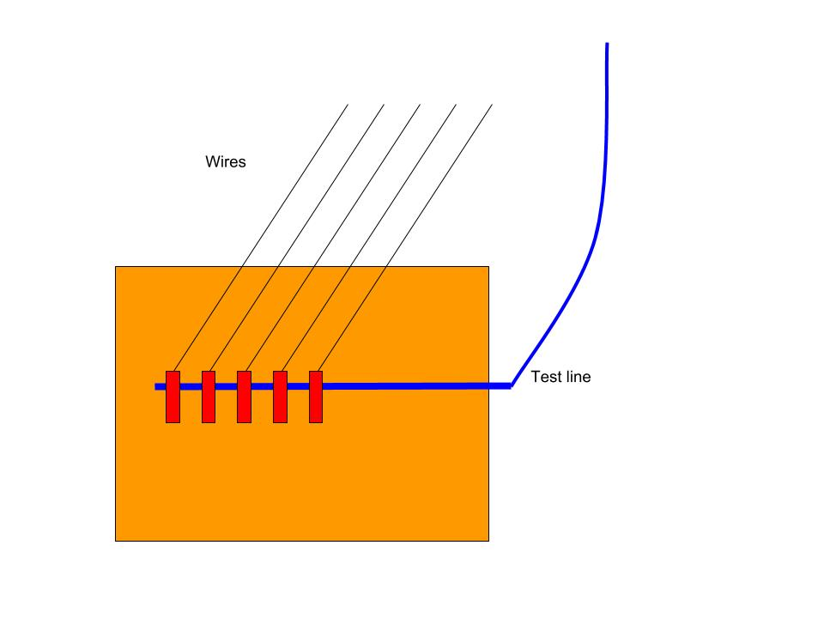
ICARUS TPC Wire Connections
ICARUS provides capacitively-coupled test pulse inputs on the bottom wire boards
Can be used to test wire connectivity and full electronics chain

Slide 4
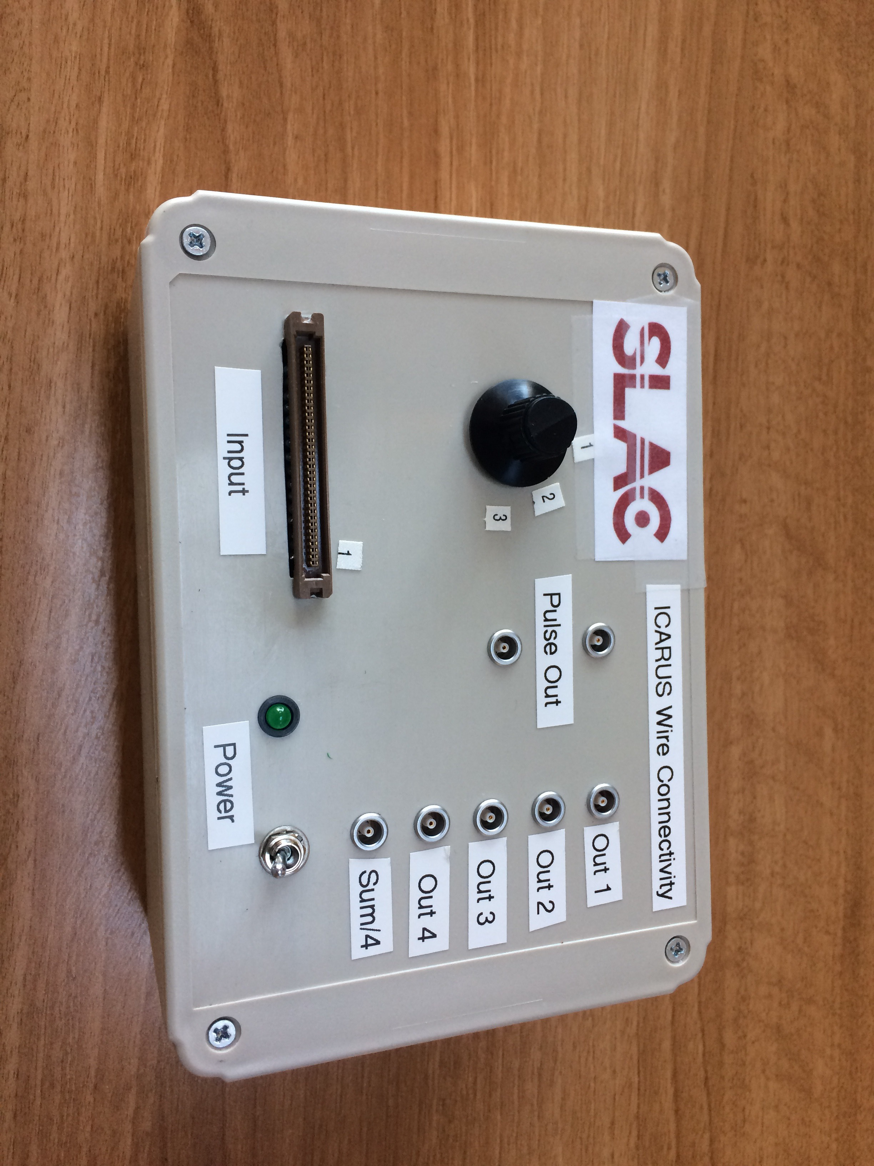
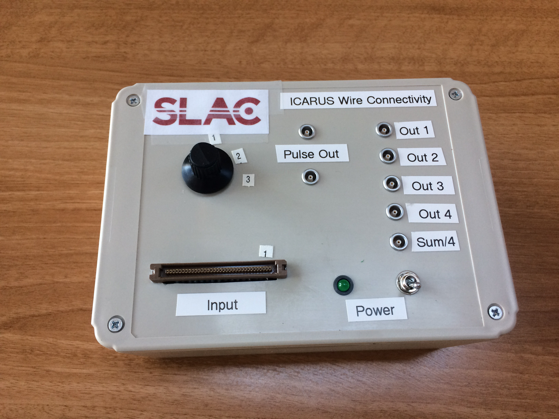
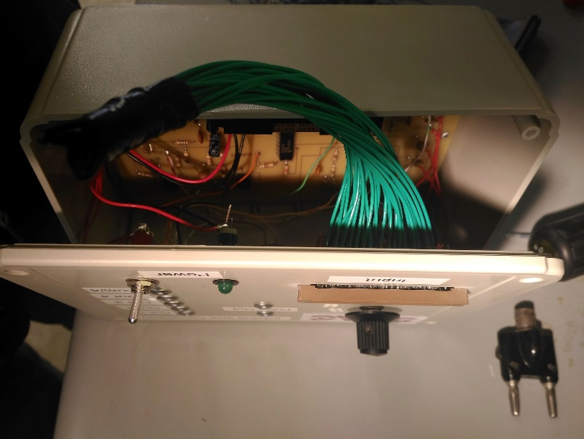
The Test Box
Battery powered
  No ground loops and portability
Built in pulser outputs on lemo
  Both polarities
  100 Hz, 5V, 1 μs rise time, 100 μs length
TPC cables plug into connector
  All grounds connected together?
  Be careful about signal/ground polarity
8-position rotary switch switches 4 channels at a time
4 Amplified signals and sum are available
Cable shields connected together, but not to ground of box
2 boxes built
  One with “extra” outputs to allow direct connection to wires and shields

Slide 5
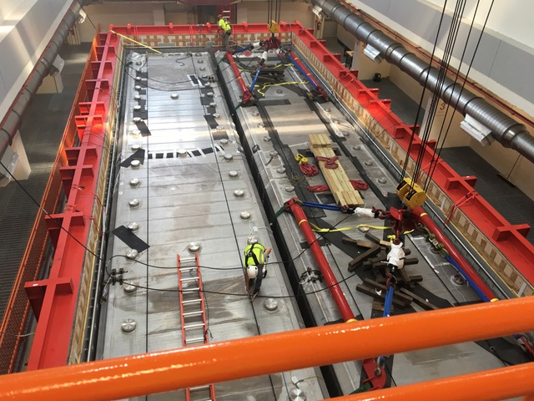
TPC Numerology
Two T300 modules: W and E
Two TPCs per module WW, WE, EW, EE
20 chimneys per TPC, e.g. WW5
  18 “normal” chimneys 2-19
    Contain cables for wires that terminate on top horizontal edge
  2 “corner” chimneys 1 and 2
    Contain cables for wires that terminate on vertical edge
      Horizontal
      “Triangle”
18 Cables per normal chimney (for WW and EW)
  1-9 Collection
  10-18 Induction-2
8 pulser cables/chimney
  Red group – input to daisy chain
  Blue group – output of daisy chain (not used here)
Pulser cable assignments (for WW and EW odd chimneys)
  Red/White: Cables 2-9 (daisy chained)
  Red/Green: Cable 1
  Red/Black: Cables 11-18 (daisy chained)
  Red/None: Cable 10
  So cables 1 and 10 are “special”

Slide 6
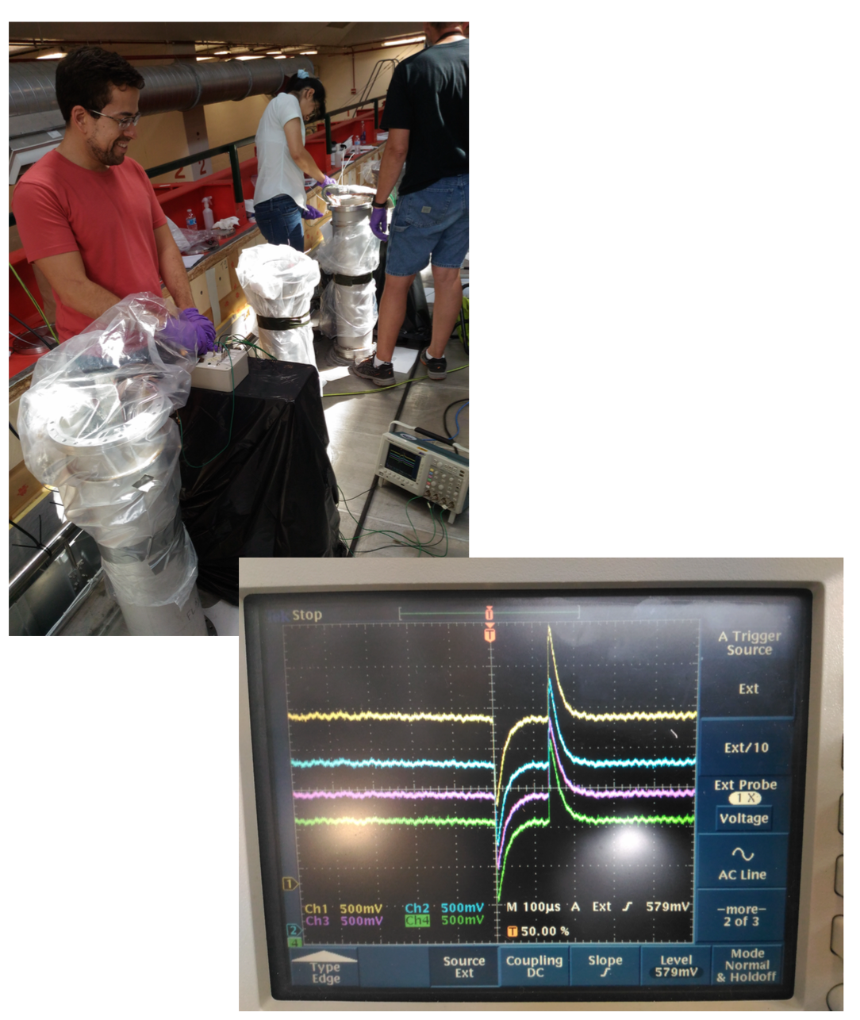
The Testing Procedure
For each cable, connect the appropriate pulser cable to the box output
Cycle through the 8 positions to measuring 4 channels at a time
Check data on scope and record to laptop.
Note anomalies on checklist
  Offline analysis to confirm
But, some problems in the beginning:
Not always clear which pulser cable is the right one to use
See pulses even when cable intentionally unplugged!!!
    Due to cable-to-cable cross-talk
    Similar size to “direct” signal
    Special cables show pulses from two different pulser cables
The combination of these two problems made interpretation of the data very confusing!

Slide 7
Pulse Signals Size with Cross-talk
    Large cross-talk due to cable shield wires not being grounded in the test box (my mistake)
    Does not suggest a problem with TPC signals once all shields are grounded!!
    Severely complicates signal interpretation!!
 | Shields Grounded | Shields Isolated
Cable Connected | ½ Size Signal | Full size signal
Cable Disconnected | No signal | ½ Size Signal
    If full size signal is observed, no ambiguity
    If ½ size problem could due to either grounded shield or disconnected cable
    By intentionally grounding shields, could have removed ambiguity – all data taken with ungrounded shields
    About 10% of shields are unintentionally grounded inside cryostat – known problem

Slide 8
Normal Chimneys Pulse Height Map
Analyze saved waveforms to find pulse-height
Plot as map to identify interesting features
Yun-Tse and Gianluca P. collected and analyzed 10368 files
Cable #
Chimney #

Slide 9
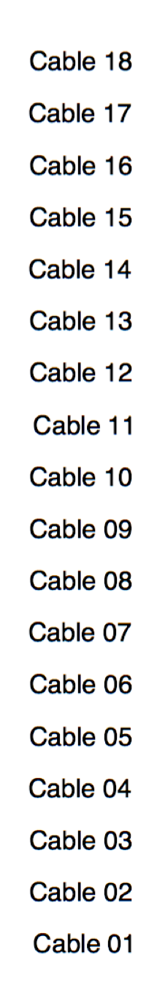
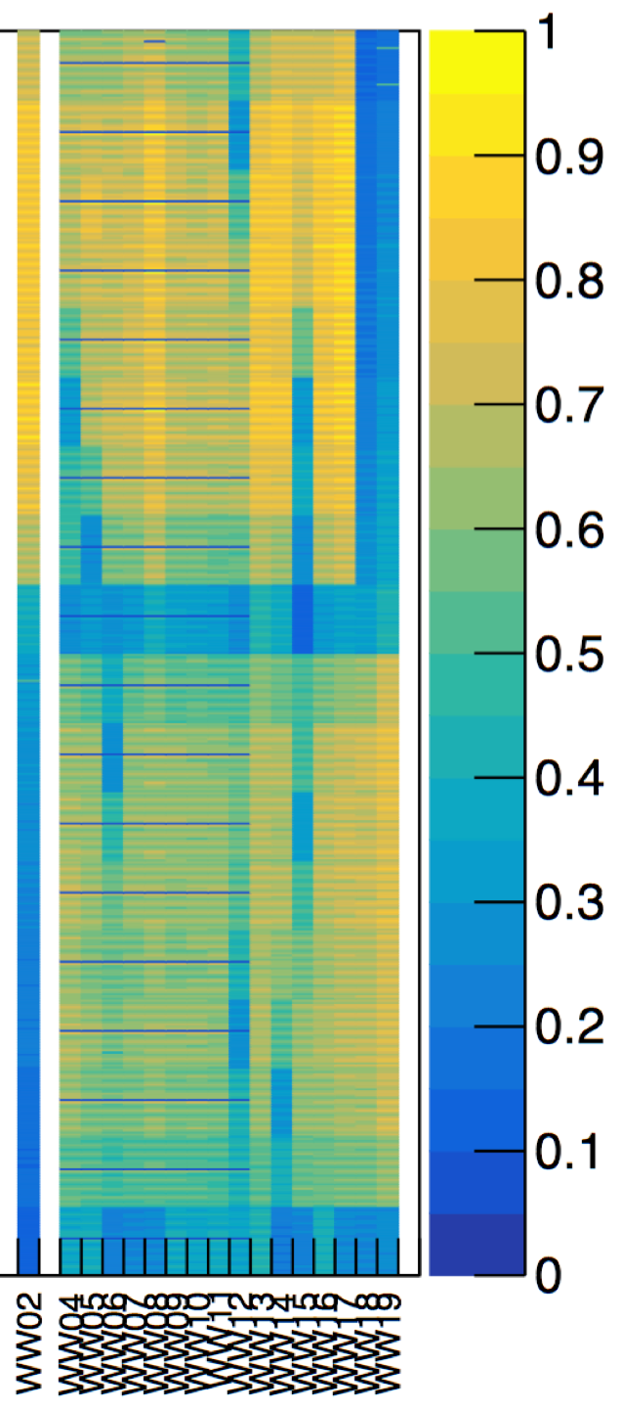
Reading the Map
Half-size signals show up as blue
Cables 1 and 10 are pulsed separately and don’t have cross-talk -> ½ size signals
WW18 and WW19, channels 10-18 are “triangle wires” that don’t get test pulses
Blue Spots: ½ size signals where we don’t expect them could be either:
  Disconnected cable
  Grounded shield.

Slide 10
Checking for Grounded Shields
For all available “blue spots” that showed up in the map, Donatella et all, checked to see if their shields were grounded
  EE3: 13,14,17, EE6: 5, 10, EE8: 2, 7, 8, 13, 18, EE10: 16, EE15: 2, 16,EE17: 11,EE18: 1, 6, 8, EE19: 2,6
  WW4: 13, WW5: 11, WW6: 8, WW12: 4,17,WW14: 3,WW15: 7, 11, 13.
  WE4: 7, 13, 15
  EW7: 4, 6, EW10: 6,7, EW12: 2,4, 8, 10, EW15: 2,6, EW16: 1,2,3
All 44 of these cables were found to have their shields grounded
  We conclude that grounded shield is the reason for these cables low pulse-height and they are NOT disconnected cables
A similar number of “blue spot” cables were in chimneys that were already closed and so could not be checked
Based on the 44 cables we did check, we infer that very few of those are disconnected cables, but this is only a statistical argument

Slide 11
Pulsing Triangle, Corner and Horizontal Wires
Horizontal and corner wires don’t get test pulses
Alberto B. developed a way to pulse them by plane-to-plane capacitance
  Inject a test pulse on all 32 wires at once of an INDUCTION 2 cable
  Look at induced signal on each of the 1056 horizontal wires
Alberto, Donnatella and Brenda, tested all 8448 horizontal wires (mostly over last weekend)
  Tested with grounded shields
  Did not save data, simply looked at scope
  Found 15 apparently dead wires
Triangle geometry and lack of time made interpretation difficult
  Triangle wires not systematically tested in this round

Slide 12
Conclusions I
Despite early confusion, we were finally able to do definitive continuity tests by analyzing the acquired data offline
For the “normal chimneys”
  Full understanding took some time (~two weeks) and we could not delay installation work to fully apply this understanding
  We now believe that we understand things well enough that would identify disconnected cables or major problems with high efficiency (probably not 100%)
      “Special” cables (e.g. 10 and 18) are higher risk, because we may not have been pulsing them with the right cables
      Fixed:
        One disconnected cable
        Several single cut conductors

Slide 13
Conclusions II
  For the horizontal wires in the “corner chimneys”
    All were tested. No disconnected cables found. 15 isolated dead wires found
  All hardware, software, and shifter techniques are well developed for January campaign with de-coupling boards in place
    Alberto checked that test pulses also propagate through the DBB’s. This gives us the capability to check the detector's status even during vacuum tests and cooling down (of course also for periodical check ups during it's entire life), and monitor eventual electrical changes.

