Slide 1
ICARUS
HV Drift and Field Cage Measurement
Linda F. Bagby on behalf of
HV Working Group
September 19, 2018

Slide 2
Outline
HV Drift Field Cage measurement motivation
Schematics
Test Procedure
Results

Slide 3
Motivation
Before welding the cryostat access hatches closed, it is desirable to apply an external voltage to the HV Drift cup and measure the resulting voltage via the field cage ‘pick-off’ leads.
If the voltage and current measurements are not as expected, the circuit is accessible for repairs or adjustments.

Slide 4
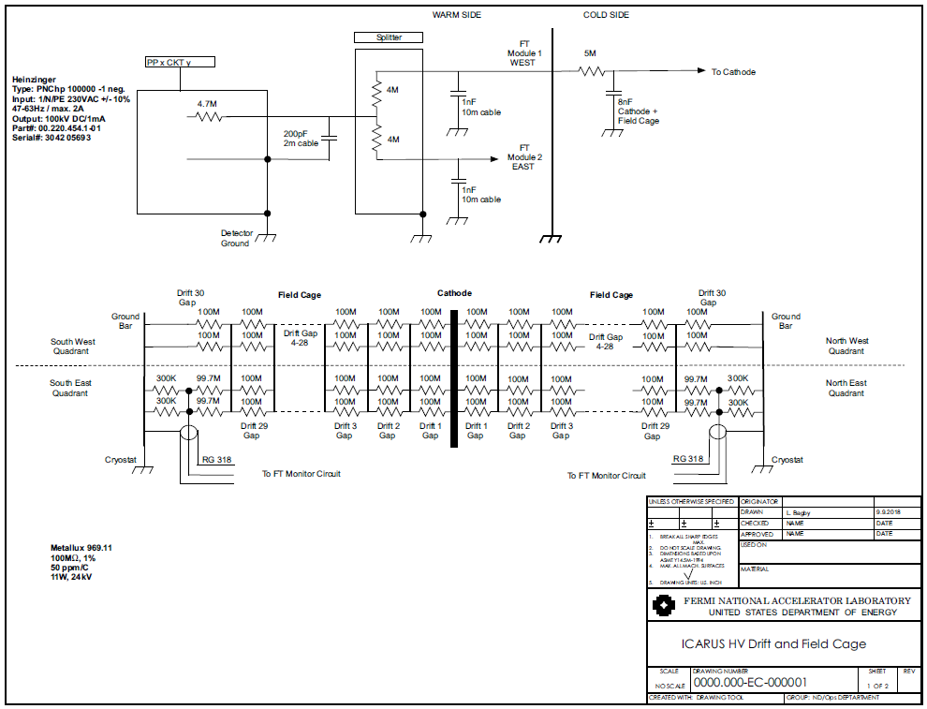
HV Drift and Field Cage Circuit: Module 1
Keithley 237

Slide 5
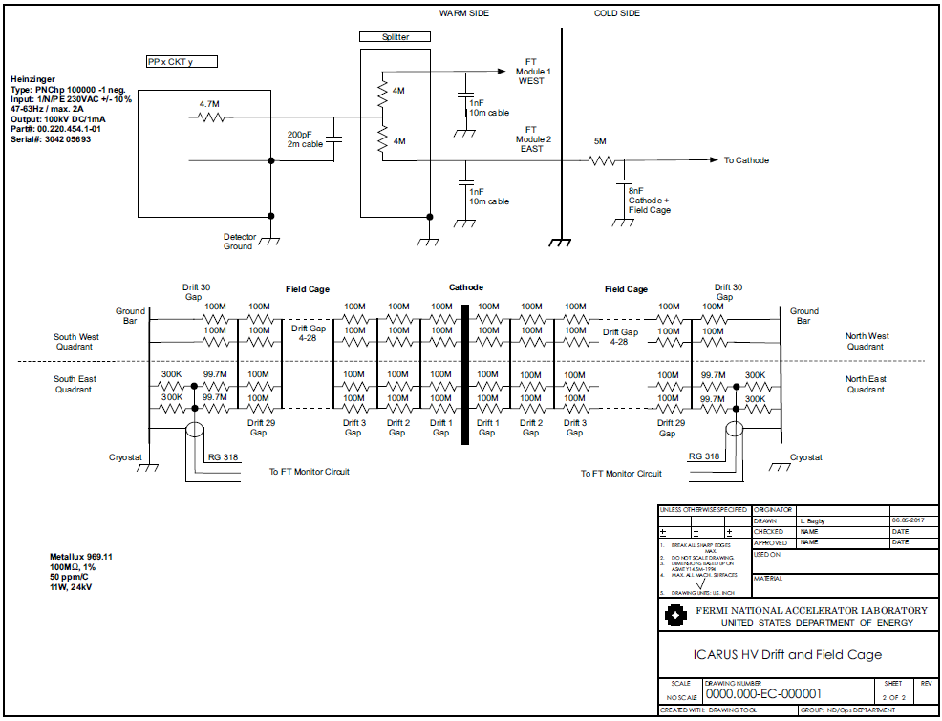
HV Drift and Field Cage Circuit: Module 2

Slide 6
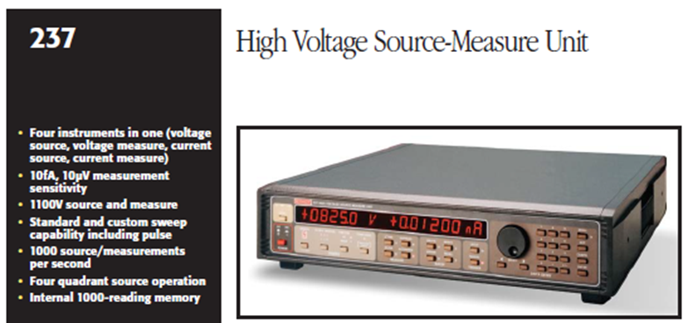
Test Procedure
Connect a high voltage power supply (current limited) to the cathode cup.
Connect a volt meter to the ‘pick-off’ cable leads on the warm side of the feedthrough.
Increase power supply voltage from 0V – 1100V in 100V increments, monitoring and recorded power supply displayed current and ‘pick-off’ voltage value.
Plot value in real time to visually see deviating trends.

Slide 7
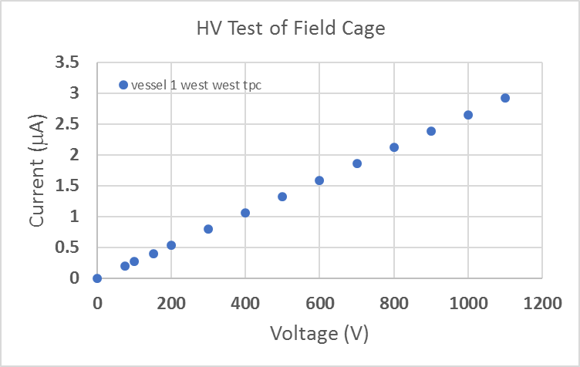
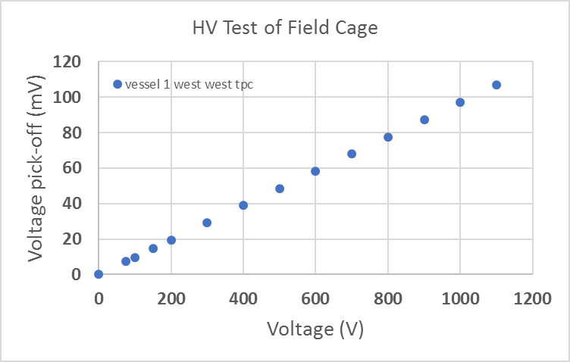
Results
All four Field Cage circuits have been measured for continuity.
The voltage expected at the ‘pick-off’ for a 1100V cathode voltage is within ~2.4% of the calculated value for all 4 Field Cage chains.
Calculated ‘pick-off’ voltage = 108.6mV.
Measured ‘pick-off’ voltage = 105.4 – 106.9mV.
The Field Cage circuits have been verified for proper connectivity.

