Slide 1
ICARUS at FNAL:
Status of the installation and Working Groups Activities
C. Montanari – FNAL and INFN-Pavia

Slide 2
Status/planning of ICARUS installation: recent activities
The two cold vessels have been positioned inside the cold shields and thermal insulation on August 9 and 14 respectively. The accuracy in vertical positioning is ±0.3 mm, that one in the horizontal plane is ±6 mm in both coordinates.
From August 15 to 22, the area on top of cold vessels has been prepared (secured to allow access without special safety training) for the chimney installation that started with the training of working teams on August 23.
At the same time the two cold vessels have been accessed for internal inspection, removal of fixings used for transport and handling, installation and test of HV resistors and for installation of the corner chimneys.
The chimney installation and the sealing of the manholes has been completed. A helium leak tightness test of the chimneys is being prepared and it is expected to be completed by September 30.
Top part of cold shield will be installed end of Sep - mid Oct followed by the warm vessel roof installation (mid Oct. to mid Nov.).
Starting from beginning of December, the installation of the crosses and feedthrough flanges with associated internal electronics will take place after some preparatory activities that will start around mid November.

Slide 3
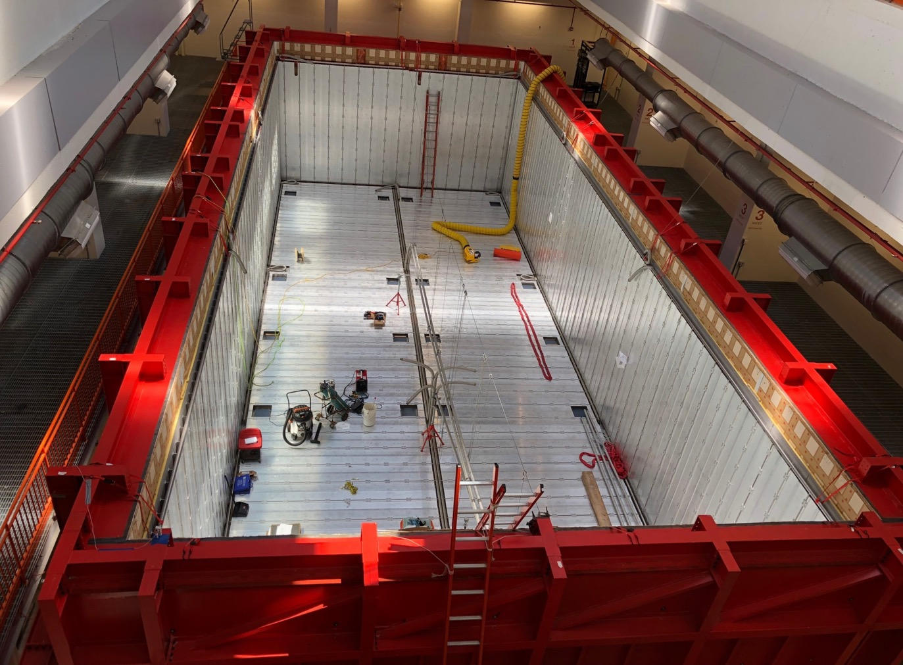
Cold Shields (June 2018)

Slide 4
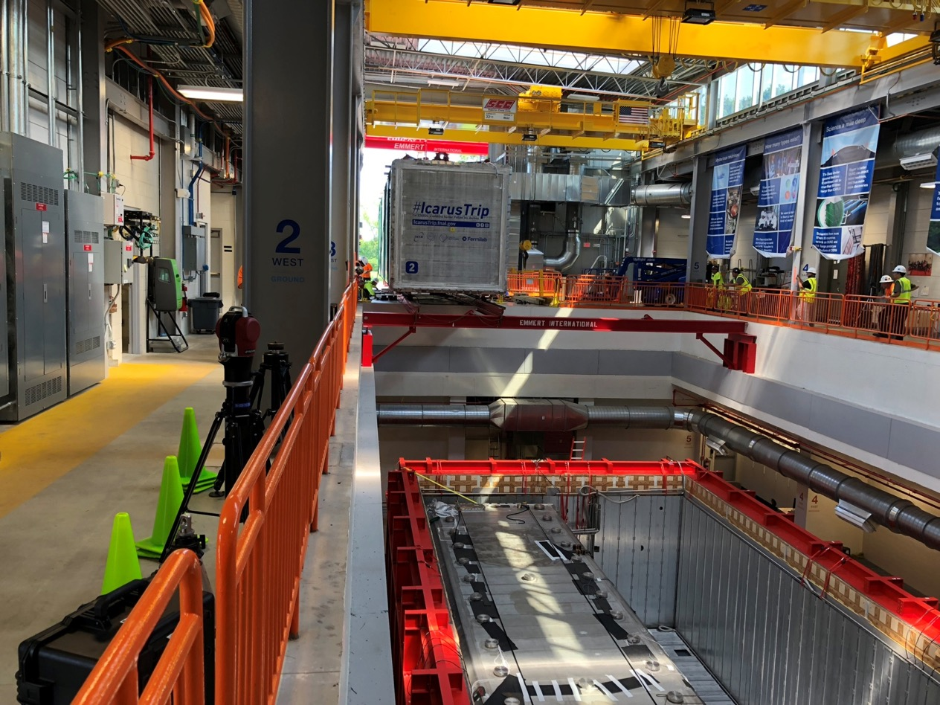
Second Cold Vessel Rigging (August 14, 2018)

Slide 5
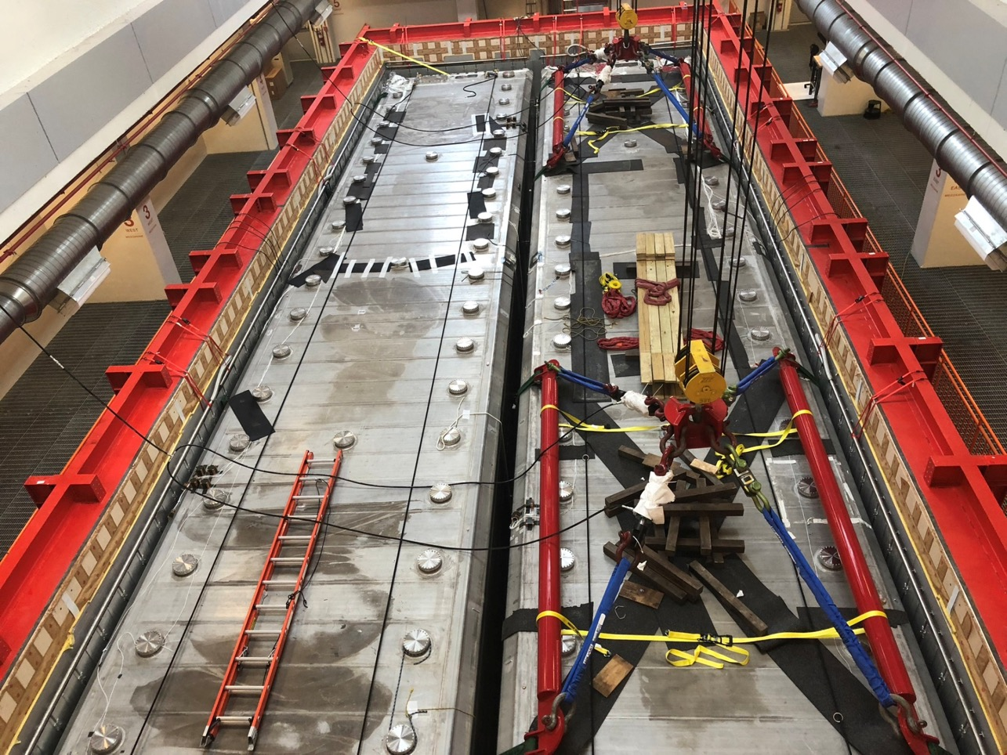
Second Cold Vessel Rigging (August 14, 2018)

Slide 6
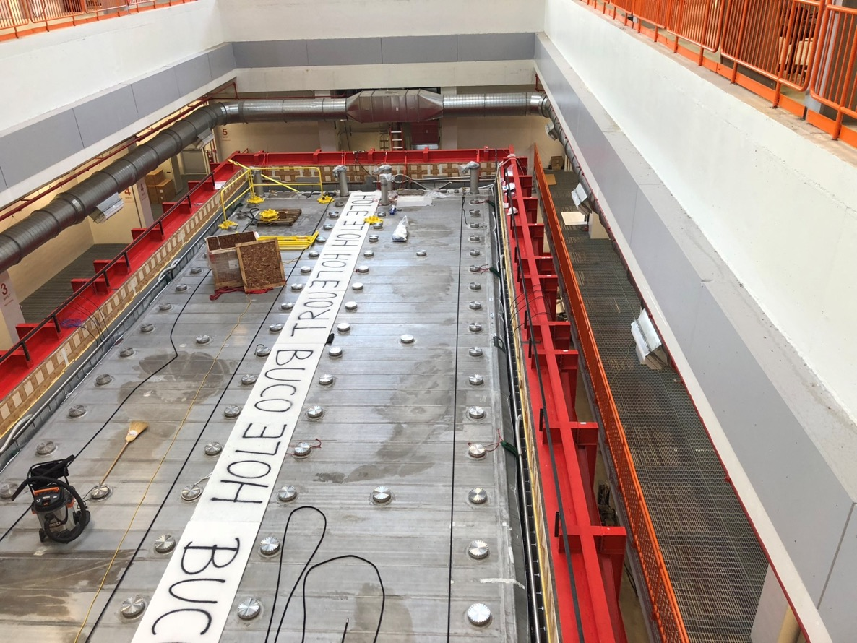
Securing the Work Area on the top
North end being isolated
Gap being covered
Hand-rails
Stairs access from the mezzanine (not visible)

Slide 7
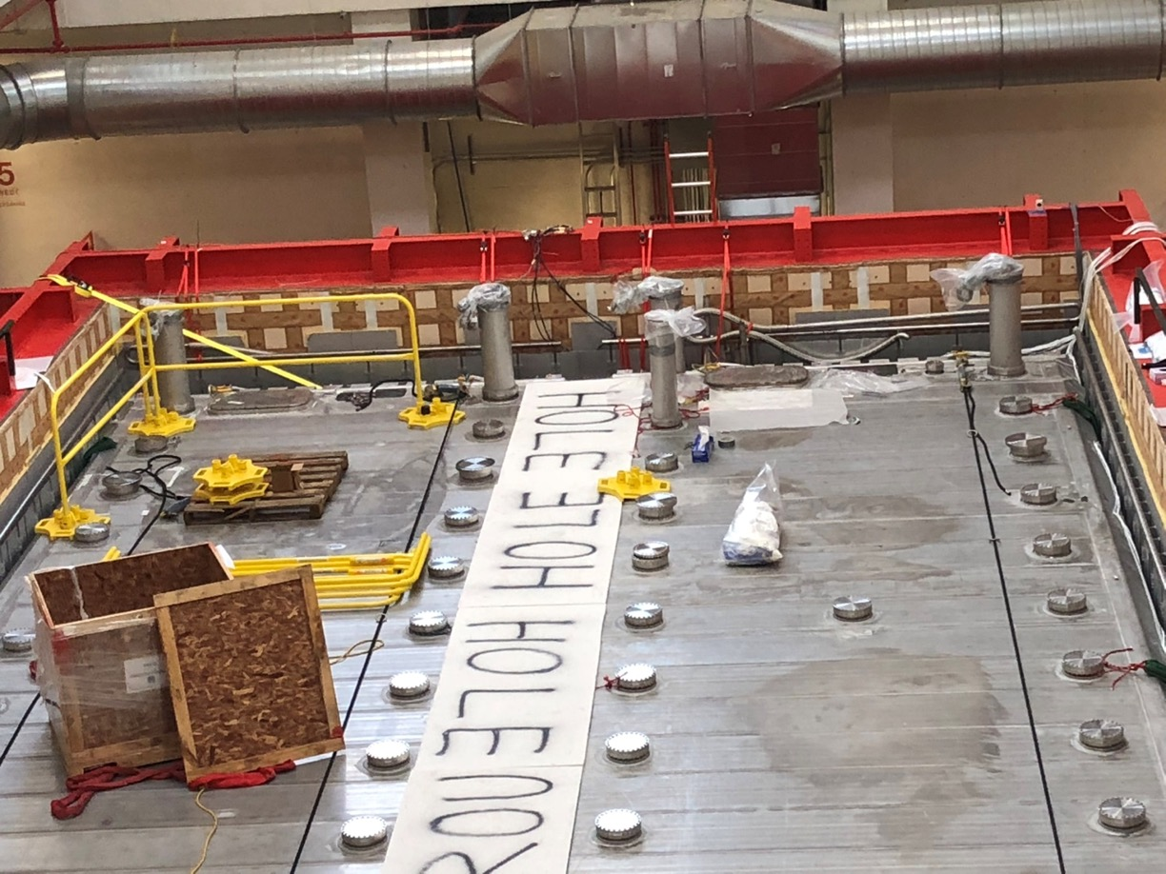
First chimneys installed (corners)

Slide 8
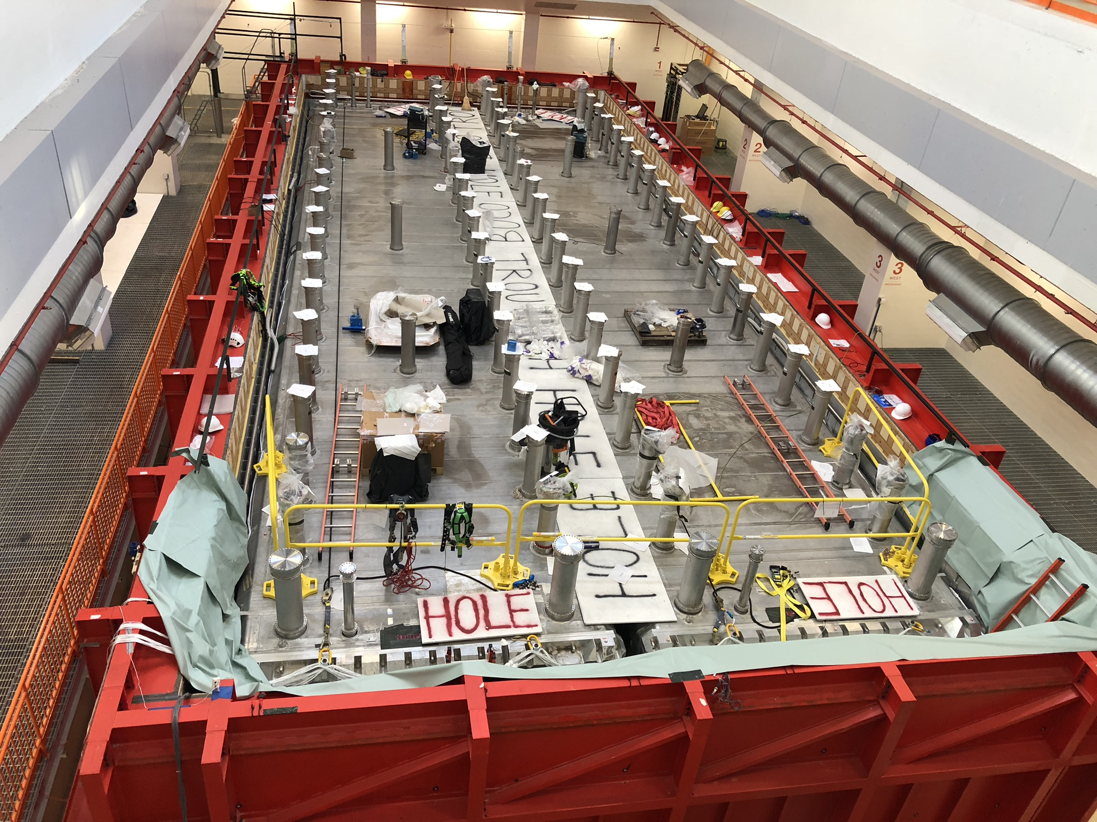
Monday – September 17, 2018

Slide 9
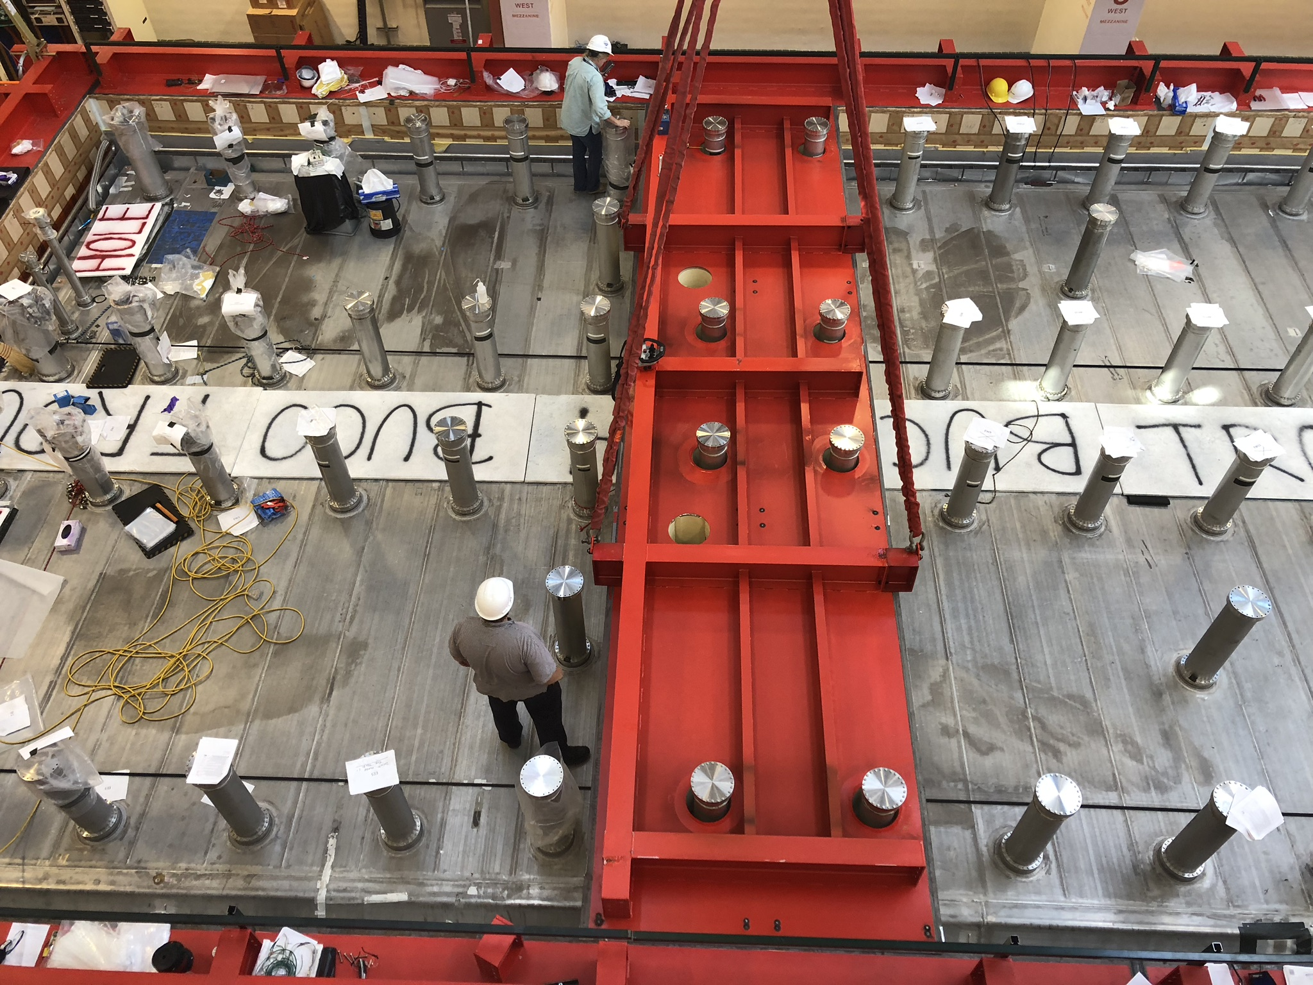
Test of installation of one part of the Warm Vessel roof

Slide 10
Status/planning of ICARUS installation: next activities
We are planning in order to concentrate most of the installation activities of the crosses and of the feedthrough flanges between mid November and Christmas, before the beginning of the installation of the proximity cryogenics.
Part of the top CRT will also start to be installed before the end of the year to allow for tests of combined operation both with the side and bottom CRT and with the TPC.
The first three months of the next year, during the installation of the cryogenic and purification systems, will be mainly dedicated to the external cabling, installation of electronics and power supplies and the relative pre-commissioning activities.
During this period there will be some interference with the installation of the cryogenics. This will be dealt with on a case by case basis.
A detailed plan for the activities during the first months of 2019 is being prepared taking into account the requirements and plans developed by the working groups.

Slide 11
Detector commissioning
We are planning in order to concentrate most of the installation activities of the crosses and of the feedthrough flanges between mid November and Christmas, before the beginning of the installation of the proximity cryogenics.
Part of the top CRT will also start to be installed before the end of the year to allow for tests of combined operation both with the side and bottom CRT and with the TPC.
The first three months of the next year, during the installation of the cryogenic and purification systems, will be mainly dedicated to the external cabling, installation of electronics and power supplies and the relative pre-commissioning activities.
During this period there will be some interference with the installation of the cryogenics. This will be dealt with on a case by case basis.
A detailed plan for the activities during the first months of 2019 is being prepared taking into account the requirements and plans developed by the working groups.

Slide 12
Working Groups
The new working groups started to meet regularly in July 2018:
  Physics Analysis
  Data Processing, DB and MC Prod.
  Data Quality
  Offline Softw. Reconstr., Simulation
  Calibration
  Sub-systems: TPC, PMT, CRT, DAQ, Trigger , Electrical, Cryogenics, Vacuum, Slow Control
  BNB Interface
  NuMI Interface
  Interface to FNAL Tech & Op. Divisions .
A 1st meeting of new Technical Board coordinating the WG activity took place on Aug 22 to be followed by a meeting as part of the Collaboration Meeting (this afternoon).
  Organization of installation activities is now fully involving all US institutions. The chimney installation involves ~20 people from the Collaboration; more than half of them are from US groups. A similar organization is being implemented for the other activities that are taking place at Fermilab.
Dedicated 1 week operative sessions on the WG activities with in person participation at FNAL have been planned.

Slide 13
Activities before the cold commissioning
  This is a list, possibly not complete, of the activities that have to take place before the start of the cold commissioning.
    DAQ tests and pre-commissioning
    Slow controls Feedthrough flanges
    Slow controls external cabling
    PMTs external cabling
    Laser calibration external cabling and pre-commissioning
    Electronics installation
    Power supply for electronics installation and test
    Power supply for the drift field installation and test
    Power supply for the wires bias installation and test
    Power supply for the PMTs installation and test
    External cabling for wire chambers
    Slow control tests and pre-commissioning
    PMTs tests and pre-commissioning
    Leak tightness tests
    Vacuum tests, pre-commissioning and commissioning
    Integration of slow control with cryogenic controls
    Control room design, setup test and pre-commissioning
  Each one of these, and additional, activities for the next year needs to planned in detail during the next month.

Slide 14
Detector commissioning
We are aiming to start the cold commissioning during April 2019. Pre-requisites are:
  The completion of the pre-commissioning tasks.
  The development of a detailed plan and organization for detector commissioning and data taking phases (TBD by end of 2018).
    Run coordination.
    Detector support and maintenance.
  The green light for the start of operation from the Fermilab Director (safety review passed).

Slide 15
Planning of ICARUS installation at FNAL
CY 2018
CY 2019
CY 2020
Q3
Q4
Q1
Q2
Q3
Q4
Q1
Vessels Rigged into Building
FNAL planning
Cold Shield completion, Warm Vessel roof
Cryogenics installation
T600 readout installation & pre-commissioning
Sides CRT Installation
Overall plan currently being updated (shortened)
Cold Commissioning, LAr filling
Top CRT installation, CRT commissioning
Overburden Installation

Slide 16
Conclusions
Next year will be an exciting one as it will see the completion of the detector installation and the start of the operation with the BNB and NuMI beams.
A lot of activities have to take place during the coming months that will require a strong involvement of the collaboration and a careful organization.
The preparation for the data run requires a boost on the activities for data acquisition, reconstruction and analysis. This is also mandatory in order to test the detector performance during the post-filling phases.
So much to do… so little time…

