Slide 1
SBN Far Detector CRT System Update
Bob Wilson
for the SBN Far Detector CRT Group
CERN, Colorado State, Dubna, FNAL,
LIP (Lisbon), INFN Bologna, INFN Frascati, INFN Milano,
Houston, Pittsburgh, UTEF (Prague)
19 September 2018
ICARUS Collaboration Meeting

Slide 2
SBN Far Detector CRT Group
Collaborative effort to provide ~4-pi coverage Cosmic Ray Tagger for ICARUS
Chaired by Umut Kose (CERN) also Top-CRT Coordinator
Side/Bottom-CRT Group (ICARUS) led by Anne Schukraft (FNAL)
Other essential contributors: Simone Marcocci (FNAL post doc), Chris Hilgenberg (CSU student), Dave Warner (CSU engineer)
Support structure design: John Belle -> Cat James + Justin Tilman (all FNAL)
New addition: Biswaranjan Behera (CSU post doc)
Joint SBN CRT Working Group
Conveners: Umut Kose (chair), Igor Kreslo (MicroBooNE/SBND), Bob Wilson
Coordination and cooperation between all SBN CRT groups
Most slides for this presentation provided by Umut and Anne – thanks!
Will move through quickly – more time for discussion in Friday SBN WG meeting

Slide 3
Side/Bottom CRT

Slide 4
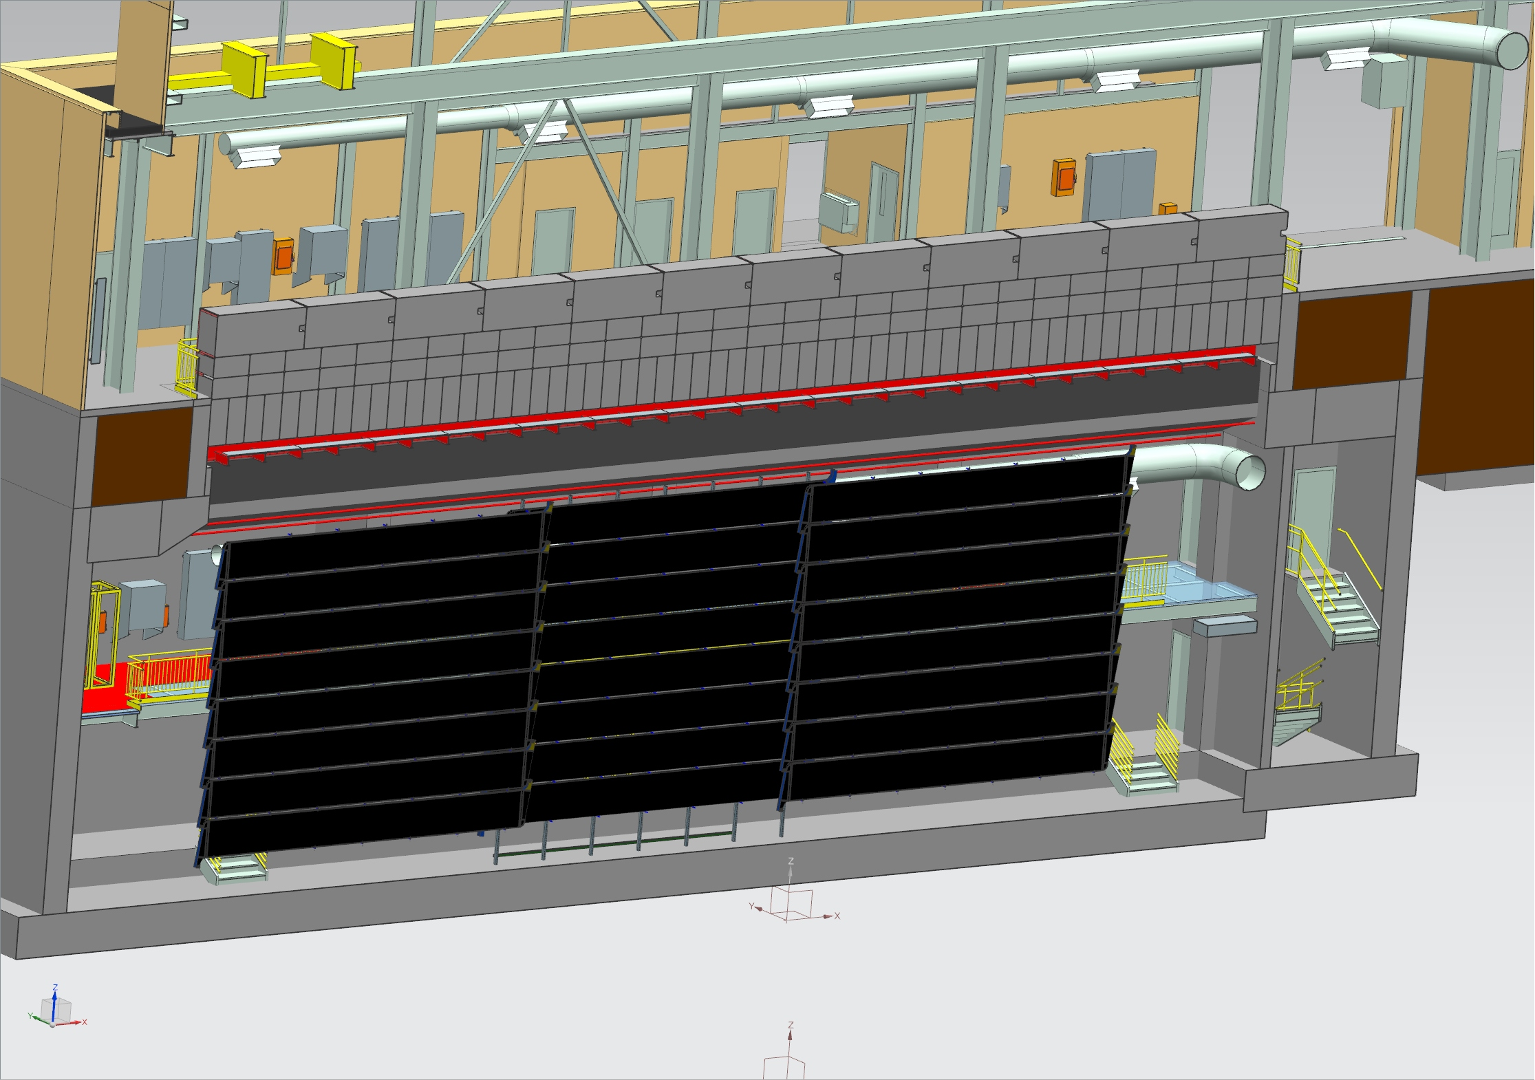
Side CRT system overview
ICARUS side system includes coverage of four sides of the detector: East, West, South, North
Re-use of MINOS scintillator modules from far detector cosmic veto. Dimensions: 8 m x 80 cm
172 good modules (tested) - enough for a double-layer coverage on all four sides
Configuration
East and West: three wall segments of two layers of parallel (1/2 strip width offset) modules
South: one wall segment, horizontal and vertical layer
North: Conceptual design layout: patch of reduced length modules around cryogenics (cutting and resealing has been tested)

Slide 5
East/West Wall
Overburden
Top CRT
(vertical portion, North wall)
Top CRT
(vertical portion, South wall)
Top CRT
(Horizontal portion)
Beam Direction
Guardrail
Access Stairs
Cryogenics Area
Side CRT (long sides in 3 sections, which overlap)
Active Volume (field cage)
Insulation
Cryostats
Argon Volume (interior of cryostat)
Warm vessel
SiPM sensors and FEBs can be attached after the modules have been installed
Procurement of mounting parts has started. Installation will be stretched over longer time period.

Slide 6
South Wall
Overburden
South wall will also have two layers of modules.
Second layer final layout TBD.
Need to leave space for access stairs to warm vessel top
Top CRT
(vertical portion, on south wall)
Building
Foundation
Walls
Top CRT
(angle portion, on E-W walls)
Side CRT (long sides)
South Side CRT offset around stairs
Side CRT (south side, upstream)
Active Volume (field cage)
Argon Volume
(interior of cryostat)
Cryostats

Slide 7
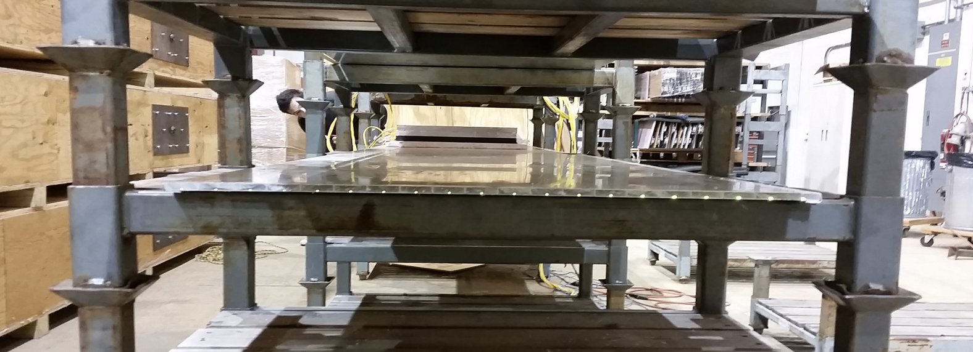
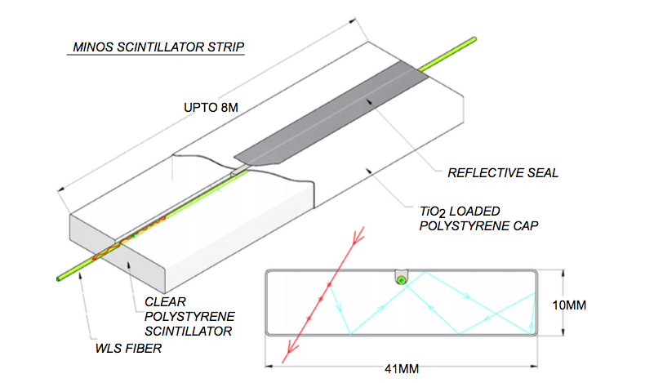
Re-use of MINOS scintillator modules
MINOS module snout
20 strips per module (each 4 cm wide)
The strips are glued to and wrapped in a light-tight aluminum skin
One fiber per strip, readout on both ends -> 40 channels per module (40 * 172 = 6880 channels total)
Main difference to other CRT systems (top, SBND, MicroBooNE):
Only 1 fiber per strip instead of 2 – cannot require coincidence between SiPMs for noise reduction
Fibers read out on both ends

Slide 8
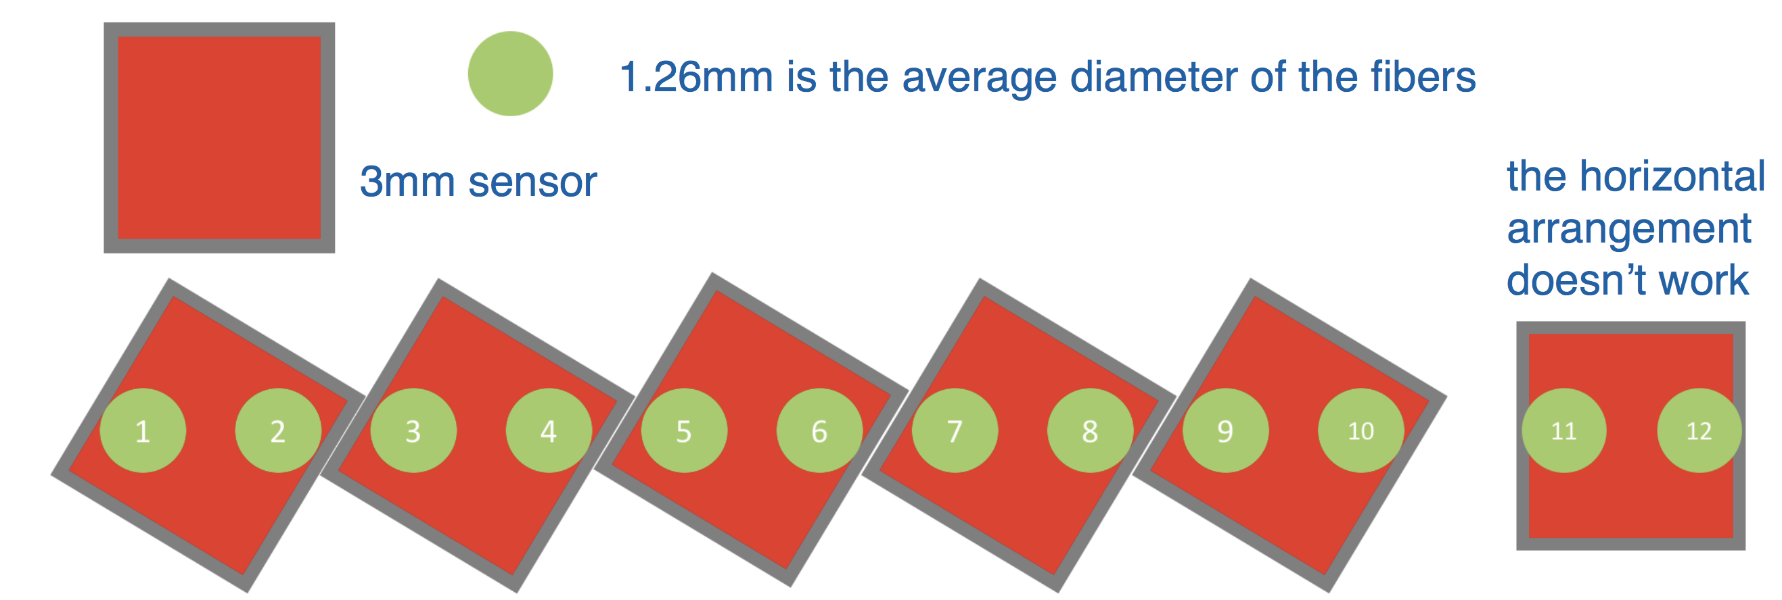
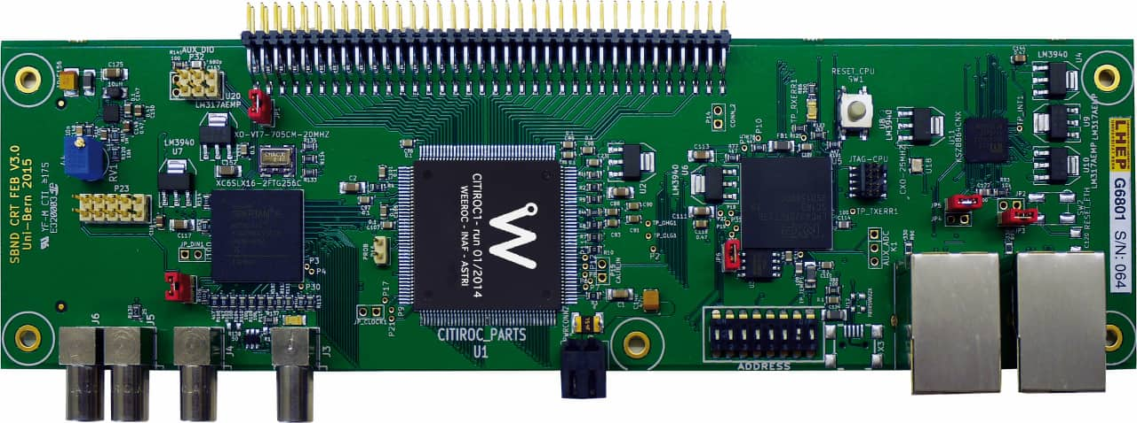
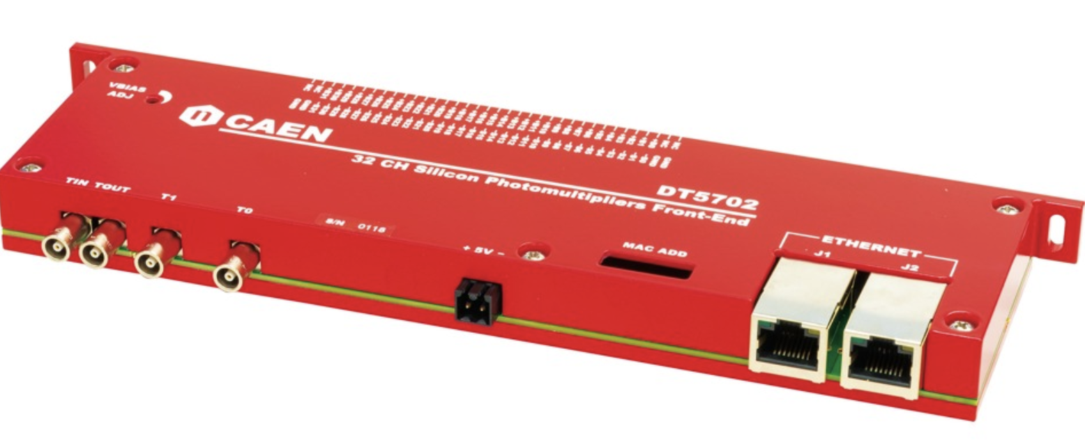
Readout design
Photosensors:
MINOS modules were originally read out by multi-pixel PMTs – replaced with compact, low voltage SiPMs
Some geometrical challenges finding best commercial solution to optimize SiPM and fiber matching
Chosen solution: 3mmx3mm SiPMs, optically ganging two channels (4 cm granularity -> 8 cm granularity)
SiPMs have been ordered after technical review of the readout design (documentation: https://sbn-docdb.fnal.gov/cgi-bin/private/DisplayMeeting?conferenceid=2612)
Electronics:
Front end readout board is CAEN A1702 (developed by University of Bern for use in SBND and MicroBooNE)
Same readout board as used in the top CRT and SBND and MicroBooNE. Will simplify common DAQ and analysis.

Slide 9
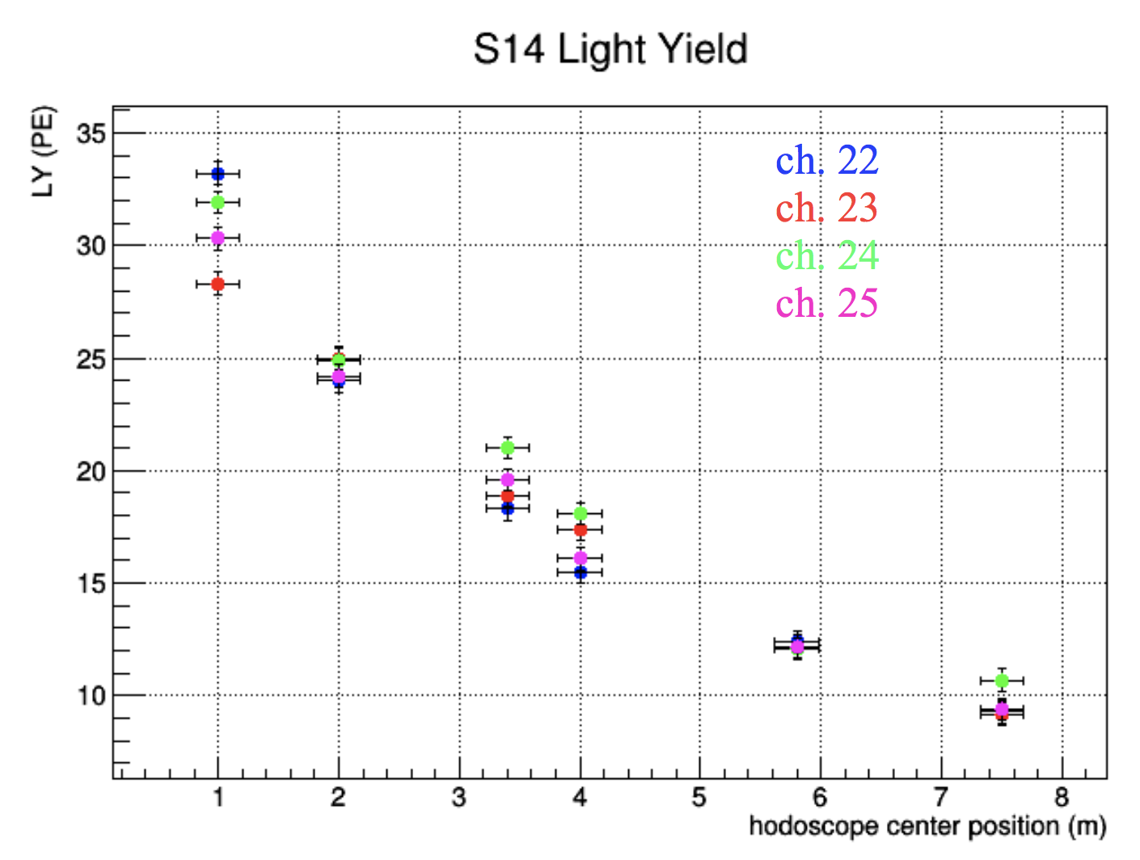
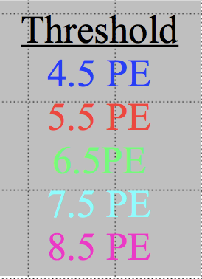
Results: Module and sensor testing
3mmx3mm SiPM solution was prototyped and tested for a mini-version of 4 (of 10) SiPMs (= 8 of 20 strips). Results: https://sbn-docdb.fnal.gov/cgi-bin/private/DisplayMeeting?conferenceid=2612
Light-output and efficiency measurement using external hodoscope to trigger
Efficiency requirement
(0.95 per double layer)
95% efficiency per double-layer can be reached

Slide 10
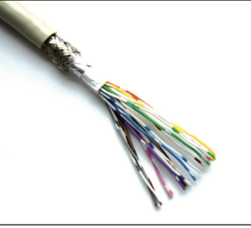
Design production housing and cable
Sensor board and housing being designed by CSU
150 SiPMs purchased for prototype sensor boards
FNAL currently comparing cables (twisted pair, shielded) between sensor boards and front end boards
Prototype boards and 3D-printed prototype housings will be produced by CSU and tested at FNAL
Design technical review before the end of the year
Production of boards and housings at CSU
Detailed schedule developed
Pre-production prototypes and testing phase at CSU ~4 months
Ready for production review late October
Production January-April 2019
CSU providing funds for the photosensor housing production

Slide 11
Tentative schedule (slightly updated since Director’s Review)
CY 2018
CY 2019
CY 2020
Q3
Q4
Q1
Q2
Q3
Q4
Q1
Design and review of mechanical support structure for side CRT
Installation of mechanical support structure
Installation of mechanical support structure and all modules complete
Prototyping of SiPM board
Production and testing of SiPM boards
Completion of fabrication and testing of SiPM boards and delivery to FNAL
Rack design, cable map design, electronics procurements
Electronics installation
Installation of readout electronics, readout racks and DAQ racks complete
DAQ development
Side CRT system fully commissioned

Slide 12
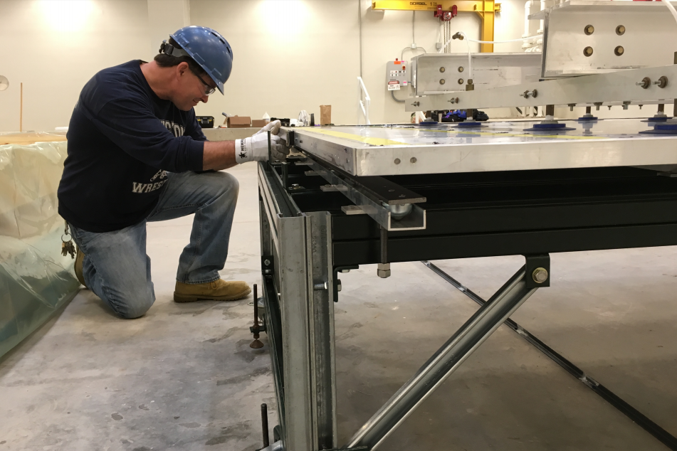
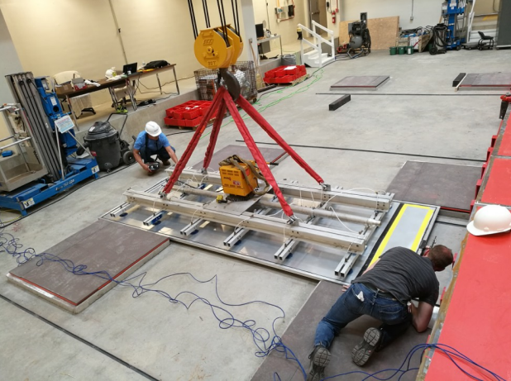
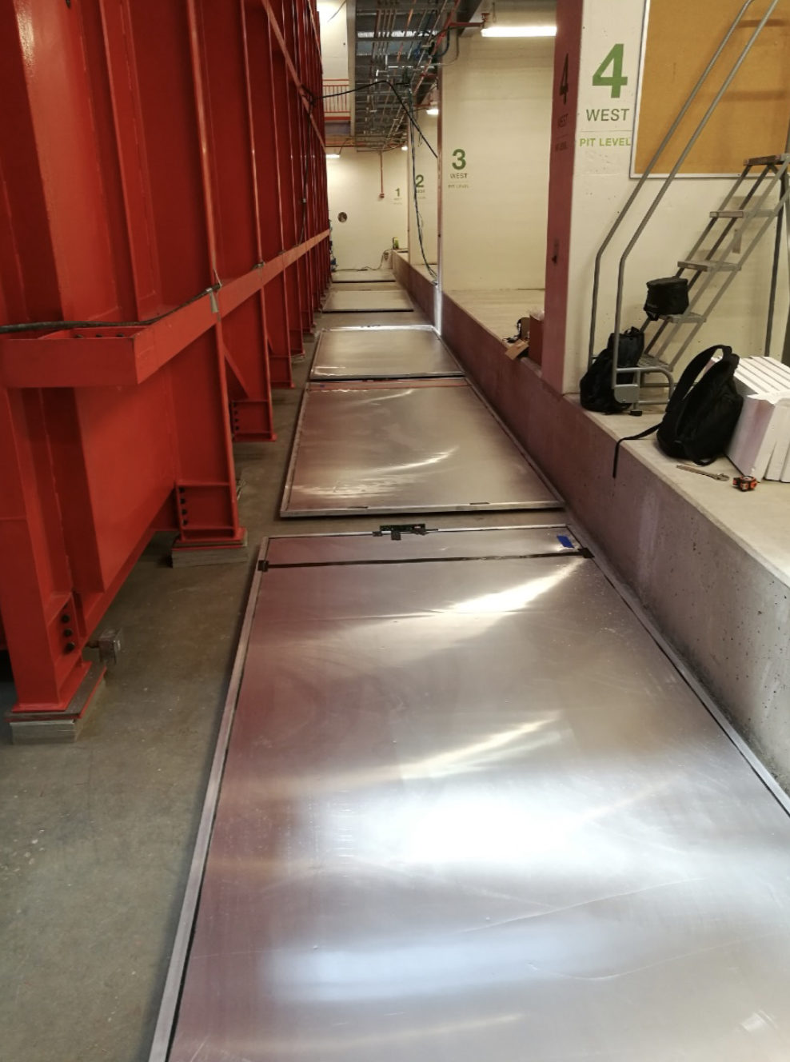
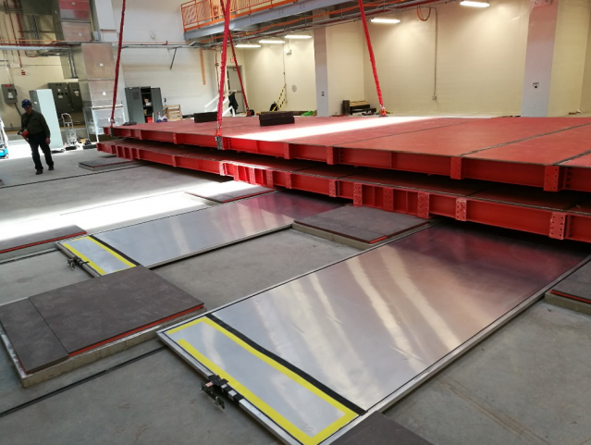
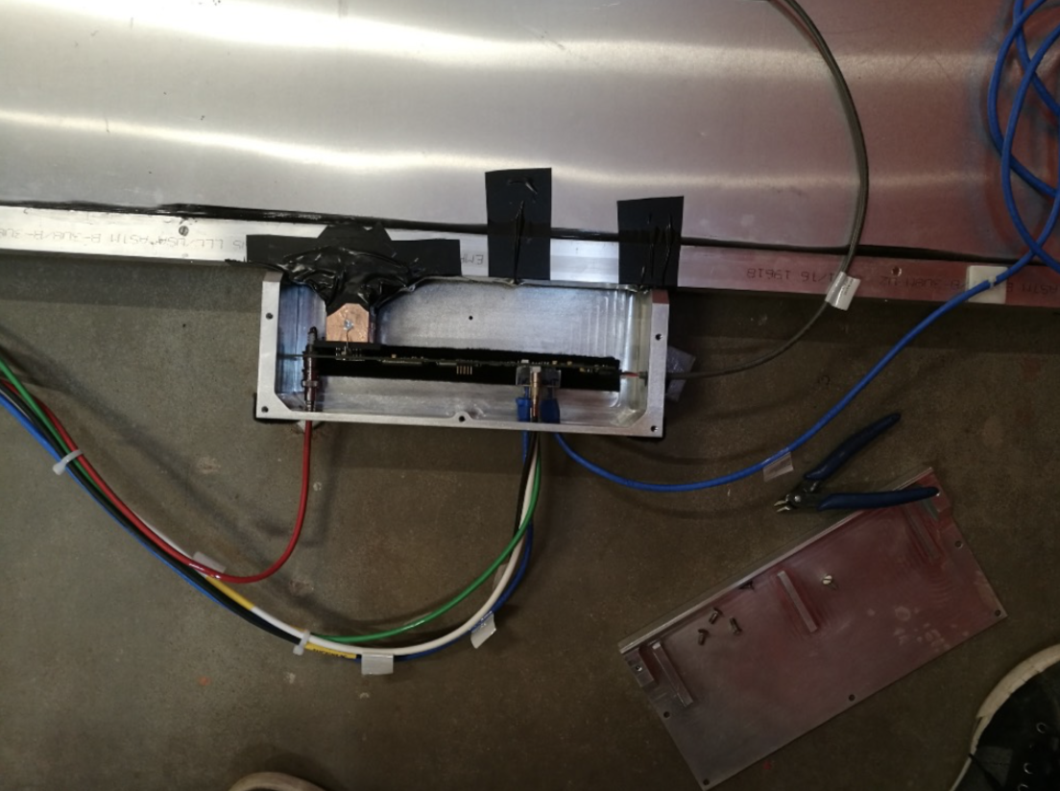
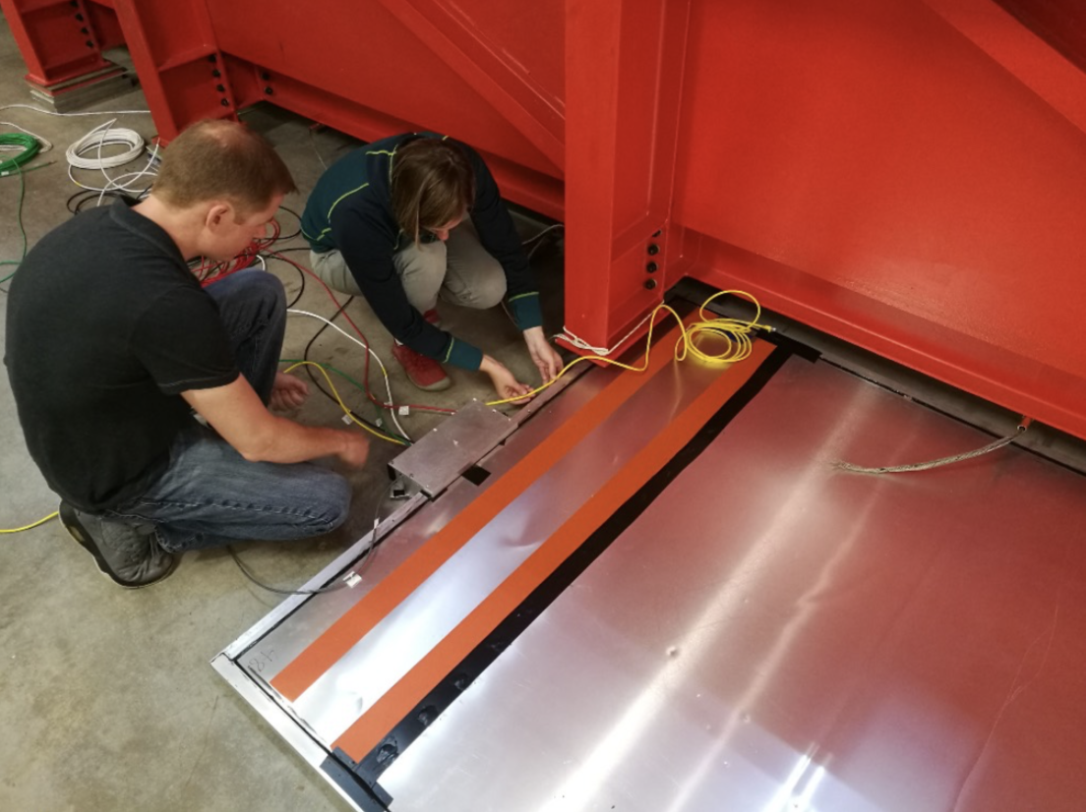
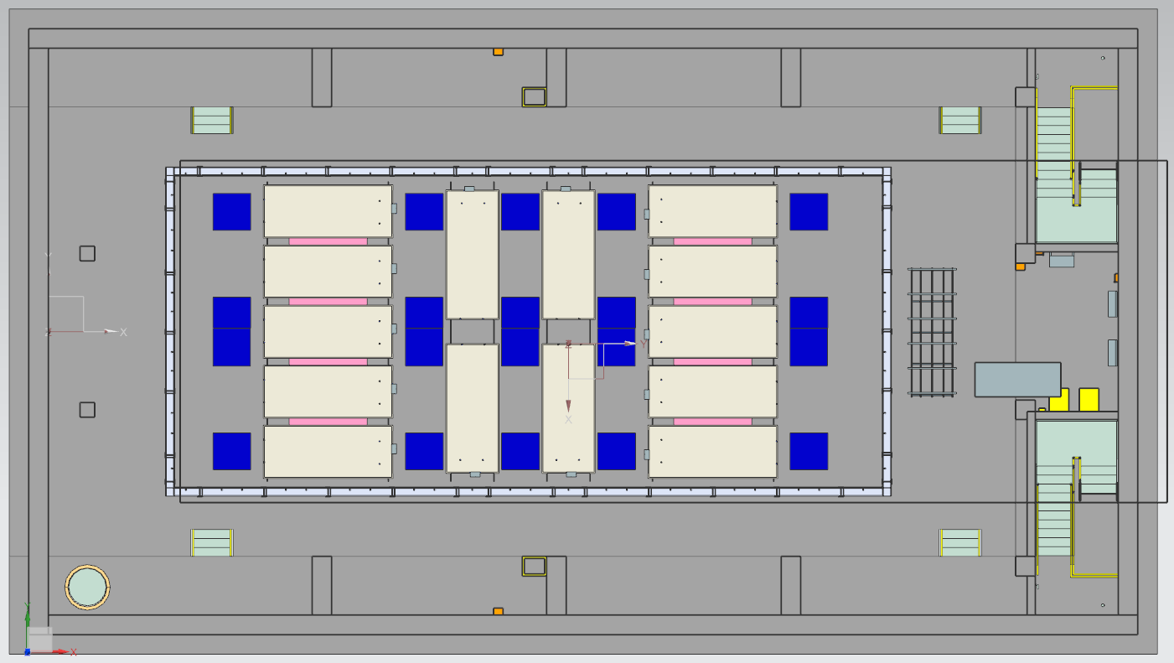
Bottom CRT
14 Double Chooz modules were installed in 2017 underneath the warm vessel
Remaining tasks
Rack
Move equipment from test rack into production rack w/ rack protection and slow control
Add system to slow controls
Proper cable routing in the pit (can only be done once installation of side CRT and cryogenics has progressed further)
DAQ
Currently using standalone test DAQ. Needs integration into experiment DAQ.
Same modules are being used by ProtoDUNE. Can re-use DAQ work from ProtoDUNE.
Needs additional effort.
Bottom CRT layout
CRT modules
Foam spacers
Warm vessel support feet

Slide 13
SBN Far Detector TOP CRT System
Slides from Umut Kose

Slide 14
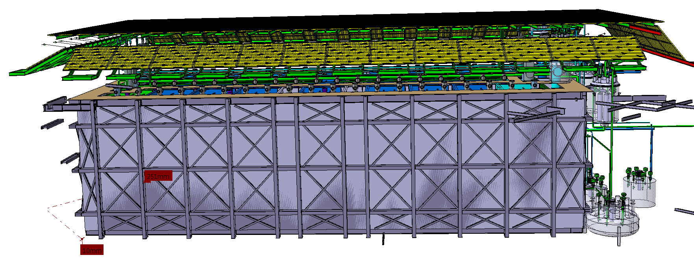
Top CRT System:
Top Cosmic Ray Tagger (CRT) system deployed above the ICARUS detector to tag cosmic ray events
Composed of 5 scintillating planes:
an array of 1.9 x 1.9 m² of modules: 84 modules below concrete plug, 38 modules on sloping parts and some spares
Expected rate of cosmic events → 28 kHz
Tagging of 80% of the muons
Modular Design:
independent square modules placed each one contiguous to the next one
Each module contains both X and Y oriented scintillator bars (8 bars/layer).
Single CRT module

Slide 15
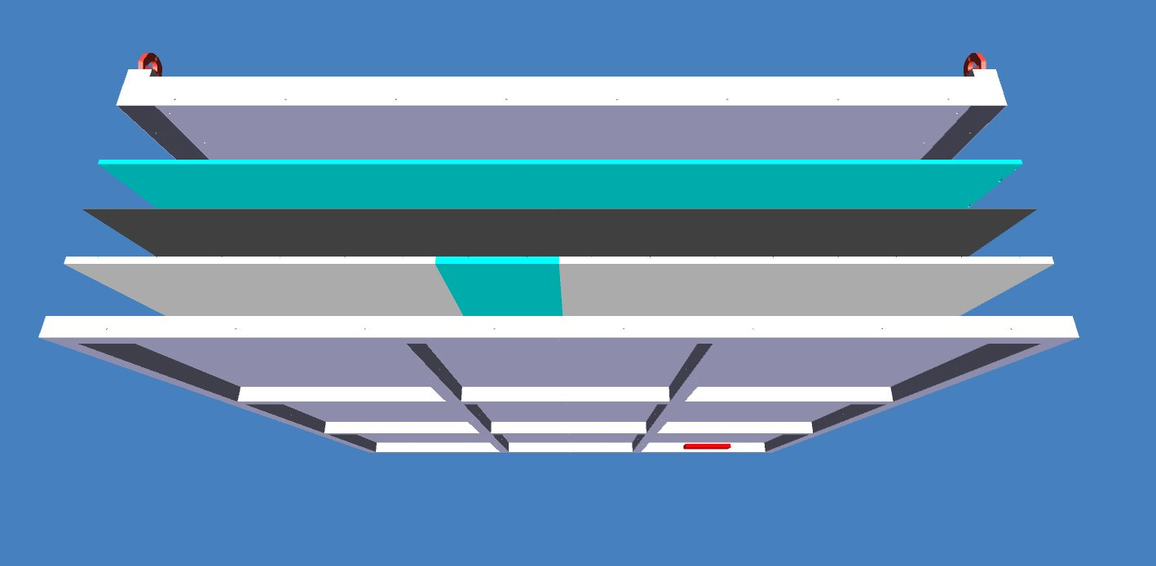
CRT Module
Removable hooks
Al cover + foam
Scintillator layer (10 mm)
Foam layer
Scintillator layer (15mm)
Al bottom + foam
Front End Board
The weight of single module is about 160 kg.
In total 125 modules including spares to be constructed for CRT Top units.

Slide 16
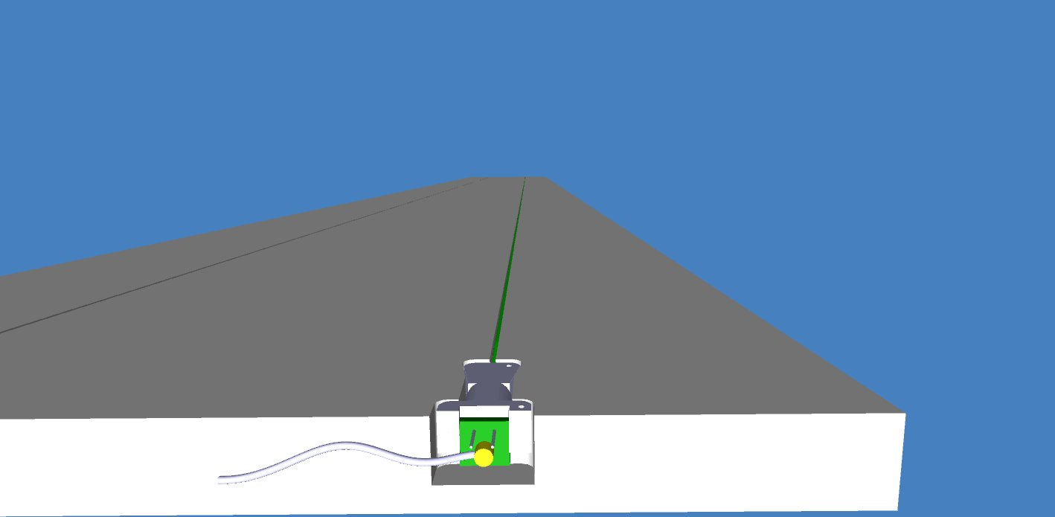
Scintillator production companies:
10 mm thick bars from NUVIA, Kralupy, Czech
15 mm thick bars from ISMA, Ukraine
60% of the scintillator bars received.
Two scintillator quality check stations: Prague and Dubna
[1] Attenuation length using Sr90 source
[2] Light yield using cosmic muons
Each bar: 230 mm (W), 1840 mm (L) and 15 mm (H) coated with white reflecting paint.
Multiclad WLS fibers: Kuraray Y11(200) 1 mm diameter. Cutting, polishing two ends, aluminization of one end by magnetron sputtering technique and quality control have been done in LIP, Lisbon, Portugal.
Photosensor: Hamamatsu S13360-1350CS SiPM with an active area of 1.3 × 1.3 mm² - procured
PCBs: SiPM holder and Adapters designed and produced
Module Readout: 32 channels CAEN FEB (Bern design, as SBND) Logical OR of 16-paired channels + coincidence between layers - procured

Slide 17
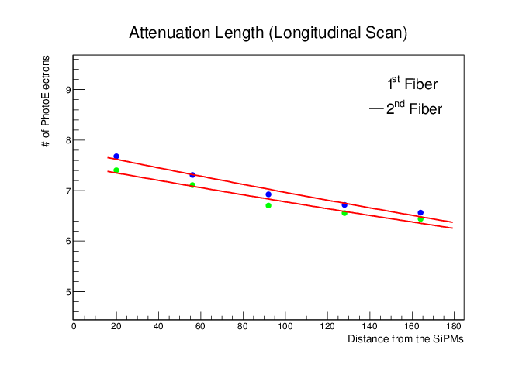
Scintillator quality check
Cosmic muons (calibration with Sr90 source)
Across the scintillator bar
Along the scintillator bar
WLS fibers location
Quality requirement: # Ph. E. > 15 for 10 mm thick and > 18 for 15 mm thick ; scintillator attenuation > 30 cm

Slide 18
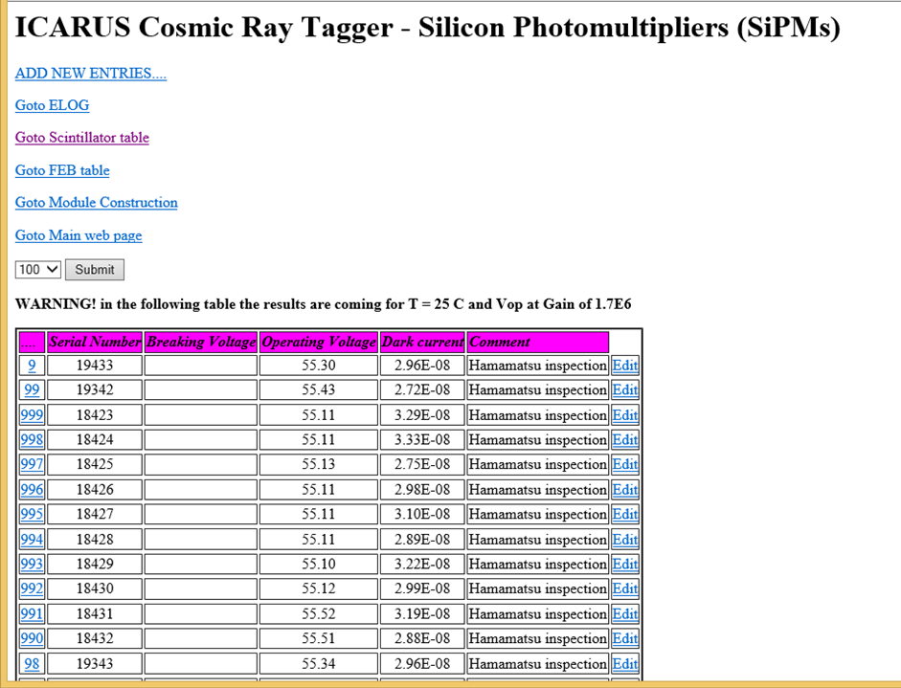
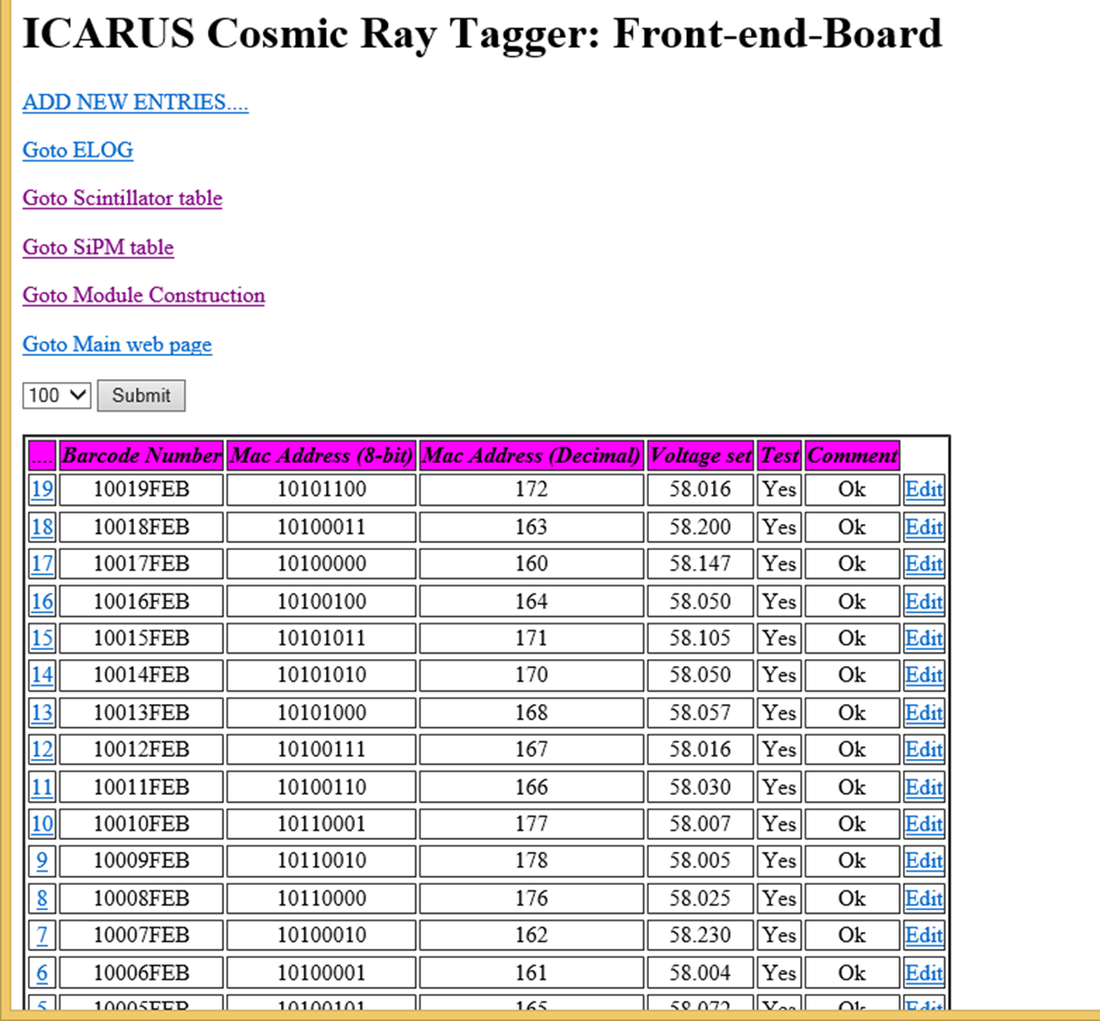
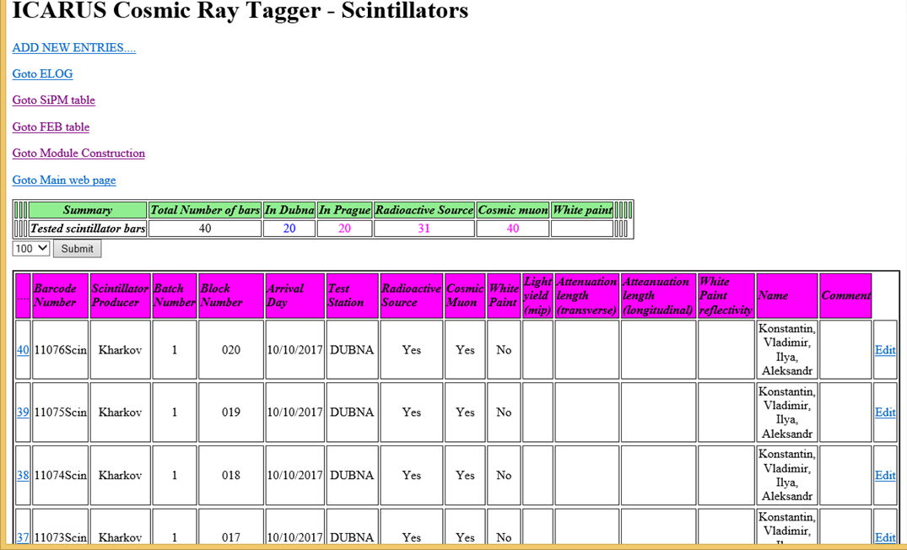
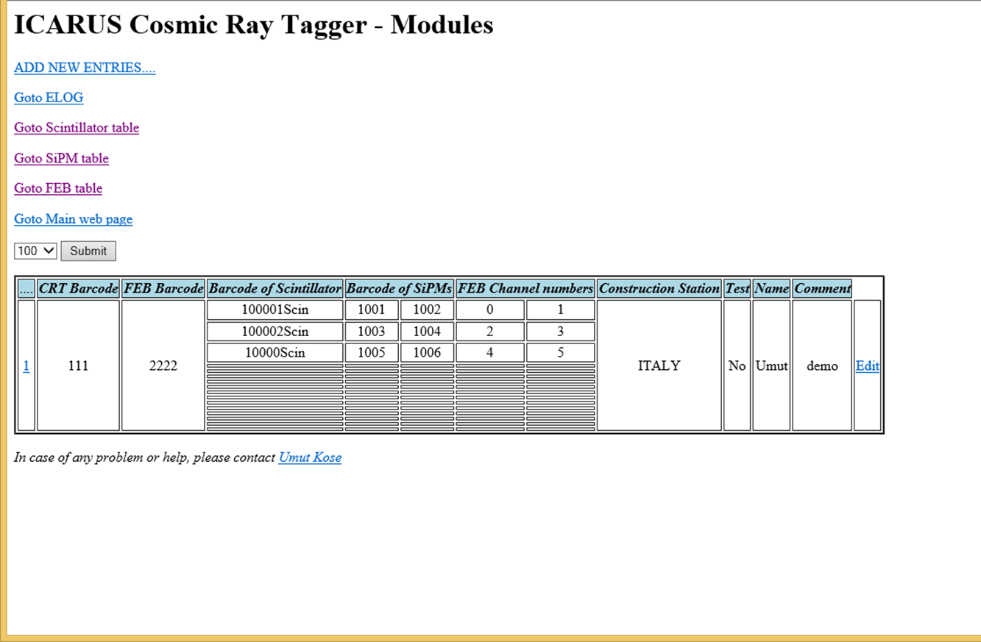
Database of module measurements
Barcode system used to know within CRT module the history/configuration of each single piece: scintillator production batch, characteristics of SiPMs connected to FEB channels, FEBs configurations etc.

Slide 19
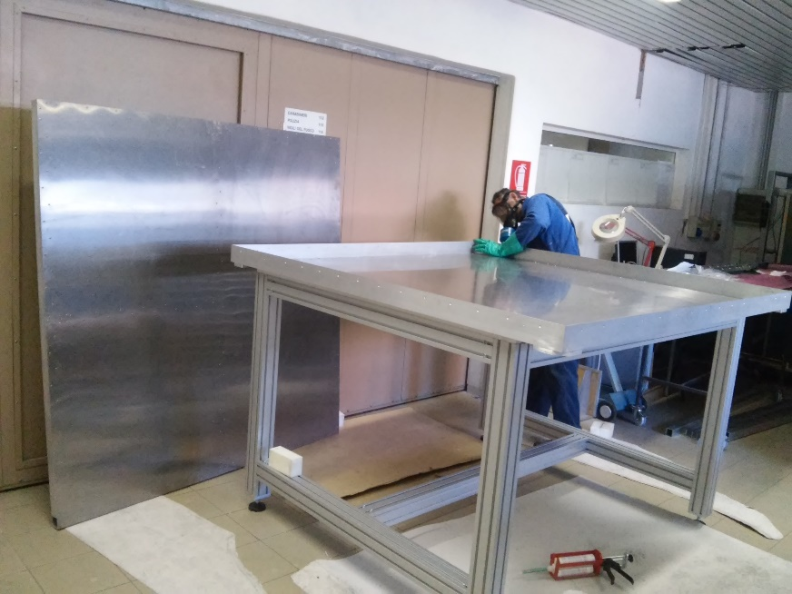
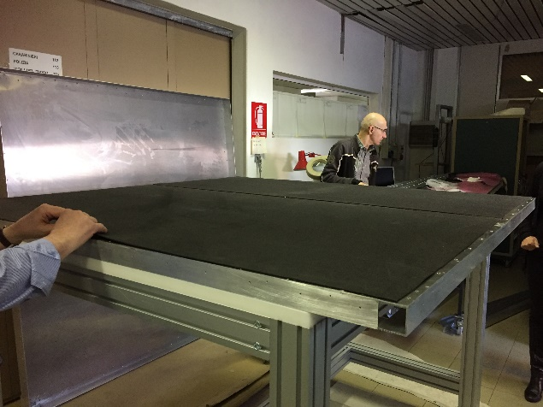
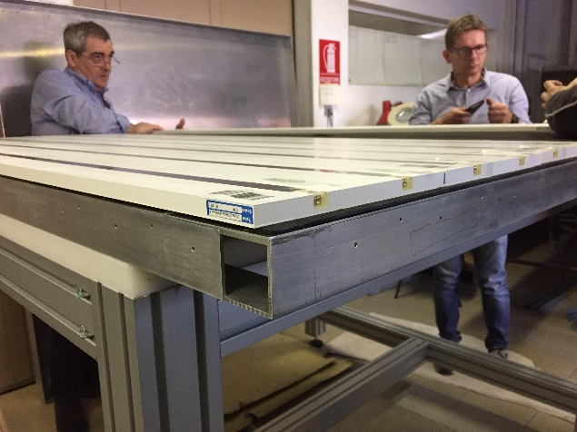
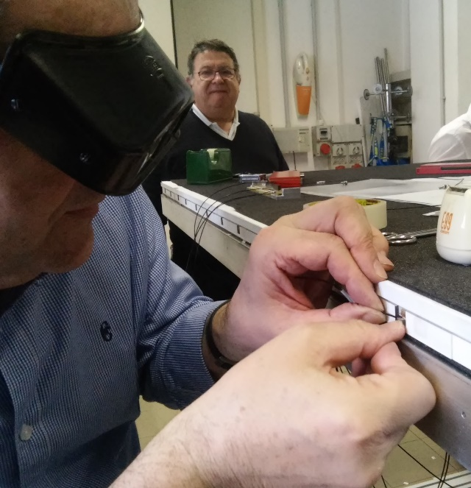
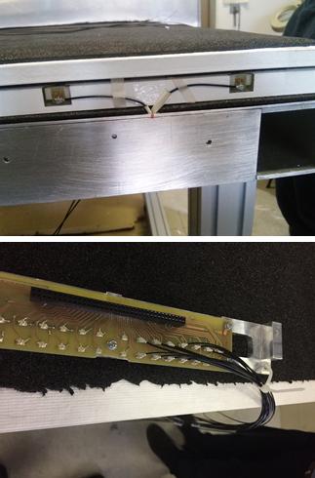
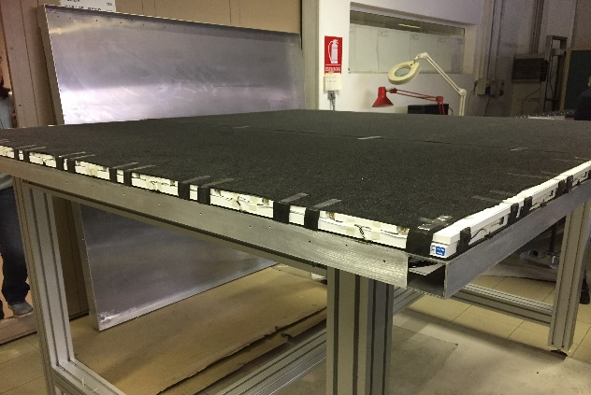
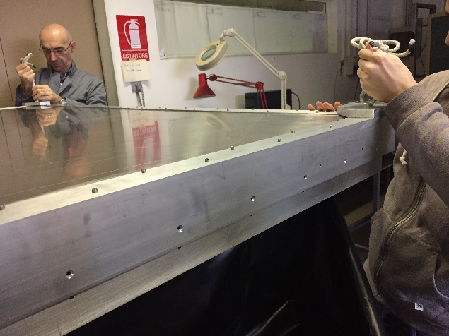
CRT Module Prototype in Bologna: I
Aluminium Box
Assembly
Cabling
Closing
Ready to close

Slide 20
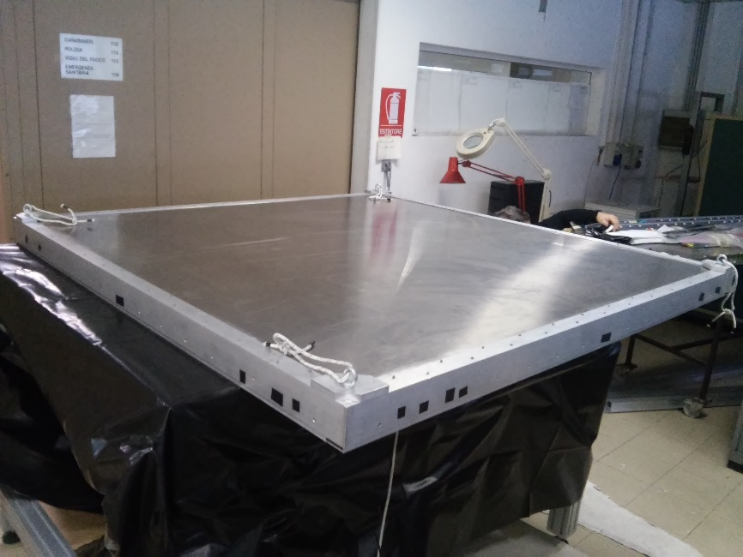
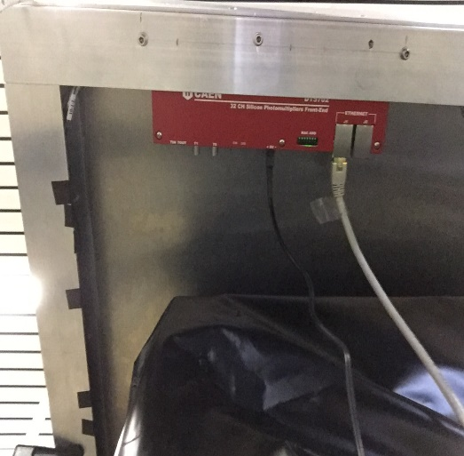
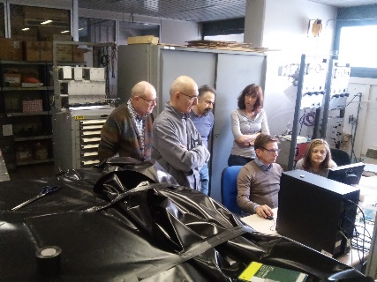
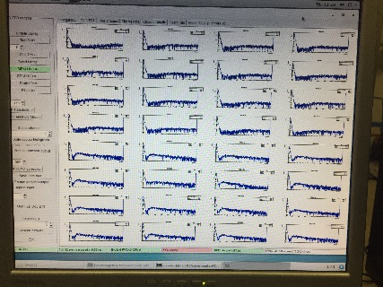
CRT Module Prototype in Bologna: II
FEB accessible from the bottom side of the module
Checking all FEB channels before and after closing the module

Slide 21
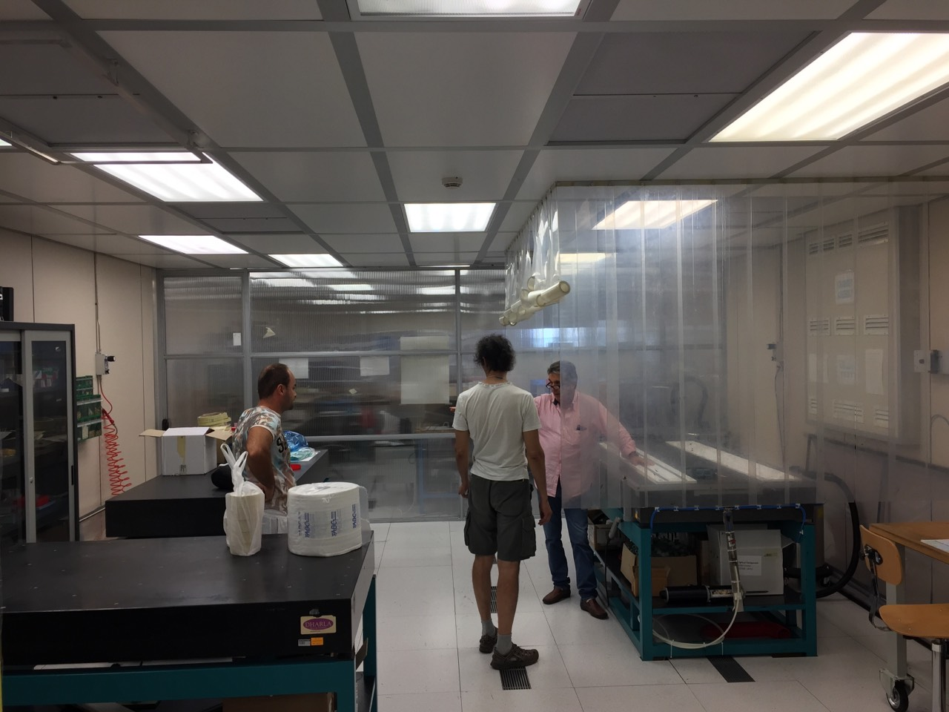
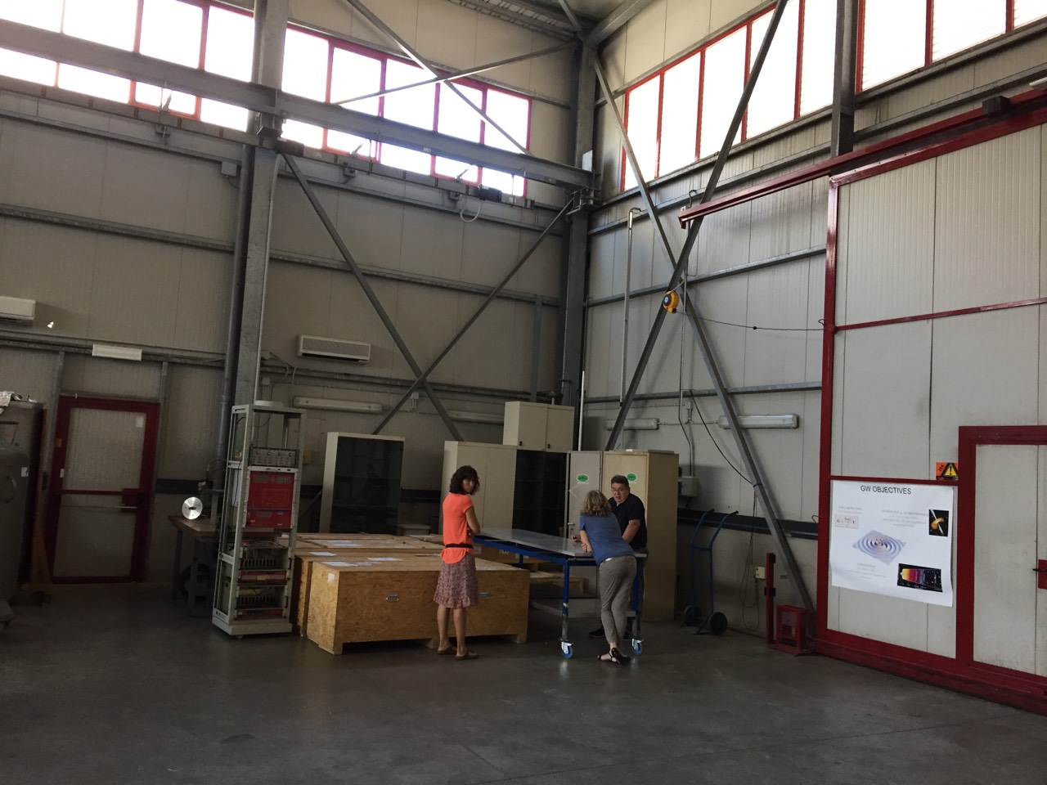
CRT Module assembly in Frascati
Clean room for gluing fibers to the connectors and scintillator bars
Experimental hall for CRT module assembly
Gluing started mid of July and is ongoing
Assembly will start at the end of October 2018.
(Machining of Al profiles finishing within 4 weeks)
Goal to assemble two modules per day.

Slide 22
Top CRT Schedule:
Module Design finalized – February 2018 ✓
Prototyping completed – March-April 2018 ✓
Full test of 10% of scintillator bars for each batch: ✓ following production
Database of all parts and their performances: implemented, being filled
Material Procurement :
Scintillators: 60% produced, last delivery expected November 2018
WLS+SiPM, Micro-coax cable - received ✓
Connectors 50% 3-D printed
Aluminum box in progress
CAEN FEB received (firmware and quality testing underway) ✓
Assembly Lab + construction tools - ready ✓
Module Test Stand (Cosmic Rays) in progress (~ 2 months)
First production module complete - end of October 2018
First modules for inclined TOP CRT parts delivered to Fermilab - depends when we have 38 modules ready to be transported!
The rest of the modules delivered to Fermilab - July 2019
Module installation complete – Summer 2019

Slide 23
CRT DAQ
Work being done as part of the SBN DAQ joint Working Group led by Wes Ketchum
He will report in the SBN meeting on Friday
Other ICARUS collaborators: Bill Badgett (FNAL), Tyler Boone (CSU student)
Test facility being set up at FNAL
New addition: University of Houston (Dan Cherdack)
Will purchase readout electronics and computers
Set up a test station at UH
Will add postdoc and students

Slide 24
Summary
Side-CRT
Modules testing and waiting installation
Photosensors selected and purchase order placed
Photosensors housing designed – prototypes under construction
Production schedule developed
Cable candidates tested – selection imminent
Modules to be installed in ICARUS Hall ~April 2019
Electronics installation and commissioning ~July 2019
Top CRT
Scintillator selected and 60% procured
All SiPMs and readout electronics procured
Prototype modules constructed and tested
Production facility is ready
Complete delivery to Fermilab ~July 2019
CRT support structure designed, parts under procurement
Far Detector CRT system complete ~ late summer 2019

Slide 25
Additional Material

Slide 26
Side-CRT Photosensor Assembly Pre-production Schedule
MPPC PCB/housing prototype fabrication/testing
9/19: Prototype MPPC mount PCB ordered
9/27: Prototype MPPC mount PCB delivered
9/19 – 9/27: 3 sample PCB mount PCB housings/alignment plates fabricated
10/5: 3 test assemblies fabricated & QA/QC tests completed
10/8 – 10/12(?): test assemblies operated at CSU/FNAL
10/15: Test assemblies ready for pre-production review
Cable-strain relief outer housing prototype fabrication/testing
9/28: Cable selection made
10/8: Design complete
10/10: Three 3-d printed prototypes made
10/12: Prototype testing/QC/QA complete (including dark tests)
10/15: Cable-strain relief housing design ready for pre-production review
10/22(ish): Pre-production review(?)
10/29: Release for production

Slide 27
Side-CRT Photosensor Assembly Production Schedule
1/7/19: MPPCs available at CSU, mechanical QA/QC complete
1/14/19: Fabrication of alignment plates begins
Fabrication of PCB housing block mold begins
Fabrication of cable strain relief housing begins
MPPC mounting PCB ordered
1/22/19: MPPC mounting PCBs arrive
1/28/19: First alignment plates arrive
MPPC mounting board/alignment plate assemblies begins
3/4/19: PCB mounting block pieces arrive
First cable strain relief housings arrive
3/11/19: First assemblies complete
4/19/19: Production complete

