Slide 1
ICARUS
Electrical Working Group Kick-Off
Linda F. Bagby
September 20, 2018

Slide 2
Outline
Welcome
Our Mission
AC Distribution and ‘Isolated’ Grounding scheme
Infrastructure options

Slide 3
Our Mission
Generate electronics rack build specifications and graphics.
Donatella and Angela have been instrumental in collecting information.
Summarized in SBN DocDB #1383
Provide design documentation for all custom designed equipment.
Summarized in SBN DocDB #1466
Generate AC and DC power distribution schematics for installation and safety reviews.
Assist with Operational Readiness Clearance documentation and participate in Reviews.

Slide 4
AC Distribution
The AC Distribution has been designed to provide power to individual T300 cryostats.
75kVA transformers are provided for each cryostat (T-300).
All sub-systems are configured to provide services to individual cryostats.
EXCEPT the HV Drift.
Impedance monitor configuration, part of the AC Distribution and Grounding scheme, is an attempt to resolve the general location of a possible short, T300-1 or T300-2.
This talk provides an explanation of the grounding configuration which defines the stability of the experiment’s reference ground.

Slide 5
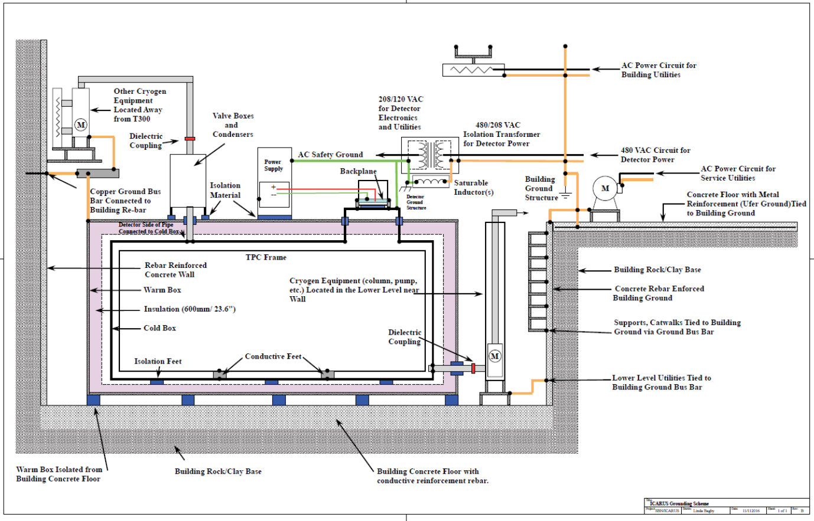
AC ‘Isolated’ Grounding Scheme Graphic

Slide 6
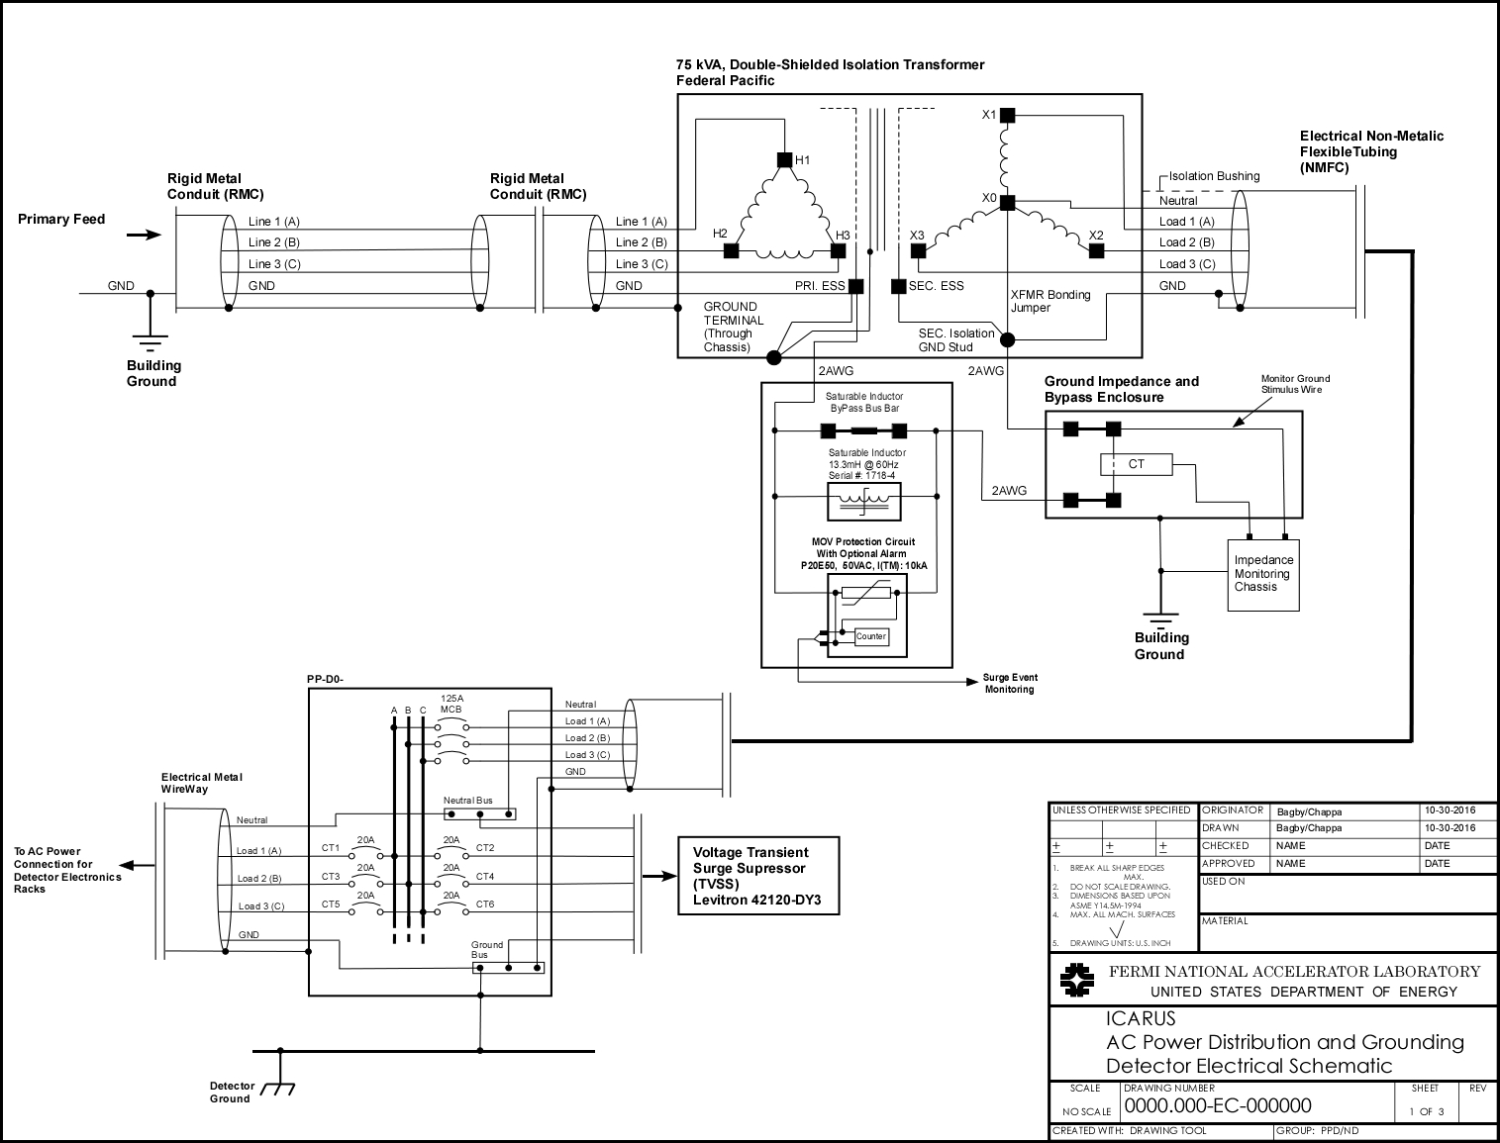
AC Power Schematic
Detector Ground
cable from here
or here

Slide 7
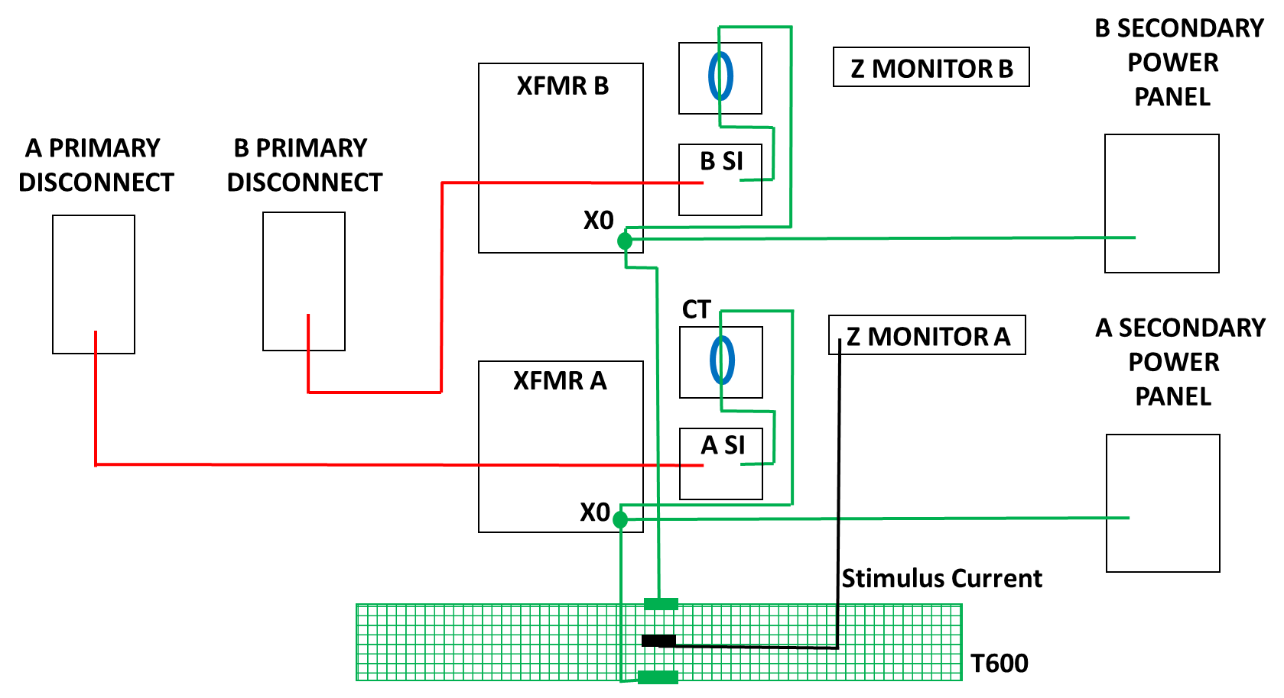
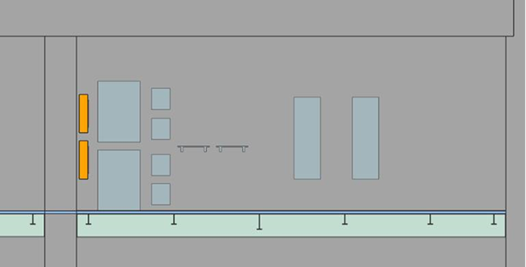
Impedance Monitor Connectorization
Key Parameters
XO cable (Detector ground) must be same length to either side of each T-300.
One stimulus current.
Stimulus connected in center.
Matching Saturable Inductor frequency response.

Slide 8
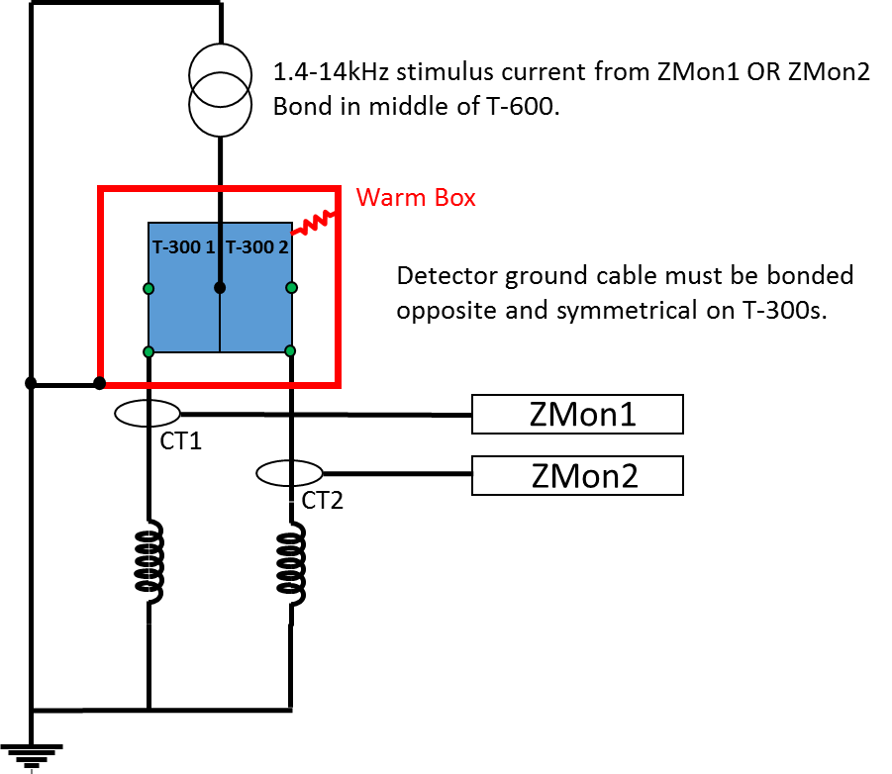
How it works----

Slide 9
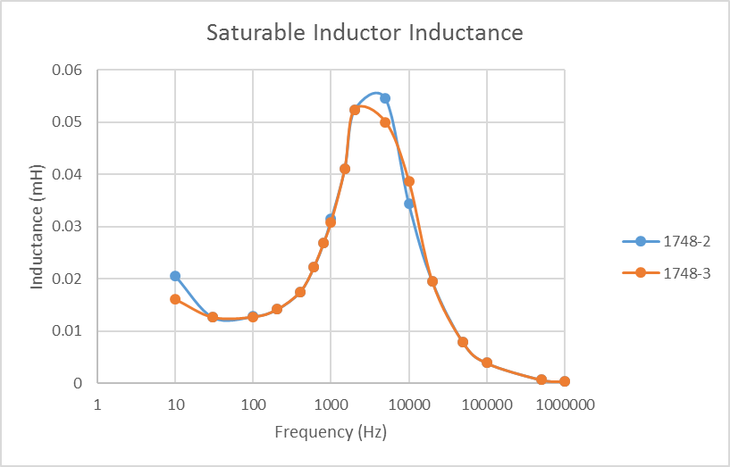
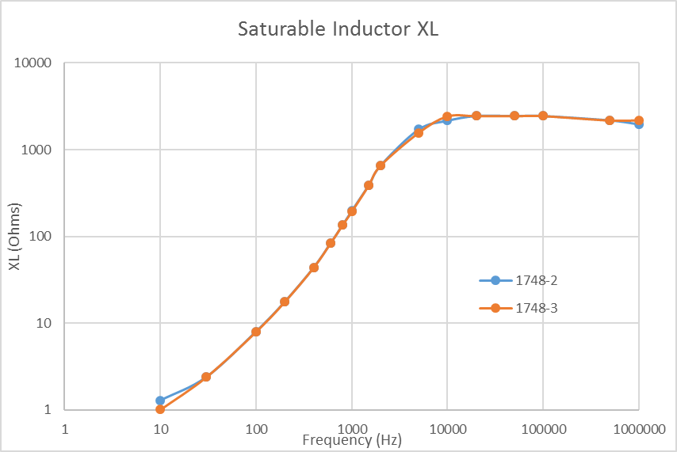
Saturable Inductor Frequency Response
Frequency response curves generated for the saturable inductors to find two that match.
1748-2 and 1748-3 will be used.

Slide 10
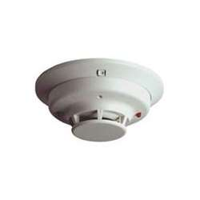
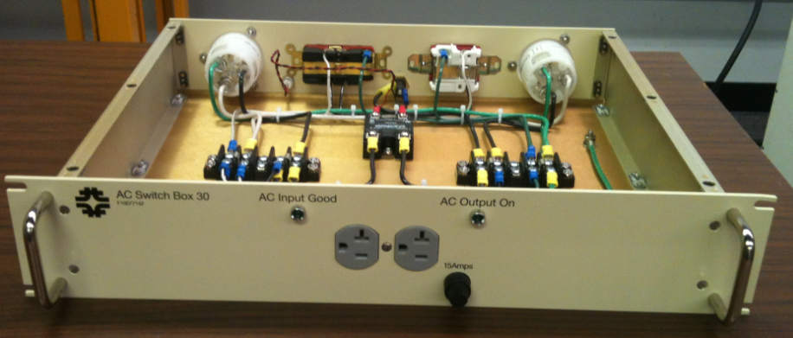
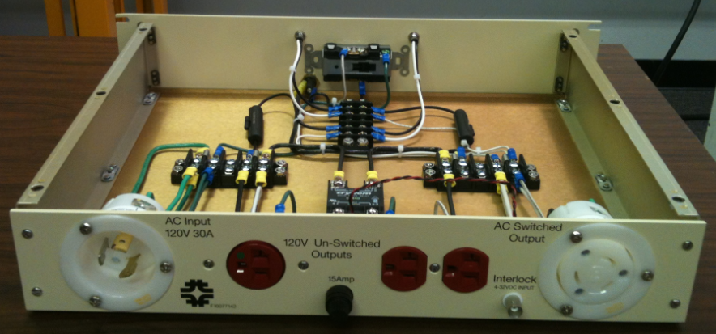
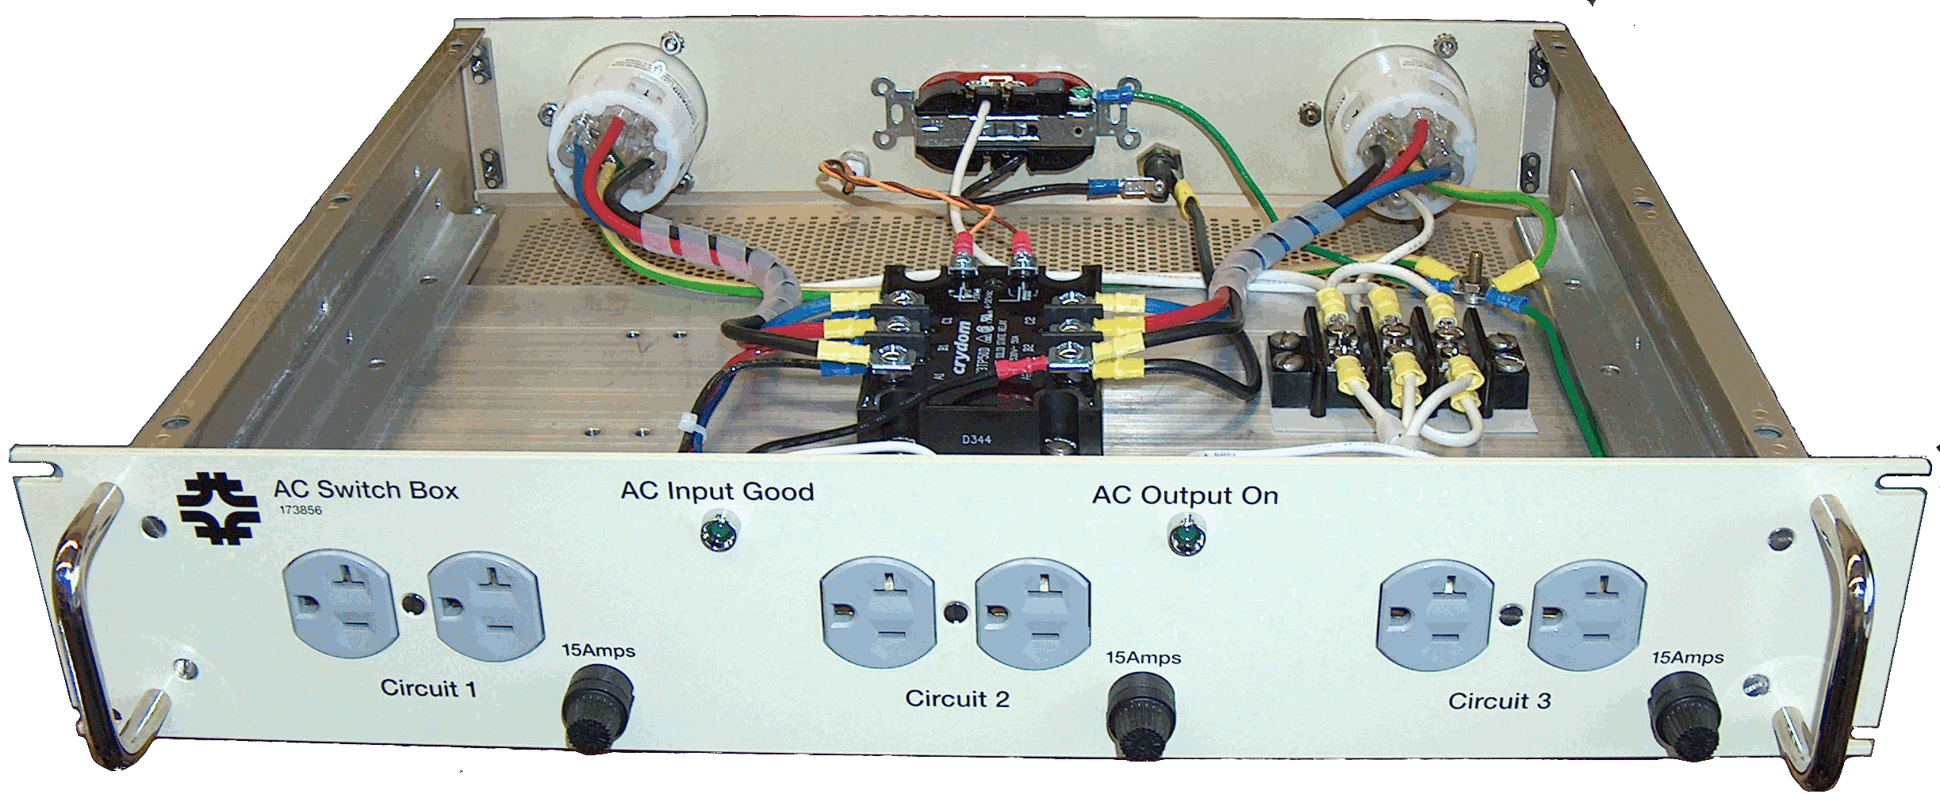
Rack Protection System and AC Distribution Solutions
Sensor System 2W-B or 2WT-B
Photoelectric
smoke/temp (135$°$F) sensor
120V/20A (16A cont.)
120V/30A (24A cont.)
Rack Protection Chassis
208V/3φ/30A (24A cont. / φ )

Slide 11
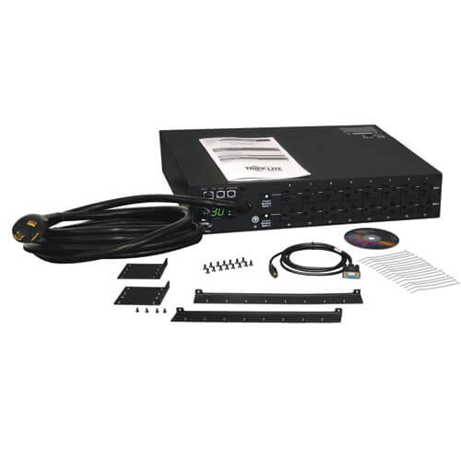
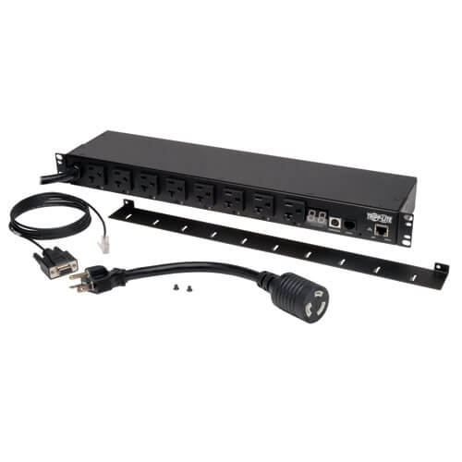
TPC Power Supply AC Distribution Solutions
Managed non-interlockable PDU options
120V/20A (16A cont.)
PDUMH20NET2
120V/30A (24A cont.)
PDUMNH30

Slide 12
Rack AC Distribution Design Requirements
Racks with deep CAEN chassis equipment or DAQ servers requires a ~3’ deep rack to allow room for PDU, cable dressing, maintenance, and air flow.
AC Distribution within each rack will be selected based on the maximum current capability of the equipment. There are 3 options available:
120V/15A (12A continuous)
120V/30A (24A continuous)
208V, 3-phase, 30A (3 banks of 120V/24A continuous)
Maximum current load per circuit is regulated through an engineered hardware design.
Enclosed racks will have a rack protection system equipped with a sensor to monitor smoke and temperature to protect equipment.
Total rack power is limited based on AC Distribution scheme and cooling infrastructure choices.

Slide 13
Summary
The cryostats are solidly bonded together via the thermal shields, the metal compression plates, and additional grounding straps located on the top ends of the cryostats.
The ground reference saturable inductors and connecting ground cables are equivalent to minimize a step function between the cryostats.
Our 1st task is to finalize the AC Distribution scheme of the experiment.
We’ll discuss options after the round table.

Slide 14
Extras

Slide 15
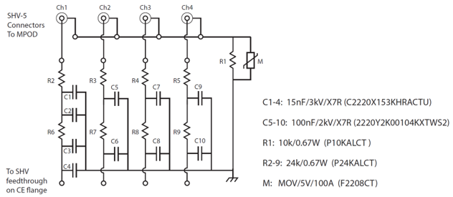
DC Distribution
The TPC power supplies float, meaning the return is referenced only at the TPC warm electronics crate, via the backplane, to the cryostat (Detector Ground).
Where are the PMT power supplies referenced?
Where are Wire Bias power supplies referenced, through a resistor via the filter network? Here’s an example----

