Slide 1
ICARUS TPC-HV Electrical Working Group Meeting
ICARUS AC distribution Drift and Wire Bias AC power source
Alberto Braggiotti
September 19th, 2018

Slide 2
Current plan:
HV Drift and T300-1 HV Bias on Transformer 1
T300-2 HV Bias on Transformer 2
All 40 power chords for T300-1 HV Bias PS’s are distributed to the PSU’s from a single panel powered by a single phase of Transformer 1: Node distribution scheme, no daisy chain, no mesh.
All 40 power chords for T300-2 HV Bias PS’s are distributed to the PSU’s from a single panel powered by a single phase of Transformer 2: Node distribution scheme, no daisy chain, no mesh.

Slide 3
Constraint:
HV Drift is shared by T300-1 and T300-2
➔
T300-1 HV Bias and T300-1 HV Bias must have a common reference of some kind
➔
A connection of some kind has to be made somewhere between T1 and T2
to ensure the common reference
➔
The connection will create the first and only mesh of the entire HV distribution circuit
A mesh is potentially dangerous as it represents a path for current.
We cannot be sure that the mesh will represent the return path for our signals only. Current from other sources might share the same path.

Slide 4
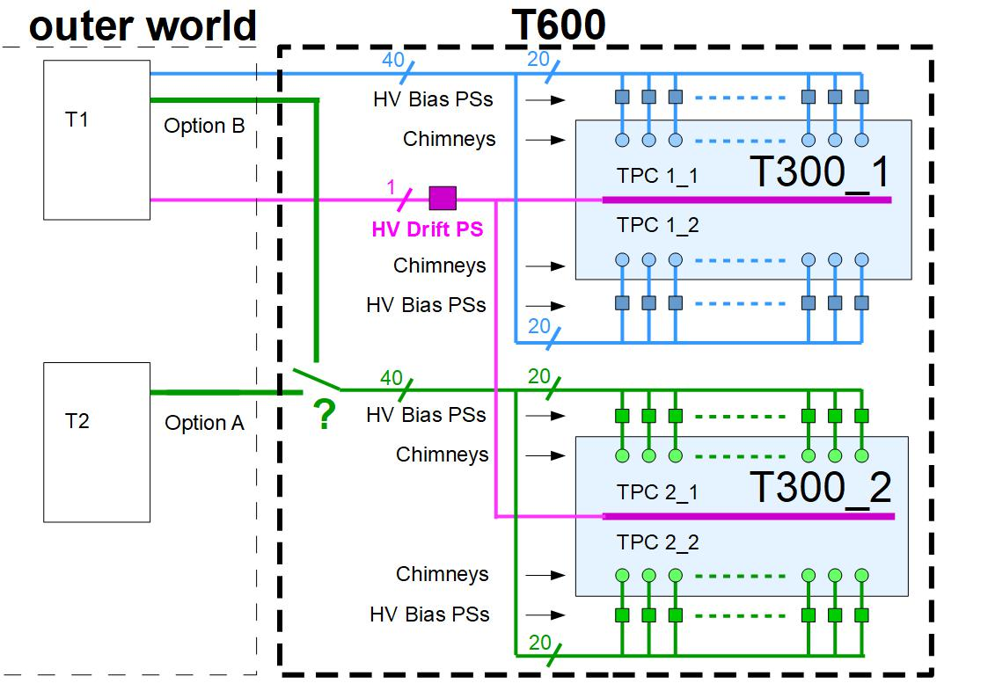
Question:
Do you think it would be advisable to power T300-2 HV Bias from the same phase of transformer 1 used to power T300-1 HV Bias, so to maintain a full node distribution scheme (Option B) and avoid a priori the creation of the mesh and consequently the flowing of unknown currents?

