Slide 1
Report on the activity of Trigger system WG
V. Bellini (Catania)
S. Centro, A. Guglielmi, G. Meng, F. Pietropaolo, S. Ventura (Padova)
A. Falcone, G.L. Raselli, M. Rossella (Pavia)
M. Diwan (BNL) C. Hilgenberg, R. J. Wilson (CSU)
W.F. Badgett, M. Betancourt, A. Fava, W. Ketchum, D. Torretta (FNAL)
V. Paolone (Pittsburg)
G. Petrillo, Y.T. Tsai (SLAC)
J. Assadi, A. Chatterjee, A. Falcone, H. Carranza, J. Yu (UTA)
involved/participating to Trigger WG meetings
co-convener: A.G., the 2nd will be designed by participating US groups
Notes:
1

Slide 2
ICARUS Trigger system
Trigger WG activity started in July defining deliverables/related time schedule with a recognition of needs/ available resources. Meeting documentation is available on SBN DocDB.
ICARUS Trigger will be initially based on the recognition of PMT signals within the gate of BNB/NuMI beam extraction. T600 – BNB clock synchro will be guaranteed at ~50 ps level by White Rabbit system.
The adopted FPGA programmable tables in the Trigger layout will allow to implement step by step complex trigger logics, initially set according to MC events, then tuned on real events to match the actual experimental conditions.
Furthermore this will allow to test directly different trigger configurations to gradually reduce the recorder event rate from 5 Hz of BNB spill to < 1 Hz, depending from the detector noise conditions (~0.2 Hz expected from cosmics + ν-interactions + beam halo events inside the beam spill).
Setting up the Trigger system will involve technical aspects of programming the trigger boards as well as dedicated the analysis of MC events/real data. The careful study of ν interactions vs cosmics is mandatory to implement the trigger algorithm to extract ν signals from cosmogenic background using CRT and possibly then the bunched beam structure.

Slide 3
ICARUS Trigger layout
90 PMTs/TPC are connected to 6 CAEN V1730B boards which produce a set of discriminated output signals in terms of OR/AND of pairs of adjacent PMTs. Trigger logic based on multiplicity/topology of fired PMTs in each TPC will be implemented according to the expected event feature.
Furthermore due to the low energy of BNB/NuMI beams, neutrino events are expected to be spatially confined in a small ~ 3 m long section of T600, involving ~ 15 neighboring PMTs.
PMTs
The analogue sum of 15 PMT signals in a ~3 m slice can be included in the trigger scheme to identify neutrino interaction.
PMT
SPLITTER
90% Signal
To Digitizers
Each PMT line can be split to feed both digitizers and 15 signal adder where waveforms are summed up and then discriminated /digitized.
PMT
SPLITTER
PMT
SPLITTER
To DAQ
Trigger
10% Signal
ADDER
According to ICARUS experiment at LNGS this would increase the Trigger recognition capability rejecting at same time detector noise, and possibly identifying the interested detector region.
The proposed PMT clustering would allow to increase the event recognition capability of Trigger system, possibly identifying the interested detector region.

Slide 4
ICARUS trigger crate
Based on NI PXIe instrumentation: PXIe-8135 CPU, a Real Time (RT) controller, SPEXI board by Incaa Computers and 3 NI boards (PXIe-7820R) for the PMT Trigger and the General Trigger:
RT controller implements all features for communication with DAQ, monitoring of available buffer/veto generation;
SPEXI synchronizes timing of whole detector handles beam extraction messages, and generates signals for TPC readout, Clock & Reset for PMT;
PMT trigger 7820 boards: generate a PMT Trigger & the start to pulse digitizers for PMT activity recording in correspondence of interactions in LAr as detected by PMTs;
General Trigger 7820 board combines PMT Trigger with SPEXI signal to generate a Global Trigger in coincidence with beam extraction from BNB/NuMI (early warning).
ICARUS Trigger NI Crate
S
P
E
X
I
7
8
2
0
R
General Trigger
7
8
2
0
R
PMT
Trigger
7
8
2
0
R
PMT
Trigger
RT Controller
8135
CPU
Dedicated algorithms will be implemented in PMT Trigger Logic to select ν events from of cosmics.

Slide 5
PMT DAQ + Trigger Test Bench/Studies
A test bench set-up to test V1730B PMT digitizers and FPGA programming, test of 7820 board + SPEXI board + 8135 CPU + LVDS-TTL level-shifter:
Programming of trigger logics and measuring the occurring rates of different configurations in terms of coincidence/majority of PMTs;
Programming SPEXI to generate TT-Link, Clock & Beam Gate signals to be combined in the PMT trigger;
Clock distribution/synchronization of different boards; timing resolution of different PMT ‘s lit by the laser to optimize the PMT time alignment.
Firmware for programming FPGA:
VHDL codes for generating TT-Link and clock are ready for test (Padova);
VHDL codes for reception of beam Early Warning in preparation (Padova);
LabVIEW driver for SPEXI/FMC-DIO hardware in preparation (Pavia).
Software for WR calibration/configuration is being prepared by FNAL group. Latency tests and beam counter signal tests in progress.
Study of both beam and cosmic MC events from point of view of PMT response planned according to Software WG activities: waiting for the first MC event release.

Slide 6
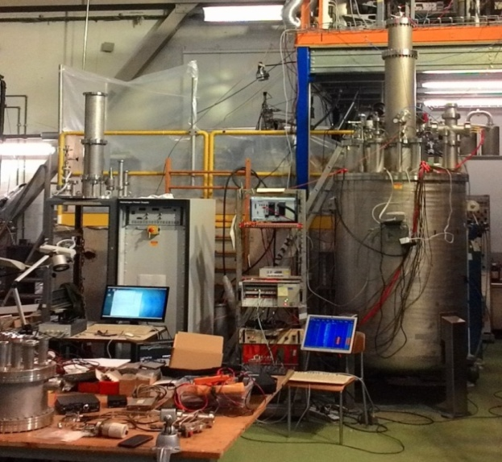
LAr test facility to test DAQ/ Trigger systems (CERN)
A small scale LAr test facility is ongoing at CERN to test DAQ, on-line and define electronic synchronization (trigger/wire/PMT) and the DAQ timing.
10 R5912 Hamamatsu PMTs equipped with laser calibration system are arranged into ~1600 liters LAr cryostat exposed to c-rays /α source inserted in LAr
PMT array is complemented aside with the already operational ICARUS 50 l LAr-TPC to perform synchronous DAQ for both PMTs and TPC wire Signals.
Cosmic muons crossing both TPC and PMT dewar will be selected by external plastic scintillators.
PMT waveform recording, initially performed with CAEN software, will later be based on ArtDAQ
Also a test bench for prototypes or components of trigger system, i.e. analog adders, level shifters and laser components.
Extendible
feed-through
Dewar cap
Scintillator
LAr
Scintillator
Cosmic
Ray
50 l
LAr-TPC
Alpha
Source
10 PMTs
ELECTRONICS
DEWAR

Slide 7
Monte Carlo studies plans
Trigger studies using Monte Carlo simulation:
Animesh Chatterjee, Andrea Falcone, Gianluca Petrillo, Yun-Tse Tsai (within the trigger group)
more people (and also support from software working group) welcome!
Goals:
determination of thresholds and topology for trigger settings (end of 2018)
estimation of trigger efficiencies for selected signal processes (spring 2019)
estimation of the trigger rates for DAQ (spring 2019)
with commissioning data, measure trigger efficiency (summer 2019)
Other tasks:
understand CRT and how to take advantage of it
consider whether TPC may help with triggering on wires
make a plan for trigger efficiency measurement from data (including how much zero bias data is needed, the matching with different subdetectors…)

Slide 8
Planning for implementation of Trigger system
A tentative time schedule: to be discussed
Sept ->: study of both cosmics/ ν interactions MC events (previous slide)
Oct: test of beam signal receiving/decoding (SPEXI board) at Fermilab
Sept- Jan ‘19: test of DAQ, timing of event building, LAr-test facility CERN
Feb ‘19: test of trigger gate generation with beam signals
Mid Feb: DAQ/Trigger ready for installation; test-pulse on 1st T300
March: completion of trigger installation on 2nd T300
Mid June: activation/commissioning of T600 Trigger/data taking with c-rays, BNB and NuMi beams;
Mid July: post commissioning run: detector calibration and trigger studies;

