Slide 1
Installation Progress
Aria Soha, Installation Working Group
ICARUS Collaboration Meeting
19 Sept 2018

Slide 2
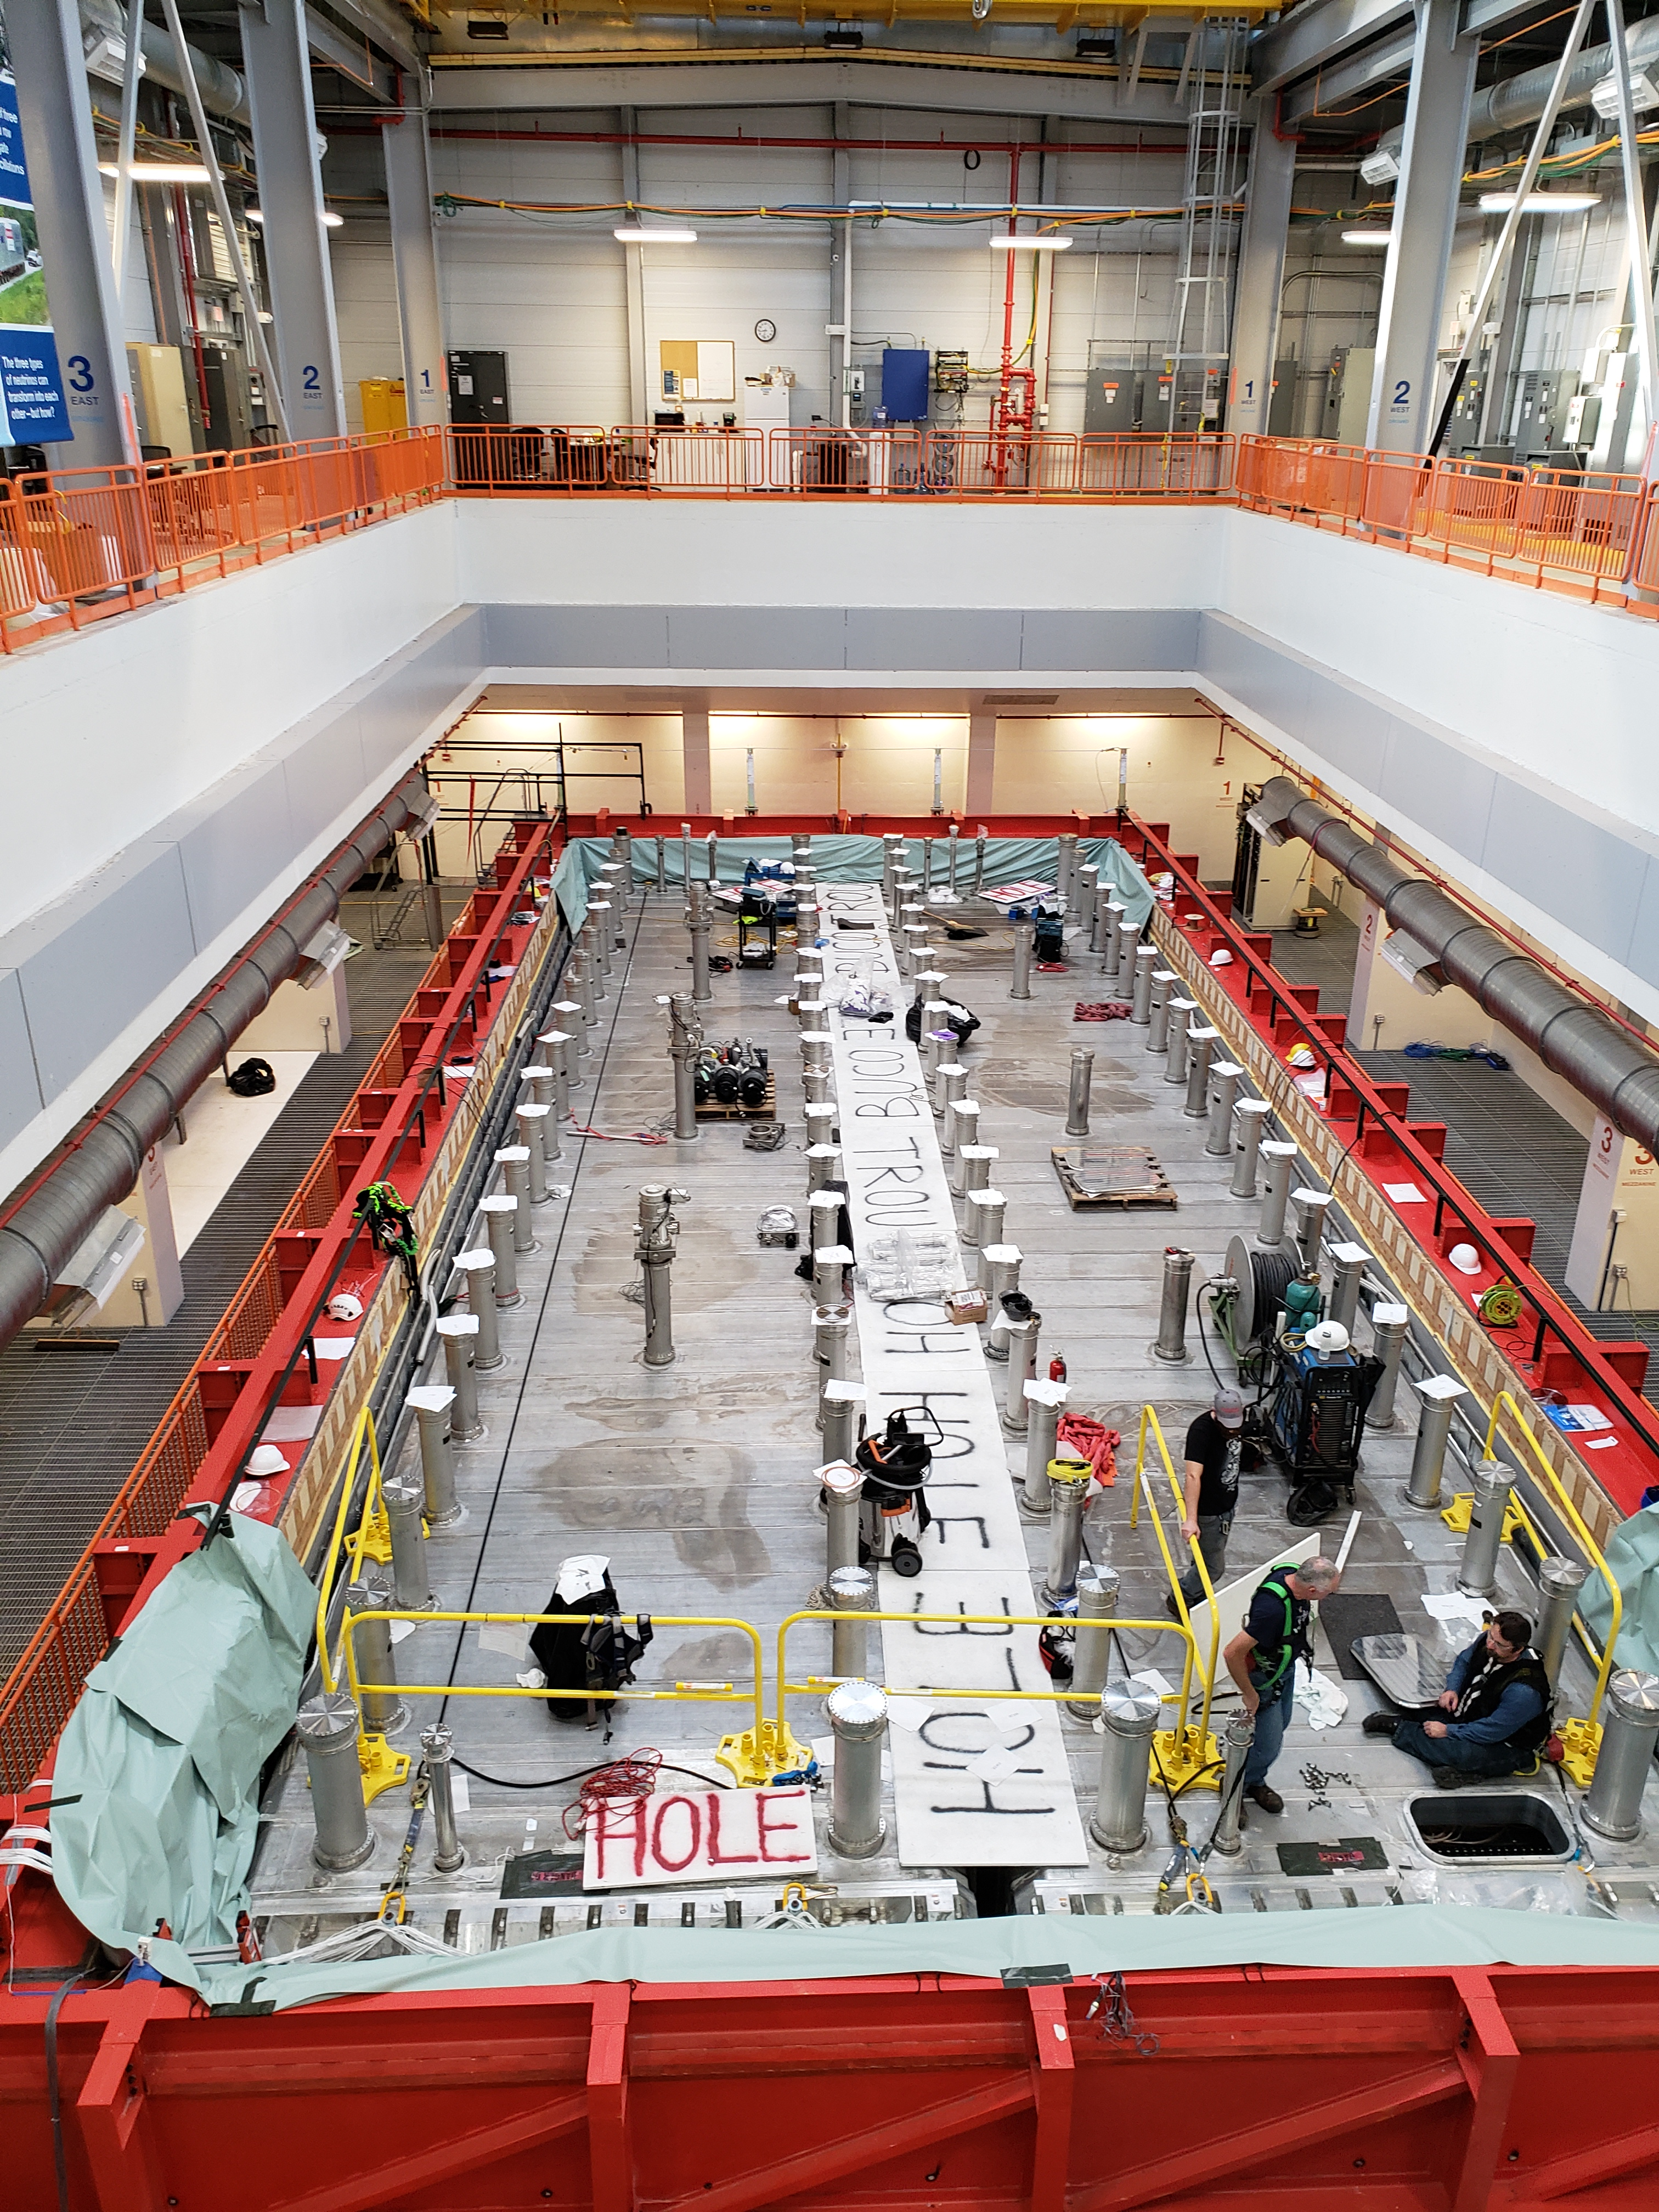
Current Status
Chimney Installation Complete
Side Penetration Job Complete
Man holes 7942 In Progress
Vacuum Equipment Installing
Test placement of Warm Vessel roof piece on Friday morning
Proto-typing the decking in SBND with 3 south most roof pieces

Slide 3
Current Status
Cold Shield supply lines
  Ready to weld spool pieces on supply lines
Installation of Guardrails 8080
  Will start grinding edges where box beam goes
  Waiting on stud gun & part to begin outside
Piping work in chase can continue 7170
  Needs to be complete before cyo platform goes in
  Bob is working on Muon; Need parts?
Instrument air skid in place. (needs electrical work) 7918

Slide 4
Short-Term Schedule
Grounding tied together for vessels – waiting on safety line removal
Vacuum test – Sept 21 – 28
  Setting up now
CRT steel to be installed – Sept 18
  Fit Up Steel Framing (3 days) Tue 9/18/18 Thu 9/20/18
  Remove Steel Framing (2 days) Fri 9/21/18 Mon 9/24/18
  EC 01 Install Cryo Platform (8 days) Thu 9/20/18 Mon 10/1/18
  EC 01 Install Cryo Grating (2 days) Wed 9/26/18 Thu 9/27/18
  EC 04 Stair Installation (2 days) Mon 9/24/18 Tue 9/25/18
Terminating Strain gauge cables
  Sean Johnson will get plan from Marzio/Olga
Install & weld cold shield top panels & return lines – Oct 1-8
Pressure test of full cold shield loops – Oct 9-12
Need a Low-dust area to work on HV flanges – 3 East bay?

Slide 5
Long term schedule
Shifting Detector Electrical power from East to West?
Install Warm Vessel Roof Pieces – Oct 15 (5 wks)
  Cut adjustments to holes – Test on Friday
  Weld Warm Vessel Roof (Bold later)
  Leak check Warm Vessel *
American Thanksgiving Holiday Nov 22-25
Install side CRTs?
Install grid decking – Dec 3-14
Install pipe stands, valve box stands – Dec 17-21
Install Crosses – Dec 17
Install AC distribution on top of vessel
Demaco – January 2019

Slide 6
A New Policy – Work Planning
Work groups may not be aware of each other’s plans
Implementing a policy based on CERN
Planning work makes everything more efficient and less stressful

Slide 7
How to plan
Write down
  what you want to accomplish
  the steps to accomplish it
  The people (names and/or roles) needed to accomplish it
  The equipment/tools/materials needed
  Pre-conditions (what needs to be in place before you can do it)
  Schedule constraints (Does it have to happen before something? Are there experts only available at certain times?)
  Do you need Engineering documents?
  Do you need a written Hazard Analysis
Submit a Work Request here: https://goo.gl/forms/7qgOR6WtzXTAdc7W2
Present your plan at a scheduled meeting
Revise your plan as needed
Get approval
Work is Scheduled

Slide 8
Work Plan Approval
ICARUS Installation Coordinator
(Aria Soha)
ICARUS Technical Coordinator
(Claudio Montanari)
Environment, Safety & Health – Angela Aparicio
Floor Manager – Kelly Hardin
Program Engineer – Barry Norris
Program Electrical Coordinator – Linda Bagby
Infrastructure Technical Coordinator – Cat James
Program Coordinator – Peter Wilson
Deputy Technical Coordinator – Angela Fava
Once approved, Note will be made in elog

Slide 9
Active Job Plans: Approved, Submitted, Planning
7170: Installation of piping in SBNFD crawl space (Phase 2) – Geynisman & Tillman
7942: Welding Access ports shut – Geynisman/Wilson
7918: Installation of Instrument Air Skid – Geynisman
  Need electricians
8080: Installation of Guard Rails – Cat James
  Ordering stud gun & part….
8245: Installation of Cold shield phase 2 – Montanari & Zuckerbrot
  Need Drawings from Claudio
  Need to understand support for supply lines after 90 bend

Slide 10
To be Scheduled:
Warm Vessel Roof – Nessi or designee (in a couple weeks)
Installing the condensation prevention system – Nichols
Side CRT Installation – Cat James
Installation of Decking – Cat James
Installation of AC Power Distribution & Racks – Torretta
Installation of Pipe Stands & Valvebox stands – Geynisman
Cryo Controls – Nichols
Cable Trays – Bagby/Torretta
Gas Sealing of the Warm vessel (boots?) – Montanari
What are You working on?

Slide 11
Thank you for your attention
Additional Slides

