Slide 1
Status of MCC11
T. Yang
ProtoDUNE Sim/Reco Meeting
Aug 29, 2018

Slide 2
Plan for MCC11
Changes/updates in MCC11
Readout window size reduced from 10k to 6k (Leigh Whitehead)
Beam instrument information (Pablo Fernandez, Leigh Whitehead)
Updated CRT locations (Martin Tzanov)
CRT readout simulation (Andrew Olivier)
Updated space charge effects with liquid flow (Mike Mooney, Hannah Rogers, Erik Voirin)
dQ/dx and dE/dx calibration and database interface (Ajib Paudel, Jon Paley)
Improved Pandora reconstruction (Steve Green, et al.)
Updated photon detector channels (Alex Himmel, Chris Macias)
Other incremental improvements
Test sample using v07_02_00:
/pnfs/dune/scratch/users/tjyang/MCC11-test/ProtoDUNESP/v07_02_00/reco/mcc11_protodune_beam_p-7GeV_cosmics_3ms_sce/files.list

Slide 3
Issues resolved
Alex fixed the photon detector channel numbers
He will give a talk on this later
Fixed in dunetpc v07_03_00
SCE electric field map was fixed
Ajib found a problem with the implementation of electric field map with SCE
Hannah confirmed and fixed the field map
Fixed in dunetpc v07_03_00
Chris Backhouse fixed an issue in SpacePointSolver to handle hits with negative width
Fixed in this week’s larsoft release

Slide 4
Changes to low level reconstruction
Noise filter will be changed from Wigner filter to Gaussian filter in deconvolution to reduce wiggles.
GausHitFinder will be configured to reconstruct a series of narrow hits for a long pulse (Bruce)
Wigner
Gaussian

Slide 5
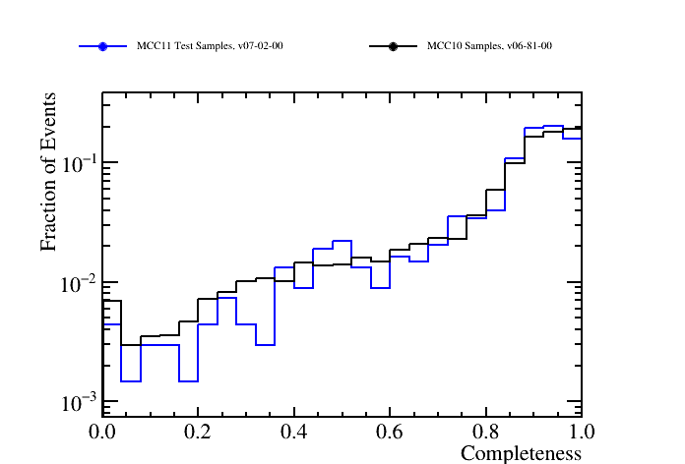
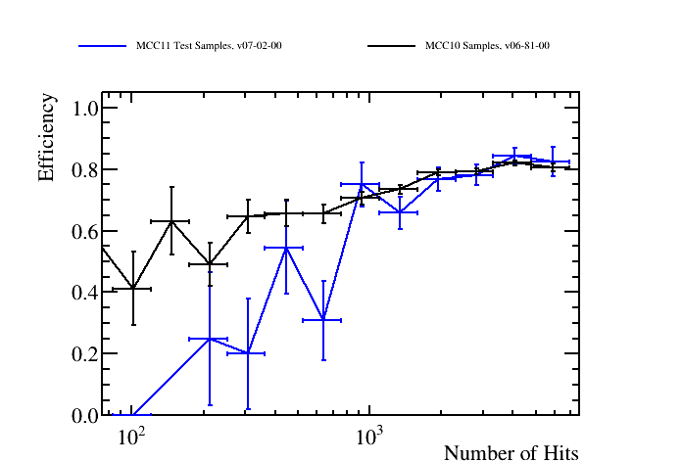
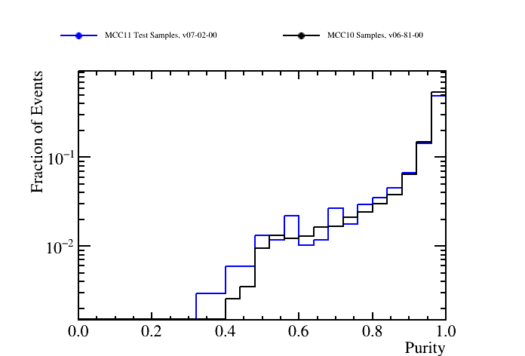
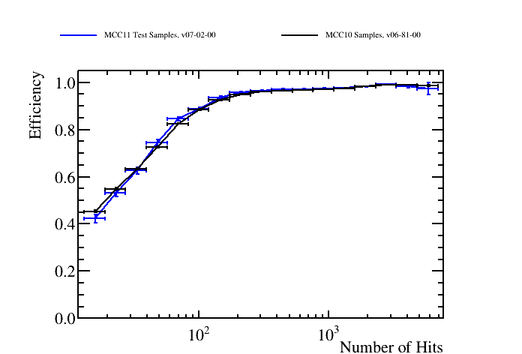
Pandora Validation
Steve Green

Slide 6
Plans
Start MCC11 simulation with v07_03_00.
Start MCC11 reconstruction with v07_04_00.

