Slide 1
Summary
Argonne workshop
14 August 2018
Marcel Demarteau & Dave Nygren
University of Texas at Arlington
Argonne High Energy Physics Division
September 29, 2018
Fermilab, Batavia

Slide 2
Background
A Brief Historical Perspective
LBNF/DUNE is the flagship program for the US with a significant capital investment that promises to make definitive measurements in the neutrino sector
Dave and I asked ourselves the question:
Is the current technology optimized for DUNE to be a discovery machine, given that much is likely to be known in the neutrino sector when DUNE starts to take data?
We answered, for ourselves, that question in the negative.

Slide 3
Background
A Brief Historical Perspective
LBNF/DUNE is the flagship program for the US with a significant capital investment that promises to make definitive measurements in the neutrino sector
Dave and I asked ourselves the question:
Is the current technology optimized for DUNE to be a discovery machine, given that much is likely to be known in the neutrino sector when DUNE starts to take data?
We answered, for ourselves, that question in the negative.
Enter CPAD meeting at Caltech
on October 13, 2017:
“Must think out of the box! (perhaps
over the cliff … )”
Proof of Concept in IceCube:
Clocks ±2 ns rms within 1 km³ of ice,
with oscillator precision ~1 x 10^{–10}/s
Decided to have a small ‘brain-storming’ workshop ….

Slide 4
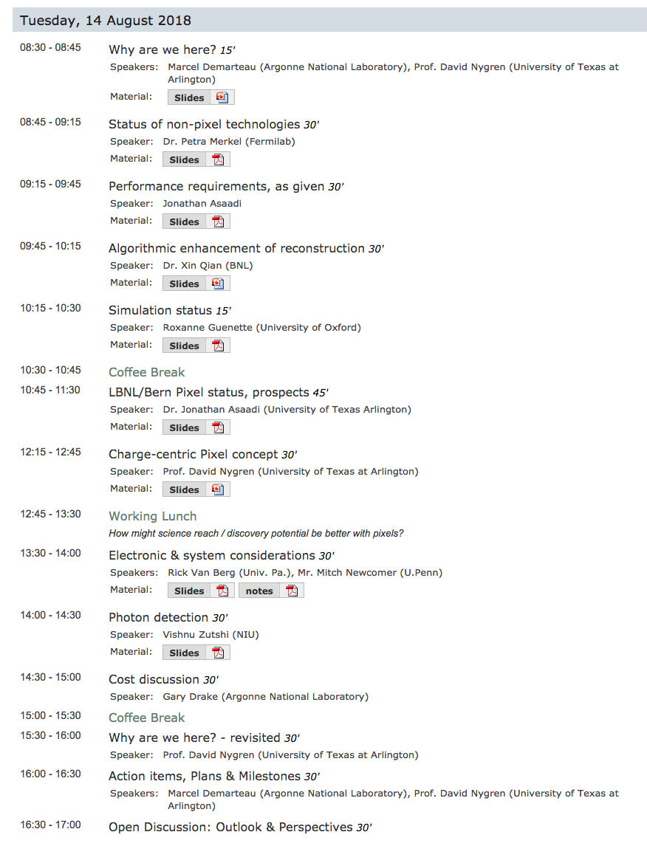
Workshop agenda
Aspirations of the Workshop
What are the current performance metrics ?
  single-phase, dual-phase, …
What are the limitations and challenges of the current technologies ?
What is needed to know whether pixelization is beneficial for FD optimization ?
Is it conceivable that FD pixelization is both technically possible and affordable?
What is the status and promise of current approaches to pixelization of LAr TPCs?
What is the sense of overall feasibility including schedule and demonstrators?
What actions should / should not be undertaken to understand opportunity ?

Slide 5
metrics…
Defining The Metric for Pixel Readout (Jonathan)
5-7 April 2017
For the Far Detector, to be able to move forward, the metric that demonstrates the scientific advantages of pixelated readout will have to be demonstrated quantitatively.
What other quantitative measures can we define for discovery science?
5 years !

Slide 6
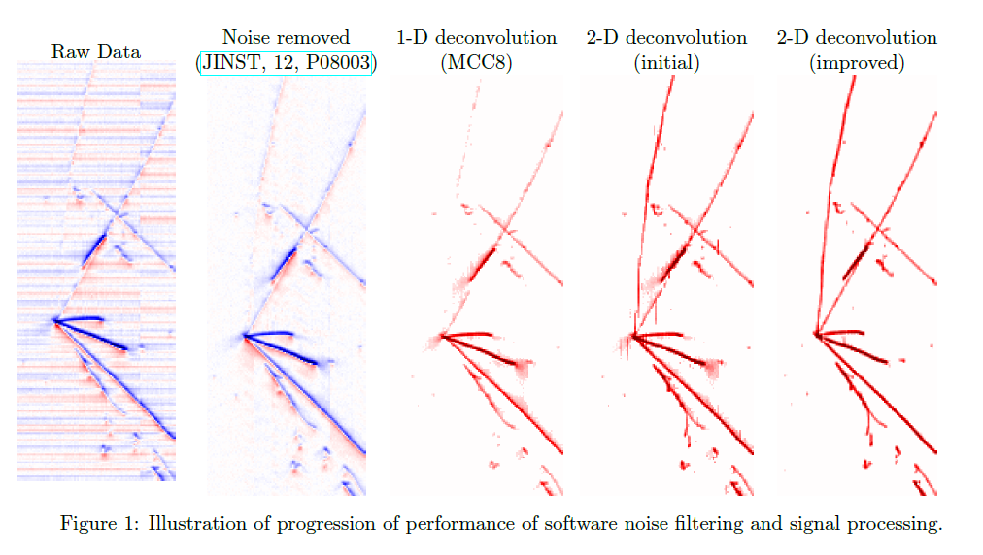

Evolution of Signal Processing in MicroBooNE
Algorithmic Enhancement of Track Reconstruction (Xin)
MicroBooNE: JINST 13 P07006/P07007 (2017)

Slide 7
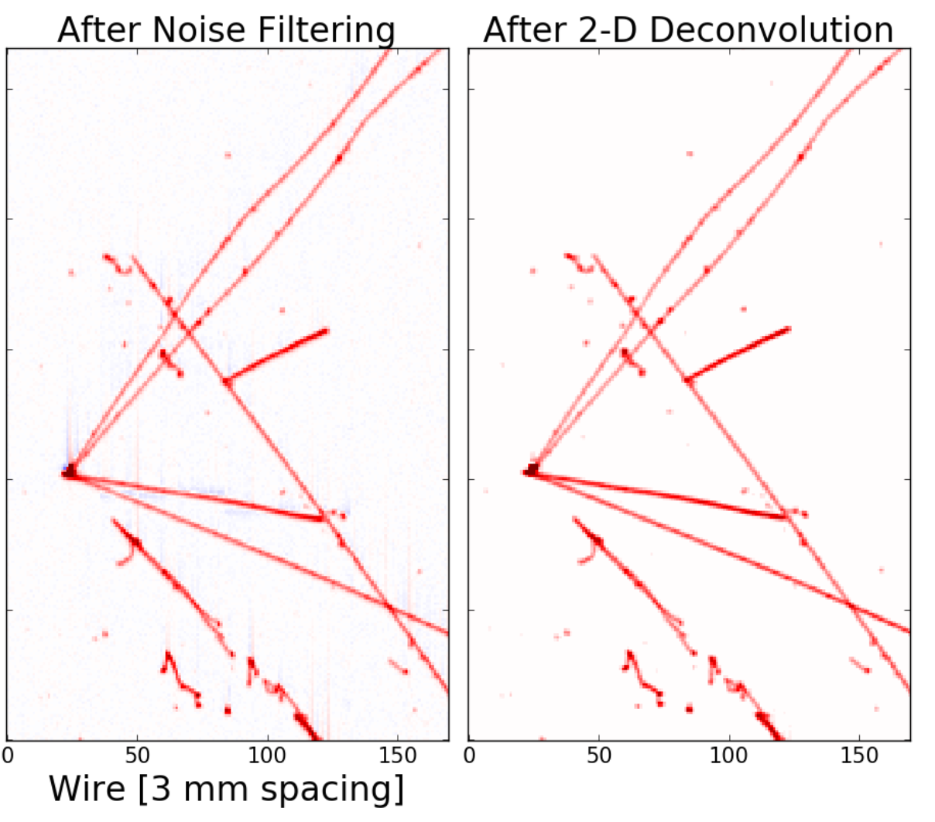
Thoughts on Pixel Readout
Requirements for Reconstruction (Xin)
Statistical uncertainty of charge determination
  Control electronics noise → low ENC
  Ability to filter electronics noise is desired → scheme of zero suppression
Systematic uncertainties of charge determination
  Field response
    Scheme of zero suppression, grid plane
  Electronics response
    Uniformity and calibration
  ADC performance
    Nonlinearity and calibration
Charge readout must respect the fully-active detector design
  No gap is crucial for subsequent pattern recognition steps

Slide 8
Event reconstruction
Comparing 2D vs 3D Reconstruction using ML (Roxanne)
Parameters of the study:
  BNB energy spectrum; peak at 800MeV, lower than DUNE
  No signal digitization for the pixels
  Noise not included
  2D: 3mm x 3mm; 3D 1.2cm x 1.2cm

Slide 9
System aspects
Readout, Rates, Data Volume, … (Rick)
Assume 5 mm x 5 mm pixel → 500 x 1200 for DUNE APA = 600,000 pixels
10 MBq/cavern → 50,000 ³⁹Ar / APA volume / sec
  Pixel # - 20 bits
  Time – 32 bits (if 2 MHz clock, rolls over in ~ .5 hour)
  Charge – 8 bits
  → 8 B / hit → 400 kB/sec (peanuts!)
Take 64 channels per chip, ~10,000 chips per APA
Cheap circuit boards want to be < 22” x 22” so 0.5m x 0.5m PCB
  10,000 pixels per board → 156 chips/board and 60 boards per APA
Energy sensitivity down to near ³⁹Ar level –so “trigger” at a few MeV or less, which sets a noise level of << 1,000 e-
Rate capability:
  assume nearby SN, >10⁶ events in 10 sec so >> 1 hit per second per pixel
  Or, if track perpendicular to pixel plane ~ 100 hits in 0.5 ms
Required deep first stage buffer or readout at hundreds of kHz / hit – shared buffers in front end chip probably best but need simulation

Slide 10
Photodetection
A Non-trivial Issue (Vishnu)
Light yield for Arapuca like design
Simulated dark matter density in a large cluster of galaxies, using ALCF

Slide 11
Photodetection
A Non-trivial Issue (Vishnu)
SiPM possibilities
Xe doping, amorphous Se, … ?
Simulated dark matter density in a large cluster of galaxies, using ALCF

Slide 12
conclusion
A Theory Program Poised for the Next Decade
We carry a responsibility as a community to optimize the DUNE detector for discovery
All current LAr projects are very informative and form the foundation for our current efforts looking into advanced technologies that may offer unanticipated advantages
There is a lot of common ground between the pixelated readout efforts for both the Near and Far detector
One of our goals today is to continue on the path set by the Argonne workshop to develop a coherent plan that advances pixelated readout for LAr as a pathway for maximum sensitivity to new physics at the threshold of detection

