Slide 1
Q-Pix: Pixel-scale 3-D Signal Capture for the DUNE Far Detector
David Nygren
University of Texas at Arlington
29 September 2018

Slide 2
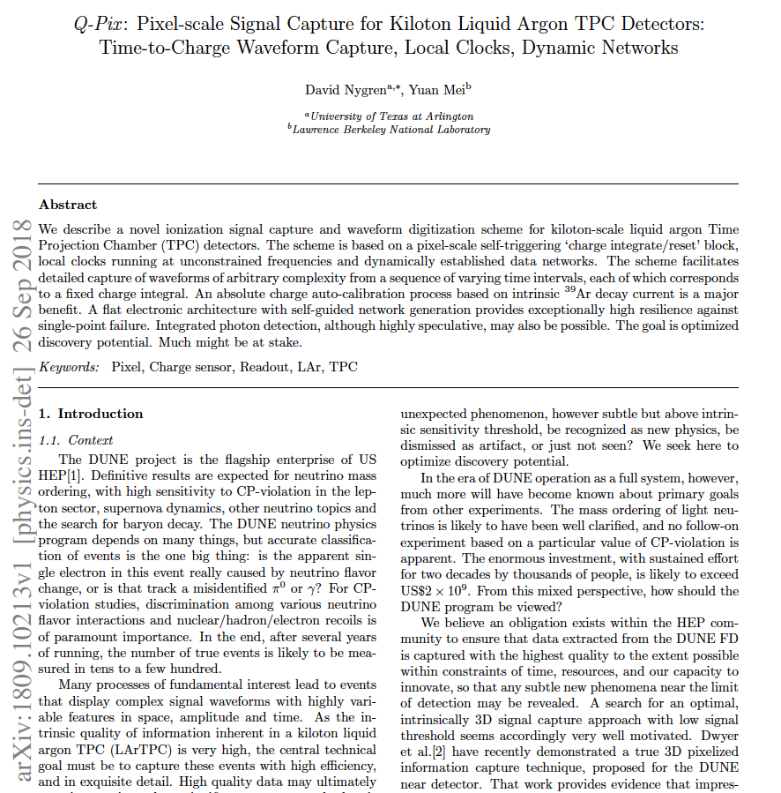
Available yesterday

Slide 3
Q-pix
Goal: Optimized discovery potential !
LAr TPC: information quality is very high
Technical pathway must:
capture information without compromise !
maintain intrinsic 3-D quality !
Aspiration: complete pixelization of DUNE FD
Immense FD scale → unorthodox solution
Electronic principle of “Least Action”
New approach: measure time-to-charge: ΔQ

Slide 4
Q-pix
A genuine innovation for signal capture:
Detailed waveforms provide:
track profiles, track continuity, dE/dx, …
Exploit ³⁹Ar decays to provide:
automatic absolute charge-energy calibration
High intrinsic single-point-failure resilience
→ Electronics permanently immersed in LAr
Allows maximal functional devolution
Novelty does not automatically confer benefit!
Much remains to be explored…

Slide 5
The Charge Integrate-Reset (CIR) Block
“reset” switch
ΔQ = C_{f}V_{th}
Out = “reset”
A = Charge sensitive amplifier
S = Schmitt trigger
V_{th} = threshold

Slide 6
The “Advanced” (CIR) Block
“reset” switch
ΔQ = C_{f}V_{th} ~ 0.7 fC
Out = “reset”
A = Charge sensitive amplifier
S = Schmitt trigger
V_{th} = threshold

Slide 7
Measure time of “reset”
Clock: local (within ASIC) oscillator free-running at 50 – 100 MHz
Basic datum is 64 bits: 32 bit time, pixel addresses, ASIC ID, …

Slide 8
What’s new here?
Take the difference between sequential resets
This is the Reset Time Difference = RTD
Total charge for any RTD = ΔQ
RTDs are not generated at ASIC level;
RTDs are computed off-detector (GPU)

Slide 9
RTDs capture the waveform !
RTD measures instantaneous current
Small average current (background): Large RTD
“Background” current from ³⁹Ar is ~100 aA
Large average current (signal): Small RTD
Typical track current from min-I is ~1.5 nA
S/B ~ 10⁷
Background and signal are easy to distinguish

Slide 10
The two RTD patterns
Seconds
µs

Slide 11
Signal Characteristics
Choose ΔQ such that Min-I track will cause several resets during one track arrival:
Choose ΔQ = 0.7 fC
Signal: a contiguous sequence of small RTDs
A conventional current waveform of arbitrary length and complexity can be reconstructed from the RTD sequence.

Slide 12
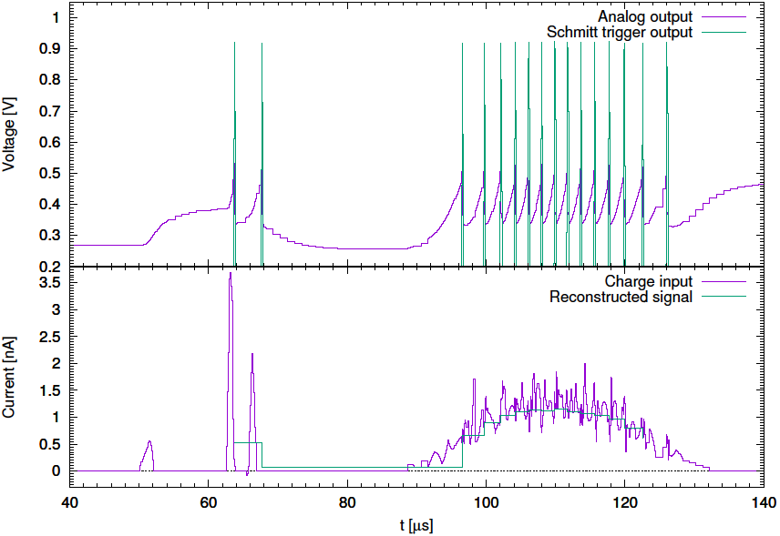
ΔQ ~1.0 fC

Slide 13
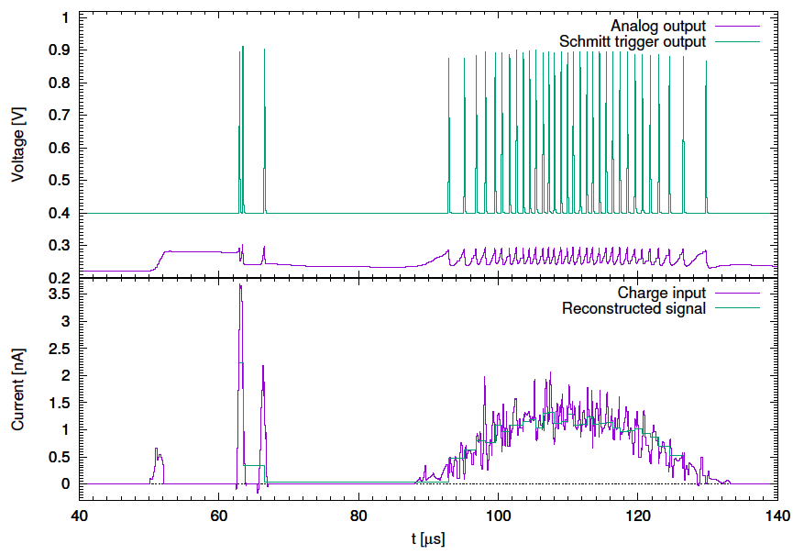
ΔQ ~0.3 fC

Slide 14
Signal capture: summary
RTD = inversely proportional to input current
Background: ³⁹Ar decays lead to ‘heartbeat’
heartbeat RTD ~11 seconds
automatic absolute charge calibration
Signal: typically a few na, → RTD < 1 µs
Five or more contiguous small RTDs
Easy to recognize signal against background!
No signal differentiation! (unlike induction wires)

Slide 15
Time-stamping: how does that work?
One clock per ASIC, runs freely at f ~50 - 100 MHz
No phase-locked loop
Requirement: Local clock must be stable:
δf/f < 1 x 10^{–6} per second
Time-stamping routine:
Once a second, ask ASIC “What time is it?”
ASIC captures local time and sends it @ ~1Hz
Simple linear transformation: T = A•F/f + B
F is master clock synched to GMT

Slide 16
This method is proven to work !
Where has this idea been realized?

Slide 17
This method is proven to work !
Where has this idea been realized?
IceCube: ±2 ns rms within 1 km³ of ice!
works flawlessly and invisibly
Oscillator precision in IceCube is ~1 x 10 ^{–10}/s
hard to measure
DUNE: ±1 µs precision
requires δf/f < 1 x 10^{–6} per second for local clock
This is probably easy to achieve in LAr

Slide 18
IceCube: Digital Optical Module Block Diagram
Trigger (2)
10b
FPGA
ADC
Pulser
1 megabaud
DOR
Delay
x16
8b
DAC
ATWD
10b
LPF
x2
x0.25
CPU
+/-5V, 3.3V, 2.5V, 1.8V
DC-DC
ATWD
10b
x 2.6
x 9
fADC
10b
Configuration
Device
8Mbit
MUX
OB-LED
40 MHz
DP Ram
32b
SDRAM
16Mb
16Mb
(n+1)
LC
SDRAM
(n–1)
20 MHz
Flash
Flash
CPLD
16b
Monitor
& Control
Oscillator
4Mb 4Mb
Corning Frequency Ctl (was Toyocom)
8b
Flasher
Board
DACs & ADCs
PMT Power
64 Bytes
GTP, LBNL, 26 Mar, 2004
8b, 10b, 12b

Slide 19
ASIC concept
16 -32 pixels/ASIC
1 free-running clock/ASIC
1 capture register for clock value, ASIC, pixel subset,
Buffer depth as needed to store beam, SN event…
State machine to manage:
dynamic network,
token passing,
clock domain crossing,
data transfer to neighbor in network,
exception states (devils in the details)

Slide 20
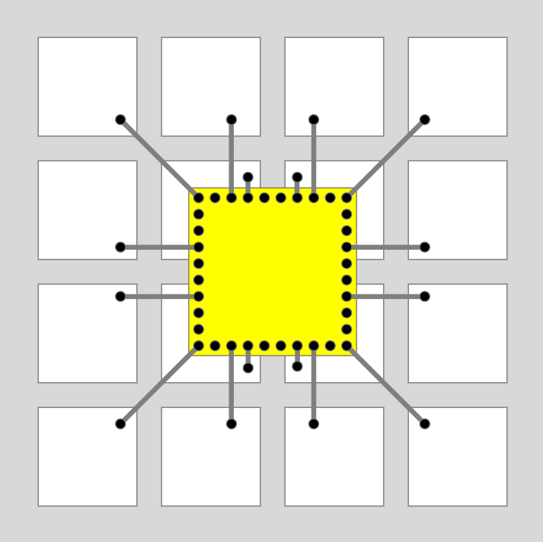
16-Pixel ASIC
The local clock serves all pixels in one ASIC
View from inactive side
Wire-bonds connect
each pixel to ASIC; via connects to small button on active side, minimizing capacitance and noise.
Pixels are 4 x 4 mm²

Slide 21
16 x 16 Tile of 256 ASICs, = 4092 pixels
Tile size:
256 mm x
256 mm

Slide 22
here…
Local clock interrogation
signal enters at any edge of tile, and propagates as a wave to any neighbor

Slide 23
Local clock interrogation
signal enters at any corner of tile, and propagates as a wave to any neighbor
Or here…
or any edge

Slide 24
DAQ Concept
Once per second, introduce “time token” at one ASIC somewhere on the tile periphery
ASIC accepts token & offers it to all neighbors
ASICs remember who gave them a token
Wave propagates across tile and establishes a network for reverse data push
Dead or defective chips are bypassed by encircling wave of DAQ
No master clock distribution + flat architecture
→ Very high resilience against single-point-failure

Slide 25
DAQ Concept
Once per second, introduce “time token” at one ASIC somewhere on the tile periphery
ASIC accepts token & offers it to all neighbors
ASICs remember who gave them a token
Wave propagates across tile and establishes a network for reverse data push
Dead or defective chips are bypassed by encircling wave of DAQ
No master clock distribution + flat architecture
→ Very high resilience against single-point-failure

Slide 26
Data Flow
Clock calibration: once per second
→ 16,384 bits/tile
Assume 20,000 tiles/10 kton module
~40 MB/s per module
Easily digestible locally by GPU to transform data to global time frame & prepare histograms.
Very little data corresponds to real event data

Slide 27
Three Central Technical Issues
CIR Input:
all extraneous leakage currents at the CIR input node are small compared to ³⁹Ar current
This must be tested in a realistic setup…
Clock:
Must be stable: δf/f < 1 x 10^{–6} per second
I think this will be easy…
Surface Charge Creep:
Must be negligible relative to ³⁹Ar current
This may require surface physics expertise…

Slide 28
Perspective
IceCube demonstrated that it is rational to embed complex electronics in perpetuity
care taken in design phase to avoid bleeding edge
care taken in qualifying parts list
care taken in fabrication & test
IceCube demonstrated that unorthodox time-stamp method meets high performance goals.

Slide 29
Summary
Q-pix extracts energy, spatial and time information with high precision, exquisite detail and appropriate dynamic range.
The unorthodox Q-Pix scheme to realize a fully pixelized DUNE FD might provide advantage for discovery at the threshold of detection.

Slide 30
Summary
Q-pix extracts energy, spatial and time information with high precision, exquisite detail and appropriate dynamic range.
The Q-Pix scheme, however unorthodox, to realize a fully pixelized DUNE FD might offer a unique advantage for discovery of new physics at the threshold of detection.

Slide 31
Thank you

Slide 32
Photon detection ?
Can the pixel surface also detect photons?
Wild speculation: coat surface with a-Se
a-Se is a photoconductor (old copiers had it)
VUV photon might liberate free electrons…
Some avalanche gain will trigger some pixels that are near trigger point.
Look for clustering of Hits in time → S1 signal
Far-fetched, but would be fabulous if real

Slide 33
The 64-bit datum
Clock value 38 bits
ASIC location 8 bits
Pixel address 16 bits
Flags 2 bits
Total: 64 bits
Datum is always the same format

Slide 34
Simulation of this idea at U Penn – Mitch Newcomer et al

Slide 35
The pixel “button”
The pixel must be a small button exposed to LAr active volume, not a space-filling square
The dielectric surface exposed to LAr active volume will automatically ‘heal” to create the desired electrostatics: “all charge to button”
→ Dielectric properties of first dielectric surface are important: teflon, …

