Slide 1
Status
of
SBN CRT Group Activities
Umut KOSE, Igor KRESLO, Bob WILSON

Slide 2
Group introduction:
SBN CRT Working Group was established to develop common strategies for the Cosmic Ray Taggers of the SBN detectors.
It is convened by Umut KOSE, Igor KRESLO, Bob WILSON
Composed of:
Near detector (SBND) CRT group
Intermediate detector (MicroBooNE) CRT group
Far detector (ICARUS) CRT groups: Side/Bottom and Top CRTs
Mailing list: SBN-CRT@fnal.gov

Slide 3
Group Activities:
Two meetings have been held:
September 14th Kick-off meeting: setting the official start of the working group, introducing the team, define the scope of the tasks and prepare for next joint working group meeting.
https://sbn-docdb.fnal.gov/cgi-bin/private/DisplayMeeting?sessionid=4072
September 21st : first discussions on SBN CRT systems; Near, Intermediate and Far CRTs.
https://sbn-docdb.fnal.gov/cgi-bin/private/DisplayMeeting?conferenceid=3564
Bi-weekly meetings on Friday 9:00 Fermilab /16:00 CERN time, keeping the off week with respect to SBN Analysis Working Group meetings.

Slide 4
Igor Kreslo: SBN Near Detector (SBND) CRT System
SBN CRT Working Group meeting, 21 Sep 2018

Slide 5
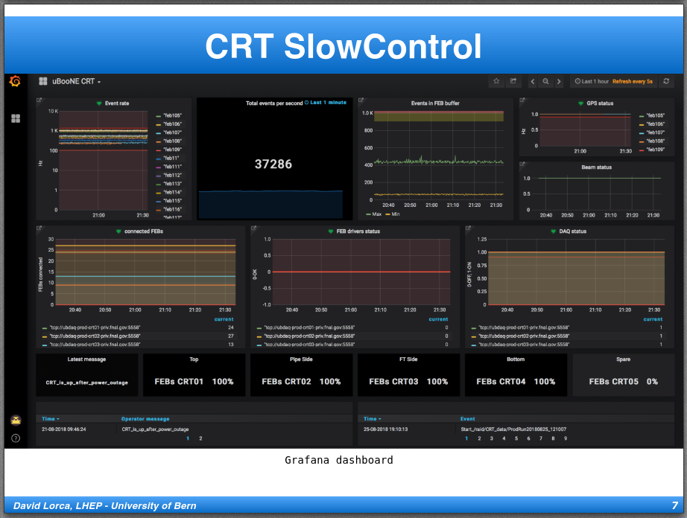
David Lorca: SBN Intermediate Detector (MicroBooNE) CRT System
SBN CRT Working Group meeting, 21 Sep 2018

Slide 6
Anne Schukraft: SBN Far Detector (ICARUS) CRT System: Bottom&Side CRT SBN CRT Working Group meeting, 21 Sep 2018

Slide 7
Paola Sala: SBN Far Detector (ICARUS) CRT System: Top CRT SBN CRT Working Group meeting, 21 Sep 2018

Slide 8
The goal:
reviewing the requirements and performance of the three systems;
improving communications and sharing of experience between the three detectors;
identifying common technical and operational solutions to the greatest extent possible;
establishing a common framework for analysis of the data with a focus on reducing systematic uncertainties in the oscillation analyses.
working in close communication with other joint SBN groups such as SBN-Physics Analysis group and SBN-DAQ group.

Slide 9
Proposed tasks:
Review the requirements and expected performances of the CRT system for all three detectors.
Review the production status and the installation plans of the CRT detector system and comment on the potential impact on the oscillation analyses.
Identify similarities and diﬀerences in the near and far detectors CRT systems that may impact oscillation analysis.

Slide 10
Proposed tasks II:
Identify which data/analyses are most critical to be performed in either the near or far detector.
Review the timing references to be supplied to the CRT FEBs: GPS time and beam-spill time.
Investigate the impact of the concrete overburden on the CRT rate both for near and far detectors.

Slide 11
Proposed tasks III:
Develop a common data model for the CRT detector systems.
Review the DAQ scheme (adjust if needed). Deﬁne a common data output format for the CRTs together with the SBN-DAQ working group.
Develop a common strategy for CRT data management proﬁting from the MicroBooNE experience.
Develop common CRT monitoring plots for all CRT systems to follow the performance; these may be shown on a common web page.

Slide 12
Proposed tasks IV:
Together with SBN Analysis groups, identify physics scenarios where CRT detector system will be valuable, such as:
calibration;
rejection of cosmic muon;
rejection of electromagnetic activity;
beam-based background, "dirt events";
understanding systematics.
Follow the tasks and organize bi-weekly SBN-CRT meetings.

Slide 13
Summary:
SBN CRT working group was established to develop common strategies .
The goal and tasks were defined and opened to the collaboration for the discussions.
Two meetings have been held up to now, bi-weekly meetings will be followed.
We will do our best to accomplish our missions.

Slide 14
Thank you!

