Slide 1
A vision for the SBN Program
Carlo Rubbia
GSSI, Gran Sasso Science Institute, L’Aquila, Italy
CERN, Geneva Switzerland
Life Member of the Senate of the Italian Republic

Slide 2
From optical Astronomy to-Particle physics
Stars are very interesting and pretty to look at — and without them, astronomy wouldn't be astronomy and we wouldn't exist — they represent a tiny fraction of the cosmic mass budget, only about 0.5 % of the total energy and mass of the Universe.
As we have known for several decades, the bulk of the constituents of the Universe are dark and only indirectly observable through induced effects.
In order to know more, the scientific activity of optical Astronomy needs to be extended in a variety of ways.
Particle physics provides attractive solutions both with accelerator and non accelerator experiments, which have recently transformed the early phases of the Universe from philosophy to an experimental science.
Slide# : 2

Slide 3
Tofay’s Universe
The Universe contains over 100 billion galaxies, each with billions of stars, great clouds of gas and dust, and perhaps heaps of planets and moons and other bits of cosmic debris. The stars produce an abundance of energy and of signals at speed of light, balancing the pull up due to gravitation.
About one-quarter of the Universe consists of Dark Matter, which releases no detectable signal, but which exerts a major gravitational pull on the visible matter in the Universe.
Dark Matter attracts, Dark Energy repels. While Dark Matter pulls matter inward, Dark Energy pushes it outward.
While Dark Energy shows itself only on the largest cosmic scale, Dark Matter exerts its influence on individual galaxies as well as the Universe at large.

Slide 4
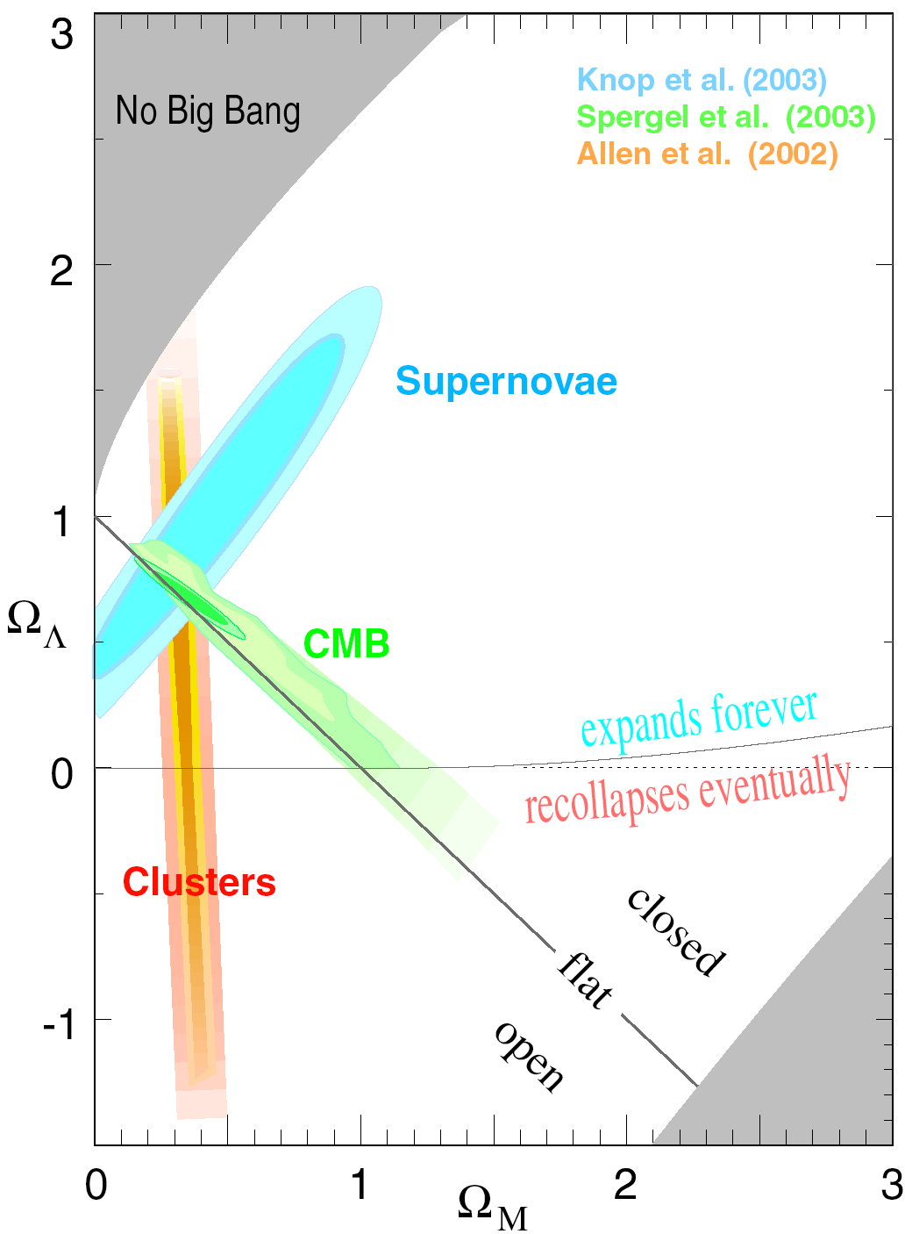
A cosmic concordance
With the recent discovery of an invisible Energy component in the empty space, about as large as the total matter of the Universe multiplied by c² (e.g. the non zero value of Ω_{Λ}) we have now for the first time a credible model for structure formation that is consistent with the data at hand.
ΩM + ΩΛ ≈ Ω0
Energy density of Universe
Matter
Energy
Nucleo-synthesis: ΩBBN = 0.044 ± 0.004
Matter density of Universe
Slide# : 4

Slide 5
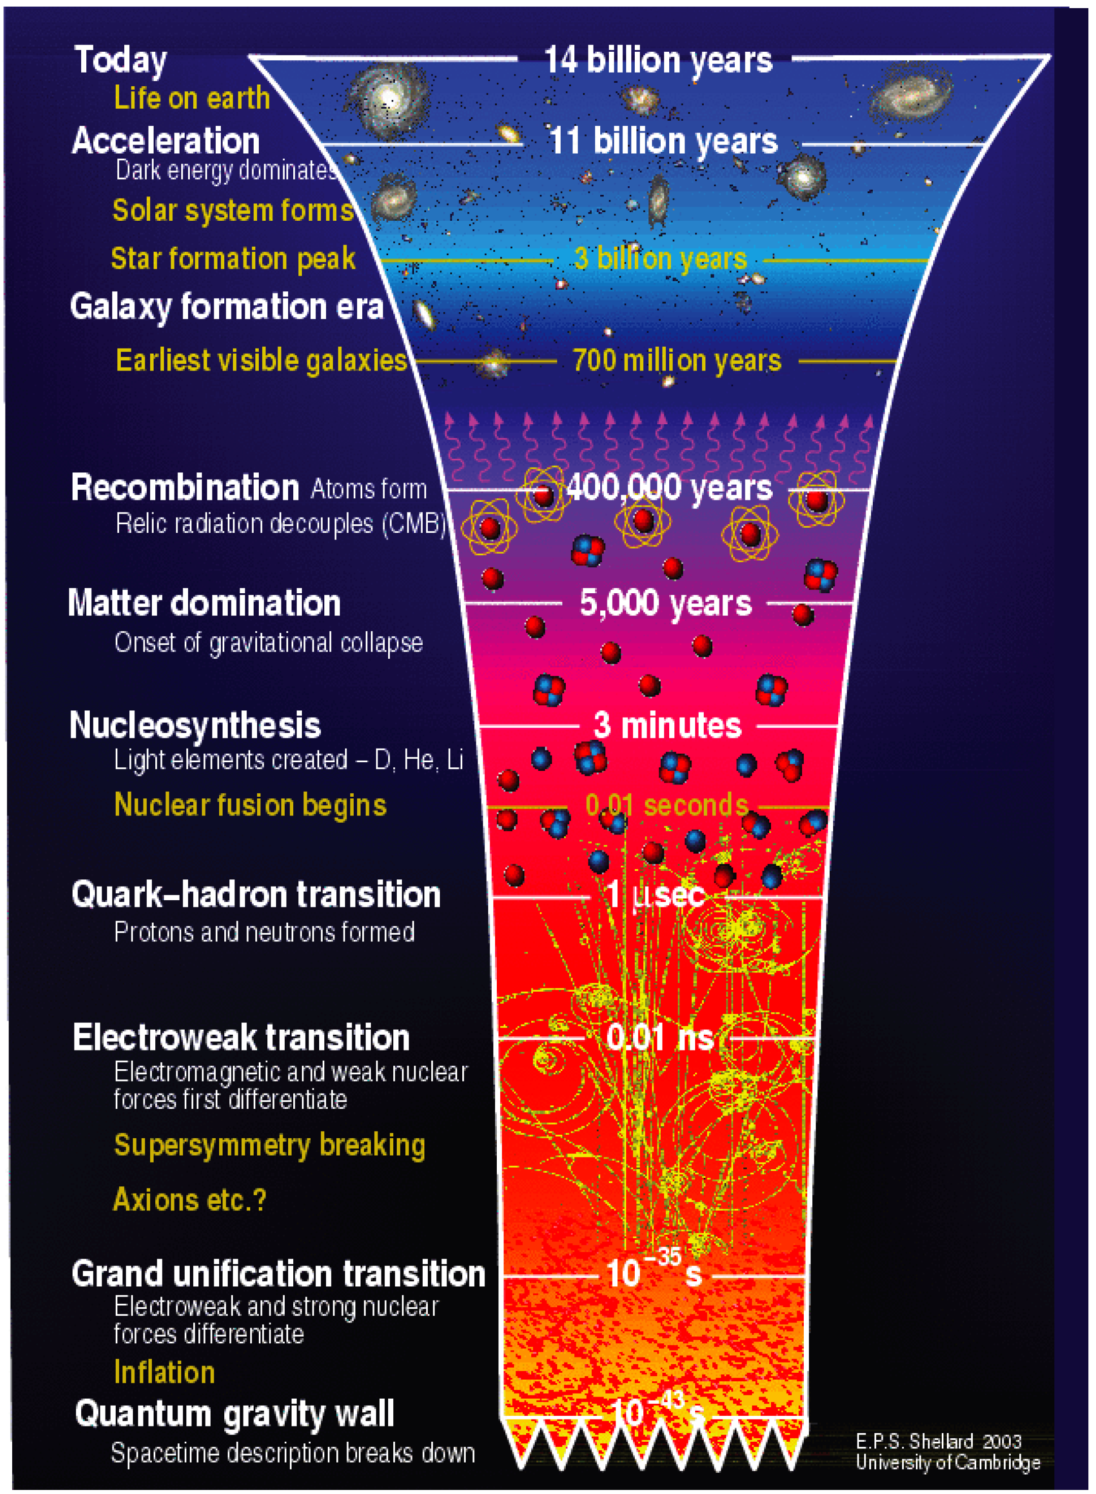
The evolution of the Cosmos after the “Big Bang”
We
are here
Astronomically
visible events
Relic radiation
decouples from matter
Accelerator
generated
experimental
simulations
Increasing accelerator
energies for shorter
times
10^{—12}s
Today’s particle
accelerator limit
Theoretical
simulations

Slide 6
The evolution of the Universe
The temperature T_{v} and the cosmic density fractions Ω_{i} ≡ a_{i}/a₀ are shown, where one sees which component dominate, fixing its expansion rate:
  first, radiation in the form of photons and neutrinos (radiation domination);
  then matter, which can be CDM, baryons and massive neutrinos at later times (matter domination);
  finally, the cosmological constant Λ takes over at low red shift z (typically z < 0.5).
a(t) is normalized to a(now) = 1 and
related to the redshift z as a = 1 /(1 + z).
Ωi
ν3
ν2
ν1

Slide 7
Nautrinos
Being fermions whose basic properties are still largely unknown, neutrinos aree one of the main experimental potentials for novel physics beyond the Standard Model.
The majority of neutrinos in the vicinity of the Earth are from nuclear reactions from the Sun. where about 65 billion (6.5×10¹⁰) solar neutrinos per second pass through every cm² perpendicular to the direction of the Sun.
The average density of neutrinos averaged over the whole Universe is of order of 300 neutrino/cm²
About 2000 neutrino induced stellar collapses have been experimentally recorded over the Milky Way.
Neutrinos can be created in several ways, like for instance
  nuclear reactions such as the core of a star, a supernova + etc
  accelerated particle beams or cosmic rays hitting atoms.
  beta decay of atomic nuclei or hadrons,

Slide 8
The relic neutrino background
The existence of a relic sea of neutrinos is a generic feature of the standard Big Bang model, each one in number only slightly below that of relic photons that constitute the cosmic microwave background (CMB).
This cosmic neutrino background (CNB) has not been detected yet, but its presence is indirectly established by the accurate agreement between the calculated and observed primordial abundances of light elements, as well as from the analysis of the power spectrum of CMB and other observables.
Neutrinos have interacted with other particles only during the early part immediately after the Big Bang. But already from T_{ν} ≤ 1 MeV they have proceeded independently.

Slide 9
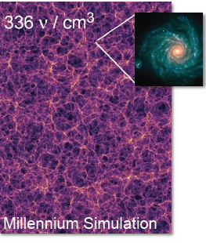
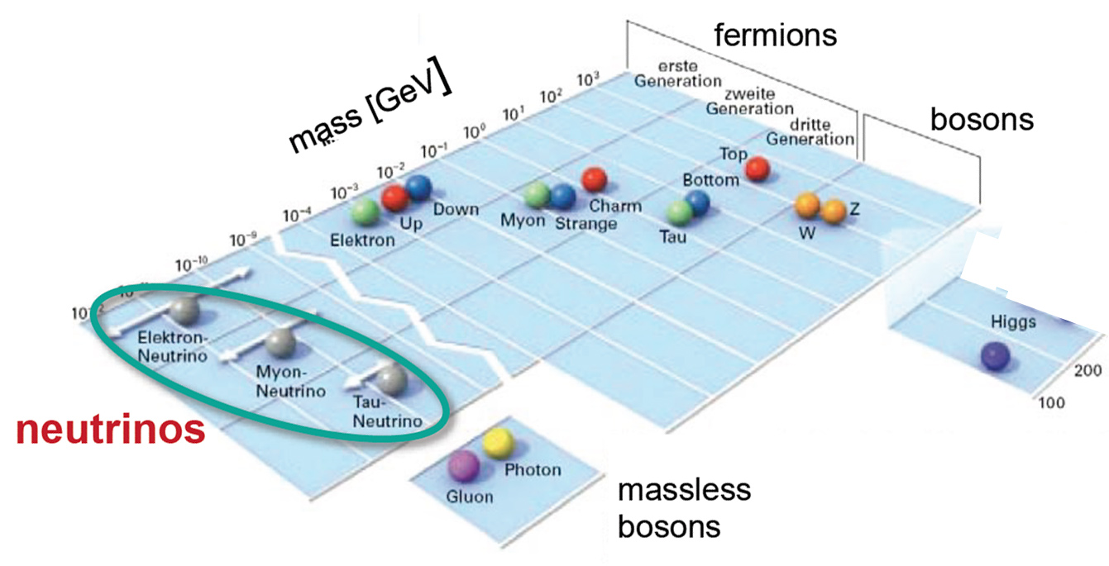
Neutrinos, unique ingredients to elementary particles
Neutrino density in the Universe: 336 ν/cm³
10² GeV
10⁻⁻³ GeV
10⁻¹² GeV
Neutrinos are the most abundant massive particles in Universe

Slide 10
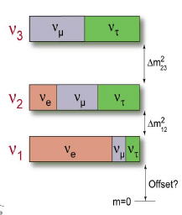
The standard neutrino picture
The sum of the strengths of the electro-weak coupling to all ν’s states has been observed from Z_{o} decays and found very close to 3. However the number of neutrino-is so far undefined.
Neutrino oscillations have established a picture consistent with the mixing of three physical neutrino νe, νμ and ντ with the help of three mass eigenstates ν1, ν2 and ν3.
A neutrino created with a specific flavor is in an associated specific quantum superposition of all three mass states.
Neutrinos oscillate in flight between different flavors, f.i., a νe may decsy as a muon or tau nneutrino
  Three angles (θ12, θ13, θ23)
  Two mass differences (Δm²12, Δm²23)
  One unkown offset from m = 0
νe νμ ντ

Slide 11
Accelerators as fundamental tools in Astro-particle physics
Today the Cosmos is characterized by an immense variety of individual configurations. But shortly after the “Big Bang” it was remarkably uniform. Therefore the re-creation with high energy accelerators of a tiny configuration represents a universal model.
COBE, WMAP and PLANCK space-crafts have recorded. cosmic microwave background radiation (CMB) emitted after the oldest moment in which visible light and matter separated out and the Cosmos become transparent to light.
Changes due to non uniformity of the Cosmos were of order ≈10⁻⁵
Particle accelerators of growing energies are therefore the main tool to study events at earlier times near the “Big Bang”.

Slide 12
The cosmic microwave background (CMB)
The cosmic microwave background (CMB) is the oldest light in the Universe, left over from the time of recombination, a signal that is not associated with any star, galaxy, or other object and for which Penzias and Wilson earned the 1978 Nobel Prize.
The radiation is isotropic to roughly one part in 100,000. with characteristic physical signatures for which Smoot and Mather have received the 2006 Nobel Prize.
For instance based on the PLANCK data, the Universe contains 4.9% ordinary matter, 26.8% dark matter and 68.3% dark energy.
All-sky map of CMB, generated
in 4 years with PLANCK data
The power spectrum of the anisotropy
as function of the angular scale (PLANCK)

Slide 13
PLANCK result on the total number of v species
The PLANCK collaboration has reported a cosmologic search for additional neutrino-like relativistic particles beyond the three families of neutrinos in the Standard Model.
Data may be combined with BAO, “Baryon acoustic oscillations”, i.e. periodic fluctuations of density of visible matter of the Universe and H0, the Hubble parameter
N=3
Using also Ho and BAO, PLANCK finds the highest value Neff = 3.52 ± 0.45.
Therefore there may be only room left eventually for only one more Neff state of unknown nature since Neff < 4 .
Number of neutrino like events Neff
for PLANCK+WP+HighL (black),
with added BAO (blue), Ho (red)
and both BAO and Ho (green)

Slide 14
“Sterile” neutrinos ?
Sterile neutrinos are a hypothetical type of neutrinos that do not interact via any of the fundamental interactions of the Standard Model except gravity.
The name was coined in 1957 by Bruno Pontecorvo, who hypothesized their existence in a seminal paper.
Since per se they would not interact electromagnetically, weakly, or strongly, they are extremely difficult to detect.
If they are heavy enough, they may also contribute to cold dark matter or warm dark matter.
Bruno Pontecorvo
Sterile neutrinos may mix with ordinary neutrinos via a mass term. Such evidence may be building up from experiments.

Slide 15
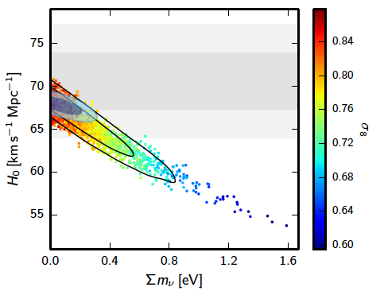
Models with sterile neutrinos
  Models with one additional sterile particle give different ΔN_{eff} values according to the actual decoupling. ΔNeff = 0.57 if at the same time as ν ‘s and ΔNeff= 0.39 before muon annihilation.
Strong dependence
from Hubble c.
4
Number of v’s ->
3
  The sum of all neutrino-like relativistic masses has a upper bound of the order of a fraction of eV

Slide 16
Persisting anomalies in the neutrino detection
Several anomalies have been reported:
  The observation of presumed excess signals of ν_{e} electrons from muon neutrinos from particle accelerators,the by now 20 years old LSND effect;
  apparent disappearance signals in the anti-ν_{e} events detected from near-by nuclear reactors and from Mega-Curie k-capture calibration sources to detect solar ν_{e(}
However none of these anomalies presents sofar the sufficient statistical impact to ensure their definitive confirmation
The most popular common direction is the one of a ”sterile neutrino” although other alternatives are also possible
These signals may all point out to the possible existence of at least one fourth non standard and heavier neutrino state driving oscillations at a small distances, with Δm²_{new} of the order of ≈ 1 eV² and relatively small sin²(2θ_{new}) mixing angles,
This may be a main discovery of the future SBN/FNAL program

Slide 17
Unexplained (seminal) νμ->νe events: The LNSD Anomaly

Slide 18
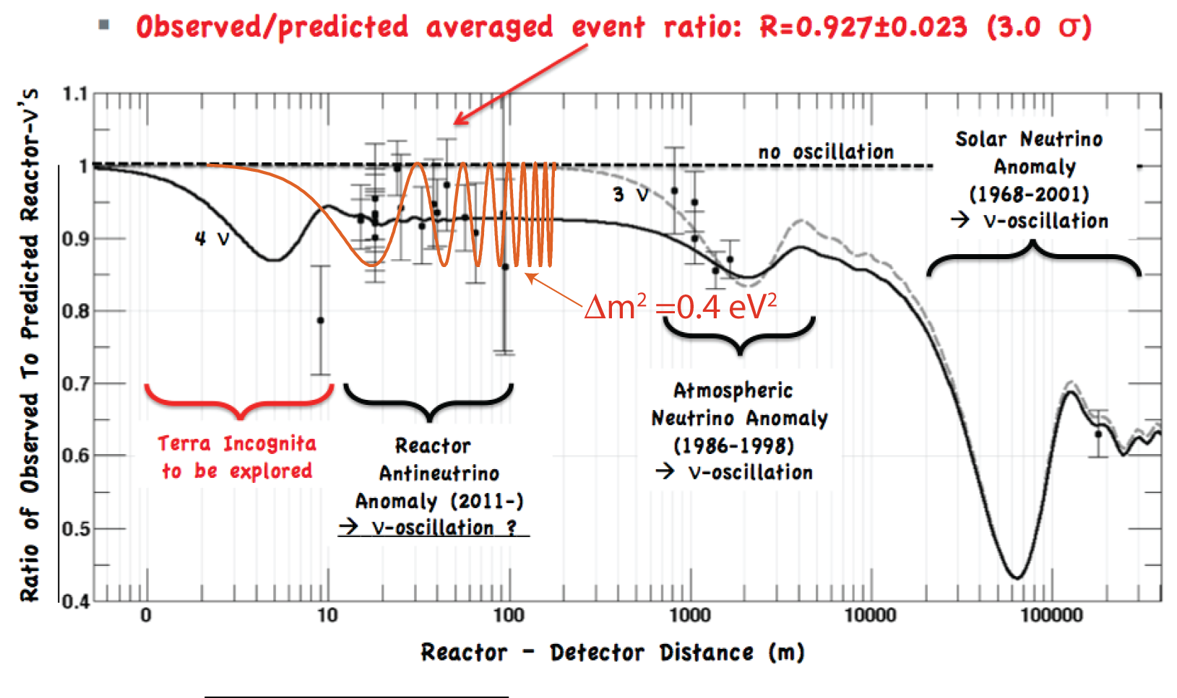
The reactor (anti)-neutrino disappearance anomaly
A recent re-evaluation of all the reactor antineutrino spectra has increased the expected flux: the ratio R between observed and predicted rates of previous experiments has been decreased to R = 0.938 ± 0.023, leading to a deviation of 2.7 σ from unity
Sterile
neutrinos ?
Δm²21 ≈ 8 x 10⁻⁵ eV²
Δm² = 1.5 eV²
Δm²31 ≈ 2.4 x 10⁻³ eV²
Reactor experiments explore distances generally far away from the perspective oscillation regions related to sterile neutrinos, giving therefore only an asymptotic value and Δm² greater than ≈ 0.1 eV/c²

Slide 19

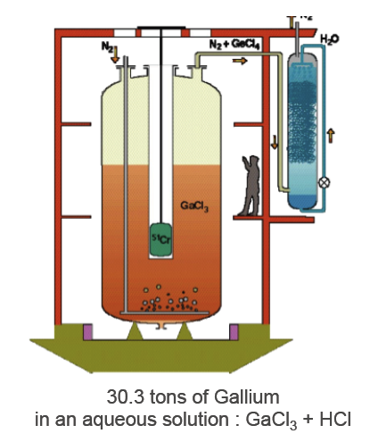
The Gallium disappearance anomaly
SAGE and GALLEX experiments recorded the calibration signal produced by intense artificial k-capture sources of ⁵¹Cr and ³⁷Ar.
The averaged result of the ratio R between the source detected and predicted neutrino rates are consistent with each other, giving R=(0.86 ± 0.05), about 2.7σ from unity
These best fitted values may favour the existence of an undetected sterile neutrino with an evidence of 2.3 σ and a broad range of values centred around Δm²new ≈ 2 eV² and sin²(2θnew) ≈ 0.3.
Notes:
19

Slide 20
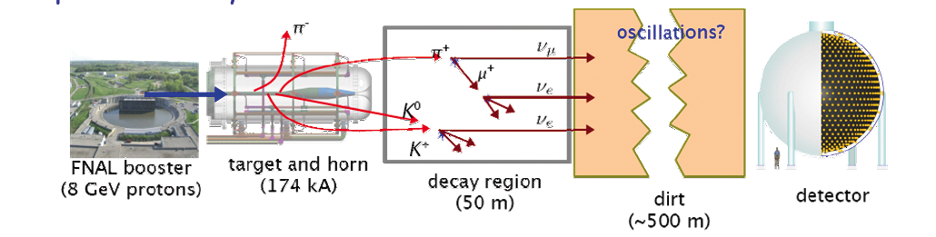
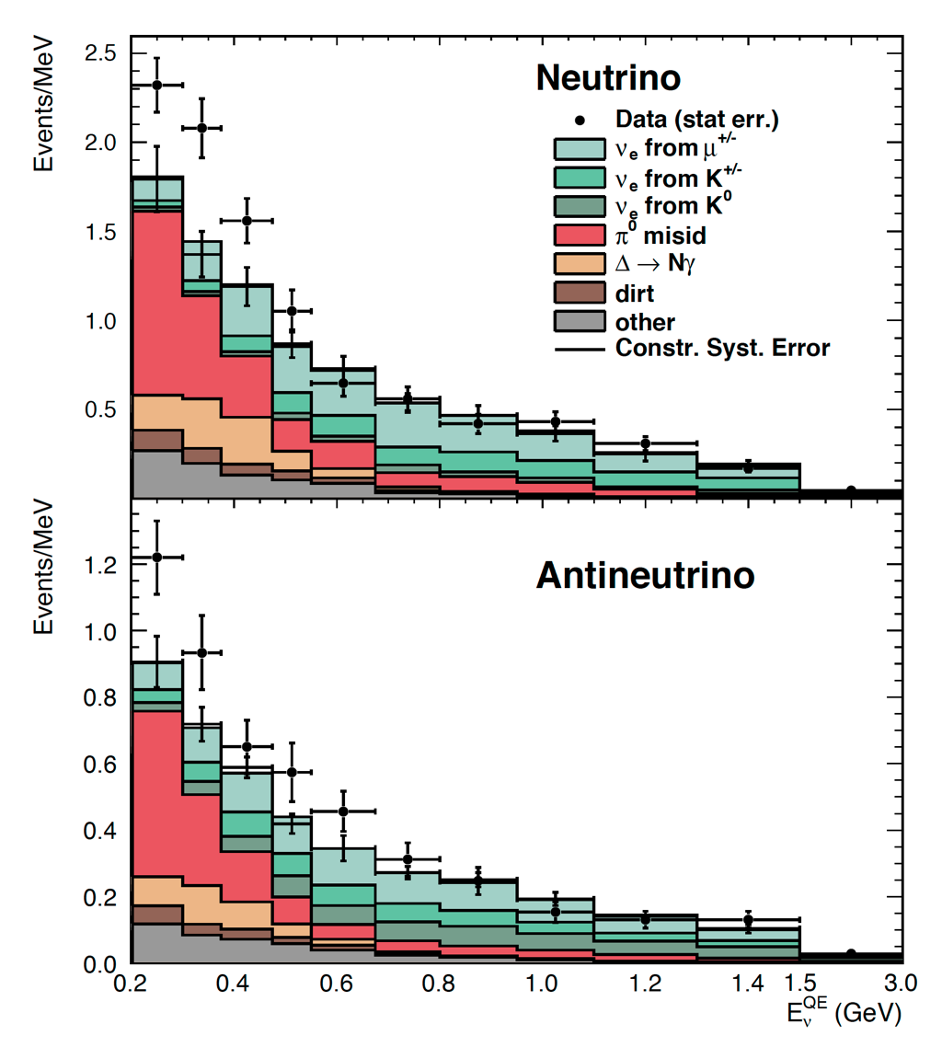
The MiniBooNE experiment at FermiLab
MiniBooNE has looked for an excess of electron neutrino events for L/E ≈ 1 in a ν and an anti-ν beams at the FNAL 8 GeV proton Booster and with ≈ 0.8 GeV neutrinos.
A very tiny, low energy excess
above a large continuum of many backgrounds
The LSND anomaly not been fully confirmed.
But a new anomaly is observed at E_{ν} energies smaller than 400 MeV for both ν and anti-ν events, to be clarified in a number of experiments and with the new LAr technology

Slide 21
Liquid Argon imaging technology.
Neutrino interactions are characterized by a very large number of potential events of different configurations and a large number of related channels which all need to be separately identified and accurately measured.
The liquid Argon Imaging technology (LAr-TPC) is a new kind of detector, effectively an electronic bubble-chamber originally proposed at CERN [CERN-EP/77-08 (1977)]
Liquid Argon can be operated with very large sensitive masses, it is continuously sensitive, self-triggering, it provides three-dimensional views of ionising events, with particle identification from dE/dx, range measurements and multiple scattering.
It acts also as a good homogeneous calorimeter of very fine granularity and high accuracy.
Argon is inert, not flammable and it is operated continuously and safely even deep underground and without pressure or moving parts.

Slide 22
Bringing the LAr –TPC technology to a success
The Italian Istituto Nazionale di Fisica Nucleare (INFN) and the ICARUS program have originally developed the technology of the LAr-TPC.
Exposed in the underground Hall B of the Gran Sasso National Laboratory in Assergi, at 730 km to the neutrino beam from CERN, the ICARUS T600 neutrino experiment has successfully completed a three years physics program at CNGS.
From October 2010 to December 2012, over 3000 neutrino events have been collected in a physics program on a high energy (≈25 GeV) neutrino beam, corresponding to 8.6 × 10¹⁹ protons on target with an instrumental efficiency exceeding 93%. Additional data were also collected with cosmic rays and proton decay.
Together with all previous test beam runs, this has allowed a very positive assessment of the detection capabilities of the LAr-TPC.

Slide 23
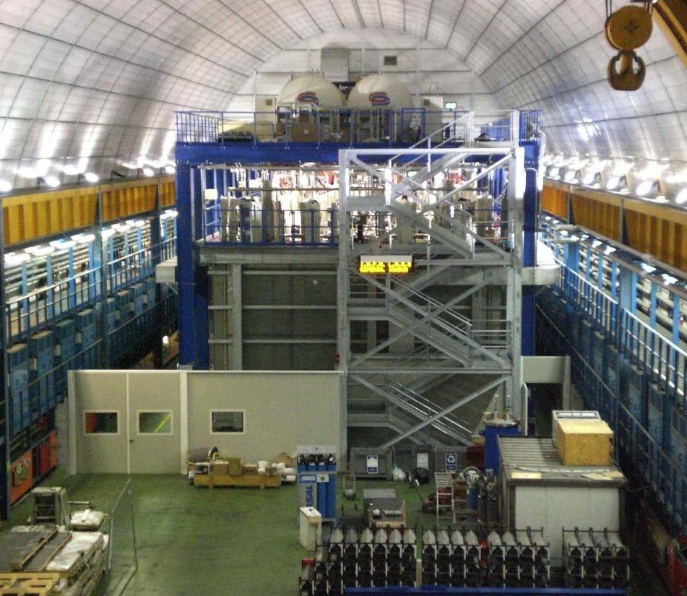
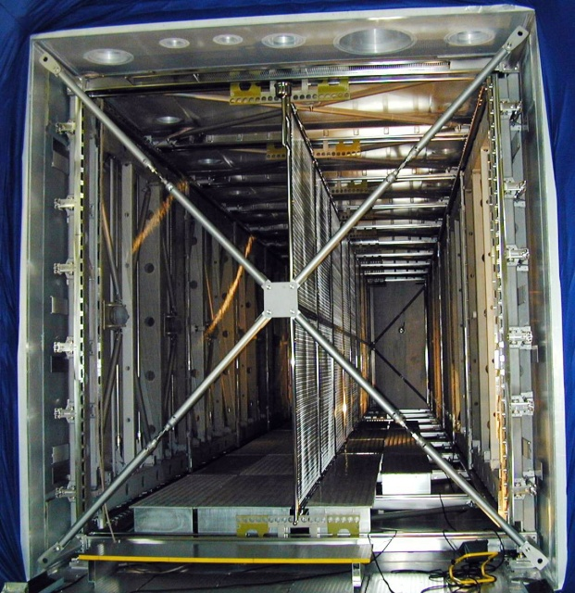
The advent of the LAr-TPC: the ICARUS-T600 detector
cathode
LN₂ vessels
1.5m
cryogenics
(behind)
readout electronics
T300
T300
E
E
readout wire arrays
Two identical modules (T300)
  3.6x3.9x19.6 = 275 m3 each
  Liquid Ar active mass: ~476 t
  Drift length = 1.5 m (1 ms)
  HV = -75 kV; E = 0.5 kV/cm
  drift velocity = 1.55 mm/μs
  Sampling time 0.4 μs (sub-mm resolution in drift direction)
4 wire chambers
  2 chambers per module
  3 “non-distructive” readout wire planes per chamber wires at 0, ±60° (ind1, ind2, coll view)
  ~ 54000 wires, 3 mm pitch and plane spacing
  Charge measurement on collection plane
20+54 8” PMTs for scintillation light detection
  VUV sensitive (128nm) with TPB wave shifter

Slide 24
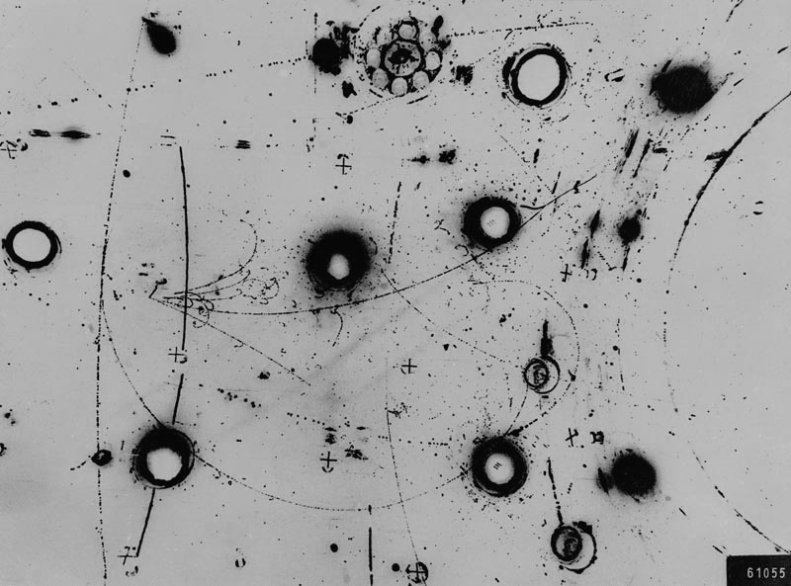
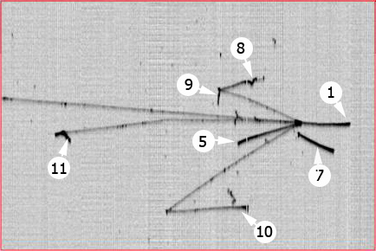
A new technology : the renaissance of visual detection
LAr is a cheap liquid (≈1CHF/litre), vastly produced by industry
Bubble diameter ≈ 3 mm
(diffraction limited)
Gargamelle Bubble chamber
ICARUS Electronic chamber
“Bubble” size 3 x 3 x 0.3 mm3
T300 real event

Slide 25
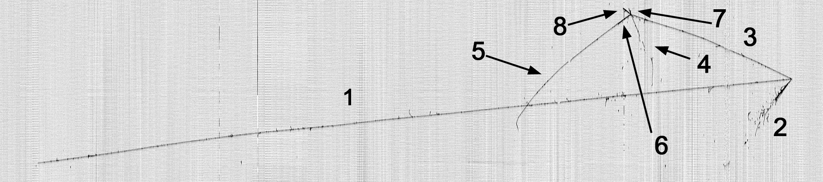
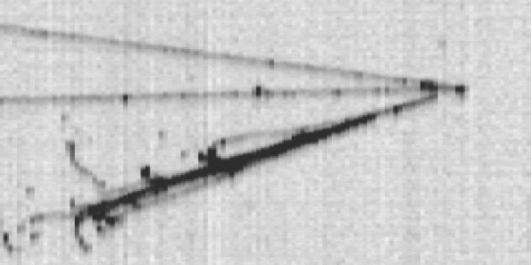
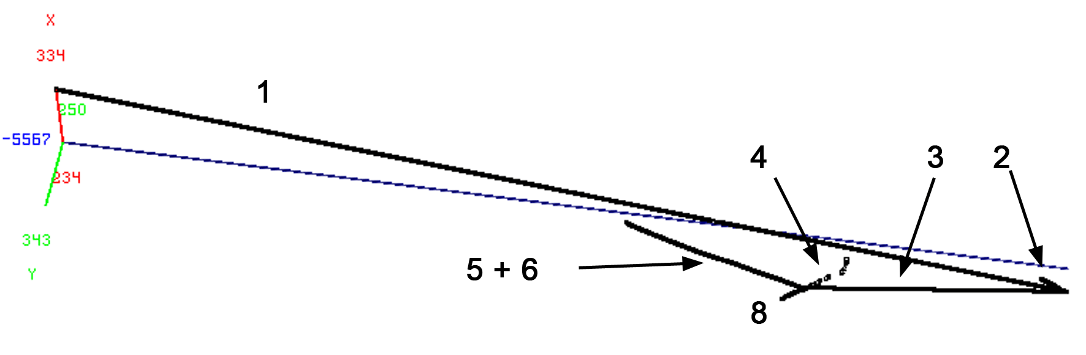
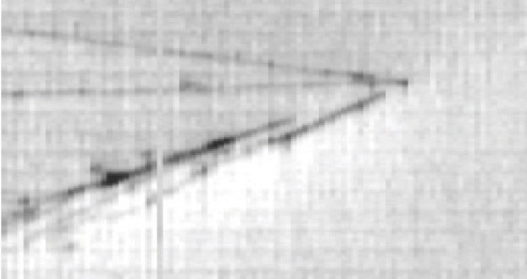
Run 9927 Event 572: ν_{μ}-CC CNGS event
Total visible energy 4.5 GeV
close-up of two e.m. showers
Primary vertex (A):
very long μ (1), e.m.cascades(2), π (3)
Secondary vertex (B):
the longest track (5) is a μ coming from stopping k (6).
μ decay is observed
Collection
3D
B
A
Track 1 (μ) 2 3 (p) Sec. vtx. 4 5 (μ) 6 (K) 7 8 | E_{dep}[MeV] 2701.97 520.82 514.04 797 76.99 313.9 86.98 35.87 283.28 | cosx 0.069 0.054 -0.001 0.009 0.000 0.414 -0.613 | cosy -0.040 -0.420 0.137 -0.649 -0.239 0.793 0.150 | cosz -0.997 -0.906 -0.991 0.761 -0.971 -0.446 -0.776
Induction2
π⁰
Conversion distances
6.9 cm, 2.3 cm

Slide 26
Improving with ICARUS the location of sterile LNSD anomaly
  At the CNGS facility in Italy, searches from neutrinos from CERN have been performed with an almost pure νμ beam in 10-30 GeV Eν range (beam associated νe ~1%) and at a distance L=732 km from target.
  ICARUS has concluded a very successful, long duration run with its T600 detector at the LNGS underground laboratory taking data both with the CNGS neutrino beam and with cosmic rays.
  ICARUS searched for νe excess related to a LSND-like anomaly,at longer distance with the observation of νe events on the νμ CNGS beam and L/Eν ~36.5 m/MeV.
  The unique detection properties of LAr-TPC technique allow to identify unambiguously individual e-events with high efficiency.
EXCELLENT RESOLUTIONS
Low energy electrons: σ(E)/E = 11% / √ E(MeV)+2%
Electromagn. showers: σ(E)/E = 3% / √ E(GeV)
Hadron shower (pure LAr): σ(E)/E ≈ 30% / √ E(GeV)

Slide 27
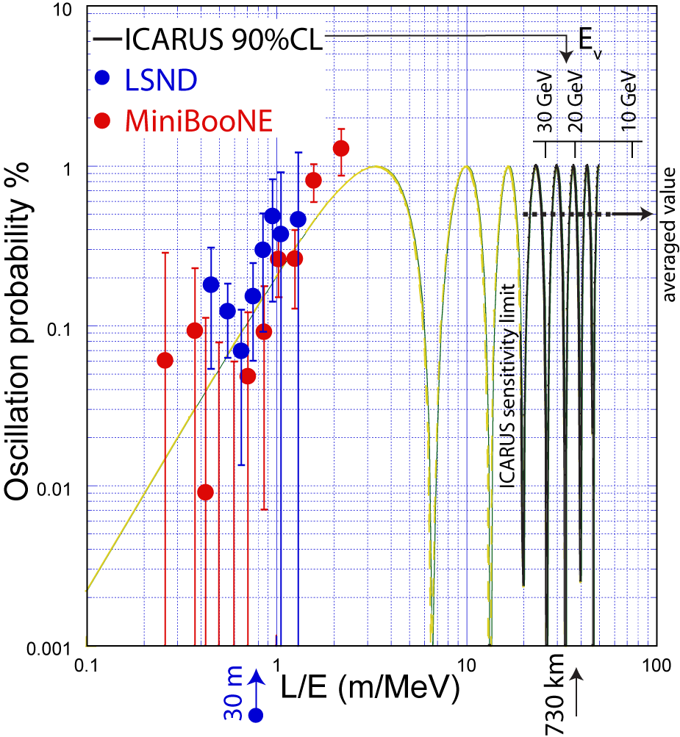
Search for ν−e events in ICARUS
  A main difference between ICARUS and LSND:
  - L/E_{ν} ~1 m/MeV at LSND, but
  - L/E_{ν} ≈36.5 m/MeV at CNGS
  - With ICARUS a common LSND –like signal averages out as sin²(1.27Δm²_{new} L /E) ~1/2 and <P>_{νμ→νe} ~ 1/2 sin²(2θ_{new})
  When compared to other long baseline results (MINOS and T2K) ICARUS because of its higher energies operates in a L/E_{ν} region in which contributions from standard ν oscillations [mostly sin(θ₁₃)] are not yet too relevant.
  .
A common LSND and ICARUS prediction

Slide 29
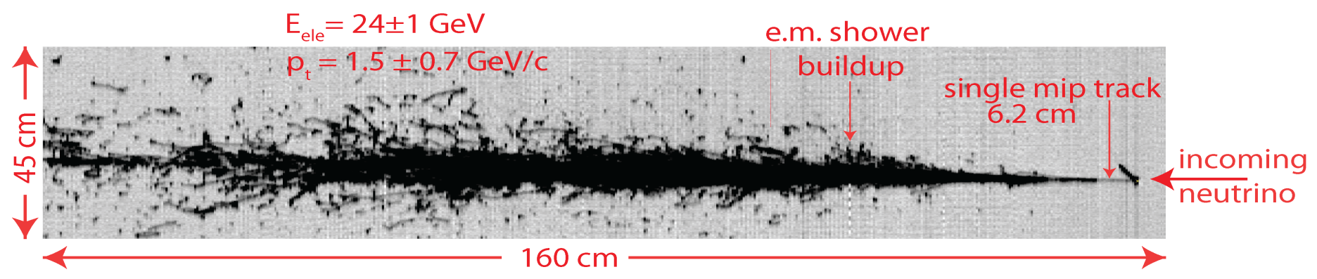
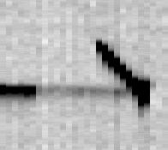
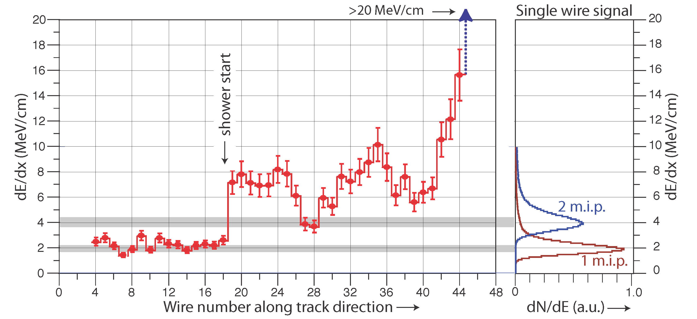
The ICARUS LAr-TPC result with 2450 ν interactions
Event with a clear electron signature found in the sample of 2450 ν interactions (7.23 10¹⁹ pot).
The evolution of the actual dE/dx from a single track to an e.m. shower for the electron shower is clearly apparent from individual wires.
Single M.I.P

Slide 30
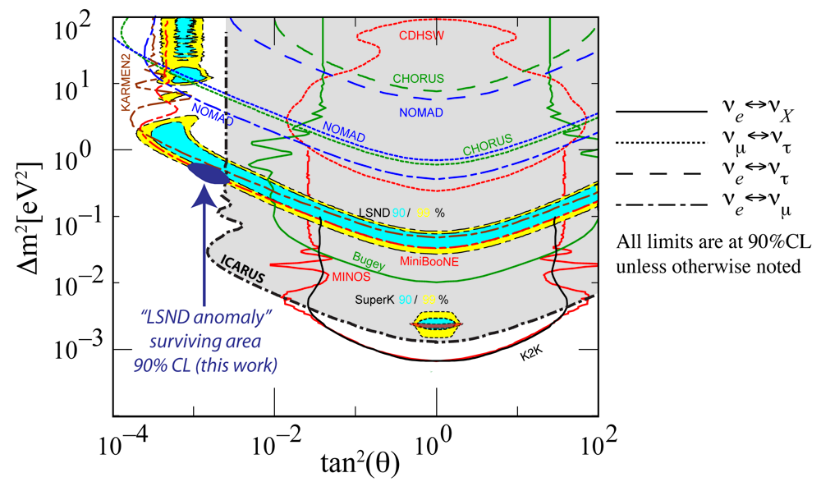
LSND-like evidence from ICARUS and other experiments
allowed MiniBooNE
Eur. Phys. J. C 73 (2013)
allowed LSND 90%
allowed LSND 99%
limit of KARMEN
ICARUS exclusion area
ICARUS has strongly limited the window of parameters for a possible LSND anomaly to a very narrow region (Δm² ≈ 0.5 eV² and sin²2θ ≈ 0.005) where there is an overall agreement (90% CL) combining
the present ICARUS limit
the limits of KARMEN
the positive signals of LSND and MiniBooNE

Slide 31
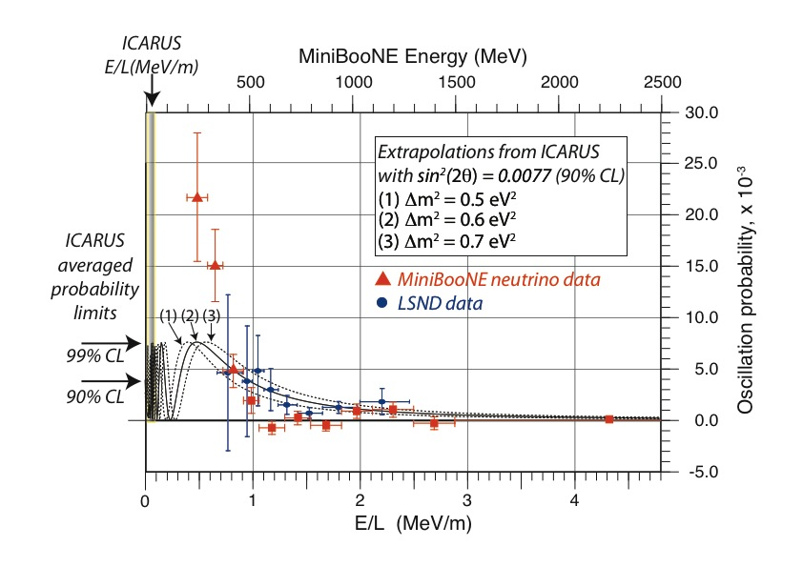
A ICARUS search of the low energy MiniBooNE effect
E/L location
of ICARUS
ICARUS has also excluded the low energy sterile neutrino peak reported by MiniBooNE in the neutrino channel. This result has also been confirmed by OPERA.

Slide 32
A “naïve expectation” for the SBN programs
Let us combine the (LSND) appearance and the disappearances (neglecting oscillations into ν_{τ} and direct νμ↔νe) as coming from an unique sterile neutrino signature with a 4 x 4 matrix U_{ik}.
The general formula in the (3+1) model is then:
where Δm₄₁² is the squared mass difference with respect to the fourth heavier neutrino
Let us take LSND with sin²(2θ_{eμ})= 4|U_{e4}|²|U_{μ4}|² ≈ 1.5 10⁻³
This implies disappearances of both νe and νμ, since sin²(2_{ee})= 4|U_{e4}|² (1-|U_{e4}|²) and sin²(2_{μμ})= 4|U_{μ4}|² (1-|U_{μ4}|²).
Reactors may claim sin²(2_{ee})≈ 0.12,hence |U_{e4}|² = 0.03.
Let us assume in addition also muon-electron Universality, such that νe and νμ disappearances are identical.
Then we expect sin²(2_{ee)}= sin²(2_{μμ})≈ 0.08, still in reasonable agreement within present observations.

Slide 33
Cancellations between disappearance and appearance
There is an important difference between the original LSND and the future SBN programs.
This is due to the fact that νe events are now produced both (1) from R_{νe}(E), the “intrinsic” νe source at about 0.5% of the muon rate and R_{νμ}(E) and (2) from a potential LSND νμ-> νe effect.
Therefore cancellation between these two contributionsis expected in the detected νe signal S_{νe}:
S_{νe} = [R_{νμ}(E)sin²(2θ_{eμ}) - R_{νe}(E) sin²(2θ_{ee})] sin²(1.27 Δm₄₁² L/E)
Δm₄₁² ,the squared mass difference with respect to the fourth heavier neutrino is a common factor as a function of mass difference and L/E.

Slide 34
Examples of electron neutrino spectra
Giunti Laveder best fit:
Δm² ~ 1.5 eV² ;
sin²(2θμμ) = 0.05 ;
sin²(2θee) = 0.1 ;
sin²(2θμe) = 1.25 x 10⁻³
Extreme case of full cancellation
Δm² ~ 1.5 eV² ;
sin²(2θμμ) = 0.016 ;
sin²(2θee) = 0.1 ;
sin²(2θμe) = 0.4 x 10⁻³

Slide 35
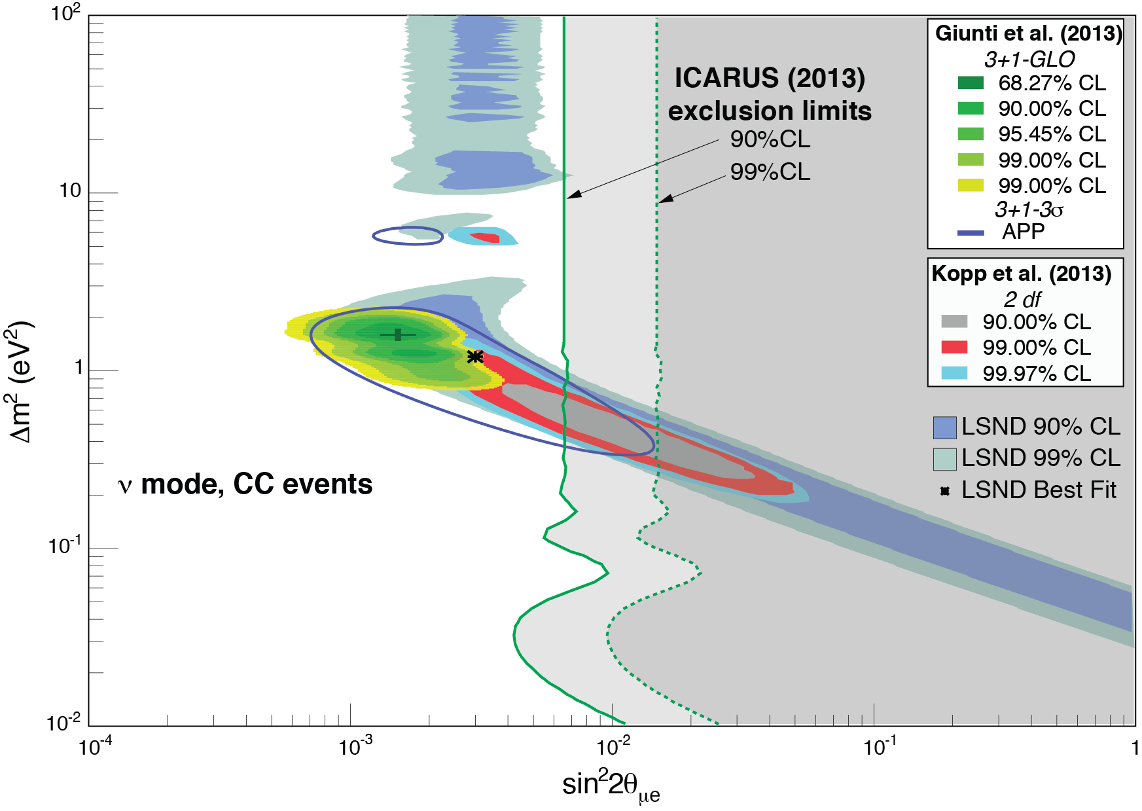

Global fits of the sterile neutrino anomalies
Recent global fit of sin²θ_{μe} and Δm² performed by Giunti et al., including all the available data is in poor agreement with the analysis of Kopp et al.
The new ICARUS exclusion value strongly limits the LSND’s window.
Large values of Δm² are in poor agreement with cosmological predictions of the sum of neutrino like masses from Planck .
Giunti et al.
Planck’s limit
Kopp et al.

Slide 36
Sterile Neutrinos from the IceCube Detector
Having crossed the Earth, up-going atmospheric neutrinos after production in either bedrock or ice and in the approximate 320 GeV to 20 TeV range are detected as charged current muons with Cherenkov light as a function of zenith angle and energy.
The detector contains 5160 modules on 86 strings arranged with spacing of approximately 125 m and vertical separation of 17 m.
Since a sterile neutrino does not interact, its detection will leave a distinct dip of the visible tracks.
In the search for the oscillation signatures into light sterile neutrinos, no evidence for ν-μ disappearance has been observed in either of two independently developed analyses, each using one year of data and about 10⁵ events.
(PRL, Aug 2016)

Slide 37
Some experimental evidence against LSND ?
Muon antineutrinos experience in the matter of the detector a strong Mikheyev-Smirnov-Wolfenstein-resonant oscillation.
Energy distributions in data and Monte Carlo events without the sterile neutrino hypothesis show a perfect agreement.
Results from the IceCube sterile neutrino: the combined analysis (solid red), the one based on shape alone (dashed blue) and from a previous sample (dashed black). Excluded regions are to the right
.
99% confidence level
The confidence level is relatively modest

Slide 38
A definitive clarification of these “anomalies”
A new SBN experiment, capable to clarify all these anomalies at the appropriate > 5 sigma level is therefore highly desirable.
Such an experiment is based on two main, innovative concepts from low energy ν and anti-ν beam from a FNAL accelerator.
  The first new concept is the comparison for spectral differences of two (or more) identical detectors located at two different distances. In the case of absence of “anomalies”, the two distributions will be a precise copy of each other, without Monte Carlo comparisons.
  The second new concept is the novel, now fully operational large mass (0.7 k ton) Liquid LAr-TPC detector developed by the ICARUS collaboration. The detector is a “bubble chamber like” sampling, homogeneous calorimeter with excellent accuracies and the total energy reconstruction of the event from charge integration.

Slide 39
ICARUS T600 in the US
The ICARUS T600, the largest 730 ton LAr detector, has completed a 3 year physics data taking program at the LNGS The LAr detector and the associated hardware (electronics, cryogenic etc. ) has been removed from LNGS and transported to CERN, where it is comprehensively overhauled in the Gargamelle Hall of the West Area. This operation has been completed by early 2017.
The detector is then to be operated again in a nearer position at FNAL ν-beam in the US in order to collect a large number (≥10⁶) of beam events both with the Booster and the Main Ring for the future DUNE experiment.
The main underlying physics motivation may be a definitive search for sterile neutrino anomalies with the help of a second, additional and smaller LAr detector SBND in the “near” position. Data will be also collected at an intermediate position by a smaller MicroBooNE LAr detector.

Slide 40
Basic features of the proposed Fermilab program
The proposed experiment, collecting a large amount of data, may be able to give a definitive answer to the 3 following queries :
  the LSND/MiniBooNE appearance of the ν_{μ} → ν_{e} oscillation anomalies;
  The Gallex + Reactor oscillatory disappearance of the initial ν_{e} signal;
  an oscillatory disappearance maybe also be present in the ν_{μ} signal, so far unknown.
In absence of any of these “anomalies”, the signals of the detectors should be a closer copy of each other for all experimental signatures.
However as already pointed out the presence of a relatively large rate of intrinsic ν_{e} events, absent in the original LSND experiment, may introduce a significant correlation between appearance and disappearance signals.

Slide 41
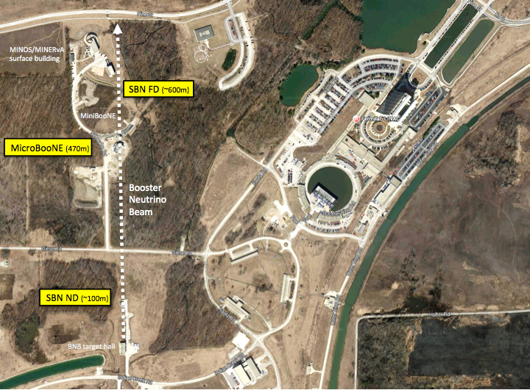
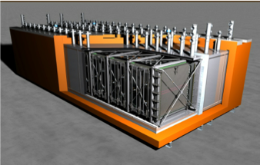

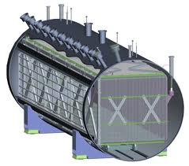
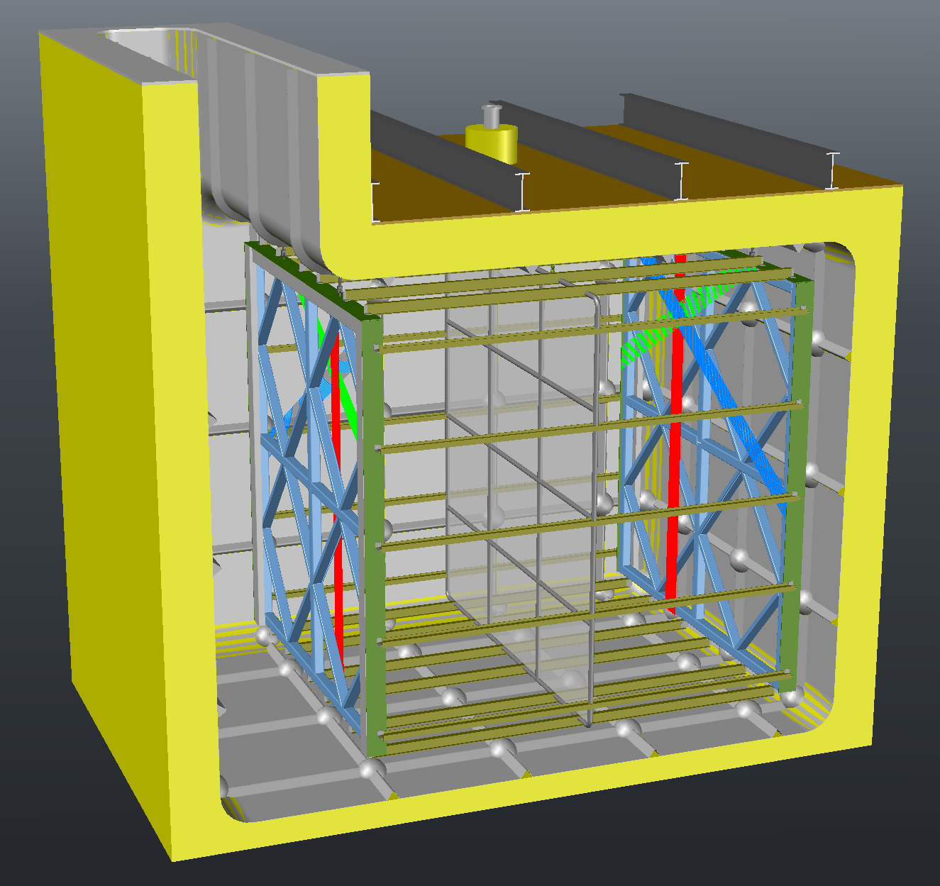
SBN@BNB
ICARUS T600
MicroBooNE
SBND

Slide 42
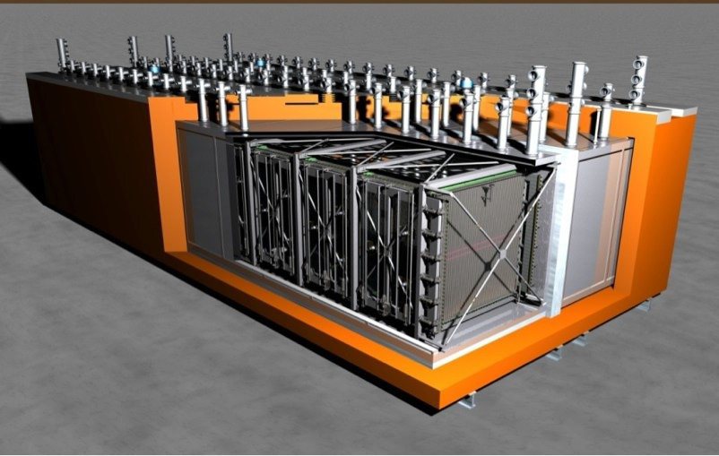
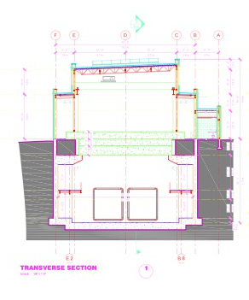
ICARUS
Multiple technological upgrades (and LAr R&D) are envisaged: new electronics (warm/cold) and DAQ, new cryogenics in view of FNAL, new containment vessels, new light collection, CR- anti coincidence shield.
FD building at FermiLab
3 m overburden
T600
LAr volumes

Slide 43
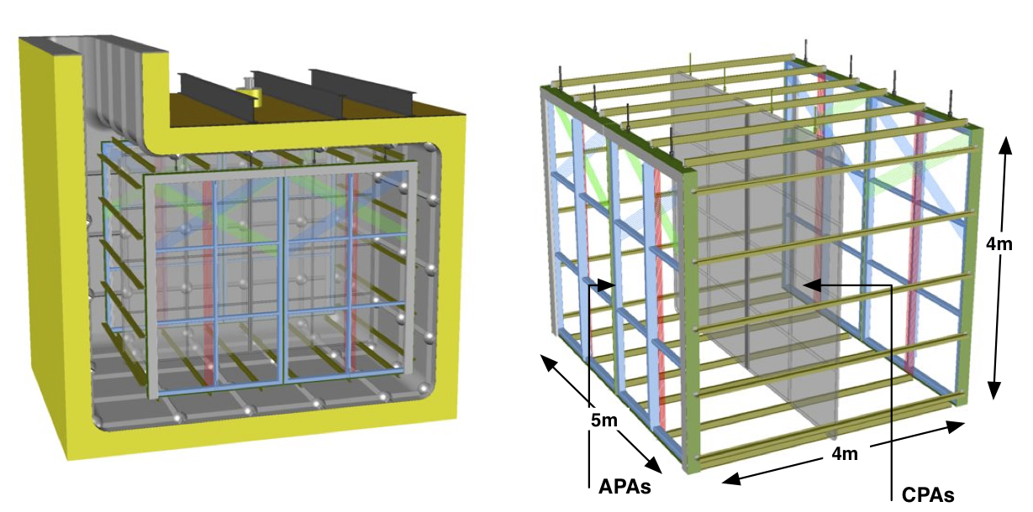
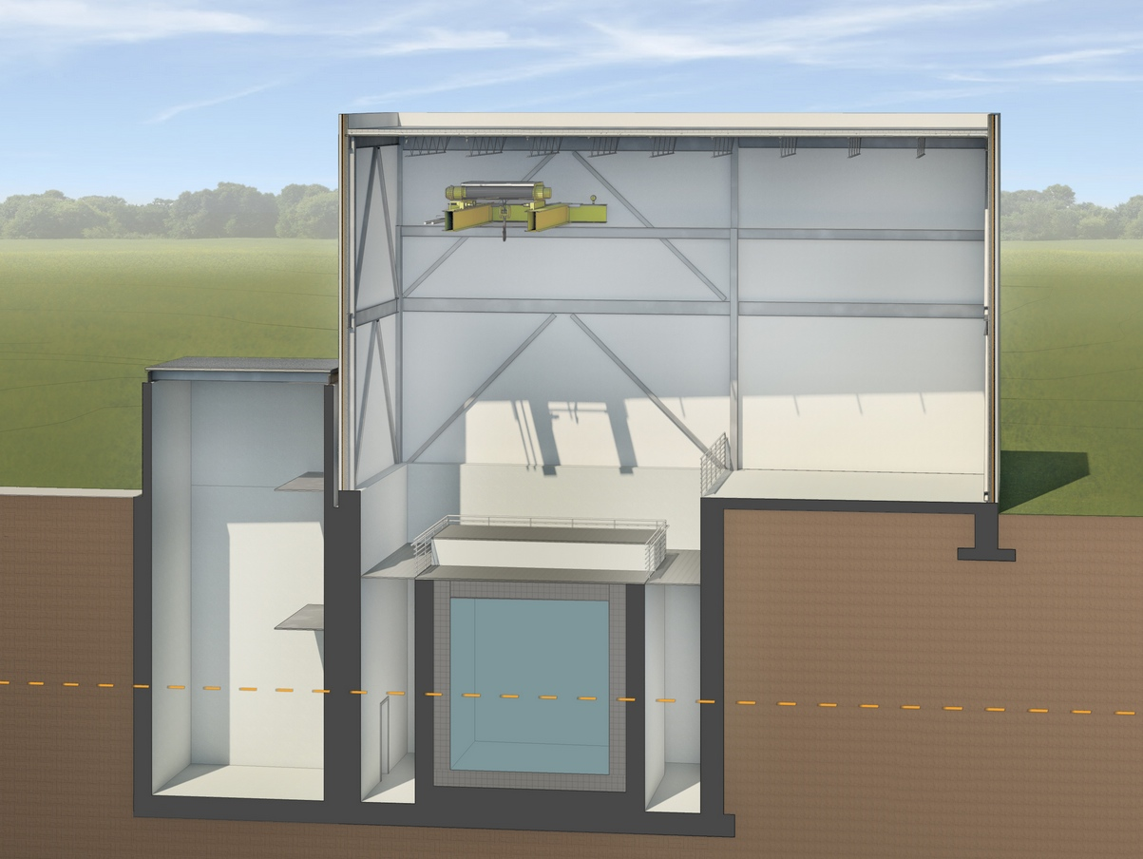
SBND
A proposed 82 ton LArTPC near detector at 100 m in FNAL’s SBN
Also inspired on INFN LAr-TPC technology.
Can provide a high statistics “near sampling” of the beam to help identify any observed excess at ICARUS and MicroBooNE
The detector will became operational in 2019

Slide 44
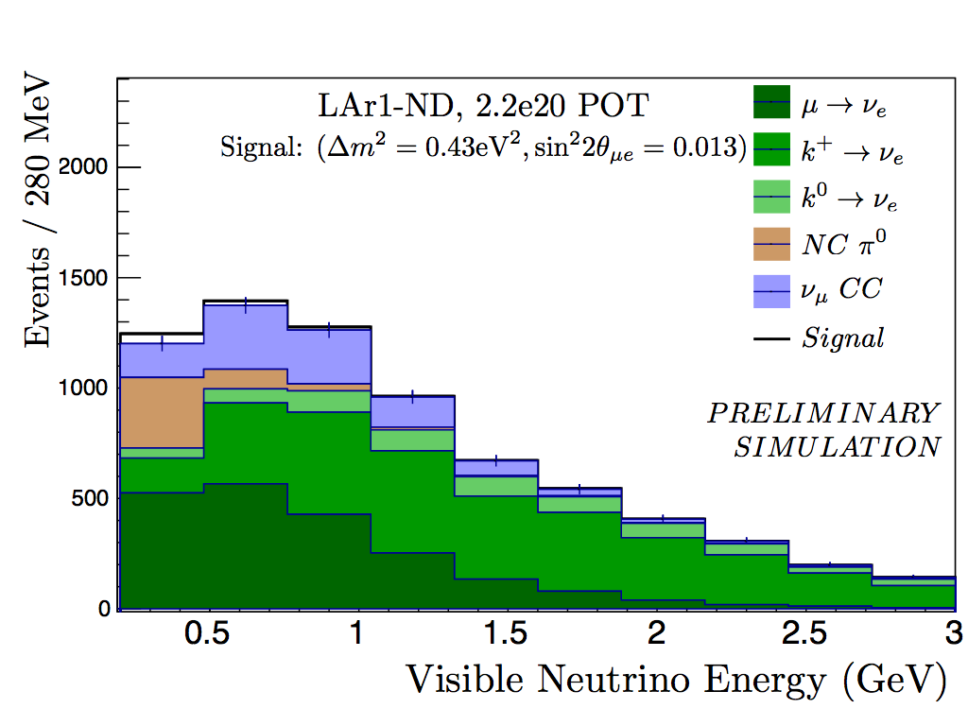
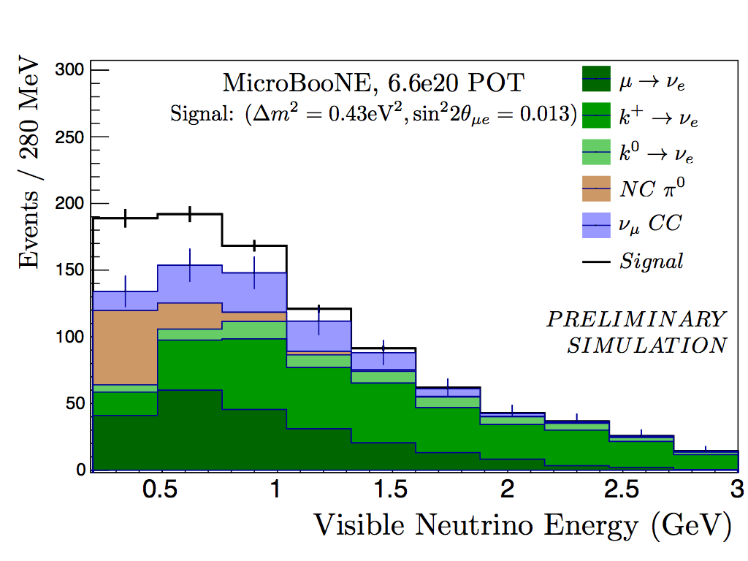
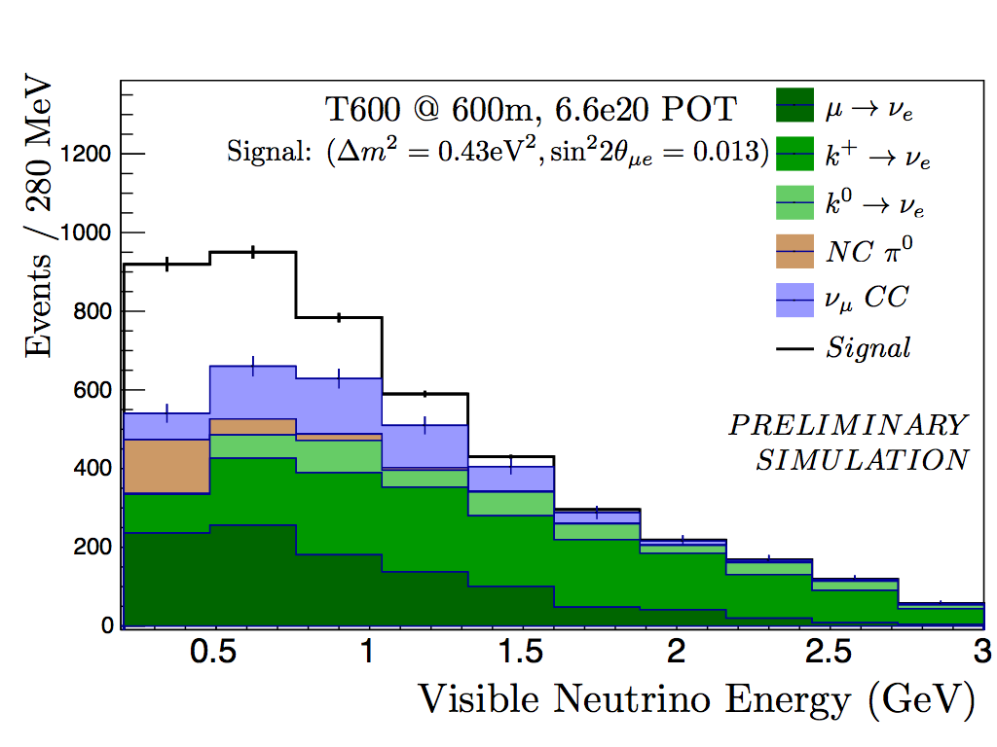
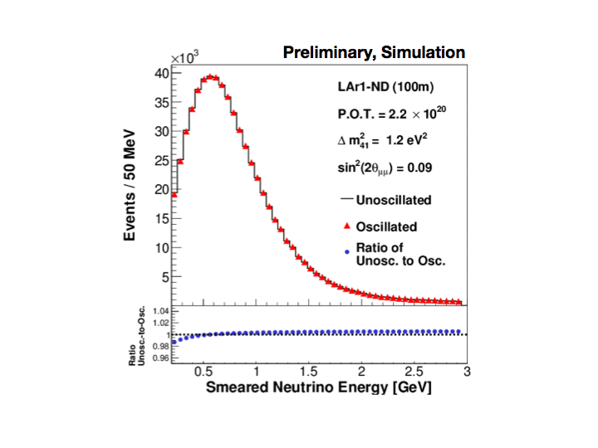
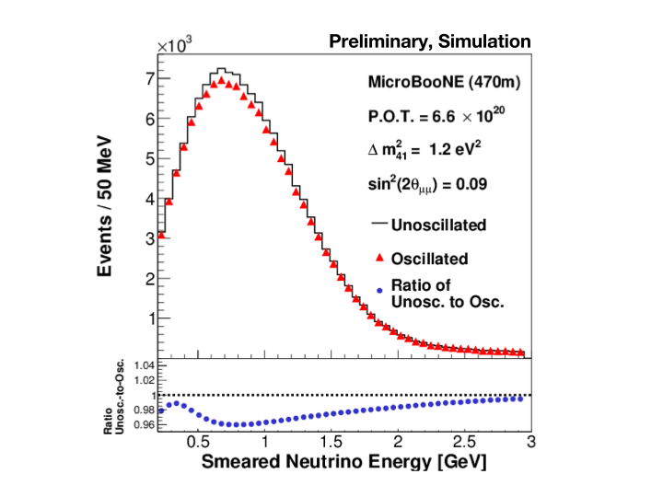
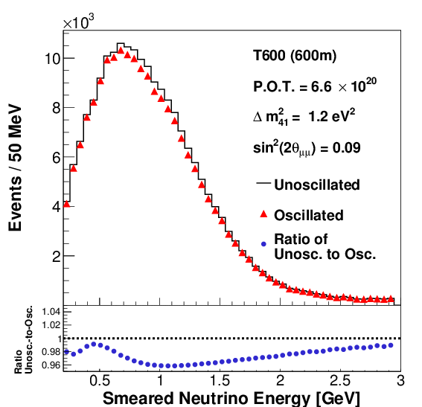
The signal for anomalies growing with distance
νe appearance signals for Δm² =0.43 eV², sin²(2Θμe) = 0.013
ND @ 100 m
MicroBooNE @ 470 m
ICARUS T600 @ 600 m
νμ disappearance signals for Δm² =1.2 eV², sin²(2Θμe) = 0.09

Slide 45
Three Detector Short-Baseline SBN Program at Fermilab
Xiv:1503.01520v1
Sensitivity comparisons for νμ → νe oscillations including all backgrounds and systematic uncertainties described in this proposal (except detector systematics, see text) assuming 6.6 × 10²⁰ protons on target in LAr1-ND and the ICARUS-T600 and 13.2 × 10²⁰ protons on target in MicroBooNE.
The three curves present the significance of coverage of the LSND 99% allowed region (above) for the three different possible combinations of SBN detectors: LAr1-ND + MicroBooNE only (blue), LAr1-ND + ICARUS only (black), and all three detectors (red).

Slide 46
Three detectors are imperative to achieving 5σ coverage
LAr1-ND at 110 m
MicroBooNE at 470 m
ICARUS T600 at 600 m
???
Significance al low Δm² appears questionable. For Δm² =0.2 eV², the LSND 99% confidence interval is 2.5 x 10⁻² < sin²(2θ_{μe}) < 0.1.
Such sin²(2θ_{μe}) signal is then predicted to become huge at large distances and it disagrees with ICARUS observations at CNGS

Slide 47
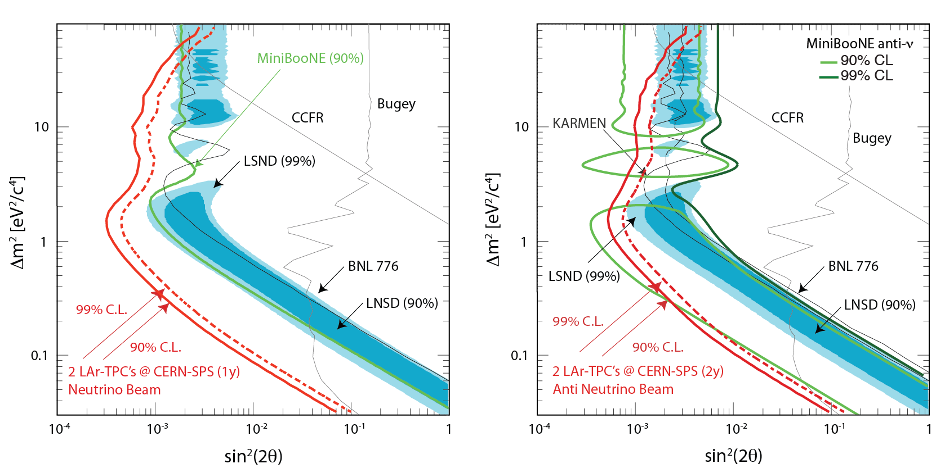
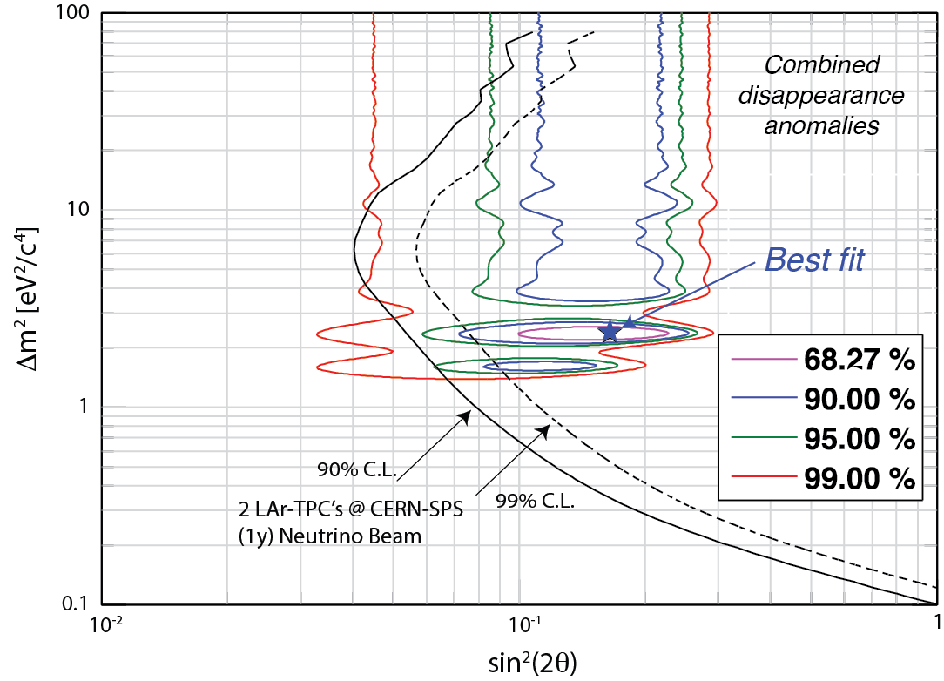
Exploring all channels: expected sensitivity
e-appearance:
1 year νμ beam (left)
2 year antiνμ beam (right)
for 4.5 10¹⁹ pot/year,
3% syst. uncertainty on ν energy spectrum.
ν_{μ}→ν_{e}
‾ν_{μ}→‾ν_{e}
LSND allowed region is
fully explored in both cases
e/μ-disappearance:
1 year νμ beam (left)
1 year νμ + 2 years anti-νμ beams (right)
ν_{e}→ν_{e}
combined “anomalies”: from reactor νs, Gallex and Sage experiments.

Slide 48
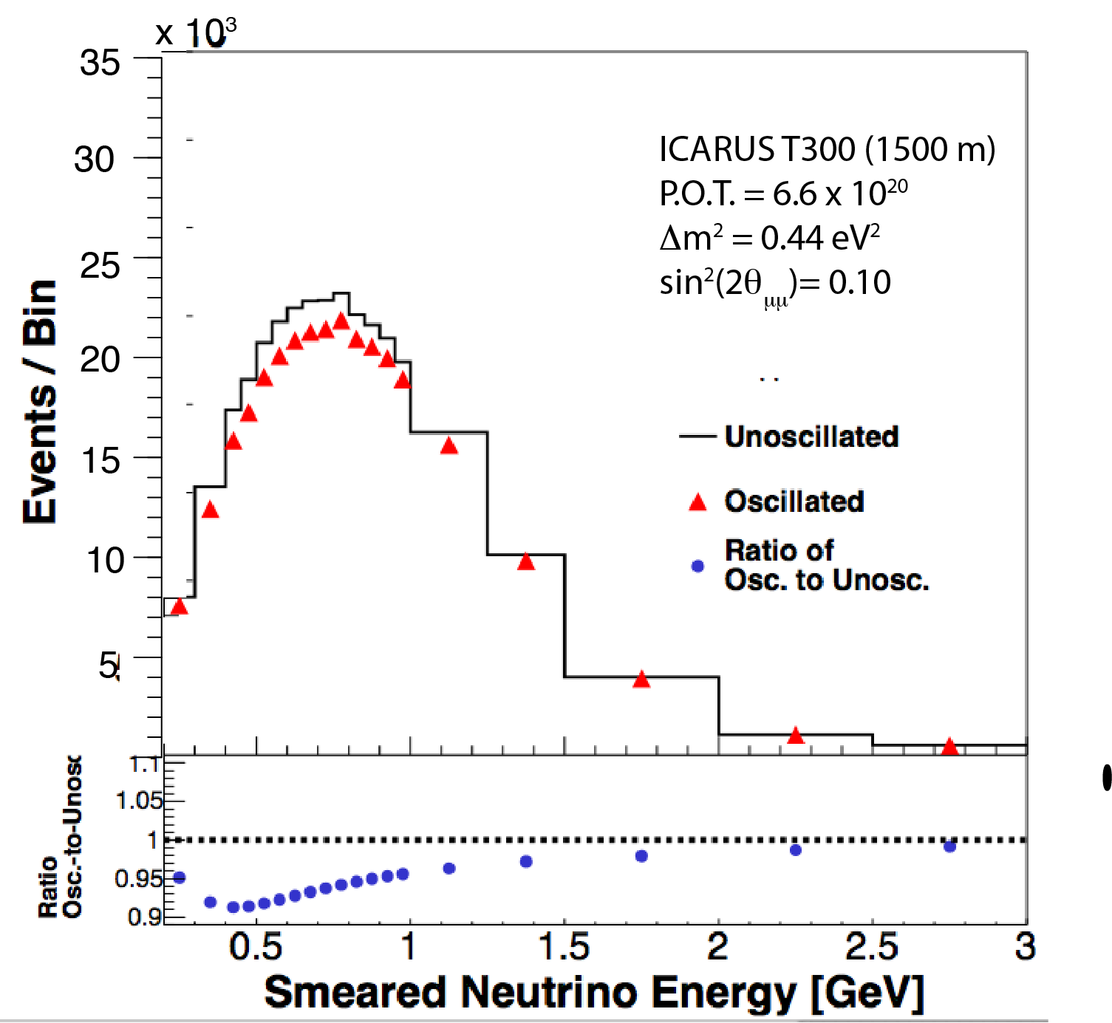
Expected disappearance for νμ signal
According to the predictions from Big Bang Cosmology, the mass difference Δm² may be small. Assume Δm² ≈< 0.4 eV² ,
The νμ disappearance effect at 600 m will be seriously limited to the lowest neutrino bin energies 0.2-0.4 GeV.
As a second phase and in order to amplify the effect, we may have to move a LAr-TPC to a distance of the order of 1500 m.
600 m
1500 m

Slide 49
Conclusions
Over the last several years, neutrinos have been the origin of an impressive number of “Surprises”:
  Masses, once zero “by ignorance”, are actually important
  Oscillations extend and complete the C+KM quark mixing
  Oscillations due to matter exist, due to neutral currents
There is a small but realistic probability that sterile neutrinos and other “anomalies” may be confirmed.
A neutrino–like object with m ≈ 1 eV/c² could be a fundamental new discovery and be a major source for the Dark Mass !
Otherimportant discovery potentials may be ahead:
The future v programs at FNAL represent many unique opportunities ,both with SBN and later with DUNE

Slide 50
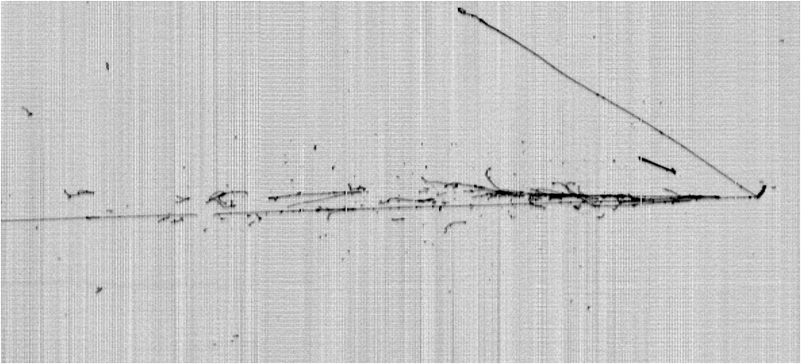
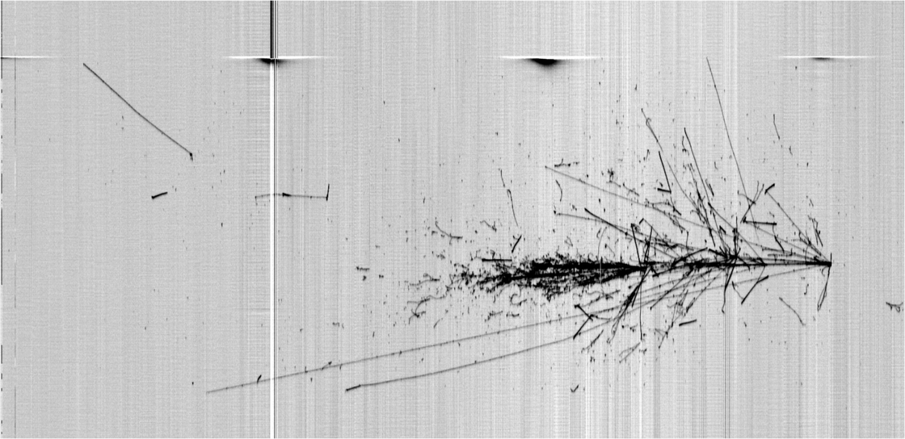
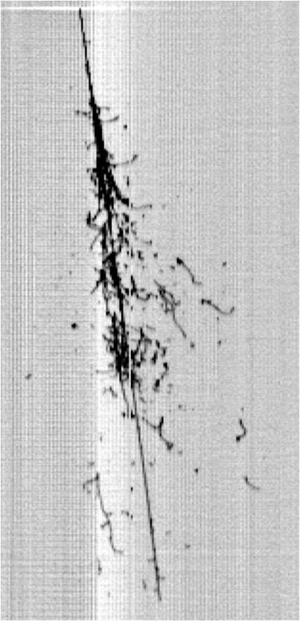
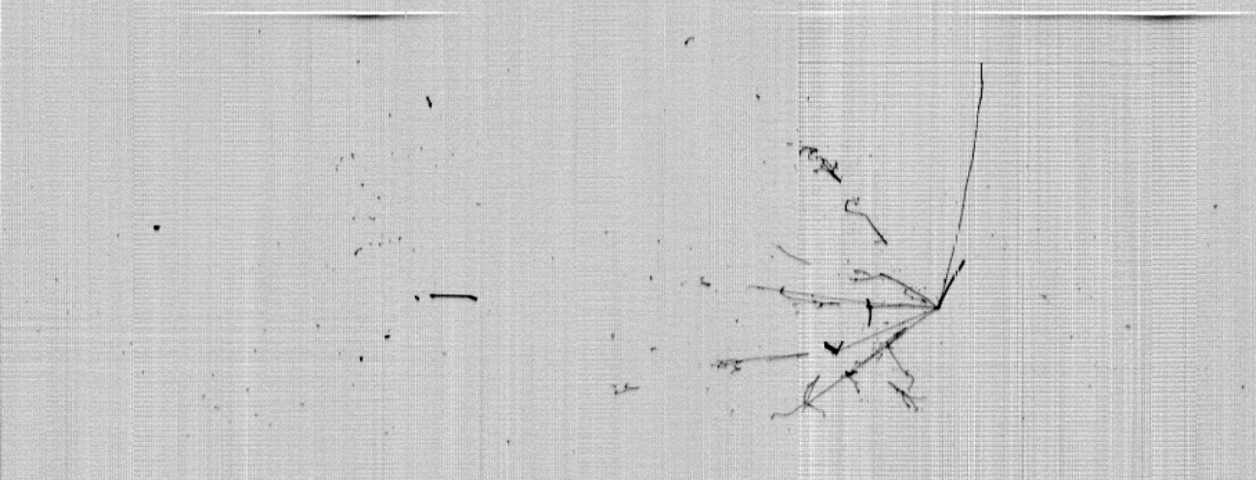
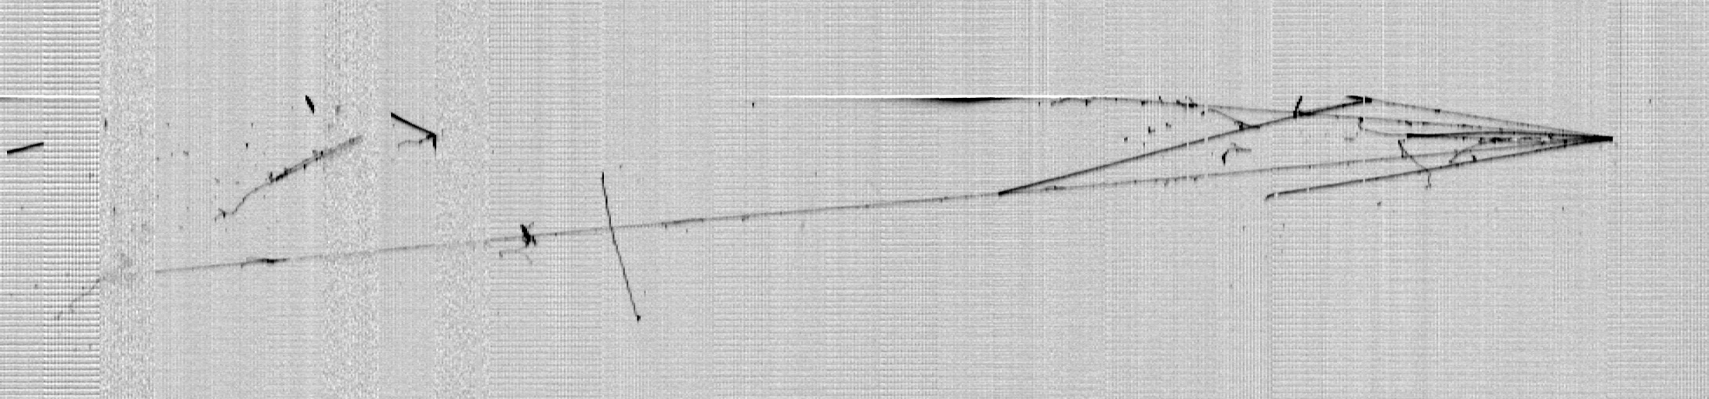
Thank you !
LNGS_May2011
Slide 50

