Slide 1
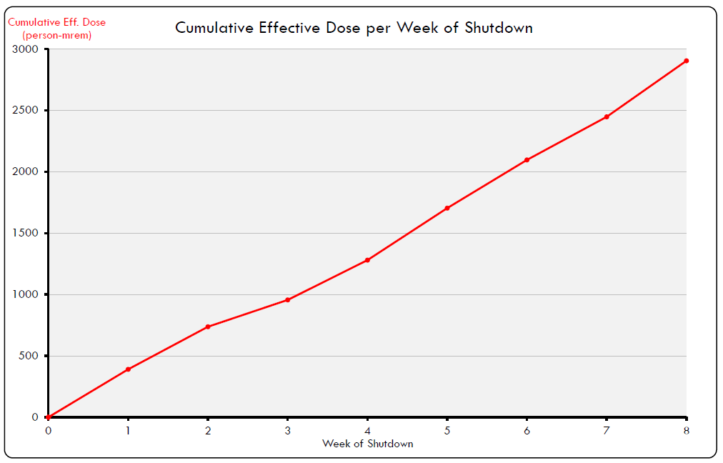
2018 Shutdown Pocket Dosimeter Reports – Week 8
WEEK 8:
457 person-mrem
60 people reported some dose, with average dose of 7.62 mrem
SHUTDOWN SO FAR:
2,904 person-mrem
141 people reported some dose, with average dose of 20.60 mrem
Total shutdown dose estimate: 6,800 person-mrem
REMINDER! If you wore your pocket dosimeter and received zero dose for the week, please enter “0” into GetDose – do not leave blank!

