Slide 1
Booster Shutdown Week 9
Joe Compton
9am Meeting
9/7/2018

Slide 2
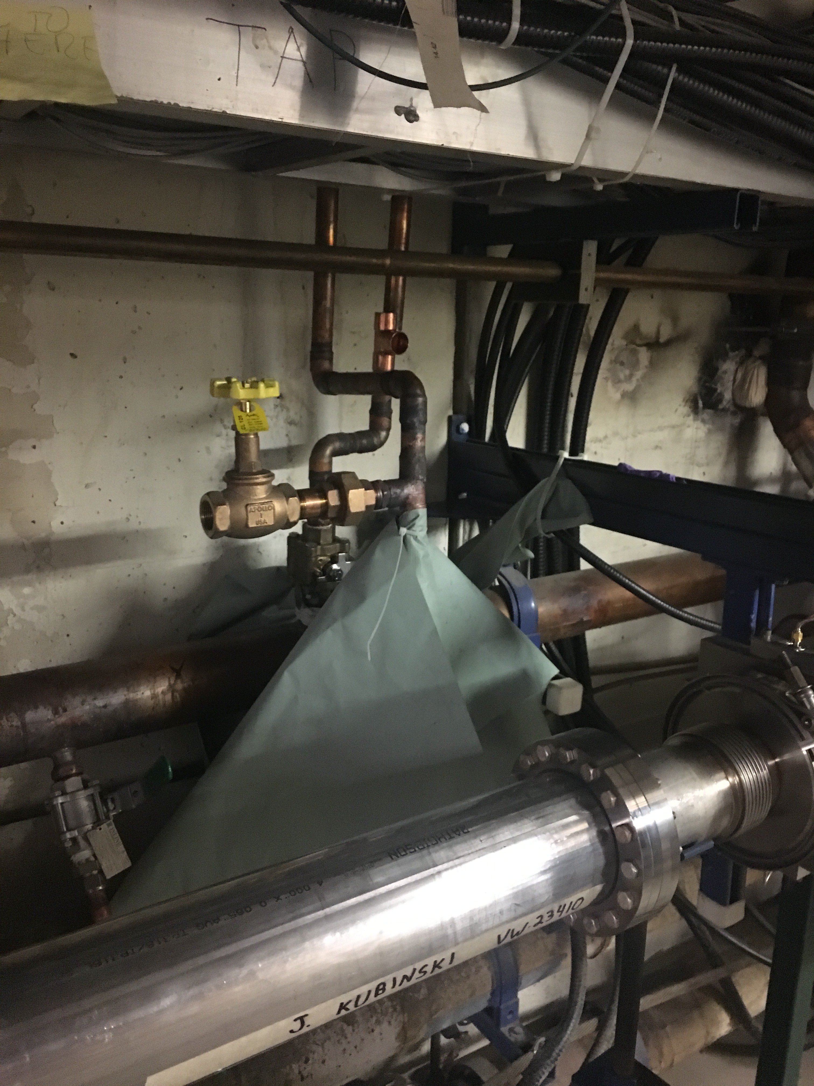
Booster
Vacuum techs replaced seals in period 17 to repair a leak
Fluids techs repaired leaks at 13-2, 2-1, and at period 8
Also working on manifold at L11
BPM upgrades continue
Booster has been safety system tested and is on operational keys
Like to secure tonight and perform power supply testing over the weekend.
RF maintenance continued

Slide 3
Booster
Kicker work continued in the enclosure
Today performing some cable dressing and removing equipment
Some minor chopper work upstairs still to go
Second harmonic cavity work continues
Reference magnet magnetic shielding installed
TORL10, TORL20, CHG0 calibrations
Dynapower PS maintenance
VBC1, DOGL3, Q800, 801, 802

Slide 5
Booster Next week
Second harmonic cavity work
Kicker maintenance
Finish up misc work
LCW maintenance
Finish LCW manifold at L11
Change filters
Finish RF maintenance/turn on
Finish BPM upgrade
Secure Booster tonight
Start power supply testing
Finish beam sign offs
Start running beam

