Slide 1
MI/RR Shutdown Status
Denton Morris
0900 Meeting
September 7, 2018

Slide 2
2018 Shutdown
“I wouldn’t want to be you.”
-Almost everyone

Slide 3
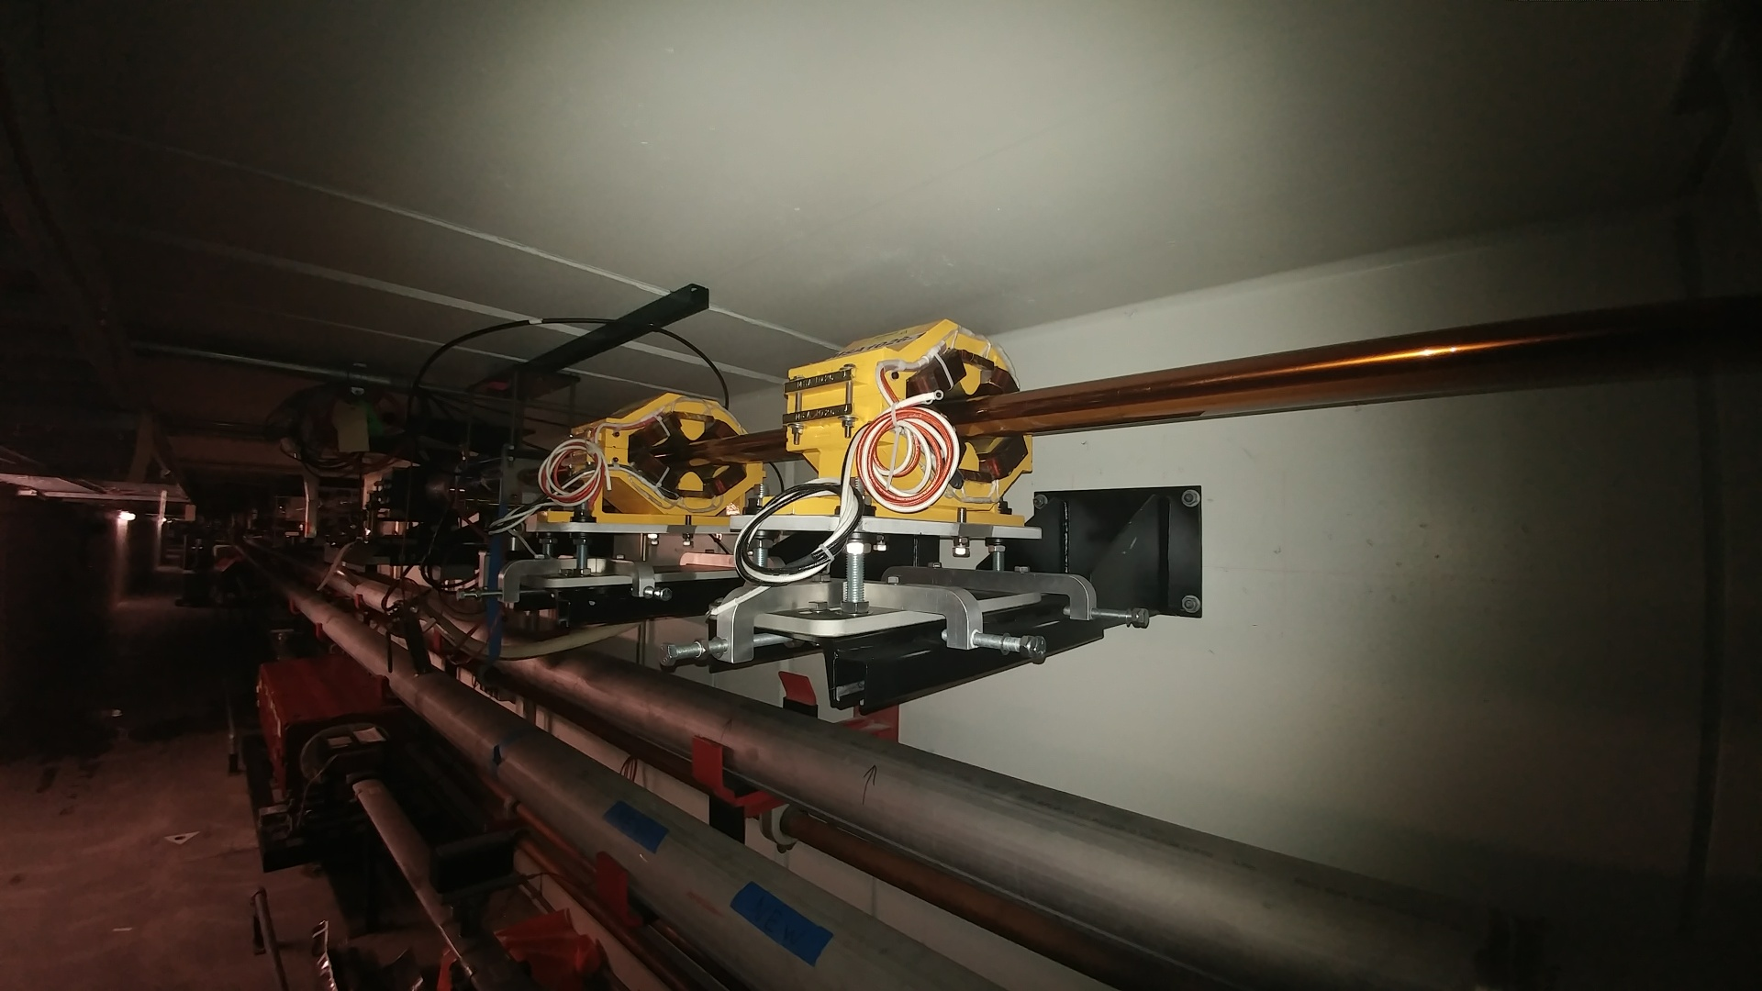
2018 Shutdown
Tunnel work:
Recycler sextupole and skew quad stand upgrade
Alignment completed MI-10 sector stands
Four new sextupoles and stands installed (ready to connect)
Four to go

Slide 4
2018 Shutdown
Tunnel work:
8 GeV Multiwires
Installing four multiwires: 826, 827, 829, 836
All four multiwires and stands are in place
Vacuum pipe welded
Flanges connected
Performing rough leak check today
Monday alignment
Final leak check
Leak check continues through RF section
RF maintenance continues

Slide 5
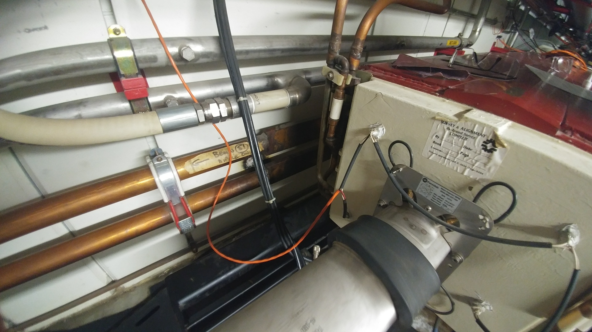
2018 Shutdown
LCW maintenance
Repaired leaking valves and repaired a leak on dipole bus

Slide 6
2018 Shutdown
MI-60 Upper Dipole Bus choke water LCW leak
Repaired in place
Pending work:
MI-40 abort vacuum
Septa RGA stand installation
MI-10 SEY sample change (Monday)
Absorber room detector installation
Miscellaneous ion pump maintenance

Slide 7
2018 Shutdown
MI-8 GeV, MI-10 and MI 20-62 enclosures will be re-keyed to operational keys for Tuesday morning access.
Monday clear LOTO locks from MI-10 lock box.

