Slide 1
SBN Program Status
Peter Wilson – SBN Program Coordinator
SBN Oversight Board
21 September 2018

Slide 2
Outline
Personnel changes
Directors review summary
Technical Progress on SBN Detectors
  ICARUS Status (brief – details this afternoon from Claudio)
  ICARUS Milestones
  SBND Status (brief – details this afternoon from Brian)
  SBND Milestones

Slide 3
Organization

Slide 4
Organization - Personnel
WBS 1
WBS 2
WBS 3
WBS 4
Program
Coordinator:
Peter Wilson
Deputy:
Cat James
Technical
Coordinator:
Brian Rebel
Deputy:
Anne
Schukraft
Technical
Coordinator:
Claudio
Montanari
Deputy:
Angela Fava
Technical
Coordinator:
Cat James
Definitions:
L1 Manager = TC
L2 Manager is next level below
MS Project File covers WBS 1-4

Slide 5
SBN Director’s Review – June 2018
A Director’s Review for SBN was held June 26-28 2018
  Review web page
The charge and format were very different from the three previous reviews:
  Focus on schedule elements and integrated schedule
  Not a review of technical choices or cost
  Small breakout sessions discussing deliverable tasks with respect to schedule
In future we are considering moving to a model where the review is charged and overseen by the international stakeholders

Slide 6
Director’s Review Summary
From the executive summary of the Review Final Report
  “The main conclusion of the review was that while an overall integrated schedule for completion of each detector was not available, the information needed to create these schedules does exist.”
  “The committee also reviewed outstanding risks, that if realized would impact the ability of the program to keep on schedule. The committee felt that the sub-system teams had a good handle on their risks and are working towards mitigating outstanding risks.”
  “The committee notes that to date the schedule for the installation of the far detector cold vessels has encountered a number of serious delays, however, the near term schedule for getting the vessels installed will be a significant achievement and careful planning of all the tasks going forward will be needed to try and accelerate the achievements of key milestones I-1 and I-2.”
  “Finally, it is extremely important that the agreements needed to begin the final design of the near detector cryostat be put into place as soon as possible, so that the schedule for the construction of the cryostat does not significantly delay achieving the milestones S-2 and S-3”

Slide 7
SBN Director’s Review Response
Intermediate milestones created for both far and near detectors
Far detector Installation Coordinator (IC), Aria Soha, has implemented a detailed work planning process:
  Each installation activity must be reviewed for resource needs, durations, engineering, predecessor tasks, safety etc
  Approval required by Aria (IC) and Claudio (TC) before work can proceed
  Feeds into a day-by-day working schedule posted online and reviewed every week
  Updated master schedule for these tasks through end of December 2018
  Master schedule update in progress for tasks up to the LAr fill (eg cryo and electronics installation) [Key Milestone I-1]
Near detector deputy IC, Joseph Zennamo, and deputy TC, Anne Schukraft, initiated complete overhaul of detector assembly and installation schedule
  Mini-workshops in early September
  Update of master schedule in two weeks for tasks up to the LAr fill [Key milestones S-1 and S-2]
  Will adopt work planning process developed by Aria for FD

Slide 8
SBN Director’s Review Response
Significant progress on multi-institutional MOU (see Steve’s talk) as crucial component to agreement on final deliverables
Outline of agreement on several outstanding deliverables between CERN, INFN, Fermilab developed by Steve B, Marzio N and Peter W in September
  Addresses ND cryostat (design contract) and warm piping for cryogenics
  Working out details now, expect to complete in October
Working to improve system for visitors coming to work on SBN detectors at FNAL
  Single contact in Neutrino Division to help interface with Users Office, Visa Office…
  Rolling out within a few weeks
  Provide input to lab
Next Director’s review planned for end of November or December
  Follow-up on all recommendations from June
  Review of updated schedule and DOE costs
  Crucial to securing remaining DOE funds

Slide 9
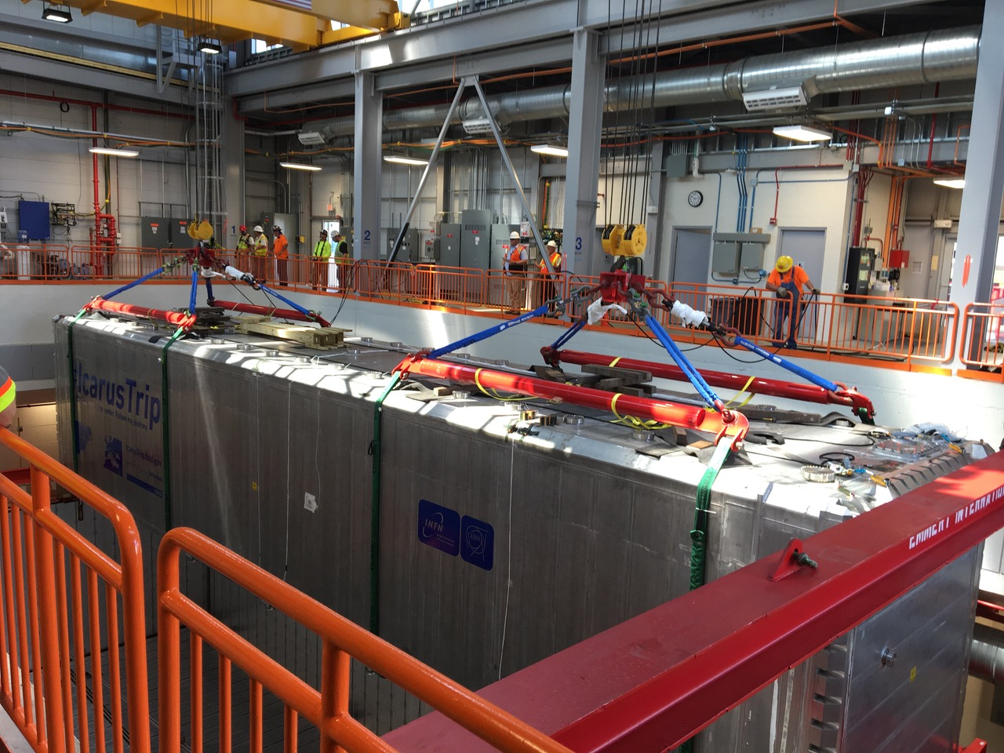
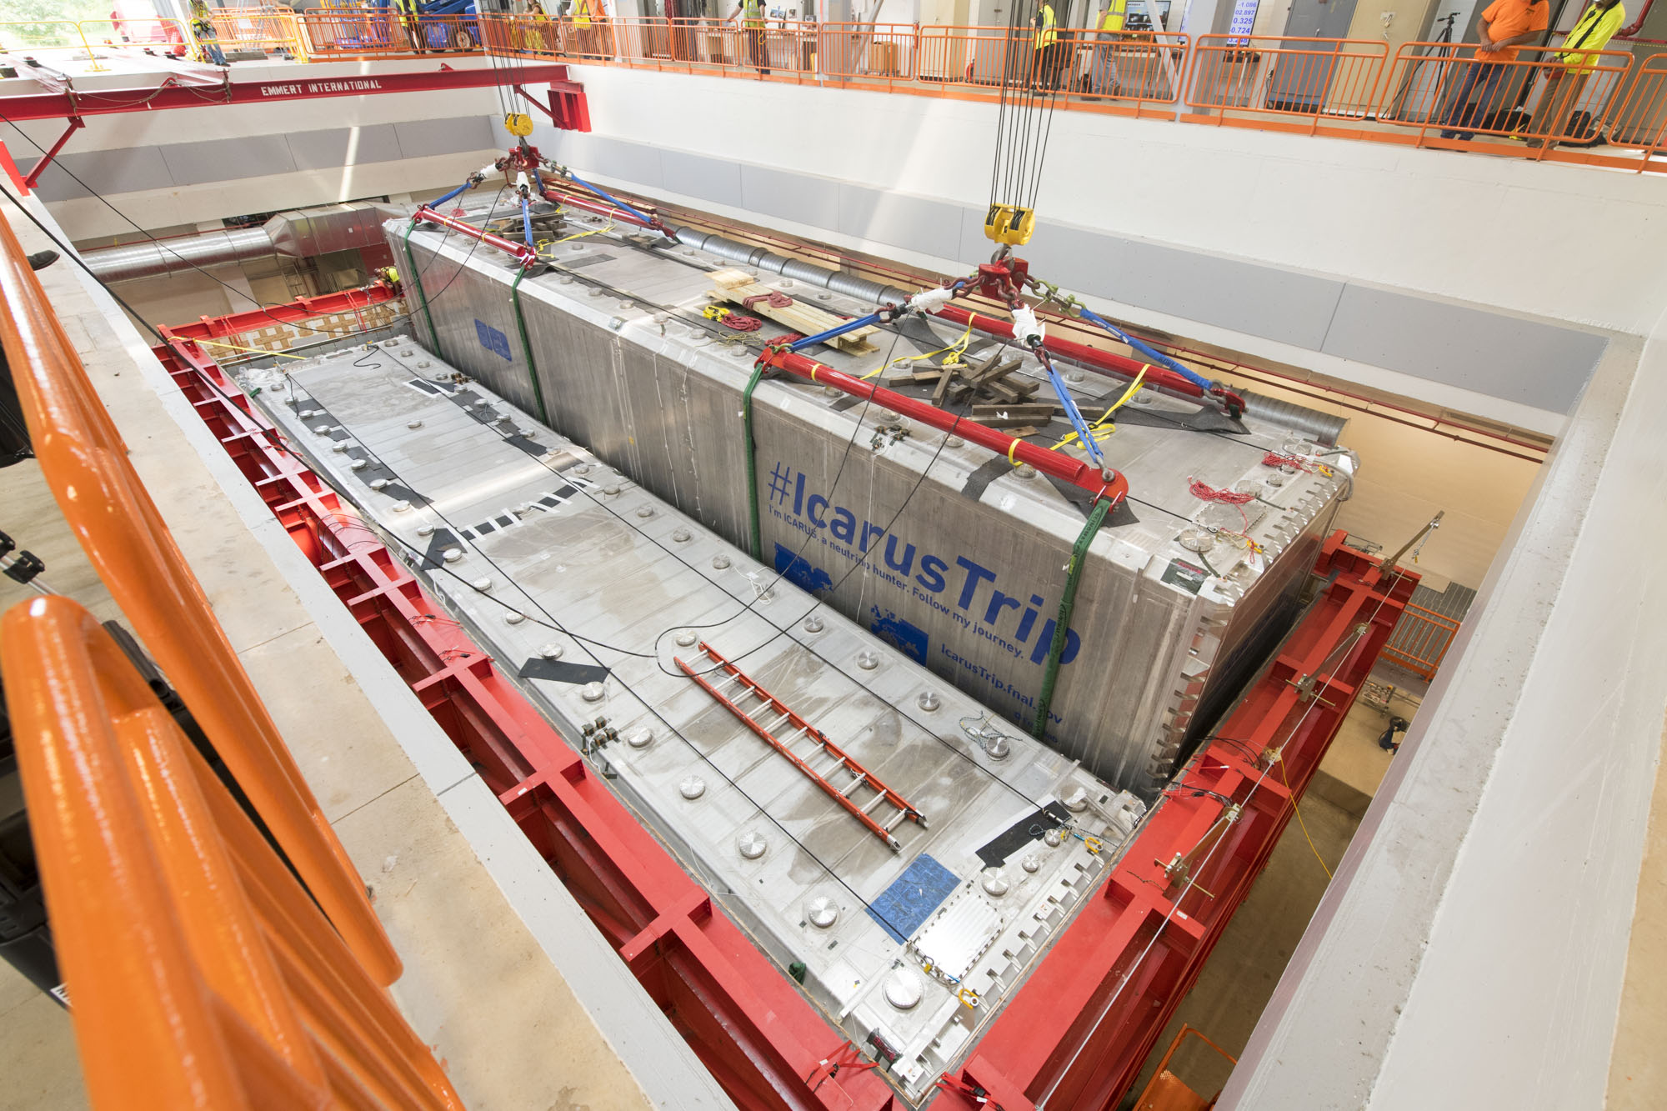
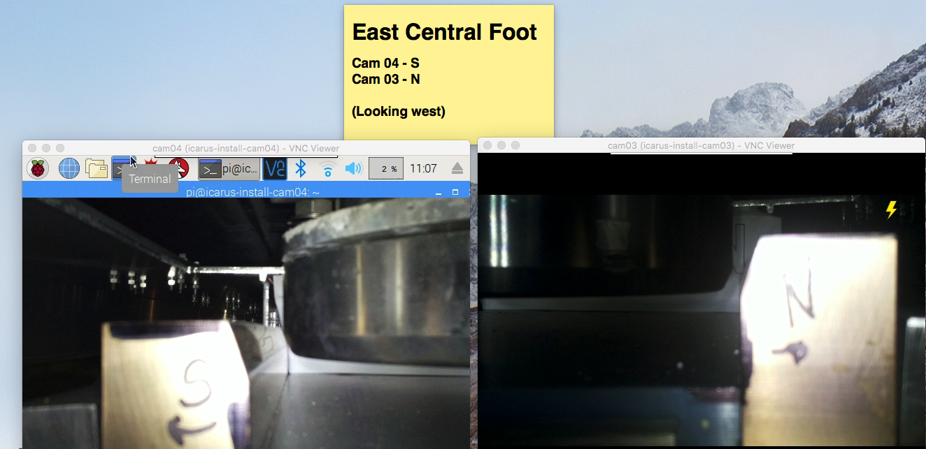
ICARUS Installation Progress
Installation staying on schedule since delivery of cold shield components in April
Vessel rigging completed on schedule :
  July 23 remove building north wall panel
  Aug 2–8 move vessel 1 (done Aug 9)
  Aug 9–16 move vessel 2 (done Aug 14)
  Aug 16 demobilization completed
Vessels Positioned to specification:
  +/- 3mm in horizontal
  +/- 0.5mm vertical
  Clearance of 30mm on sides (for slings)
No injuries or equipment damage

Slide 10
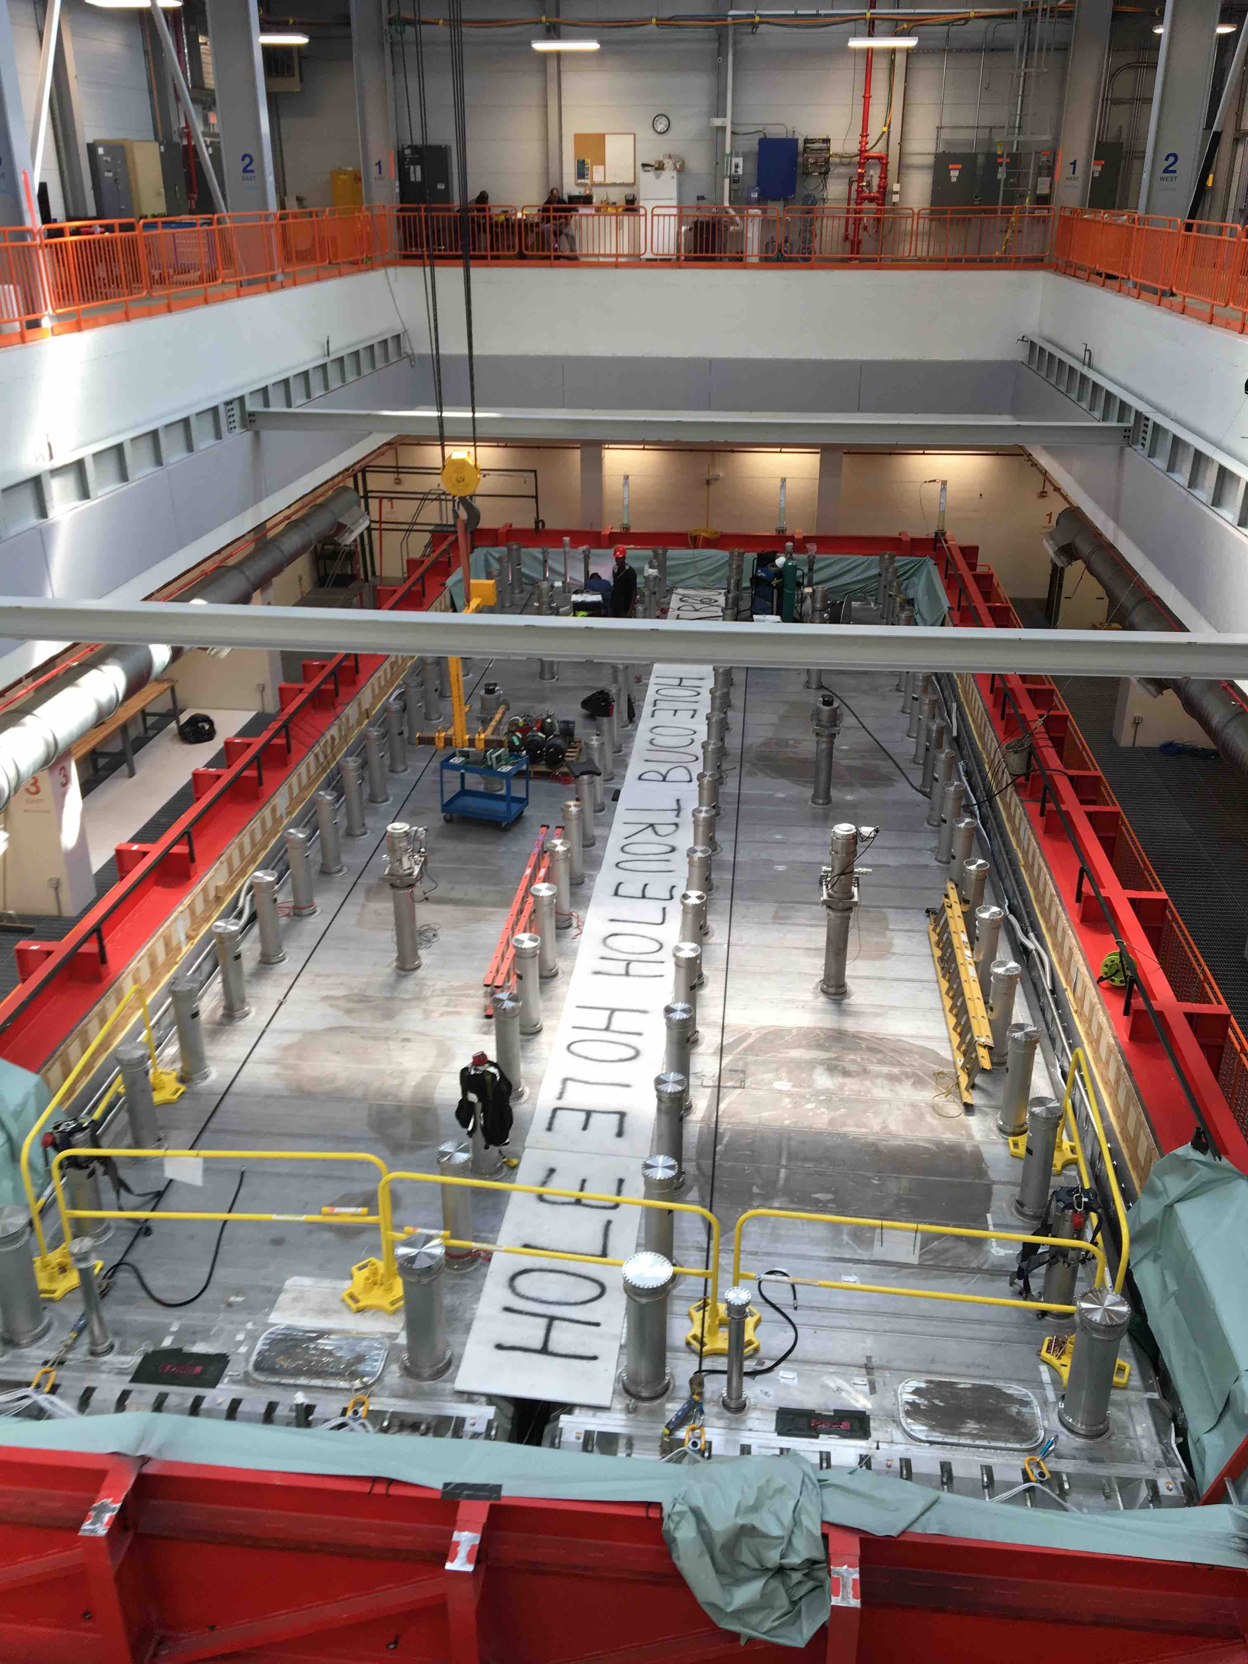
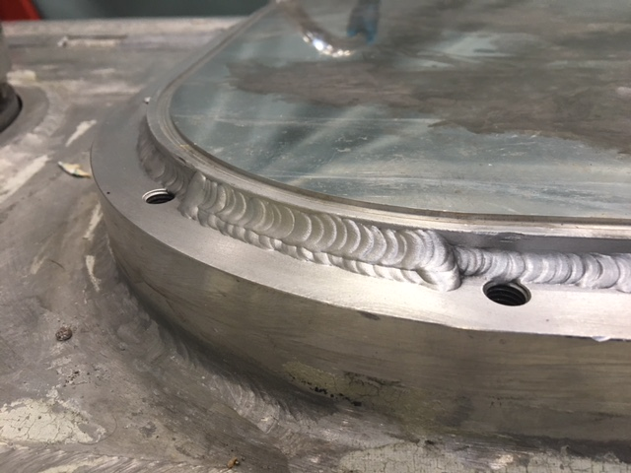
ICARUS Installation Progress
Vessel 2 Ready
TPC 1 Complete
Post rigging installation on schedule:
  Feedthrough chimneys installed and tested
  Field cage resistors installed and tested
  Personnel access ports closed and welded
  Ready to start the vacuum test
  Installation of steel structures in progress:
    CRT top steel, cryogenic platform and stairs
    Guardrails
  Top cold shield being readied (install start 10/1)
  Preparing for warm vessel roof (install start 10/14)
    Test fit of warm vessel roof piece 9/14
  Installation of crosses on chimneys start in mid-November
  Demaco (CERN contractor) scheduled to start proximity cryogenics installation in January

Slide 11
ICARUS Key Milestones
Milestone | Description | Baseline Date
I-1 | ICARUS detectors are ready to fill with liquid argon | May 2019
I-2 | ICARUS detectors are filled with liquid argon and ready for detector commissioning (LAr purity adequate for physics has been achieved) | Nov 2019
I-3a | ICARUS detectors are ready for physics data - CRT is operational | Jan 2020
I-3b | ICARUS detectors are ready for physics data - Shielding in place | Feb 2020
Baseline dates set in March 2018

Slide 12
ICARUS Milestones
Intermediate milestones leading to
Key Milestone I-1 ICARUS Ready to Fill
Intermediate Milestone | Owner | Forecast Date | Baseline Date
Vessels rigged into building | P. Wilson | 16-Aug-2018 | 16-Aug-2018 | ✓
Manholes welded and vacuum test successful | C. Montanari | 29-Sep-2018 | 10-Oct-2018
Warm Vessel roof complete | C. James | 9-Nov-2018 | 15-Nov-2018
Cryo Platform complete | C. James | 12-Oct-2018 | 15-Dec-2018
Proximity cryogenics installation begins | B. Norris | 13-Dec-2018 | 15-Jan-2019
DBB & flanges installation complete and tested | A. Fava | 01-Feb-2019 | 15-Feb-2019
Cold proximity cryogenics installation complete | B. Norris | 03-Mar-2019 | 15-Apr-2019
1st T300 readout installation complete | A. Fava | 01-Mar-2019 | 15-Mar-2019
All detector readout installed | A. Fava | 15-Apr-2019 | 1-May-2019
Begin vacuum pumping | C. Montanari | 15-May-2019 | 15-Jul-2019
Cryogenic operation approved | B. Norris | 15-Jun-2019 | 15-Jul-2019
Forecast Date Based on SBN Schedule after August Dates CR and August Milestones CR
Grey text dates – not expected to change but still cross-checking details in the schedule

Slide 13
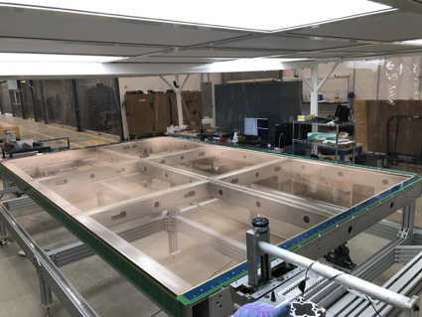
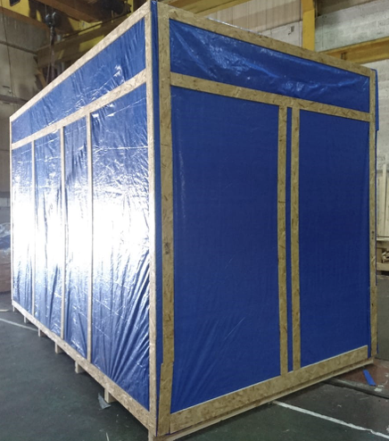
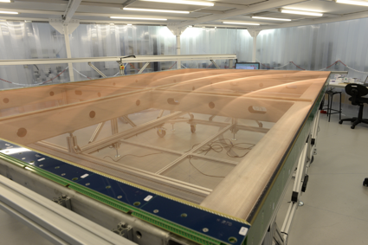
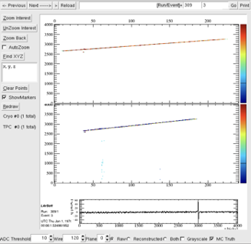
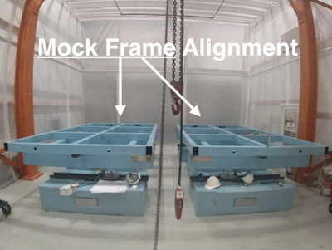
SBND Progress
TPC subsystem fabrication in final stage:
  Two (of 4) anode planes completed and ready to ship (one each in Daresbury and Yale)
  Cathode (Liverpool) delivered to FNAL
  Field cage (Yale) completed, ready to ship
TPC assembly facility setup at FNAL Dzero building and tested with mock APA frames
  TPC assembly will start this fall
TPC electronics Vertical Slice Test (VST) with LArIAT TPC
  Two runs: Beam (June), cosmics (Sept)
  Excellent noise performance
  Shakedown DAQ hardware and software
  Some issues likely related to LArIAT TPC configuration
  Production Readiness Review in October
PMT system components near complete
2 of 4 APAs Wired
CPA@FNAL
VST cosmic track

Slide 14
SBND Milestones on DOE schedule
Milestone | Description | Baseline Date
S-1 | SBND is ready for transport from Dzero Assembly Building to the SBN ND hall | Aug 2019
S-2 | SBND detector is ready to fill with liquid argon | June 2020
S-3 | SBND detector is filled with liquid argon and ready for detector commissioning (LAr purity adequate for physics has been achieved) | Oct 2020
S-4a | SBND detectors are ready for physics data - CRT is operational | Nov 2020
S-4b | SBND detectors are ready for physics data - Shielding in place | Dec 2020
Baseline dates set in March 2018

Slide 15
SBND Milestones
Intermediate milestones leading to
Key Milestone S-1 SBND ready to move
Milestone | Owner | Baseline | Forecast | Completed
First set of APAs shipped to Fermilab | K. Mavrokoridis | 24 Sep 2018 | 22 Oct 2018
PO for COTS ADCs placed | H. Chen | 31 Oct 2018 | 15 Nov 2018
All TPC components at Fermilab | K. Mavrokoridis | 29 Nov 2018 | 20 Dec 2018
Complete atf assembly at DAB | J. Zennamo | 1 Feb 2019 | 1 Mar 2019
APAs and CPAs installed in atf | J. Zennamo | 1 Mar 2019 | 22 Mar 2019
50% of motherboards at Fermilab | H. Chen | 15 Mar 2019 | 15 Apr 2019
Field Cage assembly complete | J. Zennamo | 15 Apr 2019 | 15 May 2019
Cold electronics installed and tested | H. Chen | 16 Aug 2019 | 30 Sep 2019
S1: TPC ready to move to SBN ND | A. Schukraft | 30 Aug 2019 | 30 Oct 2019

Slide 16
SBND Milestones
Intermediate milestones leading to
Key Milestone S-2 SBND ready to fill w/LAr
Milestone | Owner | Baseline | Forecast | Completed
FNAL/CERN/INFN Agree to Division of Responsibilities | B. Rebel | T0 | T0
GTT Design Study Begins | M. Nessi | T0 + 1 Month
Membrane Cryostat Completed | M. Kim | T0 + 12 Months
TPC Plug Assembly Mounted in Cryostat | M. Kim, J. Zennamo | T0 + 13 Months
Plug Welded to Cryostat | M. Kim, J. Zennamo | T0 + 14 Months
S2: SBND Ready To Fill | A. Schukraft | T0 + 16 Months

Slide 17
Summary
ICARUS installation progressing well
  Staying on schedule since arrival of cold shields at Fermilab
  Joint effort between Italian collaborators, U.S. collaborators, Fermilab and CERN
SBND construction progressing well
  Center of activity moving to Fermilab as TPC fabrication nears completion
  Near completion of agreement on cryostat
Nearly finished responding to last Director’s Review, starting planning for next review

Slide 18
Backup

Slide 19
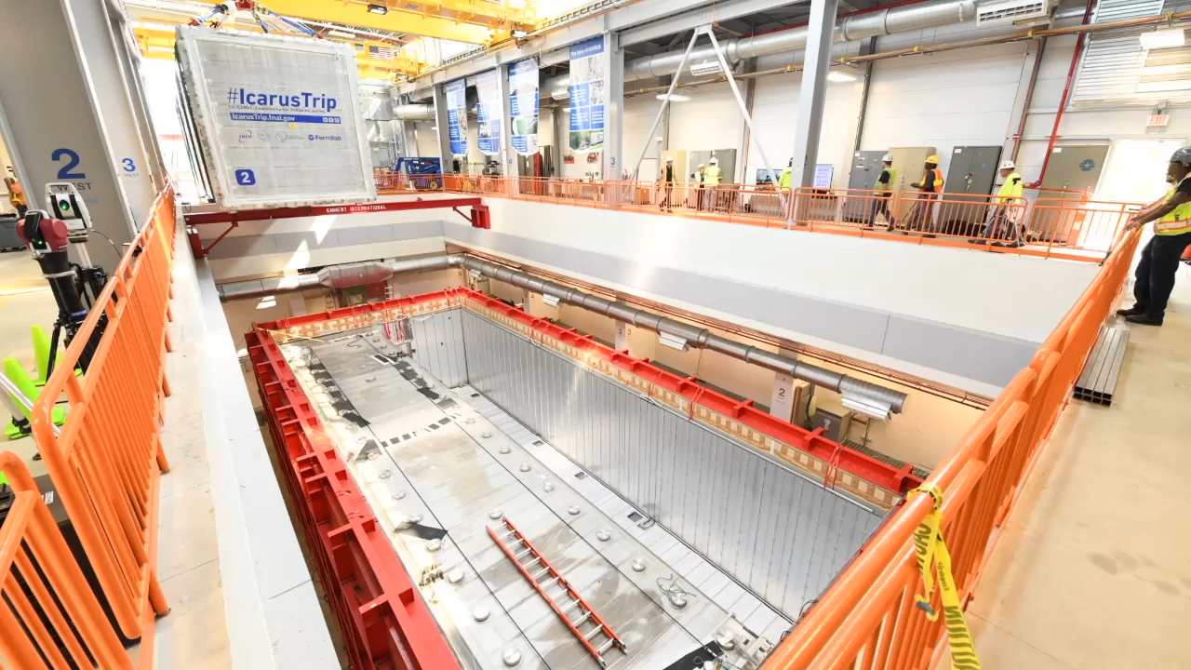
ICARUS Rigging – 2nd Vessel Insertion

