Slide 1
DSS Update
Victor Guarino

Slide 2
DSS Feedthrough Diameter
Currently 250mm outside dia crossing tube – proposed to go to ~150mm dia
Sizing of the DSS tube depends on:
  Stiffness/strength of tube to resist lateral loads
  Space available to accommodate shrinkage and location adjustment
Small Tube (~125mm dia) has less stiffness but feedthrough has been lowered which decreases moment arm.
  Smaller/shorter tube can resist 700 lbs with 3mm deflection so is ok

Slide 3
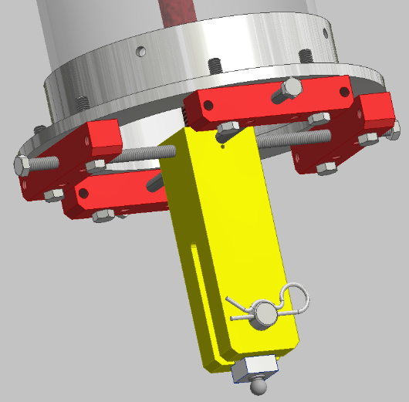
DSS Feedthrough Diameter
Clearance for Shrinkage and Adjustment
Need 17mm clearance for shrinkage
Currently have +/- 25mm adjustment to accommodate Feedthrough placement
If clevis is extended outside of tube it might be possible to keep adjustment. Constraint block has to be extended.
Loose hole for installation

Slide 4
Changes
S8 beam changed to W10 beam
APA weight increased from 1048kg to 1241kg
Analysis re-run
Detector Layout redone (see docdb 6260)

Slide 5
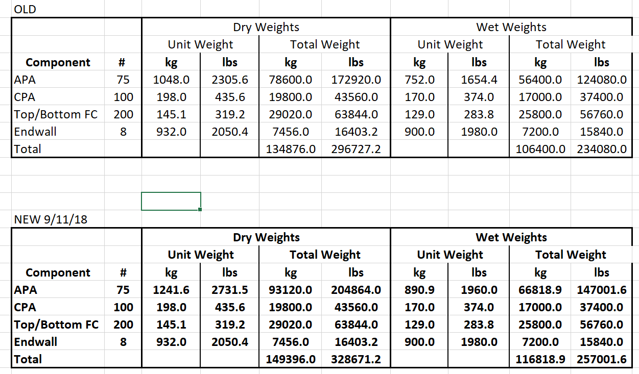
Weights

Slide 6
Impact of larger beam
DSS is closer to ceiling in order to maintain detector height
Greater DSS weight
Greater margin on strength:
  Allowable moment 62.5 kip-ft
  Load factor of 1.4 results in a Max moment is 24.2 kip-ft so a margin of 3.2
Smaller deflections

Slide 7
Deflections

Slide 8
Detailed FEA
Solid Model of Beam/clevis/rod/swivel for greatest loaded beam
  Detailed

Slide 9
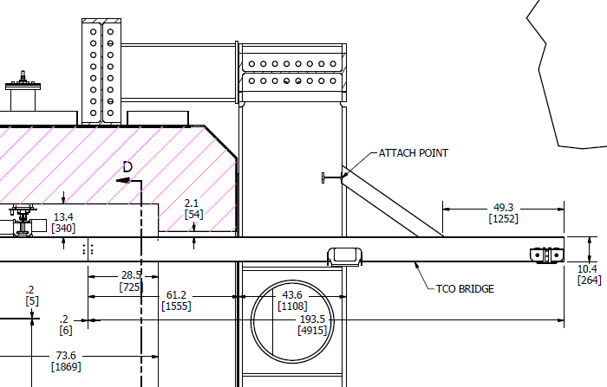
1.16m

Slide 10
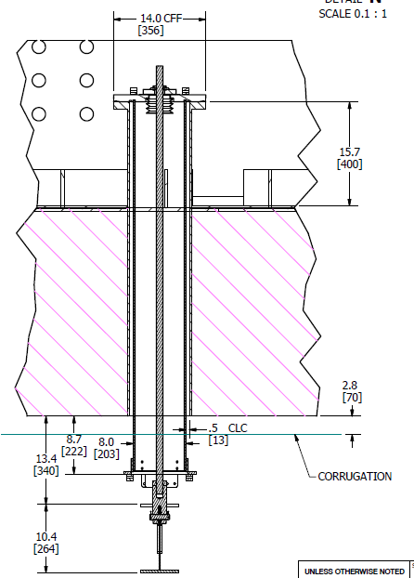
Axial
Shear
Moment

