Slide 1


Single Electron Emission Diagnostics
(SEED) Phase I DOE SBIR Project
Alex Murokh
RadiaBeam Technologies, LLC.
Single Electron Experiments at IOTA workshop, Fermilab, 09-Nov-2018

Slide 2
Background
IOTA ring is a newly constructed 45-meter circumference experimental beamline, which can host single electron experiments
A minimal additional equipment requirement (radiator + SEED), could be sufficient to start the program, given the right motivation
In 2018 RadiaBeam received a Phase I DOE SBIR award to explore these opportunities, and carry out initial design of such experiments
(Single Electron Emission Diagnostics)

Slide 3
Phase I Project Tasks and Status
Define the scientific program and the instrumentation needs for the single electron science facility at Fermilab:
  hopefully, this task will be greatly influenced and assisted by this workshop;
  we need to prepare a white paper for public release stating the scientific case.
Develop the conceptual design of the SEED undulator and prepare a procurement and manufacturing plan in preparation for the Phase II project:
  can be a newly constructed undulator, or a retrofitted used one;
  requires feedback from task 1.
Develop the conceptual design of the SEED diagnostics and prepare a procurement and implementation plan in preparation for the Phase II project:
  requires feedback from task 1.

Slide 4
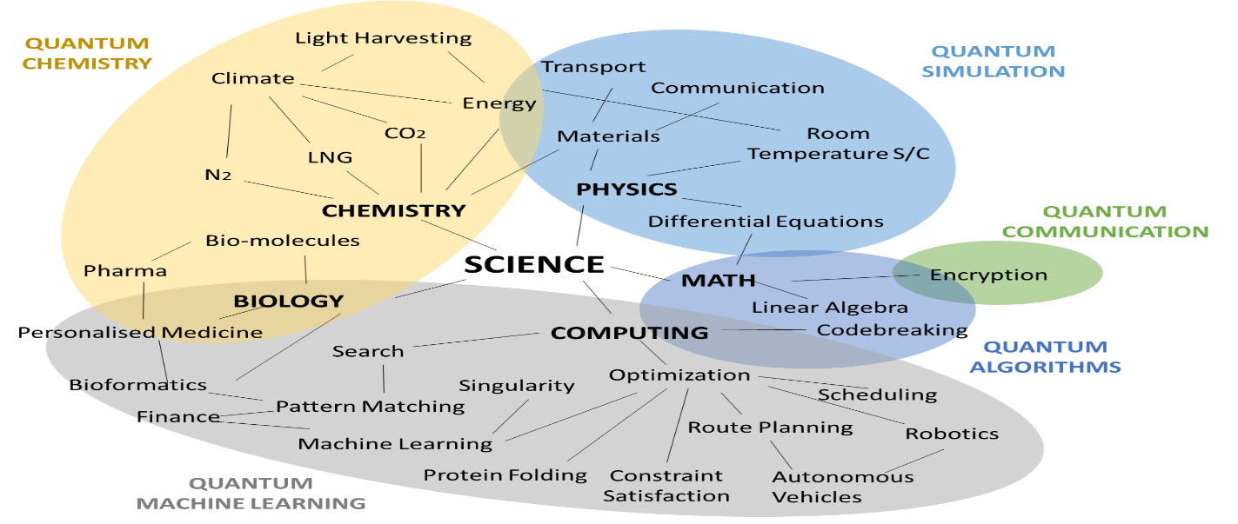
Motivation
Quantum technologies (mostly quantum computing) are forecasted to reach $8 billion volume in products and services by year 2024 (54% annual growth)
Single electron experiments can gain important insights into the physics of quantum processes, and their applications (i.e. quantum cryptography, non-invasive quantum measurements, etc.)
There are additional technological benefits to the program, such as development of diagnostic techniques.
“Quantum Computing Market & Technologies - 2018-2024”, ID: 4519299 Report January 2018 529 Pages Homeland Security Research Corporation

Slide 5
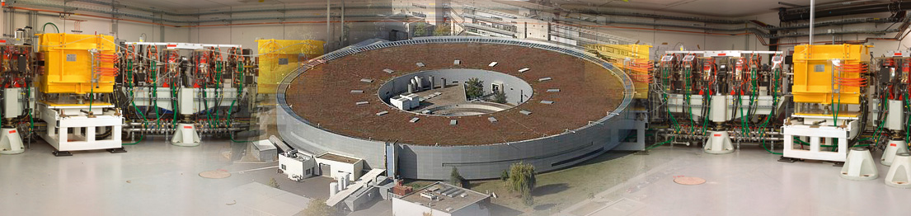
Scientific case
Study the basic physics of the radiation processes, a possible role of the quantum wave packet size, observation vs. state of the system, multi-photon emission correlations, etc.
The IOTA SEED parameters (transformed into the electron rest frame), are not far off the intense laser scattering experiments.
There are possible metrology applications (i.e. PTB storage ring)
It is also possible to achieve an important feedback on accelerator physics, FEL dynamics, etc.
M. Ware et al. "Measured photoemission from electron wave packets in a strong laser field,” Optics Letters 41(4), 689 (2016).
https://www.ptb.de/

Slide 6
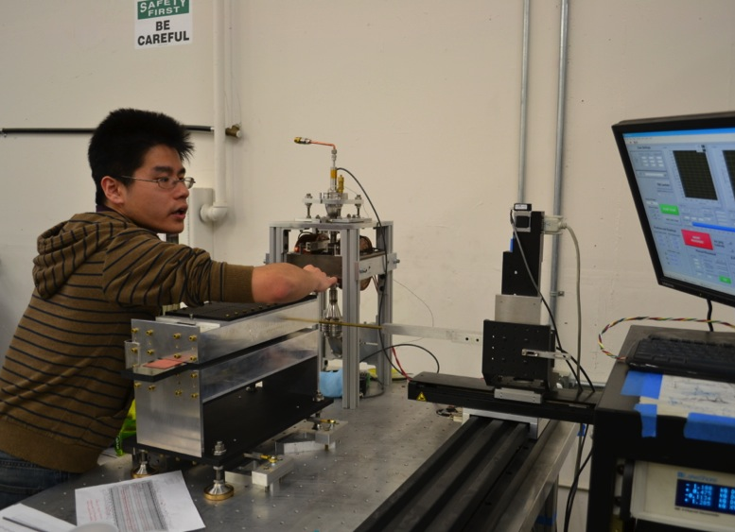
Undulator
Once the single electron experimental program is outlined we can design a radiator
We expect to develop a relatively inexpensive undulator, that is removable (EM option will be considered due to large period)
Also, we’ll consider possibilities of retrofitting an existing used wiggler

Slide 7
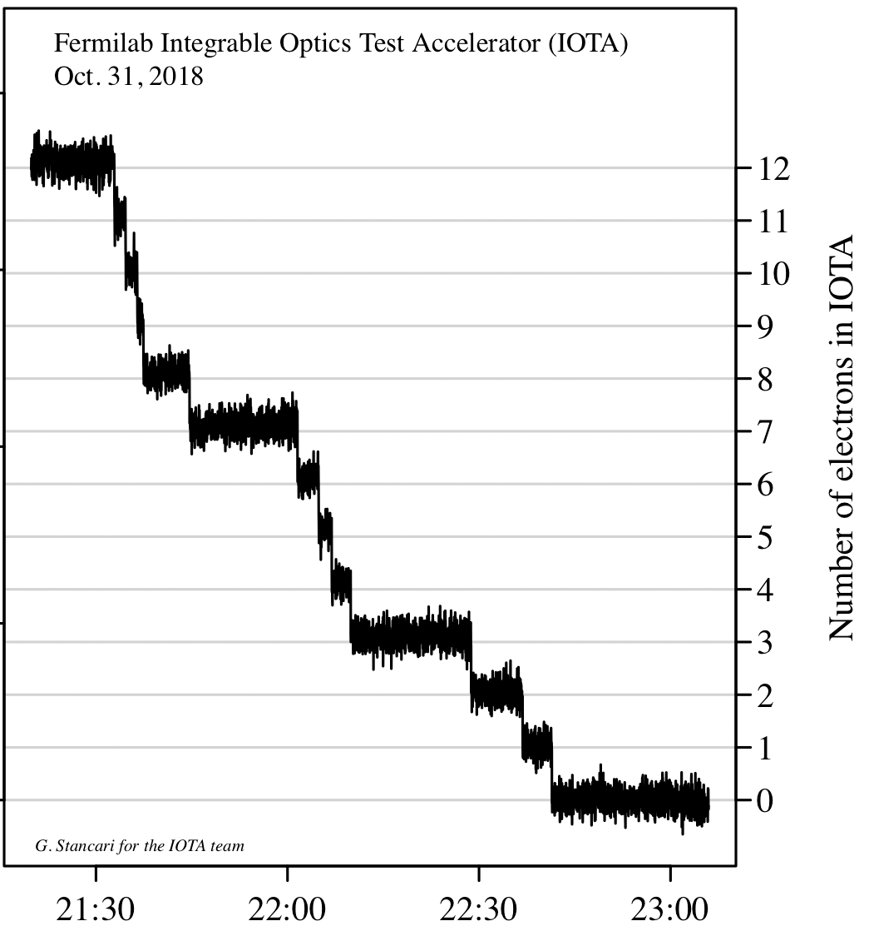
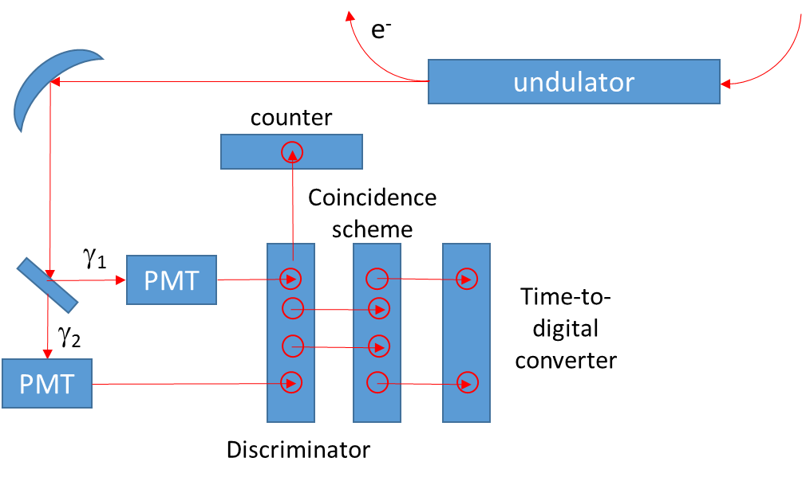
Diagnostics
Repeat (VEPP-3) photon counting experiment but with the modern fast electronics

Slide 8
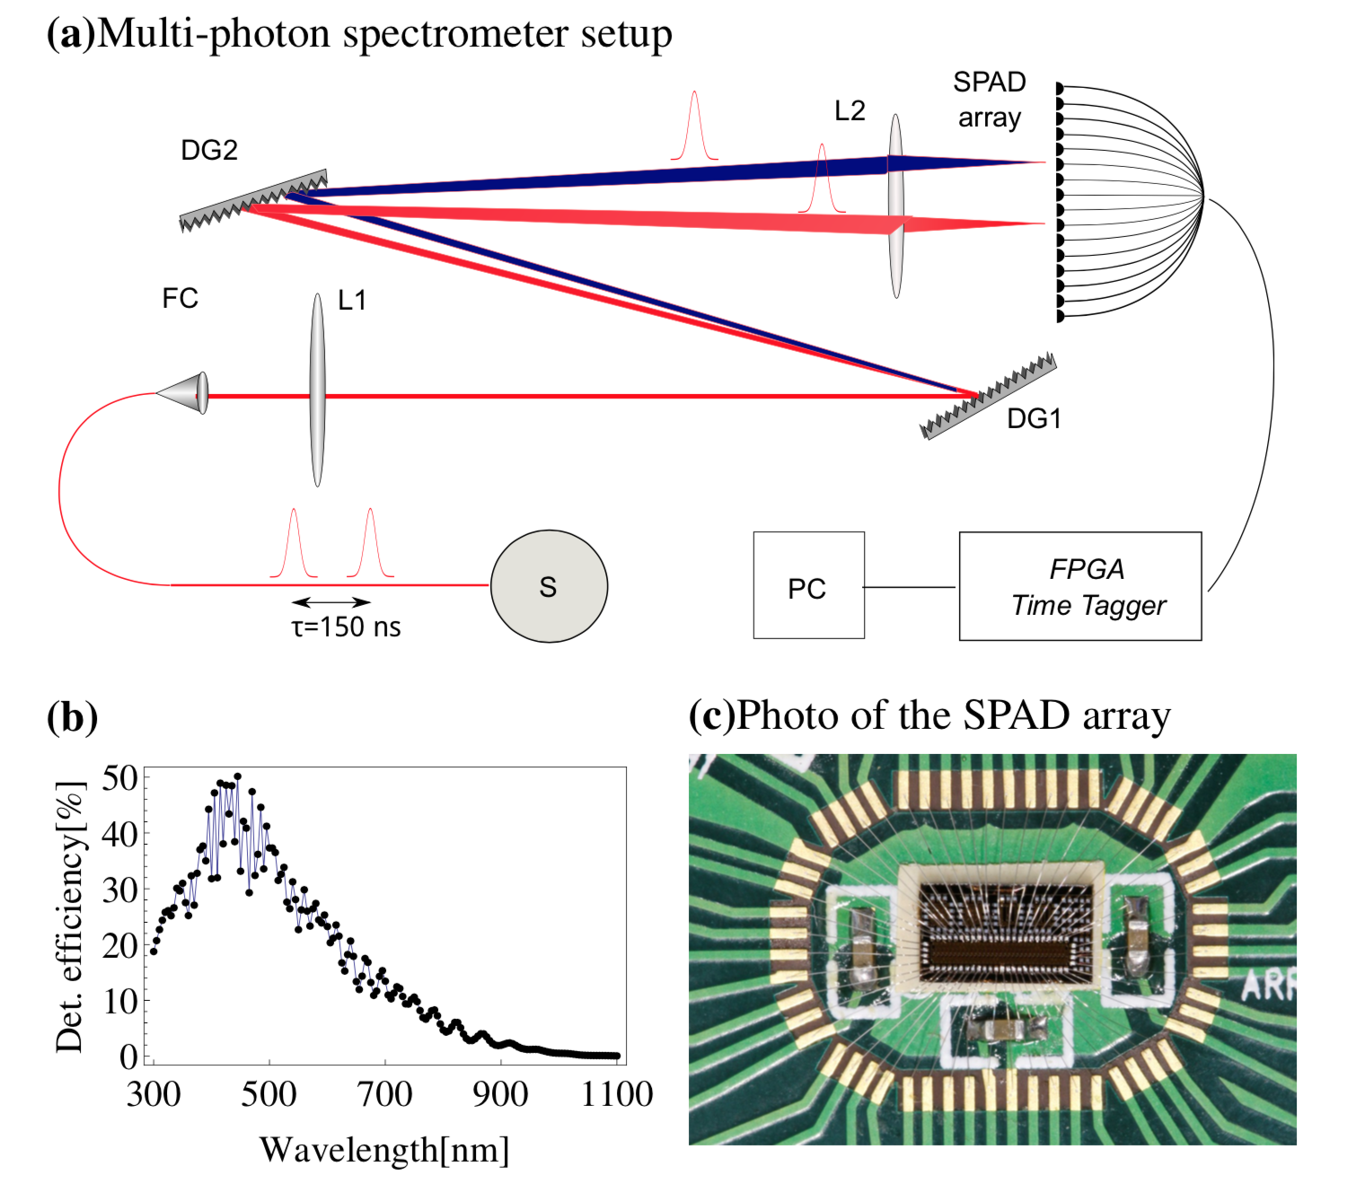
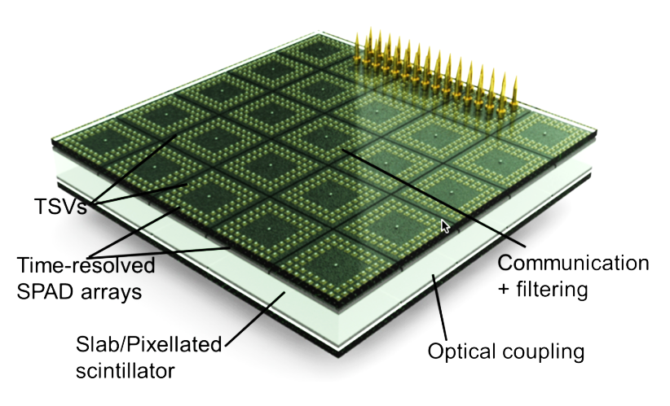
Advanced Diagnostics
Spectral measurements could also be useful in some experimental scenarios (i.e. to improve signal to noise, suppress transition undulator radiation, or color code different parts of the wiggler).
Single photon sensitive spectrometers have been demonstrated, and could be developed for the Phase II diagnostics station.
Also, photon-counting Avalanche Photo-Diodes arrays can be used for spatial differentiation
K. D. Johnsen et al. “Time and spectrum-resolving multiphoton correlator for 300–900 nm,” J. Appl. Phys. 116, 143101 (2014).
http://polis.minalogic.net/SPAD_TOF.php

Slide 9
Summary of the future plans
If an attractive scientific case for single electron experiments at IOTA is successfully established, the detailed design of the diagnostics and radiator systems will commence, and a Phase II proposal to DOE will be submitted.
If granted RadiaBeam will develop beamline and diagnostic instrumentation in support of the Fermilab IOTA experimental program.

Slide 10
Conclusions
IOTA storage ring offers unique opportunities to perform single electron experiments with a minimal investment.
RadiaBeam collaborates with Fermilab to design and develop instrumentation for such experiments.
Immediate goals are to establish primary scientific goals and to identify the specific experimental goals (this workshop helps !), in order to initiate the technical design phase.
This work is supported by DOE SBIR grant No. DE-SC0018773

