Slide 1

Dirac-Volkov model; Glauber’s model; IOTA experiment ideas (for undulator radiation produced by a single electron)
Ihar Lobach (UChicago)
Single-electron experiments in IOTA
Friday November 9th, 2018
Thesis advisors:
Sergei Nagaitsev,
Giulio Stancari

Slide 2
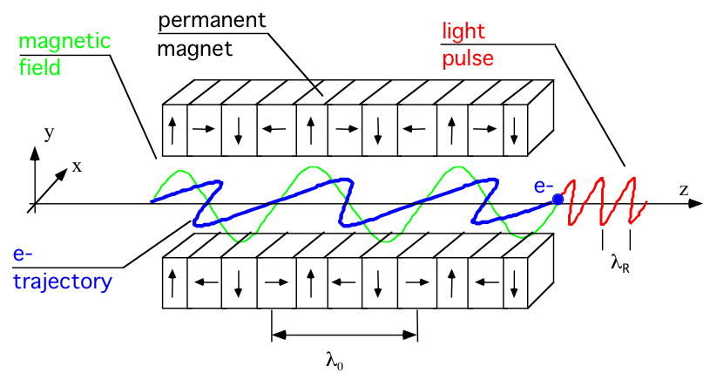
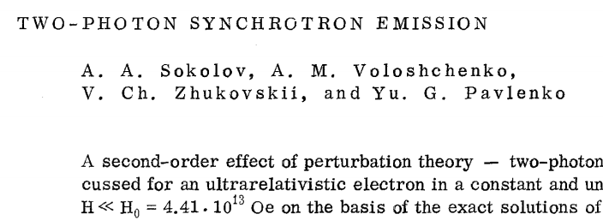

Introduction and presentation outline
Multi-photon emission
Differential rates?
Photons’ arrival times?
* figure from http://old.clio.lcp.u-psud.fr/clio_eng/FELrad.html
Part 1: Theoretical predictions
  QED approach with Dirac-Volkov solution
  (classical undulator field + quantum electron + quantized radiation)
  Glauber’s approach
  (classical current + quantized radiation)
Dirac-Volkov approach has already been used for electron in constant uniform magnetic field
Formation length in uniform field $∼R/γ$
For undulator, formation length will
be the entire length of undulator

Slide 3




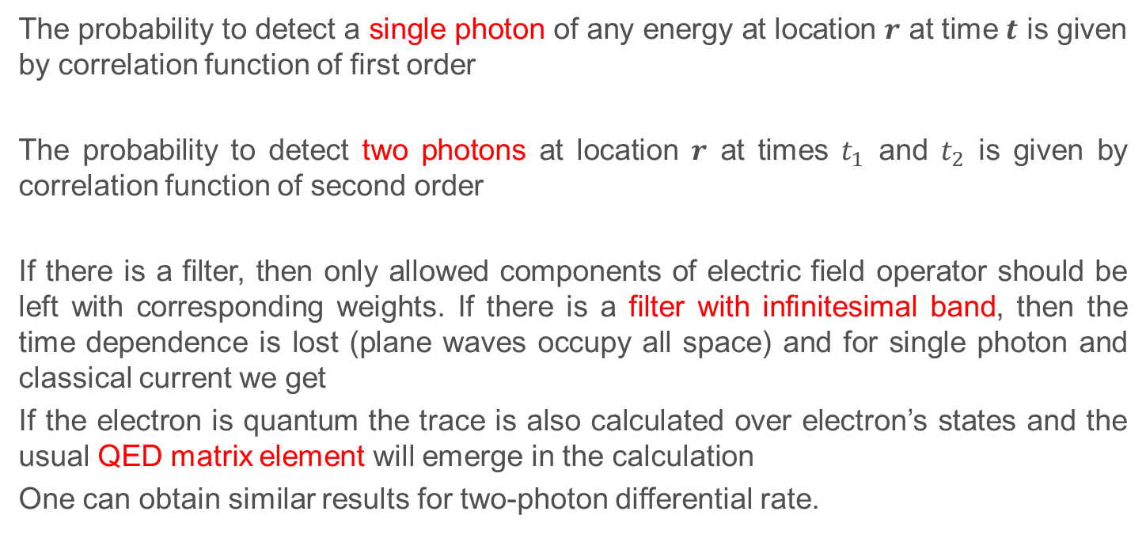
Theoretical part; General remarks
electron + undulator + radiation
interaction
The probability to detect a single photon of any energy at location $r$ at time $t$ is given by correlation function of first order
The probability to detect two photons at location $r$ at times $t_{1}$ and $t_{2}$ is given by correlation function of second order
If there is a filter, then only allowed components of electric field operator should be left with corresponding weights. If there is a filter with infinitesimal band, then the time dependence is lost (plane waves occupy all space) and for single photon and classical current we get
If the electron is quantum the trace is also calculated over electron’s states and the usual QED matrix element will emerge in the calculation
One can obtain similar results for two-photon differential rate.
*introduced by R.J. Glauber

Slide 4



Dirac-Volkov model
Volkov states are exact solutions of the Dirac equation for electron in plane electromagnetic wave
Positive and negative energy solutions:
Where
How is it related to an electron in an undulator?
*these are spinor functions
Weizsäcker-Williams approximation
In electron’s rest frame undulator’s field looks like a plane wave
*this problem has been considered in dissertation of Daniel Seipt

Slide 5
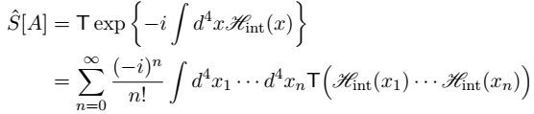

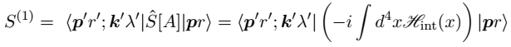
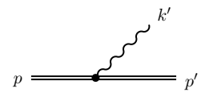
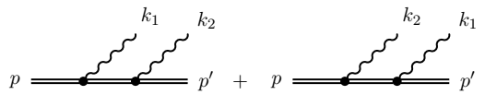


Dirac-Volkov model
Takes into account:
Quantum nature of radiated field
Quantum nature of electron, i.e.
  Finite size of electron’s wavefunction
  Electron’s spin
Furry picture
Single-photon emission
Two-photon emission
*see Daniel Seipt’s dissertation

Slide 6






Crucial parameters
Field strength parameter (undulator parameter)
Quantum parameter (electron recoil parameter)
*see E. Lötstedt and U.D. Jentschura Phys Rev A 80, 053419 (2009)
Scattering amplitude can be conveniently decomposed as a series in powers of $χ$

Slide 7

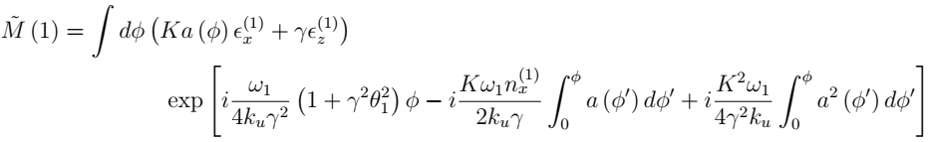
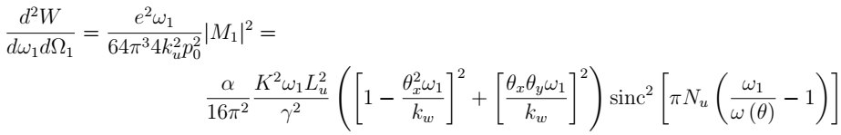
Differential rates in Dirac-Volkov model
Single-photon rate
Two-photon rate
*a factor of ½ will emerge after integration over a detector
where
Basically this is a classical result for $K∼1$. See for example V.I. Ritus, Journal of Soviet Laser Research 6.5 (1985): 497-617.
For $K≪1$, I obtained
which agrees with classical results from Jackson and, for example, V. Kocharyan and E. Saldin, arXiv:1202.0691v1

Slide 8

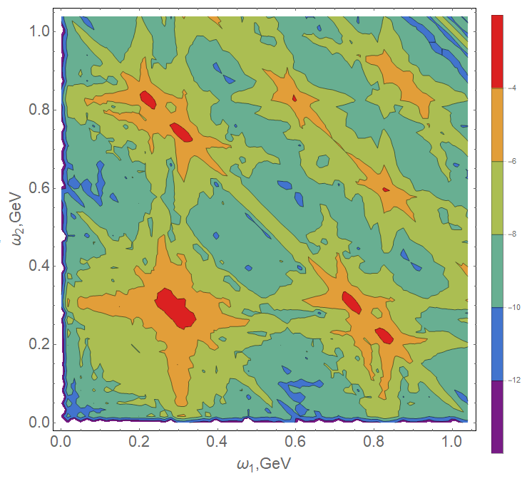
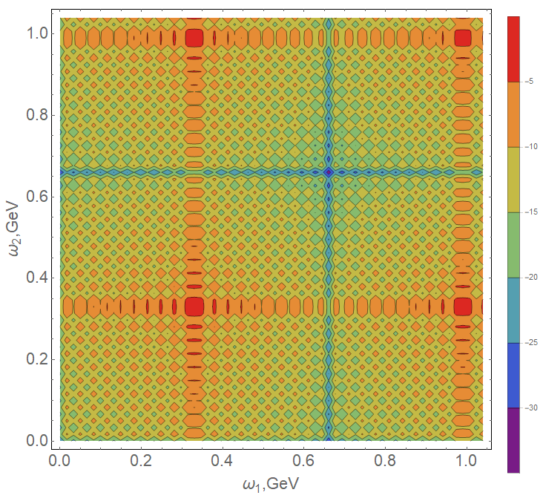


Differential rates in Dirac-Volkov model
Spin does not change. Essentially electron can be regarded as spinless
Single-photon rate
Two-photon rate
*a factor of ½ will emerge after integration over a detector
Factorization of two-photon differential rate means absence of correlation between the two photons. To increase correlation one has to increase $O(χ)$. Is it at all possible to see correlation on experiment? Yes:
In D. Seipt and B. Kampfer, Phys Rev D 85, 101701(R) (2012):
FACET-II parameters:
Energy spectrum for two-photon emission for on axis photons
Exact solution The factorized form
Optical undulator:
Color represents
differential rate:
*some difference can also be seen at 150 MeV and optical undulator

Slide 9
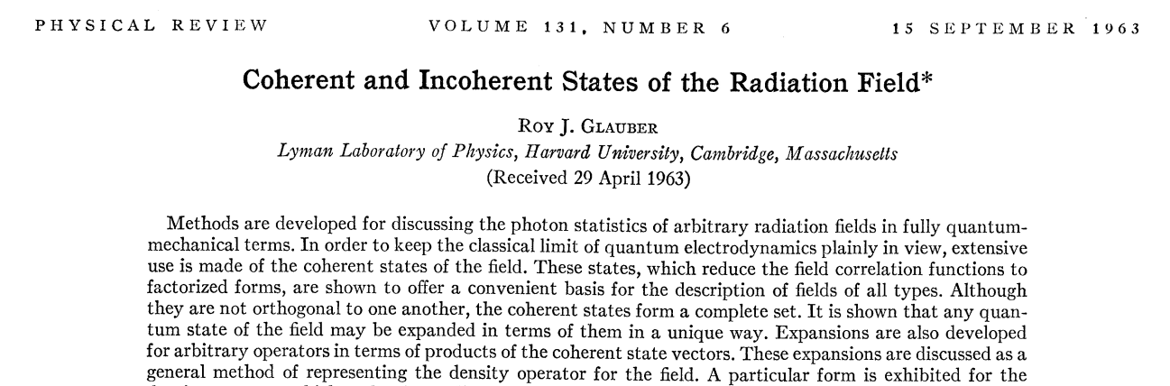









Glauber’s model
Takes into account:
Quantum nature of radiated field
Assumptions:
Negligible electron recoil (classical current)
Classical current
Operator
Displacement operator (creates coherent state):
Final state is a coherent state:

Slide 10





Glauber’s model: results for correlation function
Some noteworthy properties:
Definition of correlation function from the beginning of presentation:
For infinitesimally thin filter (spectral correlation function):
- classical result. See for example V.I. Ritus, Journal of Soviet Laser Research 6.5 (1985): 497-617.

Slide 11
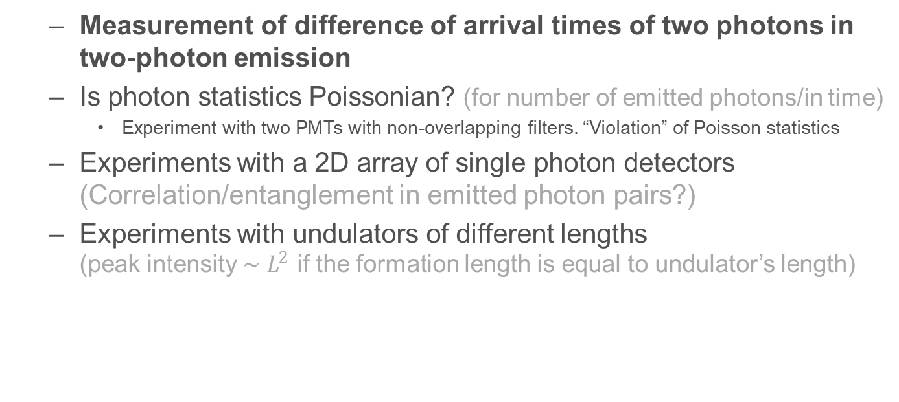
Part 2: Ideas for experiment in IOTA
  Measurement of difference of arrival times of two photons in two-photon emission
  Is photon statistics Poissonian? (for number of emitted photons/in time)
    Experiment with two PMTs with non-overlapping filters. “Violation” of Poisson statistics
  Experiments with a 2D array of single photon detectors (Correlation/entanglement in emitted photon pairs?)
  Experiments with undulators of different lengths
  (peak intensity $∼L^{2}$ if the formation length is equal to undulator’s length)

Slide 12





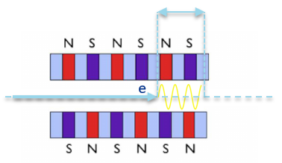
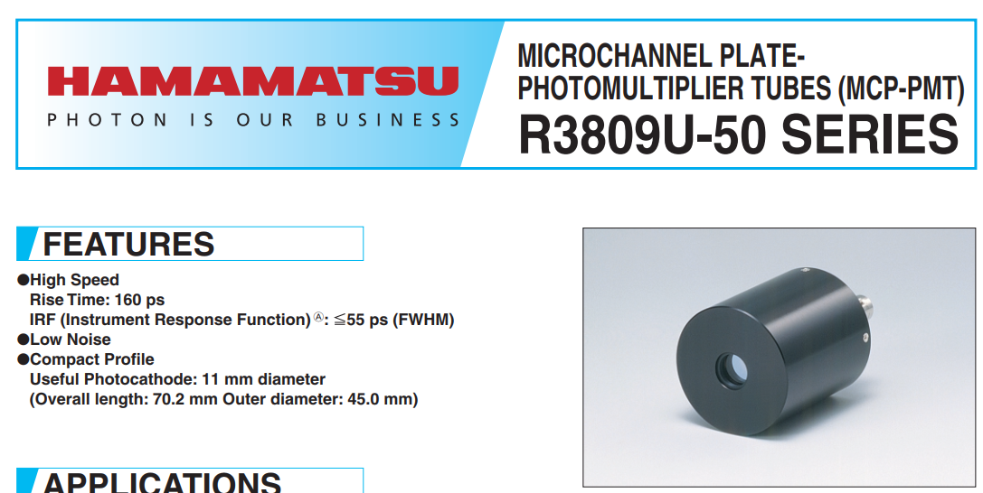
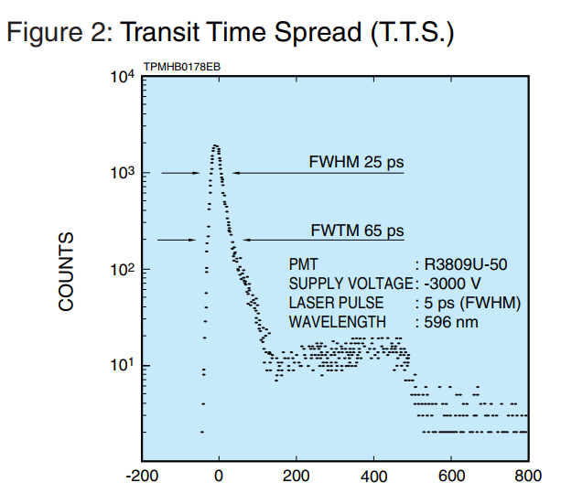
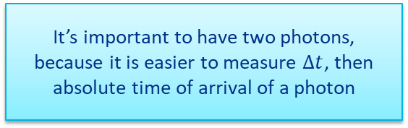
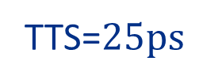
Two-photon events: time spread
Experiment idea #1
Classical formula from Jackson:
It’s important to have two photons, because it is easier to measure $Δt$, then absolute time of arrival of a photon
*S.V. Faleev in arXiv:hep-ph/9706372v1 found for dipole radiation
Capabilities of presently available PMTs:
However, if there is a considerable time spread related to electron’s wavefunction size, we will be able to see it.
TTS=$25ps$

Slide 13
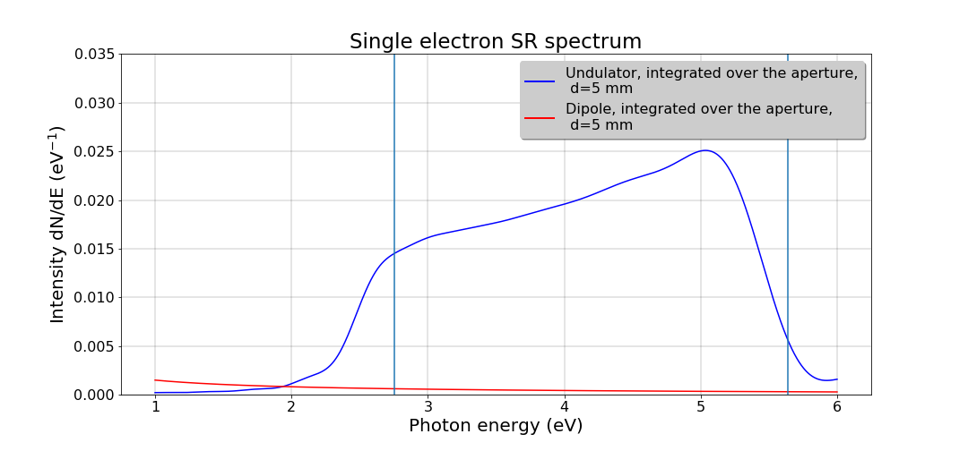
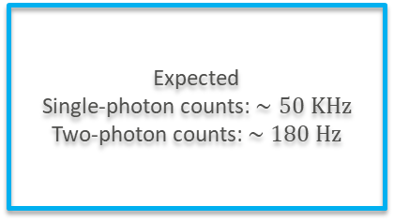
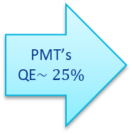
Experimental setup: Hanbury-Brown-Twiss intensity interferometer
Parameter | Value
IOTA circumference | 40 m
Turns per second | 7.5 MHz
Electron energy | 150 MeV (up to 200 maybe)
Undulator length | 60 cm (SLAC)/1.8 m (JLab)
Undulator period | 5.5 cm
Photon energy | 2.6 eV
Photon wavelength | 475 nm
SRW simulation for 200 MeV electron and 60 cm undulator:
Expected
Single-photon counts: $∼50 KHz$
Two-photon counts: $∼180 Hz$
PMT’s QE$∼25\%$
*Dipole radiation can be suppressed by vertical orientation of
undulator magnets and a polarizer. Also by a system of lenses.

Slide 14
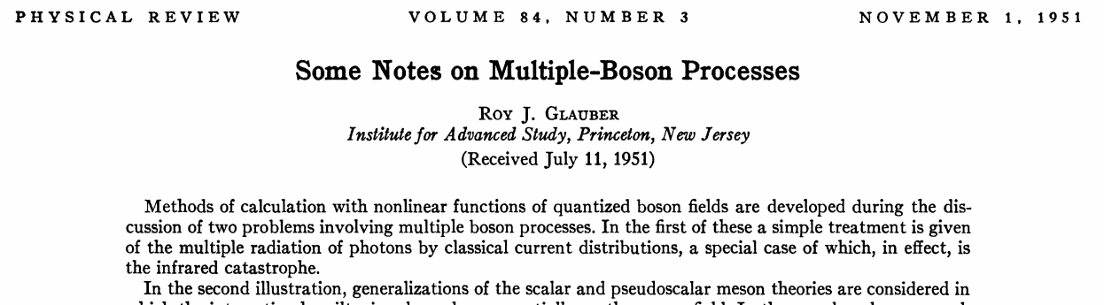



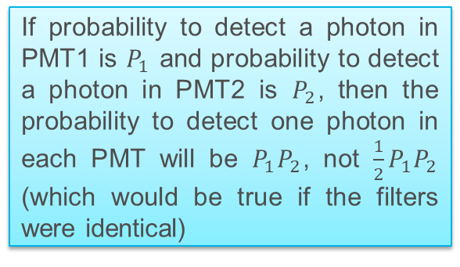
Photon statistics
Emission probabilities form Poisson distribution:
Experiment idea #2
Also does distribution of emissions
in time correspond to Poissonian?
(for single-photon and for two-photon
events)
An idea on how to “violate” Poisson statistics:
Experiment idea #3
PMT1
Filters with non-overlapping
energy bands
If probability to detect a photon in PMT1 is $P_{1}$ and probability to detect a photon in PMT2 is $P_{2}$, then the probability to detect one photon in each PMT will be $P_{1}P_{2}$, not $\frac{1}{2}P_{1}P_{2}$ (which would be true if the filters were identical)
PMT2
Beam splitter

Slide 15
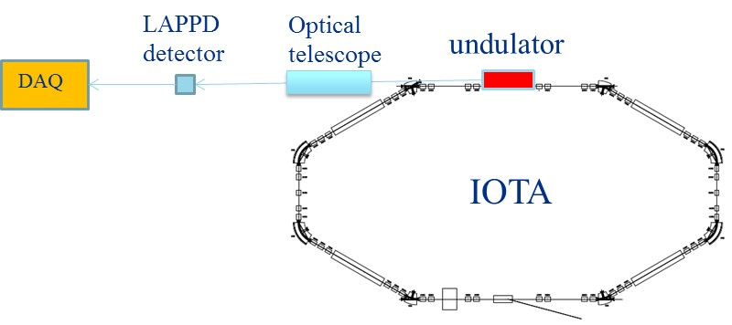
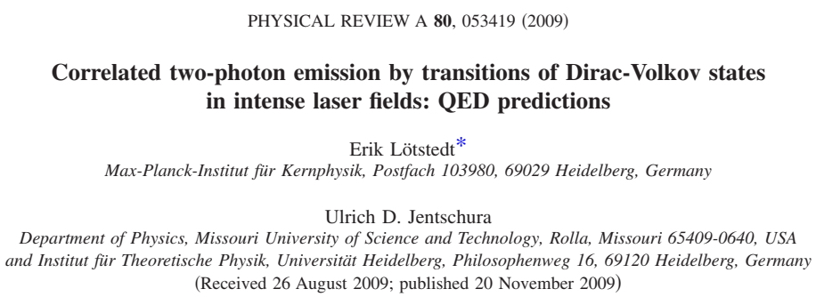
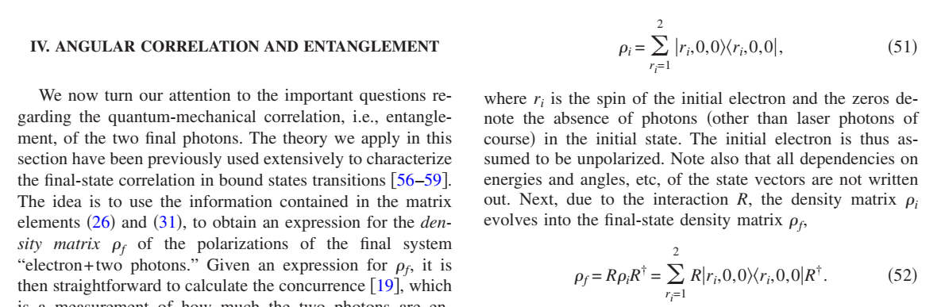
Experiment with 2D array of single photon sensors
Experiment idea #4
It will allow us to measure the angle at which a photon is detected
It will be possible to see if there is any correlation between these angles in emitted photon pairs
Also experiments aimed at polarization correlation in photon pairs may be done
Example: Large Area Picosecond Photon Detector
There is some correlation and entanglement for optical undulator (much bigger $χ$):

Slide 16








Length of formation of radiation
Experiment idea #5
A bunch of electrons can be used for this experiment
$K≪1$ here
Small aperture/small energy band detector:
If formation length is shorter than undulator:
We might have two undulators (SLAC/JLab) of different lengths to check the square law.
One cannot determine formation length with big detector because after integration over the detector the dependence on length is linear:
If formation length is shorter than undulator:
Has it been done before?

Slide 17
Conclusions
Electron recoil and spin effects are negligible
Glauber’s model with classical current is sufficient
Difference in time of arrival of photons in a photon pair is too small to be measured according to Glauber’s model. Still, if electron’s wavefunction has a considerable size (several centimeters) we will be able to see it
Glauber’s model predicts Poisson photon statistics. It can readily be tested in IOTA, along with the experiment on “violation” of Poisson statistics. Distribution of emissions in time should be checked too
Absence of transverse correlations can be tested with 2D array of single photon detectors
Experiments with small aperture/small energy band detector can be done to determine formation length of radiation

Slide 18
Thank you for your attention!

