Slide 1
Obtaining a Single Electron in IOTA
Aleksandr Romanov
9 November 2018

Slide 2
IOTA accelerator complex
IOTA gets electrons from the FAST, 1.3 GHz superconducting RF electron linear accelerator
Beam energy to IOTA: 40-200 MeV
Bunch charge: 1e- to 3 nC (160 pC nominal)
Injection frequency: up to 5 Hz

Slide 3
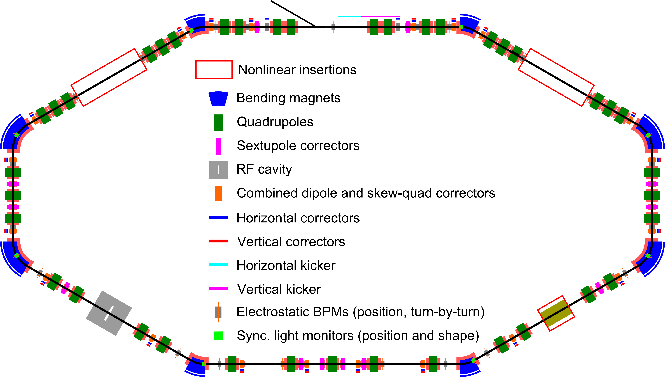
IOTA layout

Slide 4
Parameters
Momentum | < 200 MeV
Perimeter | 40 m
RF voltage | <1 kV
RF frequency | 30 MHz & 7.5 MHz
3 Experimental gaps | 2x180 cm, 1x150 cm
Main vacuum chamber aperture (R) | 25 mm
Lambertson and kickers aperture (R) | 20 mm
Electrons | 10⁹ e, 1.2 mA
Protons | 10¹¹ p, 35 mA
Vacuum | 6x10⁻¹⁰ torr

Slide 5
Main components
Lambertson magnet |  | 1 | Horizontal, injection in vertical plane
Kickers |  | 1 hor. & 1 vert. | Horizontal for studies only
Main dipoles |  | 4x60 deg & 4x30 deg | Powered in series with Lambertson
Quads |  | 39 | Powered in pairs with individual shunts
Trims | Hor. | 8 | In main dipoles
 | Vert. | 2 | For injection bump
 | Hor. | 20 | Combined correctors
 | Vert. | 20
Skew-quads |  | 20
Pickups |  | 21 | Turn-by turn position
Sync. light monitors |  | 8 | Shape and position
RF |  | 1 | Dual frequency
Solenoid |  | 1 | For electron and McMillan lenses
Sextupoles |  | 12 | In six families

Slide 6
Lattice configuration: one nonlinear magnet (1NL)
Momentum | 150 MeV
Tunes, x,y | 5.3, 5.3
Mom. comp. | 0.032
Emittances, x,y | 1.65 E-6 cm
Bunch length @1kV | 7.5 cm
Energy spread | 1.35 E-4
Sync. Tune @1kV | 3.7 E-4
Damp. times (x,y,s) | (0.8,0.8,0.3) s

Slide 7
Lattice configuration: one nonlinear magnet (1NL)
Momentum | 100 MeV
Tunes, x,y | 5.3, 5.3
Mom. comp. | 0.032
Emittances, x,y | 0.74 E-6 cm
Bunch length @1kV | 4.1 cm
Energy spread | 0.90 E-4
Sync. Tune @1kV | 4.5 E-4
Damp. times (x,y,s) | (2.8,2.8,1.0) s

Slide 8
Lattice correction
Extended LOCO method of beam based model dependent analysis and correction using Sixdsimulation will allow to have online correction capabilities.
Fit model so that it best describes measured experimental data using multiple iterations of SVD based inverse task solver.
Simulations shows that with BPMs precision of 1um and better lattice can be corrected to required levels.
Recent work demonstrated that it
should be possible to correct lattice
parameters to required precision
(THPOA24, NAPAC 2016)
Parameter | Max error
Betas at the insertion | 1%
Beta beating | 3%
Dispersion | 1 cm
Phase adv in T-ins | 0.001

Slide 9
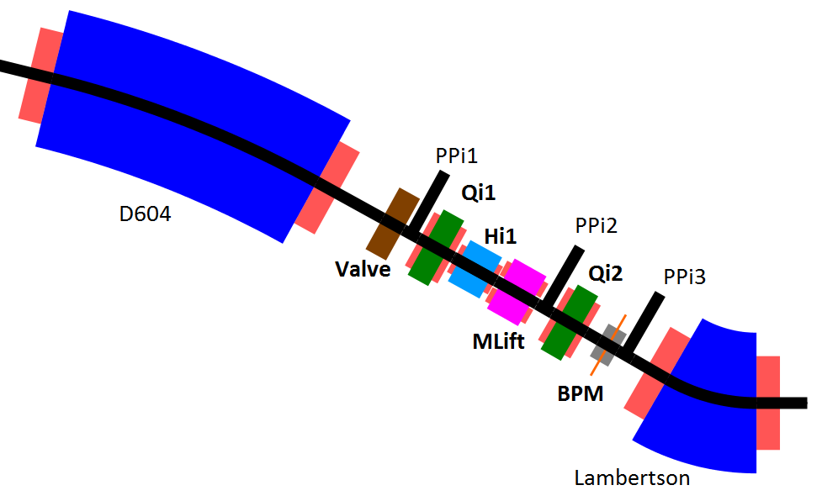
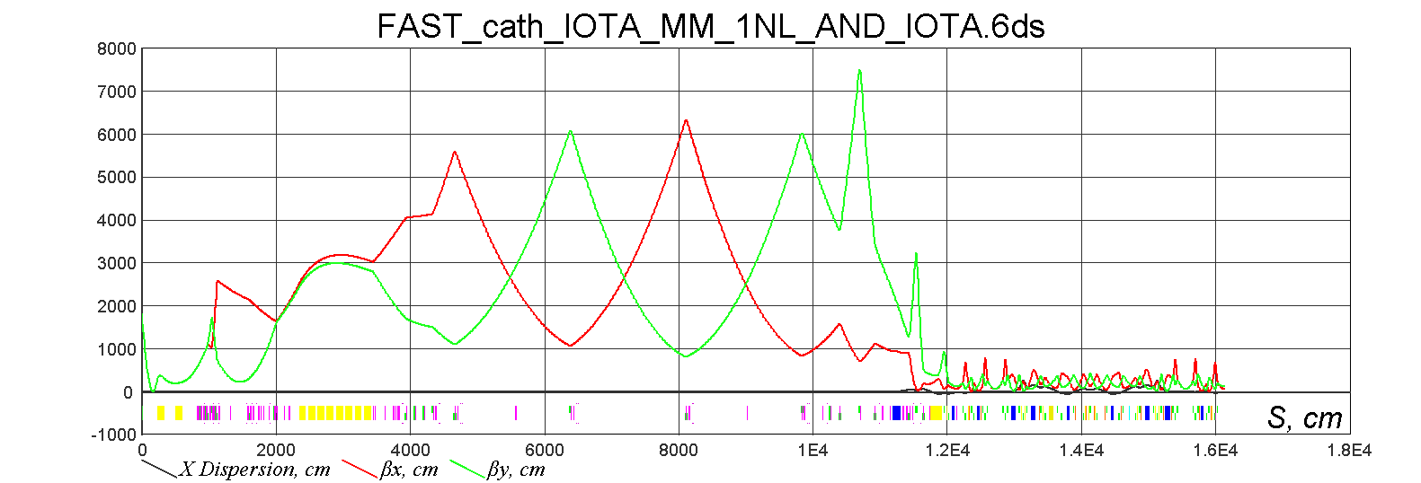
Injection
Protons fill all injection channel (d=15 mm)
Aperture limitations
20 mm radius in Lambertson
20 mm radius for plates in kickers
Kicker strength limited to equivalent of 70 G for electrons and around 500 G for protons
Field in combined correctors limited to 120 G
Field in bump correctors limited to 1 kG

Slide 10
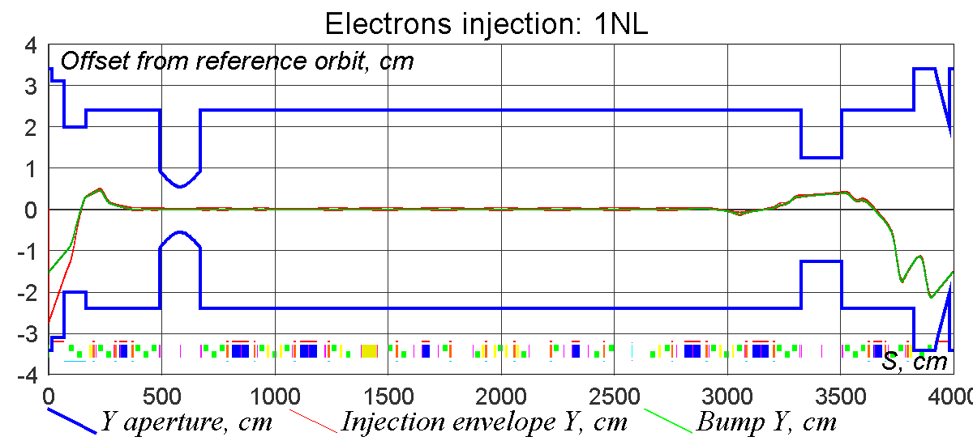
Injection: electrons
Clearance (Y): | 3.8 mm | 18 sigmas

Slide 11
Matching beam from FAST into IOTA
Several iterations of the following steps are necessary to achieve desired parameters:
Manual propagation of the beam as far as reasonably possible
Measurement of the beam parameters
Adjustment of the nominal lattice to get desired beam parameters at specified location
LOCO based correction of the focusing elements
Centering of the trajectory in focusing elements
Verification of the beam parameters close or at the point of interest

Slide 12
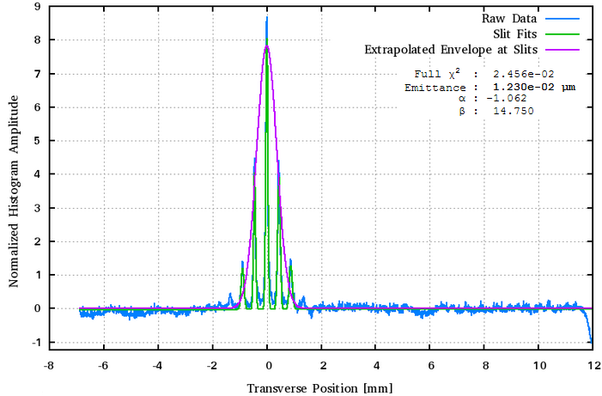
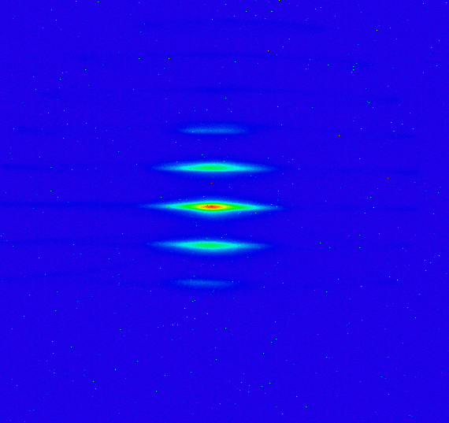
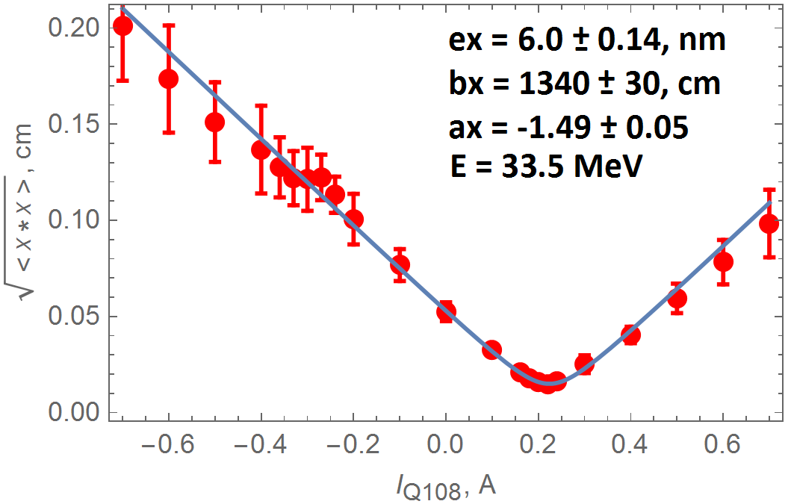
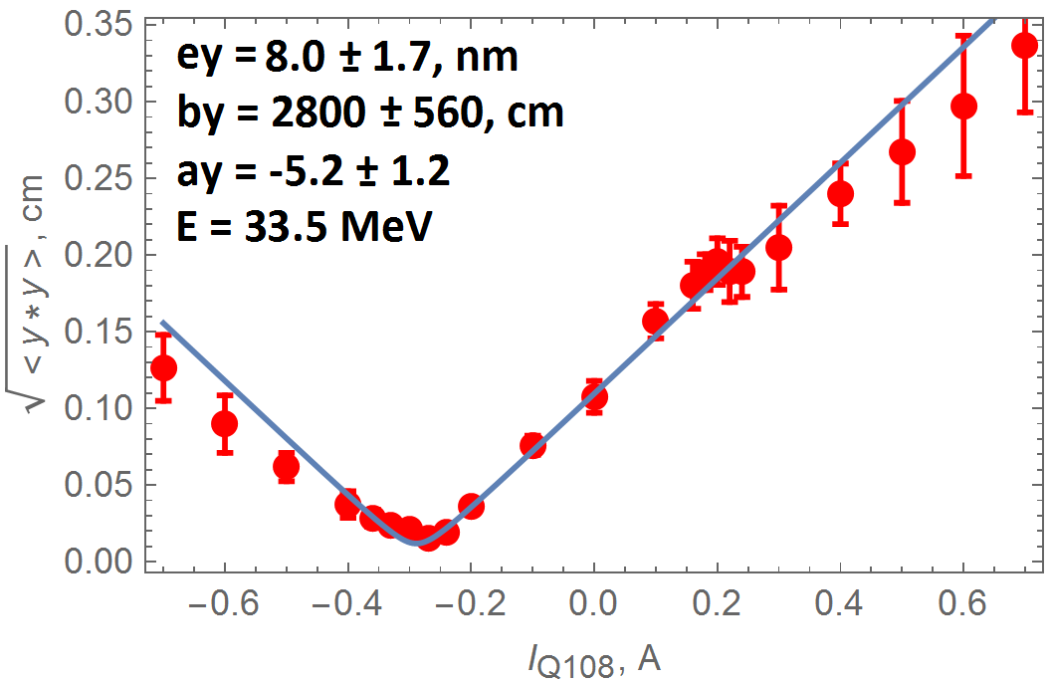
FAST beam characterization
Beam conditions after CC2
Slits
Single quad scan
Beam phase space tomography
Beam parameters before D600 (close to IOTA):
Multi-quad scan

Slide 13
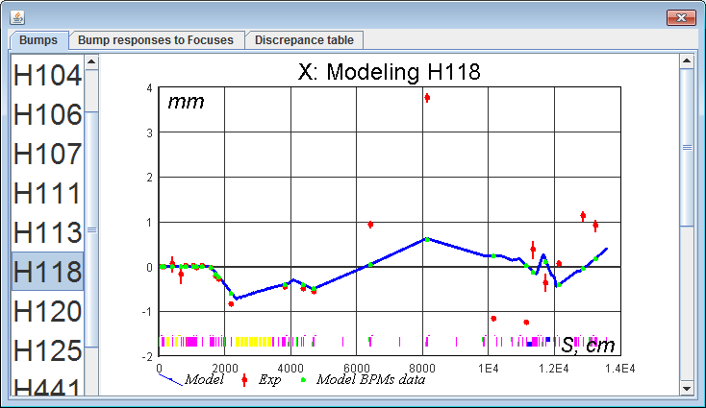
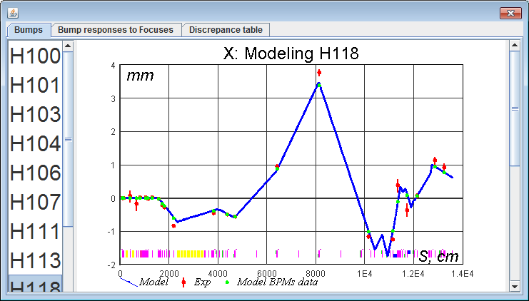
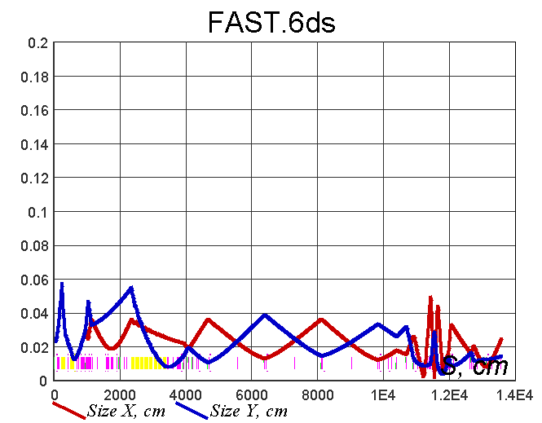
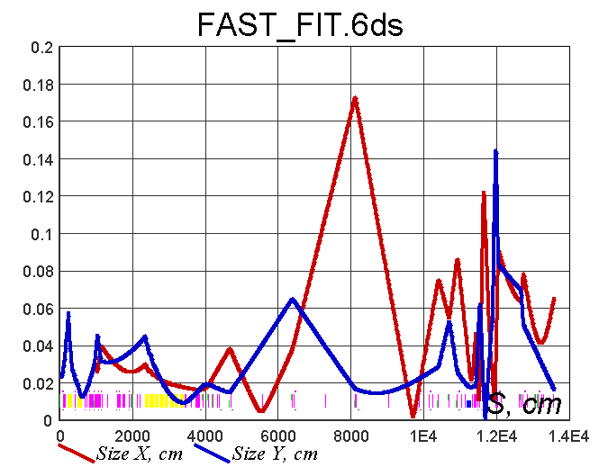
Tuning quads in FAST
LOCO integrated with ACNED by Sixdsimulation
Fit model to measurements
Implement correction

Slide 14
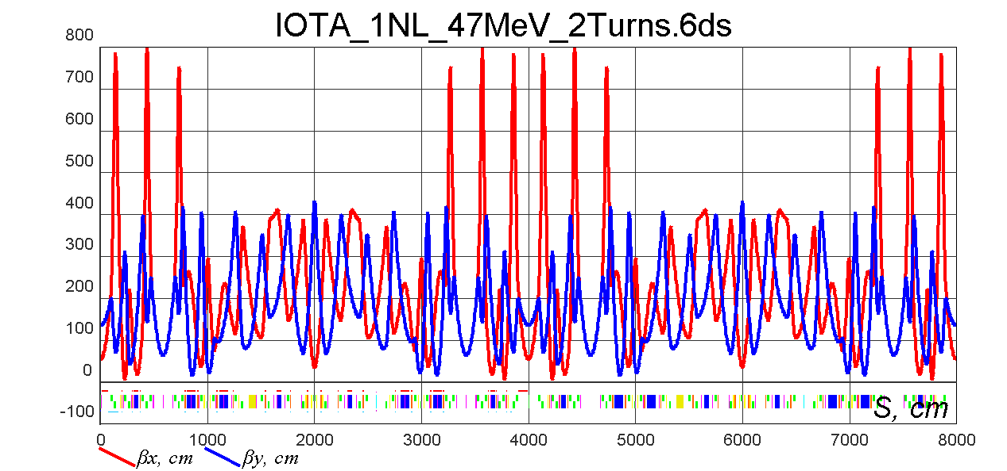
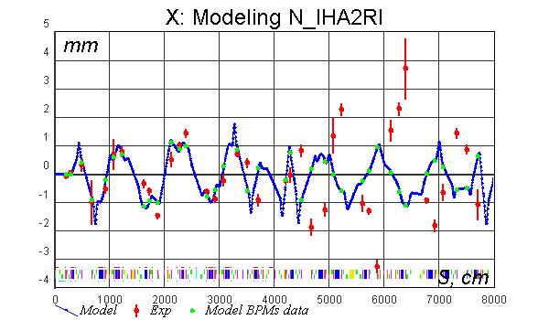
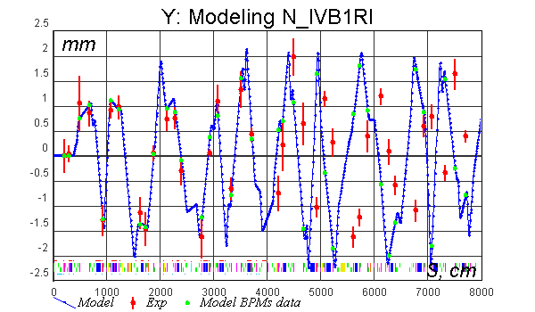
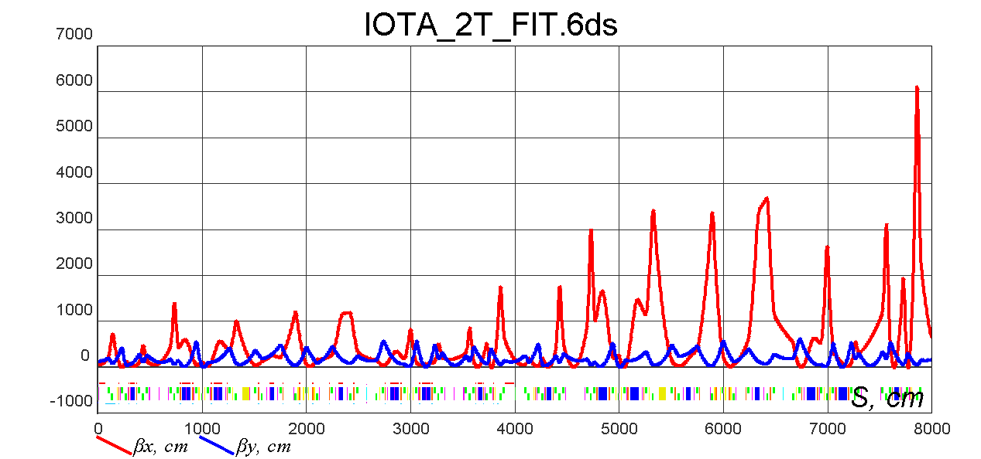
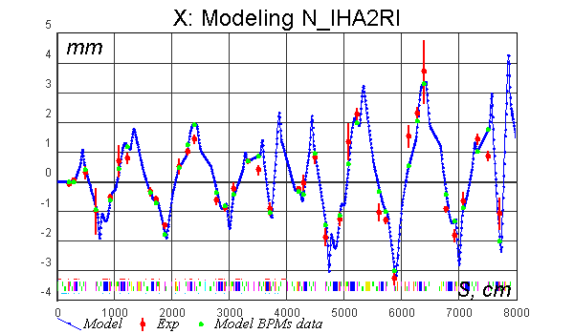
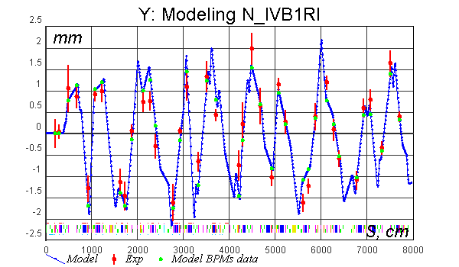
Betatron capture into IOTA
Measured data: 21 BPMs x 20 trims
Model adjusted to match measured data by tuning 39 quads
Model lattice and corresponding sample responses compared to measured
Fitted model has clear instability in X plane
First correction iteration made stable betatron lattice

Slide 15
Single electron injector
x
x
Block laser with shutter to get only dark current
Insert several OTR foils in LE and HE lines
Decrease last injection quadrupole to stretch phase volume and distort incoming trajectory

Slide 16
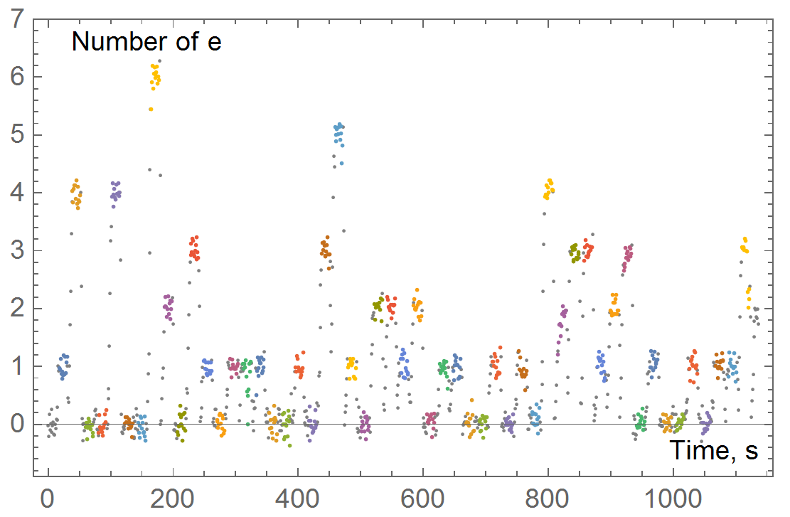
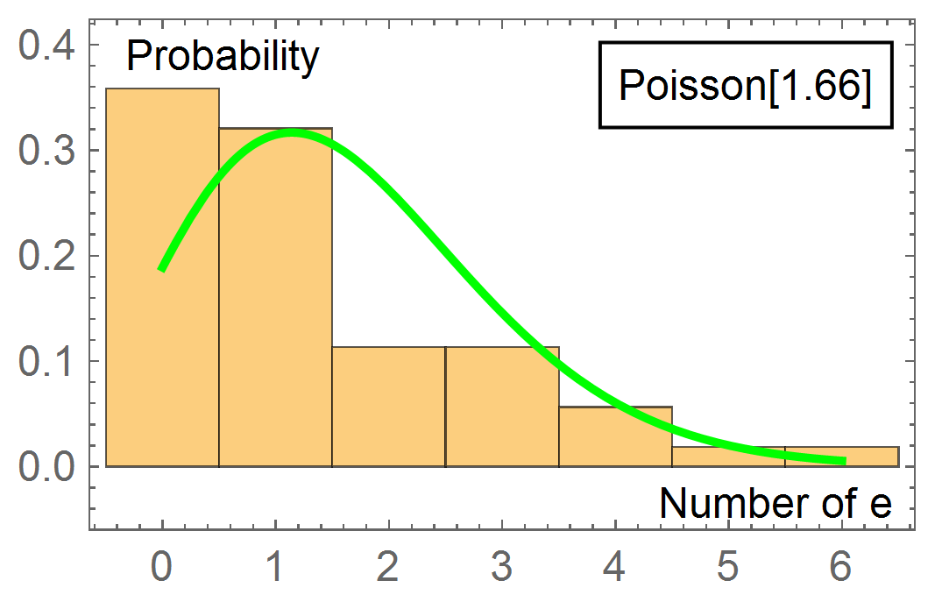
Single electron capture probability
To test selected method of intensity attenuation 53 injections were done with interval of 21 seconds
Resulting probability of single electron injection: 32%
For purely Poisson distribution maximum probability is 36.8%

Slide 17
To be continued…
Technical goal of reliable injection of a single electron into IOTA is achieved.
Diagnostics tools are in good shape and continue being developed
A lot of interesting experiments are imminent!

Slide 18
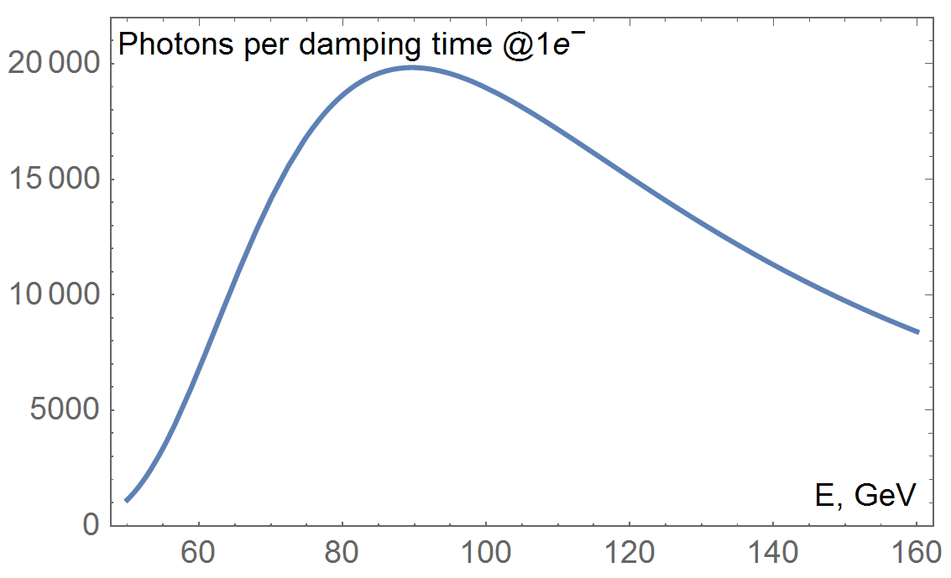
Single electron in IOTA: “Rectangular” beam
Real time footage from M2R camera after specially developed noise cancellation algorithms
Clearly visible “stopping” points due to integration time of less than damping time

Slide 19
Planned experiments
1,2,3… electron tomography in 3D using 8 cameras
Knowing exact number of particles will allow to recover their amplitudes in 6D phase space from 2D images
May be possible to recover phase by adding fast diagnostics tools
Looking at correlations
Random walk due to synchrotron radiation
Gas scattering
Intrabeam scattering for 2,3... electrons

