Slide 1


DUNE Project Status
Jolie Macier
DUNE PMG Meeting
18 September 2018

Slide 2
Outline
ES&H Update
QA Update
Schedule & Budget Status
PM Update
DUNE Update
  FD Engineering
  FD Installation
  FD TPC Electronics
  FD APA
ProtoDUNE Onsite Report
Upcoming Events

Slide 3
ES&H Update
LBNF/DUNE ESH Introduction video is complete
  Video will be shown as part of the SURF site ESH orientation training
Meeting with LBNF Cryogenic Safety Committee chairs to discuss to discuss DUNE detector filling process
  Personnel access to the 4950L
Participate in the LBNF/DUNE Interface Meeting at CERN​
  Site tour to observe ProtoDUNE detector filling operations
Supporting the development of the DUNE design review process
  Supported DUNE Detector Support System conceptual design review & interface meetings at CERN

Slide 4
Quality Assurance
DUNE Detector Support System (DSS)
  Participated remotely in the review of the DUNE Detector Support System (DSS) conceptual design (30% design)
  DUNE Quality Assurance Specialist
  Position description has been developed and a job has been posted for the QA Specialist to assist the Consortia in the development of QA/QC procedures and plans.

Slide 5
DUNE Milestones
Filling complete 13 Sept, 1am (CERN time)

Slide 6
DUNE Stop Light Report for Current Month
Still unraveling lingering costs on ProtoDUNE Design & Construction

Slide 7
DUNE Stop Light Report – Cumulative

Slide 8

Project Management Highlights
Completed the comprehensive bottoms-up cost/schedule estimate
  FY19 DUNE-US Project Office includes DUNE Technical Coordination until distinct funding source is confirmed
  DUNE-US also includes:
    Support of various consortia R&D and production: SP Photon Detector, Cryogenic Instrumentation & Slow Controls, DAQ, HV
    Nominal support of Near Detector Installation
  DUNE International schedule integrated with LBNF/DUNE-US P6 schedule
Actions for October cost/schedule review moving forward
  BCRs in process for the DUNE-US re-estimate
  Draft charge & agenda prepared
  Update documentation including Project Management Plan & Project Assumptions
Significant outcome of August LBNF/DUNE integration meeting was action to resolve stored energy issue associated with filling of detector #1 concurrent with installation of detector #2
Many requisitions initiated for FY19 SOWs

Slide 9
Far Detector Engineering
Detector component integration and installation
  Conducted conceptual design review for SP detector support system, submitted review report and recommendations
  Developed conceptual design review charge for SP photon detector and integration test facility
  Developed preliminary design review charges for anode panel assembly
  Presented plans for rack cooling and cavern bridge at integration meeting at CERN
  Reviewed and provided comments to Arup on conceptual design of cavern bridge and assembly cranes
  Finalized requirements for integration test facility cold test boxes
  Worked with APA engineering & APA consortia to develop plan for structural analysis of APA
DUNE Detector electronics and grounding
  Reviewed the ARUP EXC and 30% BSI Document Releases and provided feedback on the infrastructure grounding and details which need to be better defined moving forward.
  Participated in meeting with CD Core Computing groups to discuss networking between Fermilab and SURF. Began initial discussions related to specific requirements which DUNE will have at SURF. Bi-weekly meetings will be held to continue discussions.
  Participated in an Integration Meeting at CERN August 22-23. One of the items discussed was the possibility of a new mezzanine which would house the majority of the electronics readout and CISC racks required for DUNE (not the DAQ racks). This concept is now being studied.

Slide 10
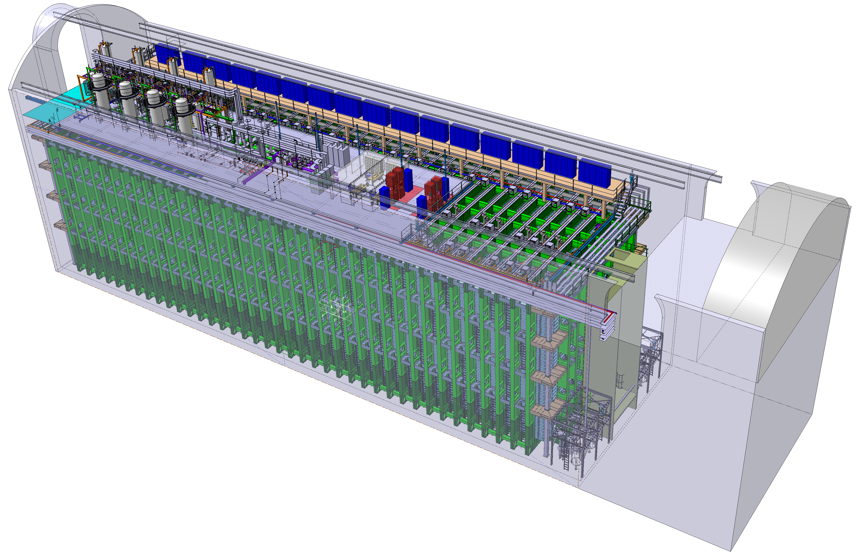
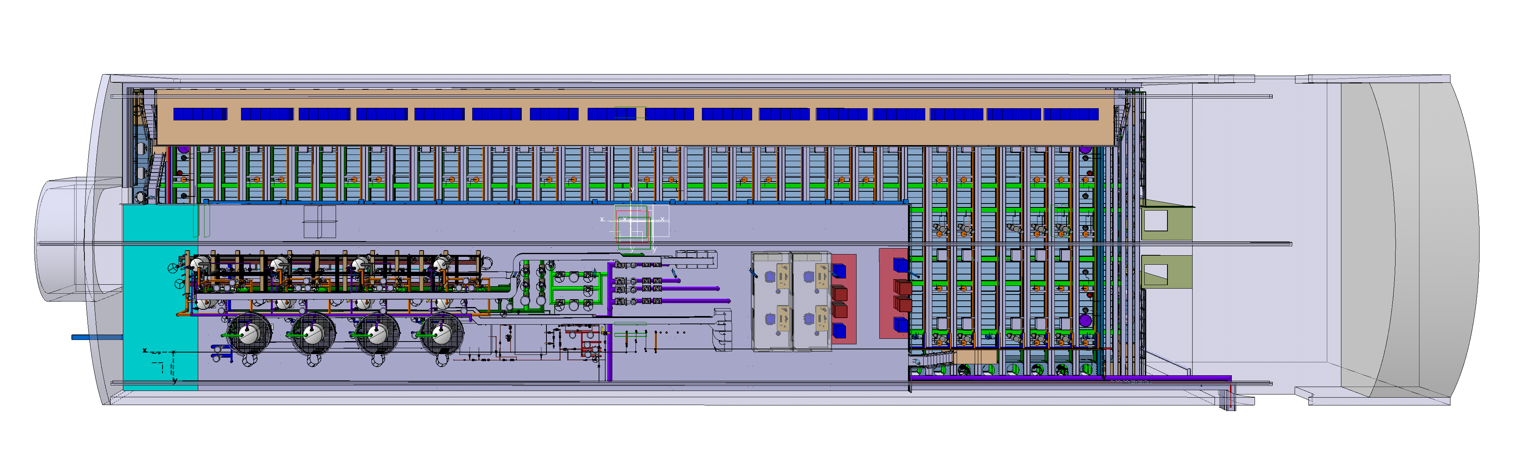
Far Detector Engineering
The new mezzanine

Slide 11
Detector Support Structure DSS 30% Design Review
DUNE DSS CDR took place August 20-21 at CERN
  Review Indico Page
  Revew Charge
  Review Committee
    Steve Kettell (chair), Farshid Feyzi, Olga Beltramello, Dan Wenman, Dmitar Mladenov, Peter Sutcliffe, Marzio Nessi, Mike Andrews, Kevin Fahey, Terri Shaw, Jack Fowler, Diamanto Smargianaki, Bill Miller, Eric James (ex-officio)
  Requirements, DSS design, Engineering Analysis, Interfaces, Quality Assurance, Installation, and Cost.
Several suggestions for design improvement
In general it was felt that what was presented met the requirements for a 30% design.

Slide 12
Installation
During LBNF/DUNE Interface meeting, 21-23 August, safety concerns were raised related to working near the cryostat during filling.
  The concern is related to pressure and stored energy from the gas in the vessel.
  This is being evaluated by FNAL safety and LBNF Cryogenics Safety Committee
  The installation process could be significantly impacted by this so work is paused on installation planning while the evaluation is ongoing.

Slide 13
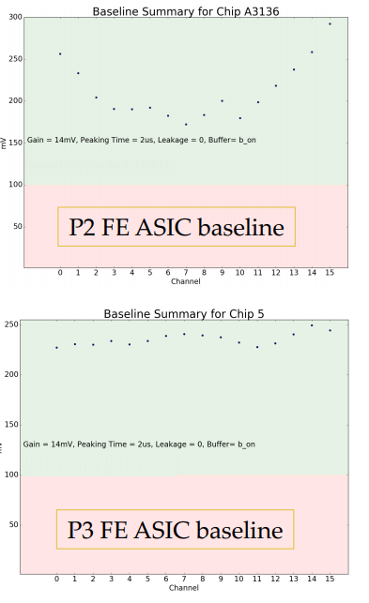
Cold Electronics – ASIC Submissions
LArASIC v8 (Front-End ASIC)
  First 240 chips received at BNL at the end of August
  Tests ongoing, all the design changes implemented in this version are working properly (address problem of non-uniform baseline, new default setting for gain)
New Cold ADC
  Running full chip simulation and fixing minor mistakes in the design
  Discussing the scope of mixed-mode simulations and how many to perform prior to October submission
  First internal full layout of the chip available at the end of this week, but we still need a visit to Fermilab from a BNL engineer to address a few remaining issues on their part of the design (cannot be done at BNL due to differences in the design kit used).

Slide 14
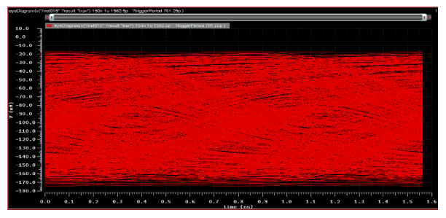
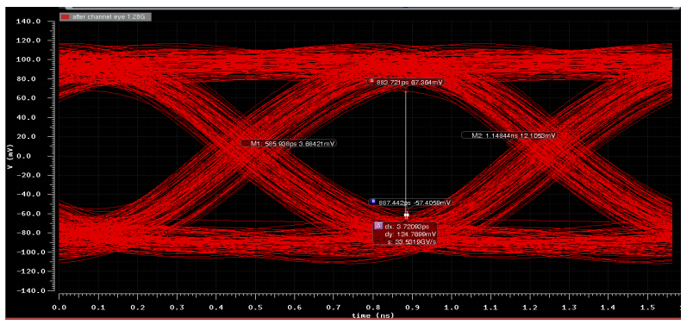
Cold Electronics – ASIC Submissions (i)
COLDATA
  Design of line driver with pre-emphasis progressing at SMU, results for 1.28 Gbit/s transmission (this will be included in November prototype) are promising
  Timeline for November submission is getting tight (main FNAL digital engineer was supposed to transition from ColdADC to COLDATA, may need another 2-3 weeks)
SLAC CRYO
  Work on CRYO for DUNE put on hold at SLAC, higher priority given to other developments (SLAC is short of ASIC engineers, like other national labs)
  Submission now likely postponed to November
System Tests
  Delays in ASIC submissions are reducing the time available for the completion of system tests prior to the CD-2/3b review in Fall 2019

Slide 15
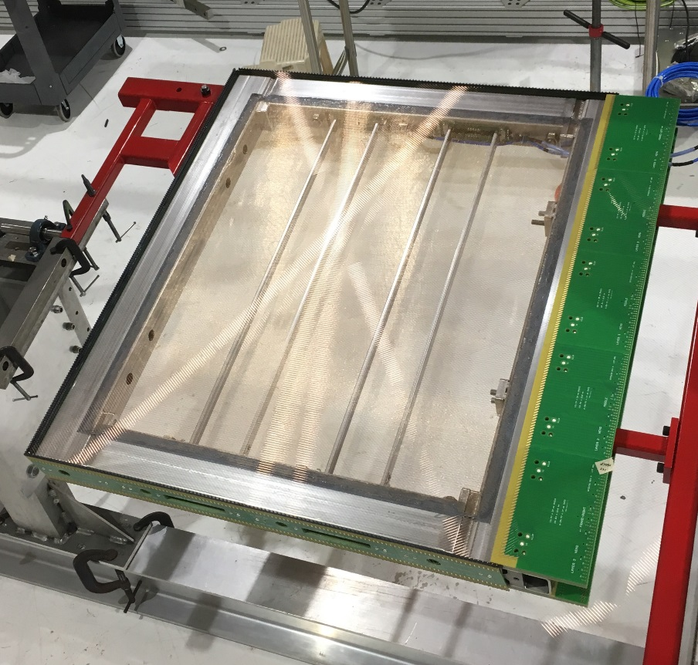
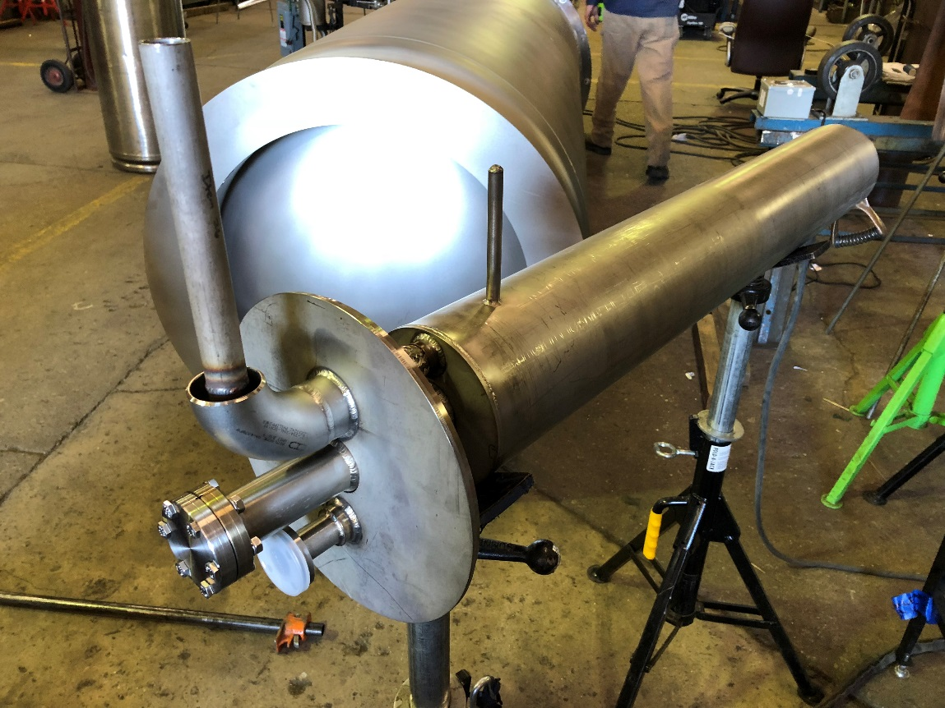
Cold Electronics – Small TPC Construction
Steady progress according to schedule
  Expecting APA at Fermilab in early October
  Expecting cryostat at Fermilab toward the end of October
  DAQ commissioning progressing at Fermilab
  Will be fully commissioned with protoDUNE electronics by year’s end

Slide 16
Cold Electronics – Schedule
Significant progress with P6 schedule
  Fully resource loaded schedule available in P6 since last week
  First cost roll-up done on Thursday (and mistakes fixed)
  Cost uncertainty added today
  Started to write fully detailed BoE files (over 20 to be done, half of them needed to get to 92% of total cost)
Initial cost estimate is $60M from FY19 to FY27
  Expect small reduction when university resources are properly implemented (for the moment we are using FNAL costs without overheads, this is an overestimate)
  Small revisions (hopefully downward) still possible
Discussions on SOWs with BNL and LBNL almost complete
  For most other institutions starting extending old SOWs / start new ones not as urgent
  Will discuss involvement of each institutions in the full construction project in the coming weeks, then work on SOWs for FY19 for Universities

Slide 17
FD APA
Major effort in the last month to input APA cost & schedule in P6, with essential input from PSL, University of Wisconsin, on ProtoDUNE actual costs.
Assumes 3 APA production sites in the US (U. Chicago, Yale U., PSL), with 2 + 2 + 1 winders
  No attempts to customize costs to the different facilities
Included activities for FY19, preparation of SOWs well underway for FY19
  PSL, University of Madison, for designing and engineering in preparation of the TDR and CD2/CD3 review (~$1M). NSF contribution for FY19 has been taken into account.
  Harvard University, for contribution to the Wire Measurement Task Force (~$70k)
  University of Iowa, for participation in frame assembly at PSL and a machining test of APA frame components, (~$40k)
Includes contingency estimates
Total cost for 150 APAS (two 10 kt modules) dominated by labor, in the range $50-55M (without contingency)

Slide 18
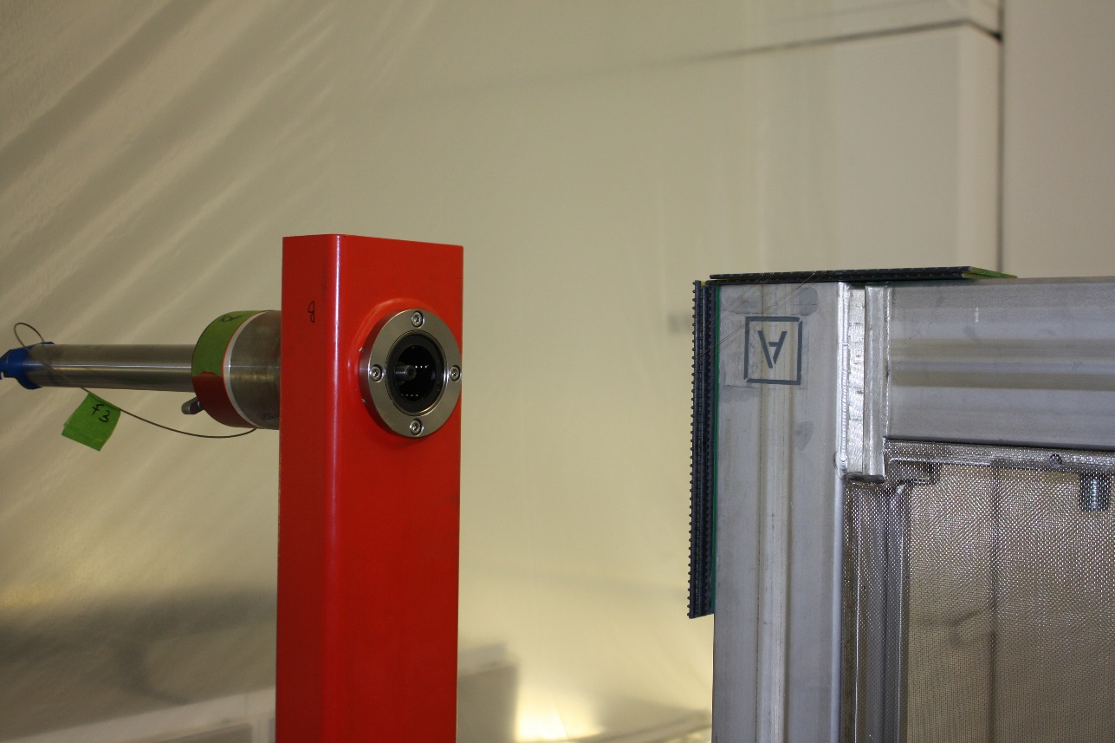
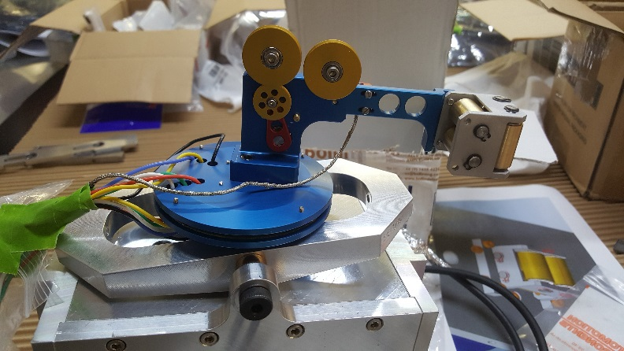
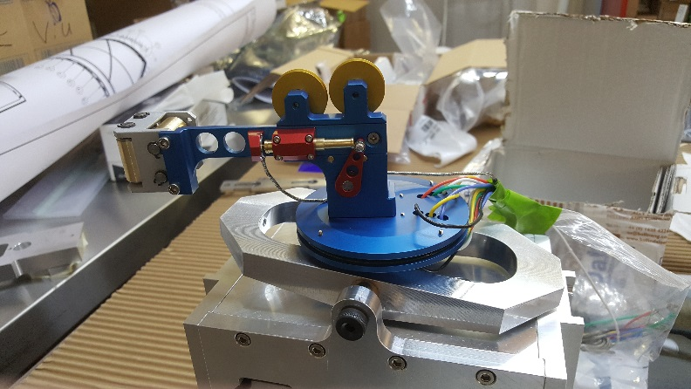
FD APA
All mesh panels delivered to Daresbury Lab and assembled on ProtoDUNE-style APA#7.
Good progress in commissioning the modified winder, with participation of PSL personnel. Tested all wire configurations, in the order: X, V and U wires.
Assembled the new winding head, with tensioning feedback mechanism. It will not be used, at least initially, for ProtoDUNE-style APA#7.
4 U wires in the upper corner

Slide 19
ProtoDUNE-SP Onsite
Filling of ProtoDUNE-SP complete on 13 September
Shifts began 23 August, with activation procedures.
  "light version" shifts (i.e., two 4-hours shifts each day on weekdays, no nights, no weekends)
  (1) develop experts on running the DAQ and performing basic troubleshooting. Almost all the first shifts are taken by people who will be at CERN throughout the beam run, to ensure there is a pool of people, in addition to the DAQ experts, who can assist or replace shifters as needed
  (2) exercise DAQ and online monitoring, to assess stability, identify issues and debug
  (3) Develop and constantly improve shifter manual and procedures. DAQ operations are progressively becoming more smooth and stable, and the documentation is being updated daily

Slide 20
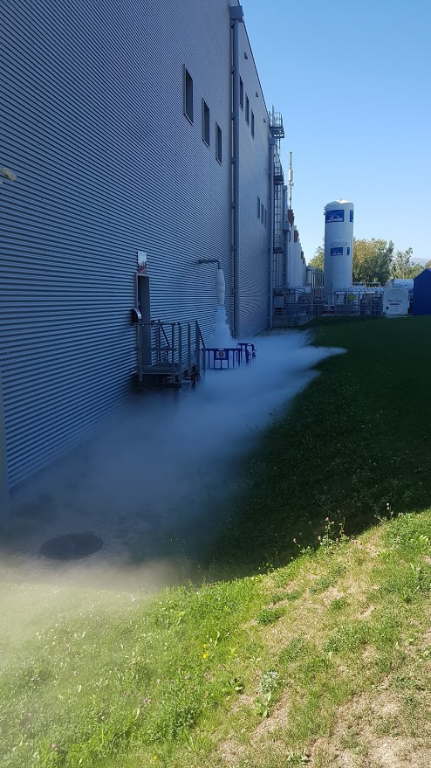
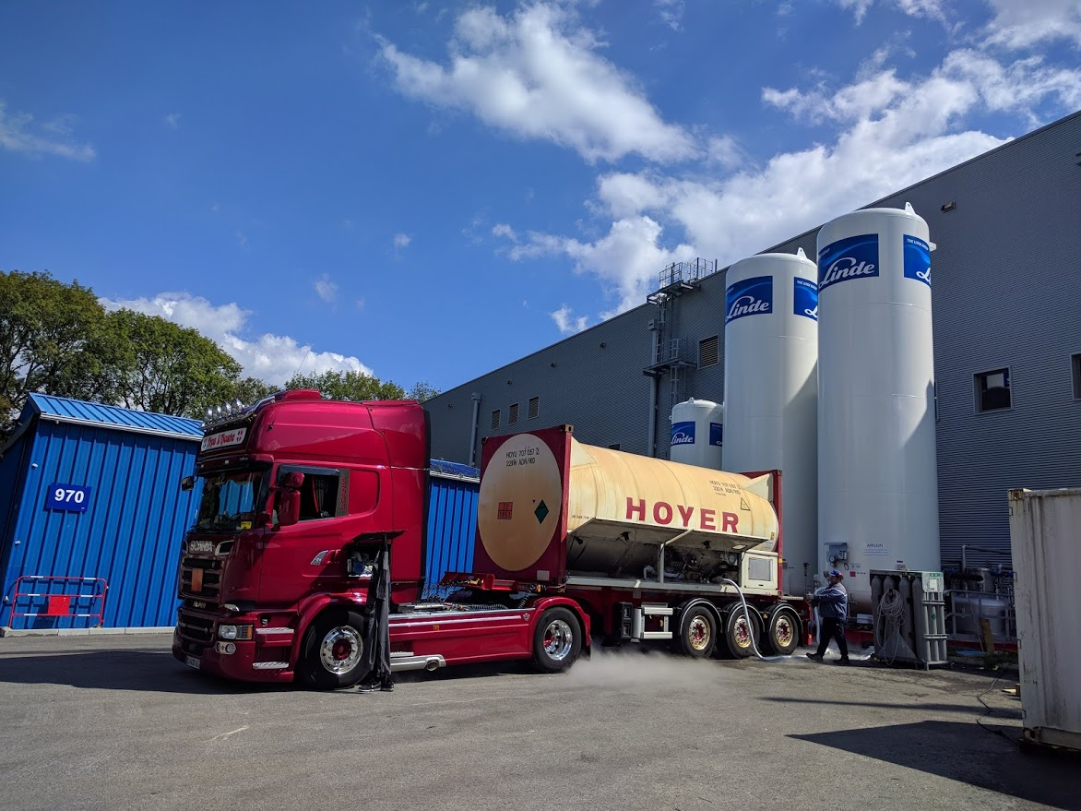

Slide 21
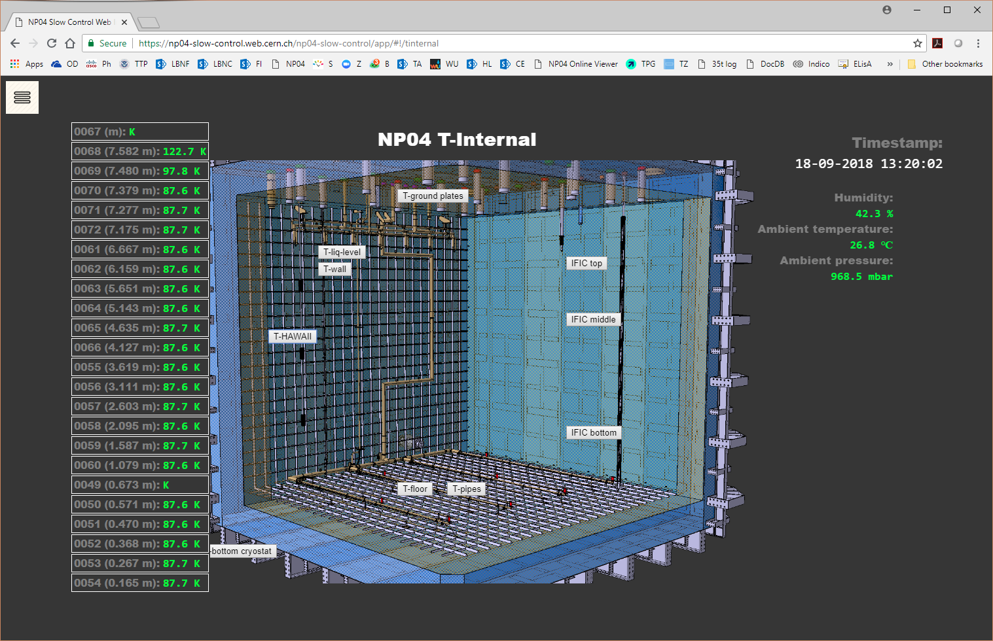

Slide 22
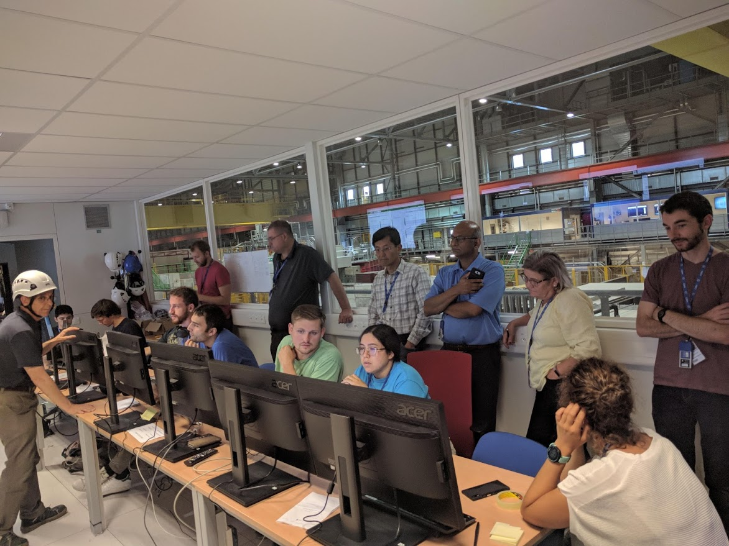

Slide 23
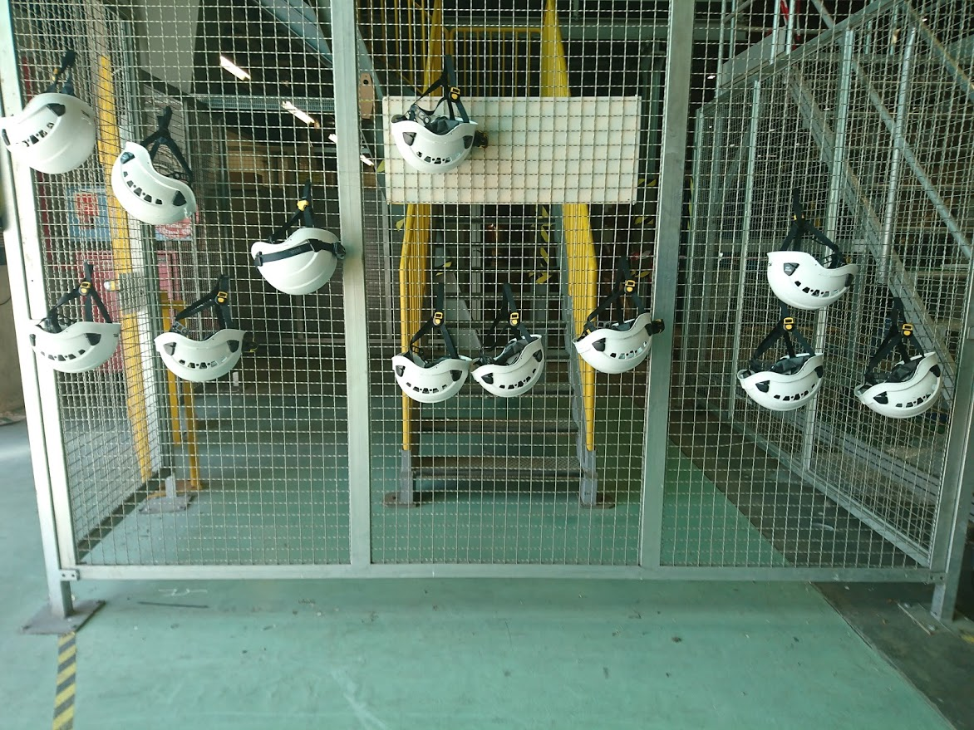

Slide 24
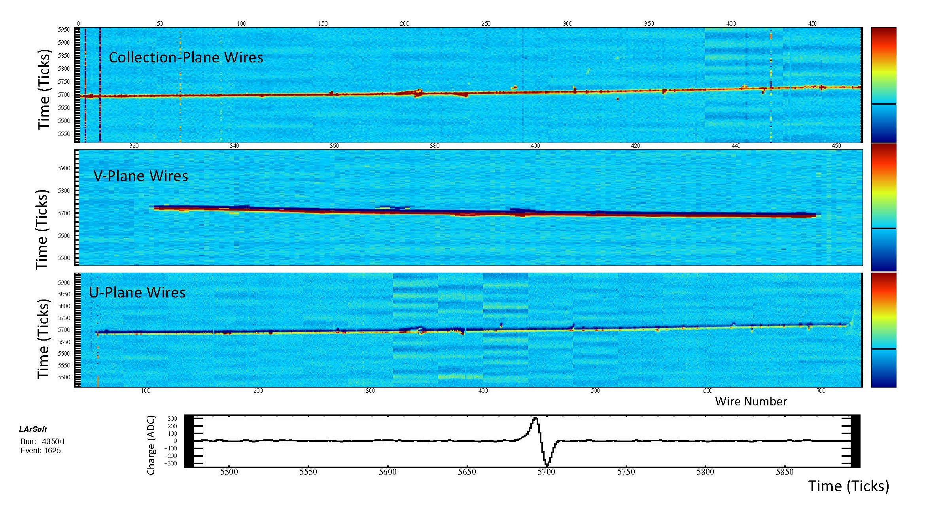
ProtoDUNE Event Display, 120kV

Slide 25
Upcoming Events
DUNE Collaboration Meeting, 24-28 September at Fermilab
Director’s Cost/Schedule Review, 25-26 October at Fermilab
LBNF/DUNE Integration Meeting, week of 29 Oct at SURF
Integration Test Facility planning workshop, week of 29 Oct at SURF
Installation 30% design review, TBD
SP Photon Detector 30% design review, Nov TBD at Fermilab
DAQ 30% design review, Dec TBD at CERN
LBNC, 13-15 Dec at CERN
DOE IPR, 8-10 January 2019 at Fermilab
DUNE Collaboration Meeting, 28 Jan – 1 Feb 2019 at CERN

Slide 26
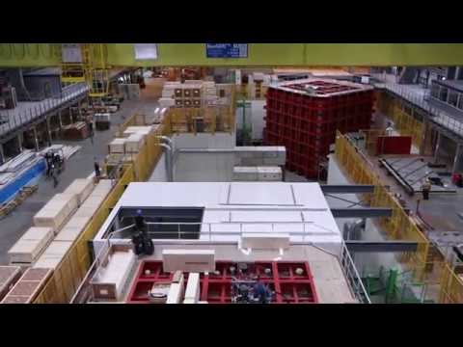
https://youtu.be/HNg49L4BNAE

