Slide 1
Cryostat Assembly Status Update
Roger Rabehl
September 17, 2018

Slide 2


CERN and FNAL personnel visited the cryostat assembly tooling vendor last week.

Slide 3
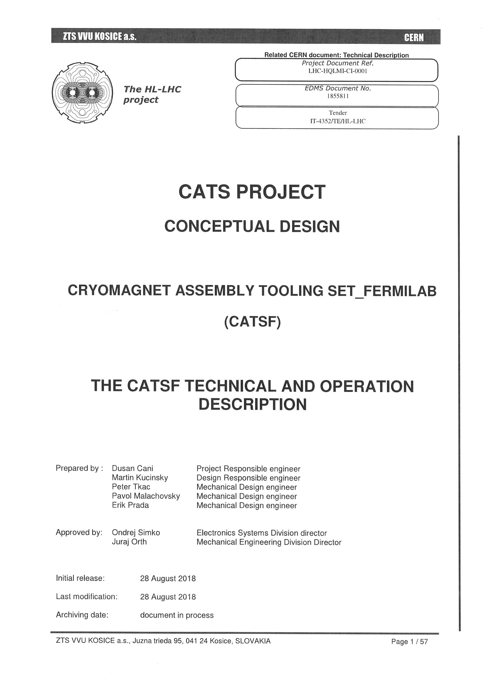
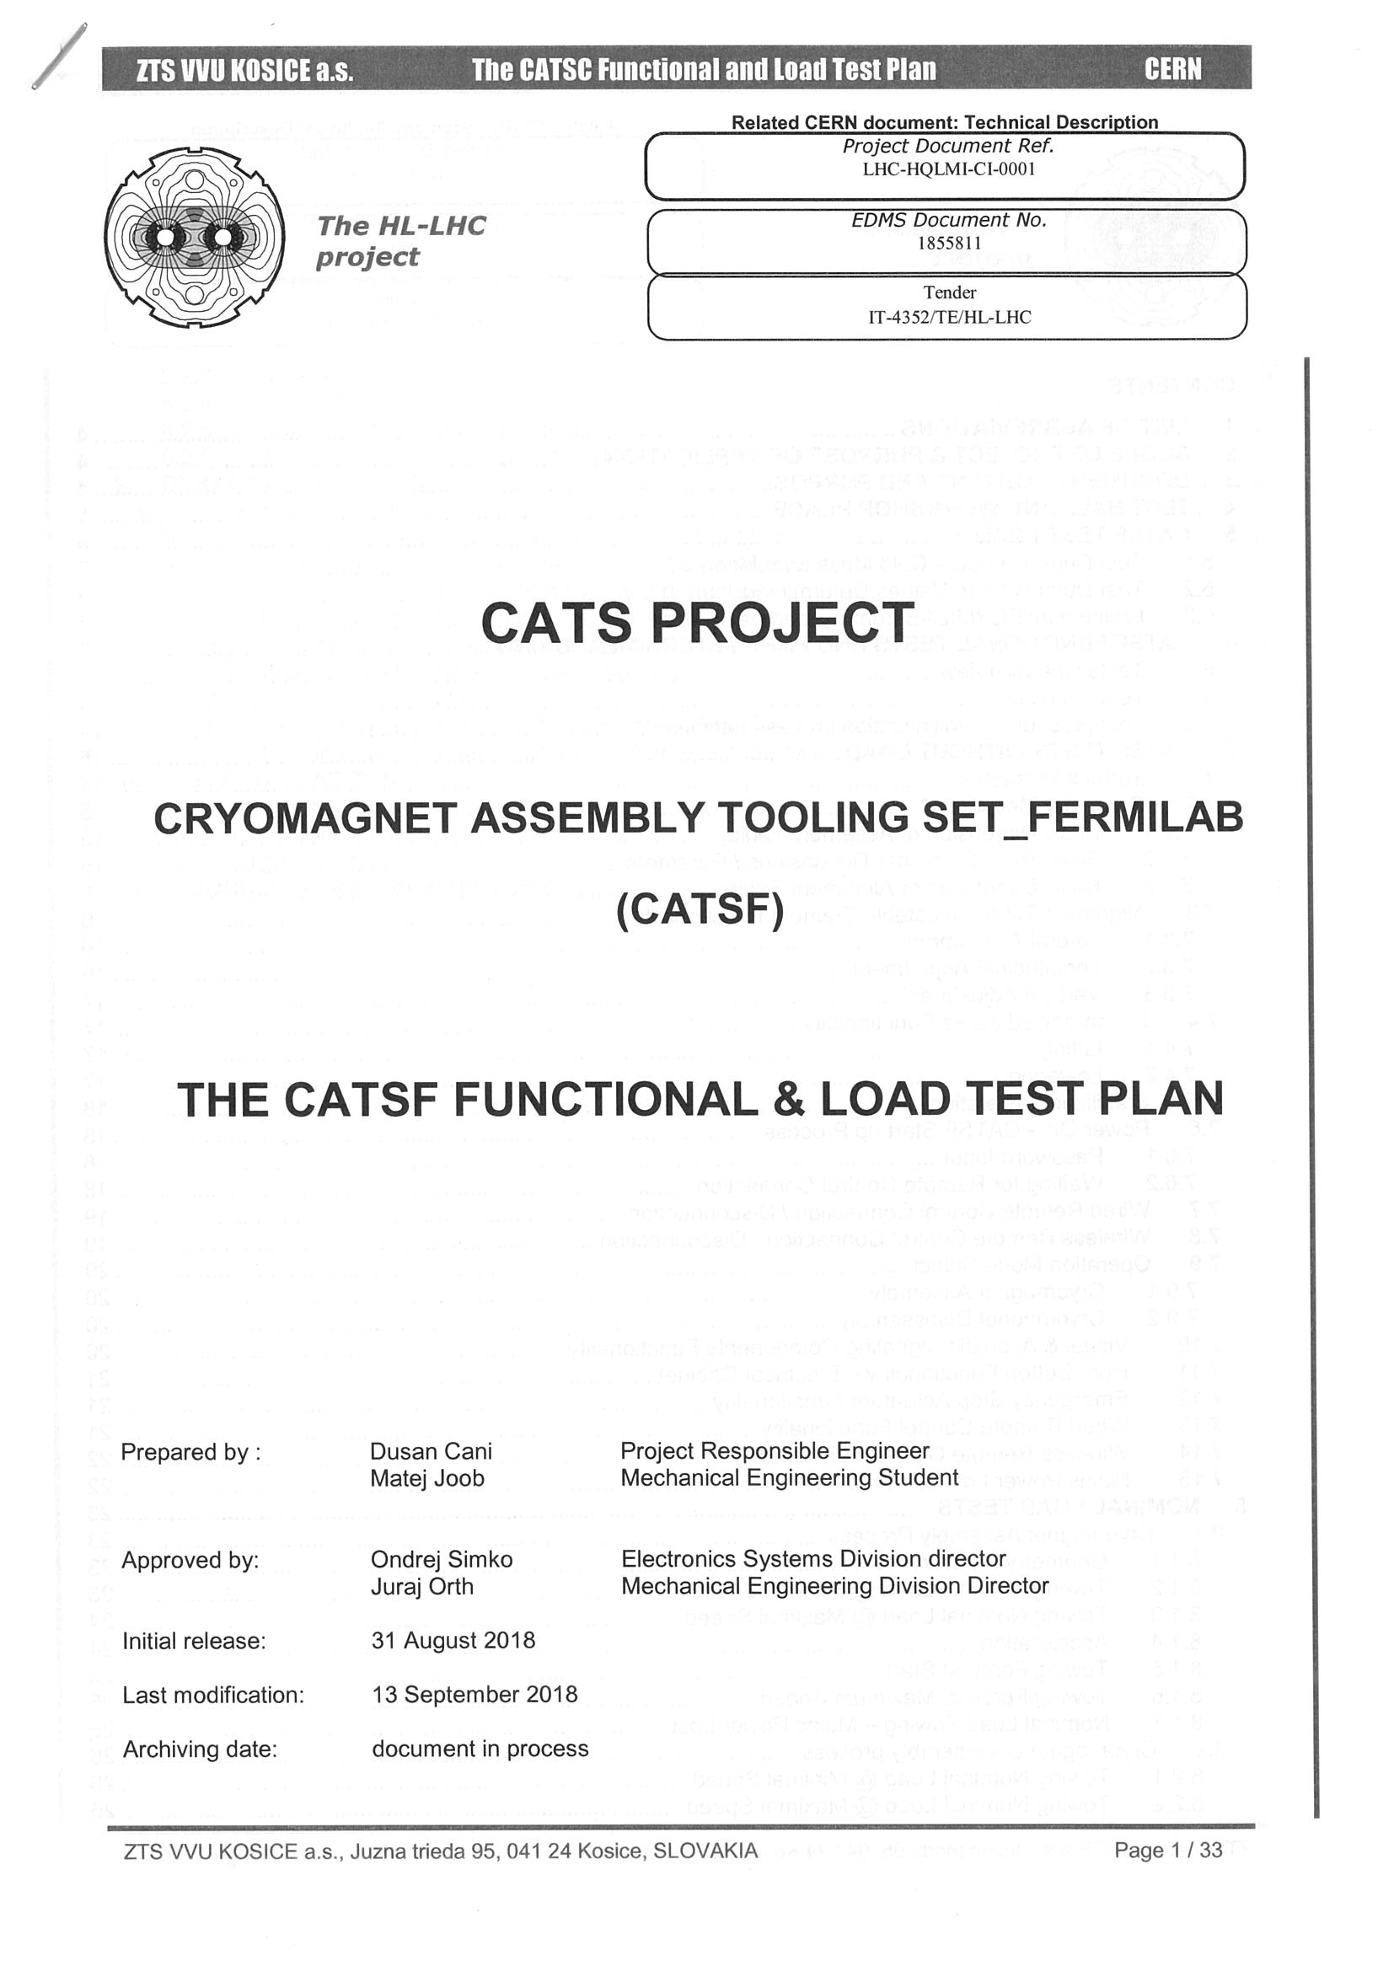
The vendor provided several documents and a design status update.
Conceptual Design (Technical and Operation Description) and Functional & Load Test Plan for both systems (CATSF and CATSC)

Slide 4
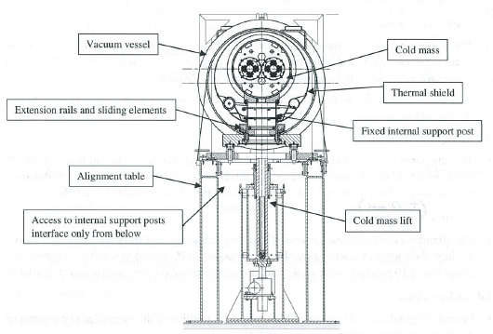
Design details remain to be finalized, especially related to the ability to cryostat and de-cryostat both now and old magnets.

Slide 5
Schedule was also discussed.
May 31, 2019: Fermilab delivery
Vendor will not be able to meet this deadline.
August 31, 2019: Latest Fermilab delivery as per project schedule
Unclear if vendor can meet this deadline.
Vendor will submit a proposed schedule amendment to CERN.

